Slide 1
Trending Tech Tools
What’s New, What’s Improved & What’s on the Horizon for Assistive Technology & Accessibility Tools
Rachel Kruzel, ATP
Accessing Higher Ground - 2019

Slide 2
Objectives
Give participants updates on both assistive technology and accessibility tools and the landscape of this work.
Notes:
Focus on AT and Accessibility given role as AT specialist and doing some EIT work on campus

Slide 3
Assistive Technology & Accessibility Tools

Slide 4
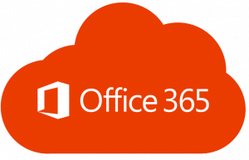
Read&Write – Platform Access
Access for RW customers on all platforms:
Windows
Mac
Google
Office 365

Slide 5
Read&Write – Microsoft Accounts
Increased access for Microsoft accounts
Access Read&Write for Google Chrome without Google Account
Log-in with Microsoft Credentials built-into program
May have to log out and log back in
Integration of full toolbar with Microsoft Word Online
Redesigned portal for administrators to manage student access to program

Slide 6
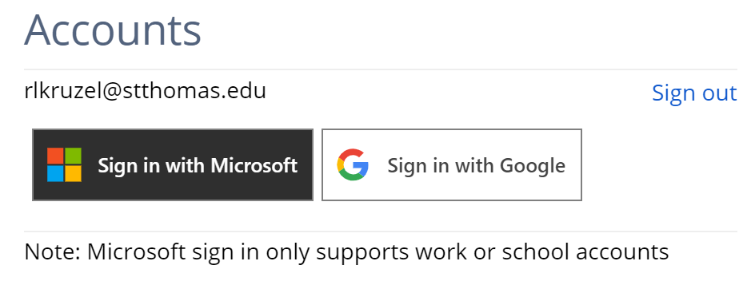
Sign-In with Microsoft Accounts

Slide 7
Read&Write within Microsoft Word Online

Slide 8
Read&Write ePub Reader
EPub Reader coming in 2020
Windows, Mac, Google, and Office 365
Currently one for Google – getting updated
Looks familiar to current toolbar

Slide 9
Read&Write Exam Mode for Windows
For one student on particular computer
Advanced Mode for computers on network
Future date range for automatic enablement
Provides Access to:
Only select features
Speech Settings:
Voice Selection
Speed
Pitch
Speak As I Type

Slide 10
EquatIO – The 5 C's
Conversion: Efficiency for making Math/STEM content accessible
Instant conversion to MathML for to NVDA and JAWS access
Consumption: Easy, independent access to Math/STEM for sighted users
Creation: Multiple methods for creating Math/STEM in documents (Microsoft and Google), Canvas, and PowerPoint (coming soon)
Collaboration: Easily author math add into live shared environments (Google Docs)
Compliance: Makes significant portion of college's Math/STEM content accessible
Notes:
Consumption: Using the Screenshot reader

Slide 11
EquatIO updates
New Speech Input in Windows and Mac
If an early adopter, ay need to download the new version manually from website
EquatIO Academy with tips, tricks, how-tos, and videos
Inset Text: Insert inline text into math document
Text Color
New version of Desmos
More accessible for screenreader users
Added labels, buttons, and pop-ups

Slide 12
Artificial Intelligence & Automation
Becoming more prevalent in all aspects of technology
Huge benefits for accessibility and for the field
Document remediation, live captioning, video captioning, behind the scenes making technology "tick"
Cost Savings
Cannot rely 100% on AI and automation yet
60-80% accurate
Assumption that AI and Automation "is enough"
Notes:
Years away from full it being 100% or even close to this
Many people on campuses that are in positions of authority are seeing the dollar sign savings
Also think they do not have to be 100% correct to provide "equal access"
There’s also my bit on “how compliant do we have to be?” or “isn’t X% compliant good enough?”
“Think about it this way, if someone in a wheelchair can only get “X%” of the way up the ramp and into the building, that building’s not fully accessible and you’re still at risk for non-compliance.”
Talk About MNAHEAD Listserv when making the presentation
Talk about company with 8-15 second captioning delay

Slide 13
AI, Automation and Accuracy
"There’s no phase of accessibility (creation, testing, remediation, etc.) that can be done 100% through automation. There will always be some level of human interaction required. And, anyone who tells you that their process is 100% automated and 100% accurate is either 100% wrong or 100% lying to you." - Paul Rayius, Commonlook

Slide 14
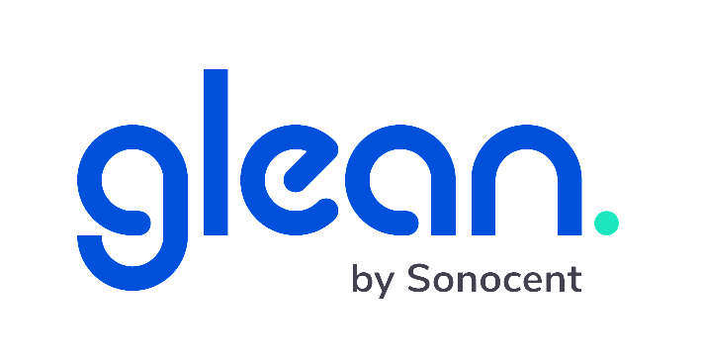
Glean – from Sonocent
Web app
Work online and offline
Simplistic design
Clean-workspace
Distraction-free
Focus in the classroom
Organize and utilize information to create meaningful notes
Intuitive to use
Free trials with schools and students
Notes:
Session after this one where this will be showcased

Slide 15
Glean by Sonocent
Notes:
Looks a bit like Cornell Notes
So busy on Glean no updates for AN this year

Slide 16
Otter.ai
Transcription based notetaking tool
Otter for Teams
$75 per student (50% off) for educational accounts
Over 30 university partnerships
UCLA, Virginia, Harvard, Tulane
Export to Word; integration with Dropbox
SRT captioning export
Highlighting export highlights only
Custom vocabulary
Notes:
.

Slide 17
Google Voice Dictation App
Both Pixel 4
Free
Transcribe and search
Animal sounds, laughter
Export to .txt file to Docs
English with more languages to come
Can be installed on older Pixels
No transcription available
Notes:
No word yet if it is coming to iOS

Slide 18
Microsoft – Learning Tools
Voice updates through early 2020
English, Spanish, Chinese, German, and Italian
Immersive Reader in Microsoft Forms – beta
Other programs: Teams Assignments and Whiteboard
Formatting continuity in Immersive Reader
Bold, Underline, Italics
Page Color options added to Word
Notes:
Less robotic sounding, high quality
Teams Assignments: Reads instructions and feedback

Slide 19
Learning Tools Resources
Two new resources
Article and guide with listing of where Immersive Reader is available: All About Immersive Reader
Immersive Reader Interactive Guide
Notes:
Less robotic sounding, high quality

Slide 20
Microsoft - Dictate
Available in some Office 365 programs (Word, PowerPoint, OneNote, Outlook)
Microsoft Dictate – standalone install stopped working October 15th, 2019
Dictate in 29 other languages
Will be built into future versions of software
Use Speech Recognition if Office product doesn't have Dictate yet
Notes:
Dictate is starting on the web first
AI powered
Translates into 60 languages

Slide 21
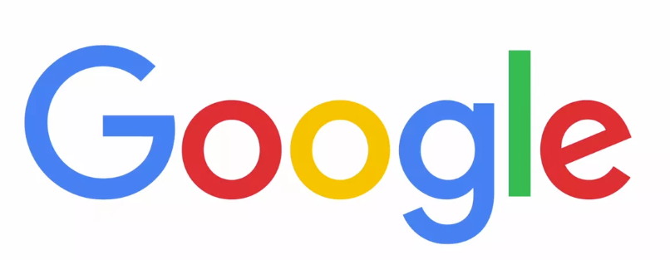
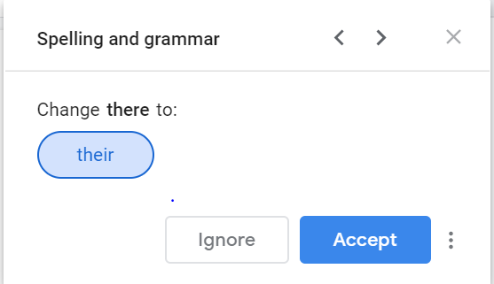
Google – AI Grammar Checker
March 2019 Release (finally)
Uses Machine Translation
Turn on through Tools – Spelling and Grammar menu
Squiggly blue line under text
Misuse of words, spellings, and grammar rules (prepositions)
Comparison to other tools?
Notes:
How does it compare?

Slide 22
Dragon Dictate Solution for Mac
Dragon Dictate discontinued
Voice Control on iPhone, iPad, and Mac OS
Same/similar Dragon commands
Toggle on and off
AI
Customize dictionary
Contextual cues moving from dictation to commands
Notes:
Dictate and control your Mac
Not as good as Dragon but does the trick
AI behind it so it could get better over time
Upgrade from voice to text dictation

Slide 23
Smartpens - Echo
Echo pens are not discontinued
Low stock of pens and supplies at start of semester
Echo Desktop now compatible with Mojave and Catalina OS
Past issues for students using Macs
May have to uninstall and reinstall the program for full functionality
Notes:
Low stock means by early!

Slide 24
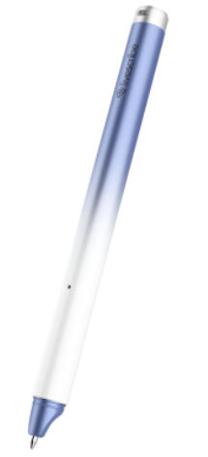
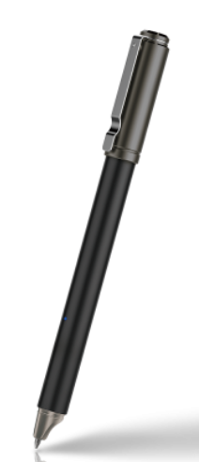
Smartpens - Aegir
New Black Dolphin (professional) and Blue Dolphin (education)
Professional Edition and Education package editions
Pen, Journal (notebook for education), Personalized stickers
Handwriting made searchable
Add tags to notes
Convert handwriting into text
27 languages recognized
Stickers use with ADNA Discovery App
Notes:
Standard edition is $99.95
Education $109.95
Professional $119.95

Slide 25
Grackle Suite
Accessibility checker for Google Docs, Sheets, and Slides
Pricing still $500 for an institution
100 site licenses covering over 2000 schools, college and universities
Add-ons with minor upgrades
Grackle Marks – markup, redact, share documents
Grackle Chrome – browser extension with immediate report of document without running the checker
Grackle Merge – merge data from Sheets or Gmail into accessible Doc

Slide 26
Grackle Drive
Accessibility audit tool for Google Drive
Glance of Drive documents in its entirety
Open document and correct errors with Grackle Suite
Priced higher than Grackle Suite
Checks docs, sheets, slides, and PDF

Slide 27
Grackle Drive Scanning

Slide 28
Grackle Drive Report

Slide 29
Alternative Format & Course Materials

Slide 30
The Law and Accessible Texts Whitepaper
The Law and Accessible Text: Reconciling Civil Rights and Copyrights Whitepaper
July 22nd, 2019 release of whitepaper by the Association of Research Libraries and the University of Virginia
Investigated the copyright laws around accessible text creation
Work funded by Institute of Museum and Library Services
Whitepaper was their report
Notes:
Too many people doing the same work
Not enough people to do the work
Overlap of doing the same work at multiple campuses
If collaboration is viable
Article from UVA Library
How to meet the need to provide accessible texts within the framework of copyright law

Slide 31
Goals of Whitepaper and Repository
Reduce duplicated efforts
Cumulative efforts across campuses
Decreased turnaround time to get books to students
Libraries also working towards this
…"Unsworth believes that this partnership 'will one day include many other universities, will improve the delivery of library services and reduce their costs, and will help universities provide all students with a level playing field.'” - Article: Federating Repositories of Accessible Materials for Higher Education” awarded a $1,000,000 grant from The Andrew W. Mellon Foundation

Slide 32
Pilot Repository for Accessible Text
$1,000,000 Grant from Andrew W. Mellon Foundation
Two-year project awarded to the University of Virginia
"Federating Repositories of Accessible Materials for Higher Education" project name
Seven schools:
University of Virginia, George Mason, Texas A&M, University of Illinois, Northern Arizona University, University of Wisconsin-Madison, Vanderbilt University
Library and Disability Resources participate
4 schools publishing presses
Partner with Hathi Trust, Bookshare, and The Internet Archive
Creation at UVA: EMMA (Education Materials Made Accessible)
Authentication, search, selection, download, upload path for remediated works
Notes:
Press: GMU, UVA, Madison, Vanderbilt
...said Dennis Lloyd, Director of the University of Wisconsin Press, “we can identify potential implementation challenges from the inside of the publishing process."

Slide 33
ePubs and PDFs
More ePubs instead of PDFs
Process has become a barrier
“We recognize that our process is inefficient. We are taking steps to address it, which will hopefully be ready for the next back to school season. ” – Pearson Representative
Administrative sign-off on providing PDFs
Keep advocating for needs
Notes:
Sessions this week that address this topic more holistically

Slide 34
Kurzweil File Delivery
Partnerships with AccessText Network and Pearson
Direct delivery of files to Kurzweil
Notes:
General software updates online and in desktop

Slide 35
Microsoft Edge and ePubs
Edge will no longer support ePub files
One less place to read ePub files
Common reader for Blind/Low Vision users
Microsoft points users to Microsoft Store for other readers
"Microsoft has collaborated with our partners and the DAISY Consortium to shortlist a few accessible ePub applications within the Microsoft Store." - Article: Download an ePub app to keep reading e-books
Notes:
As a result this is one less place to have ePub files read

Slide 36
Updates

Slide 37
Questions

Slide 38
Contact Me!
Rachel Kruzel, ATP
Accommodations & Assistive Technology Specialist
RESNA Certified Assistive Technology Professional
University of St. Thomas
St. Paul, MN
Email: rlkruzel@stthomas.edu
Phone: 651-962-6312

