Slide 1
“This isn’t why I became an instructor!” Motivating Faculty to Embrace Accessibility
Dr. Jennifer Pedersen & Dana Haff
Kenai Peninsula College
University of Alaska, Anchorage

Slide 2
Agenda
Introduction
Where to Start?
Padlet
Finding Motivators
Faculty Perspectives
Embracing Accessibility Initiatives

Slide 3
Lil’ ’ole me & UA
Journey back to Alaska
University of Alaska System
University of Alaska Anchorage
Kenai Peninsula College
Academic Innovations & eLearning (AI&e)
Educational Technology Team (ETT)
Instructional Designers Alliance

Slide 4
Accessibility Initiatives
Office of Civil Rights Complaint
Voluntary Resolution Agreement
Public Facing Websites
Training on Accessible Document Creation
Misunderstanding
Confusion
Chaos

Slide 5
Where to Start: A3 Model
Advocacy
Accommodations
Accessibility
OCR Complain: Blessing and a Curse
Raise Awareness
Highlight Need for Change
Heavy Emphasis on Compliance
Change Perspectives
From Compliance
To Eliminating Barriers to Learning
Focus on Student Success!
Reactive
Typical University Response
Reflects Medical Model
Diagnosis of Deficiency
Disability is the “Problem”
Burden on Students
At UAA:
Student Disclosure to DSS
Qualify for Accommodations
DSS Plan & Notification
Proactive
Reflects Social or Cultural Model
Correcting Differences
Valuing Diversity
Eliminating Barriers
For Faculty
For Students
(Burgstahler, 2015; Edyburn, 2010; Jackson, 2018

Slide 6
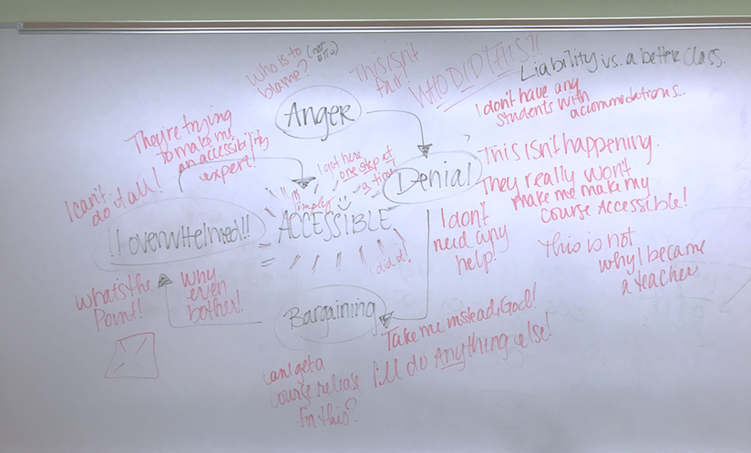
Faculty Workshop Activity Example

Slide 7
Early Faculty Perspectives
“Overrated. We are catering to the lowest common denominator which in most cases is not necessary and adding to the workload of faculty. Students are not requesting accessibility and do not seem disenfranchised over accessible documents.”
“I think it very important, but I am not sure how I can find the time to put into getting everything accessible for those rare occasions when I have a student who needs it.”
“It is a slow process, but one that needs to be accomplished. However, there is no way that faculty can do it on their own time without getting paid as much as the private companies charge.”
“It is a nice concept but not actually possible. Some types of degrees are not possible for folks with certain accessibility issues. Those courses should be made exempt from unnecessary accessibility modifications.”
“If a degree never has a student that needs it to be accessible it seems that making it accessible actually lowers the look/feel/appearance/ease of understanding.”
“Accessibility is one of the reasons that I am retiring.”

Slide 8
Barriers to Accessibility
Accommodations vs Accessibility
Lack of Skills
Time Constraints
Tool Constraints
Financial Constraints
Boring Content
(Lee, 2017; Lombardi & Murray, 2011)

Slide 9
Accommodations vs Accessibility
“None of my students need accommodations”
Change perspective
Redirection
“You can’t be a professional in my discipline with any form of disability”
Challenge stereotypes and biases
(Lee, 2017; Madaus, 2005; Rothstein, 2015; Wagner, 2005))

Slide 10
Lack of Skills
“I don’t know how to make my course accessible”
Problems:
Inconsistent Message
Lack of standardized message
No unified direction
Legitimate lack of knowledge, skill, and ability
Overwhelmed
Frustrated
Defensive
(Lombardi & Murray, 2011)

Slide 11
Time Constraints
“I don’t have time to make my course accessible”
Start ”Small”
Better not Perfect
Prioritize First 2 Weeks
No New Inaccessible Content

Slide 12
Tool Constraints
“I don’t have the tools I need to make my course accessible”
Accessibility Workshops
Blackboard Ally
Training
Sandbox
Simply Accessible Series
eTech Fair
NDLW Daily Communication
EduTips
Individual Consultations

Slide 13
Financial Constraints
I don’t have the money to make my course accessible”
Captioning
3Play Media

Slide 14
Boring Content
“Making my class accessible strips it of anything innovative and cool and makes it boring”
Opportunity to Refresh
CourseArc

Slide 15
Faculty Motivation
Incentives
QM Mini-Grants
Make it Easy to Create Accessible Material
Workshops
Scaffolding
Positive Reinforcement
Just-in-Time Video Tutorials
Accessibility Co-horts
Accessible Syllabus Templates
Tech-Fellows: OER
Faculty Champions

Slide 16
Later Faculty Perspectives
“I feel I have received the training and have VERY knowledgeable and willing staff to support my implementation. This just takes time, tinkering and familiarization.”
“Yes, I believe I can do it and am close with the help of Anchorage captioning my presentations to making all my classes accessible!”
“I feel like accessibility is something that should have been mainstream from the start because there are always people who can benefit from it even if they don’t know or don’t want to say they need additional resources for understanding the material. I think people deserve to have equal access to education and material so I appreciate what accessibility has to offer.”

Slide 17
References
Edyburn, D. L. (2010). Would you recognize Universal Design for Learning if you saw it: Ten propositions for new directions for the second decade of UDL. Learning Disability Quarterly, 33, 33-41.
Hamraie, A. (2016). Beyond Accommodation: Disability, feminist philosophy, and the design of everyday academic life. philoSOPHIA, 6(2), 259-271.
Jackson, M. A. (2018). Models of disability and human rights: Informing the improvement of built environment accessibility for people with disabilities at Neighborhood Scale. Laws, 7(10). doi:10.3390/laws7010010
Lee, K. (2017). Rethinking the accessibility of online higher education: A historical review. Internet and Higher Education 33, 15-23.
Lombardi, A. R., & Murray, C. (2011). Measuring university faculty attitudes toward disability: Willingness to accommodate and adopt Universal Design principles. Journal of Vocational Rehabilitation, 34, 43-56. doi: 10.3233/JVR-2010-0533
Madaus, J. W. (2005). Navigating the college transition maze: A guide for students with learning disabilities. TEACHING Exceptional Children, 37(3), 32-37.
Wagner, M. (2005). After high school: A first look at the postschool experiences of youth with disabilities: A Report from the National Longitudinal Transition Study-2 (NLTS2). SRI International.

