Slide 1
The Great PDF Purge
NC State University
Crystal Tenan
go.ncsu.edu/GreatPDFPurge

Slide 2
Step 1: Identify the Problem
Problem: A legion of inaccessible PDFs plaguing NC State websites
They’re multiplying!
Notes:
Many campus PDFs are critical to completing important tasks like: signing up for benefits, filling out on-boarding paperwork, and hiring student workers.

Slide 3
Background: Are PDFs innately bad?
Nope.
But it does take work to make them accessible… sometimes a lot of work!

Slide 4
Portable Document Format (PDF) Files
Great for things designed to be printed
Often just images (not readable text)
Images typically missing alternative text
Often orphaned and not updated for long periods of time
Requires full version of Adobe Acrobat to edit and update
Large files can be slow to download
Typically formatted to print vertically
Takes more time and effort to find and remediate accessibility barriers

Slide 5
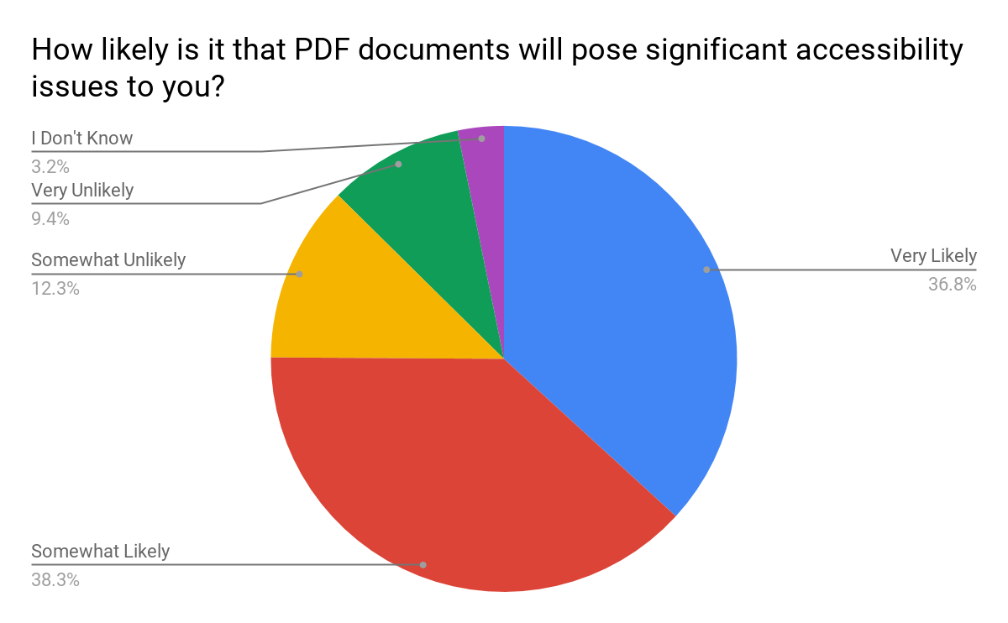
2019 WebAIM Screen Reader Survey Results
The vast majority (75.1%) of respondents indicate that PDF document are very or somewhat likely to pose significant accessibility issues.
Source: WebAIM Screen Reader Survey

Slide 6
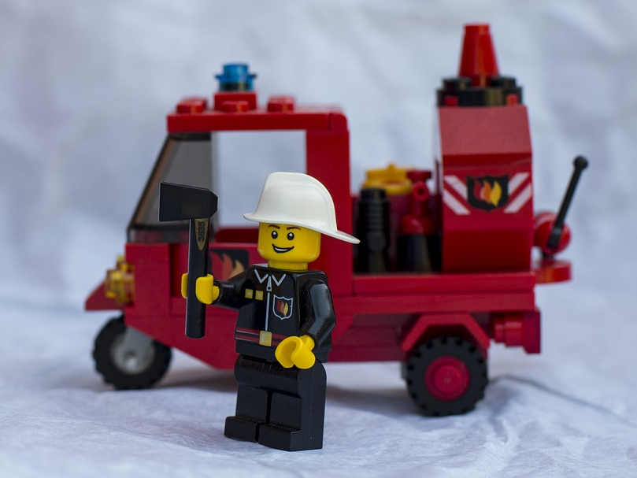
Step 2: Possible Solutions & Tough Choices
Option #1: Burn down every NC State website and start over

Slide 7
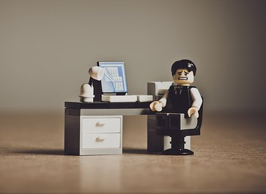
Step 2.5: Possible Solutions & Tough Choices
Option #2: Work collaboratively with content owners on campus to address their inaccessible PDFs

Slide 8
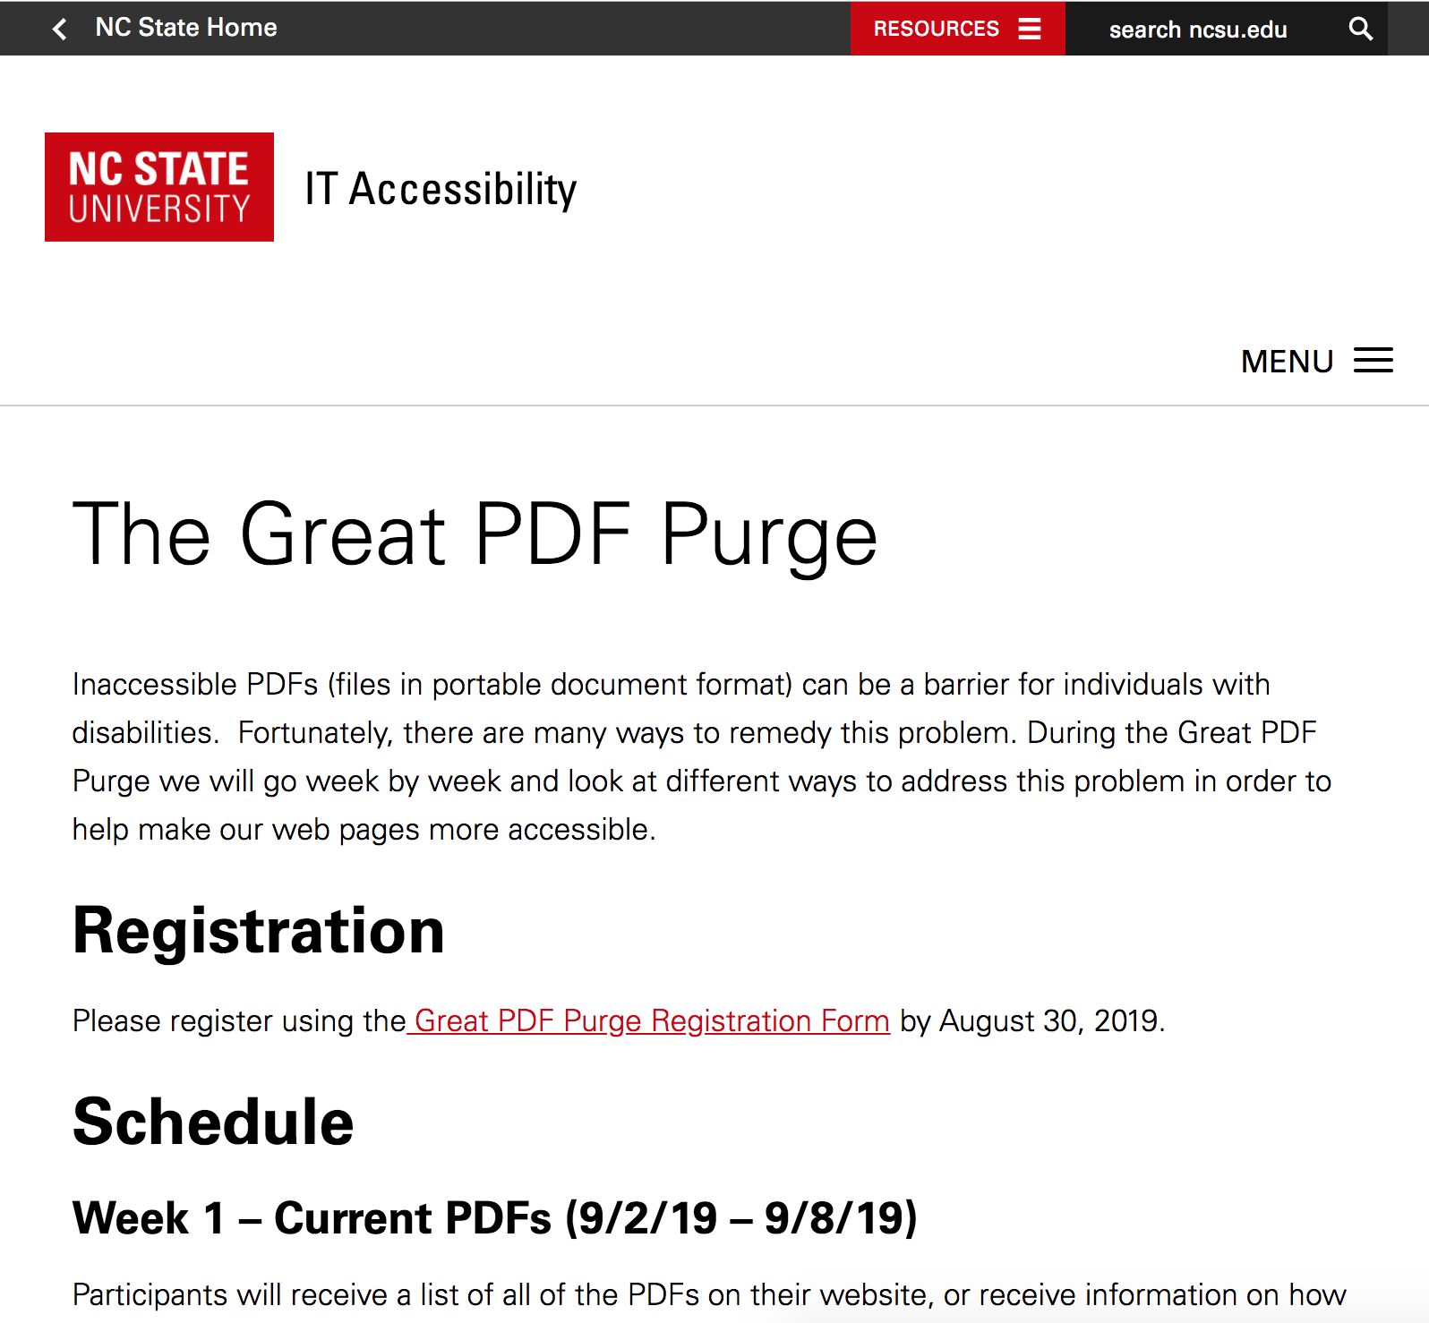
Step 3: Get campus on board
Give it an eye catching name
Campus dog & pony shows
Catchy emails
Informational website

Slide 9
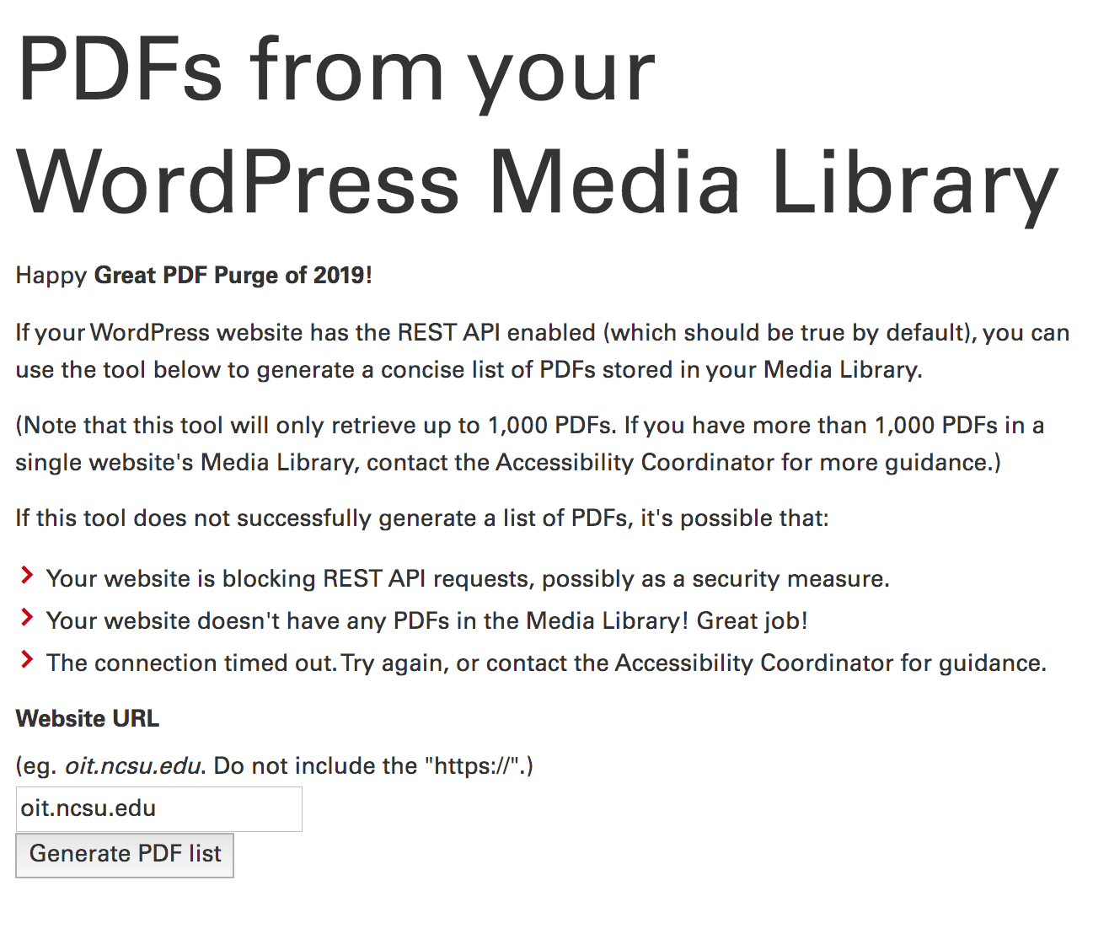
Step 4: People are signed up… Now what?
Pull a list of all of their PDFs
Tools used:
Brian’s WordPress Media Library Magic
SortSite
Create a Google Sheet for each site
Each week send instructions email
Notes:
*demo Brian’s WordPress Media Library Magic

Slide 10
Week 1- PDF Lists
Let’s Get Started
Participants sent Google sheet with their website PDF list
PDF information divided into:
PDF URL
Remove PDF (y/n)
Convert (y/n)
Keep - Make Accessible (y/n)
Notes
Assignment:
Review list of PDFs
Identify PDFs that can be:
Removed
Converted to web page or web form
Kept internally
Resources:
Office Hours
Notes:
Note: Most faculty are surprised to learn that their students can edit ther

Slide 11
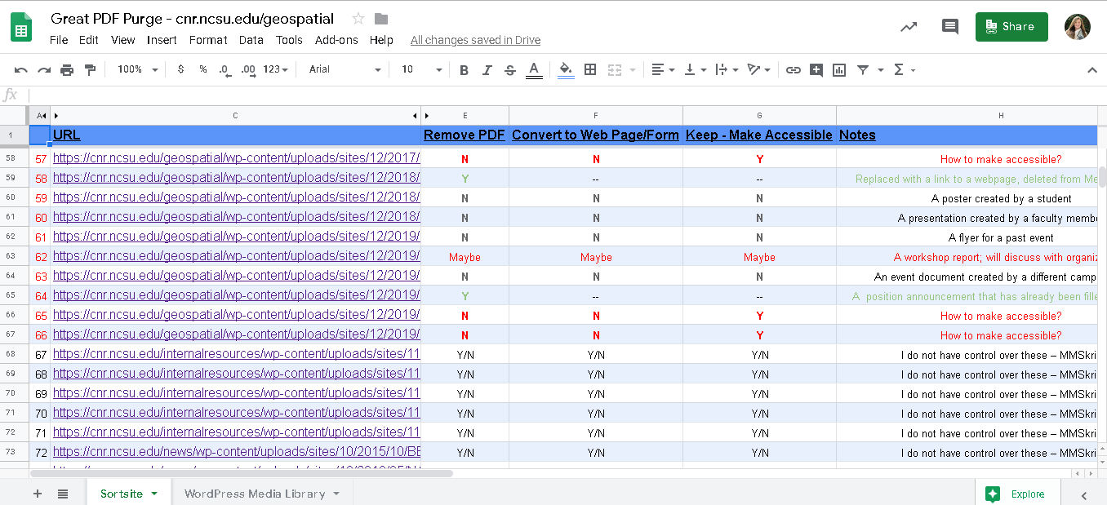
Google Sheet Example

Slide 12
Week 2 - PDF vs. HTML
HTML Benefits:
Accessibility GOLD!
Easy to update
Better mobile experience
Easy language translation
Analytics tracking
Assignment:
Review PDFs marked “Convert to Web Page/Form”
Begin converting to web pages
Resources:
Office Hours
Dinolytics Training
WCAG Quick Reference

Slide 13
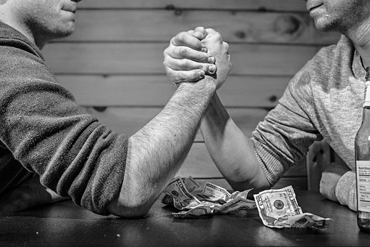
Week 3 - PDF Form vs. Web Form
Web Forms:
All the web pages benefits
Automatic submission
Easier for the user
Shibboleth security
Assignment:
Review PDFs marked “Convert to Web Page/Form”
Begin converting to web forms
Resources:
Office Hours
WCAG Quick Reference Guide
Notes:
Participants will learn the benefits of converting (when possible) inaccessible PDF forms to accessible web forms. Participants will receive information on how to create accessible web forms.

Slide 14
Week 4 - PDF Remediation
Accessible PDFs:
Option #1 - Update the source file (Recommended)
Option #2 - Adobe Acrobat Make Accessible Action Wizard and Accessibility Checker
Assignment:
Check remaining PDFs
Follow accessibility checker prompts and fix barriers
Resources:
Office Hours
Lynda.com: Creating Accessible PDFs
WebAIM: Acrobat & Accessibility
YouTube Accessible Acrobat Forms
PDF Remediation Vendors
Notes:
Participants will learn how to evaluate their remaining PDFs for accessibility and how to make them accessible. In-person and online training on this topic will be available.
Participants will also be given information about vendors that their departments can hire to make their PDFs accessible if they do not have the in-house resources to do so.

Slide 15
Week 5 - Feedback Survey
Q1: Before this event, were you aware that many PDFs are inaccessible for people with disabilities?
Yes (3)
No (0)
Notes:
Award distribution & accolades! Followed by a participant survey.

Slide 16
Feedback Survey Q2
Q2: Did you find the information about PDF alternatives helpful?
Yes (3)
Somewhat (0)
No (0)
Notes:
Award distribution & accolades! Followed by a participant survey.

Slide 17
Feedback Survey Q3
Q3: How do you plan on remediating any remaining PDF documents that you need to keep in PDF form?
Outside vendor (0)
In-house (3)
N/A (0)
Notes:
Award distribution & accolades! Followed by a participant survey.

Slide 18
Feedback Survey Q4
Q4: Did the information from this event impact how you will share information on your web pages in the future?
Yes (1)
Somewhat (1)
No (1)

Slide 19
Week 5 - Celebration!

Slide 20
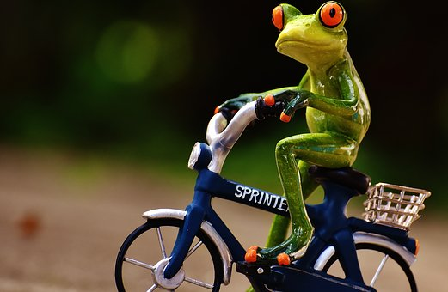
Measuring Success - The Numbers
Participation:
24 individual websites signed up
10 with 0 found PDFs
7 actually participated
Outcomes:
204 PDFs removed completely
4 turning in web pages or web forms
37 being made into accessible PDFs

Slide 21
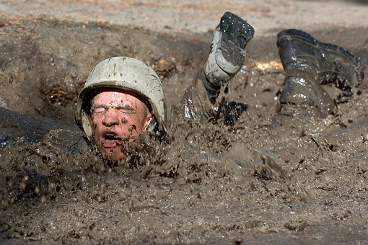
The Challenges
Who owns this document?
Legacy content
Time
Cost of paying vendors
Looming misconceptions about PDFs
Getting the word out

Slide 22
The Victories
Victory #1: Awareness
“I wasn't able to do anything other than look at our PDF list (...) There are a few PDFs I can purge from my site and still plan on doing it eventually, so it was still a helpful exercise.”
Victory #2: We chipped away at the inaccessible PDFs
Victory #3: Paying it forward

Slide 23
Planning for Next Year
Longer time for the event
More marketing of the event
More one on one interaction with groups
Possible RFP for remediation services to attempt to save money

Slide 24
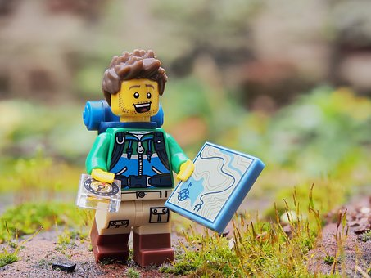
Questions & Discussion

Slide 25
Contact Us
Brian DeConinck
bpdeconi@ncsu.edu
Crystal Tenan
cltenan@ncsu.edu

