Slide 1
Providing Tactile Tours to Increase Usability of Tactile Graphics
UITS Assistive Technology and Accessibility Centers

Slide 2

Presenters
Brian Richwine, CPACC
Manager
UITS Assistive Technology and Accessibility Centers
Mary Stores, CPACC
Principal Accessibility Consultant
UITS Assistive Technology and Accessibility Centers
Other contributors (not presenting):
Dillon Ang, Lead Math Editor
Christopher Goodbeer, Literary & Music Braille Transcriber
Destin Hubble, Alternate Media User Support Specialist

Slide 3
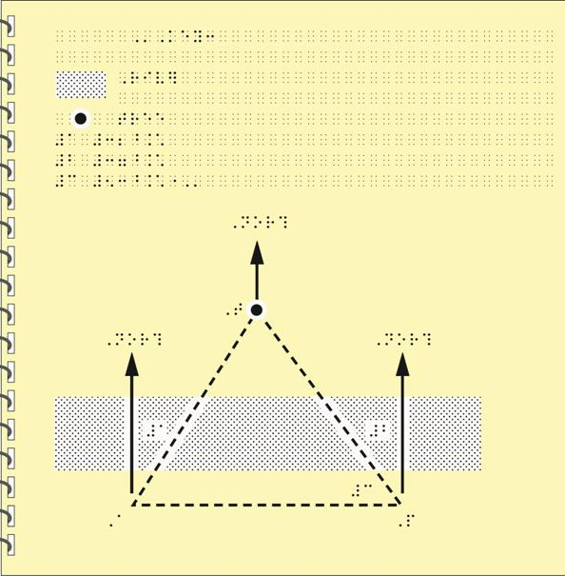
Key points
Experience perceiving tactile graphics without use of eyesight
Discover how a “tactile tour” can aid the perception of tactile graphics
Discuss the unique features in creating tactile tours
Note: This presentation assumes some familiarity with tactile graphic design and image description
Image Credits: BANA Guidelines and Standards for Tactile Graphics,
(2010), APH, 6-83,

Slide 4
Why Tactile Diagrams are Necessary
First things first

Slide 5
Some images can be described using text:
[begin figure description]
This figure has two illustrations one left and one right, each with a top and bottom part.
Left illustration – no violation of doctrine:
Top: A police officer stands next to a wall and there are plants behind the wall. The officer is tall enough to be able to see over the wall.
Bottom: A police officer stands next to the driver’s side of a car. The officer shines a flashlight into the car and at the driver of the car.
Right illustration – violation of doctrine:
Top: A police officer stands on a ladder next to a wall and there are plants behind the wall. The officer needs the ladder to see over the wall.
Bottom: A person looks through binoculars and sees another person in a ski-mask who seems to be in the process of picking a lock.
[end figure description]

Slide 6
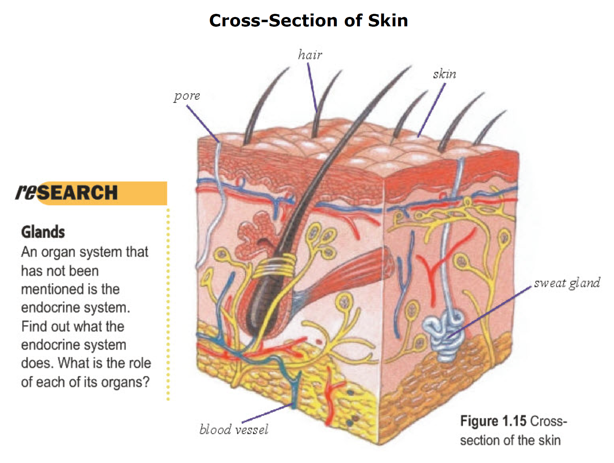
However, some images really do “say a million words”

Slide 7
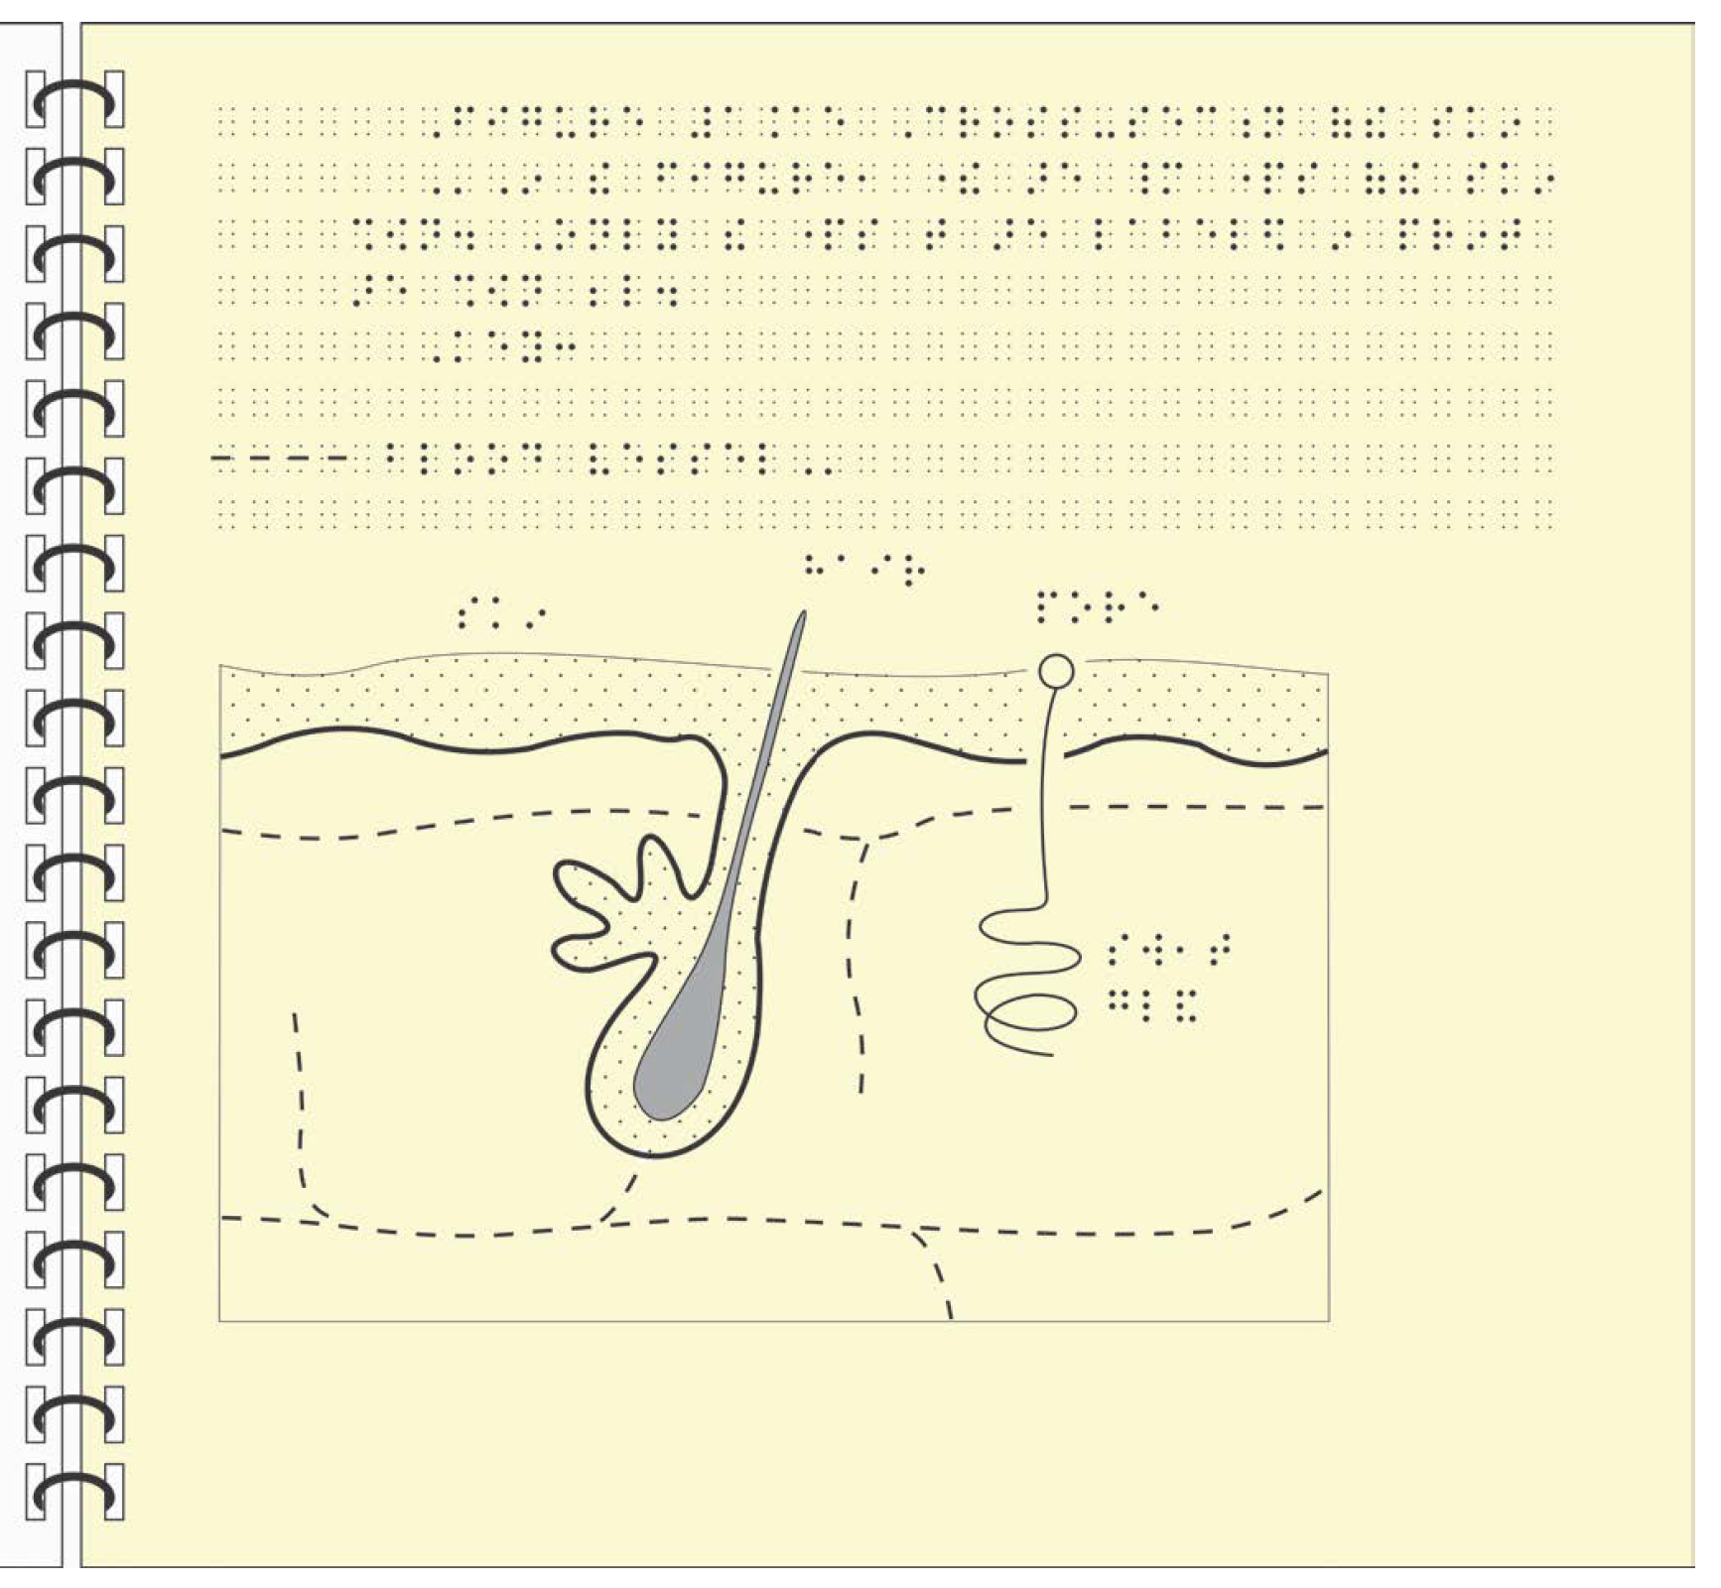
Tactile Graphic for the Previous Image

Slide 8
So, What Are Tactile Graphics?
An alternate media format where students with visual impairments may use their fingers to perceive information by exploring raised tactile features that sighted students would perceive visually.

Slide 9
Exploring Tactile Graphics by Touch Only (without eyesight)
Key point 1:

Slide 10
The “No Peeking!”
Tactile Graphic Challenge
Try not to look inside at the image
Slip your hand inside the
envelope and…
Explore!
What is the symbol? (Don’t spoil it!)
Hints to follow…

Slide 11
Hints for the Tactile Challenge
Hints embargoed until after presentation
Slides will be updated after the presentation

Slide 12
Answers: Images Used as Tactile Graphics
Answers embargoed until after presentation
Slides will be updated after the presentation

Slide 13
How “Tactile Tours” Can Aid in the Perception of Tactile Graphics
Key point 2:

Slide 14
The Problem
Graphics used in higher education are often complex, full of small details, and deal with new and unfamiliar ideas
Resulting tactile graphics, even if well designed, could not be used independently by students with visual impairment
Student feedback described tactile graphics as confusing, stressful, and exhausting

Slide 15
Found inspiration in two works:
Hinton, Ron (1996) Tactile Graphics in Education, Moray House Publications, ISBN: 0901580775, “6.4 Audio scripts for use with diagrams”
Ricker, K S (1981) Writing Audio Scripts for Use with Blind Persons, Journal of Visual Impairment and Blindness, 75 (7), 297-9.

Slide 16
Our Answer: Tactile Tours
A Specialized Text-based Image Description
Similar to a guided introduction to a museum or a location’s notable landmarks and the identifying features of those landmarks
A “tactile tour” is a guided introduction to the features on the tactile that a reader would need to be aware of and look out for

Slide 17
Goals for a Tactile Tour
Allow the reader to conceptualize the information prior to using their fingertips
Reduce confusion by describing design techniques used
Enable the reader to strategically explore the tactile by locating and describing features in the tour
Facilitate perception of each prominent detail

Slide 18
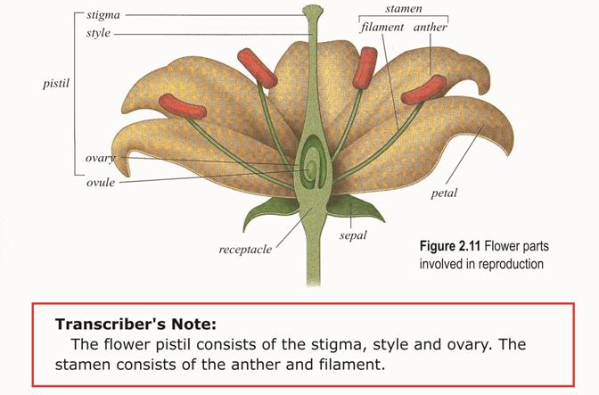
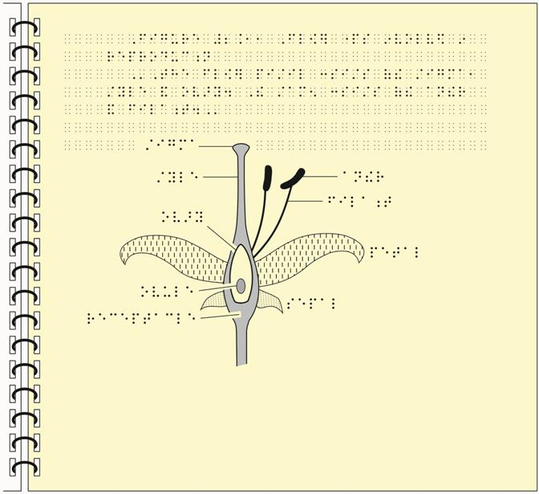
Not just a Legend or Typical Transcriber’s Note
Example typical transcriber’s note found in Guidelines and Standards for Tactile Graphics, (2010) APH, 3.10-3.11

Slide 19
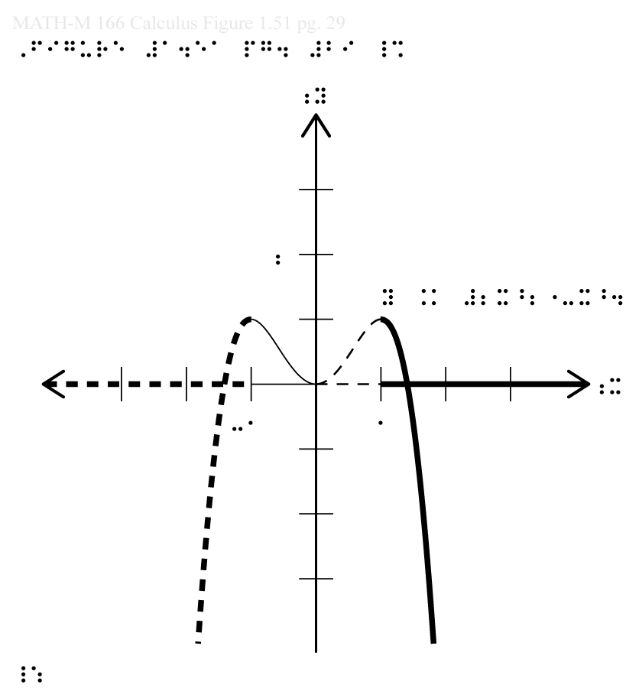
Example Calculus Tactile Graphic
Note the possible sources of confusion in the tactile graphic pictured here:
Multiple line types even for the same features (x-axis, function curve)
Braille labels in Nemeth Code
Density of features (curve, axis numbering, axis/domain line, axis tick marks)

Slide 20
The Corresponding Original Image
For reference, here is the original image.
Note the use of the green, red, blue, and black colors that might be referenced in the text, problems, or in the lecture.
Image credit:
Figure 1.51, Briggs, William L., Lyle Cochran, and Bernard Gillett (2015), Calculus, p. 29

Slide 21
Corresponding Tactile Tour
Notes:
These notes contain the tactile tour using MathSpeak Grammar for the math content:
[Begin tactile tour]
Function plot of [Begin math] y equals 2 x squared minus x Superscript 4 [End math] on a Cartesian graph with the origin centered at the middle of the graph. The x-y axes are marked with medium-width solid lines and are drawn from negative 3 to 3 with tick marks in increments of 1. The axes are labeled at y equals 2, x equals negative 1, and at x equals 1. The x-axis and the function’s curve are highlighted in four colors that represent four different domains of x. For each domain, listed from left to right, the x-axis line and function curve’s share the same line style:
Bullet: For the green domain x equals left-parenthesis negative infinity comma negative 1 right-bracket, a thick dashed line is used.
Bullet: For the red domain x equals left-bracket negative 1 comma 0 right bracket, a thin solid line is used.
Bullet: For the blue domain x equals left-bracket 0 comma 1 right-bracket, a thin dashed line is used.
Bullet: For the black domain x equals left-bracket 1 comma infinity right-parenthesis, a thick solid line is used.
In the positive x-axis domain, the function goes through the origin rising exponentially to y equals 1 at x equals 1 and then drops exponentially towards negative infinity passing y equals negative 3 around x equals 1.75. The function’s curve is mirrored around the y-axis.
[End tactile tour]

Slide 22
Creating Tactile Tours
Key point 3:

Slide 23
Tactile Tours = Carefully Designed Briefings
Be concise!
The goal is to enable the reader to conceptualize the information and diagram structure as best as possible prior to when they use their fingertips.

Slide 24
Tactile Tours = Carefully Designed Briefing
Provide only enough information to:
Form a mental image of what features are contained in the diagram and how those features are represented
Layout details to enable confident exploration of the tactile
Understand how the tactile graphic differs from the original image

Slide 25
First: Briefly Set the Context
Start with a brief description of what’s in the image or diagram.
For example, is it a:
Bar graph
Cross section
Histogram
Line graph
Map
Scatter plot
Etc.

Slide 26
Describe the Features and Their Design Techniques
Examples:
Let readers know of how features in the graphic are labeled (Is a key used? How are braille labels placed relative to objects?)
Explain if leader lines or arrows are used to connect labels to features as the added lines can create confusion
Describe other potentially confusing or distracting features (large areas of fill textures with parallel lines, tight spacing, uncommon use of line types, etc.)

Slide 27
Use Consistent Terms
Line widths: “thin”, “medium”, “thick”
Line types: “solid”, “dashed”, “dotted”, “dot-dashed”, etc.
Points or dots: “solid circle”, “hollow circle”, “small cross”, etc.
Textures:
It’s best to provide a key. Mention that a feature is textured, and then be sure to refer to the key.
Otherwise be sure to develop standard texture fills and consistently use descriptive names for how they feel (horizontal line pattern, vertical line pattern, dot pattern, etc.)

Slide 28
Make Design Details Obvious
For example:
If two different circle types (solid vs. hollow, etc.) were used to distinguish two data sets then make that explicit.

Slide 29
Ensure Important Features Are Not Overlooked
Don’t assume the student has a systematic approach for reading tactile graphics
Provide clues on how to approach the tactile graphic if the reader may benefit from exploring the diagram via a particular approach
Be sure to cover each prominent feature to assist the reader in perceiving the entire diagram:
Locate
Describe
Discuss

Slide 30
Describe How the Design Differs from the Original
Was the image broken up into multiple tactile graphics?
Were textures or line types used to represent what was originally conveyed by color or other visual attribute?
Was a 3D image converted into a cross section?
What details were removed? Were two trains on a railroad track rendered as two rectangles placed above a dashed line?

Slide 31
The Usual Image Description Cautions
Be as concise as possible!
Avoid jargon outside of the material’s domain
Be careful when choosing to include identity information
Include all relevant details and avoid biasing the reader
Check for accuracy!

Slide 32
Overall Benefits
Increases reader confidence and independence – Less need for sighted assistance
Speeds the perception of tactile graphics
Helps to ensure all prominent features are discovered and understood
Helps keep reader motivated – decreases cognitive burden, reduces confusion, stress, and exhaustion
Maintains investment made in production of the tactile graphic

Slide 33
When Are Tactile Tours Helpful?
Given the benefits of tactile tours, we feel they are always needed in order to fulfill the ADA’s standard of providing “substantially equivalent ease of use” as compared to the ease in which sighted users can interpret visual materials.

Slide 34
Future Work
We would like the Braille Authority of North America, or another appropriate body, to consider developing the idea into guidelines or a standard
Have a cookbook of representative images along with the corresponding tactile tours and graphics to help those new to the work and to increase consistency

Slide 35
Thoughts? Questions?
Brian Richwine, CPACC
Manager
UITS Assistive Technology and Accessibility Centers
brichwin@iu.edu
Mary Stores, CPACC
Principal Accessibility Consultant
UITS Assistive Technology and Accessibility Centers
mstores@iu.edu
atac.iu.edu

