Slide 1
Positive Forward Movements: A University's Digital Accessibility Journey and Strategies
Jen Bethmann
Web Accessibility Coordinator
November 21, 2019

Slide 2
Changing Campus Culture is HARD

Slide 3
Positive Forward Movements
Work toward the goal of usability and accessibility
Maintain a positive attitude
Image Source: https://pixabay.com/

Slide 4
Where to Start?
Image Source: https://www.flickr.com/photos/97041449@N00/6446004411

Slide 5
Start a Conversation
Chats
Department Presentations/meetings
Guest lecture in courses
Training
Lunch and Learns
Find a way to get involved and in front of campus groups
Image Source: https://pixabay.com/

Slide 6
What to say?
Know your audience
Avoid making chats stressful
Be a resource first
Be careful with legal/technical jargon (avoid glazed-eye syndrome)
Have multiple ways to talk about a topic
Show the how with the why (when appropriate)
Include 3-5 easy ways to start today
Be prepared to adapt

Slide 7
Build and Maintain Relationships
Support and Resources
Online tutorials
Website and Document Rubrics
Repetition and Reinforcement
Empower lots of people to know a little about accessibility
TRUST!

Slide 8
Connect with Campus Partners
WEB Team
Academic Technologies
Administrative Technologies
Student Access and Accommodation Services
University Marketing and Communications
Purchasing Office
Division/Department IT staff
Department staff and faculty
Human Resources
Office of Equal Opportunity and Access
General Council

Slide 9
Review Process
Automated Testing
WAVE, Chrome Lighthouse
Only catches 30% of errors
Manual Testing
Content
Structure
Links
Tables
Images
Time-based Media (Videos, audio, animation)
Design/Development/Operation
Keyboard-only
Forms
Modals
Color/Text
Responsive Design/Magnification
Screen Reader
Image Source: https://pixabay.com/

Slide 10
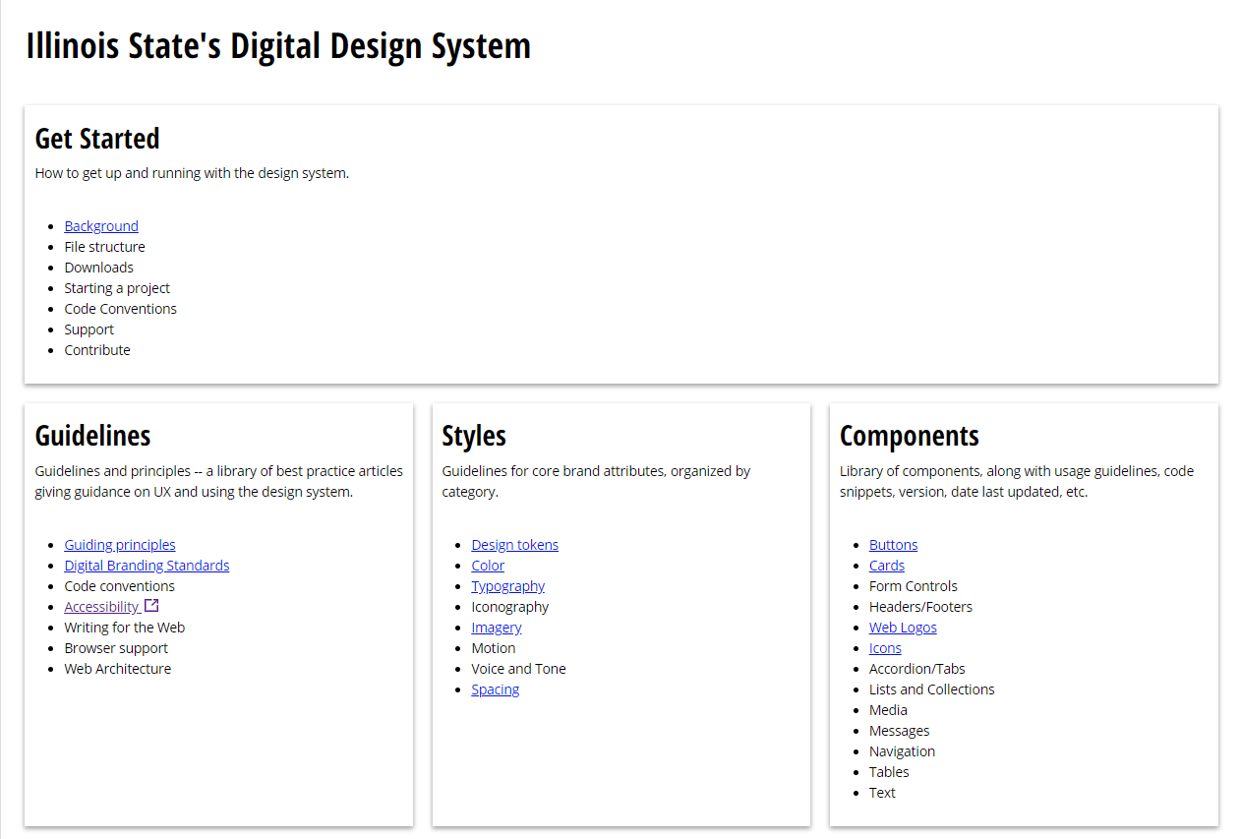
The Design System
A pattern library with shared practices organized to achieve the purpose of digital products.
Components are vetted with accessibility in mind from the beginning.

Slide 11
Timelines
Year 1:
List all websites
Prioritized by use and population
Review website template(s)
Integrate reviews into website project procedures
Develop Accessibility Rubrics
Partner with marketing office
Year 2:
Review enterprise applications
Join procurement RFP committees
Digital Accessibility Committee
Draft Accessibility Policy
Host training sessions
Present at campus conferences
The Design System

Slide 12
Moving Forward
Though accessibility is never done, keep positively moving forward. Whether it’s an inch or 1,000 miles your efforts make a difference to someone.
Image Source: https://pixabay.com/

