Slide 1
Math Made Easy:
Conversion, authoring & access with EquatIO!
November 21, 2019

Slide 2
Register here for slides and info:
text.help/AHG19-EQ

Slide 3
Today:
Overview of EquatIO
Textbook conversion
Jennifer’s Instructional Design feedback
Questions

Slide 4
Launched in 2017
Easily create digital, accessible math
Speech input, predictive math, handwriting recognition, etc
Creation & collaboration in G Suite (Google Docs)
“Accessible”= instant alt text for text-to-speech
K12 primary focus

Slide 5
EquatIO’s “5 C’s of Math”
Disability Services
Conversion
Creation
Consumption
Collaboration
Compliance
Instructional Design
Students
Math Department

Slide 6
Screenshot Reader
(OCR for Math)
Screen Capture
(MathML output)

Slide 7
Let’s take a look…..

Slide 8
Math Conversion Comparison:
“Old way” vs. “New way”

Slide 9
The Old Way:

Slide 10
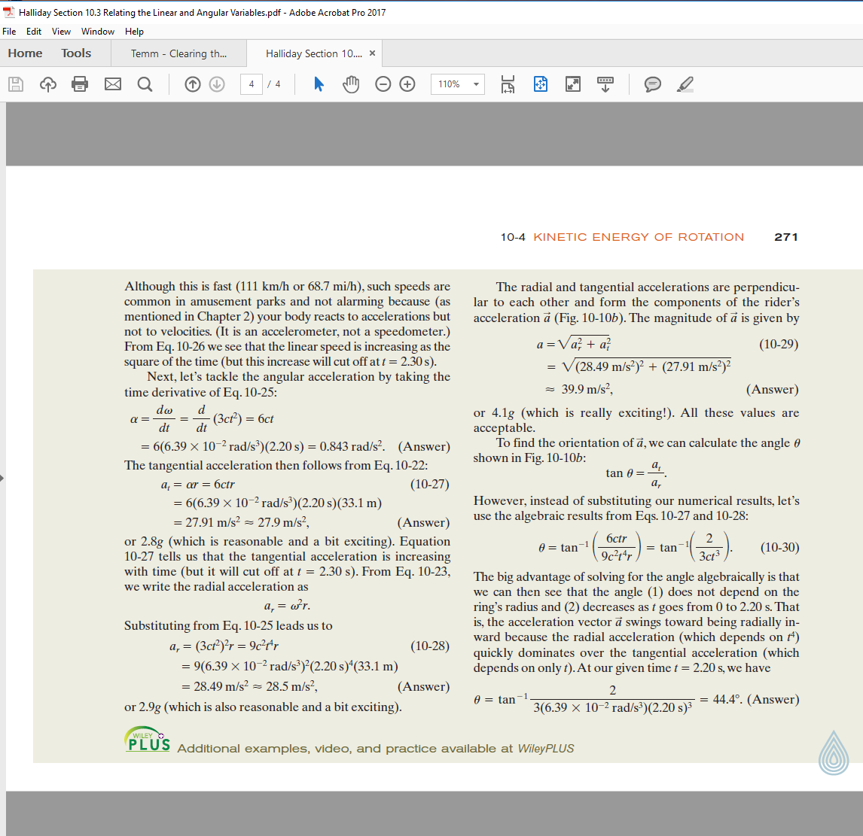
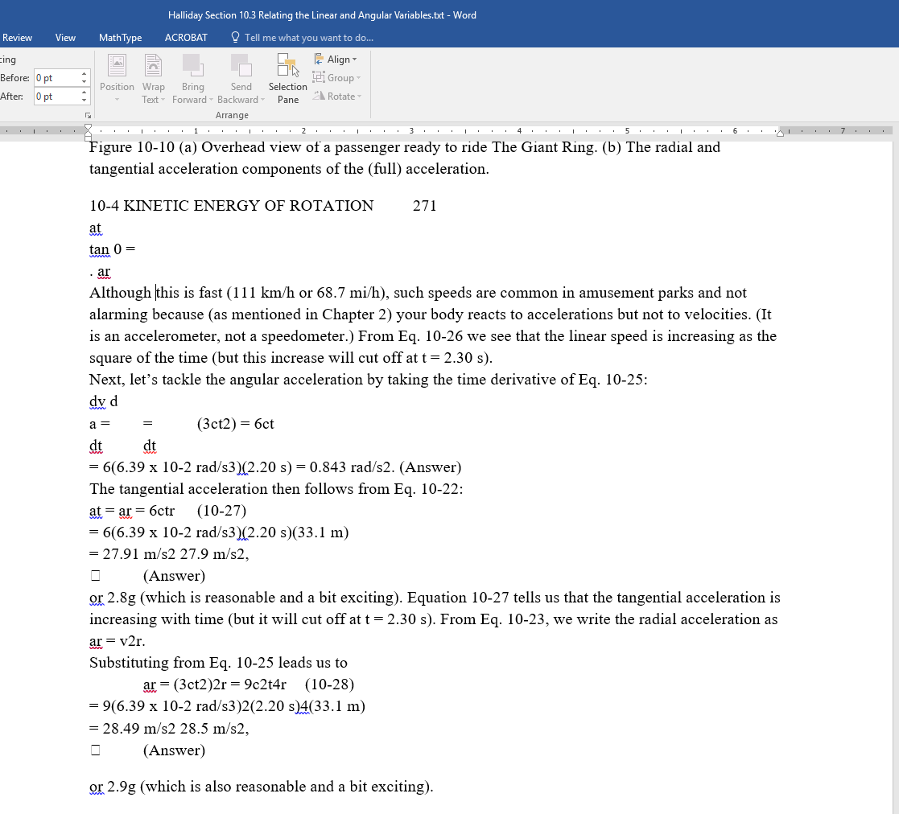
Original PDF
Extracted Word File

Slide 11
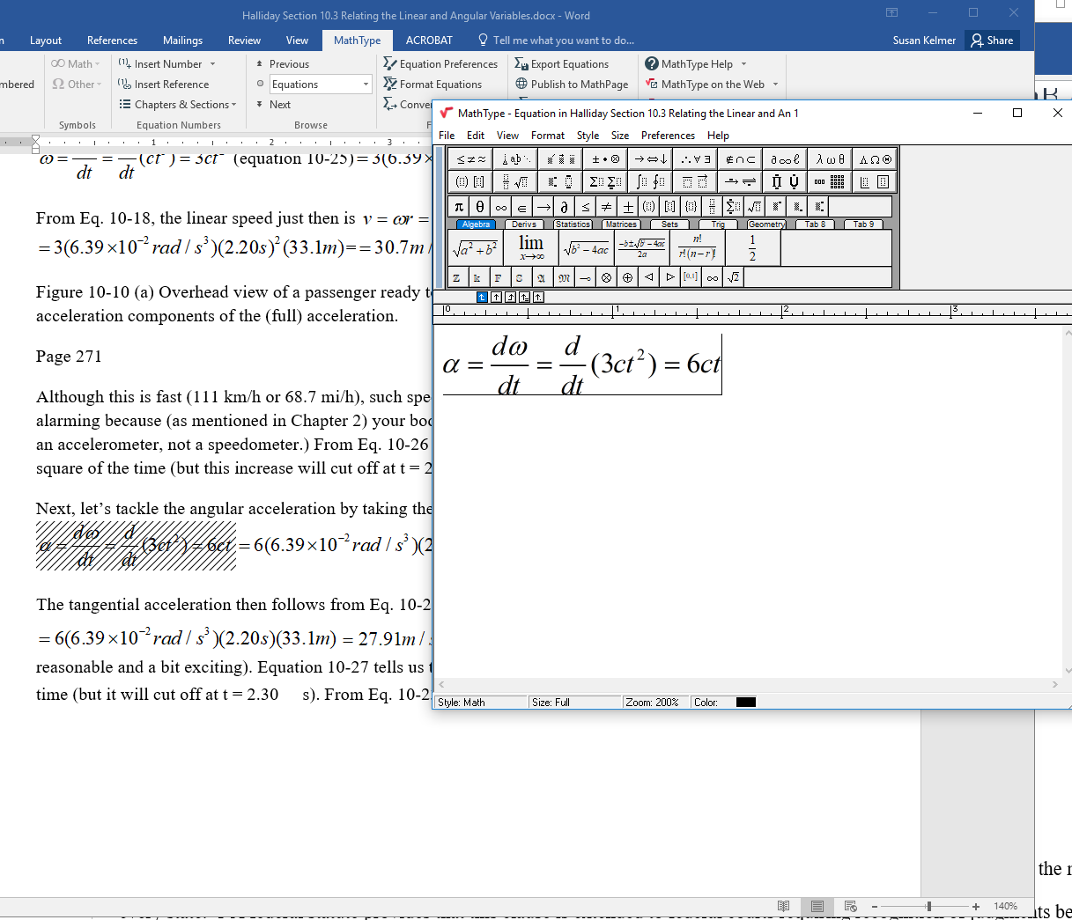
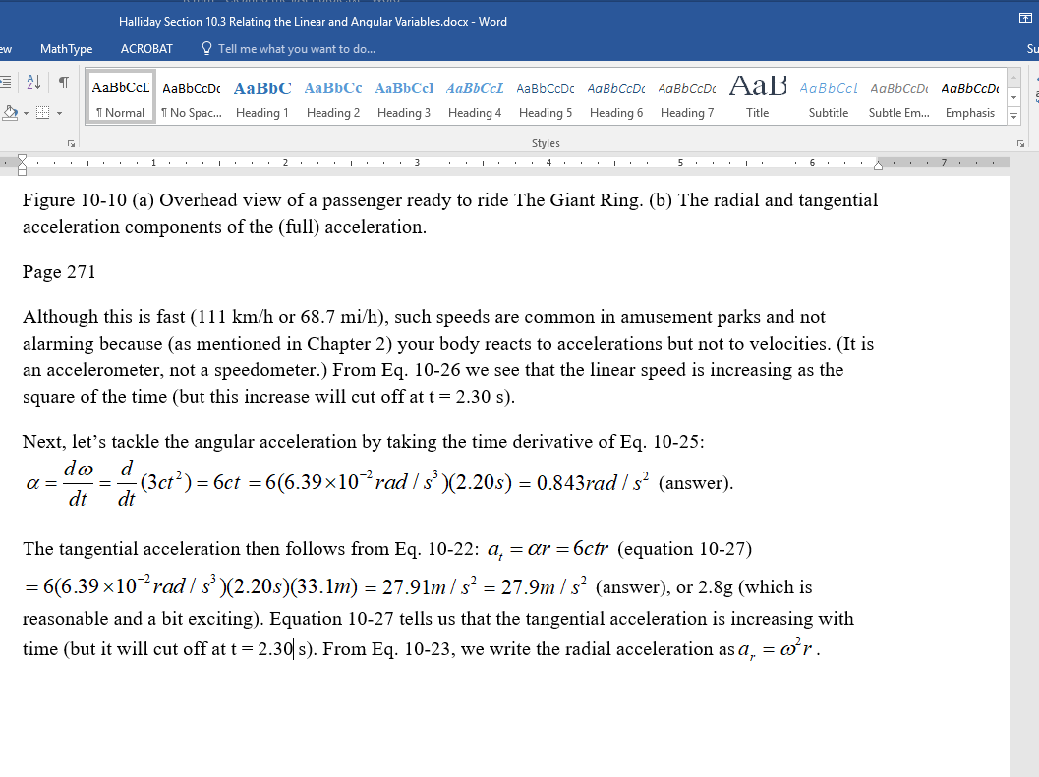
MathML Edits with MathType
MathType Equations Completed
☑ Time-consuming
☑ Human error

Slide 12
The New Way:

Slide 13
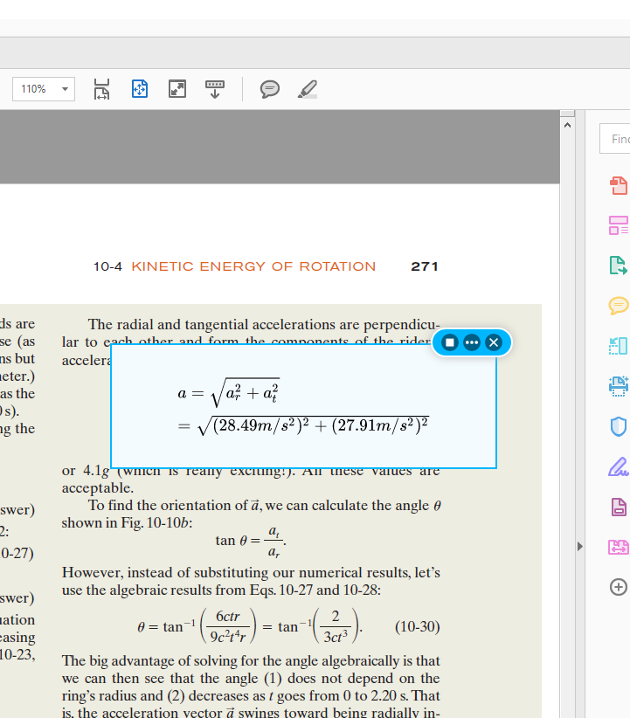
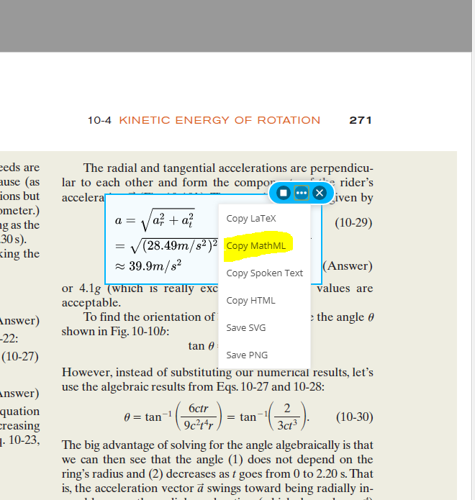
Original PDF
Copy MathML Instantly

Slide 14
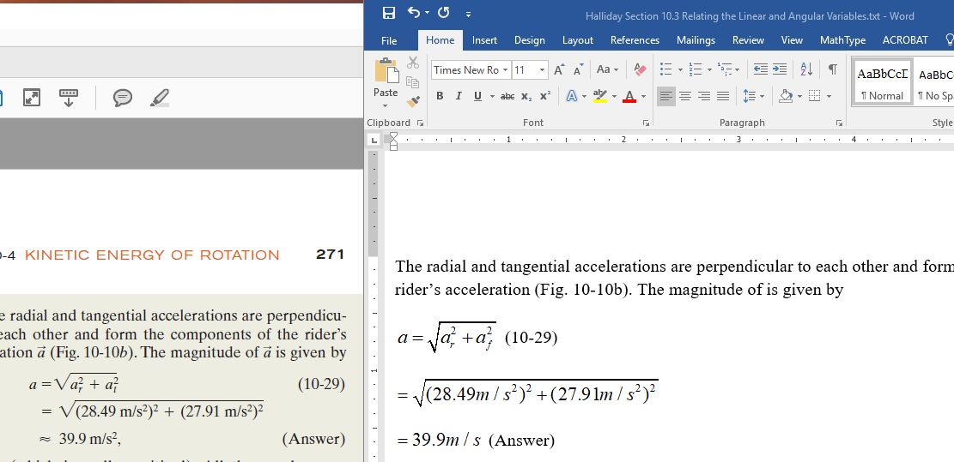
Paste into Word = DONE

Slide 15
Textbook Conversion:
150 hours
$9,000 student worker time

Slide 16
50
150 hours
$9,000 student worker time
$3,000
Savings: $6,000!

Slide 17
Questions so far?
Notes:
Final questions POLL how can we best serve you???

Slide 18
But wait… there’s more!
Math authoring tools
Notes:
Final questions POLL how can we best serve you???

Slide 19
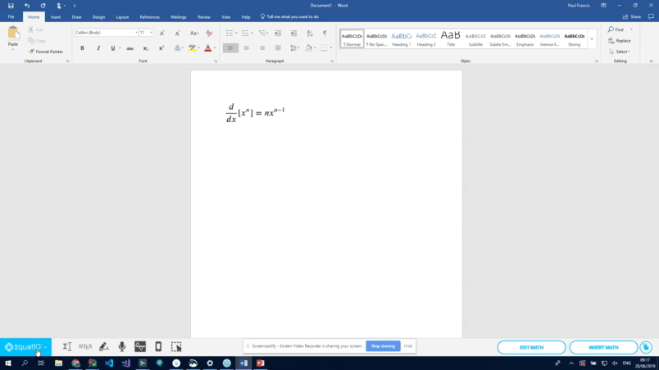
In development:
MathML creation/edit in Powerpoint:
This update will allow users to insert math
into Powerpoint on both Windows
& Mac. It will function in the same
way as the MS Word integration.

Slide 20
Instructional Design
Department pioneers new tech
Looking for accessible math tool
Saw EquatIO at AHG
Funding EquatIO (+ Read&Write)
Jennifer Pedersen
Lead Instructional Designer
University of Alaska

Slide 21
Instructional Design
“Not all Instructional Designer people speak math.”
“EquatIO makes math easy for everyone” (faculty and students).
Retention: “EquatIO helps students keep up with the challenging math instead of dropping out.”
Remedial Courses: “EquatIO can reduce the number of times they repeat the course- saving time and money.”
“We will look for other campus partners to share the licensing cost next year.”

Slide 22
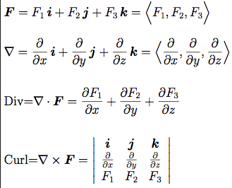
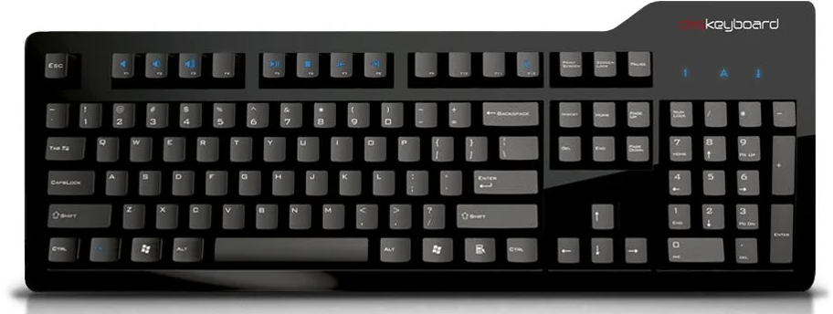
EquatIO at KPC
Math accessibility in a virtual world is not entirely about ADA compliance
Math itself is not easy in a virtual world
Requires multiple software tools that are platform neutral
Computers wouldn’t exist without sophisticated mathematical ideas… and yet...

Slide 23
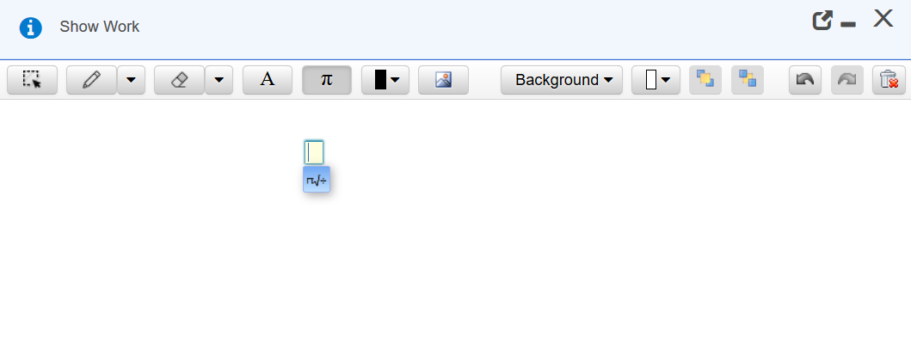
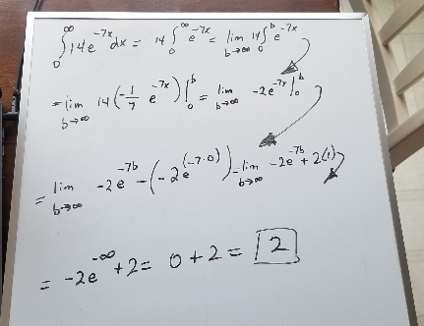
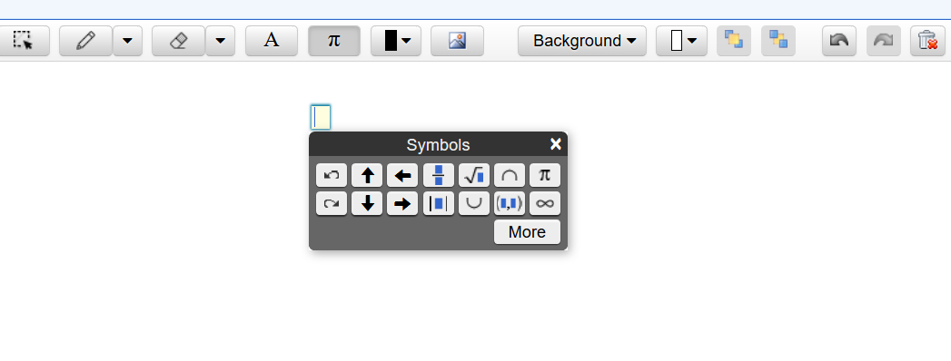
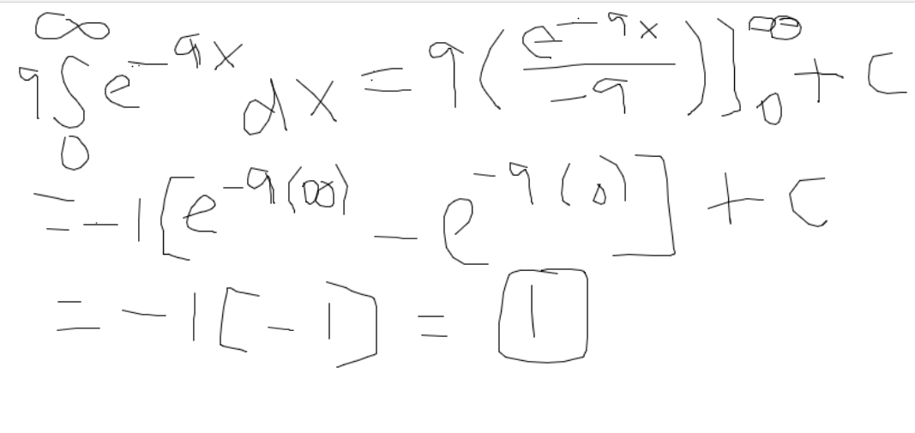
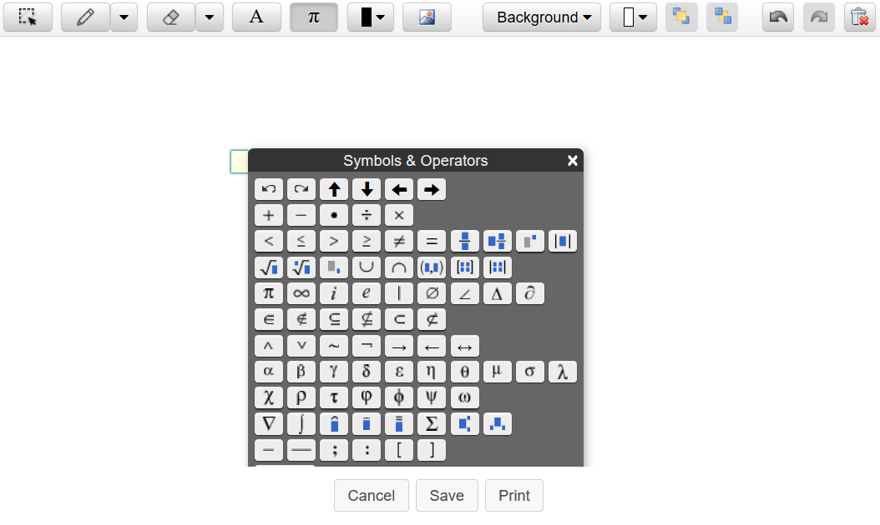
Showing Work on an Online Math Test: Then

Slide 24
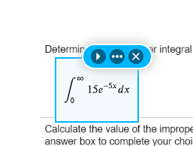
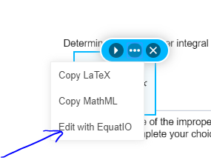
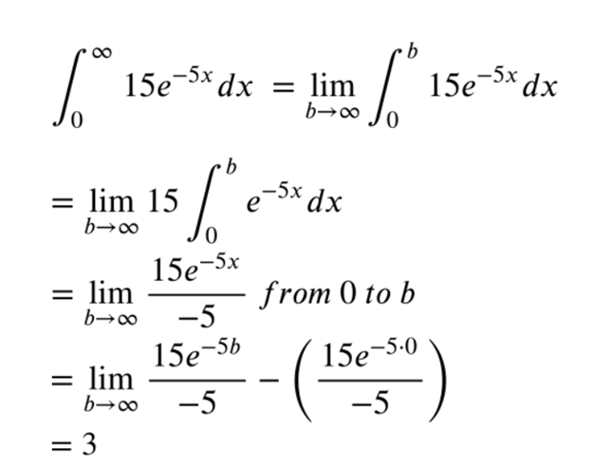
Showing Work on an Online Math Test: Now
Take a Tour with Clair Kochis,
Assistant Math Professor at KPC

Slide 25
Final Thoughts
EquatIO
Complete Tool
Already accessible
Screen reader included
Integrated with Desmos
Students can type, digitally write, or speak their work
AND… see it so that they can troubleshoot notation errors!!
Student Quote:
Hi, I wanted to say that EquatIO is super helpful for me (I use Google Docs so I have the EquatIO extension). Just wanted to put that out there if anyone in this class is hesitant to use it.

Slide 26
Math Adoption Accessibility
Compliance “Checklist”

Slide 27
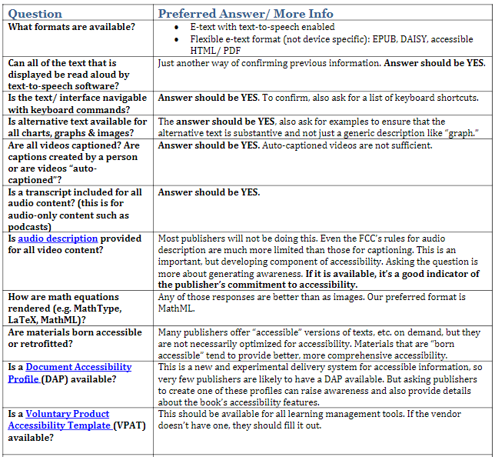

Slide 28
EquatIO Higher Ed Pricing
 | Campus (Domain)
 | 1-10,000 Students | 10,000-20,000 students | 20,000 + students
$100 (single user) | $2,735 | $4,920 | $6,145
Canvas LTI | $1,500 | $2,000 | $2,500
* University textbook conversion requires domain license

Slide 29
EquatIO Higher Ed Pricing
Read&Write customers:
25% discount
Pro-rated to date of Read&Write renewal
Non-Read&Write customers:
25% discount if also purchase Read&Write
3 initial pricing lengths:
3-month: Now through July (pro-rated)
12-month: (but you’re stranded next April)
15-month: Now through July 2020

Slide 30
Things to know:
University textbook conversion requires domain license: text.help/Mathbook (case sensitive)
The Texthelp team can assist with:
Webinars or onsite demonstrations
Local AHEAD chapter meetings
Campus pilots (including conversion capabilities)
Quotes

Slide 31
Last questions?
Notes:
Final questions POLL how can we best serve you???

Slide 32
Register here for slides and info:
text.help/AHG19-EQ

Slide 33
Thank you!
Paul: paul.brown@texthelp.com
Susan: susan.kelmer@colorado.edu
Jennifer: jpedersen@alaska.edu
Notes:
Final questions POLL how can we best serve you???

