Slide 1
Notes:
Set up external links prior to starting the presentation/make sure all other tabs are closed
Click "Record"
Top right: click "Start broadcast"
Test audio by checking for hand raises in the attendees section
"Hi everyone. We're about to get started. I wanted to make sure that everyone can hear the audio – do you mind raising your hand if you can hear me?"
Share screen
Put PowerPoint into slideshow mode
Great it looks like you all can hear me.
Thank you all for joining us today for this webinar, entitled Intro to Audio Description.
This webinar is being live captioned, and you can view those captions by clicking the CC icon in your control panel.
My name is Jaclyn from 3Play Media, and I’ll be presenting today. The presentation should take about 30 minutes and I’ll leave some time at the end for Q&A. Feel free to send us your questions throughout the presentation in the chat box so that I can answer them at the end.
One last thing, this presentation is being recorded, and you'll receive an email tomorrow with a link to view the recording and slide deck.
And with that, let’s get started!

Slide 2
Notes:
So to kick things off I’d love to take a poll and get some insight from all of you. So I posted a poll on Twitter a few minutes ago asking you about your audio description needs. I’ll give you a minute to head over to Twitter and search @3PlayMedia and answer that poll. When you’re done, I welcome you to follow us. We share a lot of content about audio description specifically. We also share content covering a wide range of accessibility topics. So we’d love to have you follow us so that you’re seeing that new content as it comes out. If not, there’s no hard feelings but please still take a moment to fill out the poll.
I also want to encourage anyone who regularly attends our webinars to ask questions for upcoming webinars on our twitter. Just tag @3playmedia or use the #3PlayWebinars. We’ll be sure to look out for those questions prior to the webinar presentation.
Have you ever watched a video with Audio Description?
Yes
No
I don’t know
What is audio description?

Slide 3
What will we cover?
WHAT is audio description?
HOW do you create audio description?
WHERE do you publish audio description?
WHY should you describe?
WHO is 3Play Media?
Q&A
Notes:
So I’m going to go over several things in this presentation including, what is audio description? How do you create audio description? Where do you publish audio description? Why should you describe? I’ll talk about who 3Play Media is. And like I said, I’ll leave some time for questions at the end.

Slide 4
WHAT IS AUDIO DESCRIPTION?
Notes:
So let’s start by defining Audio Description. Audio description is an accommodation for blind and low-vision viewers. It’s an audio track that narrates relevant visual information that’s contained within a video. And typically, audio description is represented by a little AD icon, similar to the CC icon for captioning, that allows you to turn the audio description on or off.

Slide 5
UNDESCRIBED VS. DESCRIBED
Notes:
Okay, so I’m going to show you an example of Audio Description. I’ll start by showing you a clip without Audio Description, and while I play that if you would close your eyes and see how much you can understand without audio description/what you think is happening in the clip. Feel free to write that down in the chat window:
(Play undescribed video: https://www.youtube.com/watch?v=-WdC4DaYIeQ)
Okay great. I see some of you said that it was definitely hard to follow along….
So without audio description this clip can be confusing without having access to the visual aspect of it because there’s no dialogue.
Now I’m going to play the clip with audio description. If you would, close your eyes and let me know in the chat window if you’re able to follow along better.
(Play the video with description: https://www.youtube.com/watch?v=O7j4_aP8dWA)
So, I see a lot of you are saying that with audio description you had a much easier time understanding the clip. So that is what’s really great about Audio Description.

Slide 6
“He shakes the computer.”
NARRATES RELEVANT VISUAL INFORMATION
Notes:
People tend to be more familiar with captions than they are with audio description, but audio description is similar to captions in that in makes videos more accessible, particularly to people who are blind or have low vision.
Captions assume that the viewer can’t hear, so captions transcribe relevant auditory information and then visually displays that text as the video plays.
Audio description, on the other hand, assumes that the viewer can’t see, and it translates relevant visual information into speech. For anyone who has never heard audio description, it’s often described as being similar to the sports announcer in a baseball game narrating over the radio.
In the image on the screen, it shows a man who is crying while shaking a computer. The audio description for this clip would say that he shakes the computer, whereas the captions would transcribe the audio and say that the man is “sobbing mathematically.”

Slide 7
EXTENDED AD
Notes:
There are two types of audio description: standard and extended. The example that I showed you in the beginning of this presentation used standard audio description. And what this means is that the snippets of audio description are inserted into the clip to fit within the natural pauses of the original content.
But with a video that doesn’t have any natural pauses, this is where extended audio description would be necessary. Extended description allows you to actually add pauses to the source video to make room for audio description as needed, instead of being constrained to the natural pauses.
Extended is really useful for videos that have a lot of complicated content, like an advanced physics lecture, which might have very few natural pauses.
You can see several examples of extended and standard audio description on our website.

Slide 8
HOW
DO YOU
CREATE DESCRIPTION?
Notes:
So having watched a video with audio description now, you might be wondering how you create audio description. There are several ways.
Audio description is typically and traditionally expensive, ranging anywhere from $15-75 per minute. The higher cost is because there are a lot of things that go into creating audio description. For example, production time, recording, writing descriptions into time codes, etc.
These things are time-consuming and pretty difficult to do on your own, although there are a few ways to do so, and I’ll talk a bit about that in the next slide.

Slide 9
A FEW WAYS …
Narrate visuals at the time of recording
Create a text description or WebVTT file
Record voiced description & merge with source audio
Outsource for professional description
Notes:
So here are some of the ways that you can do audio description on your own. Just take note that DIY methods are typically time consuming and expensive.
So for lecture or educational content, for example:
You can have professors or narrators narrate the visual information on their slides or in the background as they’re happening. This is one of the easiest way to cut costs.
You can create a text-only description; note that this will lose much of the cinematic detail for the viewer
You can create a text-only description that is time-coded and *fits into the spaces* of the video. If you’re using Able player, you can set timings and add the description as a webvtt track
You can also take it a step further. Once you’ve created a text description, if you have good recording equipment and video editing software, you can record voice-acted descriptions and merge it with your source audio, then output a second video with description.
The final option is to outsource. Of course, keep in mind that traditional vendors charge between $15-$75 per minute.
If you are a professor or you’re creating a talking head type of video where you have a slide deck, you can narrate the visual information on the slides or in the background of your video as it’s happening. And this allows you to eliminate the need to go through afterwards, so this is really the easiest way to cut costs.
If that’s not the case, there are still a few other ways you can create audio description yourself. The first way is to create a text-only description, and this means that you essentially write down all of the visual information that’s happening in the video. But it’s important to note that this will really lose much of the cinematic detail for the viewer, and it doesn’t include quite the same amount of accommodation.
The second option is to create a text-only description that is time-coded, just like you would time-code a captioned file. You can use this to create a WebVTT file similar to captions, but for audio description. And this is supported natively in HTML5 browsers, but most browsers and players don’t support the playing of description in the same way that they support the playing of captions.
And once you’ve created a text description, if you have good recording equipment and video editing software, you can record voice-active descriptions, merge it with your source audio, and output a second video description. And as you can probably tell, this option is a little bit more time consuming and involves a lot of work.
And then lastly, the option to outsource to a professional description vendor is an option. And one thing just to consider about this is that traditional vendors do charge between $15 to $30 per minute.

Slide 10
QUALITY STANDARDS
Notes:
So if you’ve decided to go ahead and create descriptions from scratch, you will definitely want to consider quality standards. There are best practices for description quality, and the DCMP Description Key made by the Described and Captioned Media Program has a lot of really helpful guidelines and standards to follow.
And when you’re describing, it’s important to consider what to describe, when to describe, and how to describe. So for example, things like on-screen text or credits. You want to make sure that you’re being consistent throughout.
DCMP description key is great and is important to consider whether your doing your own descriptions or using a third party vendor. You want to be sure that vendor follows these same quality standards.

Slide 11
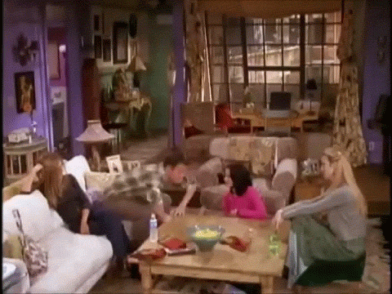
YOUR TURN
Notes:
So as practice, I’m going to show this GIF, and I’d like everyone to describe it making sure to describe the visual elements that are most critical to the viewers ability to follow, understand, and appreciate the context of this scene.
So make sure you:
Describe characters/people
Visual action and movement
Use complete sentences
Most importantly, tell the visual story of this scene.
And in case you are not able to view this GIF I will give a description of it in just a minute.
So the description I gave this gif was: Rachel, Monica, and Phoebe from the show "Friends" sit in Monica's NYC apartment watch Chandler do a goofy dance on the living room coffee table.
(read out some of the responses)
These are all really well done, concise, and descriptive is key and you’ve all really got that down!

Slide 12
WHERE DO YOU PUBLISH DESCRIPTION?
Notes:
So the big question is, where do you publish description? So unlike captions, description is not supported by most video players. It can be challenging to determine a workaround to publish audio description, but I’m going to talk about some of the steps you can take in the next few slides.

Slide 13
Mobile/Tablet
Online Video
TV, Movie Theater, Airplane, Live Theater …
Notes:
So a brief background on Audio Description: Audio description has been around since the late 1970s but it’s use has increased since then. Today, description is being applied to dozens of devices, and increasingly so for online video. It’s also used for things like live theater, movie theaters. You’ve probably noticed it on in-flight entertainment, on airplanes, and for broadcast TV. But making audio description even more widely available for online videos is really dependent on video player and browser support.

Slide 14
The short list (of players that natively support AD)
Able Player
OzPlayer
Brightcove
JW Player
Ooyala
Kaltura
Notes:
Unfortunately, the list of accessible players or platforms is pretty short. There’s:
Able Player
Oz Player
Brightcove
JW Player
Ooyala
And Kaltura
And those are really the only video players that support Audio Description at this time.

Slide 15
Ways to publish description:
Second video with description
Secondary audio track
WebVTT track
Text-only merged transcript
3Play Plugin
Notes:
So there are other ways to publish description:
1. Most players don’t support description and if your not using any of the platforms that I just mentioned, then another way to publish is to link to a second version of your video with description (like the Frozen trailer).
2. A few players support a secondary audio track, where users can select an AD audio for the same video source. Some support this by swapping in a new source video with description.
3. HTML5 natively supports a WebVTT description track (just like with captions); however, browser support and player support are lacking. Additionally, audio description must be readable by a screen reader, and right now, Able player is the only one that reliably supports this.
4. Text-only merged transcript & description are good for deaf/blind viewers, but are not time synchronized. This would be like providing a transcript only for a video.
5. 3Play Media has developed a keyboard & screen-reader accessible audio description plugin, which allows your description to play with a video player without having to republish the video.
So there you have a few ways that you can publish audio description.

Slide 16
WHY SHOULD YOU DESCRIBE?
Notes:
Next, I’m going to talk about several of the benefits of Audio Description and why you should describe your video content.

Slide 17
BENEFITS OF AUDIO DESCRIPTION
Accessibility
> Estimated 23.7 million Americans (10%) have trouble seeing.
Autism
> Helps to better understand emotional and social cues
Flexibility
> View videos in eyes-free environments
Language Development
> Listening is a key step in learning language.
Auditory Learners
> 20-30% of students retain information best through sound.
Inattentional Blindness
> Phenomena where you fail to recognize visuals “in plain sight.”
Legal Requirements
> May be required by law
Notes:
A lot of people wonder why you should describe and what the benefits are. There are a number of benefits of audio description. The number one benefit is accessibility, of course. It’s an accommodation for blind and low-vision viewers. And in 2015, the National Health Interview Survey found that 23.7 million Americans, which is actually about 10% of the population, have trouble seeing to some extent. So audio description is a critical accommodation for these viewers.
And then further benefits of audio description are:
the flexibility to view videos in eyes-free environment
the ability to help with language development and auditory learners
AD can also assist those with autism to better understand emotional and social cues
And finally, a benefit of AD is that it fulfills the legal requirement to make content accessible.

Slide 18
Rehabilitation Act of 1973
Section 504: Broad anti-discrimination law
Section 508: Electronic & information technology
Section 508 Refresh: WCAG 2.0 requirements
Notes:
So I'm going to briefly cover some of accessibility laws, which is often another reason why you should consider describing.
Section 504 is a broad anti-discrimination law. It applies to federal programs or agencies and programs receiving federal funding such as public libraries and universities, while also extending to local educational agencies such as K-12 schools. Per legal requirement, any covered entity must make itself accessible, including providing captioned videos for deaf or hard of hearing individuals.
Section 508 was introduced in 1998 to require federal communications and information technology be accessible. This law applies to federal programs or agencies, but it’s often also applied to federally funded programs through state and organizational laws to other organizations such as state universities. Audio description is a requirement that is written into Section 508, which was recently refreshed to include language from the WCAG 2.0 Level AA Guidelines.

Slide 19
WCAG 2.0 Level AA
Requires audio description for all pre-recorded, synchronized media
Success criteria
Notes:
The WCAG 2.0 Level AA Guidelines are from the Web Content Accessibility Guidelines, and this is the international standard for web accessibility. There are 3 levels of WCAG: A, AA, and AAA which is the highest accessibility standard.
Because Section 508 references WCAG 2.0 AA Guidelines, audio description is required for prerecorded, synchronized video media. WCAG also provides success criteria for how to meet these requirements, and it does allow for no audio description if the visual information is articulated in the audio of the source video.
Please note WCAG 2.1 is the most recent update, and it’s an extension of WCAG 2.0. WCAG 2.1 is backward-compliant with 2.0, but WCAG 2.0 are still the guidelines referenced in the law.

Slide 20
Americans with Disabilities Act (1990)
Title II: Public Entities
Title III: Places of Public Accommodation
ADA Title III Lawsuits
Notes:
The Americans with Disabilities Act of 1990, or ADA, has five sections. Title II applies to public entities. Title III applies to places of public accommodation, which has been extended and tested against online businesses through several lawsuits mainly having to do with captioning. There has been more and more action in audio description for online video as well.

Slide 21
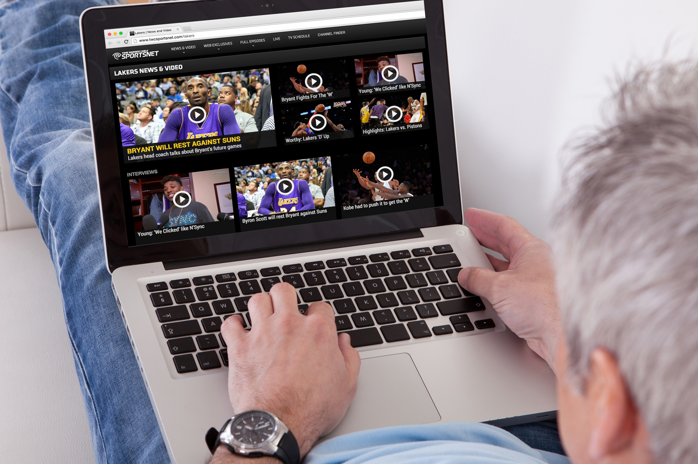
21st CENTURY COMMUNICATIONS & VIDEO ACCESSIBILITY ACT
AD requirements for prime-time viewing & children’s programming
Goal: 100% AD on TV by 2020
Notes:
Audio description has gradually been phased in to television program per the 21st Century Communications & Video Accessibility Act (CVAA). The requirement to describe TV program extends to the top 60 TV markets, and the goal is to have 100% of TV described by the year 2020.

Slide 22
DESCRIPTION LAWSUITS & SETTLEMENTS
ACB vs. Netflix
> Settlement: Netflix agreed to provide AD for many streaming titles by EOY 2016
Hamilton
> Sued for violating Title III of the ADA by failing to provide AD
AMC Theaters
> Failing to provide assistive audio description devices to blind viewers
DOJ vs. UC Berkeley
> DOJ submitted letter to UC Berkeley that their MOOC content was inaccessible
ACB vs. Hulu
> Discriminating against blind and visually impaired by not providing audio description on movies or TV shows
Notes:
There have been several lawsuits tied to audio description. So there’s:
American Council of the Blind vs. Netflix
ACB vs. Hulu
The DOJ vs. UC Berkley
And both Hamilton the Musical and AMC theaters have been involved in lawsuits
All were sued for not provided audio description and for not being fully accessible/complying with accessibility laws.

Slide 23
WHO IS 3PLAY MEDIA?
Notes:
So I’m going to shift a little bit and talk about 3Play Media and our audio description services. So who is 3Play Media? We were initially spun out of MIT in 2007, and we’re still based in Boston. We are a video accessibility company. We began as a captioning, transcription, and subtitling service, and have since expanded to offer audio description as well. So we’re really broadening our approach to accessible video as a whole.

Slide 24
Notes:
We have over 2,500 customers across many different industries, including higher education, government, enterprise, and media entertainment.
Some of those customers include:
Discovery Digital Networks
NBC Universal
The IRS
EdX

Slide 25
GOAL: MAKE ACCESSIBLE VIDEO EASY
Online Account System
Fast & Reliable Turnaround
One-Stop Shop
Audio Description Plugin
Notes:
Our goal is to make accessible video easy. We have a number of different search plugins and integrations for captioning and description that help simplify the process of creating accessible video, and we also have an easy-to-use online account system where you can manage everything from one place. But really, what we’re working toward is a one-stop shop for all your accessibility needs from captioning to description, transcription, and subtitling.

Slide 26
INNOVATING AUDIO DESCRIPTION
Notes:
We’re really innovating with audio description. The cost and process of traditional audio description can be insurmountable for many institutions, but technology is helping to innovate the process.
One place that we’re really beginning to change up the process is with the 3Play plugin which helps alleviate the difficulty of publishing audio description, and I will get to that demo shortly.

Slide 27
1: Time-Coded Transcript
2: US-based Human Describers
OUR PROCESS
3: Synthesized Speech
Notes:
Our process combines technology with human labor in a really careful and strategic way so that we can have the best of both worlds.
In our description process, we use time-coded transcripts that we’ve created along with the innovative approach to the theatrical process of where and when to describe. We do this with a US-based pool of human describers who have been trained to describe properly.
Currently, we’re using a synthesized speech engine to create the actual audio files and the audio output, and we do have options for different speeds and different voices.

Slide 28
SYNTHESIZED SPEECH - PROS
PROS
Processing Speed
> Utilizing technology to make processing automated & eliminating the need for human retakes.
Cost
> Synthesized speech drives down costs by using machines instead of voice talent.
Description Speed
> Easy to have pre-set choices to manipulate speed of voiced description w/o distortion.
Flexibility
> Allows for more creative publishing tools, like allowing users to edit descriptions.
Familiarity
> Blind users are used to screen reader voices (faster & mechanized).
Notes:
So let’s talk a little bit more about synthesized speech, because it is really a new concept when it comes to audio description. Synthesized speech is a machine-based voice, and there are a lot of pros to using synthesized speech for audio description.
Using synthesized speech as opposed to voice actors:
Speeds up the production time significantly
Cuts costs
Allows for more flexibility
And is very familiar to blind users who are used to screen reader voice which are faster and mechanized.

Slide 29
SYNTHESIZED SPEECH - CONS
CONS
Vocalization
> Sounds like a machine (because it is a machine).
Tone
> Limited ability to alter tone, although there are ways to address this.
Pronunciation
> Some issues with pronunciation due to the use of synthesized speech. Can be partially addressed.
Notes:
Of course, using synthetic speech has some cons. It does sound more like a machine than a human voice, because it is. There are some limitations to alter tone. For instance, synthetic voices can’t really convey words in a concerned or happy way or with other emotional tones. And there are sometimes issues with pronunciation. However, this can be partially addressed using phonetic speech.
Overall, there’s not too many negatives compared to the positives of using synthetic speech.

Slide 30
DOWNLOAD FORMATS
MP4
MP3
WAV
AD Plugin
OGG
WebVTT
TXT
DOC
Merged TXT
Merged DOC
Notes:
I mentioned earlier that publishing audio description can be challenging, but 3Play has a number of ways to approach that.
So we offer a number of different ways to publish, some are text-based and some are media-based. So we have:
a merged file that includes the original video with description,
a merged audio track with both the source and description,
text options of either just the description or merged with the transcript and description,
a time-coded WebVTT audio description track that can be read by screen readers,
And the audio description feature of our plugin that allows you to have your audio description file play with video players that don’t support multiple audio tracks or WebVTT description tracks.
I’d like to also mention that even after the audio description files have been processed by us, you have the option to go through and make edits. In traditional description, vendors don’t allow the end user to edit their description, but our workflow does allow you to edit description frames even after your files have been processed.

Slide 31
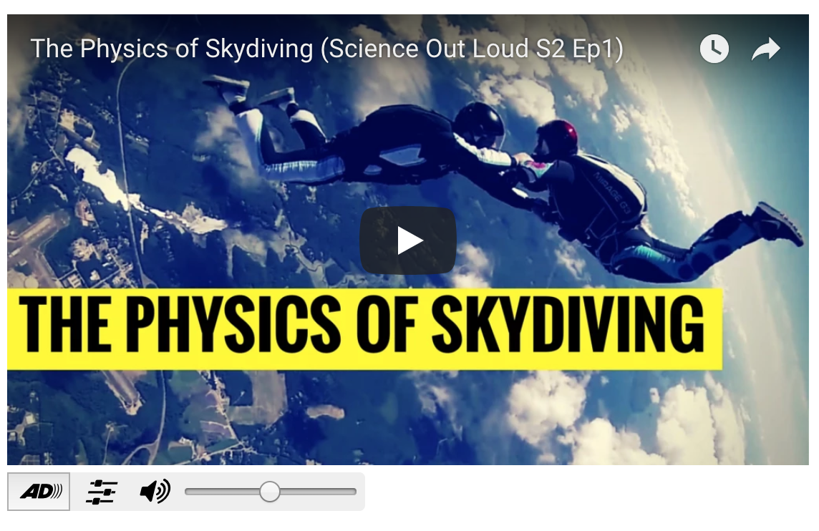
PUBLISHING:
THE 3PLAY PLUGIN
Notes:
And finally, I just want to quickly show you how simple our audio description plugin is:
(show example: http://www.3playmedia.com/how-it-works/how-to-guides/audio-description/audio-description-examples/
Notice that you can:
change volume
Turn captions off or on
Some things to keep in mind about publishing
You can publish this on YouTube videos without any need to publish second track
You can also directly publish on a webpage through a simple embed code

Slide 32
Notes:
So today we’ve covered Audio Description, but for those of you ready to dive in and learn more about video accessibility – I want to let you know about ACCESS!
ACCESS is a full day accessibility event hosted by us, 3Play Media. ACCESS is for anyone and everyone interested in learning more about accessibility. We’ll have a number of speakers, including Lainey Feingold and speakers from HubSpot, Adobe, Wistia, and more. We’ll also have workshops on all things accessibility - from the legal landscape to how to get started with accessibility at your organization. There will be networking, you’ll have the chance to talk to 3Play team members, and of course, there will be giveaways and great food.
The conference is on October 3rd right here in Boston - where we’re based out of.
AND We’re actually offering a special discount for everyone attending the webinar today. I’m dropping the link in the chat right now and will also send it out in tomorrow’s email. Early bird tickets are on sale now, which means tickets are half off. And if you use the code ”webinars”, you’ll get an additional 10% off!
So with that we’ll move to the Q&A and if anyone has more questions about ACCESS you can ask those as well.

Slide 33
Notes:
So someone is asking if the plugin is compatible with the Canvas LMS.
And yes, with the 3Play plugin and the audio description feature of this plugin, you can embed this in a web page or in any LMS system, including Canvas. So absolutely, you can add audio description to your LMS system.
you’ve said text descriptions lose detail, but don’t they make automatic translation into other languages easier than oral narration?
Yeah. So having a text description transcript would certainly make it easier to translate into other languages.
What I mentioned about losing detail is just that when you have a text-only sort of accommodation, it can be read by a screen reader. So you’ll get the detail of what’s going on, but it won’t be quite as dramatic. In terms of detail, I was referring more to cinematic detail, so it wouldn’t be as detailed as an audio track that’s kind of explaining in depth all the visual cues going on.
how we hire audio describers.
So if you’re familiar with our captioning service, all of our describers are trained and go through a rigorous process. We do use DCMP Description Key standards and make sure that all of our describers understand best practices and quality and rules for prioritizing what to describe, how to describe, when to describe, all of those things. So we do have a very strict policy and training to make sure that we have the best describers possible.
cost for using the 3Play service, and whether or not you can use audio description without using 3Play. So right now, you do have to have your files captioned or transcribed in order to use audio description, because part of our process– that’s just how our workflow works.
So as far as cost, we do have information on our website as far as cost for audio description. But like I mentioned, using technology, we have been able to bring the cost down to about $9 per minute for a standard audio description and about $14 per minute for extended audio description. And as I mentioned, traditional audio description costs can run from $15 to $30 per minute. So with our process, we have been able to bring this down quite significantly.
is there any legal requirement or recommendation for voice type? There is no legal requirement or recommendation for voice type. However, it is suggested that audio description should be distinguishable from other voices, but not jarring or distracting. So for example, you may want to use a male voice if you have other female voices in the source content, or an older sounding voice or a younger sounding voice would be fine as well, as they asked here.
would it confuse people if there’s also audio playing during the description? So it’s possible. This is why there are standards and sort of prioritization to alleviate any confusion. So this helps to understand where to place audio description, what voice to use. Like I mentioned, it must be distinguishable but not jarring. And another thing to note that it’s typically best practice to use language or vocabulary that is at the same level as the source content.

