Slide 1
Intro to Audio Description

Slide 2
Hi, I’m Jaclyn.
⬅️ And that’s my sidekick, Bernie.
👩🏼‍💻
Content Marketing Associate at 3Play Media
✍🏻
I write content on all things video accessibility.
📭
Reach me at jaclyn@3playmedia.com

Slide 3
Presentation Overview
🎧
What Is Audio Description?
How-To Create Descriptions
The Benefits
The Legal Landscape
Integrations
Publishing Audio Description

Slide 4
What is Audio Description?
🤔
Notes:
Audio Description is an accommodation for blind and low-vision viewers.
It is represented by a little AD icon that is similar to the CC icon you would see for closed captions.
But rather than tell you about it, I’ll show you.

Slide 5
Undescribed Video
🔇
Notes:
This video is undescribed, try watching closing your eyes or looking away and see if you can figure out what is going on.
Play video
Chances are it was difficult because there isn’t any dialogue.

Slide 6
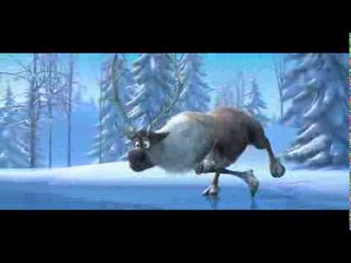
Described
Video
🔊
Notes:
Now let’s watch the described version. See if it’s easier to picture what is happening in the program.

Slide 7
Audio description narrates the relevant visual information.
🗣
Notes:
So as you just saw, audio description narrates the relevant visual information.
Audio description describes the characters, what the scene looks like, and the actions that are going on.
It paints an image of the visual for those who can’t see the screen such as blind and low vision viewers.

Slide 8
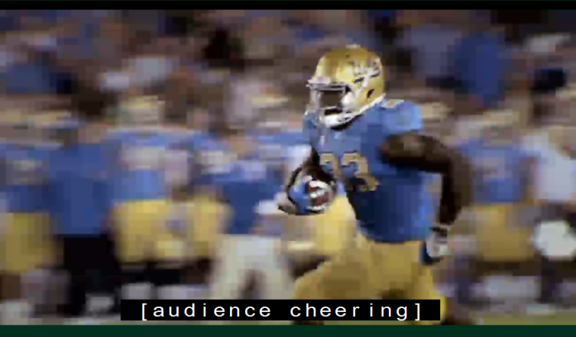
Think of audio description like a sports broadcast.
“He’s passed the 10, 5. Touchdown!”
Notes:
Audio description has been compared to a sports broadcast.
Where the captions for a touchdown would read, “Audience cheering,” the audio description would read, “He’s passed the 10, 5. Touchdown!”
You could be in the kitchen with the game on in the living room and still have a great sense of what’s going on in the game, and that’s similar to the goal of audio description.

Slide 9
Standard vs. Extended AD
Notes:
There are two types of AD: standard and extended.
The first video was standard. The audio description snippets were able to fit within the natural pauses within the video. And since there was no dialogue, there were alot of pauses.
Extended audio description allows you to add pauses to the video to make room for descriptions as needed.
Extended is great for more complicated content like lectures.

Slide 10
How to Create Audio Description
1.
Narrate the visuals at the time of the recording
2.
Record voiced description and merge with source audio
3.
Outsource for professional description
Notes:
Proactive solution: narrating at the time of the recording. For a recorded lecture, the professor can describe the visuals on the slides.
There are also some reactive solutions:
You can record a voiced description and then you can outsource for professional description. You can do this in a video editing software.
Or you can outsource for professional transcription. This option does cost more money, but it will save you a ton of time.

Slide 11
Audio Description Quality Standards
Notes:
If creating from scratch, you must consider quality standards.
Even i you are outsourcing, you should check to ensure that that the third-party service follows quality standards.

Slide 12
Let’s talk about the DCMP.
🖥
Notes:
Speaking of quality standards, this is a great time to discuss the DCMP.

Slide 13
Described and Captioned Media Program
Funded by the U.S. Department of Education
Administered by the National Association of the Deaf
Description key provides standards for audio description
Notes:
DCMP stands for Described and Captioned Media Program
funded by the U.S. Department of Education and administered by the National Association of the Deaf
Provides helpful guidelines and standards to follow for audio description

Slide 14
A Quality Description Must Be...
Accurate: No errors in pronunciation, word selection, and diction
Appropriate: Consider intended audience, seek simplicity
Prioritized: Content is essential to intended learning
Consistent: Matches the style, tone, and pace of the program
Equal: The intended meaning of the program is conveyed
Notes:
The DCMP has 5 main measures for quality
http://www.descriptionkey.org/quality_description.html

Slide 15
What to Describe.
When to Describe.
How to Describe.
💡
www.descriptionkey.org/quality_description.html
Notes:
From the DCMP, we learn what to describe, when to describe, and how to describe. It’s a great resource that I recommend everyone reference whether you’re making your own descriptions or outsourcing.

Slide 16
Why Should You Describe Video Content?
Notes:
We’ve covered some of the basics of audio description, but the next question is, why should we describe our video content?

Slide 17
The Benefits of Audio Description
📣
Notes:
And to answer that question, we’re going to cover some of the benefits of audio description.

Slide 18
Benefits of Audio Description
Accessibility
An estimated 23.7 million Americans (10%) have trouble seeing.
Flexibility
View videos in eyes-free environments
👍
🧘‍♀️

Slide 19
Benefits of Audio Description
Auditory Learners
20-30% of students retain information best through sound.
Inattentional Blindness
Phenomena where you fail to recognize visuals “in plain sight.”
👂
👀

Slide 20
Benefits of Audio Description
Language Development
Listening is a key step in learning language.
Legal Compliance
May be required by law
💬

Slide 21
The Legal Landscape of Audio Description
Notes:
Going off of the last point, I'm going to briefly cover some accessibility laws.

Slide 22
The Rehabilitation Act (1973)
🌎
Section 504: Broad anti-discrimination law; Applies to federal and federally-funded programs; Requires equal access
Section 508: Accessible electronic and information technology; Applies to federal programs and states via “little 508s”
Section 508 Refresh: WCAG 2.0 requires AD for online videos
Notes:
Section 504 applies to federal programs or programs receiving federal funding such as universities and these entities must make itself accessible to those with disabilities.
Section 508 applies to federal programs but can be applied on a state leel through what are called “little 508s”
Audio description is explicitly required in Section 508 since it references WCAG 2.0

Slide 23
Web Content Accessibility Guidelines (WCAG)
🔭
Three levels of accessibility standards: A, AA, and AAA
Level AA requires AD for all pre-recorded, synchronized media
Success criteria for how to meet requirements
WCAG 2.1 is the most recent update
Notes:
Jaclyn
Web content accessibiltiy guidelines
Three levels of accessibility standards, A, AA, AAA
Note that WCAG 2.1 is the most recent update, and it’s an extension of WCAG 2.0 but is not referenced in any laws yet.

Slide 24
21st Century Communications
& Video Accessibility Act
(CVAA)
📺
AD requirements for prime-time viewing & children’s programming
Phasing in audio description gradually
Goal: TV be 100% described by 2020
Notes:
Jaclyn
Audio description has been gradually phased into television programs over the past few years

Slide 25
The Americans with Disabilities Act (1990)
♿︎
Title II: Covers public entities; requires effective communication
Title III: Covers places of public accommodation
More action for AD in online video under the ADA; No regulations
Notes:
The ADA is a broad anti-discrimination law and prohibits disability discrimination; it requires effective communication which means providing assistive technology and services for content.
Title II covers government entities and the services, activities, and programs they provide. These things must be accessible so as not to discriminate towards people with disabilities.
Title III covers restaurants, hotels, theaters, schools, doctor’s offices, etc.
Under Title III, some precedent has been set that the ADA may apply to websites.
There’s been a lot of action to enforce web accessibility under the ADA.

Slide 26
Lawsuits & Settlements
ACB vs. Netflix
Settlement: Netflix agreed to provide AD for many streaming titles by EOY 2016
Hamilton the Musical
Sued for violating Title III of the ADA by failing to provide AD
Notes:
Netflix now offers Audio Description for nearly all of its original titles and select other movies and TV which they license, so they really stepped it up.
Hamilton the Musical suit is still ongoing, although there have been talks of a settlement where Hamilton would potentially agree to audio describe their live shows.

Slide 27
Why
Audio Description?
⭐️

Slide 28
To provide equal access for all people.
⭐️
Notes:
It’s all about accessibility. We know that there are many benefits, but we hope that the number one motivation is to provide equal access to all people.

Slide 29
Audio Description Guide
Notes:
In this section, I’ll cover some of the audio description integrations and our AD process here at 3Play.

Slide 30
The 3Play Process
1.
Time-coded Transcript
2.
Human Describers
3.
Synthesized Speech
Notes:
Our AD process at 3Play consists of 3 steps:
We start with the time-coded transcript which would be used for captions.
From there, human describers go in a create time-coded descriptions based on the content.
It’s then made into time-coded description using synthesized speech.
So from there, how would you publish it?

Slide 31
The Short List
Players that support AD:
Able Player
OzPlayer
Brightcove
JW Player
Ooyala
Kaltura
✅
Notes:
There is still a long ways to go for AD.
Currently only a handful of platforms that support it.
Hopefully this list will grow but now there are some other options you can turn to for publishing audio description.

Slide 32
How to Publish Audio Description
1.
Upload audio-described .mp4’s to your hosted video platform
2.
Publish a second video with the audio track
3.
Download .mp4 files & share directly

Slide 33
The 3Play Plugin
🔌
Notes:
Or you could use the 3Play Plugin.

Slide 34
3Play Plugin 101
🎓
Creates a fully interactive and accessible video experience for viewers
📚
Compatible with most video players and publishing platforms
💬
Enables you to add audio description to videos more easily
Notes:
The audio description embed portion of the 3Play Plugin allows you to add audio description to videos without having to republish your audio or video files. So it works with YouTube, Vimeo, Brightcove and several other video platforms. From us, you’ll get either a iframe or javascript embed code which you can then host right on your website.

Slide 35
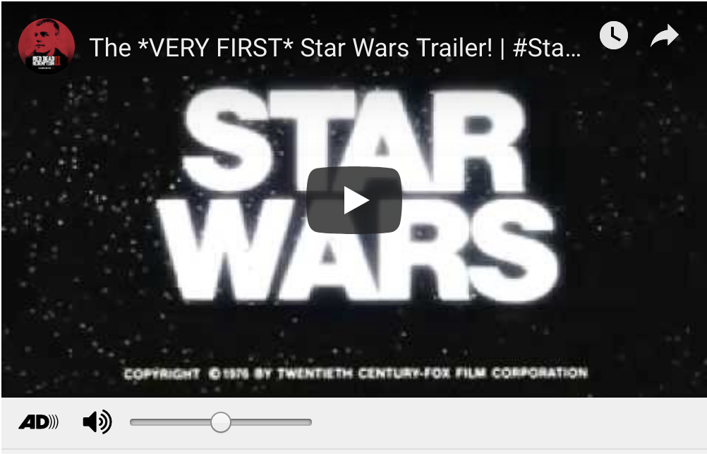
Finished
Product

Slide 36
Video Accessibility Certification
FREE | Available December 2019 | www.3playmedia.com/certification
🎓
Become an Expert | Make better, more well-informed decisions.
📚
Exclusive Content | Created to help your knowledge grow.
💬
Network | Meet other accessibility enthusiasts along the way.
Notes:
I’d like to share some exciting news with you all quickly before we move onto Q&A. We’ll be offering a free video accessibility course and certification in the coming months. So the hope is that once you take this course you’ll be equipped with more knowledge and confidence in the video accessibility space. The course isn’t available quite yet but you can sign up for updates if you’re interested and you’ll get an email when the course is up on our site: the link to that is www.3playmedia.com/certification.

Slide 37
Questions? Thoughts?
Find us:
www.3playmedia.com
@3PlayMedia
info@3playmedia.com

