Slide 1
Importance of end-user testing in accessible media capstone research
November 22, 2019
AHG Conference

Slide 2
Abstract
Graduate certificate students, in collaboration with industry partners and funded by Provincial grants, are completing applied research projects that explore ways for industry to meet accessibility legislation (AODA) requirements.
Throughout the evidence-based, applied research process, the students are to connect and collaborate with industry experts and members of the disability community, following the philosophy of ‘nothing about us, without us.’
Notes:
Setting up end-user testing and developing personas is vital to the success of their project. This talk will look at a few of the capstone projects, the process for setting up the end-user testing, and outcomes of the research.
Attendees will gain insight into the importance of end-user testing for accessibility as well as how to set it up.

Slide 3
Jennifer Curry Jahnke jennifer.jahnke@mohawkcollege.ca
@jennjahnke
905-575-2044
Notes:
IAAP CPACC
M.Ed., BA (Hons) Communicative Disorders CSUN, Post Graduate Diploma as a Communicative Disorders Assistant, Diploma ASL Interpreting

Slide 4
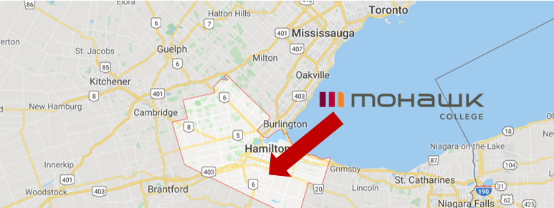
Mohawk College
Hamilton, Ontario
Notes:
www.mohawkcollege.ca/390

Slide 5

Accessible Media Production Graduate Certificate (390)
Mohawk College

Slide 6
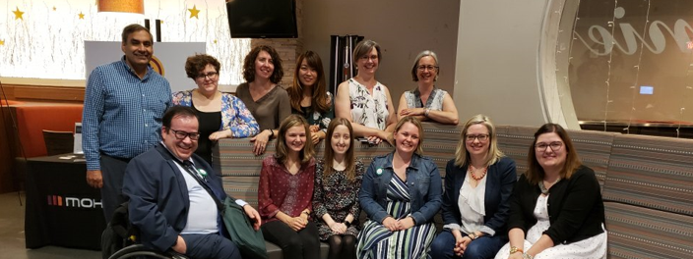
AMP Executive Delivery
Class of 2019

Slide 7
Accessible Media Production
Semester 1
Semester 2
Disability Legislation
Diversity Perspectives
Accessible Document Creation
Captioning & Description
Inclusive Writing & Comm.
Capstone 1
Accessible Document Creation 2
Assistive Technology
Web & Social Media Accessibility
Entrepreneurship / Intrapreneurship & Accessibility
Capstone 2

Slide 8
Definitions
Capstone Project
Applied Research
End-User Testing

Slide 9
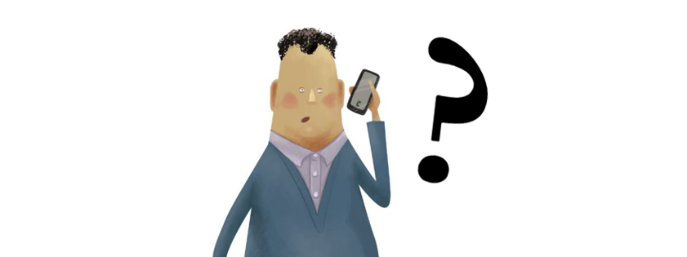
What is a Capstone Project?
Culminating Applied Research
Notes:
a capstone project is a multifaceted assignment that serves as a culminating academic and intellectual experience for students
Definition from https://www.edglossary.org/capstone-project/

Slide 10
Applied Research
“Aims at finding a solution for an immediate problem facing … an industrial/business organization … Applied research is considered to be non-systematic inquiry and it is usually launched by a company, agency or an individual in order to address a specific problem.”
| Research Methodology
Notes:
Applied Research definition - https://research-methodology.net/research-methodology/research-types/applied-research/

Slide 11
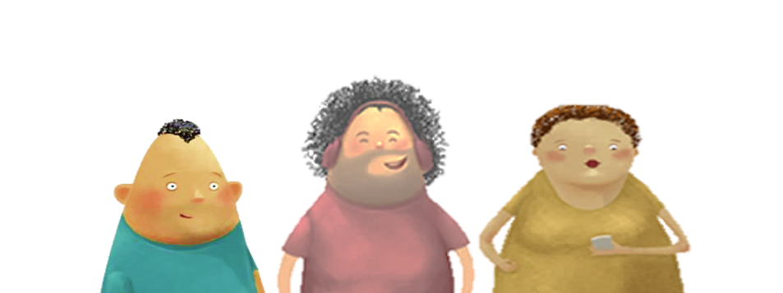
What is end-user testing?
Accessibility

Slide 12
Capstone Project Research
Semester1 (Sept-Dec)
Semester 2 (Jan-April)
Evidence-based research
Industry expertise
Legislative requirements
Current best practices
Literature & media review
End-user perspectives
Applied research
Designed to answer specific questions aimed at solving practical problems.
New knowledge acquired from applied research has specific commercial objectives in the form of products, procedures or services.
Notes:
Evidence-based research includes:
Legislation (provincial, national, international), best practices, guidelines
Peer-reviewed journals and articles
Media – vlogs/blogs, newspaper articles, websites, videos, podcasts, etc.
A heuristic evaluation is a usability inspection method for computer software that helps to identify usability problems in the user interface (UI) design. It specifically involves evaluators examining the interface and judging its compliance with recognized usability principles (the "heuristics").

Slide 13
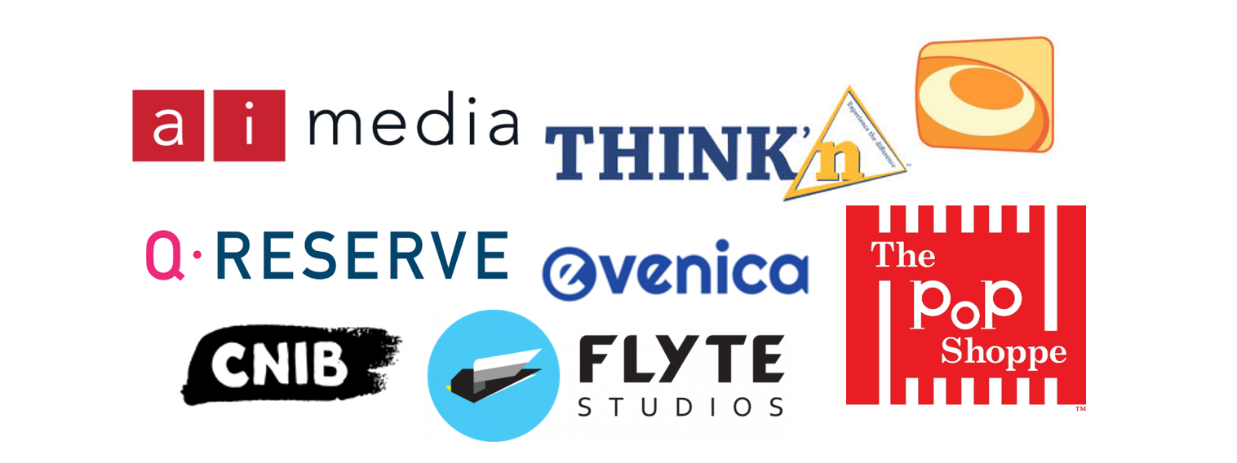
2018/2019 OCE VEB grant
Industry Partners

Slide 14

Flyte Studios
Problem:
Flyte Studios’ learning management system plug-in math based learning modules for K-12.
The modules need to be WCAG 2.0 AA by January 1, 2021 to comply with AODA legislation.
Solution:
To conduct an accessibility audit of the modules and LMS platform.
Upskill the development team for accessibility

Slide 15
Capstone Project Pathway
Semester1 (Sept-Dec)
Semester 2 (Jan-April)
Meet with industry partner
Identify problem statement
Complete evidence-based research
Group end-user testing
Draft solution
Conduct applied research
Create and test personas
Targeted end-user testing
Implement solution
Create an accessible media product of solution
Notes:
Evidence-based research includes:
Legislation (provincial, national, international), best practices, guidelines
Peer-reviewed journals and articles
Media – vlogs/blogs, newspaper articles, websites, videos, podcasts, etc.

Slide 16
Why do end-user testing?
To develop empathy
“Empathy is the capacity to understand or feel what another person is experiencing from within their frame of reference, that is, the capacity to place oneself in another's position.” - Wikipedia
Synonymous with:
  Understanding
  Sympathy
  Compassion
  Responsiveness
  Identification
Definitions of empathy encompass a broad range of emotional states.
Notes:
Definition of empathy found in Wikipedia (https://en.wikipedia.org/wiki/Empathy)
Why does this reason make me uncomfortable?

Slide 17
Think | Pair | Share
Discussion

Slide 18
Think | Pair | Share Activity
End-using testing for accessibility engages members of the disability community to determine if something is accessible.
At your place of business or educational institution:
Do you practice end-user testing? If so how?
If not – do you see potential or need for it?
Why do you think we should do end-user testing?

Slide 19
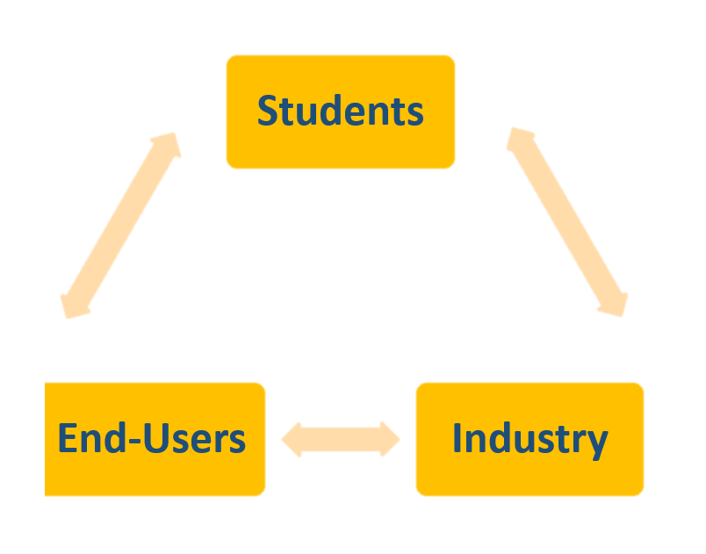
This is why we do end-user testing
Respect
“a feeling of deep admiration for someone or something elicited by their abilities, qualities, or achievements. Due regard for the feelings, wishes, rights, or traditions of others.” - Lexico
Notes:
Definition of Respect from Lexico (https://www.lexico.com/en/definition/respect)

Slide 20
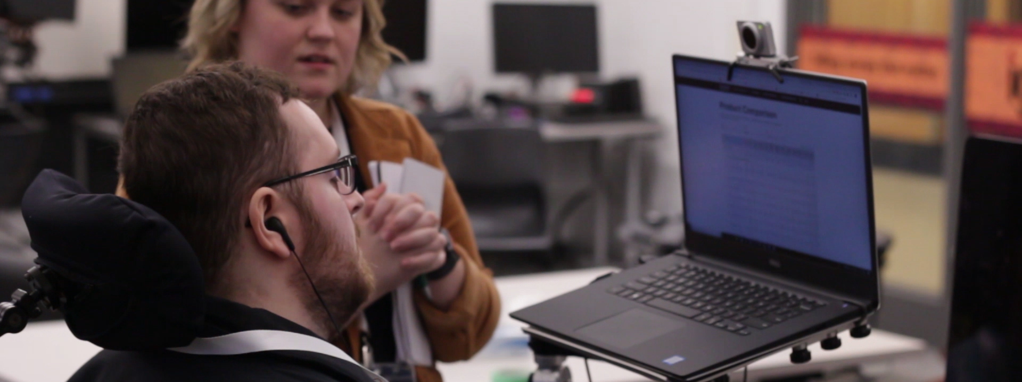
End-User Testing for Accessibility
Group Testing
Persona Profile
Formal Testing

Slide 21
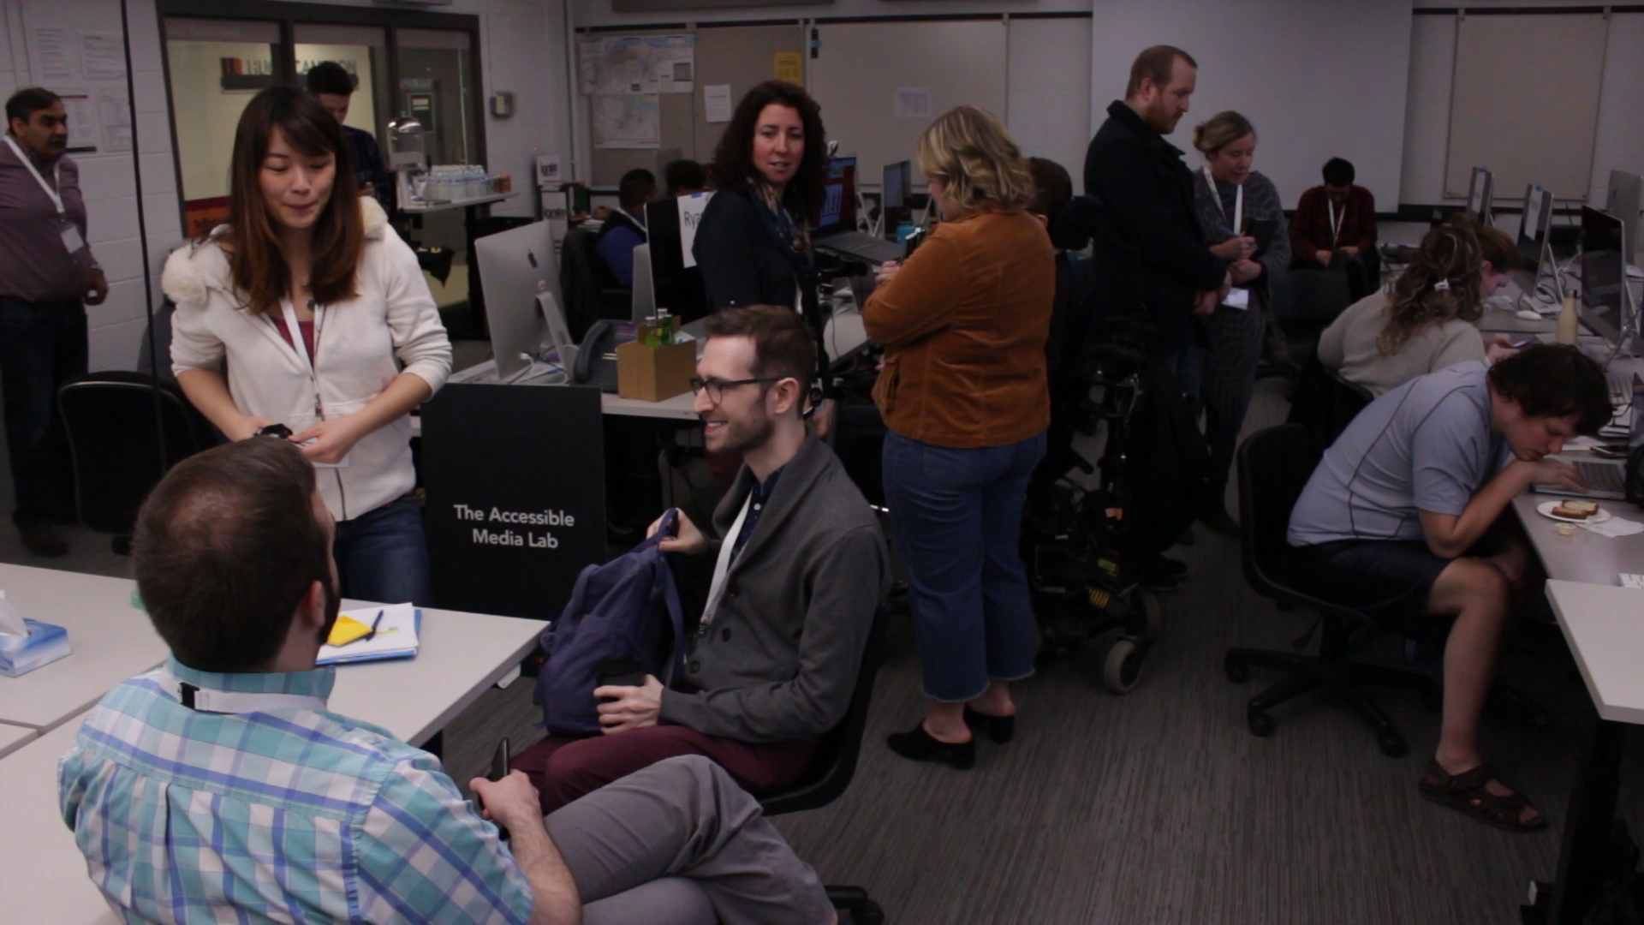
Group Testing
Large group format
15 minutes segments
Industry partners invited to participate and observe
Students determined planned destinations in advance
Notes:
Goal: to become comfortable with members of the disability community and identify area of challenge

Slide 22
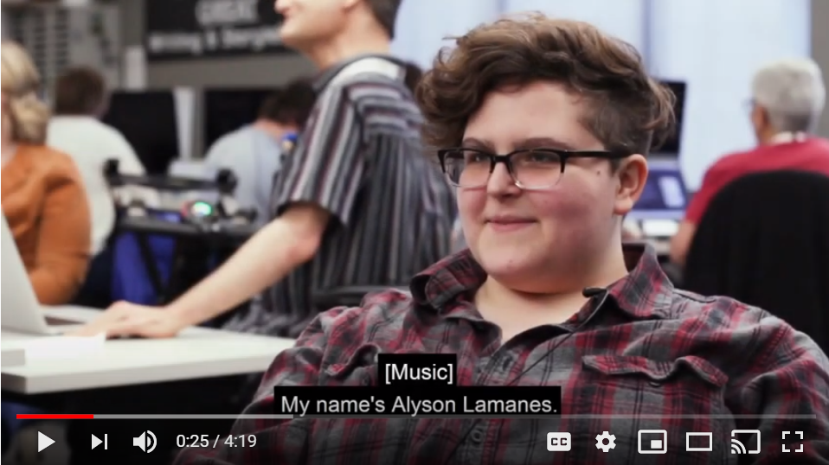
A look at end-user testing
Notes:
YouTube link: https://youtu.be/gdZW3Lk-Y2k

Slide 23
Faculty Responsibilities
Organize event
Invite members of the disability community
Ensure a wide range of AT representation
Provide accommodations
Provide payment
Prior to the end-user testing date faculty and student have a one-on-one meeting to determine:
  Destination pathways
  Benchmarking
  Open-ended questions
  Proper etiquette

Slide 24
Student Responsibilities
Planning
Testing
Planned destinations
Set benchmarks
Determine if failure is an option
Determine if tasks are the same for each user
Be prepared – have passwords and portals/sandboxes ready
Be ready to jump in – information may be required when a tester gets stuck
Compare to benchmarks – if time is different, ask tester if they think the difference is reasonable or why it might be
Ask them open ended question to get their input and insight
Collect and record data / results

Slide 25
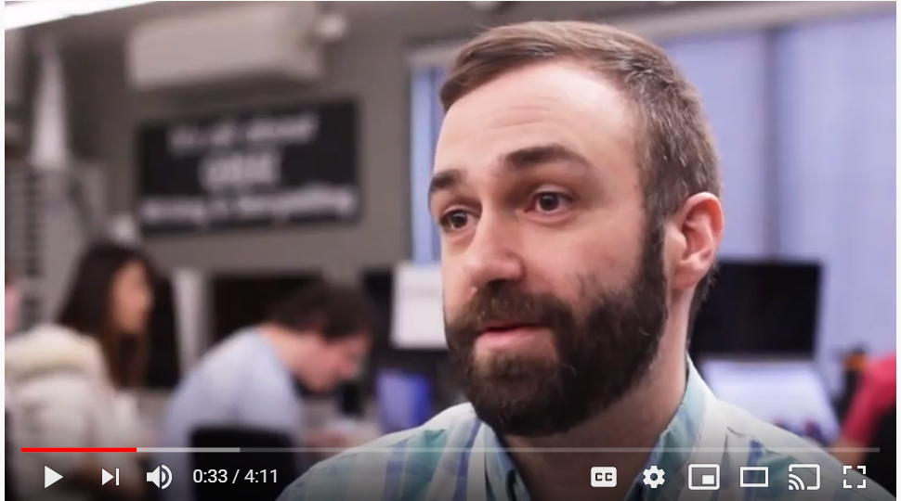
Conversation with Industry Partners about end-user testing
Notes:
YouTube link: https://youtu.be/B9VffQVdE34

Slide 26
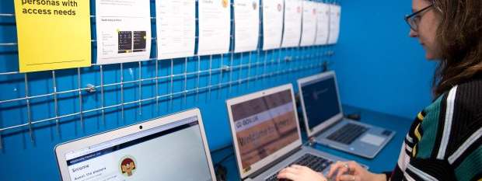
Persona Development
Access Needs
Notes:
For more information on using persona profiles to test for accessibility here is a great resource:
Henke, A. (2019, February 11). Using persona profiles to test accessibility. Retrieved from https://accessibility.blog.gov.uk/2019/02/11/using-persona-profiles-to-test-accessibility/

Slide 27
Persona Profiles
These profiles outline:
Student testing:
Barriers members of the disability community face when their assistive technologies interact with digital services
Best practice advice on how to design services for members of this community group
Persona development and testing
Classmate persona testing
Conduct heuristic review
WCAG criteria review
Keyboard, AT testing
Notes:
A heuristic evaluation is a usability inspection method for computer software that helps to identify usability problems in the user interface (UI) design. It specifically involves evaluators examining the interface and judging its compliance with recognized usability principles (the "heuristics").

Slide 28
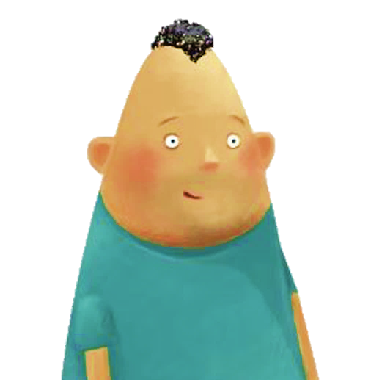
Pawel: user with Asperger's
“Websites can be so distracting. It takes me ages to do anything sometimes, as I feel like I have to read every word and click on every link.”
Pawel is 24 and lives with his mum and dad in Birmingham. He has been looking for a job as a pharmacologist since finished his chemistry degree.
He has Asperger’s, a condition on the autism spectrum that affects how he sees the world and interacts with people. He was also recently diagnosed with anxiety.
He’s recently been looking at the National Autistic Society’s resources on employment. He’ll approach them for more support when he feels a bit more ready.
Notes:
For persona examples visit this great resource from Gov.UK: https://www.gov.uk/government/publications/understanding-disabilities-and-impairments-user-profiles
Research and analysis
Pawel: user with Asperger's
Devices and technology
Pawel is good with technology and can usually figure out how things work himself. He prefers to use apps because they’re simpler and less cluttered than websites.
His parents recently bought him a laptop for his birthday, which is great for playing games and looking for jobs.
He struggles with face to face communication, but likes chatting to people in gaming communities online. He gave up social media as all the comments were making him anxious.
Goals and wishes
Pawel wishes he could find what he needs on websites more easily - sometimes there’s so much to read through.
He wants to be able to talk to people using web chat instead of the phone so he has time to think about what he wants to say.
Frustrations
Too many distractions
Pawel gets easily distracted and wants to read everything and click every link. He wishes there wasn’t as much text or links.
Pawel gets distracted by other things as well - he finds moving content like banners or video distracting, and gets stressed out by bright colours.
Services not designed for his needs
Pawel thinks websites often assume you know more than you do.
He doesn’t like using the phone, but a lot of companies don’t let you contact them by email or live chat (or they make their details hard to find).
Making things work for Pawel
What to doFurther readingAvoid bright colours or garish combinations.Colour in the GOV.UK Design System.Allow save and return on forms and ensure ‘time outs’ on forms are reasonable.Timeouts, guidance by 18F (the US government’s digital agency).Include people with autism in user research.User research for government services: an introduction, guidance on GOV.UK.Write in plain English and break up content with things like headings and lists. Use the ‘inverted pyramid’ approach with the most important information at the top.Structuring your content, guidance on GOV.UK.Provide captions for video content.Autistic spectrum, captions and audio description, article by Mindful Research.More reading
‘Designing for users on the autistic spectrum’ is one of a set of posters designed by the Home Office. You can read about and download them from this blogpost.
Statistics about autism
About 700,000 people in the UK are on the autistic spectrum.
Only 16% of people with autism in the UK are in full time paid employment.
40% of people with autism have an anxiety disorder - it’s 15% in the general population.

Slide 29
Research & Analysis
Devices and technology
Pawel is good with technology and can usually figure out how things work himself. He prefers to use apps because they’re simpler and less cluttered than websites.
Goals and wishes
Pawel wishes he could find what he needs on websites more easily - sometimes there’s so much to read through.
Frustrations
Pawel gets distracted by other things as well - he finds moving content like banners or video distracting, and gets stressed out by bright colours
Notes:
For persona examples visit this great resource from Gov.UK: https://www.gov.uk/government/publications/understanding-disabilities-and-impairments-user-profiles
Research and analysis
Pawel: user with Asperger's
Devices and technology
Pawel is good with technology and can usually figure out how things work himself. He prefers to use apps because they’re simpler and less cluttered than websites.
His parents recently bought him a laptop for his birthday, which is great for playing games and looking for jobs.
He struggles with face to face communication, but likes chatting to people in gaming communities online. He gave up social media as all the comments were making him anxious.
Goals and wishes
Pawel wishes he could find what he needs on websites more easily - sometimes there’s so much to read through.
He wants to be able to talk to people using web chat instead of the phone so he has time to think about what he wants to say.
Frustrations
Too many distractions
Pawel gets easily distracted and wants to read everything and click every link. He wishes there wasn’t as much text or links.
Pawel gets distracted by other things as well - he finds moving content like banners or video distracting, and gets stressed out by bright colours.
Services not designed for his needs
Pawel thinks websites often assume you know more than you do.
He doesn’t like using the phone, but a lot of companies don’t let you contact them by email or live chat (or they make their details hard to find).
Making things work for Pawel
What to doFurther readingAvoid bright colours or garish combinations.Colour in the GOV.UK Design System.Allow save and return on forms and ensure ‘time outs’ on forms are reasonable.Timeouts, guidance by 18F (the US government’s digital agency).Include people with autism in user research.User research for government services: an introduction, guidance on GOV.UK.Write in plain English and break up content with things like headings and lists. Use the ‘inverted pyramid’ approach with the most important information at the top.Structuring your content, guidance on GOV.UK.Provide captions for video content.Autistic spectrum, captions and audio description, article by Mindful Research.More reading
‘Designing for users on the autistic spectrum’ is one of a set of posters designed by the Home Office. You can read about and download them from this blogpost.
Statistics about autism
About 700,000 people in the UK are on the autistic spectrum.
Only 16% of people with autism in the UK are in full time paid employment.
40% of people with autism have an anxiety disorder - it’s 15% in the general population.

Slide 30
Personas used and shared
Students use their developed persona to conduct their own usability testing
Students use their persona to support and test classmates’ work
Students have others test their persona and recommend changes
Students share their persona with classmates, each student has a portfolio of personas they can share with their industry partner

Slide 31
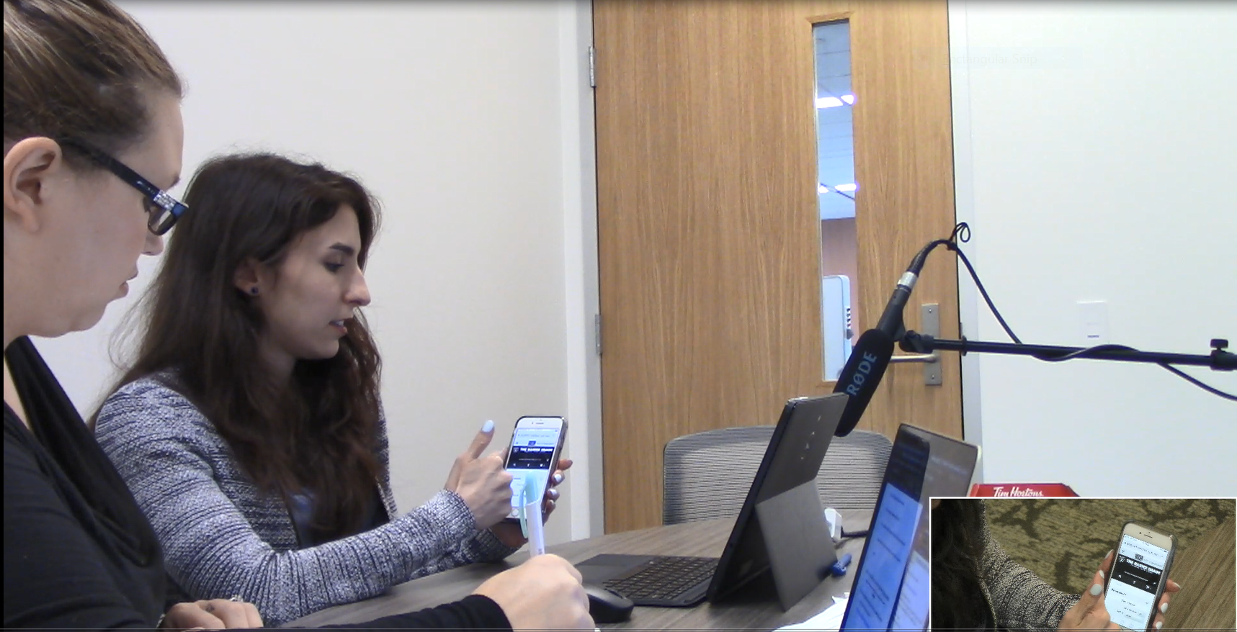
Formal Testing
Formal end-user accessibility testing in the end-user testing lab
Individual one-on-one format
15-30 minute segments
Industry partners invited to observe through 2-way mirror
Students created structured surveys

Slide 32
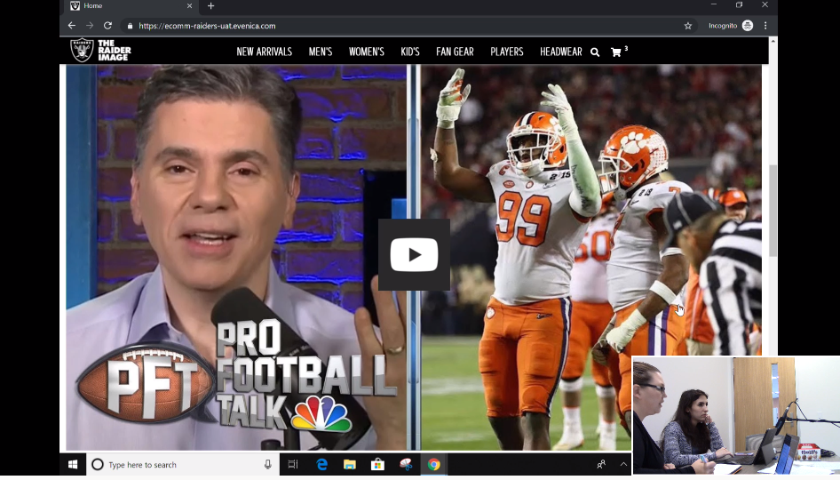
Evenica
AMP Student conducting structured survey
End-user interacting with interactive website in development using:
Laptop & mobile
Multiple browsers
Notes:
YouTube link: https://youtu.be/gjQKhaR8an4

Slide 33
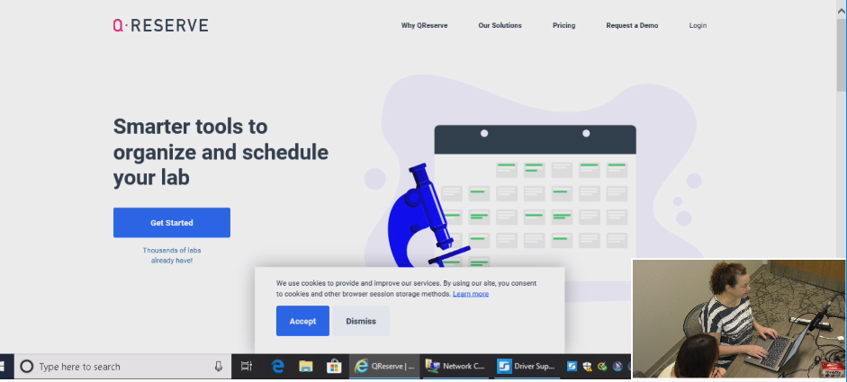
QReserve
AMP Student conducting structured survey
End-user interacting with interactive web platform for scheduling
JAWS 2019 user interacting with multiple platforms
Notes:
YouTube video link: https://youtu.be/mtCarWdm2qU

Slide 34
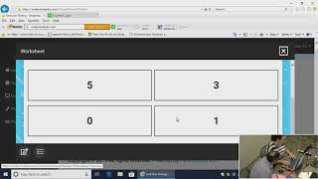
Flyte Studios Inc.
AMP Student conducting structured survey
End-user interacting with LMS math module
JAWS 2019 user interacting with math worksheet
Notes:
YouTube link: https://youtu.be/GQl6IoXRBho

Slide 35
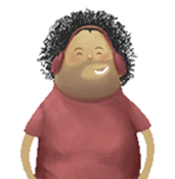
Benefits for the student?
Participate in applied research and experiential learning
Network with industry professionals and future employers
Engage in and learn from members of the disability community
Increase skills and knowledge of end-user testing, persona development, UX/UI, accessibility compliance, assistive technologies
Presentation and dissemination opportunities

Slide 36

Benefits for Industry?
Support student learning by providing an experiential learning opportunity
Engage students and disability community in applied research
Meet legislative compliance goals
Networking and learning opportunities
Upskill staff accessibility understanding and skill
Recruitment opportunities
Marketing and promotion

Slide 37
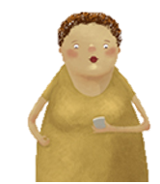
Benefits for end-user?
Employment opportunities
Support experiential learning opportunities and participate in research
Socialize with students and other participants
Share knowledge and skills
Increase accessibility of web based content and other projects
Network with industry and students
Expand skill set

Slide 38
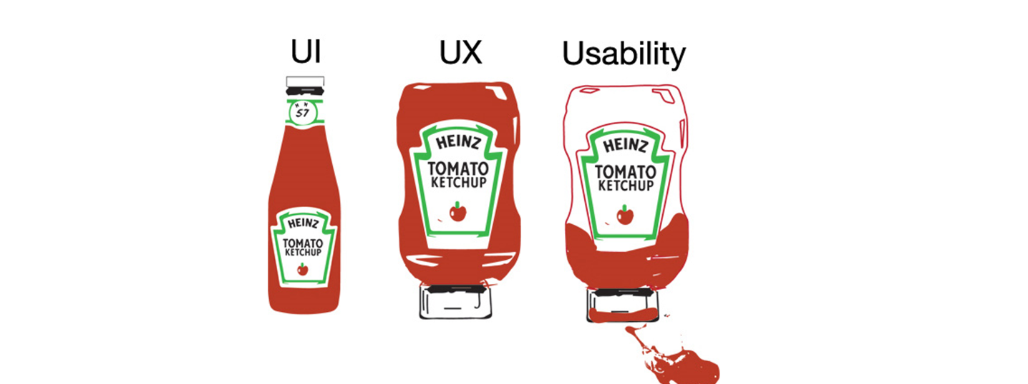
Will you implement end-user testing into your work?
Challenge
Notes:
Image borrowed for educational purposes from: https://measuringu.com/evaluating-ux/

Slide 39
Q & A

Slide 40
Resources
Boyden, C., & Greco, L. (2019, March 19). Why, and how, to test accessibility with real people. Retrieved from https://docs.google.com/presentation/d/17Wzntk8yW_bbbO6JjYGrFWXYVVT-FBM-qOuxqlnjlwE/edit#slide=id.p
Roselli, A. (2017, May 30). Inclusive user testing. Guelph Accessibility Conference. Retrieved from https://www.slideshare.net/aardrian/inclusive-user-testing-guelph-accessibility-conference
W3.org. (2014, March 14). Accessibility testing. Retrieved from https://www.w3.org/wiki/Accessibility_testing#User_testing
Wood, H., & Klinec, J. (2018, March 20). Why accessibility testing with real users is so important. Gov.UK. Retrieved from https://accessibility.blog.gov.uk/2018/03/20/why-accessibility-testing-with-real-users-is-so-important/

Slide 41

A Web for Everyone: Designing Accessible User Experiences
By Sarah Horton & Whitney Quesenbery
Notes:
https://books.google.ca/books?id=Dno3DwAAQBAJ&printsec=frontcover#v=onepage&q&f=false

Slide 42
Jennifer.Jahnke@mohawkcollege.ca
@jennjahnke

