Slide 1
Feeling Good about Your Tactile Graphics
Accessing Higher Ground, 2019
Robert Beach and Gaeir Dietrich

Slide 2
Presenters
Gaeir Dietrich
Access Specialist
Consultant
gaeird@gmail.com
408-996-6047
Robert Lee Beach
Assistive Technology Specialist
Kansas City Kansas Community College
rbeach@kckcc.edu
913-288-7671

Slide 3
Session Covers
Define tactile graphics
What to include in the tactile version
Modes of production
3D modeling
Resources

Slide 4
When More Is Needed
Sometimes even a long description will not really convey the information in the graphic.
The alt text will not be sufficient for a student’s needs.
Tactile graphics to the rescue!

Slide 5
What Are Tactile Graphics?
A tactile graphic is a tactile representation of the content conveyed by a graphic.
Tactile graphics are not simply “copies” but are new conceptualizations of the information being conveyed.
They convey the same information in a totally different form.
Notes:
Gaeir: stylized representation of the information that needs to be conveyed

Slide 6
Handling Graphics
When determining the purpose, always consider the context in which the graphic is being shown.
The same graphic may have a different purpose in a different context.
Sometimes decoration
Sometimes informational

Slide 7
How Do I Decide??
Does the student need to do something with the graphic or understand something from it?
Informational
Is the graphic simply entertaining or “pretty”?
Decoration

Slide 8
Context and Intent
What is the learning objective for this graphic?
Why is it here? What is the concept? What do the authors want you to learn?
What is it that you need to do with the information?
Activity? How do you use the information?

Slide 9
Asking Prof and Student
Can ask Prof to establish priority
However don’t just ask what tactiles to create!
Ascertain what the intent is of graphic and then use judgment
Show prof tactile image library and ask
Ask student his/her preference
Does student read braille? Have experience with tactiles?

Slide 10
Reality Check
Not all students are familiar with tactile graphics.
To help students learn…
Start with a 3D model
Present the same concept with collage
Now create a raised line representation of the concept

Slide 11
What Do You Include?
May not need the entire graphic
Focus on what the graphic is trying to convey and ignore the decorative elements
How do you know what to include?
Author’s Intent
Learning Objective
Decision Tree
Notes:
May Pole Example

Slide 12
Making a Decision
How are we going to convey the information represented in the graphic?
BANA Guidelines
BANA (www.brailleauthority.org) has a great decision tree for determining what you need for a tactile graphic
Tactile Graphics Manual
www.brailleauthority.org/tg/web-manual/index.html

Slide 13
Decision Tree for Tactiles
Purpose of the decision tree
Decide if you need to create a graphic
Figure out what you are going to include in the graphic
Figure out your method for creating the graphic

Slide 14
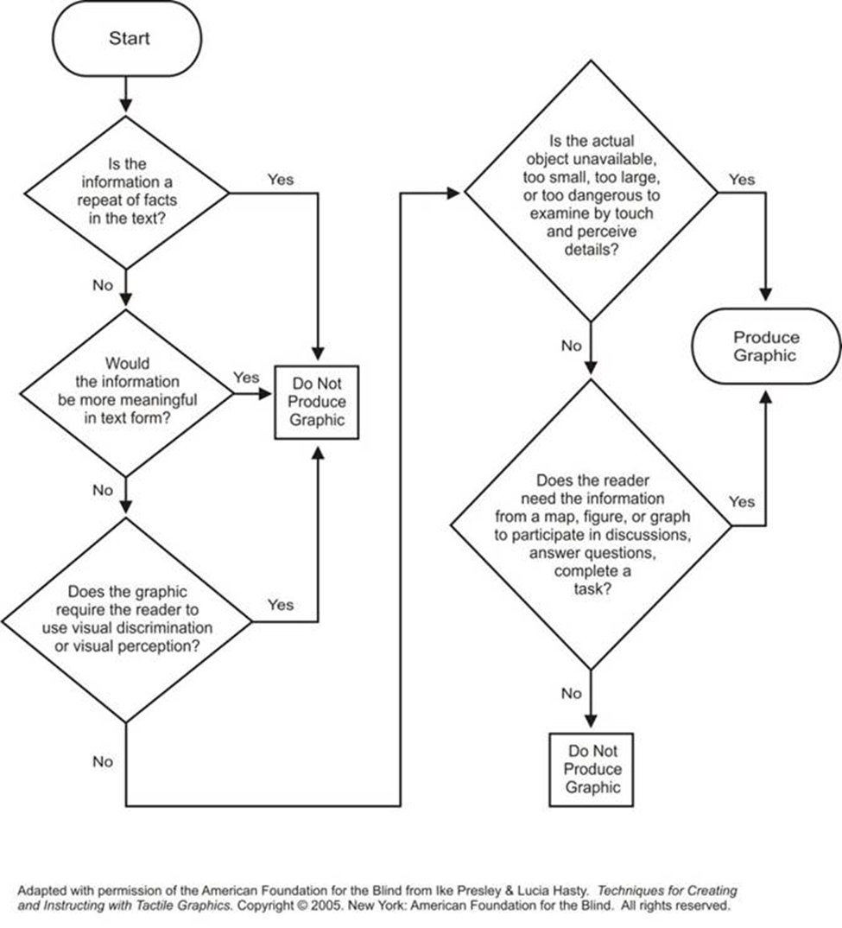
Decision Tree

Slide 15
Tactiles Often Needed
STEM subjects
Tactile graphics are often needed to convey complex concepts
Charts and graphs
Molecular structures
Circuits and vectors
Diagrams of systems
Maps
Art

Slide 16
Tactile Graphics
Creating Your Graphics

Slide 17
What Is a Tactile Graphic?
Tactile representation of a two-dimensional graphic (drawing, chart, graph, etc.)
Tactile interpretation of a graphic
Not an exact copy—convey the same information in a totally different form
You have artistic license; you can change scale and orientation as necessary

Slide 18
Tactile Representation
Simplify
Think about a young child’s coloring book
Basic outlines work well
Reduce “noise”
No shading, stippling, shadows
Limit use of “perspective”
Do not include extraneous detail
Check text to see what information is discussed
Include *only* needed information

Slide 19
Graphic Vocabulary
Distinctly different areas, fills, etc.—limit to 4 or 5 (each)
Textures / fills
Blank is a texture; avoid solid black
Lines
Smooth, dotted, thick, thin
Points
Do not use stars! Circles or squares work well
Create a test sheet in your preferred medium

Slide 20
Thinking Like an Artist
Artists do not complain that sculpting in wood is different from sculpting in stone!
Artists learn the properties of their materials and then ask, “What can I create with this?”
Focus on what the medium can do and then determine how to create end product

Slide 21
Properties
Artists understand that they have to work within the constraints of their materials
Oil paint, watercolor, oil pastels all behave differently and give different effects
With tactiles
PIAF, Tiger, Phoenix, Thermoform, etc. all have different capabilities

Slide 22
Remember…
Art is in the “eye” or, in this case, finger of the beholder
Focus on what it feels like and less on how “pretty” it looks

Slide 23
What to Consider
BANA Tactile Graphics Guidelines
BANA (www.brailleauthority.org)
Rules for tactile graphics
Accessible Image Sample Book
http://diagramcenter.org/standards-and-practices/accessible-image-sample-book.html
http://youtu.be/6iQy9avVNdU

Slide 24
Creating the Graphics
Always pretest lines and textures
Textures reproduce differently on Tiger, PIAF, Thermoform, etc.
Use heaviest lines/textures for most important elements
Place distinctly different lines/textures near each other.

Slide 25
Rule of “Fingers”
Fingers have to move to read
Make shapes at least an index-finger width wide
Except for point markers
Allow a little-finger width between labels and shapes
No extraneous lines
Limit leader lines; label areas instead

Slide 26
Braille Labels on Swell Paper
Type labels in Duxbury
Enter in print view and then translate
Copy translated braille and paste into graphics program
Select labels and make them Braille font
Fonts come with Duxbury
Set font size to about 28 point

Slide 27
Braille Codes
Old braille code (EBAE) had separate codes for
Math (Nemeth Code), Chemistry, Computer Braille (CBC)
Music
Foreign Language
New braille code, Unified English Braille (UEB), went into effect January 2016
Ask students which code they use

Slide 28
Tactile Tips
Always include a title at the top
Write out in words what the graphic is for
Figure out lines and fills before starting to draw
Develop basic axes, grids, etc. (templates) to reuse
One print graphic may be multiple tactile pages

Slide 29
Need a Key?
Always place keys before the graphic!
Use logical two-letter abbreviations, rather than numbers
Tests have shown abbreviations are easier to remember

Slide 30
Creating Tactiles
Examples of before and after transformations

Slide 31
All Samples from BANA Tactile Graphics Guidelines
Flower:
http://www.brailleauthority.org/tg/web-manual/u3parts-of-flower.html
Rainfall in Australia
brailleauthority.org/tg/web-manual/u3australia-rainfall.html
Circulatory System
http://www.brailleauthority.org/tg/web-manual/u3circulatory-system.html

Slide 32
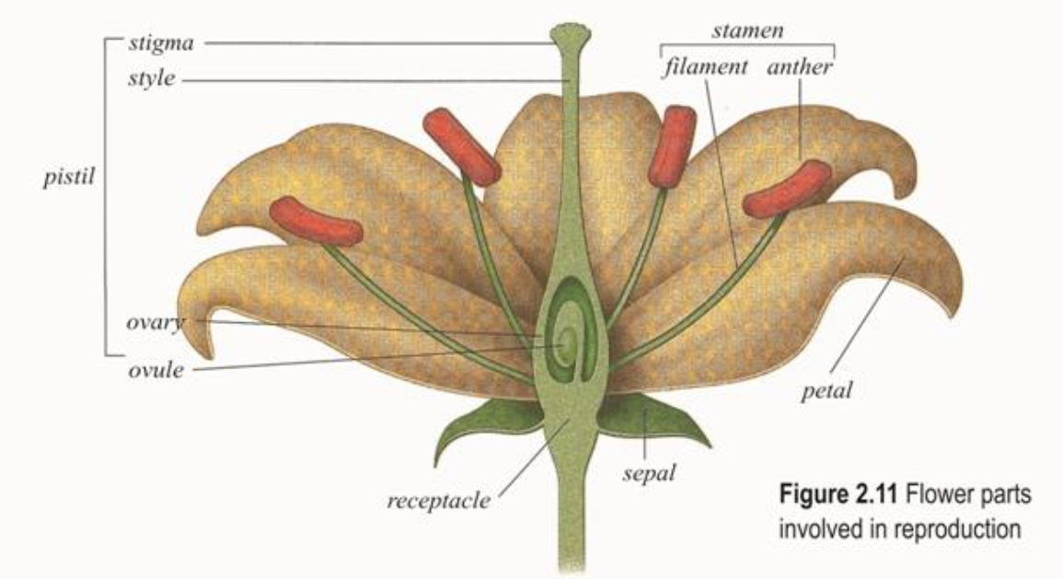
Parts of a Flower

Slide 33
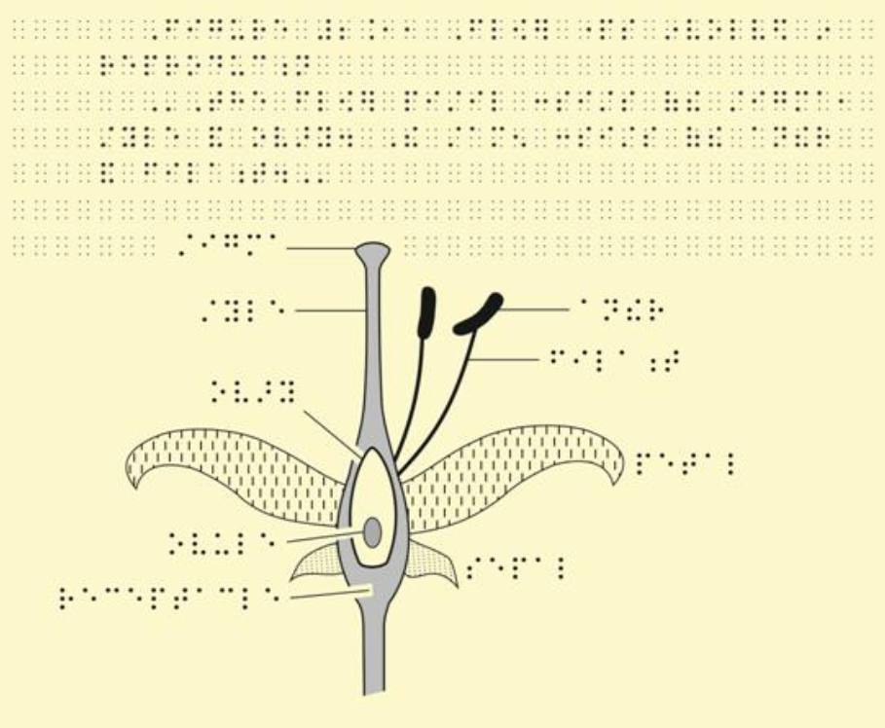
Flower Tactiles

Slide 34
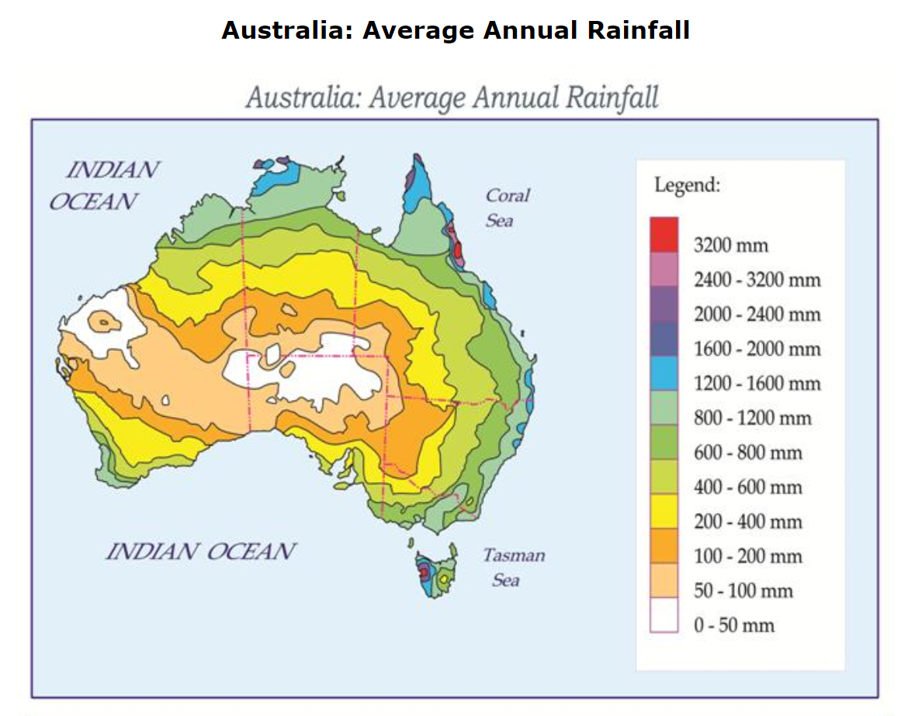
Rainfall in Australia

Slide 35
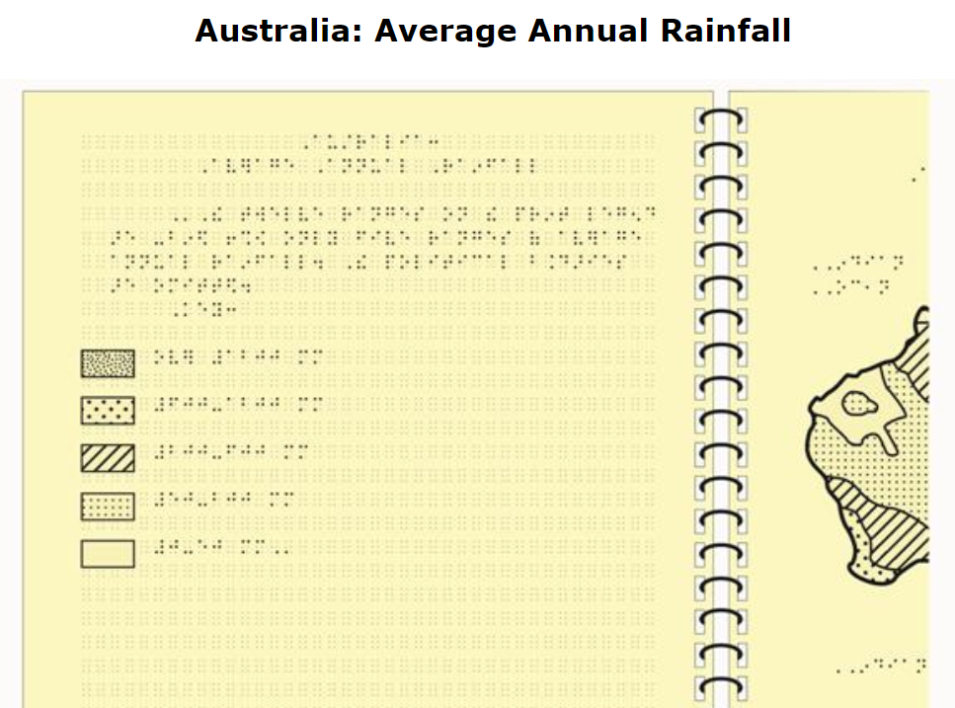
Rainfall Key

Slide 36
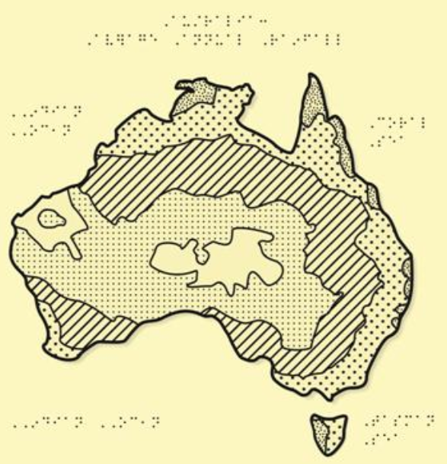
Rainfall Graphic

Slide 37
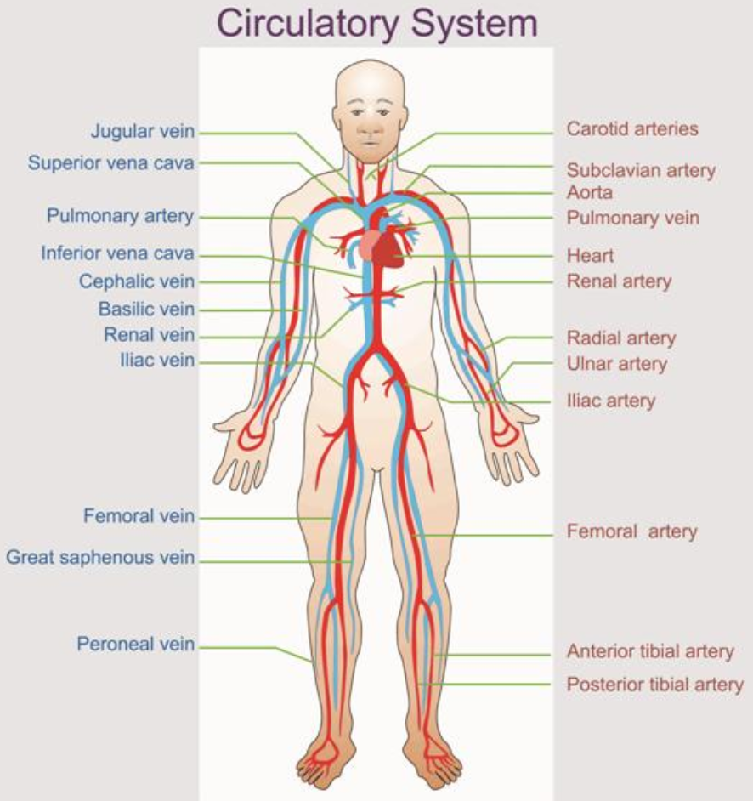
Circulatory System

Slide 38
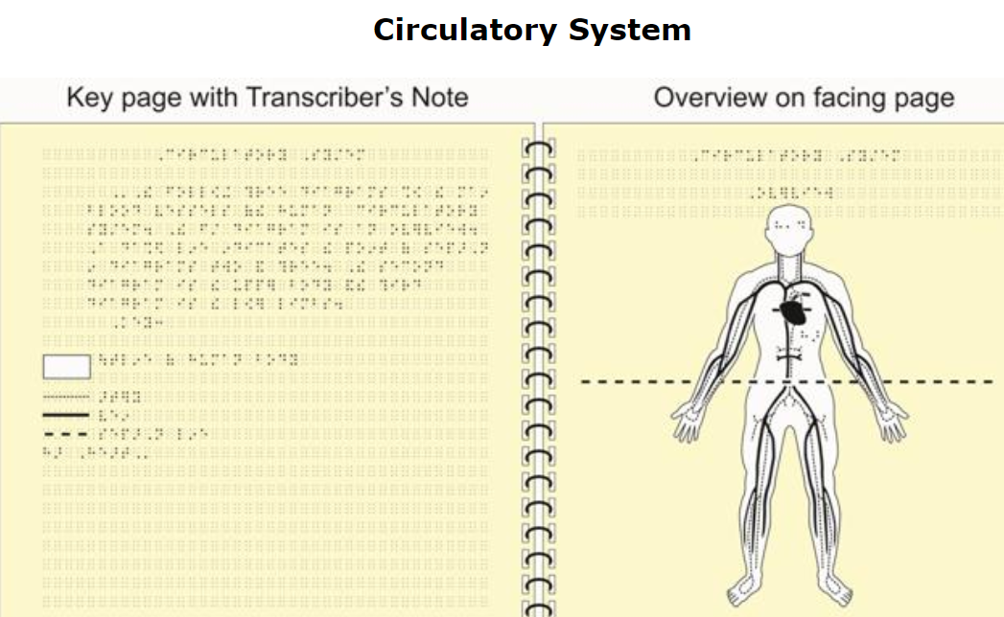
Overview Section

Slide 39
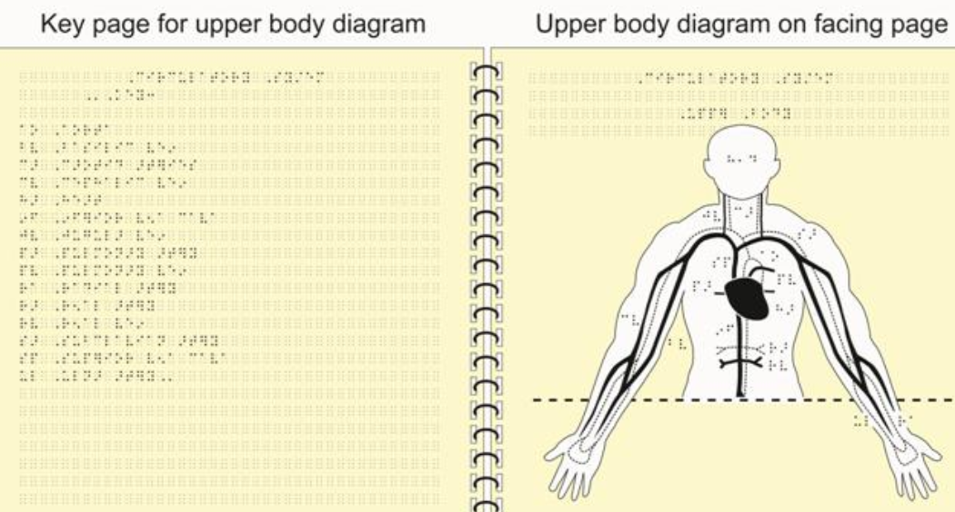
Upper Section

Slide 40
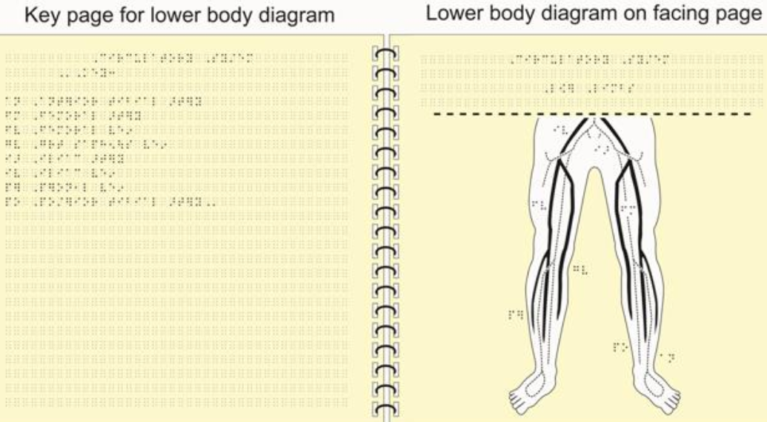
Lower Section

Slide 41
Tactile Graphics Creation
Production Methods and Techniques for Creating Tactiles

Slide 42
Production Methods Overview
Techy
Artsy
Firebird (Phoenix) / Tiger / Index Embossers
Adobe Illustrator
MS Word
Paint / Gimp / Zamzar
TactileView
Toaster Technology
3D Printers
Collage
Markers and puff paper
Puff paint
Braille graph paper
Glue sticks
Draftsman Drawing Kit
Sensational blackboard
inTACT Tactile Drawing Board

Slide 43
Tactile Graphics Mediums
Collage
Puff paint, magnets, cork boards and string, Wikki Stix
Raised line drawing kits
Draftsmen, Sewell, Sensational BlackBoard
Microcapsule Paper/ Swell Paper
PIAF (Pictures in a Flash), Zychem

Slide 44
Tactile Mediums continued
Braille embossers
Tiger embosser, Phoenix embosser
3D models

Slide 45
Using Microcapsule Paper
AKA puff paper, PIAF paper, Swell paper
Microcapsules respond to carbon on paper and puff when heated
Carbon sources
Toner
China markers
Gel pens
Very soft lead pencils
Black dry erase markers

Slide 46
Using the Computer
Design graphic on computer
Illustrator, Corel Draw
Photoshop
Word
Print from laser printer
Make copy on swell paper using copy machine
And toast!

Slide 47
Pictures to Outlines
Picture Stencil Maker
https://online.rapidresizer.com/photograph-to-pattern.php
Snaps Touch
http://www.snapstouch.com/
Also good for coloring books ;-)

Slide 48
Swell Paper Advantages
Can create templates
Graph paper
XY axes
Venn diagram
Basic maps
Basic outlines of biology concepts
Anything that you can reuse!
Can print from a PDF
Tactile Graphic Image Libraries available

Slide 49
TGIL
Tactile Graphics Image Library
Free from American Printing House
www.aph.org
https://imagelibrary.aph.org/aphb/

Slide 50
Talking Graphics
Touch Graphics
Talking Tactile Tablet
http://touchgraphics.com/products/
View Plus
Tiger Embosser
IVEO talking tablet
http://www.viewplus.com/

Slide 51
What about 3D?

Slide 52
Reality Check for 3D
Easy to create “blobs”
Best uses: science, math, maps
Some success with bas relief of artwork
Lots of questions on what is useful and what is not
If include braille labels, make sure braille is readable (28 point font)
Also beware of fragility—braille can easily

Slide 53
Diagram Center
Good information on using 3D printers
Article on how to include braille
http://diagramcenter.org/3d-printing.html

Slide 54
Technically
Requires a 3D printer
Please note: printers need to be used—sitting around is not good for them
Some online libraries contain accessible materials, but it helps if you can draw
Software makes it somewhat easier, but if you have no art background, you may struggle

Slide 55
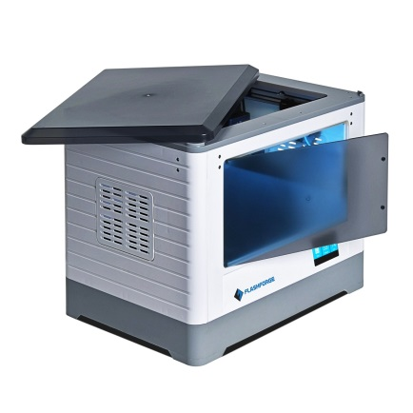
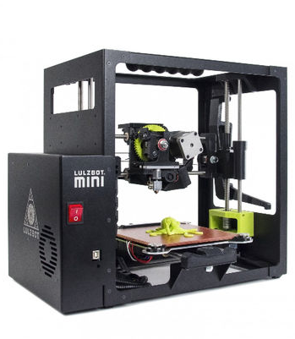
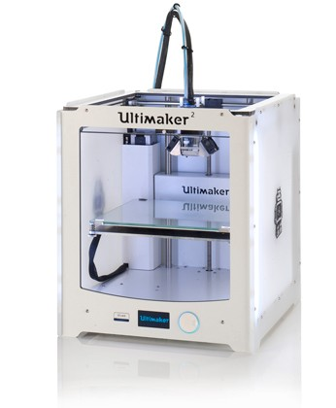
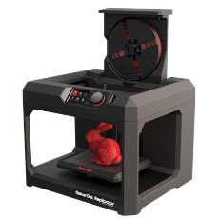
3D Printers
Wide range of options
Be aware of key characteristics
Size, filaments used, open or closed frame, ease of cleaning, cost

Slide 56
3D Modeling/Printing Software
Proprietary Applications
Some open source options available
Blender
Cura / Ultimaker Cura
TinkerCad
AutoDesk apps
OpenSCAD
Accessible CAD design
Notes:
123D Catch
Generate 3D models from photos
123D Circuits
Design your next electronic project
123D Design
Easy 3D modeling for Web, Mac, and PC
123D Make
Unique 3D models from 2D slices
123D Sculpt+
Create 3D sculptures on iPad
Meshmixer
The ultimate tool for 3D mashups
Tinkercad
Get started with 3D modeling
Tinkerplay New!
Design, customize and 3D print for play

Slide 57
Thank you!
Robert Beach
rbeach@kckcc.edu
913-288-7671
Gaeir Dietrich
gaeird@gmail.com
408-472-3146

