Slide 1
Creating and Remediating EPUB
This session will show how an EPUB can be quickly checked for accessibility issues.
We'll take a title with issues, and after some EPUB therapy we'll emerge with a file that delivers a great experience for students with print disabilities.
We will experience how quite complex publications can be made as highly structured and accessible titles using word processors and web based tools.
Attendees will have the chance to use software tools they can download and use when they return to their institutions.
Keypoints:
You can use free tools to check EPUBs for accessibility
You can edit an EPUB and quickly add value
You can make your own EPUBs from word processors and web based tools

Slide 2
Accessing Higher Ground, Westminster, CO
Creating and Remediating EPUB
November 21, 2019

Slide 3
Your workshop presenters
Richard Orme
Joseph Polizzotto
Charles LaPierre

Slide 4
Workshop overview
Dissecting EPUB
Tools for exploring and editing
Accessibility checking
Improving EPUBs
Validation
Create your own EPUBs

Slide 5
Our toolbox today
TweakEPUB
Sigil
Ace
AccessAide
EPUBCheck
Google Docs and WordToEPUB
Thorium and VitalSource Bookshelf

Slide 6
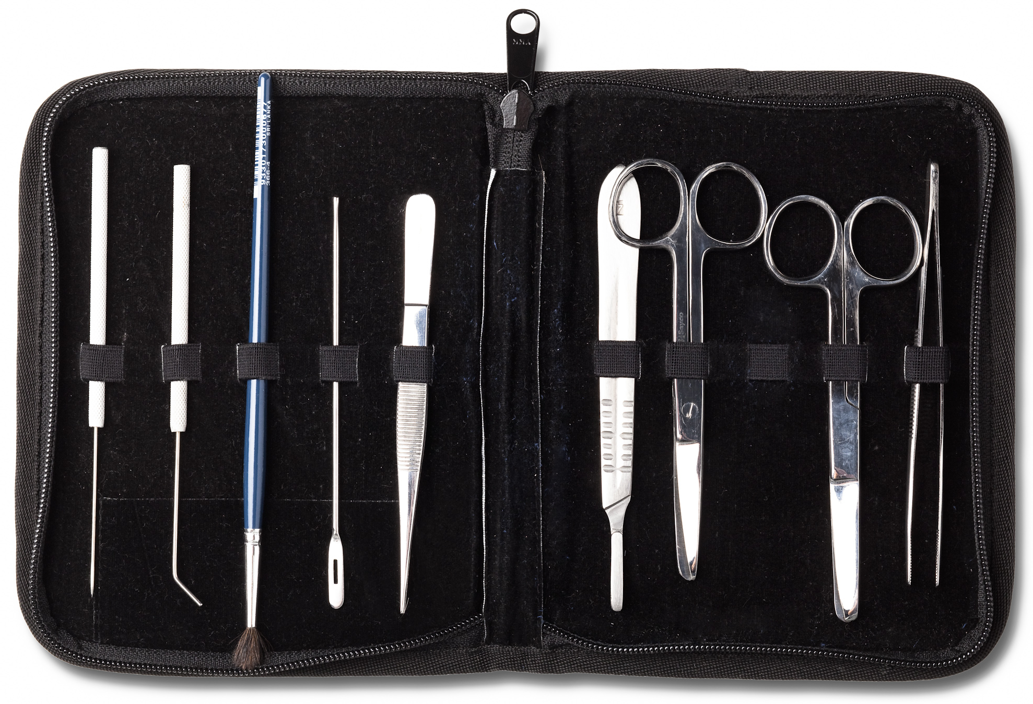
Dissecting EPUB
What is the structure of an EPUB title?
It’s a zip file containing folders and file
Content documents (usually XHTML but also HTML and HTM)
Media (e.g. PNG, JPG, SVG, GIF)
Stylesheets (CSS) and fonts (e.g. OTF)
Package file (OPF)
mimetype (file) – always the same, indicates how the eBook is formatted
container.xml – points to the package file

Slide 7
Let’s jump inside 1/2
Use File Explorer to locate the file: “The Many Faces of Strategic Voting.epub”
Make a copy of the file “experiment1.epub”
Check that you can open it as an eBook
Ensure “File name extensions” is checked in the View tab
Change the file extension of “experiment1.epub” to .zip
Open the zip and notice the folders and mimetype file

Slide 8
Let’s jump inside 2/2
Open the folder META-INF and notice the container.xml file
Open the folder OEBPS
Note the package document “content.opf”
Note the folders for images, styles and content
Open the folder “images”
View the file “Fig09_02.jpg”
Open the folder “xhtml”
View the file “16_Chapter10.xhtml” in Chrome / Firefox
Close any open files and delete your experiment files/folders
And relax…

Slide 9
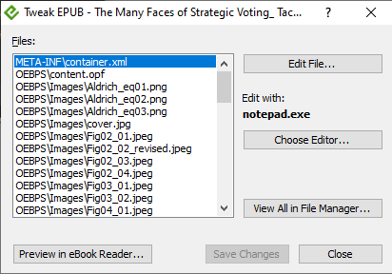
Tools for exploring and editing 1/2
Fortunately we don’t need to hand build and edit EPUB, there are tools to help us
Introducing TweakEPUB

Slide 10
Tools for exploring and editing 2/2
Introducing Sigil
Cross platform, open source editor for EPUB
Under active development
Some really useful plugins available
Not entirely accessible

Slide 11
Open an EPUB with Sigil
Use File Explorer to locate the file: The Many Faces of Strategic Voting.epub
Make a copy of the file as “experiment2.epub”
Start the Sigil from the shortcut on the desktop
File / Open the epub you just copied
Note the contents displayed in the folder “images”
Note the contents displayed in the folder “text”
Open chapter 10 in the Page Editor by pressing “F2”

Slide 12
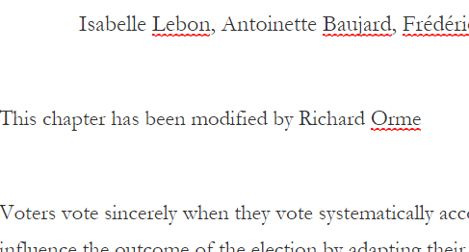
Edit an EPUB with Sigil
In the Page Editor, move the cursor to the first paragraph, which begins “Voters vote sincerely when…”
Add the text “This chapter has been modified for accessibility by <your name>” and press Enter so it is a paragraph on its own.
Save the EPUB (control S) and exit (Alt F4)
Note that the code has changed in the XHTML (line 20)

Slide 13
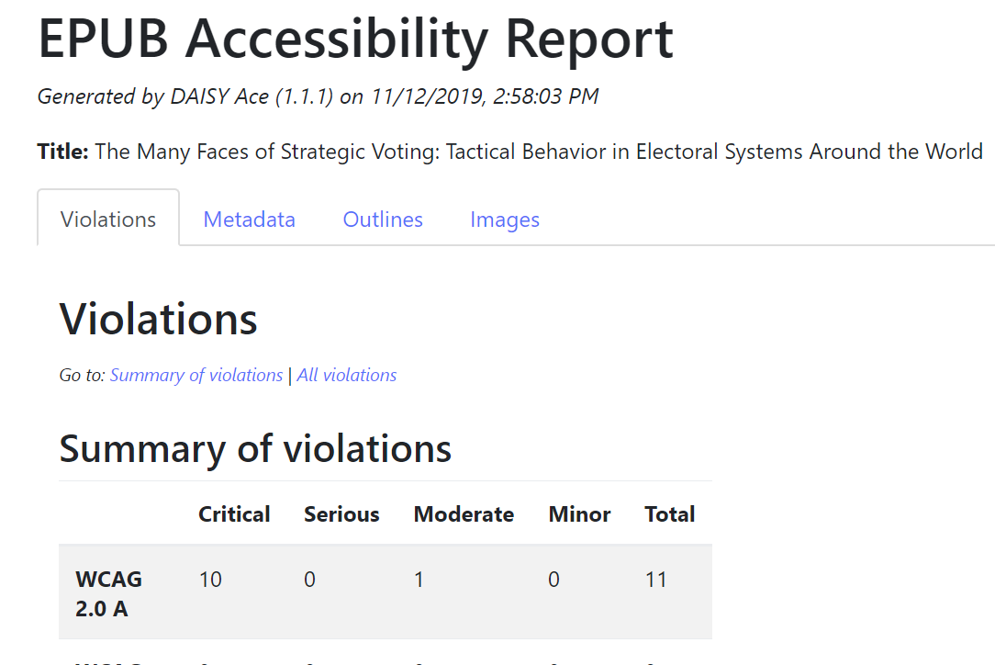
Review for accessibility
Open the EPUB in Sigil
Plugins / Validation / Ace
The Ace by DAISY tool will run and generate a report

Slide 14
Edit the metadata
Ace identifies an issue with the metadata
Go to Tools / Metadata editor (F8)
Locate the error resizeText (this is an invalid value)
Change the entry to “displayTransformability”
Save and run the Ace checker

Slide 15
Add image descriptions 1/2
Find chapter 10
Locate the code for Figure 10.2 (tip – search for “src”)
Note that alt=“”
Enter a description
Run the Ace checker again and note that description is now there
You can save the file and validate with a screen reader

Slide 16
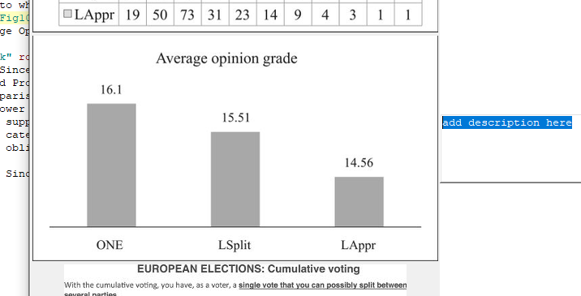
Add image descriptions 2/2
Identify the image you need to describe
Plugins / Validation / Access-Aide
Find the image in the list
Enter a description
Run Ace again and note the description is now there
You can save the file and validate with a screen reader

Slide 17
Heading structure
In the Ace report, view the Outlines tab, Headings Outline
Note that there’s a problem with the heading “Experimental protocol”
This should be heading level 4
Change the opening and closing heading tag from h1 to h4
Run Ace again and note the outline is now correct

Slide 18
Properly format a list
In chapter 10, at the end of page 208 there are three lines which should be formatted as a list. Remove the numbers and the opening and closing p tags on the three lines:
Then use Format / Numbered list to style them correctly:

Slide 19
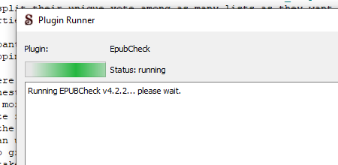
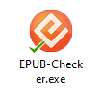
Validate changes with EPUBCheck
When you modify an EPUB, you check it is still valid
The tool is EPUBCheck, maintained and developed by DAISY
A Plugin is available in Sigil, Plugins / Validation / Epubcheck
Also, try EPUBChecker on the desktop

Slide 20
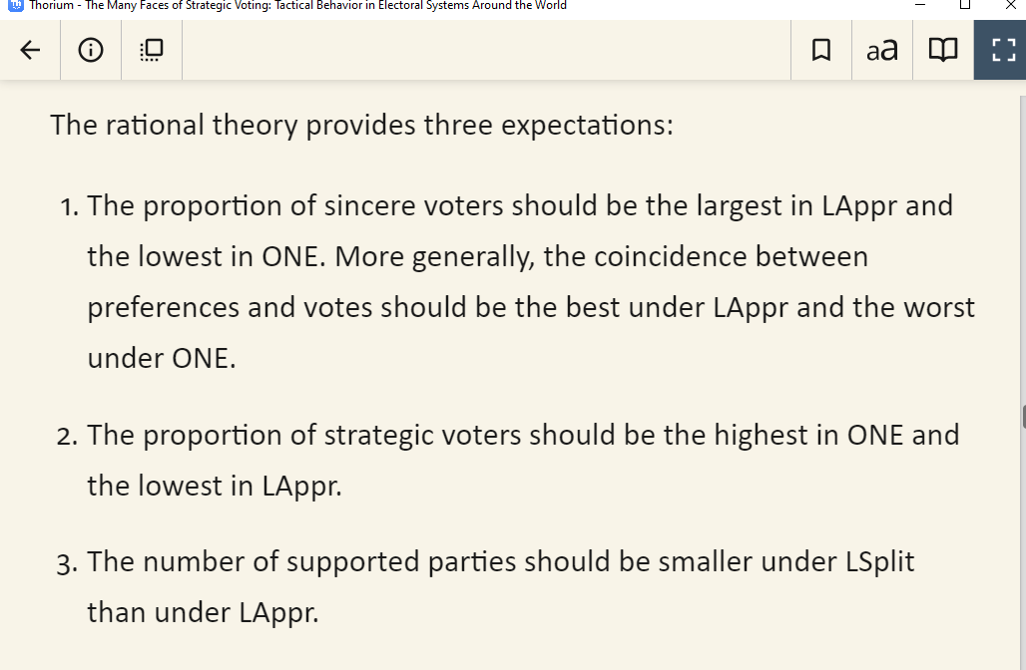
Check out your EPUB!
Browse to your EPUB with File Explorer
Open with an EPUB reader such as …
Thorium
Bookshelf
EasyReader

Slide 21
Make your own EPUB from Word 1/5
Create an accessible document in Microsoft Word
If you make an accessible Word document, you will get a great EPUB. Make sure that you:
use the built-in styles for headings, bulleted and numbered lists
for a blockquote, use the built-in styles for block text
ensure that images are inline (floating images will be included but the placement in the text will be unpredictable)
provide alt text for non-decorative images that are not described in the surrounding text. For guidance on image description visit http://diagramcenter.org)
insert proper Word tables, not images of tables
if you have references to footnotes and endnotes, use the proper Word feature, not simply a superscript number
if you include links in the document these will be included in the EPUB
include information such as title and author in the document properties

Slide 22
Make your own EPUB from Word 2/5
Use the accessibility checker
Make sure you’ve done your best to make an accessible document with the built-in accessibility checker in Word. This will help you identify issues that aren’t readily apparent. The way you get to this varies between versions. On recent editions of Word, move to the Review tab on the ribbon. Then select Check Accessibility.

Slide 23
Make your own EPUB from Word 3/5
The DAISY WordToEPUB tool can be used from within Word itself, or as a standalone application.
From within Word: the document you want to convert should be open. From the Home ribbon, select “WordToEPUB”.
Confirm the filename and folder for the EPUB and select OK.

Slide 24
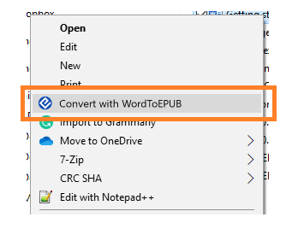
Make your own EPUB from Word 4/5
The DAISY WordToEPUB tool can be used from within Word itself, or as a standalone application.
As a standalone program: Start the WordToEPUB program from the menu or desktop shortcut, then select the document you want to convert. Confirm the filename and folder for the EPUB and select OK.
Alternatively, use File Explorer to select the Word document you wish to convert, then press right-click (or shift-F10) to bring up the context menu and select “Convert with WordToEPUB”.

Slide 25
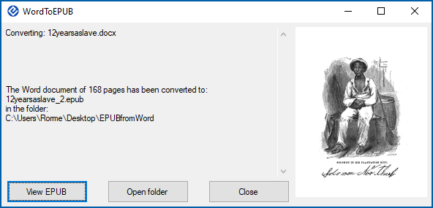
Make your own EPUB from Word 5/5
When the EPUB is ready, open in your choice of EPUB reader and you are good to go.
For bonus points, why not open in Sigil, take a look at how the EPUB is constructed, run EPUBCheck and Ace

Slide 26
Workshop conclusions
EPUB files are containers that include files that may be surprisingly familiar to you.
Software tools can quickly assess if a file conforms to the standard and help identify accessibility issues.
It isn’t rocket science to edit an existing EPUB, or to show others how they can make their own.

