Slide 1
A Global Portrait of
Inclusive Education

Slide 2
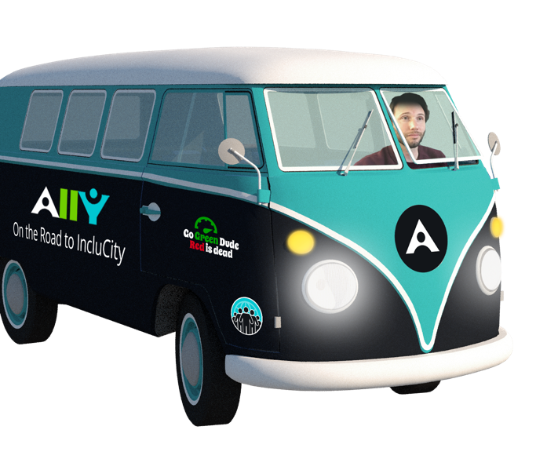
Our Mission: To Learn about…
Content Accessibility
Faculty Culture Shift
Application of UDL

Slide 3

The Road Traveled
51 Institutions
86,259 Miles
20 States, 6 Countries
4 Continents
14 conferences

Slide 4
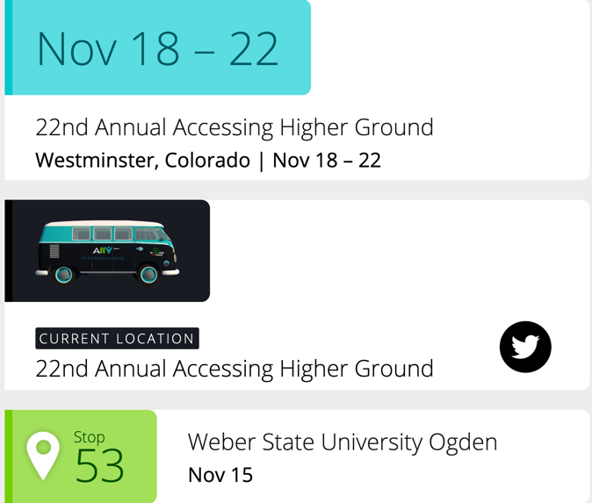
The Stories Shared: Tour.Ally.ac
7 podcasts
13 blogs
10 student interviews
23 instructors
55 admin and staff

Slide 5
Tour Stop Activities
  UDL & Ally Workshop:
        Focus on learning benefits of alternative formats and accessibility challenges
  Data Review:
        Accessibility issues across 5 key areas, usage data, and discussion of strategy
  Recordings:
        Podcast and video interviews

Slide 6

Content Accessibility
  Chipping away at a mountain

Slide 7
Tumultuous Terrain
Accessibility Issue | Ally Study 2017 | Tour Data 2019
Scanned PDFs | 12.8% | 6-12%
Untagged PDFs | 44.6% | 45-55%
Images missing description | 77.9% | 85-95%
Docs missing headings | 47.1%* | 20-29%
Docs with insufficient contrast | 35% | 35%
Notes:
Docs missing headings were calculated slightly differently for the 2017 study compared to how this number is reflected in the institutional report used to inform the tour 2019 data

Slide 8
One Example… American State U
Accessibility Issue | Total Docs Affected Fall 19
Scanned PDFs | 15,132
Untagged PDFs | 23,311
Images missing description | 15,058
Docs missing headings | 30,344
Docs with insufficient contrast | 32,399
Notes:
Institutional report scores for a mid-size State University

Slide 9





Accessibility Data for Solutions at Scale
  Inform strategy
  Benchmarking
  Assess impact

Slide 10
Designing an Inclusive Learning Strategy
Link to video “A Data-Informed Approach: Institutional Report”

Slide 11
Accessibility Data for Scalable Solutions
  Inform strategy
        Messaging and campaigns
  Benchmarking
        Goal-setting and progress on issues
  Assess impact
        How are accessibility best practices influencing the student experience?

Slide 12
Faculty Culture Shift
  Accessibility for student success

Slide 13
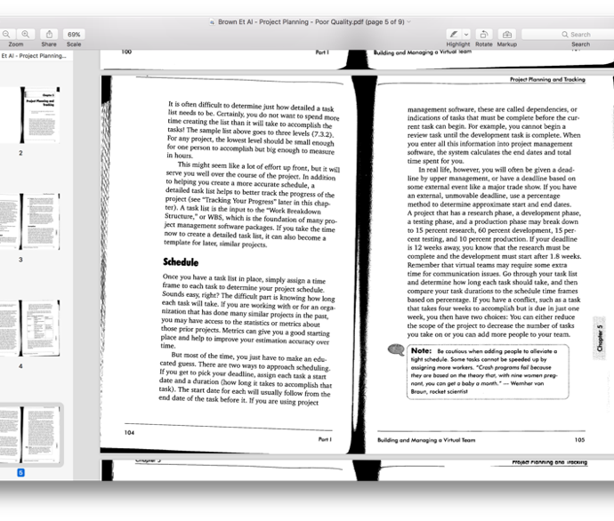
Accessibility Issues Affect Everyone
Schmutz et al (2017)
Findings on web axe:
Improved information retention
Faster speed of task completion
Notes:
The scanned PDF affects the quality of the educational experience for all students.

Slide 14

One Step in Front of the Other (NA-2019)
Ally Indicator Clicks | Files Altered | Clicks to Action | Success Rate
1,124,922 | 449,229 | 39.9% | 83%
Notes:
Clicks to Action refers to the number of

Slide 15





Types of Files Fixed (NA-2019)
Images | PDFs | Docs | Presentations | other
257,633 | 91,441 | 64,121 | 29,710 | 6,330
Notes:
Clicks to Action refers to the number of

Slide 16
Tracing the Culture Shift
Link to video “Catalyzing a Culture Shift: Instructor Feedback”

Slide 17
Strategies for Faculty Buy-in
  Set clear expectations
        Where to start, how fast to move
  Focus on improving alternative formats
        Fix issues that affect “learning tools”
  Divide and conquer
        Instructor fixes files that require subject matter expert, receives help with challenging files

Slide 18

Application of UDL
  Becoming lifelong learners

Slide 19








Diverse 21st Century Learning Needs
Notes:
Classroom diverse learners, not just culturally or racially, but also in terms of needs, family obligation, age. Our students are each on their own educational journey.

Slide 20

Multiple Modes of Representation
Multiple Senses or “Multimodal”
Multiple Devices
Multiple Needs
From the CAST website: https://tinyurl.com/y77k34qx

Slide 21
Personalization through Learner Preference
Learner Preference enhances student choice and active engagement
Learner Preference is not Learning Styles
Fosters metacognitive awareness and “executive function” for lifelong learning

Slide 22

Alternative Formats
Tagged PDF
HTML
OCRed PDF
ePub
MP3
Electronic Braille
Machine Translation
BeeLine Reader

Slide 23


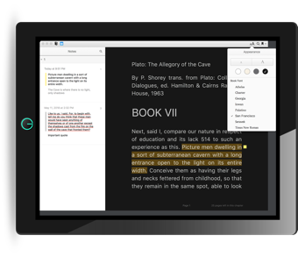

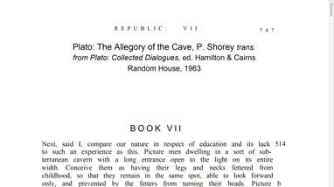
Improve study practices
Skim a Tagged PDF on a desktop
Annotate and highlight an ePub on a tablet
Listen and review an MP3 on your phone
Notes:
Use multiple formats to enhance study practices. Begin by skimming a Tagged PDF on desktop to gain a high-level understanding of the text, then use the Pub for annotating and highlighting key information, then download the MP3 to review the material on your phone, activating another sensory modality to complement reading.

Slide 24
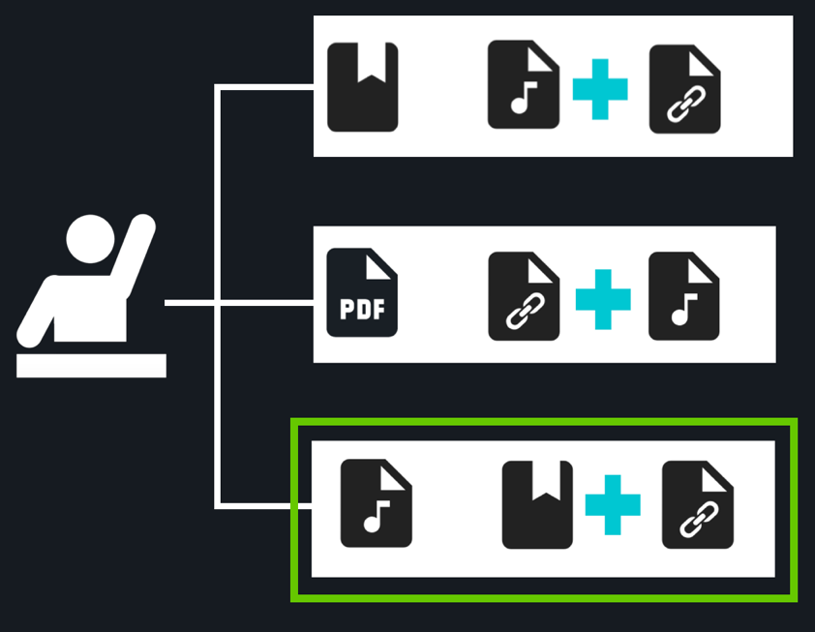
Keep a Learning Log
Activity: Students document their content engagements and study habits using different modes of learning

Slide 25

Increasing Learner Autonomy and Choice
3.7M
Alternative Format
Downloads (NA-2019)

Slide 26

Types of Formats Downloaded (NA-2019)
Tagged PDF | HTML | OCRed PDF | ePub | MP3 | Electronic Braille
2,068,734 | 1,282,656 | 153,199 | 124,291 | 90,937 | 30,745

Slide 27
Personalizing the Learning Experience
Link to video “Becoming Independent Learners: Alternative Formats”

Slide 28
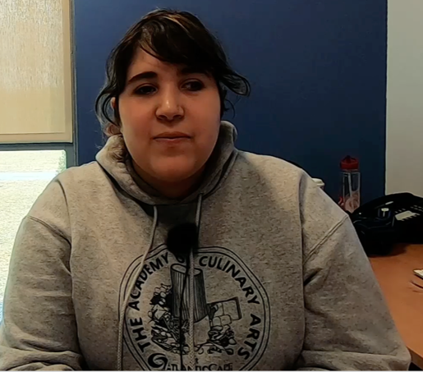
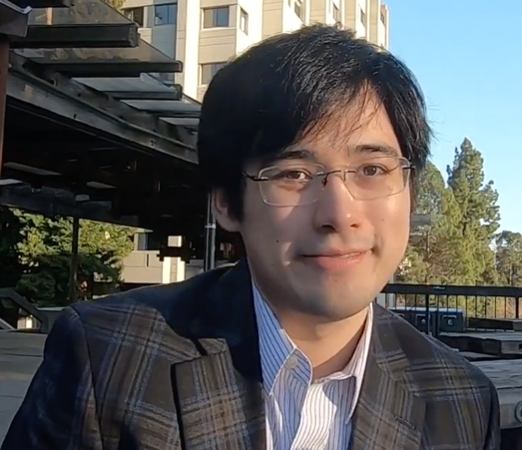
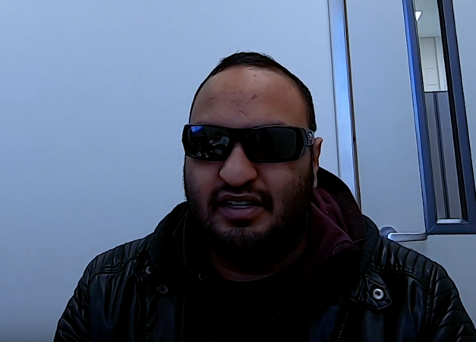
Impact of Alternative Formats on Learners with learning differences
Juliana
Andrew
Angus
Notes:
Juliana, uses screen magnification to support vision, chooses the HTML format for easy zooming as well as for saving to her browser for easier access to files. Andrew, an alumni of Berkeley and Harvard who learns through bi-modal presentation, listening and reading content at the same time. And Angus, who “relaxes” by feeling the braille and engaging his content using a tactile modality.

Slide 29

Learning Content for students with diverse needs
“You gave me part of my life back.” - commuter student, mother
https://tinyurl.com/Chicocasestudy
Notes:
A mother with a long commute to campus shared how access to the MP3 allowed her to review her material during her car ride.

Slide 30




4 Learning Benefits of Alternative Formats
Find a higher quality alternative
Enhance comprehension and retention
Improve time management
Become a better learner

Slide 31
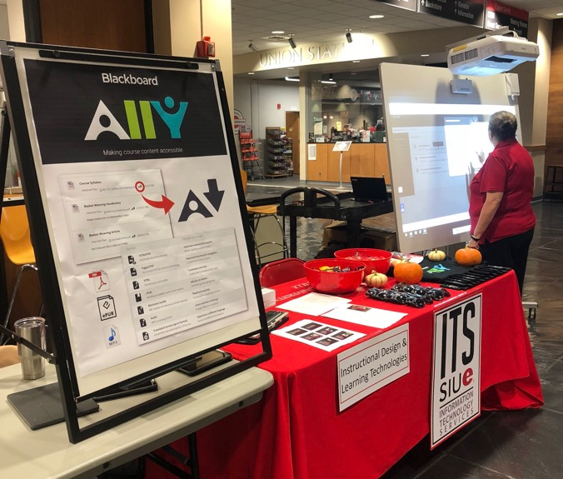
Strategies for Student Adoption
Connect with student-facing orgs across campus
Promote in high traffic areas
Include in syllabus and via LMS bulletin
Ally Tour stop at Southern Illinois University Edwardsville student center

Slide 32
What’s Next on the Road to IncluCity?
Ramping up remediation services
Changing workflows
Targeted professional development
More research and data exploration

Slide 33

Join the Ally Community
usergroup.ally.ac

