Slide 1
Lisa Morrison-Fronckowiak Sumana Silverheels Buffalo State College
Developing your Transition Toolkit
Access BSC: A Bridge to Success in College

Slide 2
Why ACCESS BSC?
Idea stemmed from an observed lack of knowledge about transition from high school to college for students with disabilities.
Parents
Students
K-12 professionals
Higher Education service providers
A 3-year experiment to support transition
Notes:
CCDA affiliation, college night feedback, student panel, Before the Cap and Gown conference
Shared experiences of professionals in the WNY area.

Slide 3
Lack of general skills
Students in general, struggle with crucial skills needed to be successful in college
Communication
Critical thinking
Technology (LMS, email, library access)
Students with disabilities also need to…
Understand their functional abilities/limitations
Know to look for resources on campus
Learn about assistive technology and tools

Slide 4
Students with Disabilities in Higher Education
High school graduates with disabilities enroll in college at a significantly lower rate than their peers without a diagnosed disability.
Unaware of resources and supports available on campuses
Do not want to seek out supports in college

Slide 5
The Program
1-week summer program 9am- 3:00pm
Recruited up to 25 students with "learning differences" who have completed their first year of high school.
Participants did not have to be committed to attending Buffalo State College.
Immersion into assistive and educational technologies
Notes:
* Learning difference was important b/c we didn't want to limit the pool of students to those who only had diagnosed learning disabilities.
* Helping to change the mindset from k-12 to higher ed. where colleges don't focus so much on the diagnoses but functional limitations.
* Important that we welcomed students who might attend other schools. There is a high transfer rate and there was a greater benefit in ensuring student preparation.
* Utilizing assistive and educational technologies regardless of the students disability label was something we'd hope would make this program unique.

Slide 6
Recruitment and Implementation
High School Students:
Recruited via high schools, colleagues, transition specialist, vocational rehabilitation programs.
Did not collect documentation of disability. Parent, student, and school counselor recommendation.
Program was free with each student receiving a Livescribe smartpen at the end.
Mentors:
Utilized current SAS Buffalo State students as paid mentors.
Handpicked by Access BSC program directors.
Mentors helped with engagement.
Shared personal experiences as a college student with a disability.
Notes:
Vocational rehab (ACCESS-VR) was particularly helpful in recommending students and spreading the word about the program.
Additionally, a lot of referrals came via word of mouth.
* Mentors were a huge component of this program. Usually hired 4-5 mentors each year. Additionally, hired either professional learning specialist, or a graduate student to present some of the sessions.

Slide 7
Sample Schedule
Monday 8:45-9:00am Arrival Butler Library Room 210 9:00am Introductions, Program Begins · Learning Styles · Intro to Lives cribe Pen · Note taking apps · Library tour and wrap up 3:00pm Dismissal Butler Library lobby | Thursday 8:45am-9:00am Meet in Butler Library lobby 9:00am Program Begins · College search process · Study skills · Self-advocacy · Small group work 3:00pm Dismissal Butler Library lobby
Tuesday 8:45-9:00am Meet in Butler Library lobby 9:00am Program Begins · Study Skills · Intro Read and Write Gold · Review self-assessment · Small group work 3:00pm Dismissal Butler Library lobby | Friday July 14th 8:45-9:00am Parents and Students meet in Butler library lobby 9:00am Program Begins · Parents are invited to an Effective College Planning transition presentation. · Mentors will continue work with students · 10:45am student groups give presentations for parents. · Reception, lunch will be provided. Please note dismissal will be early, approx. 12:15pm.
Wednesday 8:45am-9:00am Meet in Butler Library lobby 9:00am Program Begins · College search process · Study skills · Self-advocacy · Small group work 3:00pm Dismissal Butler Library lobby
Notes:
* 5 days goes by really fast we had to hit the ground running due to the amount of information.
* Needed students to start working with technology (pens, and apps) as soon as possible so they would have developed a good base knowledge.
* Socialization, icebreakers and taking in the college campus was very important. (Many of the students had issues with social interactions)

Slide 8
Spaghetti Towers
Fun icebreakers were incorporated that also reinforced skills they were being taught.
Notes:
Games to build communication and knowing one another.

Slide 9
Student Celebration and Parent Reception!
The last day of the program
Program directors Q &A and presentation for parents
Student presentations for parents
Reception
Celebrating the learning that took place during the week
Students presented with the Livescribe to take home
Parents were provided copies of Effective College planning manual and workbook
(https://www.wnyccda.org/resources.html)

Slide 10
Assistive Technology Tools
Introduce students to:
Livescribe Pen
Read&Write
iPad mini with keyboard
Organization apps
Notability
Voice Dream Suite

Slide 11
Livescribe Pen
Dependency on teacher notes
Note taking challenges in college
Missing information
Distracted listening

Slide 12
Why Read&Write
Increased focus on independent reading
1
Increased comprehension
2
Study skills feature
3
Readily available tool in local schools and colleges
4

Slide 13
iPad Mini with keyboard
Introduction to apps:
Voice Dream Reader
Voice Dream Writer
Voice Dream Scanner
Notability

Slide 14
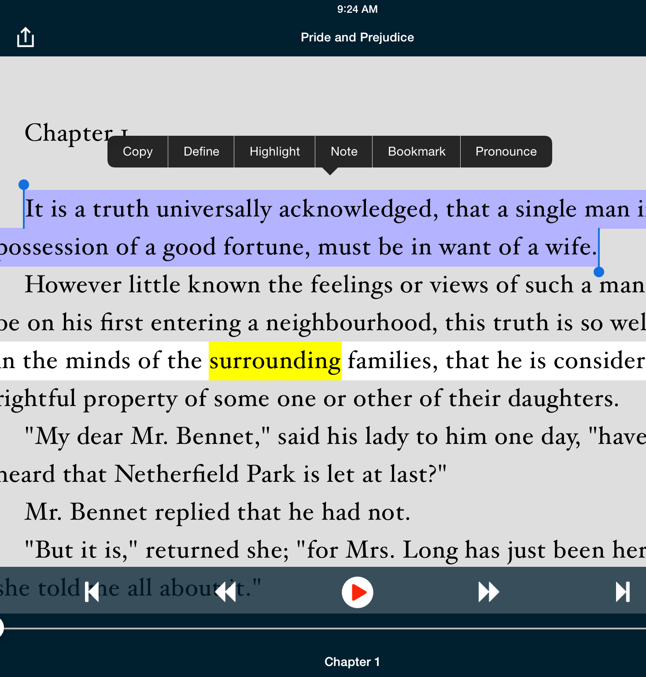
Voice Dream - Reader
Compatibility with
Google Docs
Bookshare
PDF files
Word documents
Ability to:
Track and listen to text
Highlight and look up definitions
Set bookmarks

Slide 15
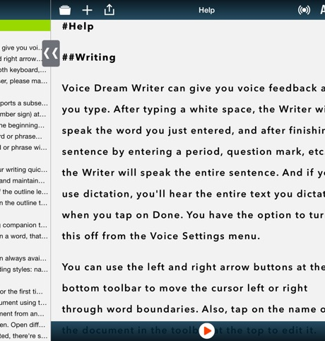
Voice Dream - Writer
Read back written information
Word prediction
Helps be a better writer
Reduces errors
Prediction for phonetic spelling

Slide 16
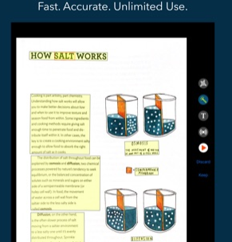
Voice Dream - Scanner
Added in year 3 of the program
Provides instant access to printed text
Option for batch scanning
Save document for use in Reader app
Is now an addition to the Reader app

Slide 17
Barriers with Implementation of Technology
iPads had to be controlled for sign in (prior to two-step verification)
Bluetooth Livescribe pen pairing interfered with other pens in the room

Slide 18
Mentor Contribution
Made students comfortable
They were relatable
Supported engagement
Expectations of the mentors
Not required to have deep knowledge of subject area
Outcome
Mentors learned more about services and technology
Reflected on their own high school experiences
Tools they would have benefited from

Slide 19
"Takeaways"
Learn from Access BSC, both success and opportunities for growth
Utilize resources in existence "Effective College Planning" www.wnyccda.org
Seek out support from local, regional and national donors.
Introduce technologies that will benefit learners with different abilities. [UDL]

Slide 20
Parent comments:
"I think this was a wonderful program for students who are considering college but will be needing assistance to do so. I felt better after the week was over knowing that my daughter had spent a week on campus, had learned what was available to her, and knowing she felt excited about taking the next steps toward college."
"This was a wonderful program and changed my son's attitude about going to college."
"We loved the program."
"We thought the program was very informative"
"We are so happy our son attended Access BSC, it made him more confident to attend college. He really loves the smart pen."

Slide 21
Student comments and feedback
“I think I will get use out of the Livescribe pen, the notebook and the apps. They are incredible devices”
“Loved it! The atmosphere is amazing, Really glad I could attend.”
“I think I'll use the Livescribe pen often because of its versatility, including its feature to record lectures”
“Enjoyed Notability to take better notes”
“I feel the program needed to be more in-depth. I feel I got a lot out of it, but not as much as I could have received if the program was longer”
“Access BSC helped me to prepare for college”
“My mentor was awesome and fun. I liked my group and got to know them better. I thought the program wouldn’t be interesting, but it turned out to be fun.”

