Slide 1
Able Player 4.2.1: A free, open source accessible media player
Terrill Thompson
IT Accessibility Team
University of Washington
tft@uw.edu

Slide 2
Overview

Slide 3
Video can be inaccessible to...
People who are unable to hear the video
People who are unable to see the video
People who are unable to operate a mouse
People who don't understand the spoken language
People who need to speed up/slow down the video
People who need to search the video's content
People who are unable to play the video (due to deaf-blindness, bandwidth, technology limitations, or a busy schedule)

Slide 4
Our mission in this session
Explore all aspects of video (and audio) accessibility using HTML5 and Able Player

Slide 5
HTML5 Media Supports Accessibility
New elements: <video>, <audio>, <source> & <track>
Five kinds of text track (<track>):
Captions
Subtitles
Descriptions
Chapters
Metadata
Adjustable playback rate

Slide 6
But browsers’ default players are all different

Slide 7
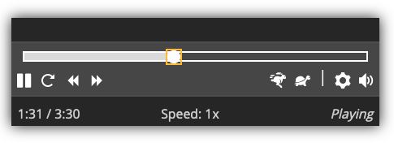
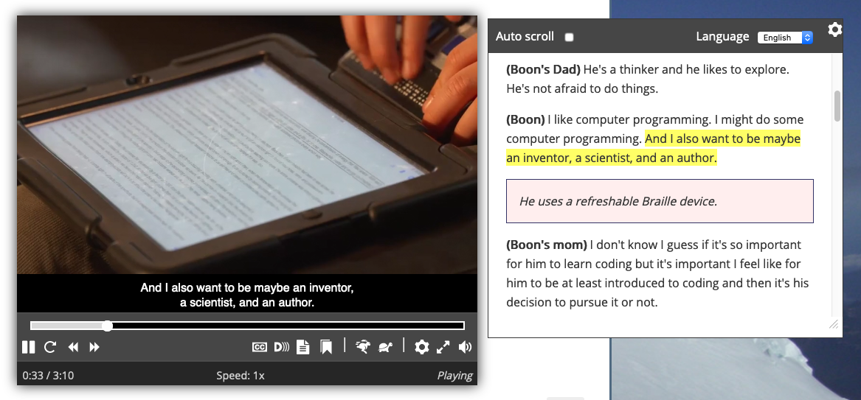
Able Player improves accessibility and works across browsers

Slide 8
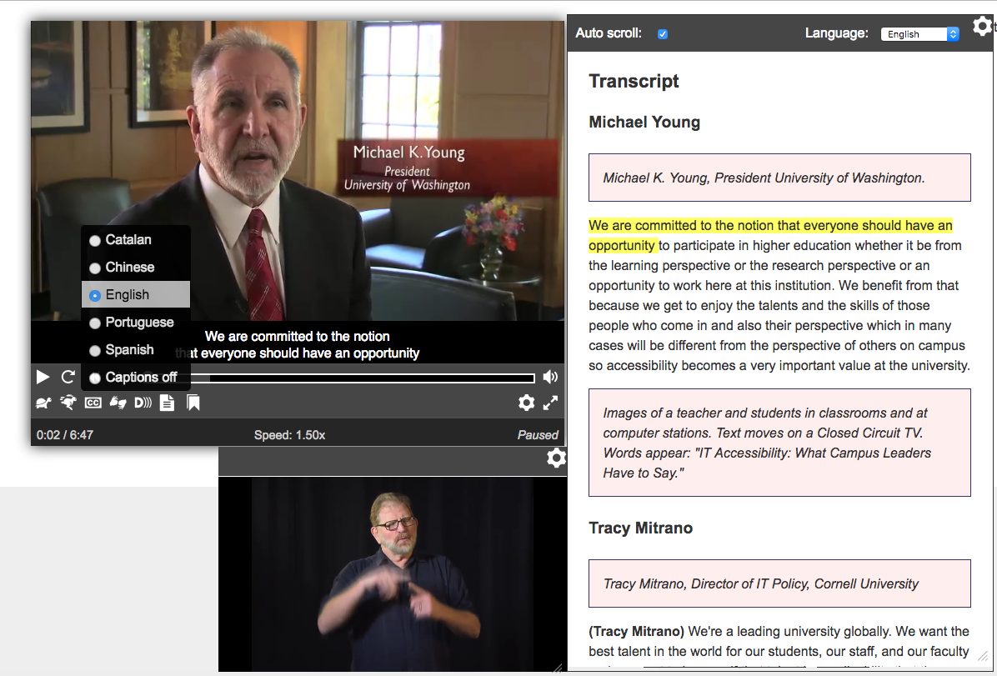
Able Player is packed with features!

Slide 9
Let’s code!

Slide 10
Playing audio with HTML
<audio src="myfile.mp3" controls>
</audio>
Notes:
Might also need to use data-translation-path

Slide 11
Providing multiple audio sources (to ensure browser compatibility)
<audio src="myfile.mp3" controls>
<source src="myfile.mp3">
<source src="myfile.ogg">
</audio>
Notes:
Might also need to use data-translation-path

Slide 12
Make it an Able Player!
<audio controls data-able-player>
<source src="myfile.mp3">
<source src="myfile.ogg">
</audio>
Notes:
Might also need to use data-translation-path

Slide 13
Playing video with HTML
<video src="myfile.mp4" controls>
</video>
Notes:
Might also need to use data-translation-path

Slide 14
Providing multiple video sources (to ensure browser compatibility)
<video src="myfile.mp4" controls>
<source src="myfile.mp4">
<source src="myfile.webm">
</video>
Notes:
Might also need to use data-translation-path

Slide 15
Make it an Able Player!
<video controls data-able-player>
<source src="myfile.mp4">
<source src="myfile.webm">
</video>
Notes:
Might also need to use data-translation-path

Slide 16
Adding captions
<video src="myfile.mp4" data-able-player>
<track kind="captions" src="mycaptions_en.vtt" srclang="en" label="English">
</video>

Slide 17
WebVTT Format
Stands for "Web Video Text Tracks"
https://w3c.github.io/webvtt/

Slide 18
Example WebVTT Caption File
WEBVTT
00:00:00.599 --> 00:00:04.069
<v Michael Young> We are committed to the notion
that <b>everyone</b> should have an opportunity
00:00:04.069 --> 00:00:06.809
to participate in higher education
00:00:06.940 --> 00:00:09.500
whether it be from the learning perspective
or the research perspective
00:00:09.500 --> 00:00:12.200
or an opportunity to work here
at this institution.

Slide 19
Adding subtitles
<video src="myfile.mp4" data-able-player>
<track kind="subtitles" src="mysubtitles_es.vtt" srclang="es" label="Español">
</video>

Slide 20
Example WebVTT Subtitle File
WEBVTT
00:00:00.599 --> 00:00:04.069
<v Michael Young> estamos comprometidos con la noción que <b>todo el mundo</b> debería tener la oportunidad
00:00:04.069 --> 00:00:06.809
a participar en la educación superior
00:00:06.940 --> 00:00:09.500
ya sea desde la perspectiva de aprendizaje
o la perspectiva de la investigación
00:00:09.500 --> 00:00:12.200
o una oportunidad de trabajar aquí
en esta institución.

Slide 21
Adding descriptions
<video src="myfile.mp4" data-able-player>
<track kind="descriptions" src="mydesc_en.vtt" srclang="en" label="Audio Description (English)">
</video>

Slide 22
Example WebVTT Descriptions File
WEBVTT
00:00:00.000 --> 00:00:02.000
Michael K. Young, President, University of Washington
00:00:40.000 --> 00:00:44.000
Tracy Mitrano, Director of IT Policy, Cornell University
00:01:22.000 --> 00:01:32.000
Edward Ray, President, Oregon State University

Slide 23
Putting it all together =
<video data-able-player>
<source src="myfile.mp4" type="video/mp4">
<source src="myfile.webm" type="video/webm">
<track kind="captions" src="mycaptions.vtt" srclang="en" label="English">
<track kind="subtitles" src="mysubs.vtt" srclang="es" label="Español">
<track kind="descriptions" src="mydesc.vtt">
<track kind="chapters" src="mychapters.vtt">
</video>

Slide 24
A highly accessible experience

Slide 25
Audio Description
If a <track> is provided with kind=descriptions, this will be read aloud.
By browsers (4.0 and higher)
By screen readers (prior to 4.0)
The user can turn on "Automatically pause video when description starts" in preferences
If an alternative described version is available, use data-desc-src
Either way, the user can toggle descriptions on/off using the "D" button

Slide 26
Sign Language
Use data-sign-src to point to a sign language video
The sign language video should be tightly synced with the program video.
The sign language video, if toggled on, appears in a pop-up window that can be moved and resized.

Slide 27
A source tag, with all the fixin's
<source type="video/mp4"
src="myvideo.mp4"
data-desc-src="myvideo_described.mp4"
data-sign-src="myvideo_signed.mp4">

Slide 28
Playing YouTube video
<video data-able-player
data-youtube-id="xxx"
data-youtube-desc-id="yyy">
</video>

Slide 29
Playing Vimeo video (4.0 and higher)
<video data-able-player
data-vimeo-id="xxx"
data-vimeo-desc-id="yyy">
</video>

Slide 30
A few issues with Vimeo
Hiding the default controller requires video to be hosted on a Plus account or higher
Controlling the playback rate (slower/faster) requires a Pro account or higher (and must be enabled for each video; off by default)
Able Player cannot repurpose captions as a transcript if captions are hosted on Vimeo
Users cannot control display of captions if captions are hosted on Vimeo

Slide 31
With both Vimeo and YouTube…
Use <track> elements to get full Able Player functionality

Slide 32
Adding metadata
<video src="myfile.mp4" data-able-player>
<track kind="metadata" src="metadata.vtt">
</video>

Slide 33
Example WebVTT Metadata File
WEBVTT
00:01:00.000 --> 00:01:20.000
#popup
00:03:30.000 --> 00:03:31.000
#quiz
PAUSE
FOCUS:#input1

Slide 34
Playlists (1 of 3)
<ul class="able-playlist" data-player="video1">
The value of data-player must match the id of the media element
Each <li> can include:
A data-poster attribute (to display an image)
A <span> with class="able-source" for each source element.
A <span> with class="able-track" for each track element.
A <button> containing the clickable content for this item in the playlist

Slide 35
Playlists (2 of 3)
Each <span> should include all the needed attributes for that source or track, prefaced with "data-". For example:
data-src (for both source and track)
data-desc-src (for source)
data-youtube-src (for source)
data-kind (for track)
data-srclang (for track)

Slide 36
Playlists (3 of 3)
How it works: When a users clicks a <button> within a <li> in the playlist:
A new <source> is added to the DOM for all <span class="able-source"> elements inside the clicked <li>. All data-* attributes are added to the new <source> (without the data- prefix).
A new <track> is added to the DOM for all <span class="able-track"> elements inside the clicked <li>. All data-* attributes are added to the new <track> (without the data- prefix).
The new media file is loaded and starts playing.

Slide 37
Transcript
data-transcript-div – id of an external div in which to display the transcript (instead of a popup)
data-transcript-src – id of a pre-existing manually-edited transcript (auto-generated transcripts are rarely perfect). Coding instructions are provided in the documentation.
Able Player includes "Video Transcript Sorter (VTS)", a utility to help sync the various timed text sources so they flow properly in the auto-generated transcript.

Slide 38
WordPress Plugin
https://wordpress.org/plugins/ableplayer/
Enables author to add an Able Player instance via HTML
Supports shortcodes for adding YouTube or Vimeo videos:
[ableplayer youtube-id="xxx" youtube-desc-id="yyy"]
[ableplayer vimeo-id="xxx" vimeo-desc-id="yyy"]

Slide 39
Drupal Module
https://drupal.org/project/ableplayer
Currently a work in progress for Drupal 8
Maintained by Max Bronsema & Nigel Packer @ Western Washington University

Slide 40
LTI (plugin for LMSs)
Coming soon!
(maybe)

Slide 41
Resources
Able Player https://ableplayer.github.io/ableplayer/
Able Player WordPress Plugin https://wordpress.org/plugins/ableplayer/
Able Player Drupal Module https://drupal.org/project/ableplayer
DO-IT Video (uses Able Player) https://uw.edu/doit/videos
WAI Web Accessibility Perspectives (uses Able Player) https://w3.org/WAI/perspective-videos/
Creating Accessible Videos (UW) http://uw.edu/accessibility/videos

