Slide 1

Tips for promoting accessible IT campus-wide within the context of a universal design framework
4:30 p.m. | Tips for promoting accessible IT campus-wide within the context of a universal design framework
Sheryl Burgstahler, Director
Accessible Technology Services, UW-IT

Slide 2

Two ATS Centers at UW
        Access Technology Center
          1984–
          To ensure IT procured, developed & used at UW is accessible
          DO-IT Center
          1992–
          Supported with grants
          2007– DO-IT Japan
Disabilities
Opportunities
Internetworking
Technology

Slide 3
Basic approaches
When we are working with faculty, staff, institutions, technology companies, we promote
UNIVERSAL DESIGN (UD)
When we are working with students, we promote
SELF DETERMINATION

Slide 4
Presentation outline
Resources
An inclusive environment
History of approaches to human differences
The UDHE Framework
How a campus-wide UD Framework can guide inclusive practices

Slide 5
Online resources
Center for Universal
Design in Education
www.uw.edu/cude
UDL on Campus
udloncampus.cast.org
IT Accessibility
www.uw.edu/accessibility
AccessComputing
www.uw.edu/accesscomputing

Slide 6

Book: Universal Design in Higher Education (UDHE): From Principles to Practice
> 40 authors/co-authors
Harvard Education Press
Email doit@uw.edu to join
the UDHE online community
of practice

Slide 7

In an “inclusive” environment everyone
  who meets requirements, with or without accommodations, is encouraged to participate
  feels welcome
  is engaged

Slide 8
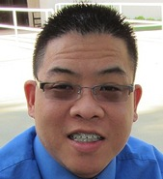
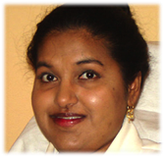
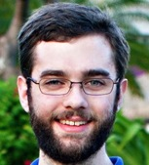
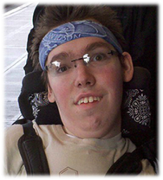
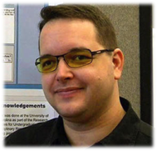
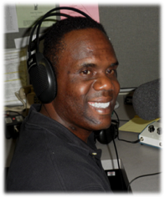

Characteristics

Slide 9
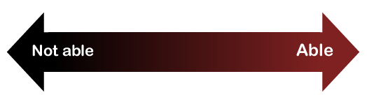
Consider ability on a continuum
understand English, social norms
see
hear
walk
read print
write with pen or pencil
communicate verbally
tune out distraction
learn
manage physical/mental health

Slide 10
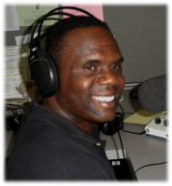

One-minute history lesson—Evolution of responses to human differences
        Eliminate, exclude
        Segregate
        Cure
        Rehabilitate
        Accommodate
        Social justice: Inclusion &
        universal design

Slide 11

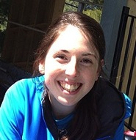
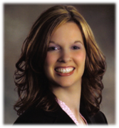
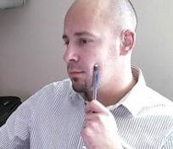
Note
Most disabilities are “invisible”
Fewer than 1/3 of students with disabilities may be reporting them to the disability services office

Slide 12
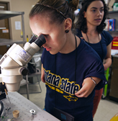
Typical approach— accommodation
An accommodation adjusts a product
or environment to
provide access to a
specific person
(extra time,
alternative formats,
sign language
interpreters, …).

Slide 13
Incorporating UDHE Framework within
an Inclusive Campus Model
How can the UDHE Framework underpin an Inclusive Campus Model?
How could this model guide the procurement, development & use of accessible IT?

Slide 14
UDHE Framework
Scope
Definition
Principles
Guidelines
Process
Practices

Slide 15
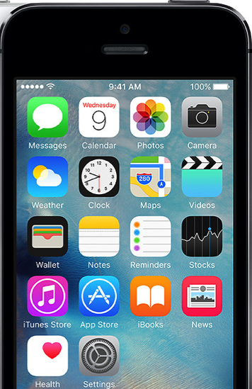
Universal design =
  “the design of products & environments to be usable by all people, to the greatest extent possible, without the need for adaptation or specialized design.”
  The Center for Universal Design
  www.design.ncsu.edu/cud

Slide 16
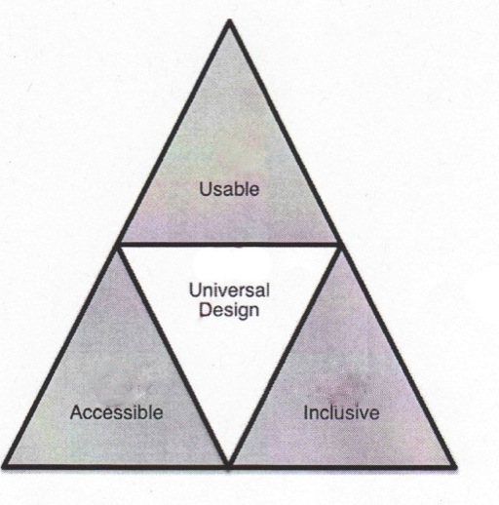
Terminology
Accessible design
Usable design
Inclusive design
Universal design
Barrier-free design
Design for all

Slide 17

Apply UD to create inclusive
        physical spaces
        services
        learning activities
        technology

Slide 18
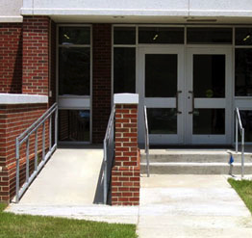
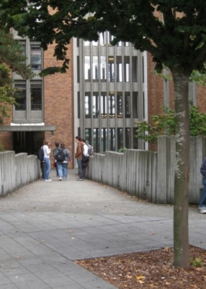
UD on a continuum
Interpreter for deaf student
Captioned & audio described video
Uncaptioned
video
Captioned video

Slide 19
Applications of UD

Slide 20
Examples of UD

Slide 21
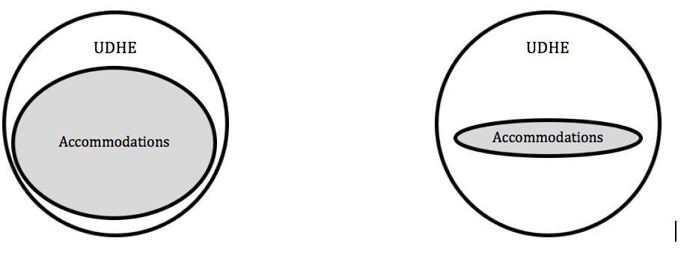
Relationship between UD strategies & accommodations on (1) accommodation-focused & (2) UD-focused institution of higher education (UDHE)

Slide 22
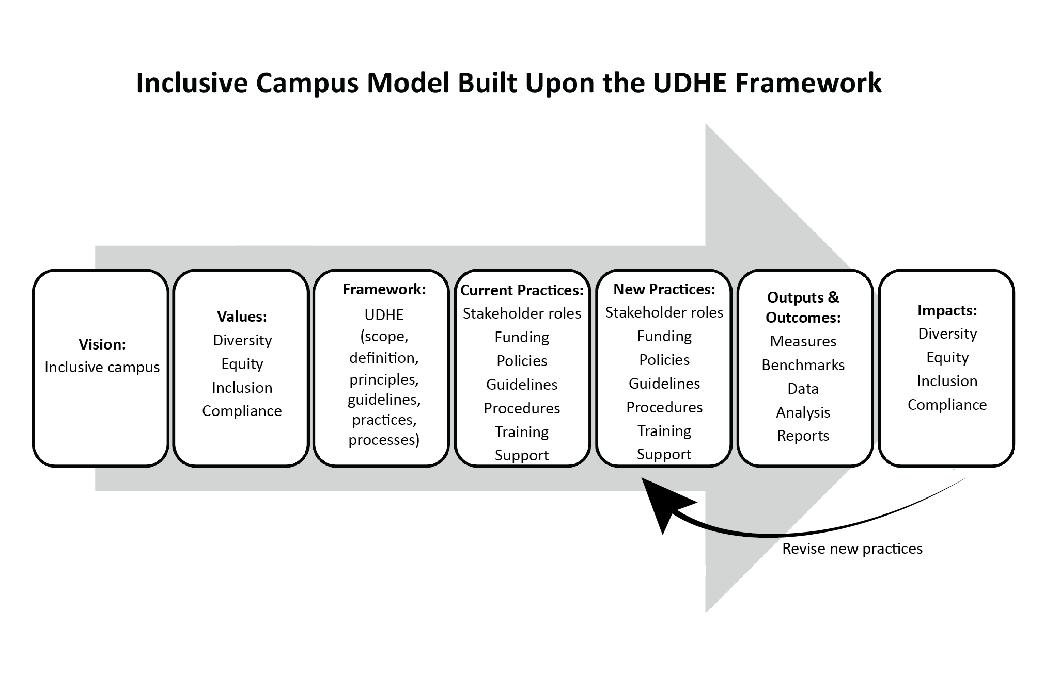
The Inclusive Campus Model
Underpinned by UDHE

Slide 23
Campus vision/mission
The University of Washington educates a diverse student body to become responsible global citizens & future leaders through a challenging learning environment informed by cutting-edge scholarship.
-UW

Slide 24
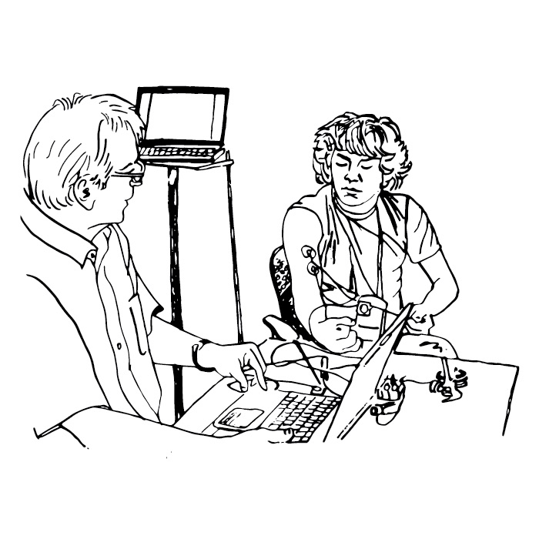
Campus values
Integrity
Diversity
Excellence
Collaboration
Innovation
Respect
-UW

Slide 25
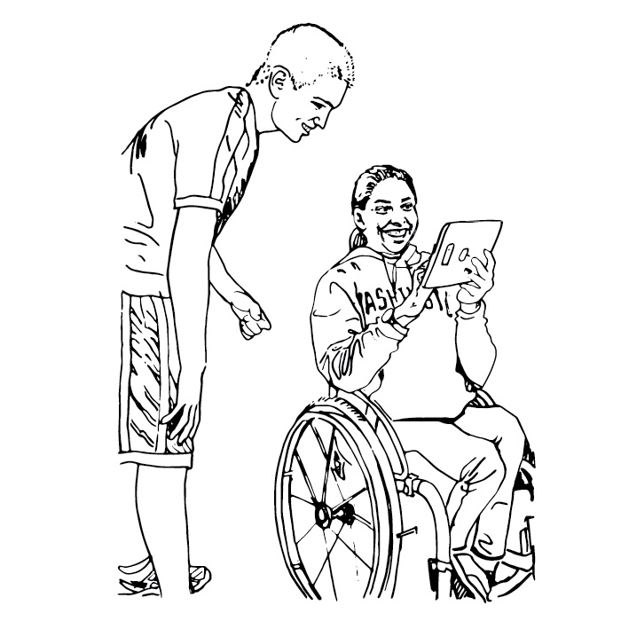
Diversity values
Excellence
Equity
Access
Community
Social justice
Innovation
-UW

Slide 26
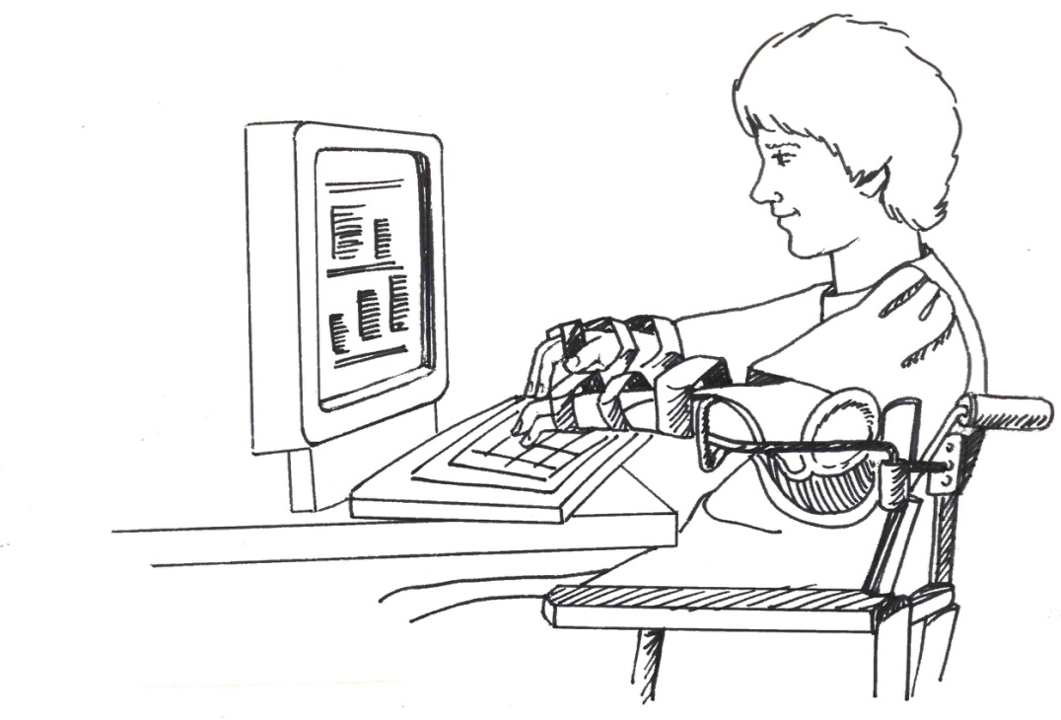
Potential goals
  Equity
  Inclusion
  Compliance
  &/or???

Slide 27
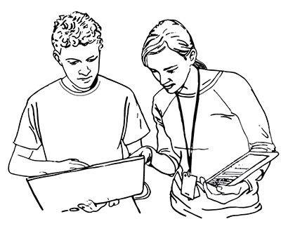
Current practices
Stakeholder roles
Funding
Policies
Guidelines
Procedures
Training
Support

Slide 28
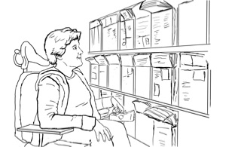
New practices
Stakeholder roles
Funding
Policies
Guidelines
Procedures
Training
Support

Slide 29
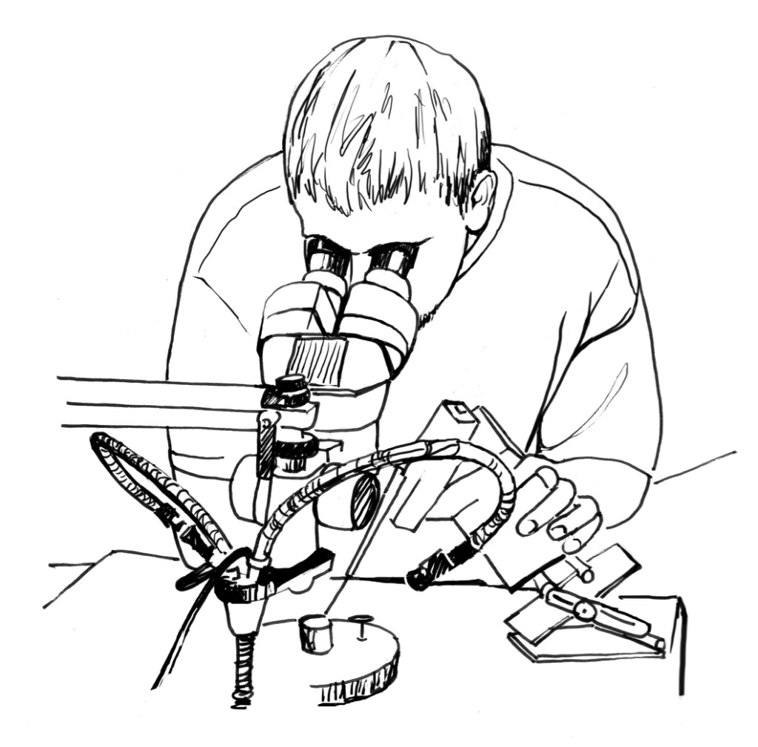
Potential outputs & outcomes
  Measures
  Reports
  &/or???

Slide 30
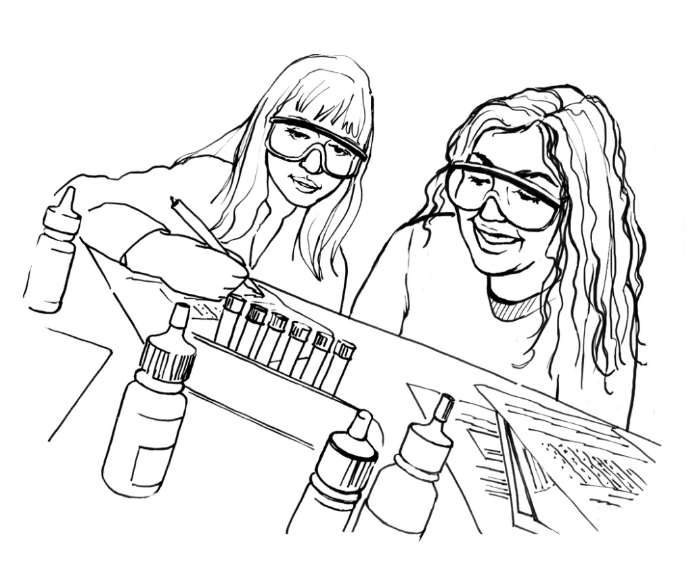
Potential impact
  Equity
  Inclusion
  Compliance
  &/or???

Slide 31
The Inclusive Campus Model

Slide 32
Incorporating UDHE Framework within an Inclusive Campus Model
How can the UDHE Framework underpin an Inclusive Campus Model?
How could this model guide the procurement, development & use of accessible IT?

Slide 33
Apply the Model to accessible IT
Vision: IT procured, developed, used is accessible
Values: Diversity, equity, inclusion, compliance
Framework: UDHE: Scope, definition, principles, guidelines, practices, processes.
Current practices: Stakeholder roles, funding, policies, guidelines, procedures, training, support
New practices: Stakeholder roles, funding, policies, guidelines, procedures, training, support
Outputs & outcomes: Measures, benchmarks, data, analysis, reports
Impact: Diversity, equity, inclusion, compliance

Slide 34
UW leadership
  IT Accessibility Coordinator
  IT Accessibility Team (ATS)
  IT Accessibility Task Force
  IT Accessibility
  Liaisons

Slide 35
Policy, guidelines, checklists…
UW’s IT Accessibility Guidelines:
Purpose
Definition
Scope
Standards—Web Content Accessibility Guidelines (WCAG) 2.0 Level AA
Progress & Plan
Resources

Slide 36

Sample of UW approaches 1/2
Promote accessibility within context of UD & inclusive campus
Model IT accessibility compliance after IT security compliance efforts
Build on existing policies, procedures, & job/unit assignments. Assign specific roles to individuals
Undertake efforts that are both
  reactive & proactive
  top-down & bottom-up

Slide 37
Sample of UW approaches 2/2
  Integrate training, activities within those sponsored by other campus units
  Search for internal funds to:
    offer incentives (e.g., videos, PDFs)
    hire hourlies/consultants
    purchase tools (e.g., Site Improve, Ally, SensusAccess)
  Benefit from external funding
  Create resources

Slide 38
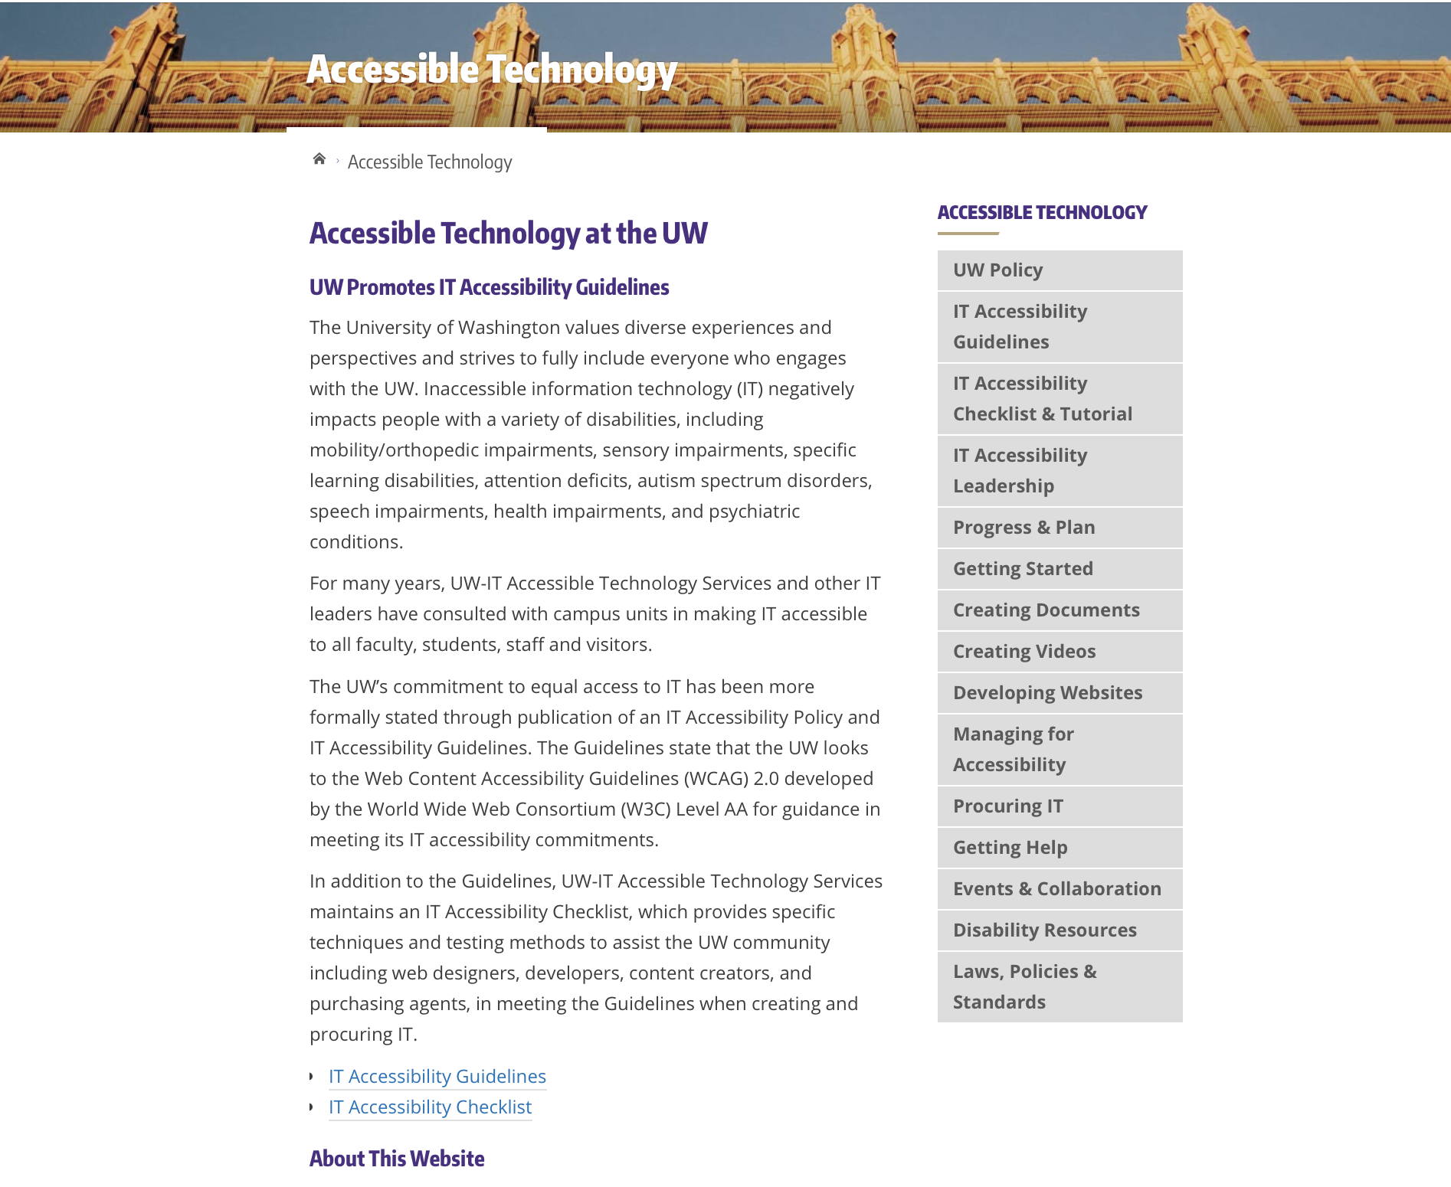
Accessible Technology website
Notes:
Terrill

Slide 39

Q&A
Sheryl Burgstahler
sherylb@uw.edu

