Slide 1
Lessons Learned in the Website Revision Process
Petra Hartman and Grace Moskola
Accessible Education Office
Harvard University, Faculty of Arts and Sciences

Slide 2
Accessible Education Office at Harvard University
Scope and size of student populations served
Varied accommodation needs throughout campus
Challenges and opportunities of decentralization
Office philosophy and staffing shift 2 years ago

Slide 3
Today’s Objectives
Project management and organization for website development
Writing for the web, and keeping policy language readable
Maintaining websites for long-term use

Slide 4
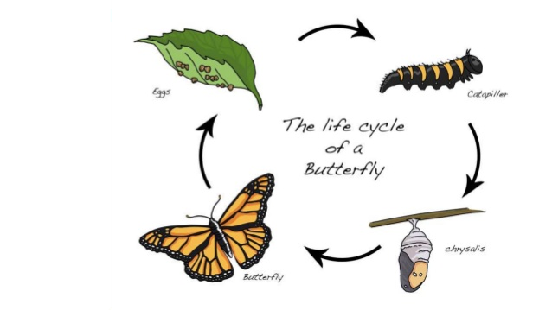
(Acknowledging that the website needs help )
Seeds of change
Current website
(unsightly, greedy, mean, boring, or impractical entity that devours everything)
Website Re-Design
(identifying a plan and participants)
Website turning into literal goo
(tears, avoidance, denial, pain and struggle)
Beautiful final result

Slide 5
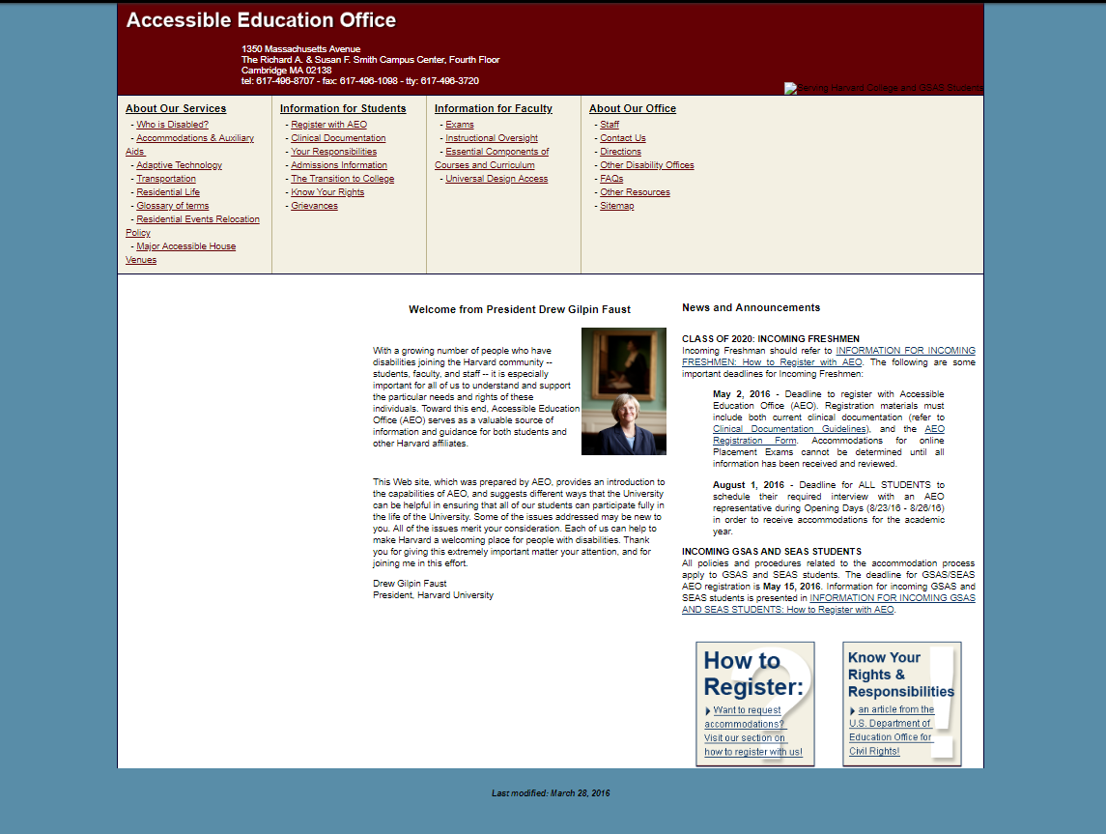
The “Old” Website
Formatting and accessibility challenges
Tone and implicit messages
Navigation issues
Overall Read-ability

Slide 6
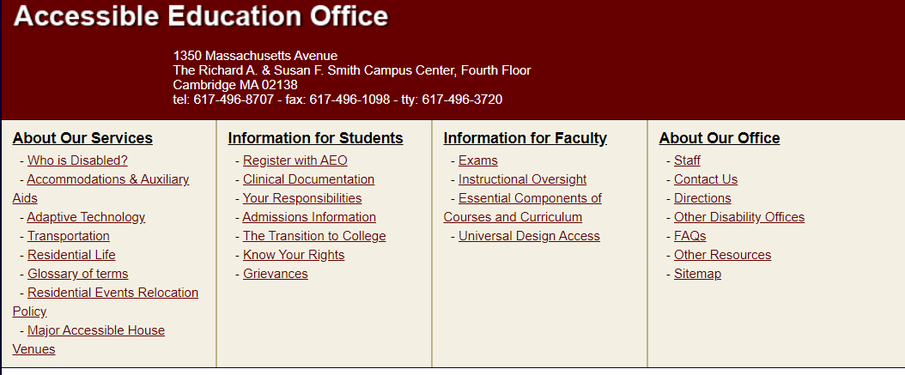
A Problematic Header
Gate-keeper mentality
Medical model language
Inaccessible formatting

Slide 7
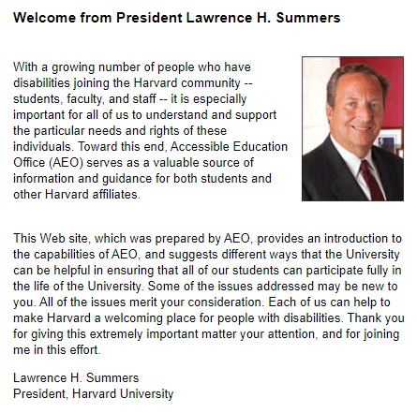
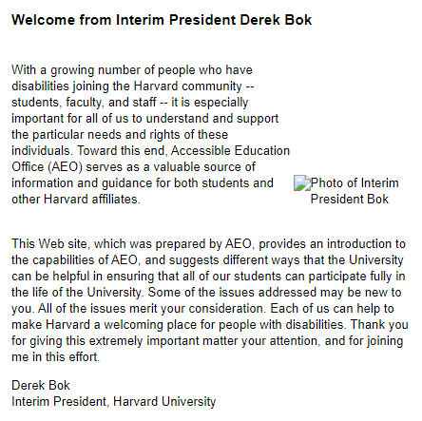
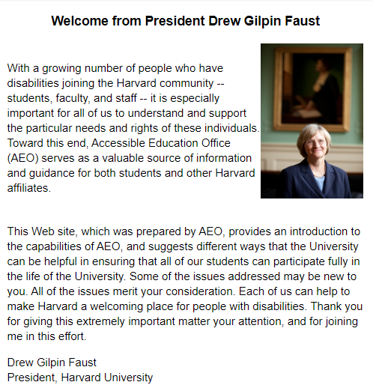
Welcome Message
Who is the intended audience?
What are the implicit messages to students with disabilities?
Why is this the centerpiece of the front page of the website?

Slide 8
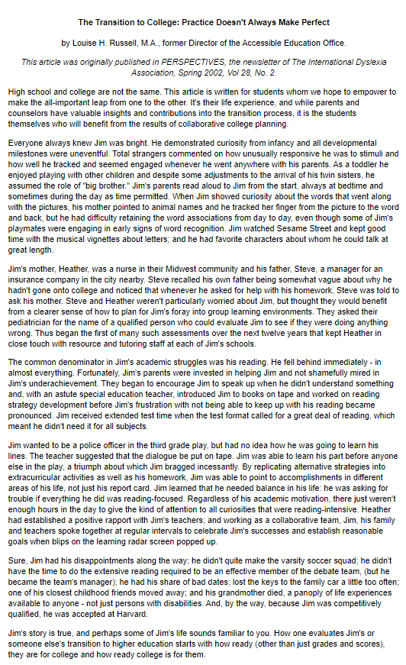
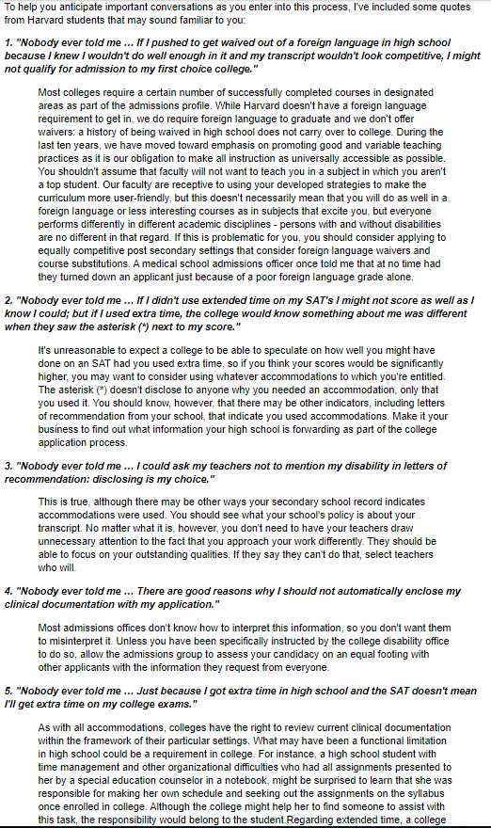
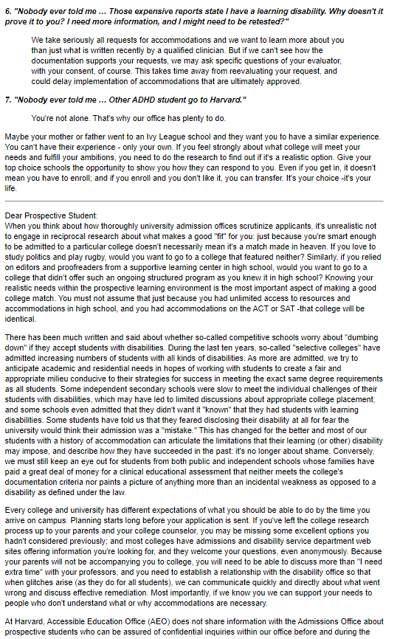

Slide 9
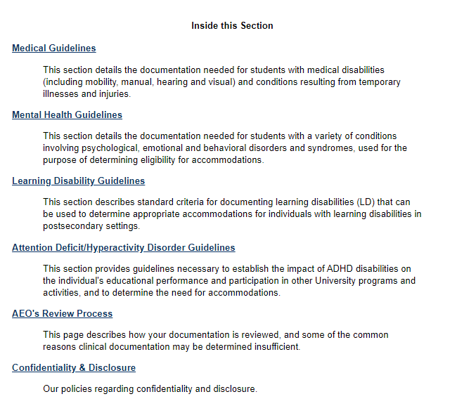
Documentation
Gatekeeping?
More Navigation Problems?
Lets take a closer look!

Slide 10
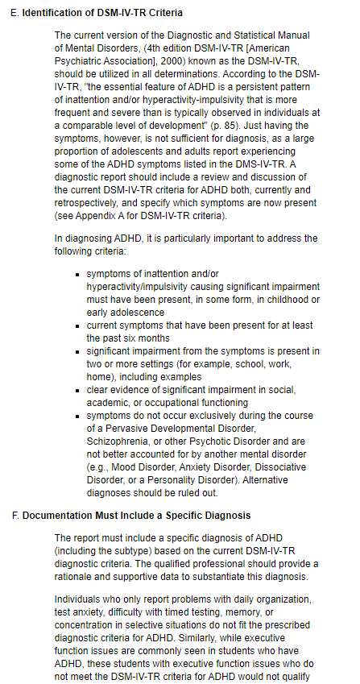
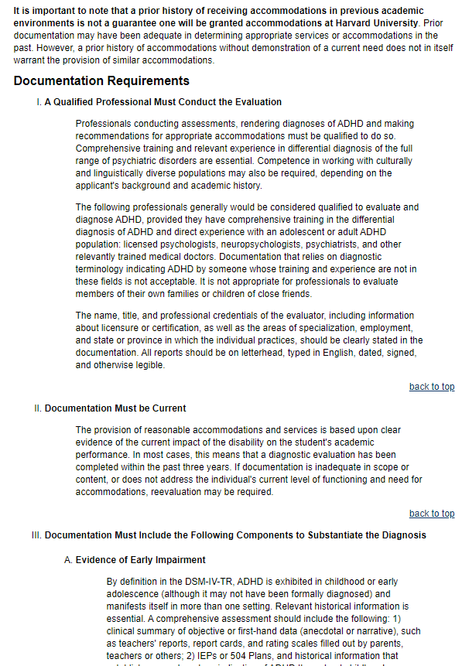
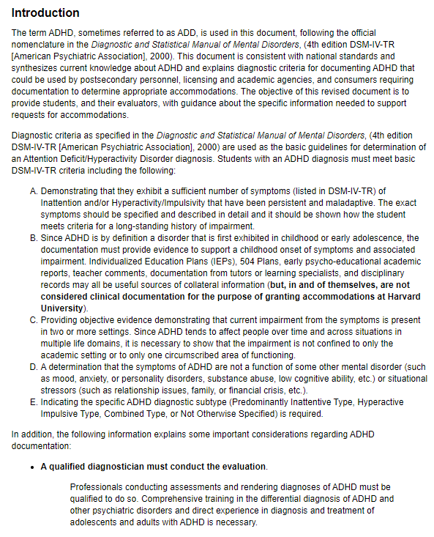
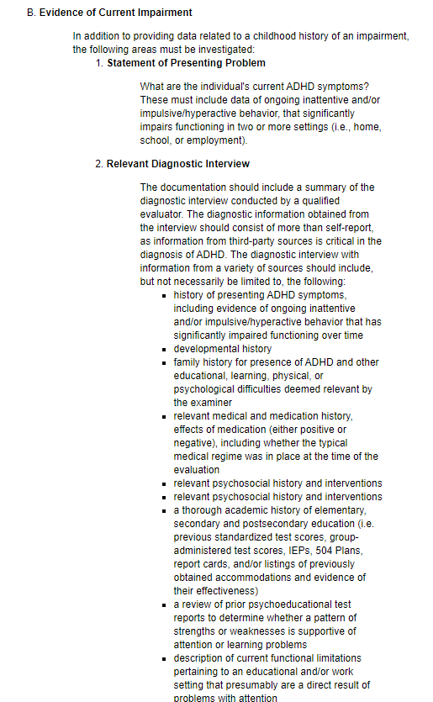
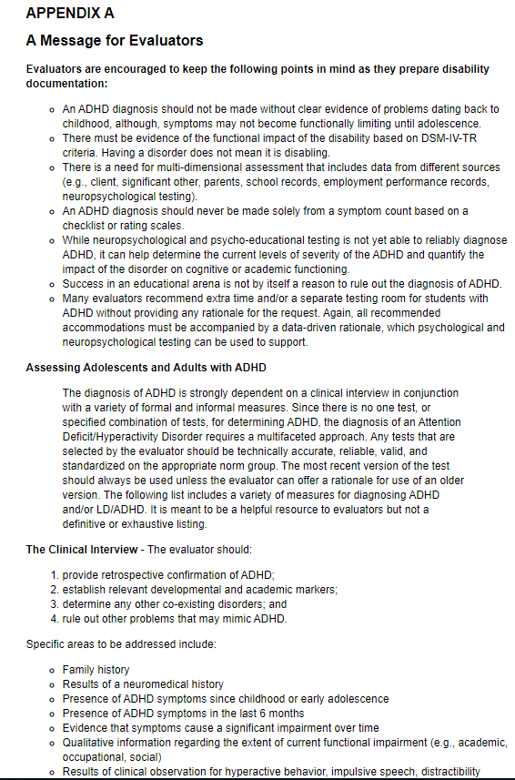
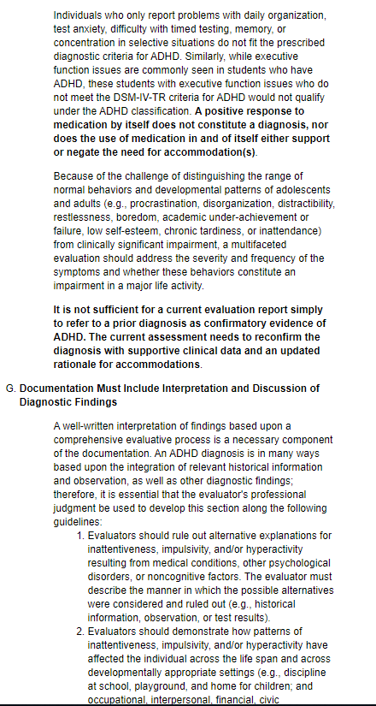
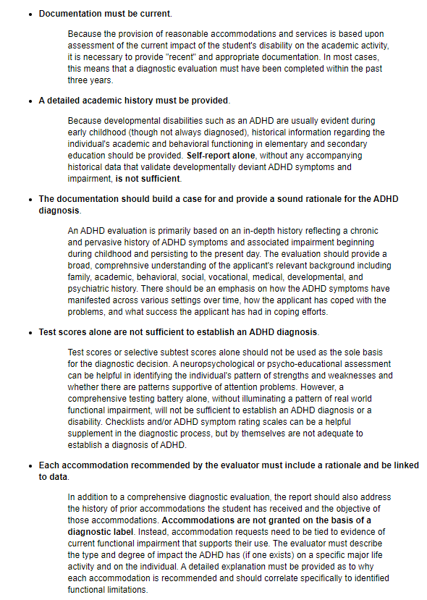
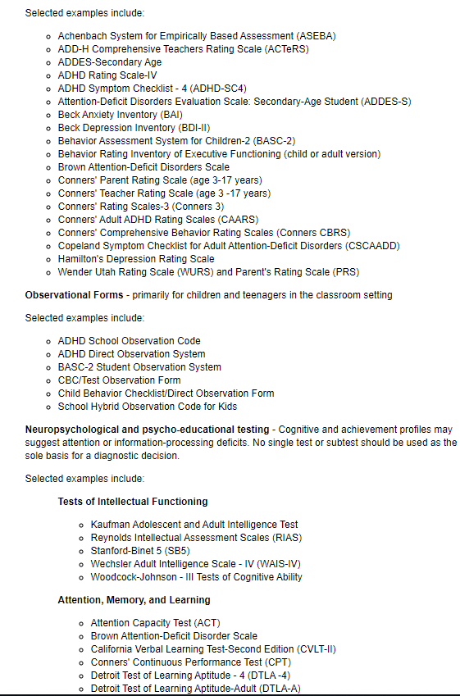
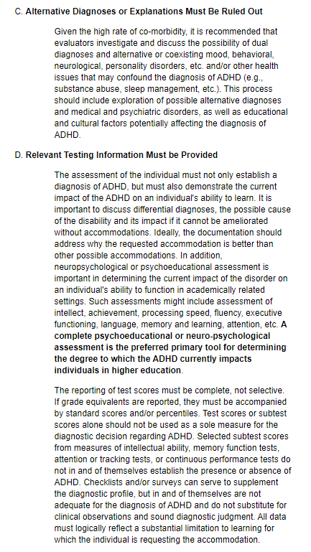
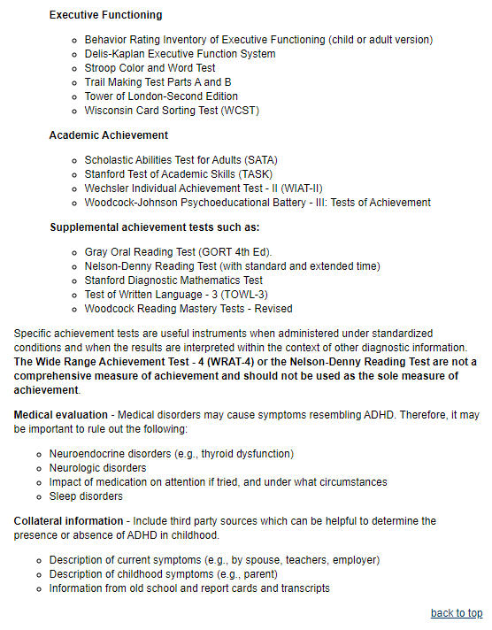
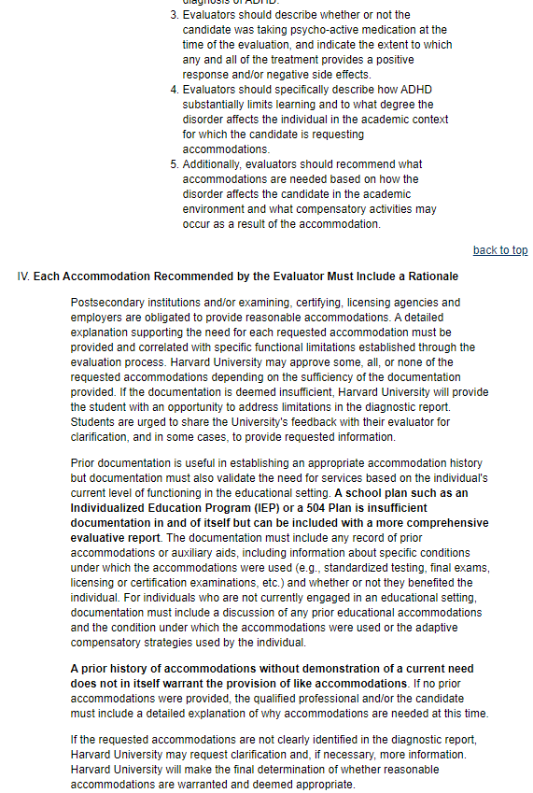
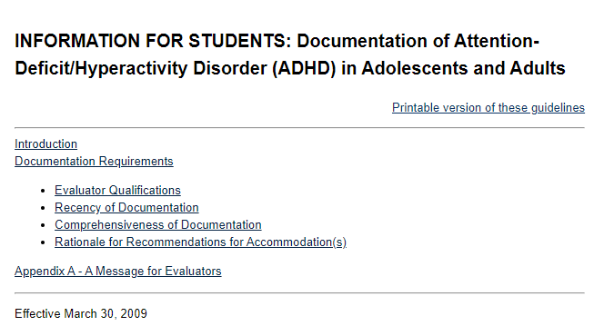

Slide 11
In Review
Some progress had been attempted but never moved forward
Delegation issues and time constraints from understaffing
Required more team effort

Slide 12
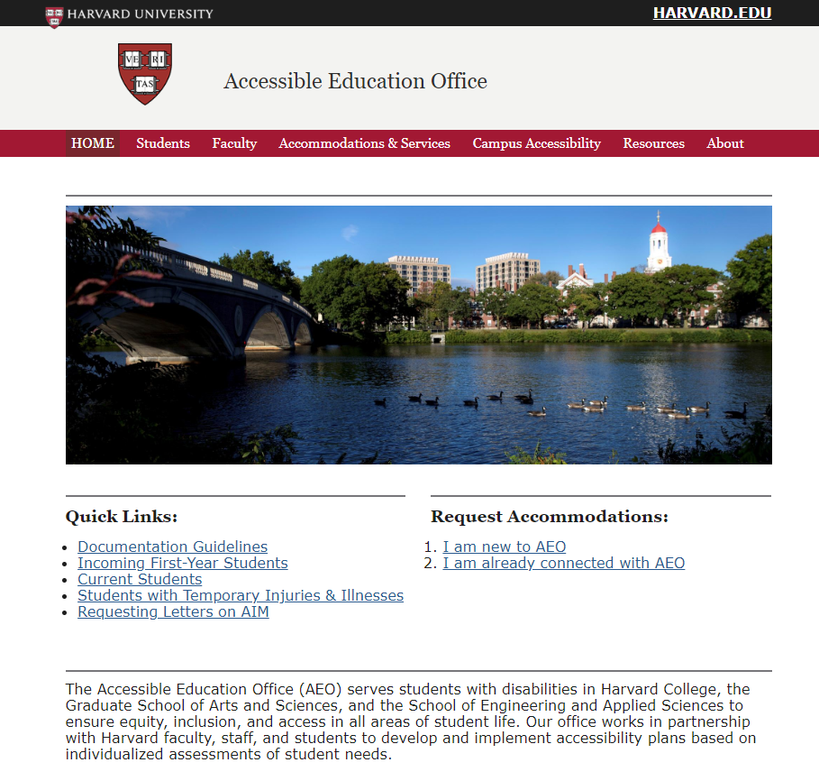
Our Revised Site

Slide 13
Forming & Storming

Slide 14
Our Current Platform
Harvard uses OpenScholar
Not an endorsement; use whatever your university uses or WordPress or Drupal
As long as it’s WCAG standard, it’s all good

Slide 15
Website Design Considerations
Who is the intended audience?
What is the essential information that needs to be communicated?
When or at what stages of the educational process will users need to access the website?
Why do users access the website?
How does the design of the website facilitate learning?

Slide 16
Brainstorming Meeting
Post-it notes are critical
Have people put up every page they think is critical
Group into categories based on topic and intended reader
Develop this into your initial menu layout
See if there is anything missing
Our Groupings:
Student, Faculty, Accommodations, Campus Access, Resources, About

Slide 17
Our Menu
Registration
Documentation
Policies
Exams
Faculty Letters
FAQ
Universal Design
Blurbs
Housing
Graduate Tests
Maps
Van Service
Public Transit
University
Student Groups
Wider Resources
Our Office
Staff
Hours
Location

Slide 18
Writing it Out

Slide 19
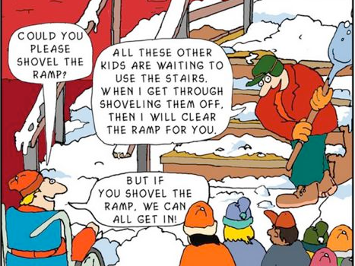
Reframing your Approach
What is your office disability model?
How do you want it to come across to students?
Critical time to think about what your processes are
Opportunity to reexamine office culture

Slide 20
Writing Distribution
How do you want to divide up ALL of these pages?
Who is best suited to write certain pages?
Have people decide what they want to specialize in and commit

Slide 21
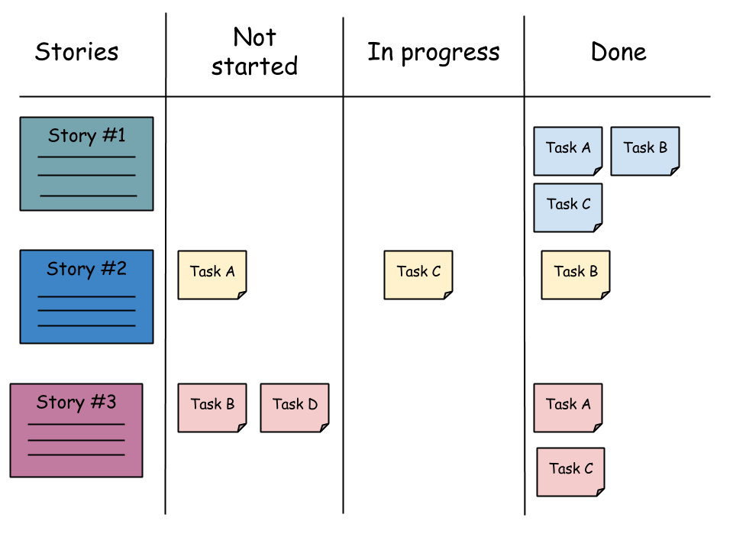
Scrum Boards

Slide 22
Tracking Progress
Have a master list of pages that everyone has access to
Track progress and who is in charge of this list
Put in reminders and notes for any future updates

Slide 23
The Hard Pages
Grievance & Confidentiality Policies
Student Rights & Responsibilities
Animal Policies
Do you want your documentation process to change?

Slide 24
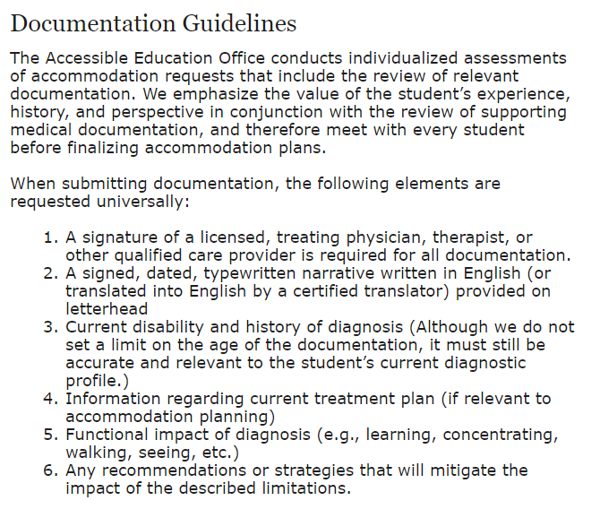
Our New Documentation Page
Notes:
https://aeo.fas.harvard.edu/students/documentation

Slide 25
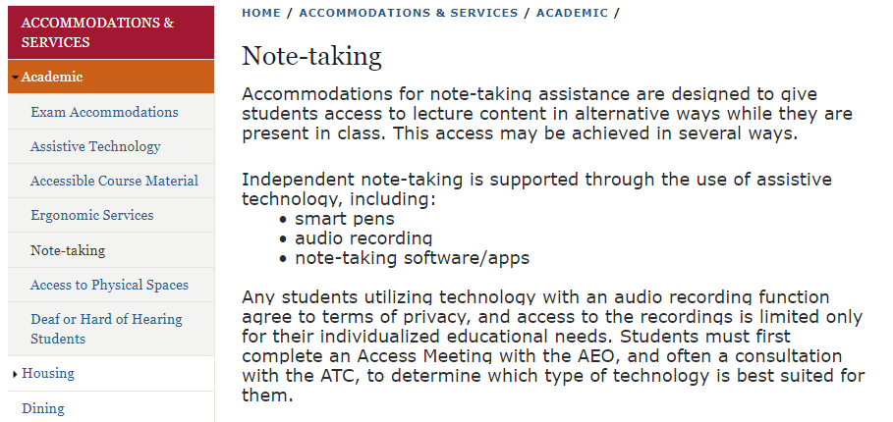
Writing Menus?
Notes:
https://aeo.fas.harvard.edu/accommodations-services/academic/class-notes

Slide 26
Disagreements
Tips on disagreements
Getting to consensus
Five fingers vote (straw vote where people rate 1-5)
Put on hold and gather info
Take breaks and have cheese

Slide 27
Actually getting people to read it

Slide 28
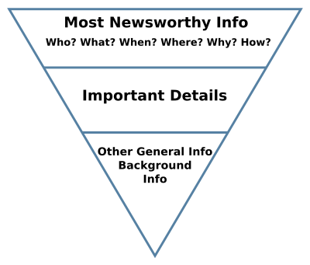
Writing for the Web
The big difference between policies and what student will actually read
Bullet points are your friend
Notes:
https://en.wikipedia.org/wiki/Inverted_pyramid_(journalism)

Slide 29
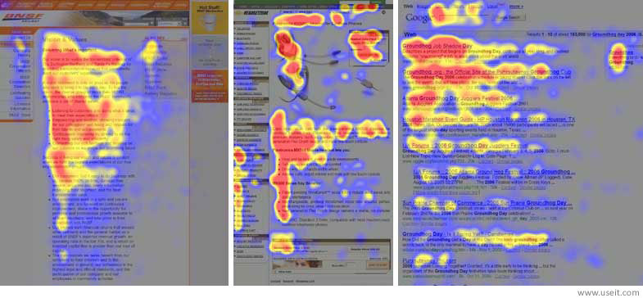
Online Reading Patterns

Slide 30
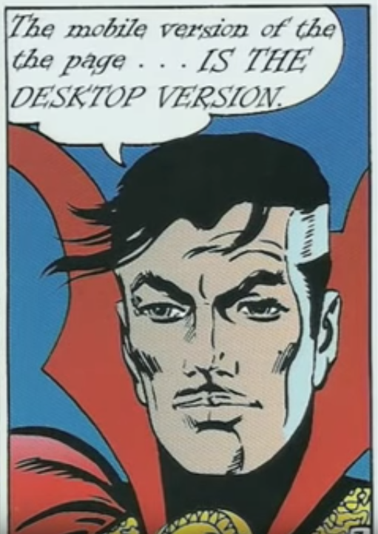
Mobile vs PC Traffic
49% of web traffic is from mobile devices
Need to take note of this in designing!
Notes:
James Mickens https://www.youtube.com/watch?v=D5xh0ZIEUOE&t=179s
https://www.statista.com/statistics/277125/share-of-website-traffic-coming-from-mobile-devices/

Slide 31
Editing
Can circle through edits
Make sure you have one final reviewer so that there is one consistent voice
Final review meeting for quality
Internal Consistency → “AEO” or “The AEO”

Slide 32
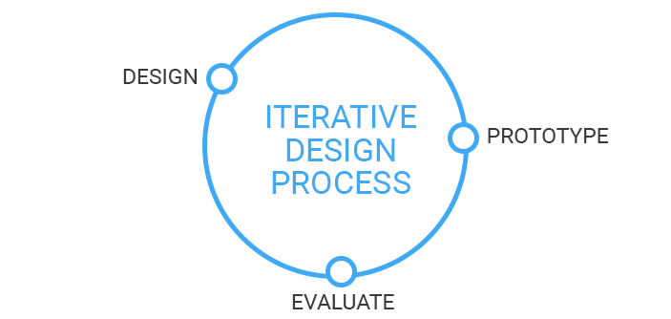
Testing
Design is an iterative process
Find your stakeholders to get feedback
Faculty
Students
Offices you work with
Go back to them!
Notes:
https://medium.com/@justinmind/the-iterative-design-process-at-tokbox-3b61dd4a9063

Slide 33
Making it real

Slide 34
Launching
Make sure to create list of redirected links
Let partnering offices know of any URL changes
Google Analytics is helpful in seeing behavior patterns and if there are any bugs

Slide 35
Maintenance
Keep a spreadsheet of links
Test external links every other month to check for dead links
Student group links (if they are external) have high probability of going dead
Spreadsheet of pages and who took it on
Website Revision Log
Having a list of annual news and announcements
Annual quality review at least every summer
“Do we still follow this process?”

Slide 36
Expanding
If you are also thinking of going paperless…
Website is a good first step in building confidence
In the time you are scanning all of your files, think about:
What shifts will you need in layout?
Will your registration process change at all?
What are you going to call the system? Will it need approval from PR?
Any accommodation shifts?
Where do you need to put the user guide?

Slide 37
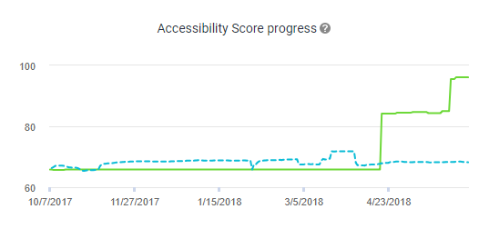
Conclusion
Hope that this has given good advice or tips on how to update your website
Prepare for the time it may take
Accessibility to information is critical for everyone

Slide 38
Questions

