Slide 1
Teaching Accessibility Topics in Computing Curriculum
Sheryl Burgstahler
sherylb@uw.edu
Terrill Thompson
tft@uw.edu
AccessComputing University of Washington
https://uw.edu/accesscomputing

Slide 2
NSF-funded AccessComputing
DO-IT Center
Department of Computer Science & Engineering
iSchool
To increase participation of people with disabilities in computing & IT fields & improve these fields with their expertise & perspectives; to increase knowledge of future IT professionals about accessible design

Slide 3
Presentation topics
General access approaches/content
Motivation
Survey
Examples

Slide 4
Look at ability on a continuum
see
hear
walk
read print
write with pen or pencil
communicate verbally
tune out distraction
learn
manage physical/mental health

Slide 5
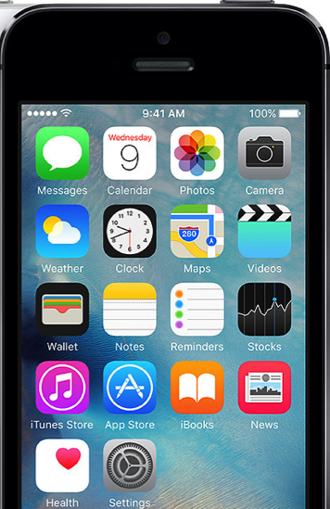
Universal design =
“the design of products & environments to be usable by all people, to the greatest extent possible, without the need for adaptation or specialized design.”
-The Center for Universal Design www.design.ncsu.edu/cud
Accessible design =

Slide 6
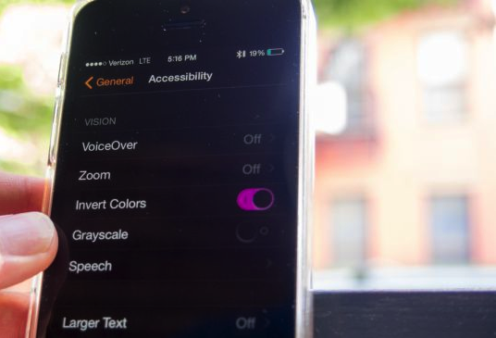
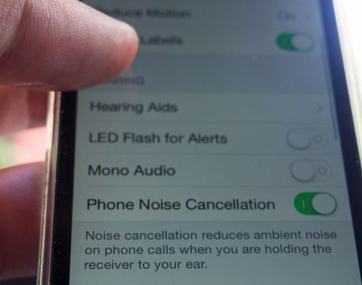
Universally designed technology
builds in accessibility & flexibility
is compatible with assistive technology

Slide 7
Where is accessibility covered in computing/IT curriculum/textbooks?

Slide 8
Motivation to Teach UD/Accessibility
reach diverse audiences
disability-related legislation
ethics, social justice
accessibility benefits everyone
emerging standards: ACM, ABET…
demand from companies: teachaccess.org

Slide 9
Accessibility innovations matter
Innovations for
Disability
Solutions for
Everyone
Captioning
Personal texting
Personal Video Chat
Optical Character Recognition
Speech Synthesis
Speech Recognition

Slide 10
Engineering design definition
"Engineering design is the process of devising a system, component, or process to meet desired needs & specifications within constraints. … examples of possible constraints include accessibility, aesthetics, constructability, cost, ergonomics, functionality, interoperability, legal considerations, maintainability, manufacturability, policy, regulations, schedule, sustainability, or usability.”
-ABET (accreditation board for postsecondary engineering & computing programs)

Slide 11
Question
“Who Teaches Accessibility?: A Survey of U.S. Computing Faculty”
RIT: Kristen Shinohara,
UW: Saba Kawas,
Amy Ko
Richard Ladner
2018 Proceedings of the 49th ACM Technical Symposium on Computer Science Education, pp. 197-202.
faculty.washington.edu/ajko/papers/Shinohara2018AccessComputingSurvey.pdf

Slide 12
Research questions
Who is teaching accessibility?
What barriers do faculty see to teaching accessibility?
What factors predict who is teaching accessibility?
+ What resources do you need?

Slide 13
Survey sample
Faculty at 4-year universities & colleges
Computer Science
Information Science
Other interdisciplinary computing departments
Major accredited programs identified:
Wikipedia
Computing Research Association
iSchool Caucus charter list for Information Schools

Slide 14
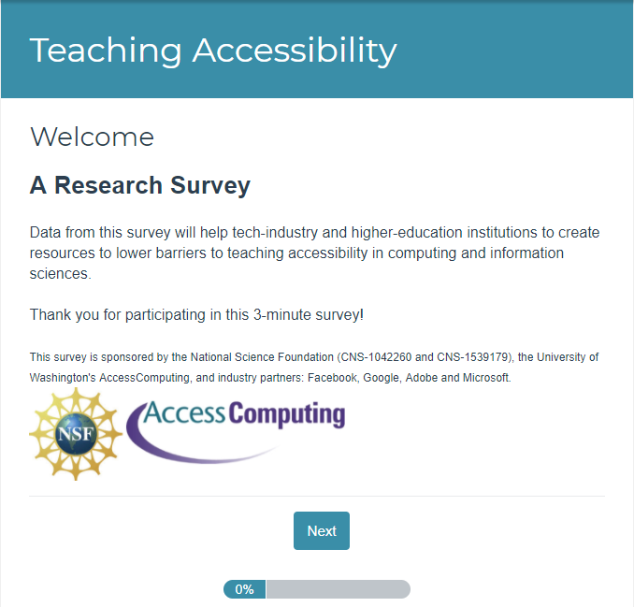
Survey launches & response rate
SurveyGizmo, 3 launches
Emails with link to survey to
14,176 faculty
from 352 institutions
Response rate: 13%

Slide 15
1: Who is teaching accessibility?
20% of respondents
More females
More likely to know someone with a disability
More likely to think it is part of computing
Most common area of expertise: Human-Computer Interaction
17% have a disability

Slide 16
1: Learning objectives
Understand technology barriers
Understand design concepts
Engage diverse populations
Evaluate web accessibility standards & heuristics
Develop accessible web technologies
Employ design techniques
Understand Legal regulations (Section 508, ADA)
Understand Models of disability
Employ accessibility-focused technical languages & tools

Slide 17
2: Challenges to incorporating accessibility
Not core part of curriculum
Don’t know enough to teach it
No appropriate textbook
Lack of students & administrator awareness
Lack of support for topics addressing real challenges for disabled
Difficulty engaging students
Lack of demand in industry
Difficult to recruit people with disabilities

Slide 18
2: What do faculty need?
Help with connections to people with disabilities to interact with 1-1 &/or bring into classroom
Tools, technologies, guidelines, problem examples
Curricular samples for specific courses
Training & other opportunities to gain expertise

Slide 19
2: We need…
“Appropriate lesson plans for different classes (algorithms, theory, intro programming). This should be taught across the CS curriculum, not just in a specialty topics course. But, I feel that students & faculty feel that “it is not directly related to the curriculum” & so they don’t incorporate it.”
-Survey comment

Slide 20
Three Examples

Slide 21
Example 1

Slide 22
Web Design & Development I Course Curriculum (WebD2)
uw.edu/accesscomputing/webd2

Slide 23
Teaching Respect for Diversity while Teaching Coding
There is no technology without users
Each user is different
When learning to code, students should actively consider their users, including user differences
All this diversity provides technology teachers with a great opportunity!

Slide 24
WebD2 Features
Teaches standards-based & accessible web design
Is platform & vendor-neutral (teaches concepts, not specific tools)
Standards-based, accessible design is taught early as a core design principle, & reinforced throughout the course
For assignments students must use valid code & conform to accessibility standards

Slide 25
Course Outline
Designing & Planning Web Pages
Creating Content & Structure with HTML
Formatting Web Pages with Style Sheets
Graphics
Scripting
Quality Control
Website Management & Authoring Tools
Client Website / Final Project

Slide 26
Not just a curriculum, it’s a community
Nearly 6000 registered teachers worldwide
Nearly 1000 of those are "active" (having logged in over the last 2 years)
Discussion list with over 1000 subscribers
Teachers provide peer support:
Help with coding problems
Sharing resources
Discussing teaching strategies

Slide 27
2018 WebD2 Teacher Survey
151 responses (95 in the first 24 hours)
Approx. 8,000 students have used the curriculum since Fall 2016 (as reported by survey participants)
Results: https://uw.edu/accesscomputing/ webd2/survey2018.html
One question: "Please describe how disability, accessibility, &/or universal design topics were integrated into your web design or other computing courses."

Slide 28
Themes in Teachers’ Responses
Inviting guest speakers (e.g., webmasters who are aware of accessibility mandates)
Evaluating websites (school site, others)
Tapping into the perspective of students with disabilities
Disability simulations (#nomouse)
Extending accessibility into other courses

Slide 29
Example 2
https://info343-au16.github.io/

Slide 30
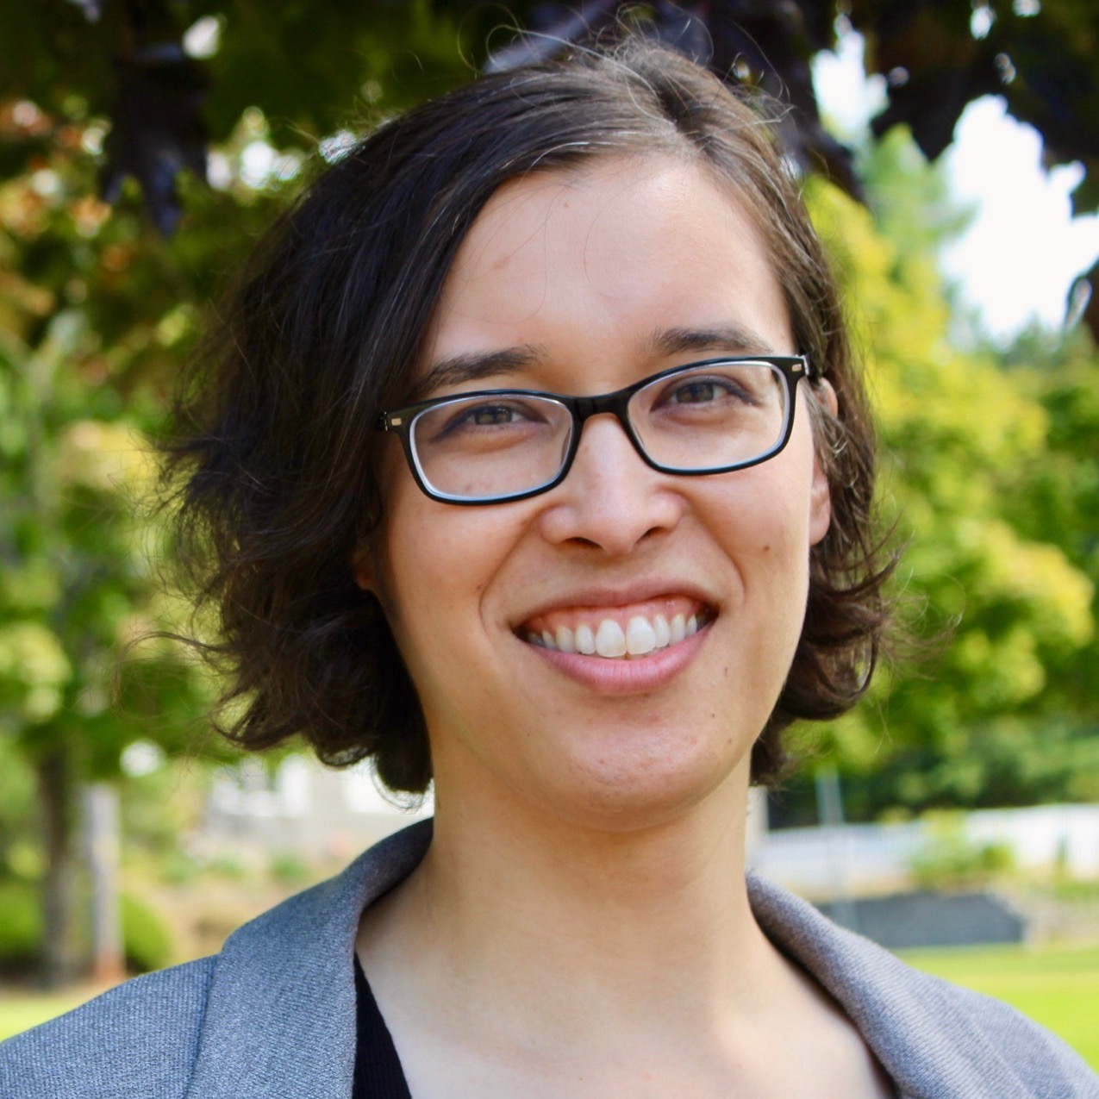
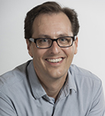
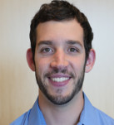
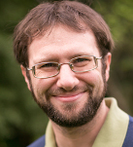
INFO 343
“Hey guys, interested in incorporating accessibility into INFO 343?”
“Sure!”
Notes:
INFO 343 = Client-side Web Development Dr. Amy Ko initiates

Slide 31
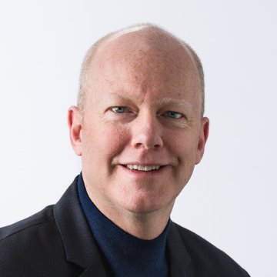
Accessibility Basics
“Hey Terrill, can you teach these three about web accessibility basics?”
“Sure!”

Slide 32
Critical parts and standards
“Here are the most critical parts of the most critical standards”
“We could redesign our overview of markup to cover these…”

Slide 33
Testing?
“Who wants to commit to doing this?”
“I will! I’m teaching a summer course where I can test it out.
Notes:
Dr. Joel Ross volunteers to take the lead

Slide 34
Check in
“How’s the summer course planning going?”
“Good! I was just about to revise the lesson this week.”

Slide 35
Check in again
“How did the lesson go?”
“It was much better than the last version; more engagement, especially with screen readers.”

Slide 36
Review
“Have you guys seen Joel’s new accessibility lesson?”
“No. How’d it go Joel? Can I use it?”
“Sure, here’s the link.”

Slide 37
280 web developers per year now know accessibility basics.
Notes:
One year later…

Slide 38
From the INFO 343 Course Description:
“This course will teach you the skills and techniques necessary for creating sophisticated and accessible interactive web applications. It focuses on the client-side languages, tools, and libraries that professionals use to build the web sites you use every day. We will learn not only the basic syntax and mechanics of web development, but also the best practices that separate professional developers from amateurs.”

Slide 39
Example 3

Slide 40
Go where the students go.

Slide 41
National Student Electronic Media Convention
Audience is about 75% students, representing college media outlets, mostly radio stations
40 students at my session on web accessibility, mostly students who create/maintain websites for their stations
Many said afterwards they had never thought about accessibility before, and were genuinely excited to be made aware of this issue
Lots of excellent questions afterwards

Slide 42
Q&A, discussion
Sheryl Burgstahler sherylb@uw.edu
Terrill Thompson tft@uw.edu
uw.edu/accesscomputing

