Slide 2
Hello, I’m Laura!
Laura Trimble
Territory Director
@LAFTrimble77
l.trimble@texthelp.com
913-982-7369

Slide 4
Register here for slides and info:
text.help/
Notes:
Get stats at https://nces.ed.gov/collegenavigator/

Slide 5
Register here for slides and info:
text.help/
Notes:
Get stats at https://nces.ed.gov/collegenavigator/

Slide 6
?
What is
Literacy software
20 AT tools in one
Over 20 million users
Supports reading, writing, research & testing
Covers many platforms

Slide 7
for Windows
for Mac
for Google Chrome™
for iPad
for Android
for Microsoft Edge
✔ Annual subscription
✔ Includes ALL platforms
✔ Continual development

Slide 8
Meets the needs of many departments:

Slide 9
Top Uses:
PDFs
Lock-Down Browser (Testing)
Accuplacer
No scanning (instant access)
Scanning when needed
Testing center restrictions/control
LMS Access
Retention
Notes:
Get stats at https://nces.ed.gov/collegenavigator/

Slide 10
for Windows
for Mac
for Google Chrome™
for iPad
for Android
for Microsoft Edge

Slide 11
Demonstration

Slide 12
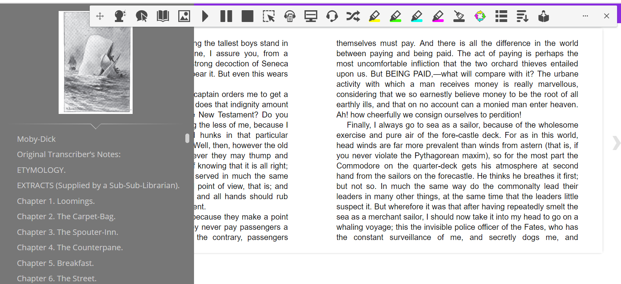
ePUBs
Notes:
A new ePUB Reader will be coming to Windows, Mac and Google versions of Read&Write in 2020 (there currently is one for Google users but we’re updating that as well). Will have a lot of familiarity to existing Read&Write versions. It “might” look something like this….

Slide 13
Metropolitan State University of Denver:
20,000 students
Notes:
Get stats at https://nces.ed.gov/collegenavigator/

Slide 14
Read&Write Licensing
 | Single | 1-10,000 Students | 10,000-20,000 Students | 20,000 + Students
Annual Cost | $145 | $3,645 | $6,560 | $8,195
All licenses include all platforms of Read&Write and all campus and student devices

Slide 15
Meets the needs of many departments:

Slide 16
Retention
Enrollment | 20,000
First-year students
First-year dropout rate
Tuition
Annual loss
Read&Write cost
Notes:
Get stats at https://nces.ed.gov/collegenavigator/

Slide 17
Retention
Enrollment | 20,000
First-year students | 10,000
First-year dropout rate
Tuition
Annual loss
Read&Write cost
Notes:
Get stats at https://nces.ed.gov/collegenavigator/

Slide 18
Retention
Enrollment | 20,000
First-year students | 10,000
First-year dropout rate | 45% (450)
Tuition
Annual loss
Read&Write cost
Notes:
Get stats at https://nces.ed.gov/collegenavigator/

Slide 19
Retention
Enrollment | 20,000
First-year students | 10,000
First-year dropout rate | 45% (450)
Tuition | $8,000
Annual loss
Read&Write cost
Notes:
Get stats at https://nces.ed.gov/collegenavigator/

Slide 20
Retention
Enrollment | 20,000
First-year students | 10,000
First-year dropout rate | 45% (450)
Tuition | $8,000
Annual loss | $3,600,000
Read&Write cost
Notes:
Get stats at https://nces.ed.gov/collegenavigator/

Slide 21
Retention
Enrollment | 20,000
First-year students | 10,000
First-year dropout rate | 45% (450)
Tuition | $8,000
Annual loss | $3,600,000
Read&Write cost | $6,500
Notes:
Get stats at https://nces.ed.gov/collegenavigator/

Slide 22
Questions?

Slide 23
Wrap-Up:
Texthelp reps available for:
Webinars
Meetings
Discussions
Quotes
30-day trials/pilots available for all products
Notes:
Get stats at https://nces.ed.gov/collegenavigator/

Slide 24
Thank you!

