Slide 1
Acrobat Pro DC – Creating Accessible PDF Forms
Rob Haverty, Sr. Accessibility Product Manager
Revised November 2019

Slide 2
Agenda
Introduction to Forms
Adding Form Fields to a Tagged PDF
Adding Form Fields to an Untagged PDF
Resources
Goals:
  Understand the tools to use for creating accessible PDF forms
  Choosing the right approach to creating accessible PDF forms
  There is always more to learn ☺

Slide 3
Session 1 – Forms

Slide 4
Session 1A – Introduction to Forms

Slide 5
Approaching Forms
Choose the approach that works best for your situation
Considerations:
  Are you working with the original source document?
  Has the PDF been tagged and was there a lot of remediation work done?
  Are the form fields well defined?
  Is it best to add form fields and then tag or add form fields to the tagged PDF
Options
  Auto detect the form fields before tagging (may require less remediation of <Form> tags in the Tag Tree but will require fixing the other types of tags as neccessary)
  Auto detect the form fields after tagging (always requires fixing <Form> tags in the Tag Tree but not other types of tags)
  Manually add the form fields (requires the most work)
Regardless of approach use the Prepare Form tool in Tools Pane

Slide 6
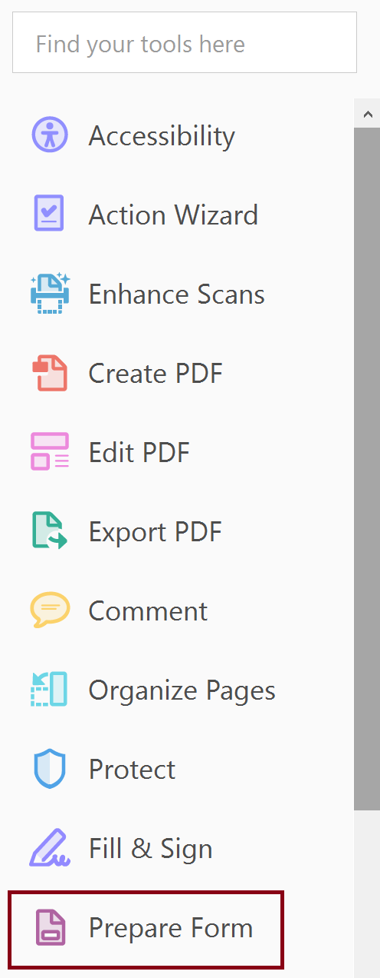
Prepare Form Tool
Added by default to the Tools Pane

Slide 7
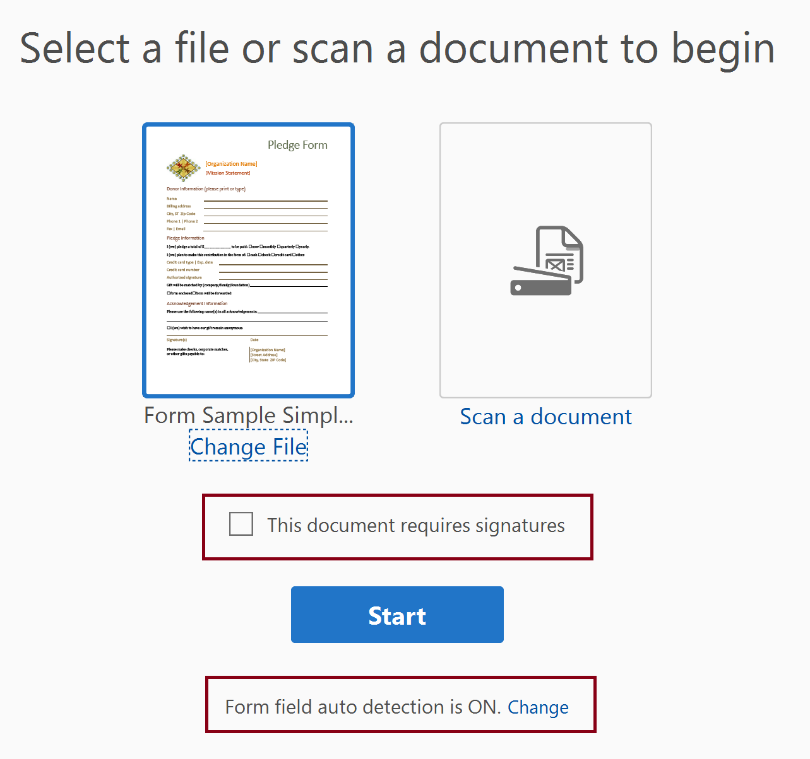
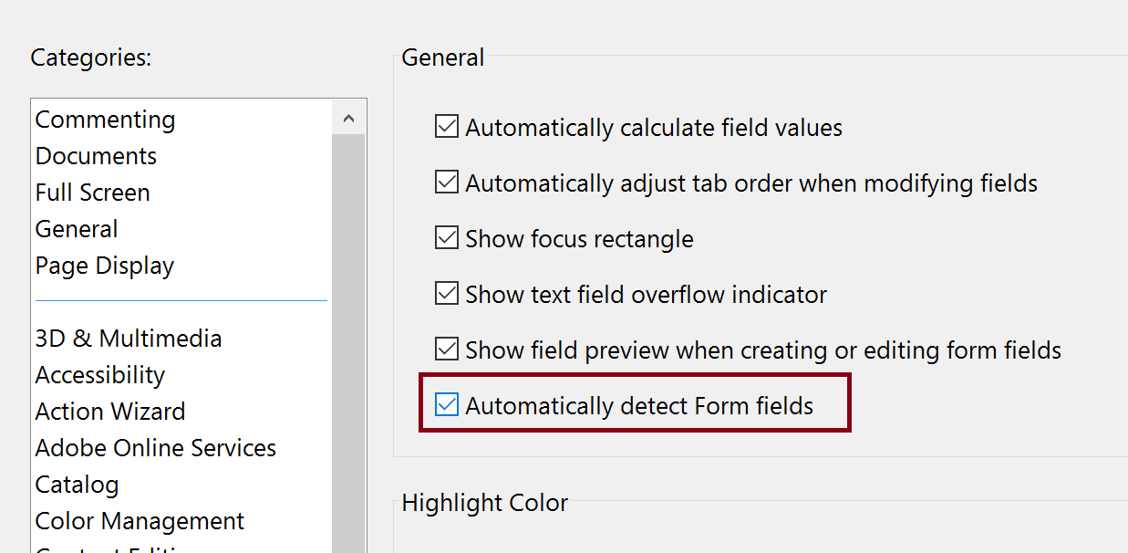
Select a Form
Choose document, if you open the document in Acrobat first it is a simple step.
Do not check “This document requires signatures”, signature field applied regardless
  Some functionality missing in Properties dialog (a bug?)
Choose whether to auto-generate form fields or not.

Slide 8
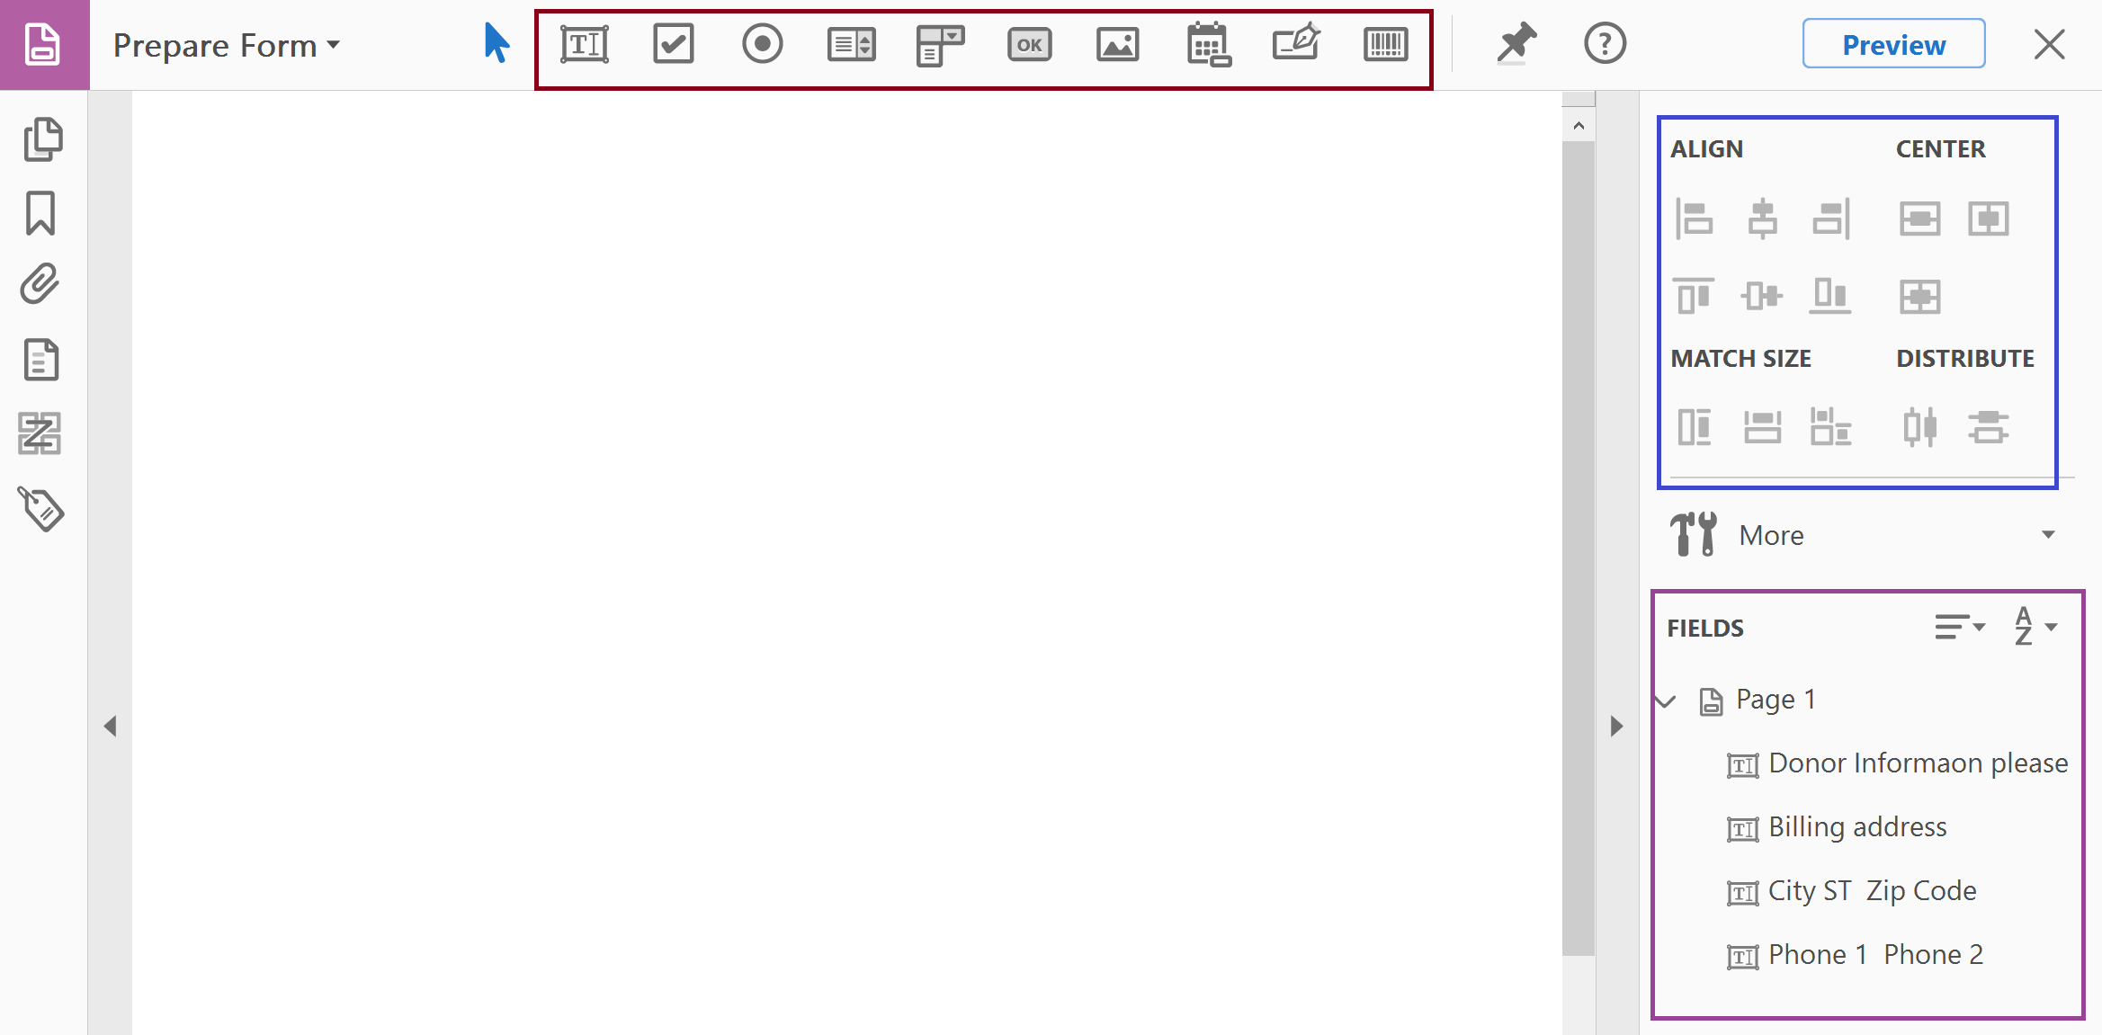
Layout of the Prepare Form Tool Functions
Manually Add Form Fields
Position Form Fields
Set Tab Order

Slide 9
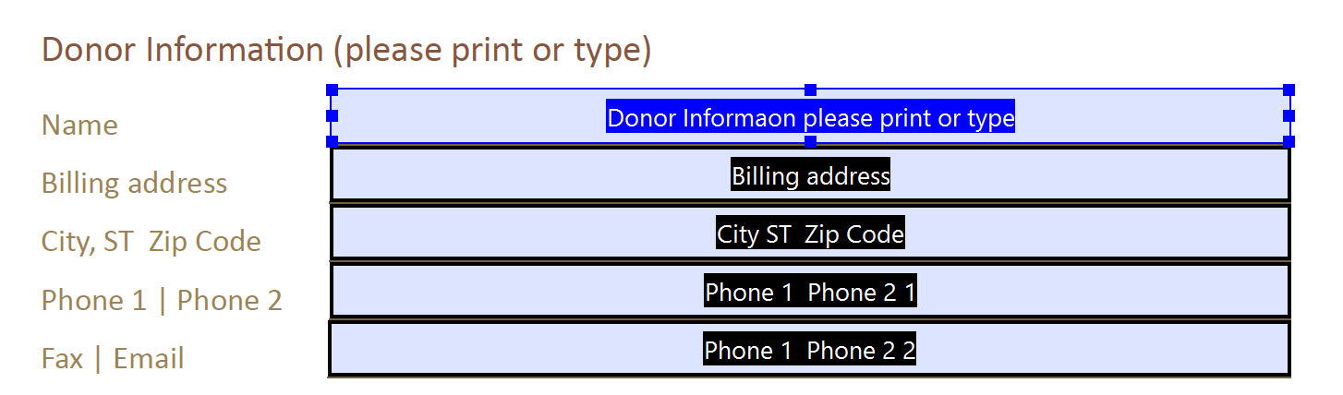
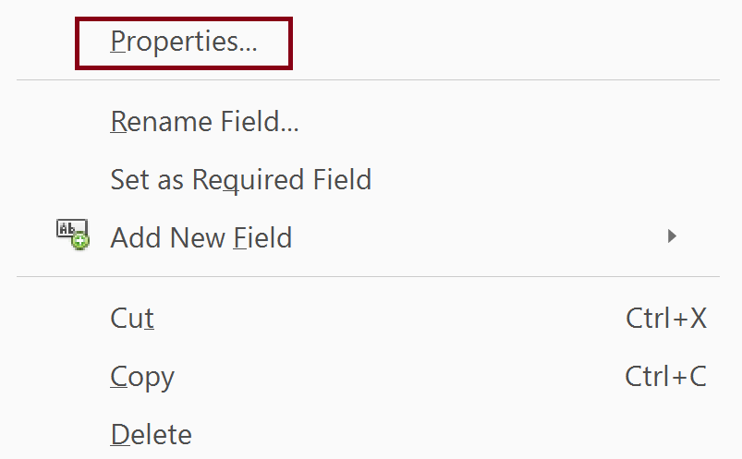
Accessing the Form Field Properties
Select Form Field
Right Click and Select Properties

Slide 10
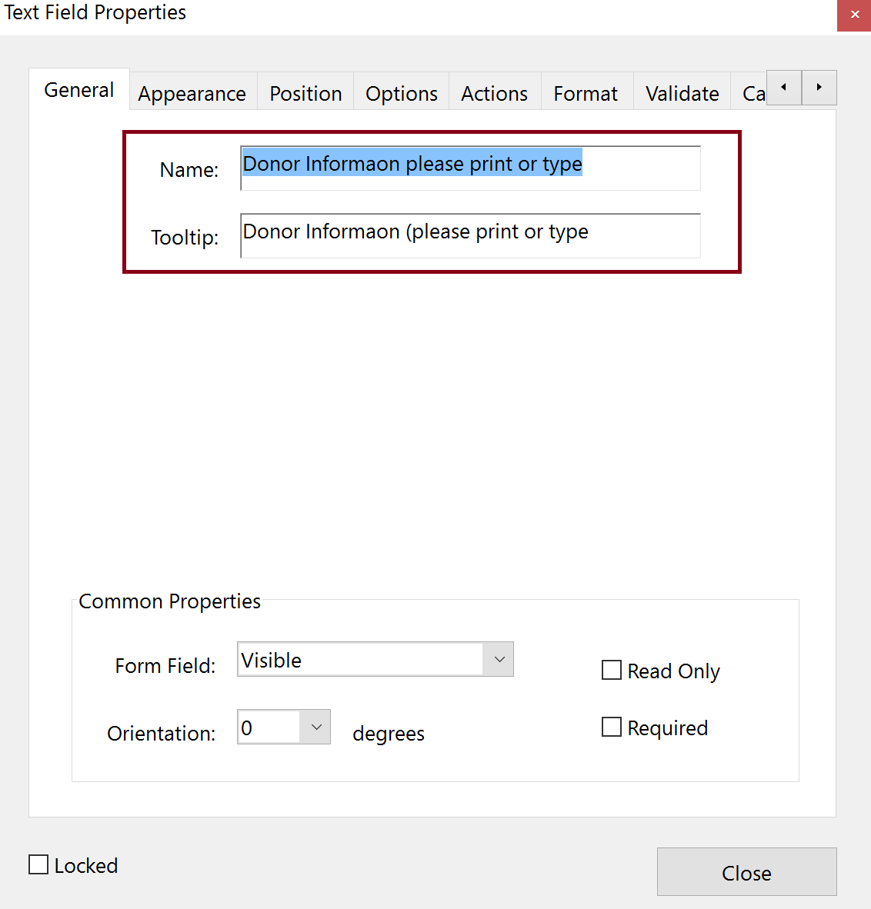
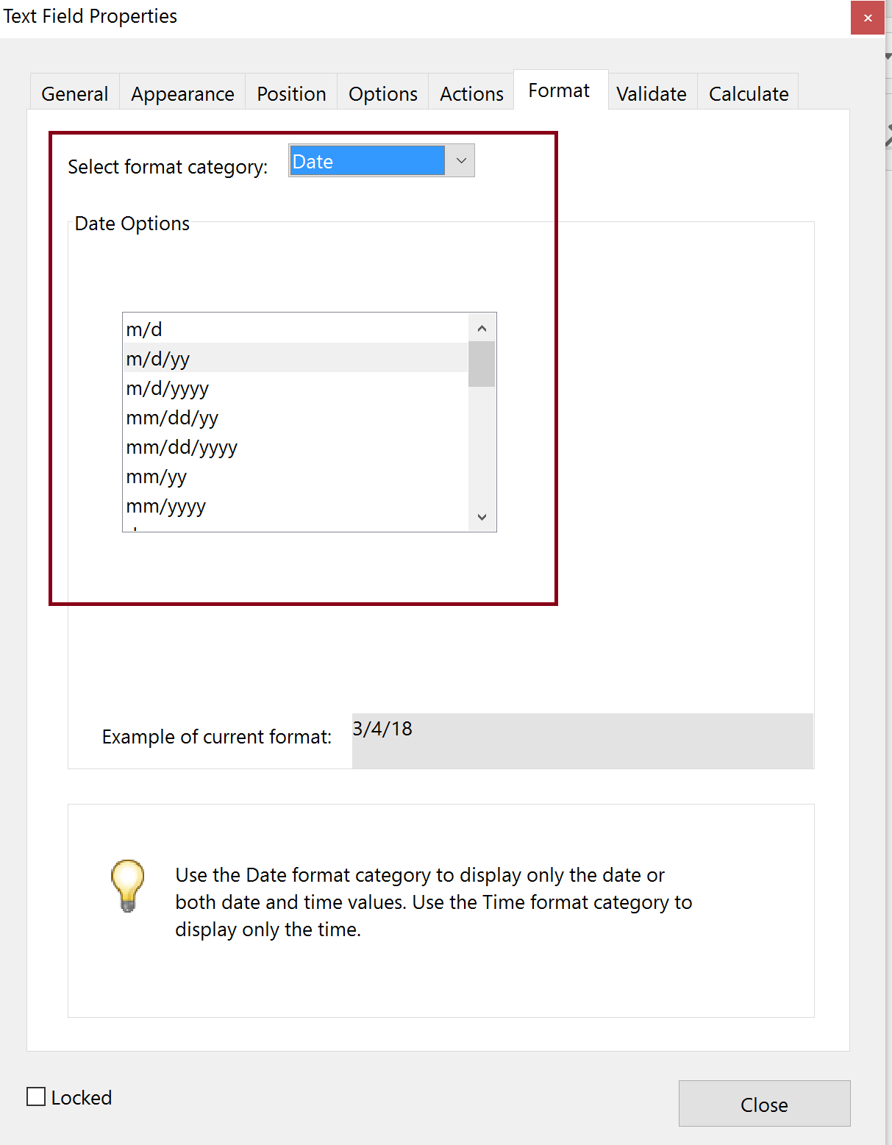
Key Field Properties

Slide 11
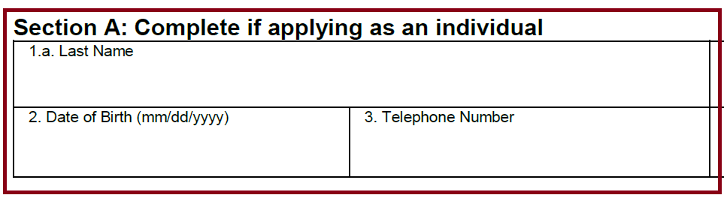
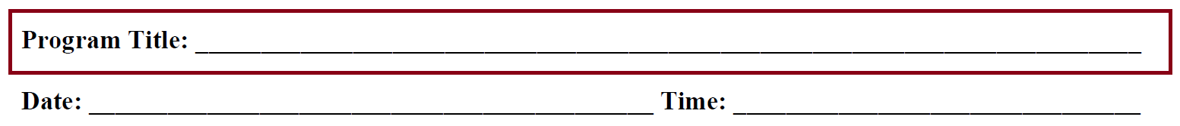
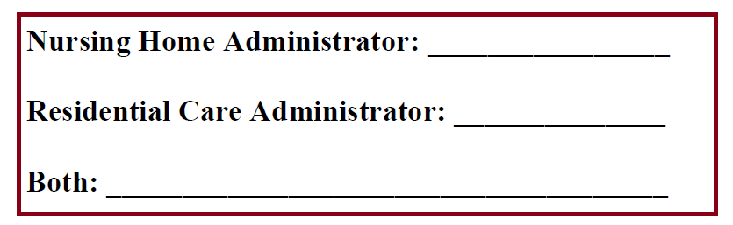
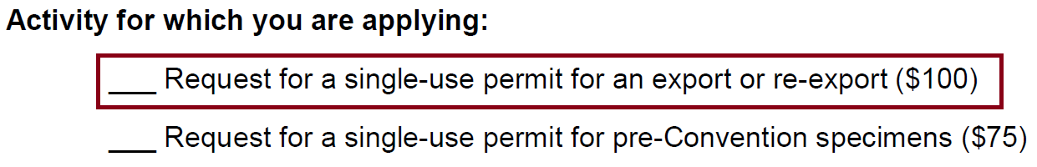
Forms Design
Clearly identify Form Fields (good examples)
Radio buttons need to be circles (bad examples)
Radio buttons (good examples)
Do not use Tables for layout

Slide 12
Creating Form Fields in the Source Document
Use the appropriate tools to add forms controls
  e.g., Word – Developer Tool (addition to the Ribbon)
      Or
Use the appropriate shapes
  e.g., Word - Insert the circle shape for radio buttons

Slide 13
Session 1B1 – Adding Form Fields to a Tagged PDF

Slide 14
Steps for Adding Form Fields with Auto Detection
Use PDF EX1a - Form - FWS Permit - Tagged no form fields or EX1b - CEU Accreditation Form - Tagged no Form Fields
Run “Prepare Form”
Fix form field properties (name and tooltip)
Check other properties
Add format to date field
Manually replace checkboxes with radio buttons as needed

Slide 15
Getting Started with Auto Detection of Form Fields
Do not check “This document requires signatures”
  Signature field applied regardless
  Some functionality missing (a bug)
Set “Form field auto detection” to On.

Slide 16
Fixing Form Field Properties

Slide 17
Session 1B2 – Manual Creation of Form Fields, Tagged PDF

Slide 18
Adding Form Field Manually
When to manually add form fields
  Creating a form from scratch
  Adding/fixing form fields where form fields were auto detected incorrectly
Steps
  Prepare Form
  Manually place form fields
  Complete process for finalizing the form for tagged PDFs

Slide 19
Multiple Form Field Options
Manually Add Form Fields
Common Fields
Text
Checkbox
Radio Button
Lists
Calendar
Signature
Position Form Fields
Set Tab Order

Slide 20
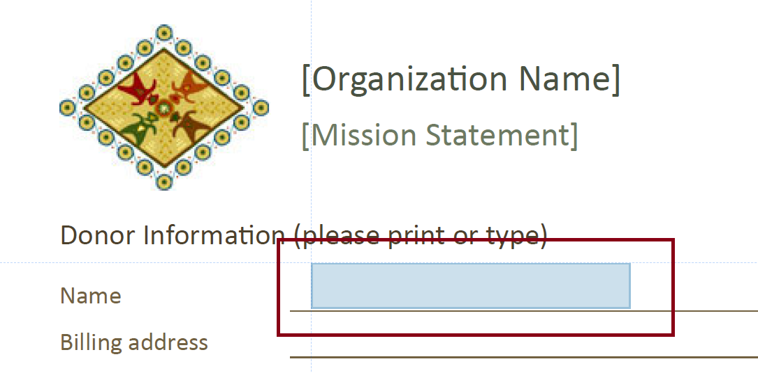
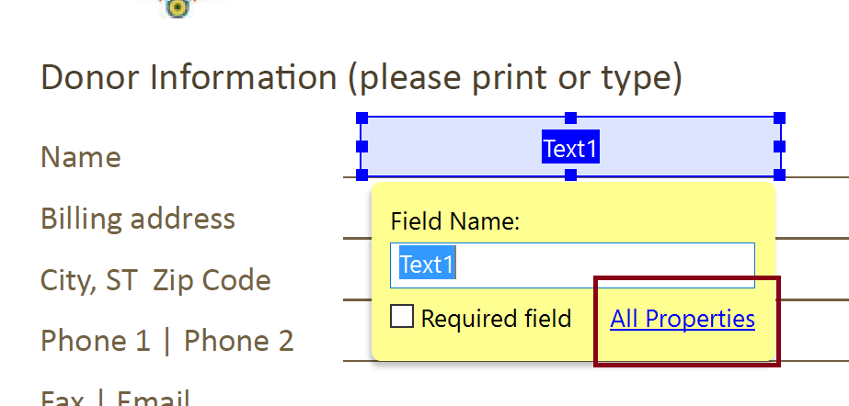
Add a Form Field (Text)
Select form field type (Text)
Drag/Drop form field in place and edit properties

Slide 21
Session 1B3 – Finalizing the Form for Tagged PDFs

Slide 22
Steps to Finalize the Form
Verify and fix tab order
Test the form
  Preview the form
  Verify entering data in the fields
Create Form tags or Auto-tag the Form and fix the Tag Tree

Slide 23
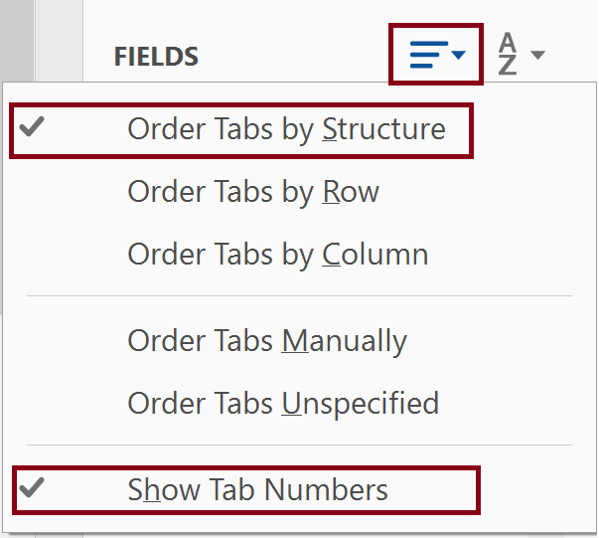
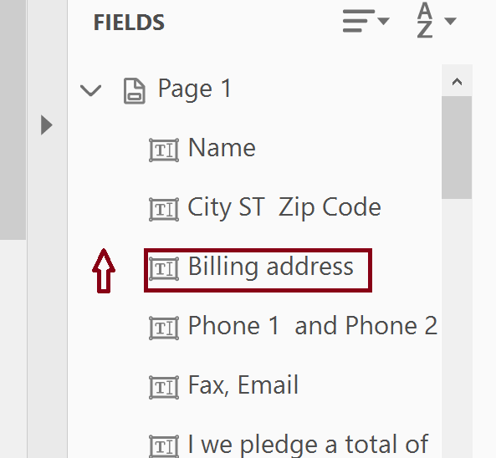
Verify and Fix the Tab Order
Enable “Show Tab Numbers”
Set the Tab order by dragging up and down

Slide 24
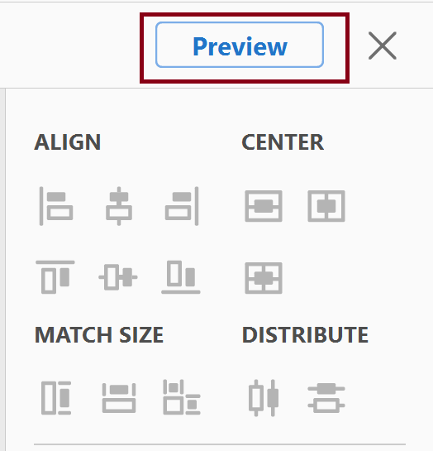
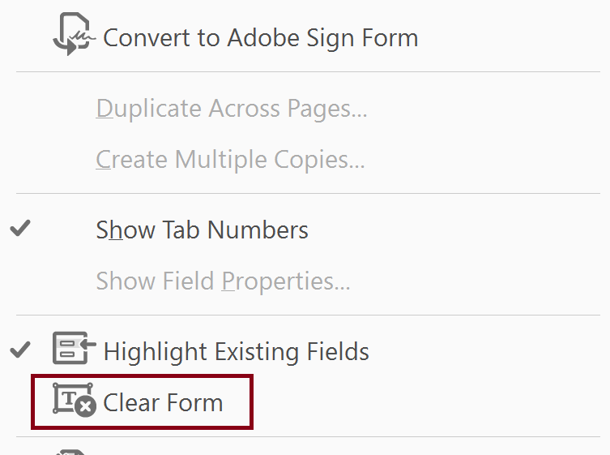
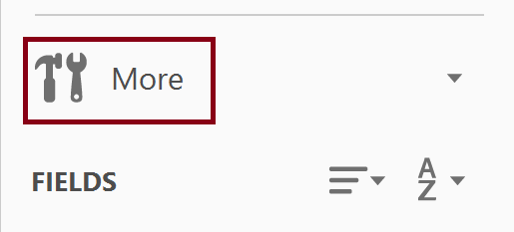
Testing the Form
Select Preview (toggles back to Edit)
Clear the form after entering data in the form fields

Slide 25
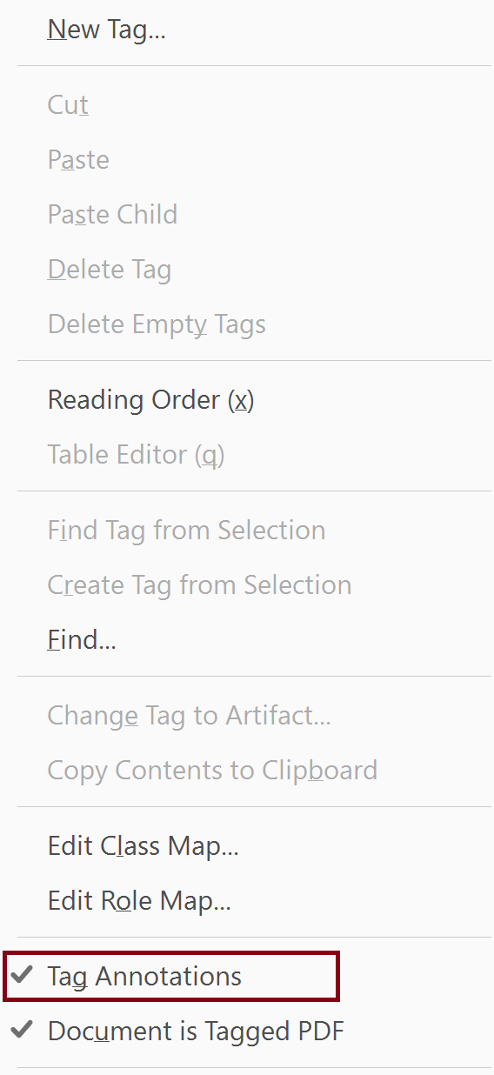
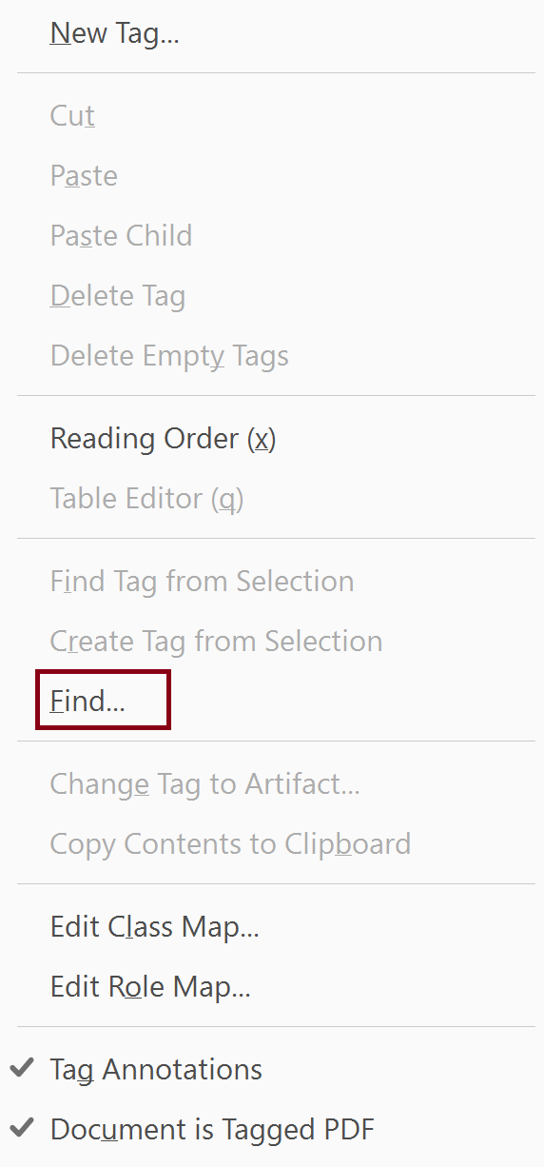
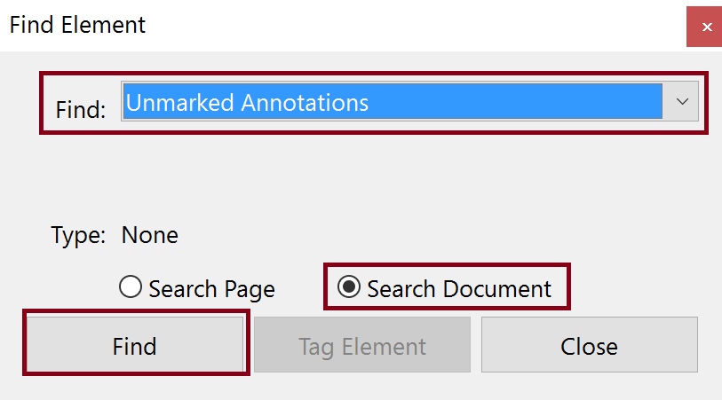
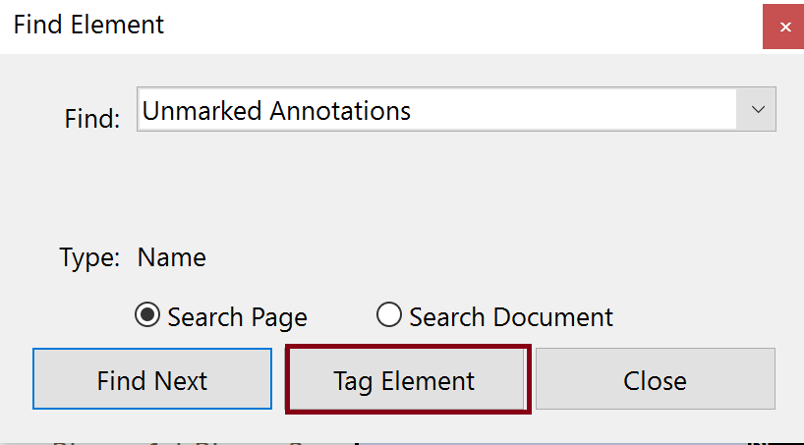
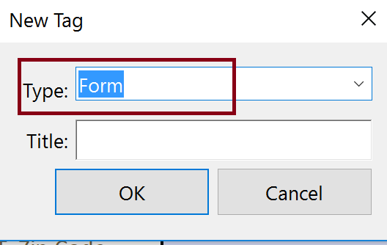
Manually Adding Form Fields to the Tag Tree
Steps
Place focus on “root” Tag
Tag Annotations
Find Unmarked Annotations
Tag Element
Set Tag Type to Form

Slide 26
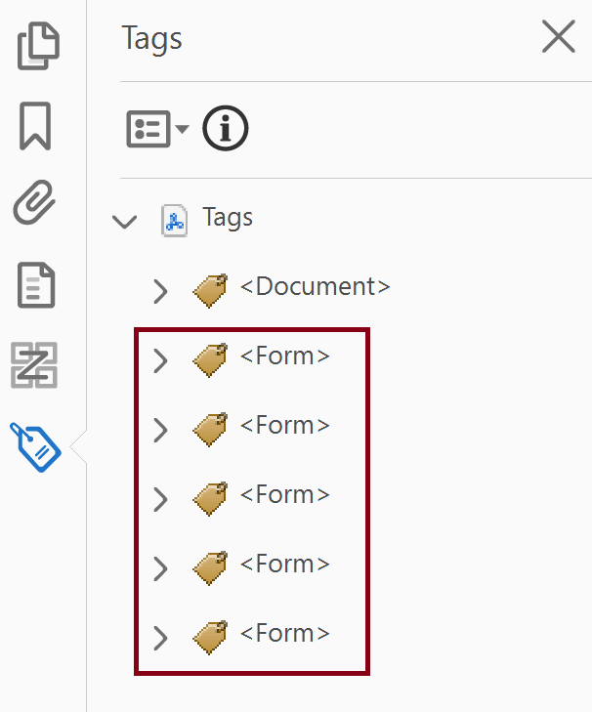
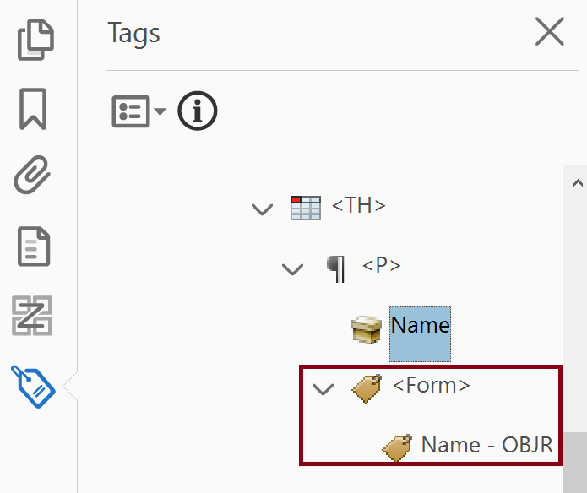
Fix Tag Tree
Form fields appear at the bottom of the Tag Tree
Move <Form> tag to the correct place in the Tag Tree as a peer of the <P> tag content.

Slide 27
Session 1C1 – Adding Form Fields to an Untagged PDF

Slide 28
Steps for Adding Form Fields with Auto Detection
Use PDF EX2a - Form - Pledge Template - Untagged no Form Fields or EX2b - Form - FWS Permit Form - Untagged no Form Fields
Run “Prepare Form”
Fix form field properties (name and tooltip)
Check other properties
Add format to date field
Manually replace checkboxes with radio buttons as needed

Slide 29
Getting Started with Auto Detection of Form Fields
Do not check “This document requires signatures”
  Signature field applied regardless
  Some functionality missing (a bug)
Set “Form field auto detection” to On.

Slide 30
Fixing Form Field Properties

Slide 31
Session 1C2 – Manual Creation of Form Fields, Tagged PDF

Slide 32
Adding Form Field Manually
When to manually add form fields
  Creating a form from scratch
  Adding/fixing form fields where form fields were auto detected incorrectly
Steps
    Prepare Form
    Manually place form fields
    Complete process for finalizing the form for tagged PDFs

Slide 33
Multiple Form Field Options
Manually Add Form Fields
Common Fields
Text
Checkbox
Radio Button
Lists
Calendar
Signature
Position Form Fields
Set Tab Order

Slide 34
Add a Form Field (Text)
Select form field type (Text)
Drag/Drop form field in place and edit properties

Slide 35
Session 1C3 – Finalizing the Form for Untagged PDFs

Slide 36
Steps to Finalize the Form
Verify and fix tab order
Test the form
  Preview the form
  Verify entering data in the fields
Create Auto-tag the Form and fix the Tag Tree

Slide 37
Verify and Fix the Tab Order
Enable “Show Tab Numbers”
Set the Tab order by dragging up and down

Slide 38
Testing the Form
Select Preview (toggles back to Edit)
Clear the form after entering data in the form fields

Slide 39
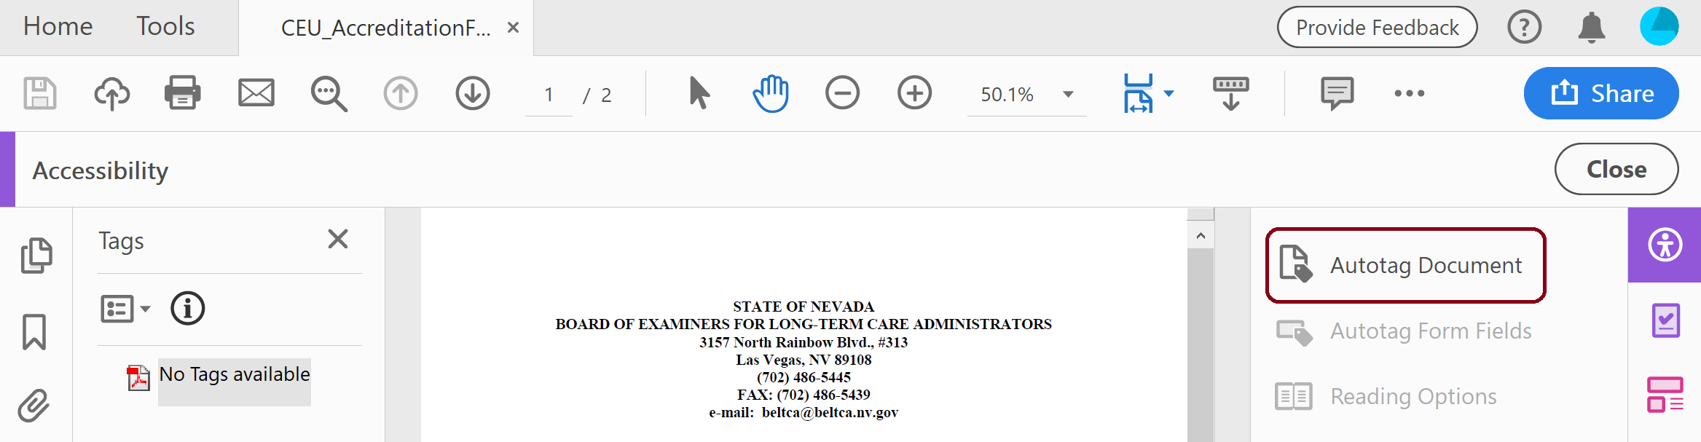
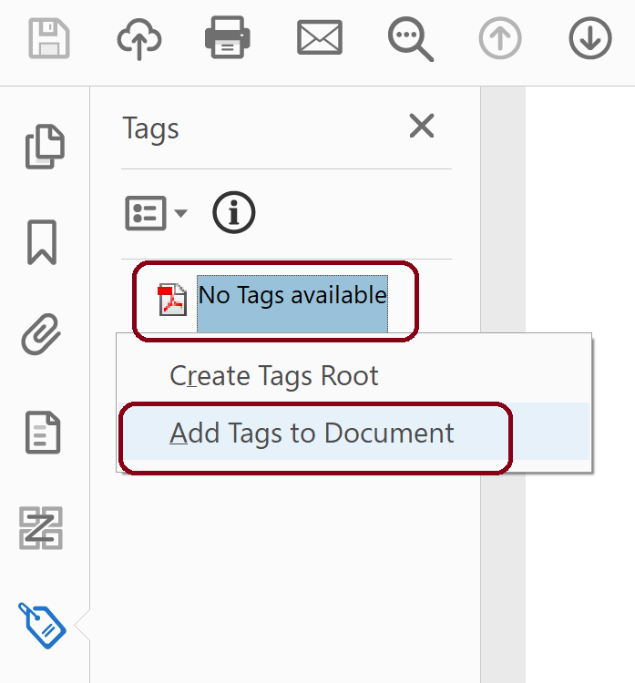
Autotag Form
Accessibility Tool > Autotag Document
Tag Tree
Put focus on No Tags Available
Right click for context menu
Select “Add Tags to Document”

Slide 40
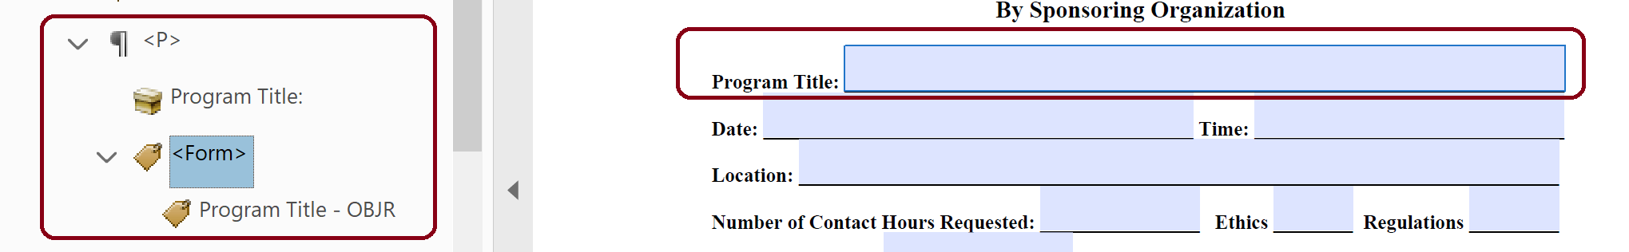
Fix Tag Tree
Fix and move <Form> tags (as necessary) so that they have the following format:

Slide 41
Session 1D – Special Form Fields

Slide 42
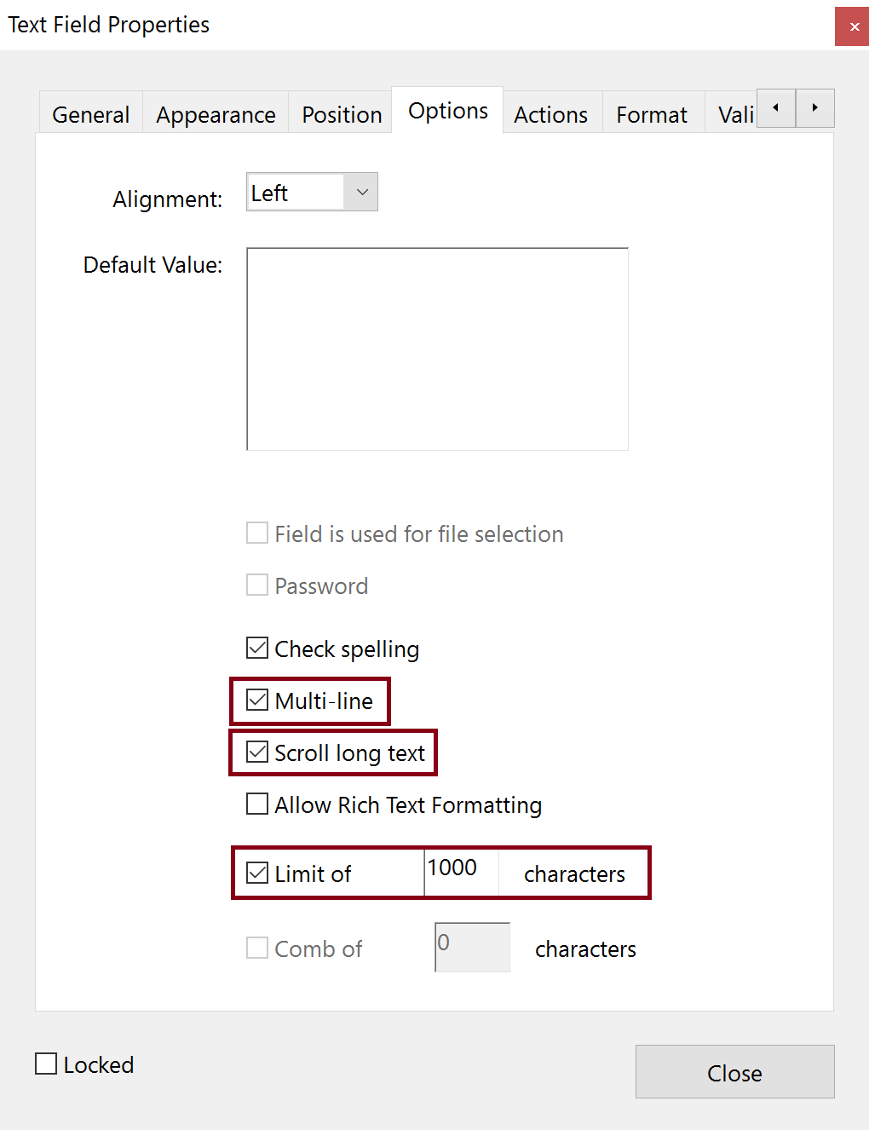
Multi-line Text Box
Regular Text field
Size to space for text
Go to Text Field Properties > Options > Multi-line
Scroll long text
Limit of “x” characters
Notes:
  Characters, not words
  500 words is approximately 3000 characters
  Spaces count as characters
  Even if visually there are multiple lines only create one text box

Slide 43
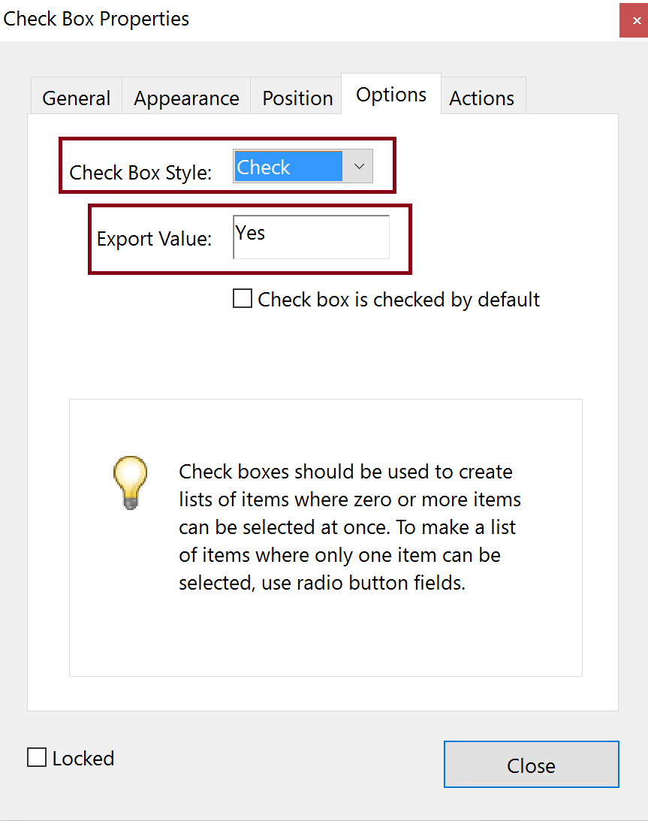
Check Box
Select Check Box
Select “Pin” to create multiple check boxes
Set Name and Tooltip
Set Options
  Check Box Style
  Export Value

Slide 44
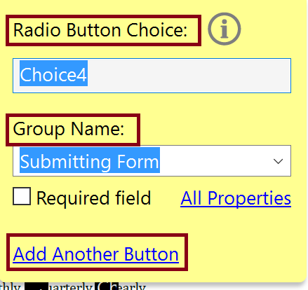
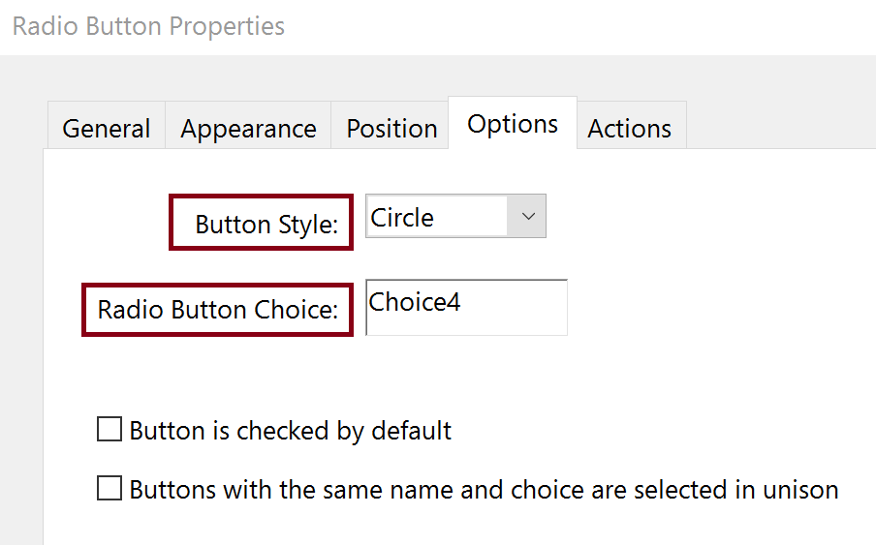
Radio Button
Select Radio Button
Create Choice – unique to the radio button
Add Group Name – common to the set of radio buttons (also the Name in the properties)
Add Another Button – until all buttons are created
Select All Properties
  Set Tooltip
  Set Options
    Button Style
    Verify Radio Button Choice

Slide 45
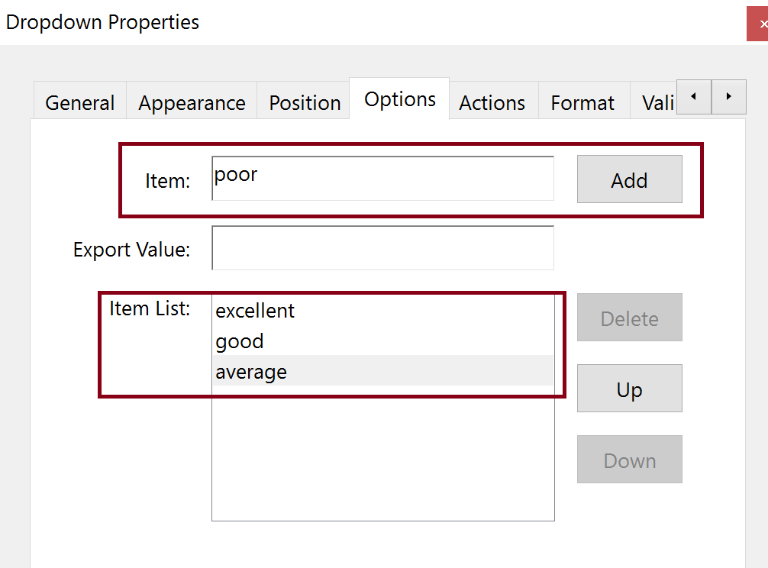
Dropdown List Box
Select Dropdown List
Set Name and Tooltip
Set Options
  Add Items to select Item List
  Export Value

Slide 46
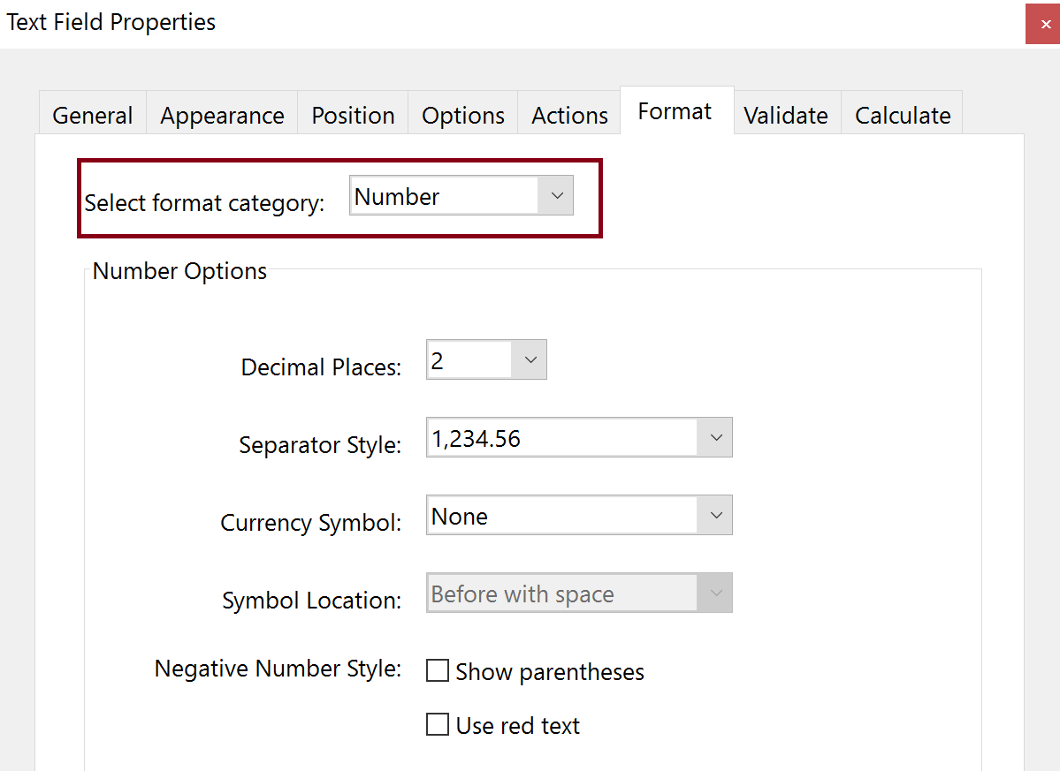
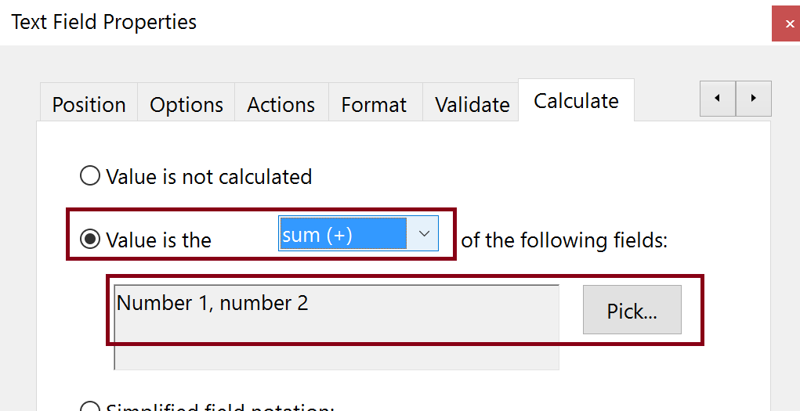
Calculations
Create Text Field
Format Tab in Properties
  Set Format Category to Number
  Choose Number Options
Calculate Tab
  Create Calculation (Value is the . . .)
  Add fields to be included in the calculation
Options Tab
  Set Alignment

Slide 47
Resources

Slide 48
Training Options and Materials
Regular Webinars
    https://events-ar.adobeconnect.com/content/connect/c1/881497641/en/events/catalog.html?OWASP_CSRFTOKEN=1e73e0edb7545f3f9fdd08e895e134213f26efe05c1067bb15b4fc6234076238
Webinar Recordings
    http://adobe.lookbookhq.com/acrobataccessibility
Upcoming 2-day Train-the-Trainer session at Accessing Higher Ground Conference (Teaching you how to teach others how to create accessible PDFs). November 2019 in Colorado
    www.accessinghigherground.org

Slide 49
Acrobat Pro DC Helpful Links and Resources
Acrobat DC Accessibility
    https://www.adobe.com/accessibility/products/acrobat.html
Adobe Acrobat DC Accessibility Features
    https://www.adobe.com/accessibility/products/acrobat/acrobat-accessibility-features.html
Acrobat Reader DC Accessibility features
    https://helpx.adobe.com/reader/using/accessibility-features.html
Acrobat DC and Reader DC Accessibility Blogs
    https://theblog.adobe.com/document-cloud/ (search for PDF or Accessibility)
Using the Acrobat Pro DC Accessibility Checker
    https://www.adobe.com/accessibility/products/acrobat/using-acrobat-pro-accessibility-checker.html
Create and verify PDF accessibility
    https://helpx.adobe.com/acrobat/using/create-verify-pdf-accessibility.html
Acrobat Pro DC PDF Accessibility Repair Workflow
    https://www.adobe.com/accessibility/products/acrobat/acrobat-pro-dc-pdf-accessibility-repair-workflow.html

Slide 50
Contacts
Rob Haverty
  Haverty@Adobe.com
Adobe Accessibility Website
  www.Adobe.com/Accessibility
Accessibility Compliance
  https://www.adobe.com/accessibility/compliance.html
Follow us on Twitter @AdobeAccess
PDF Standards
  ISO 32000 (free)
  ISO 14289 (PDF/UA) (purchase)

Slide 51
Adobe – Make it an Experience

