Slide 1
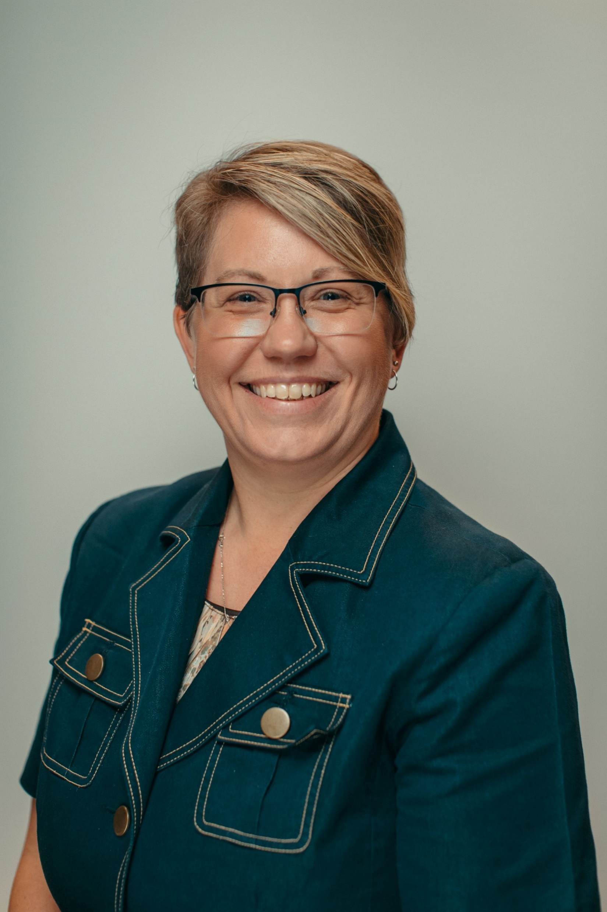
Who, What & Where: The Facts About VPATs Voluntary Product Accessibility Templates
Kara Zirkle Training and Compliance Manager
Notes:
Are Voluntary Product Accessibility Templates (otherwise known as "VPATs") worth it? Accessibility is a concept that has entered the business world with tremendous velocity and ferocity. The consequences of not having an accessible product are massive. Product owners and product managers are responsible not only for building amazing products but for making sure that every single person - all people - can use it. VPATs are becoming a requirement for RFPs from all industries. What once was a requirement for just government and higher education has now cascaded through to any company acquiring any product. In just 30 minutes, this webinar will define the VPAT history and build your VPAT roadmap. We will answer: What is a VPAT? Do I need one? Who writes it? How long does it take? What are the consequences of not being accessible? And we will leave time for Q&A so you can ask your VPAT questions in a safe environment.

Slide 2
Voluntary Product Accessibility Template
Voluntary
Product
Accessibility
Template
Notes:
Let’s get started by polling and asking everyone What is your Familiarity of VPATs A pop up will come up– Once you select your answer and hit submit we’ll show the results shortly.
VPATs are used by buyers to determine how accessible a product is and where any potential deficiencies are. They essentially work as an accessibility checklist.
More governments and state governments and universities are requiring a VPAT to be part of their procurement initiative.
Second part:
It is essentially a checklist showing the level of accessibility of a product.
Provides a single source standardized file for review of accessibility.
Currently on Version 2.3 (December 2018)
Allows for Universal Language
Section 508
WCAG 2.1
EN 301 549

Slide 3
What is a VPAT?
Voluntary
Product
Accessibility
Template
It’s a starting point of communication about accessibility!
Provides a checklist showing the level of accessibility of a product.
The Information Technology Industry Council VPAT® is the leading global reporting format for assisting buyers and sellers in identifying information and communications technology (ICT) products and services with accessibility features.
Notes:
Let’s get started by polling and asking everyone What is your Familiarity of VPATs A pop up will come up– Once you select your answer and hit submit we’ll show the results shortly.
VPATs are used by buyers to determine how accessible a product is and where any potential deficiencies are. They essentially work as an accessibility checklist.
More governments and state governments and universities are requiring a VPAT to be part of their procurement initiative.
Second part:
It is essentially a checklist showing the level of accessibility of a product.
Provides a single source standardized file for review of accessibility.
Currently on Version 2.3 (December 2018)
Allows for Universal Language
Section 508
WCAG 2.1
EN 301 549

Slide 4
Do VPATs apply to you?
I’m a corporate company or I don’t sell to the Government or Higher Education?
I’ve only been asked a couple times, is the ROI really worth it?
I don’t have the time and resources to apply to it.
What if I rely on 3rd party applications in addition to my product?
We’re not accessible, won’t telling a client that hurt us?
Notes:
Read quest first
Corporate companies are starting to see it regardless who they sell to. We’ve seen financial institutions, ecommerce, hotels, etc. also asking for VPATs because they are wanting to be accessible, they can only achieve that if they expect the same of vendors they use.
Completing it once every major update allows you to have the necessary documentation to share to any current or future client for sales.
It is best to get a 3rd party accessibility company to complete the VPAT anyways. Some procurement requirements will not accesspt VPATs completed in house due to biased or inaccurate information.
It is ok to still complete a VPAT if you rely on other technologies. It just needs documented and then you should expect the same of those 3rd party companies to provide you with the same level of information (a VPAT) as you’re having to provide to your clients.
Being up front with a client is always setting precedence than lying to them. Knowing that you’re transparent and are aware of accessibility whether they be pitfalls or improvements helps set a tone for a partnership.

Slide 5
Cautionary Tales
Check the date in which the VPAT was created
Check the Version of the Product listed on the VPAT vs Current Version
Is it an updated VPAT?
VPAT Change Tracking (April 2019)

Slide 6
VPAT Levels of Accessibility
Supports
Partially Supports
Does Not Support
Not Applicable
Not Evaluated
The functionality of the product has at least one method that meets the criterion without known defects or meets with equivalent facilitation.
Some functionality of the product does not meet the criterion.
The majority of product functionality does not meet the criterion.
The criterion is not relevant to the product.
The product has not been evaluated against the criterion. This can only be used in WCAG 2.0/2.1 Level AAA.
Notes:
Not applicable could be if you don’t have videos on your website or application

Slide 7
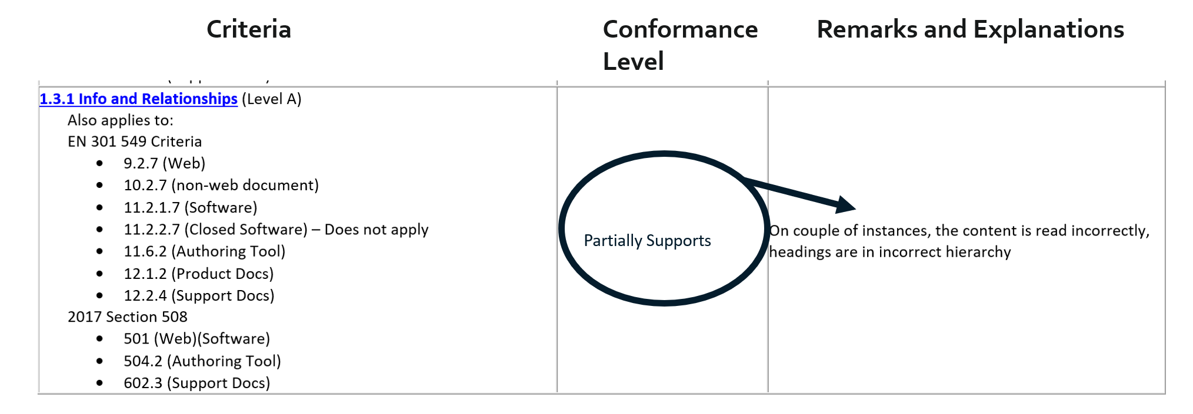
Sample VPAT – Partially Supports and Has Remarks
Notes:
Vendor claims partially supports but describes the issues

Slide 8
Sample VPAT – Supports with no Remarks
Notes:
Vendor states supports but does not describe how

Slide 9
Sample VPAT – Supports and has Remarks
Notes:
Ideal VPAT sample
Pause for Erics Question

Slide 10
Who is invited to the VPAT party?
You
Your Customer/ Prospective Customer
Accessibility Vendor
Notes:
You = from The Vendor
Customer/Prospective Customer (Higher, Edu, Gov, Corporate, etc.)
Asking for a VPAT to simply get a response from the vendor starts conversation to help show the vendor understanding of accessibility. Do they have one readily available or are they aware of what a VPAT is? Using the question as a tell into the future.
Accountability for procurement and contracts – whether it is a VPAT or a roadmap, or both, applying the documentation as part of the contract helps hold the vendor accountable if any issues pop up in the future.

Slide 11
Who is invited to the VPAT party?
You
Your Customer/ Prospective Customer
Accessibility Vendor
We update our software often. How do we keep up?
There is not enough time to remediate accessibility errors plus update the software per our roadmap.
What happens if we can’t make the product accessible?
VPATs aren’t always accurate, so it isn’t always helpful.
Too high level.
Multiple users profiles on the same VPAT.
Unsure about accuracy.
Incomplete VPATs.
Often a rapid response.
VPAT requires a test of the application, takes time, on average 150-200 hours.
Advocating for compliance.
Advising which WCAG level (2.0 or 2.1, Level A or AA) to test for, roadmap and timeline.
Notes:
You = from The Vendor
Customer/Prospective Customer (Higher, Edu, Gov, Corporate, etc.)
Asking for a VPAT to simply get a response from the vendor starts conversation to help show the vendor understanding of accessibility. Do they have one readily available or are they aware of what a VPAT is? Using the question as a tell into the future.
Accountability for procurement and contracts – whether it is a VPAT or a roadmap, or both, applying the documentation as part of the contract helps hold the vendor accountable if any issues pop up in the future.
Some common questions or challenges faced by each group are: things on the deck

Slide 12
Who is crashing the VPAT party?
You
Procurement Officer
Product Vendor
What does the school, government, etc. think about when they’re asking?
Holds the vendor to the level of compliance stated on the VPAT. If the vendor went down the line and checked everything off without testing to show a better score, it can hurt them in the long run.
Don’t necessarily know what they are looking at, they’ve just been told what to ask.
Not all VPATs are completed correctly, if done in house, and may not be enough.
Hard for Procurement to verify accessibility.
Can be confusing sans education around VPATs.
Don’t always understand the requirements (WCAG 2.0 vs WCAG 2.1 vs Section 508 vs EN 301 549)
Prioritization of work (user platforms, roadmap, etc.)
Concern of accountability versus resources.
Notes:
You = Customer Requesting VPAT
More common challenges

Slide 13
The VPAT Process
Option 1 You
VPAT Request
Internal Team Completes VPAT
Send to Customer
Customer Returns VPAT with Questions
Deal Stalls
Option 2 You with help
VPAT Request
A11y Vendor Completes VPAT
Send to Customer
Customer is Happy
Win Deal
A11y Vendor
Education & Guidance
Automated Testing
Manual & Functional Testing
Comprehensive VPAT Completed

Slide 14
Verifying a VPAT
Run a free automated accessibility checker on the tool
Don’t have access to the tool? Run it on the company website. Often times its easier to incorporate accessibility into a website than it is an application. It helps show the level of prioritization the company sees accessibility.
Pay attention to the Explanations section. The more detailed the better.
Ask the company for their accessibility point of contact.
What is the level of knowledge they have about accessibility?
Did they complete the VPAT in house or did they go to a 3rd party company?
If they did it in house, did they test the product using individuals with disabilities?

Slide 15
Procurement Requirements – Is it really “Voluntary”?
US Government Agencies – GSA using Artificial Intelligence (AI) to help ensure minimum procurement requirements.
Local and State Government Agencies
Higher Education
K-12 Institutions
“Voluntary” is no longer an option in many procurement policies.
Voluntary only applies to the vendor if they choose not to complete the documentation to make a sale.
CSU Vendor Accessibility Requirements
University of Washington
George Mason University
Texas A&M University
Temple University
San Jose State University
University of Alaska Anchorage
University of California
Kent School District (K-12)
Miami University
Notes:
How GSA uses AI to keep agencies on the right side of the law

Slide 16
Is it really worth having a VPAT?

Slide 17
Q&A
Kara Zirkle Training and Compliance Manager kzirkle@essentialaccessibility.com

