Slide 1
EDIT 526: Web Accessibility and Design
Course Information: https://cehd.gmu.edu/courses/EDIT-526/
Assistive Technology Initiative (ATI)
Korey Singleton, ATI Manager

Slide 2
EDIT 526 Course Overview
Week | Topic | Assessment
1 | Simulation Activities | Simulation Lab Report
2 | Disability Laws & Guidelines Testing Websites & Software Apps
3 | Testing Websites & Software Apps | Testing a Website for Accessibility
4 | Document Accessibility (Word, PPT, PDF/3cr) | Creating an Accessible Word, PPT, & PDF document
5 | HTML Basics | Create a Practice Web Page
6 | Complex HTML Elements and CSS
7 | Complex HTML Elements and CSS ARIA Accessible Video (3cr)
8 | Final Project | Create an accessible instructional product using HTML & CSS
8-week summer course
Course built around 8 asynchronous modules. Each incorporates readings, video (lecture/demo), discussion, and assessments).
3 synchronous sessions were added in Sum 2018 to support hands-on activities.

Slide 3
Sample Resources – Intro to Web Accessibility
Intro to Web Accessibility
WebAIM – Intro to Web Accessibility
W3C – Intro to Web Accessibility
UW – Accessible Web Design (Video)
How Individuals with Disabilities are Impacted on the Web
WebAIM – Visual, Auditory, Motor, Cognitive
W3C – Web Accessibility Perspectives (Video)
Web Accessibility Testing
Easy Checks – A First Review of Accessibility
Demo Videos (Testing Tools)
Additional Supports:
Demo Videos (Assistive Technology & the Web)

Slide 4
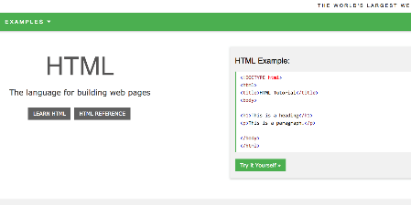
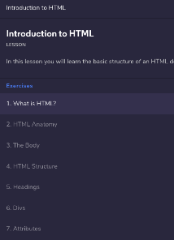
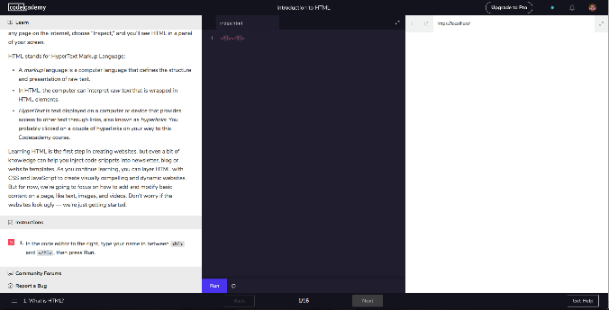
Sample Resources – HTML & CSS
Web Design & Accessibility (Simulations)
Codecademy.com (HTML & CSS)
Textbook – Recommended, not required
W3Schools.com – HTML5, CSS

Slide 5
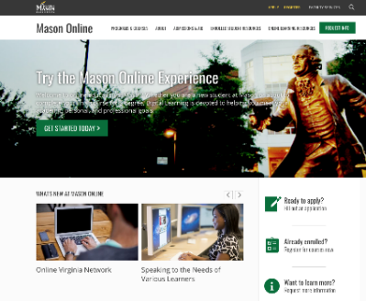
Impact...
CEHD
Instructional Technology Masters & eLearning Certificate Program (Elective)
Assistive Technology Masters & Certificate Programs (Elective)
Assistive Technology Masters & Certificate Programs (Modules shared with faculty)
Office of Digital Learning
Modules incorporate into faculty trainings
Support IDs (Testing of supplemental applications)

Slide 6
Contact Us
Assistive Technology Initiative
Aquia Building, Rm. 238
Mail Stop: 6A11
Phone: 703-993-4329
Email: ati@gmu.edu
Web: http://ati.gmu.edu
Twitter: @AccessibleMason

