Slide 1
Teaching Accessibility: Case studies of courses that include accessibility topics in their curricula
Howard Kramer, University of Colorado Boulder
Terrill Thompson, technology accessibility specialist, University of Washington
Korey Singleton, ATI Manager, George Mason University

Slide 2
My Projects
Howard Kramer
PI for Promoting the Integration of Universal Design into University Curricula (UDUC), CU-Boulder
Teach Universal Design for Digital Media
Accessing Higher Ground: Accessible Media, Web & Technology Conference
Notes:
Find out background of audience also.
AHG – AHEAD conference.

Slide 3
Presentation Topics
Motivation
Resources for Teaching about Accessibility
UDUC Project
Notes:
Motivation – my argument is that there is a fairly new benefit for teaching about accessibility that I never see mentioned when arguing for teaching about accessibility.

Slide 4
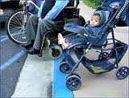
Why Teach about Accessibility & Inclusive Design? (the usual arguments)
Social Case
Legal
Accessibility benefits everyone
Reaching diverse audiences
Notes:
Sheryl referred to these as motivations

Slide 5
Career benefits for students
Changing landscape for accessibility skills in tech & design
In 2015 tech firms such as Yahoo, Facebook, Dropbox and LinkedIn announced that they will develop standard language that lets applicants “know that having accessibility knowledge is preferred” to land a job.
Notes:
Mention Teach Access Project
Transition: now a career benefit

Slide 6
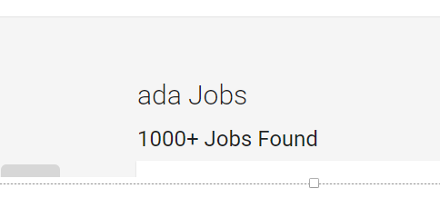
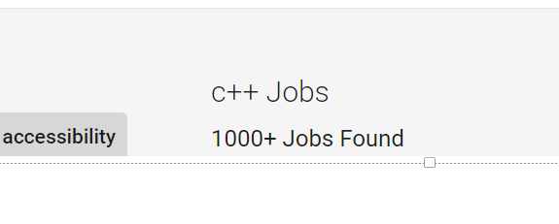
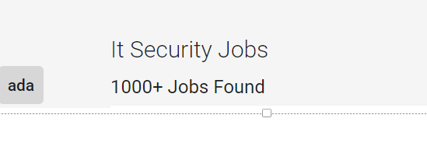
WCAG: 299 jobs
ADA: 1000+
Accessibility: 1000+
C++: 1000+
IT Security: 1000+
Notes:
Refer to study from 2008 with search on Monster.com

Slide 7
Where’s the gap?
Teaching Accessibility: Three Case Studies
Teaching Accessibility: Three Case Studies
Notes:
So currently there’s a big gap between need and the skills of recent graduates. And the reason for this is ….

Slide 8
RQ1: What institutions teach accessibility?
375/1857 (30%) responding faculty teach accessibility
375/14176 (2.6%) faculty teach accessibility
175/352 (50%) institutions have faculty who teach accessibility
75/352 (21%) institutions have at least 2 faculty who teach accessibility

Slide 9
RQ2: What are barriers to teaching accessibility?
N = 1,857
Faculty who do not teach twice as likely to view as barriers:
Don’t know enough about accessibility
No textbook
Challenges engaging students
Notes:
Chart has three bars.
80% of respondents don’t know enough to teach accessibility (54.9% don’t teach accessibility, while 26.1% do).
36.2% of respondents lack a textbook (12.4% don’t teach accessibility, while 24.8% do).
27.1% of respondents have challenges engaging students about accessibility (7.9% don’t teach accessibility, while 19.2% do).

Slide 10
RQ2: What do faculty need?
“If you wanted to incorporate accessibility into your curriculum, what resources would be helpful?”
Connecting or bringing people with disabilities into classroom
Resources like tools, technologies, guidelines, problem examples
Access to curriculum building and curricular samples in specific courses
Training and opportunities to gain expertise

Slide 11
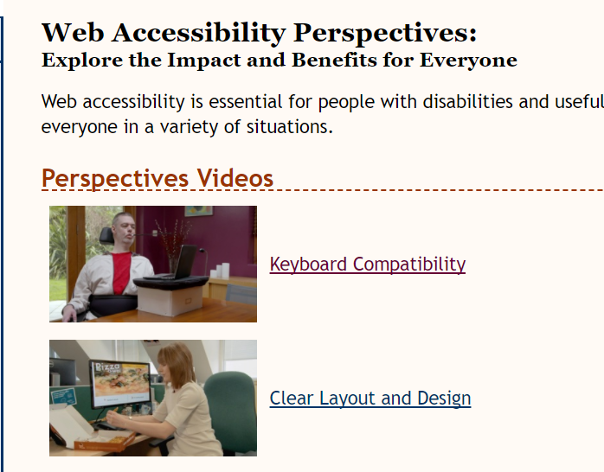
Resources to introduce and convey accessibility issues 1/2
WAI – Accessibility Perspectives
https://www.w3.org/WAI/perspectives/
Notes:
Also show the intro to accessibility video at https://www.w3.org/WAI/intro/accessibility.php

Slide 12
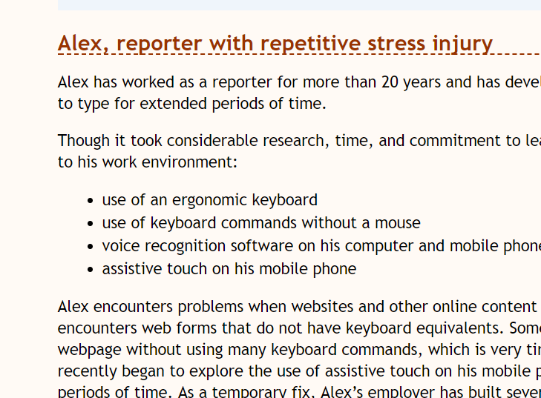
Resources to introduce and convey accessibility issues 2/2
WAI – How people with disabilities use the web
https://www.w3.org/WAI/intro/people-use-web/stories
Notes:
Issue that often comes up in teaching about a11y – how do we convey the accessibility issues of persons with disabilities
Above link starts off on overview page – then go down to stories of web users

Slide 13
Real examples of individuals using assistive technology
Tommy Edison – the Blind Film Critic
https://www.youtube.com/watch?v=c0nvdiRdehw
S—t people say to blind people
https://www.youtube.com/watch?v=4uk8pwEHMBE
Notes:
This relates to the issue mentioned in the survey – hard to recruit people with disabilities.
If not able to bring in guest speaker, use the Internet.
Great example of a blind person using voiceover on an iPhone
2nd video – very entertaining – helpful for teaching about sensitivity, etiquette.
Can talk to Disability Services Offices, National Organizations

Slide 14
Social model of disability https://youtu.be/9s3NZaLhcc4
Notes:
Rejection of medical model (where person is treated or provided with AT)
Environment needs to be changed, not person with (or without) disability
(Thinking about diversity of population when designing – User Centered Design with a wider range of user abilities and limitations).

Slide 15
Notes:
Here’s an example I use in my class of
accessibility vs. Universal Design in the electronic environment.
Kennedy Center Web Page (from 2014)
Notice that calendar for text only version are for 2006 events. These screen shots are from 2014.
According to WCAG or the old section 508, these might not be viewed as accessible.

Slide 16
Books & curriculum material
A Web for Everyone: Designing Accessible User Experiences
Norman, David A. The Design of Everyday Things (2002).
InterACT with Web Standards: A holistic approach to web design, Anderson, et. al.

Slide 17
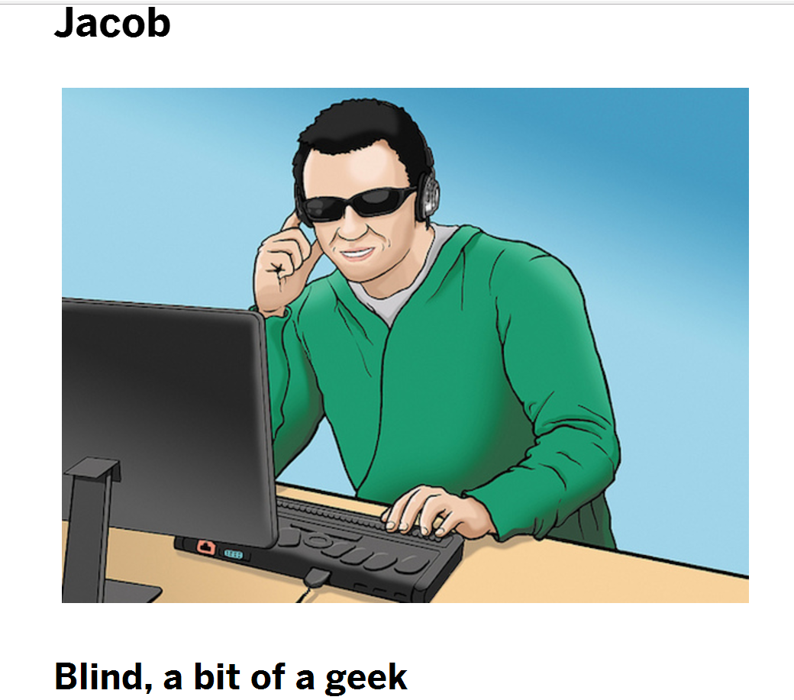
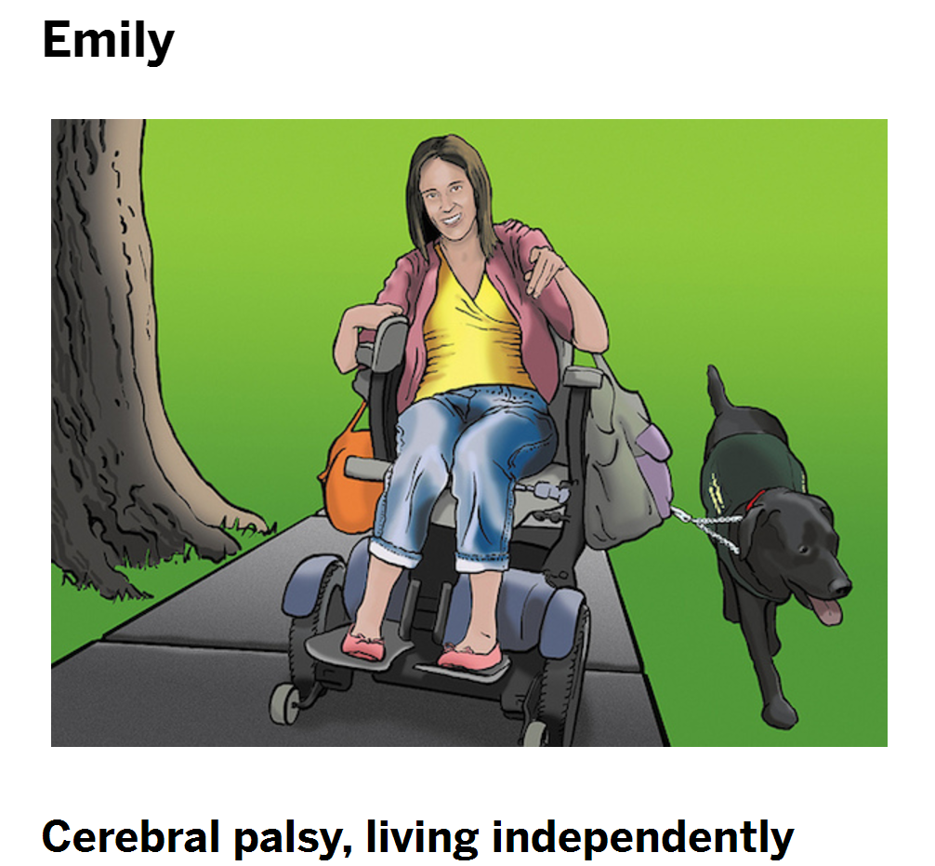
A Web For Everyone Personas
Excerpts
http://rosenfeldmedia.com/books/a-web-for-everyone/#excerpts
Notes:
Mention you can get a 3rd of the book online

Slide 18
Aspects of course that is particularly effective at promoting UD
Demographic assignment
Emphasis on multi-faceted benefits – mobile, SEO, etc.
AT user Interview
Use of screen reader and other evaluation tools
Opportunity for them to redesign a site of their choice

Slide 19
Notes:
Show video

Slide 20
Bremerton Beyond Accessible Playground
Notes:
Show video
Play until around 2:22
Note: features for different abilities: physical, autistic, sensory,
Ability to play alone or with groups
Wheelchair accessible swings

Slide 21
Teach Access - Initiatives
Other Resources / Projects
Include accessibility in tech job requirements
Conduct faculty training
Provide guest speakers from tech companies for the classroom
Develop training tutorials on accessibility
Notes:
Tutorial is start of teaching repository on teaching accessibility

Slide 22
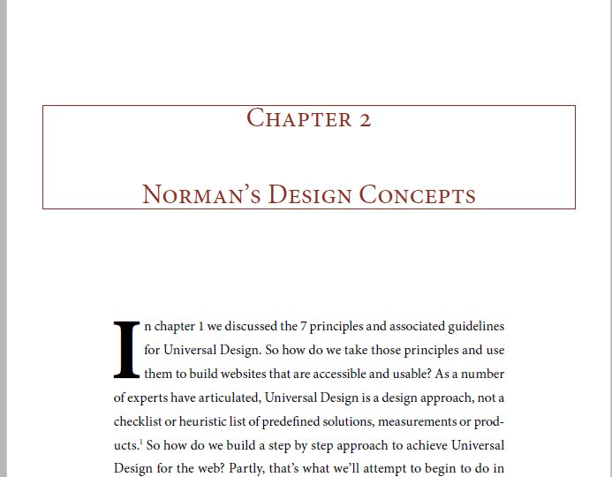
No Book Version
WAI – How people with disabilities use the web
https://www.w3.org/WAI/intro/people-use-web/
Universal Design for Digital Media (eBook)
http://www.uduc.org/resources.php
Notes:
What other resources do I use for the no book online class.

Slide 23
WAI - The Business Case for Digital Accessibility https://www.w3.org/WAI/business-case/
New Resources / Projects
Business case from market and legal standpoint
Universal Design aspects and examples
Case Studies
Bibliography provides index out to many useful topics and statistics
Notes:
Includes demographics
Could build many aspects of a course out of material in resource and the articles in the bibliography.

Slide 24
Promoting the Integration of UD Content into University Curriculum (UDUC) 1/2
Other Resources / Projects

Slide 25
Promoting the Integration of UD Content into University Curriculum (UDUC) 2/2
Other Resources / Projects
Increasing the number of classes that address UD (content) in post-secondary
Determining resource needs for teaching UD
Developing resources for teaching UD – syllabi, curriculum, teaching resources, etc.
Sampling familiarity of students taking design/tech classes
Surveying benefit of UD and accessibility skills in obtaining employment
Notes:
2-year NEA grant
Resources could be a curriculum exchange or model curriculum components.

Slide 26
W3C WAI Resources
Other Resources / Projects
Before and After Demonstration (BAD)
Web Accessibility Tutorials
Developing Presentations and Training
Future Resources
Notes:
Already talked about “how people with disabilities use the web”, particularly the personas
Before and after – show forms (survey)
Web Accessibility Tutorials

Slide 27
Promoting the Integration of Universal Design into University Curricula (UDUC) Opportunities for Collaboration
Sharing of Resources
E-text book
Joining UDUC network/mailing list
Distributing surveys to students – benefits of taking classes with Inclusive Design and accessibility topics

Slide 28
Accessing Higher Ground Virtual Conference
Accessible Media, Web & Technology
November 12 – 18, 2018
Westin Hotel - between Boulder & Denver
http://accessinghigherground.org/virtual
Free Coursera MOOC
Basics of Inclusive Design for Online Education
https://www.coursera.org/teach/inclusive-design/
Notes:
Still accepting proposals until the end of May
Looking for presentations on including UD / accessibility in curriculum

Slide 29
Crossing silos: Resources on campus
English; Communication (accessible information)
Art (graphic design)
Psychology; Sociology (effective engagement)
Business (market research)
Education (legacy of inclusion)
Library (models)
Disability Services (practical guidelines)
Administration (mandates)

Slide 30
Another tool: Accessibility Curriculum
(Sessions later in the week
to highlight)

