Slide 1
Best Practices for Automating Document Accessibility
Accessible Document Solutions for the Future

Slide 2
Agenda
The Problem
Challenge
Solutions
Auto Tagging
Template Tagging
On-line
Smart Phone

Slide 3
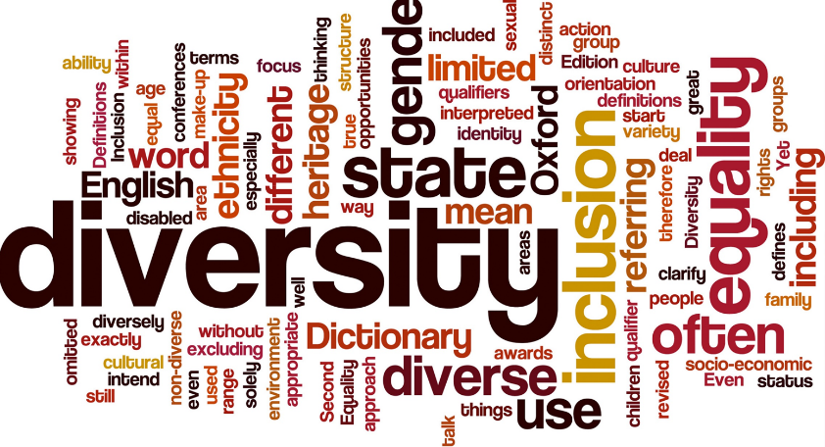
Accessibility Solutions
Goals
Be in compliance with evolving regulations on delivering accessible documents to blind, partially sighted and cognitively disabled individuals
Meet the inclusive needs and requests of a large and growing population
Automate and scale the creation of accessible documents in all formats

Slide 4
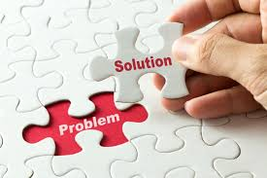
The Problem
Desktop based or manual
Not scalable and requires expertise
Not cost effective
Not secure
No inclusive answer for all

Slide 5
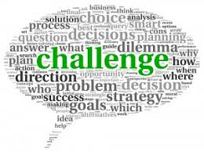
The Challenge
Making content, educational content, published content, personal and confidential information accessible quickly and easily
Providing anyone the ability to make content accessible
Training

Slide 6
What is the state of document accessibility
Manual remediation
Off Shoring
Desktop remediation
Expensive cost per page
Training all staff or some staff?

Slide 7
Desktop Remediation
Adobe Acrobat PRO DC
CommonLook Global Access
Foxit
Others

Slide 8
The Solution – Apply Technology
Awareness of Accessibility, document accessibility is growing considerable
Scalable solutions are now available
Application technology for easy access

Slide 9
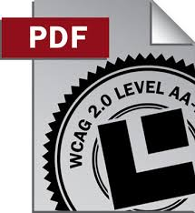
Goal
Scalability, time and cost savings

Slide 10
Technology
Computer based tagging tools
Heuristic Algorithms
Understanding of PDF / document “guts”
Font exposure
Document structure and positioning
Understanding Print Description Languages

Slide 11
Technology to Human Comparison
Auto Tagging with Post Remediation
Desk Top Remediation
Speed
Off Shoring
Manual Remediation
Cost

Slide 12
Accuracy vs Time
Auto Tagging with Post QA
Manual Remediation
Accuracy
Auto Tagging
Template Tagging
Desk top Auto Tagging
Time

Slide 13
Print Ready Files (PDL)
Text Content
Fonts
Structure
Tables
Graphics

Slide 14
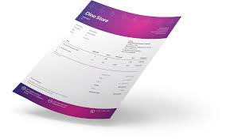
Template Remediation
Input - systematically generated documents in in any printer ready format – remediation at hundreds to thousands of pages per second.
Generally Personal & Confidential

Slide 15
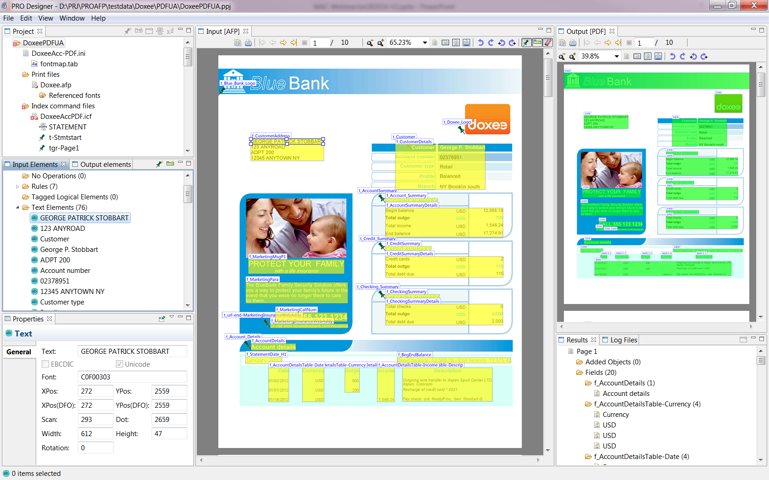
PRO Designer Screen Shot
MO:DCA-P
Mixed Object: Document Content Architecture-Presentation
IPDS
Intelligent Printer Data Stream
BCOCA
Bar Code Object Content Architecture
PTOCA
Presentation Text Object Content Architecture

Slide 16
Tagging documents for accessibility
Graphical user interface
Simplifies setup and configuration with no need for developer resources

Slide 17
Results
Remediation in seconds
100’s to 1000’s PDFs per second

Slide 18
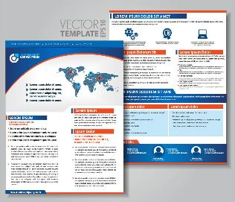
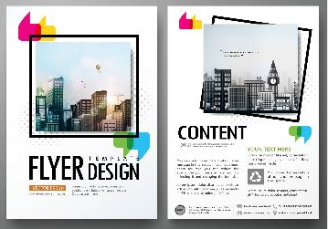
Auto Tagger for Accessibility
Completely automates the conversion of business & marketing documents to Accessible PDF or Accessible HTML5

Slide 19
Auto Tagger for Accessibility
Auto Tagger for Accessibility
Completely automates converting unstructured documents to accessible PDF or HTML in real-time
Eliminates the manual remediation/tagging step by doing it automatically using intelligent algorithms
Cuts cost in half for ad hoc usage
Reduces turnaround times from days to minutes
Notes:
CrawfordTech to the rescue with automated intelligent tagging

Slide 20
Auto Tagging – Server solution
Hundred of pages per second to Hundreds per minute

Slide 21
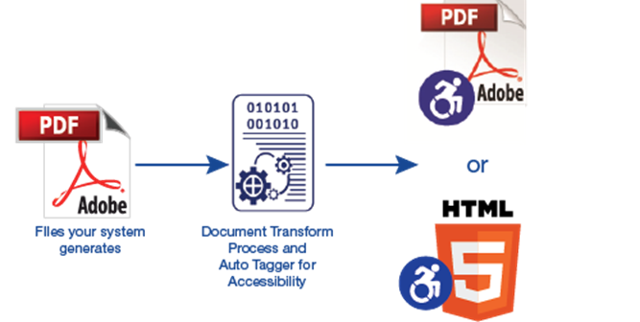
Auto Tagging - future
Reduce training and become compliant
Can be automated like a drop box
Users can upload and pull from an outbox or routed

Slide 22
Results
Depending on document quality – Average 30-90% time savings
100’s to 1000’s PDFs per second

Slide 23
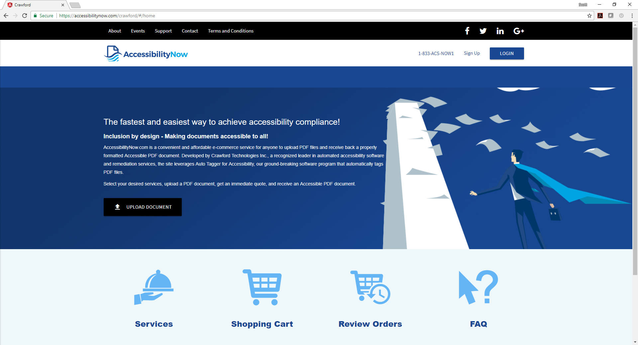

Slide 24
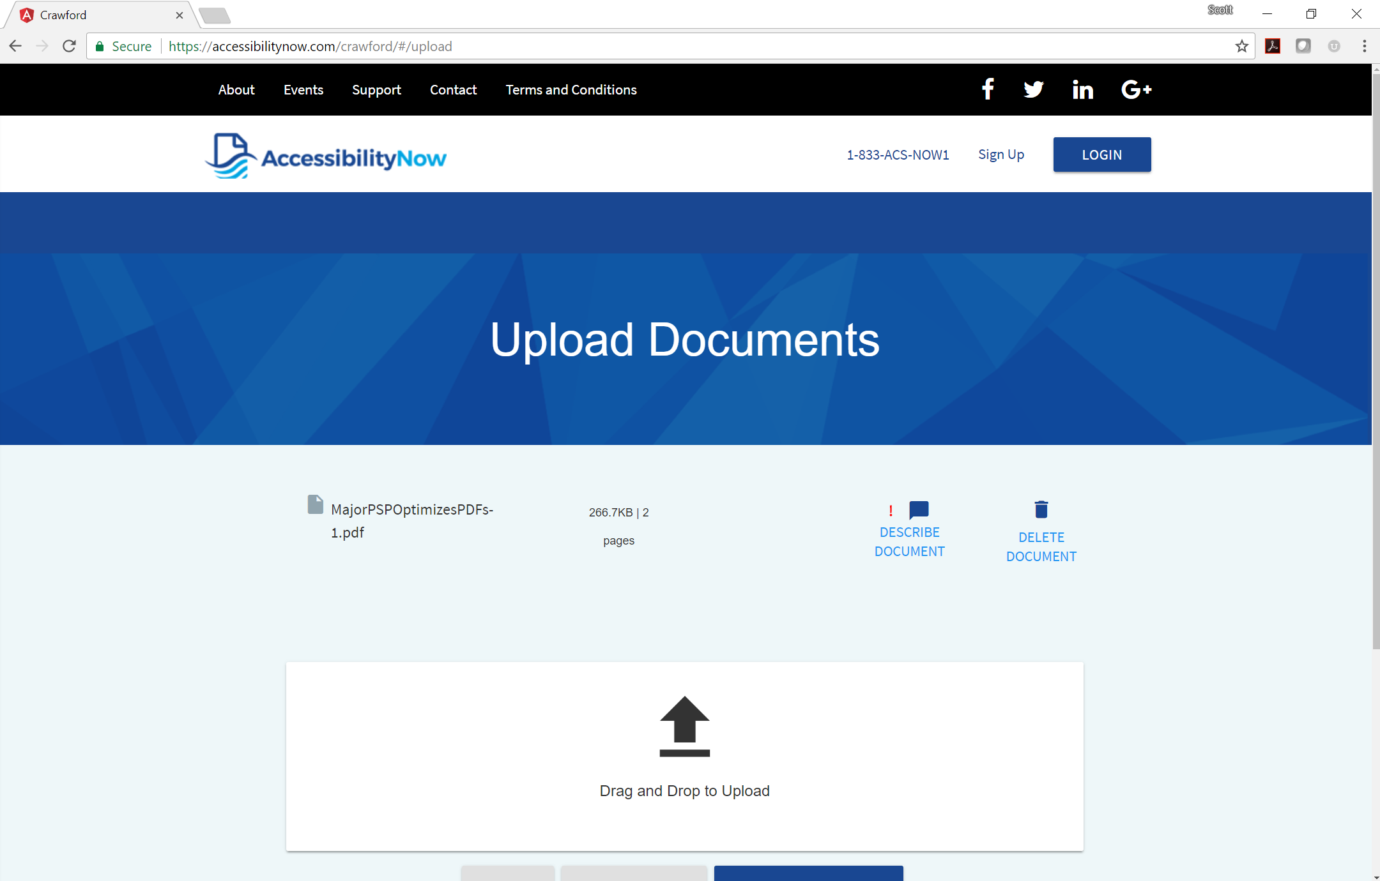

Slide 25
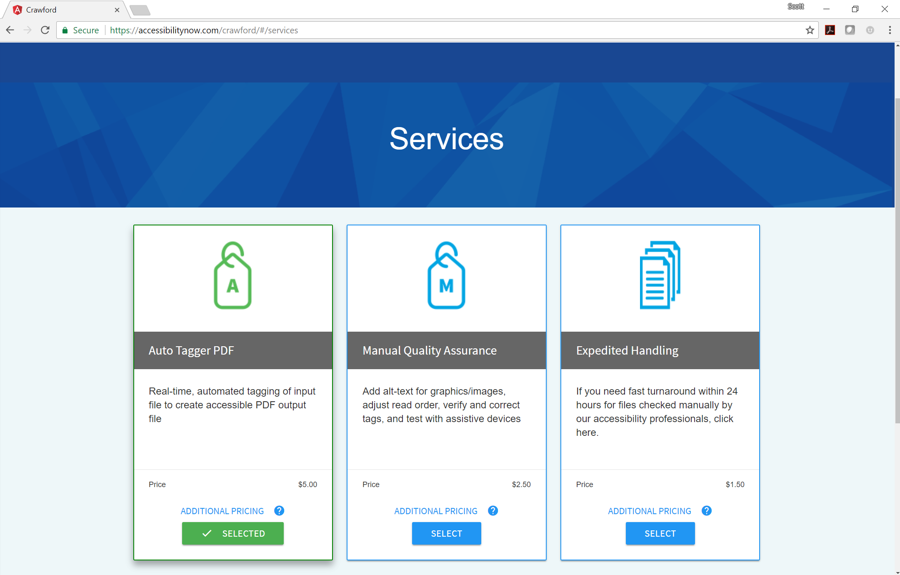

Slide 26
Pitfalls

Slide 27
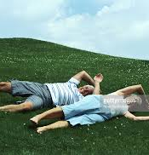
Pitfalls – ALT Text

Slide 28
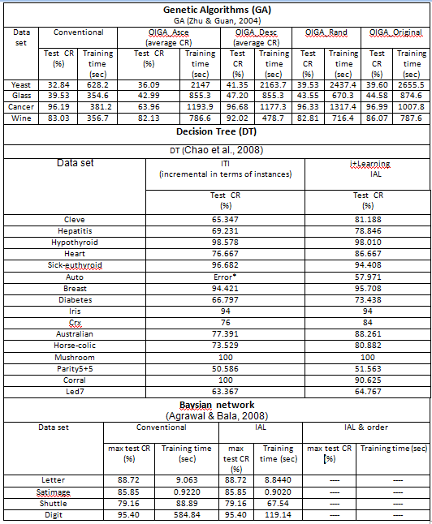
Complex Tables

Slide 29
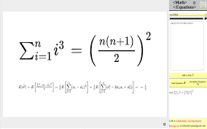
Mathmatical / Sybology

Slide 30
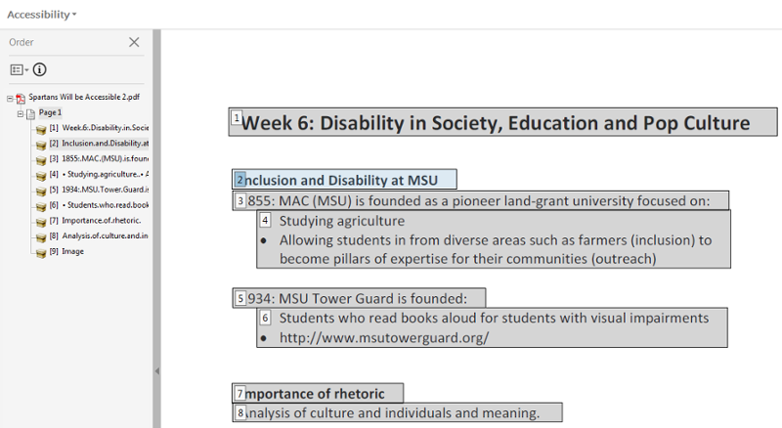
Read Order

Slide 31
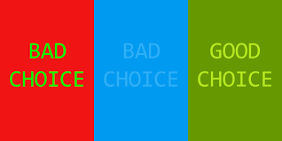
Contrast

Slide 32
Scanned Text

Slide 33
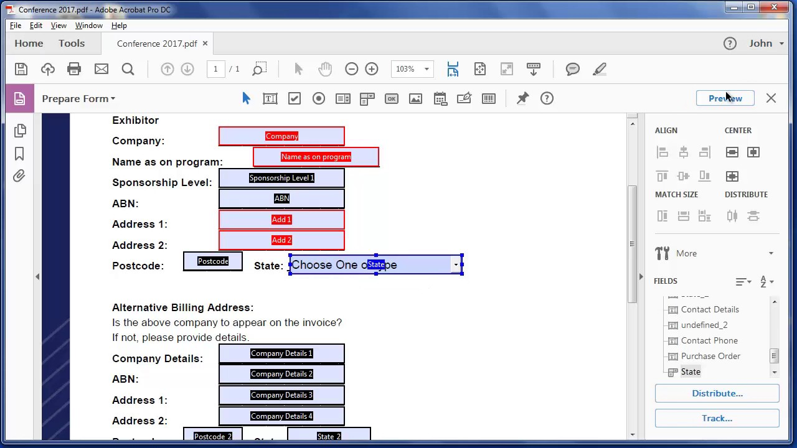
Fillable Forms
Hours of remediation
Very expensive

Slide 34
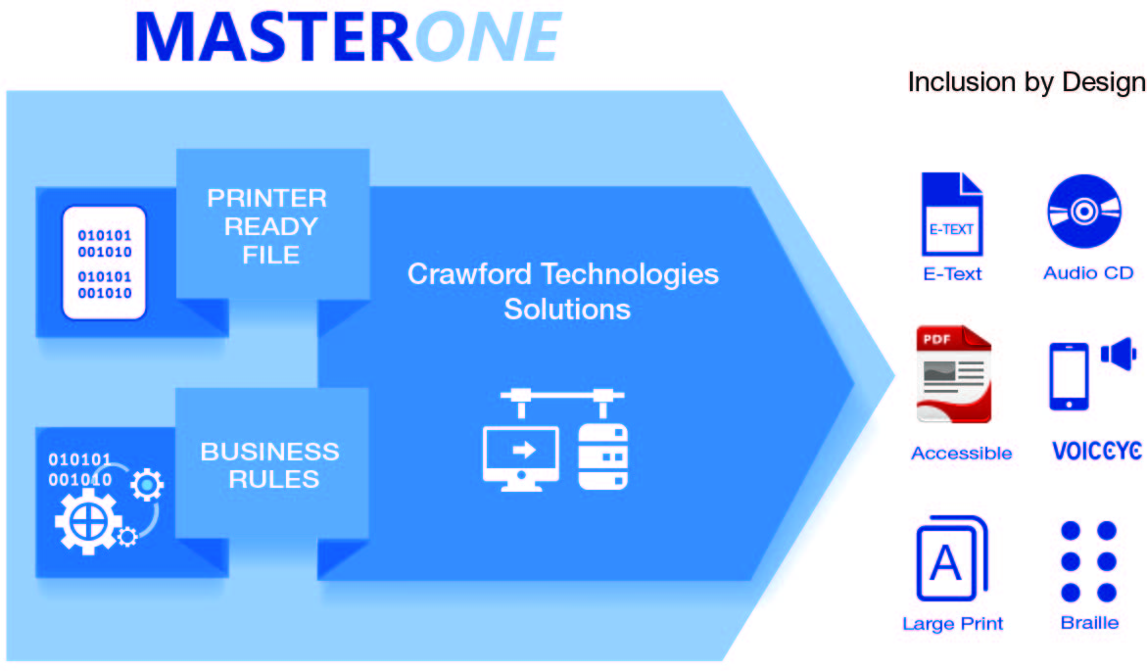
MasterOne Architecture Diagram
Alternate Formats
-braille
-large print
-eText
-Audio
-ePub 3.0
-HMTL5
Notes:
MasterOne Architecture diagram

Slide 35
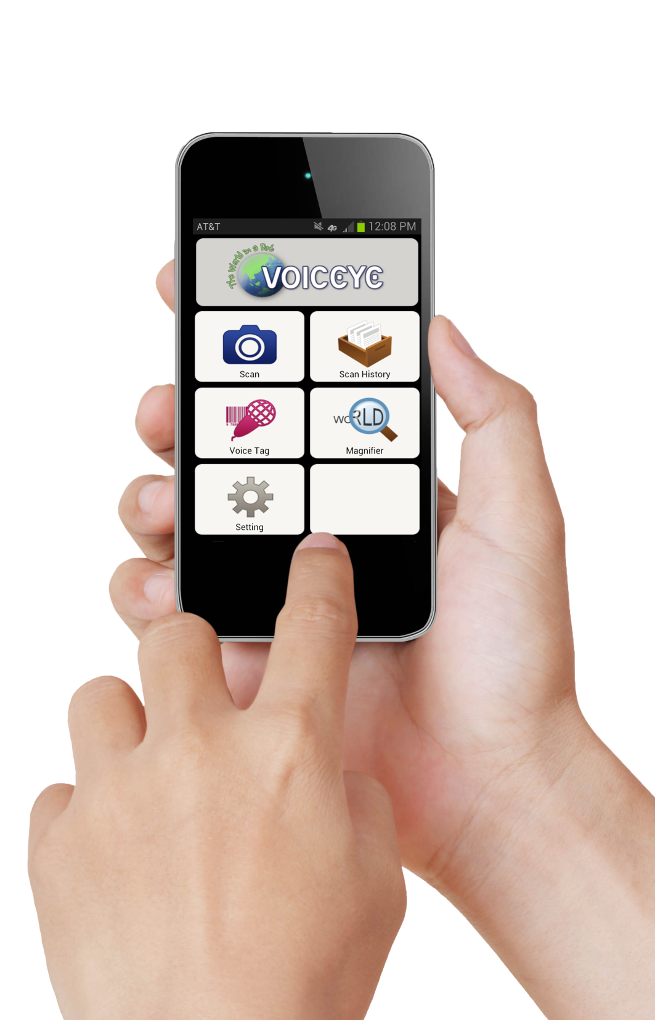
Different from QR
Voiceye is unique in that the amount of information stored in a single Voiceye code can exceed two pages of text. This information density allows users to access the text using their phone without internet or phone connectivity while making accessing information simple and effective.

Slide 36
Voiceye

Slide 37
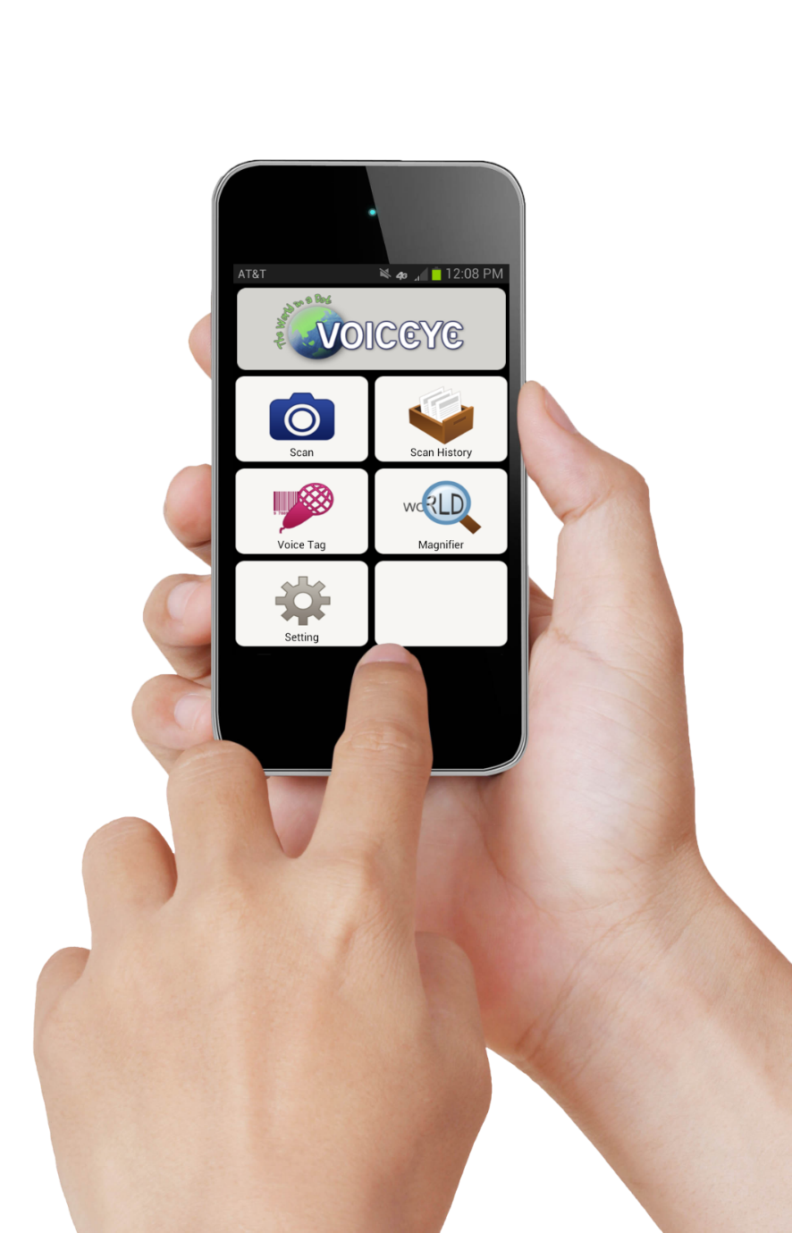
Voiceye App and barcode scan
Refreshable Braille Display

Slide 38
What does it do?
Encodes transactional print streams and MS-Word documents content into a 2D barcode – 100% accuracy.
Sets up read order (transaction)
Carries up to 250,000 characters per barcode
Applications are wide ranging – from Word Documents to bills, statements etc.
Highly portable
Not great for a truly blind person

Slide 39
Testing – Quality Assurance / Control
Human based testing
Assistive technology
Electronic testing – PAC 3.0, Adobe Acrobat PRO
USEABILITY VS ACCESSIBILITY

Slide 40
Learn More
Find us on Facebook, LinkedIn, Twitter and Google+ Visit: www.crawfordtech.com or e-mail: dquon@crawfordtech.com
Phone: 647-928-9008

