Slide 1

Creating Inclusive Learning Environments with Microsoft Accessibility
Manju Banerjee, Ph.D.
VP of Educational Research and Innovation
Landmark College
Anita Mortaloni
Principal Program Manager
Microsoft
@anitamortaloni

Slide 2


Landmark College
Landmark College is a not-for-profit 2- and 4-year college that exclusively serves neurodiverse students, including students with Dyslexia, ADHD and Spectrum Disorders.
Landmark College's mission is to transform the way students learn, educators teach, and the public thinks about education. We provide highly accessible approaches to learning that empower individuals who learn differently to exceed their aspirations and to achieve their greatest potential.

Slide 3


Microsoft Mission
Microsoft Mission
Empower every person and every organization on the planet to achieve more

Slide 4

Empowerment begins with inclusion
For educators, diversity demands they provide inclusive, accessible learning environments that inspire confidence
and encourage independence.
“Students would rather go without than stand out. We need to move from assuming access to ensuring access in classrooms.”
– Robin Lowell, Special Education Teacher

Slide 5

Landmark
College
Focus on cognitive access​
Anchored in a strength-based model vs. a deficit model​
Pedagogy is guided by the principles and mindset of Universal Design​

Slide 6

Cognitive Access
Strategies and Accessibility Tools
Reducing Cognitive Load
Increasing Working Memory
Activating Prior Knowledge
Supporting Learning Efficiency

Slide 7
Reducing Cognitive Load
Intrinsic Load; Extraneous Load; Germane Load
Learning Tools | Editor | Office Lens
Assist with comprehension, fluency, and decoding | Write easy-to-read documents that are professional | Digitize whiteboard notes and convert them to Microsoft Word, PowerPoint, or PDF
Word, OneNote, Outlook Web Access, and Edge | Word, Excel, PowerPoint, OneNote, Outlook | Office Lens
aka.ms/LearningTools | aka.ms/editor | aka.ms/OfficeLens

Slide 8
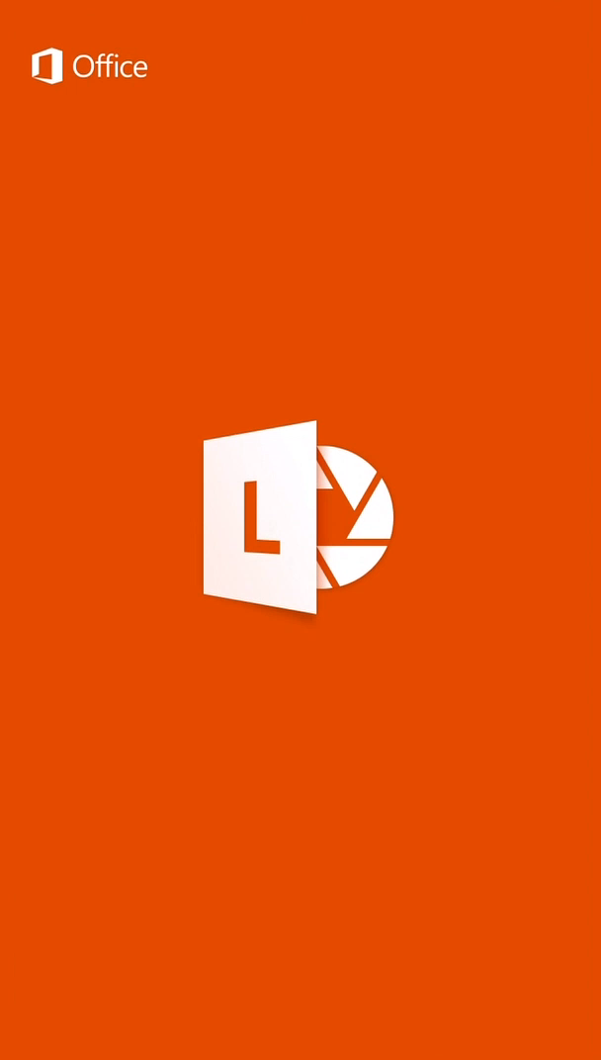
Office Lens

Slide 9
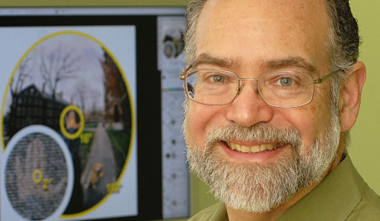
Visual Magnocellular Deficit Theory (Eden, 2016)
In a study with high school students with dyslexia, Schneps (2013) found that reading on the palm-sized screen of an iPhone reduced inefficiencies in the ways students’ eyes flitted across the page. The shorter lines on the screen made reading faster, without diminishing comprehension.

Slide 10
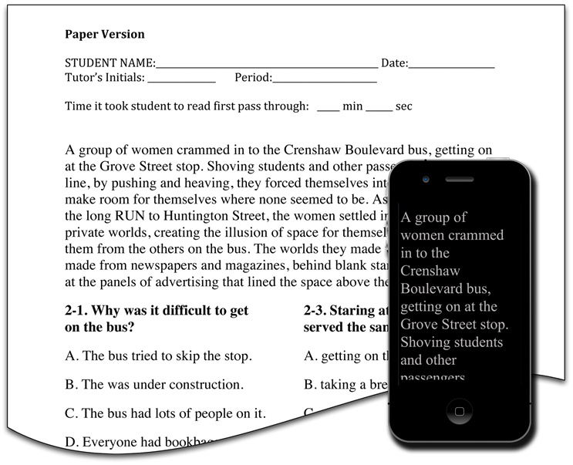
eReaders are more Effective than Paper for some Dyslexics – Matt Schneps (2013)
Banerjee 2017

Slide 11



Working Memory (WM)
WM is the ability to hold information in transient memory AND be able to process and manipulate it.
Smart Look Up | Microsoft Search | Focus Mode
Get more information, definitions, history and other resources related to that word or phrase | Personalized search across Office 365 that brings content, actions and search into your workflow | Sustains attention and improves reading speed
Word | Word, Excel, PowerPoint, Office Online, SharePoint, Bing | Word, OneNote, Outlook Web Access, and Edge
aka.ms/SmartLookup | aka.ms/MicrosoftSearch | aka.ms/LearningTools

Slide 12



Activating Prior Knowledge
Learning occurs when we add new information to our existing schema of prior knowledge.
Math in OneNote | Researcher | Ideas
Write or type any math problem and OneNote for Windows 10 solves | Find and cite reliable sources for your research paper in just a few steps | Understand your data through high-level visual summaries, trends, and patterns
OneNote | Word | Excel
aka.ms/OneNoteMath | aka.ms/WordResearcher | aka.ms/IdeasExcel

Slide 13



Supporting Learning Efficiencies
Outsource lower level tasks; built-in ease of access; coherence of experience; less time needed to complete task; accommodation that does not result in parallel learning
Get in the zone | Outlook & OneNote Tasks | PowerPoint Designer
Minimize distractions by reducing animations and blocking alerts with focus assist | Manage deadlines and remember the things on your to-do list via Outlook Tasks | Create professional looking slides in one click though design ideas generated based off your content
Win10 | OneNote, Outlook | PowerPoint
aka.ms/Win10Focus | aka.ms/OutlookTasks | aka.ms/PPTDesigner

Slide 14

Learn More!

Slide 15
Microsoft Education Solutions
Reducing Cognitive Load | Working Memory (WM) | Activating Prior Knowledge | Support Learning Efficiencies
Learning Tools Assist with comprehension, fluency, and decoding | Smart Lookup Get more information, definitions, history and other resources related to that word or phrase | Math in OneNote Write or type any math problem and OneNote for Windows 10 solves | Get in the zone Minimize distractions by reducing animations and blocking alerts with focus assist
aka.ms/LearningTools | aka.ms/SmartLookup | aka.ms/OneNoteMath | aka.ms/Win10Focus
Office Lens Digitize whiteboard or blackboard notes, convert them to Word, PowerPoint, or PDF | Microsoft Search Personalized search across Office 365 that brings content, actions and search into your workflow | Researcher Find and cite reliable sources for your research paper in just a few steps | PowerPoint Designer Create professional looking slides in one click though design ideas generated based off your content
aka.ms/OfficeLens | aka.ms/MicrosoftSearch | aka.ms/WordResearcher | aka.ms/PPTDesigner
Editor Write easy-to-read documents that are professional | Focus Mode Sustains attention and improves reading speed | Ideas Understand your data through high-level visual summaries, trends, and patterns | Outlook Tasks Manage deadlines and remember the things on your to-do list via Outlook Tasks
aka.ms/editor | aka.ms/LearningTools | aka.ms/IdeasExcel | aka.ms/OutlookTasks

Slide 16
Microsoft Education Resources
3 trainings to share with educators | 5 free tools to try today | Contact us and learn more about Microsoft Accessibility technologies
Educator Training on Inclusive Content aka.ms/AccessibleContentTraining Educator Training for Personalizing Learning education.microsoft.com/GetTrained/accessibility Training on Creating a Digitally Inclusive Learning aka.ms/AchievementForAll | Communicate and collaborate seamlessly with Office 365 aka.ms/OfficeEducation Engage your diverse audience by presenting with subtitles aka.ms/TranslatorForEducation Create assignments that are accessible by design aka.ms/AccessibleTemplates Go paper-less with Office Lens and Seeing AI aka.ms/OfficeLens & microsoft.com/en-us/seeing-ai/ Encourage independent reading and writing aka.ms/LearningTools | Disability Answer Desk for phone/chat/ASL Help Aka.ms/AccessibilitySupport User Voice Forum for Accessibility Feedback Aka.ms/AccessibilityFeedback Microsoft Educator Community http://education.microsoft.com #MicrosoftEDU

Slide 17
Resources and Professional Development Events by Landmark College

Slide 18
Navigating Today’s Workplace: Strategies and Job Opportunities for Neurodiverse Young Adults
One day event hosted by Landmark College at:
The Conference Center at Bentley University, MA
Saturday, March 23, 2019
With Representatives on Job Hiring Programs from
Microsoft; Fidelity; Ernst & Young; MGH- AspireWorks; JPMorgan Chase
For more information contact:
Carol Beninati at carolbeninati@landmark.edu
(802) 387-7115

