Slide 1
Teaching Accessibility: A National Survey and the Way Forward
Richard Ladner University of Washington
Accessing Higher Ground
November 16, 2018

Slide 2
Who am I?
Professor at the University of Washington since 1971
Paul G. Allen School of Computer Science and Engineering
Emeritus since 2017
Current Activities
Accessibility research

Slide 3
AccessComputing Goal
Increase the participation and success of students with disabilities in computing fields.
Strategies
Direct Interventions with students
Institutional change
Knowledge dissemination

Slide 4
Institutional Change Goal
Increase the teaching of accessibility related topics in computing courses.

Slide 5
Outline
National Survey
How to increase the teaching of accessibility related topics

Slide 6
National Survey
Kristen Shinohara, Saba Kawas, Andrew J. Ko, and Richard E. Ladner. 2018. Who Teaches Accessibility?: A Survey of U.S. Computing Faculty. In Proceedings of the 49th ACM Technical Symposium on Computer Science Education (SIGCSE '18). ACM, New York, NY, USA, 197-202. https://doi.org/10.1145/3159450.3159484

Slide 7
Related Work
How to Teach Accessibility Bigelow, 2012; Bohmon, 2012; Ko et al, 2016; Ludi, 2002, 2007; Martin-Escalona, 2013; Putnam et al., 2016; Shinohara et al., 2016; Waller, 2009.
Diverse perspectives
Engaging people with disabilities
Project-based learning
Guest speakers and video testimonials
Curricular interventions Waller et al., 2009; Ludi, 2002
Curricular change Barnett et al, 2001; Kirk and MacDonald, 2001; Kezar and Eckel, 2002
Notes:
Curricular change occurs when social and instructional discourse among faculty organically contribute to constructing instructors’ knowledge; may also depend on institutional culture

Slide 8
Survey
352 institutions
14,176 faculty
1,857 responses from 318 institutions

Slide 9
Research Questions
RQ1: Who is teaching accessibility?
RQ2: What barriers do faculty see to teaching accessibility?
RQ3: What factors predict who is teaching accessibility?

Slide 10
Survey Sample
Faculty at 4-year universities and colleges
Computer Science
Information Science
Other interdisciplinary computing departments
Major accredited programs as identified in:
Wikipedia
Computing Research Association
iSchool Caucus charter list for Information Schools

Slide 11
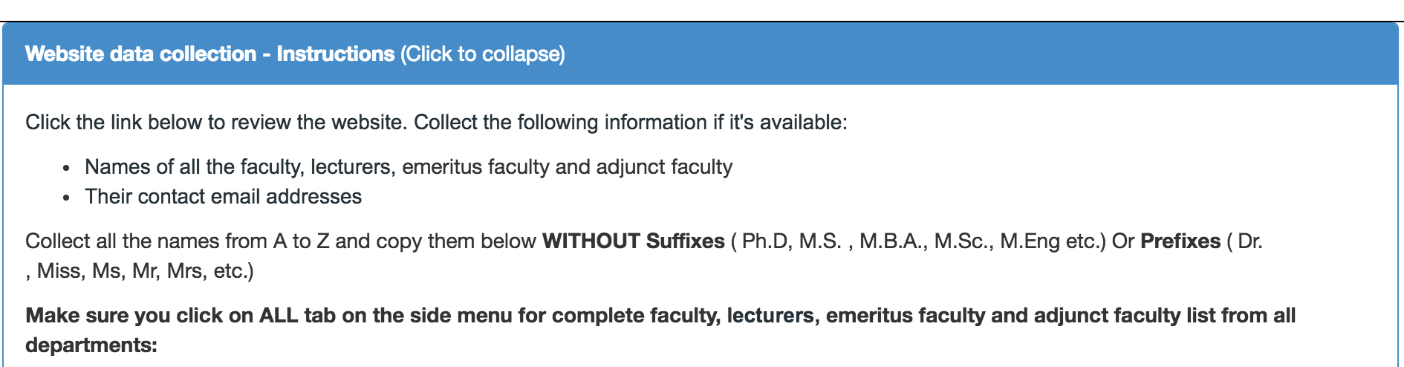
Finding Contact Information
Mechanical Turk
Providing department and college site information

Slide 12
Survey Instrument
RQ1: Who is teaching accessibility?
Demographic information: gender, years teaching, area of expertise, personal connection to disability
Do you teach courses that include accessibility?
What pedagogies do you use to teach about accessibility?
RQ2: What barriers do faculty see to teaching accessibility?
Should accessibility be taught as part of computer science?
What resources would be helpful?

Slide 13
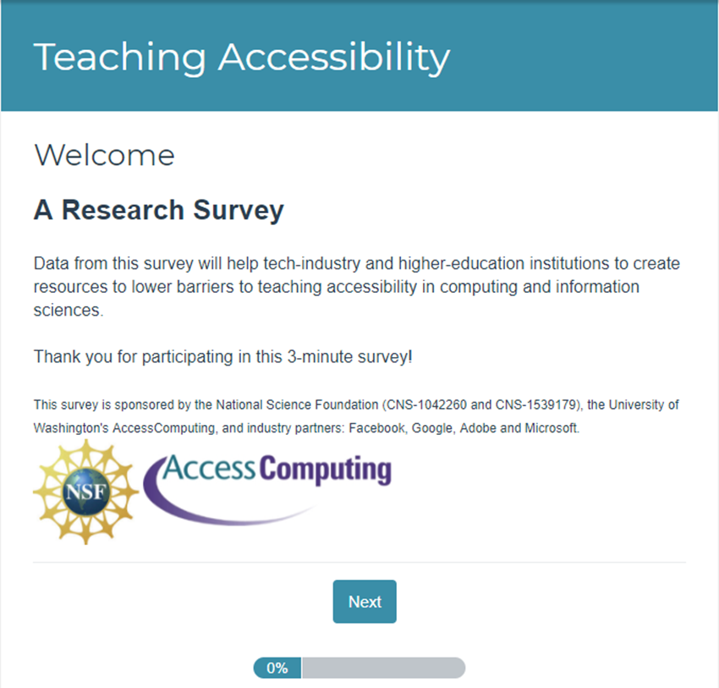
Survey Launch
SurveyGizmo, 3 Launches
Emails with link to survey sent
To 14,176 faculty
From 352 institutions
Received full responses
From 1,867 faculty
From 318 institutions
Response rate of 13%

Slide 14
RQ1: What institutions teach accessibility?
375/1857 (30%) responding faculty teach accessibility
375/14176 (2.6%) faculty teach accessibility
175/352 (50%) institutions have faculty who teach accessibility
75/352 (21%) institutions have at least 2 faculty who teach accessibility

Slide 15
RQ1: What institutions teach accessibility?
Top college and universities
10
11
11
21
9
11
8
9
12
Notes:
Top institutions teaching accessibility:
University of Washington (21)
Kent State University (12)
Indiana University at Bloomington (11)
Rochester Institute of Technology (11)
University of Michigan (11)
Carnegie Mellon University (10)
University of Maryland, Baltimore County (9)
University of Maryland, College Park (9)
University of Missouri (10)

Slide 16
Why is University of Washington so Good?
Combined UW faculty in CSE, iSchool, and HCDE is about 150
Six focus primarily on accessibility research
UW author contributions to ASSETS over time is 272.
Next highest UBMC with 139
Strong accessibility ecosystem
CSE, iSchool, HCDE, Engineering College
Access Technology Center
DO-IT Center
DUB

Slide 17
RQ1: Who is teaching accessibility?
Identified as female
More likely to know someone with a disability
Most common area of expertise: Human-Computer Interaction
17% identified as having a disability
375
1,482
Notes:
Chart shows: 37.6% of those who teach accessibility are women and only 19.6% of those who do not teach accessibility are women. Sample size is 375 who teach accessibility and 1,482 who do not.

Slide 18
RQ1: Areas of Expertise N=424/1857
Teaches Accessibility
Does Not Teach Accessibility
HCI
Software Engineering
Information Assurance
Cybersecurity
Library and Information Science
Computer Science Education
Other Applied Areas
Algorithms
Theory
Artificial Intelligence
Machine Learning
Programming Languages

Slide 19
RQ1: Learning Objectives
Understand technology barriers
Understand design concepts
Engage diverse populations
Evaluate web accessibility standards and heuristics
Develop accessible web technologies
Employ design techniques
Understand Legal regulations (Section 508, ADA)
Understand Models of disability
Employ accessibility-focused technical languages and tools

Slide 20
RQ2: Challenges to incorporating accessibility
Not core part of curriculum
Don’t know enough to teach it
No appropriate textbook
Lack of students and administrator awareness
Lack of support for topics addressing real challenges for disabled
Difficulty engaging students
Lack of demand in industry
Difficult to recruit people with disabilities

Slide 21
RQ2: What are barriers to teaching accessibility?
N = 1,857
Faculty who do not teach twice as likely to view as barriers:
Don’t know enough about accessibility
No textbook
Challenges engaging students
Notes:
Chart has three bars.
80% of respondents don’t know enough to teach accessibility (54.9% don’t teach accessibility, while 26.1% do).
36.2% of respondents lack a textbook (12.4% don’t teach accessibility, while 24.8% do).
27.1% of respondents have challenges engaging students about accessibility (7.9% don’t teach accessibility, while 19.2% do).

Slide 22
RQ2: What do faculty need?
“If you wanted to incorporate accessibility into your curriculum, what resources would be helpful?”
Connecting or bringing people with disabilities into classroom
Resources like tools, technologies, guidelines, problem examples
Access to curriculum building and curricular samples in specific courses
Training and opportunities to gain expertise

Slide 23
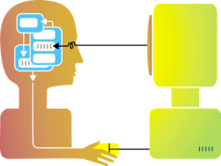
RQ3: What predicts teaching accessibility?
1.5 times as likely to know someone with a disability
2 times as likely to identify as female
2.1 times as likely to agree that accessibility is part of computing
3.5 times as likely to report having knowledge of accessibility

Slide 24
How to increase the teaching of accessibility related topics

Slide 25
People
Hire more women
Hire more people with diverse backgrounds
Hire in Human-Computer Interaction

Slide 26
Create an Accessibility Ecosystem
University commitment to accessible education
Not just IT departments
Not just Disability Resources for Students (DRS)
Department commitment to teaching accessibility
Industry need
ABET definition of engineering design
Individual commitments to teaching accessibility
Design/Development courses
Capstone Design
Other Courses

Slide 27
University Commitment
Not just compliance, but welcoming
Stanford Office of Accessible Education
Stanford University has a strong commitment to maintaining a diverse and stimulating academic community, representing a broad spectrum of talents and experiences. Students with disabilities, actively participating in the various aspects of life at Stanford, are an essential part of that diversity.

Slide 28
Department Commitment
University of Washington School of Computer Science and Engineering
The Allen School is a community that celebrates and values differences among its members. We strive to create an inclusive environment for people of all backgrounds. … The Allen School actively works to increase access to CS education and careers for people with disabilities.

Slide 29
Industry Need
Founded 2015
Industry, academia and advocacy have come together to create models for teaching and training students of technology to create accessible experiences.
http://teachaccess.org/

Slide 30
ABET
Engineering Design – Engineering design is the process of devising a system, component, or process to meet desired needs and specifications within constraints. … examples of possible constraints include accessibility, aesthetics, constructability, cost, ergonomics, functionality, interoperability, legal considerations, maintainability, manufacturability, policy, regulations, schedule, sustainability, or usability.
http://www.abet.org/accreditation/accreditation-criteria/criteria-for-accrediting-engineering-programs-2018-2019/

Slide 31
Design/Development Courses
Introduction to Human Centered Design
Web design and development
App design and development
iOS
Android
Microsoft

Slide 32
Accessible Apps and Webpages
Web Content Accessibility Guidelines 2.0
http://www.w3.org/TR/WCAG20/
Microsoft Accessibility
http://www.microsoft.com/enable/
Apple Accessibility
https://www.apple.com/accessibility/
Android Accessibility
https://developer.android.com/guide/topics/ui/accessibility

Slide 33
Accessibility Capstone – Example projects
The Phone Wand - Navigating routes using orientation and vibration feedback.
Pic2Speech - Custom augmented speech.
Street Sign Reader - Reading street signs so you don't have to.
WhosHere - Finding out which friends are around you.
TapBeats - The sound of gestures.
Sound Detector - Detecting recognizable sound patterns to alert the user.

Slide 34
Other Courses with Accessibility Content
Computer Vision
OCR
Automatic image description
Natural Language Processing (NLP)
Complex language simplification
Annotations for dyslexia
Signal Processing
Speech recognition
Data Compression
Braille
Software Engineering
Accessible integrated development environments (IDEs)

Slide 35
What can IT professionals do?
Partner with departments and faculty to help create accessibility content for courses.
Accessing Higher Ground attendees have a lot of knowledge that can help faculty member create content
Advocate that your university move from a “compliance stance” to a “welcoming stance.”
Help move “stigma” to “celebration of differences”

Slide 36
References
Kimberly E. Bigelow. 2012. Designing for Success: Developing Engineers Who Consider Universal Design Principles. Journal of Postsecondary Education and Disability 25, 3, 211-225.
Andrew J. Ko and Richard E. Ladner. 2016. AccessComputing Promotes Teaching Accessibility. ACM Inroads 7, 4, 65-68.
Stephanie Ludi. 2007. Introducing Accessibility Requirements through External Stakeholder Utilization in an Undergraduate Requirements Engineering Course. In Proc Software Engineering ’07, 736–743.
Stephanie Ludi. 2002. Access for everyone: introducing accessibility issues to students in Internet programming courses. In 32nd Annual Frontiers in Education, S1C–7.
Israel Martin-Escalona, Francisco Barcelo-Arroyo, and Enrica Zola. 2013. The introduction of a topic on accessibility in several engineering degrees. In 2013 IEEE Global Engineering Education Conference (EDUCON), 656–663.
Cynthia Putnam , Maria Dahman , Emma Rose , Jinghui Cheng , Glenn Bradford. 2016. Best Practices for Teaching Accessibility in University Classrooms: Cultivating Awareness, Understanding, and Appreciation for Diverse Users, ACM Transactions on Accessible Computing (TACCESS), 8, 4, 1-26.
Brian J. Rosmaita. 2006. Accessibility first!: a new approach to web design. In Proc SIGCSE 2006, 270–274.
Kristen Shinohara, Saba Kawas, Andrew J. Ko, and Richard E. Ladner. 2018. Who Teaches Accessibility?: A Survey of U.S. Computing Faculty. In Proceedings of the 49th ACM Technical Symposium on Computer Science Education (SIGCSE '18). 197-202.
Kristen Shinohara , Cynthia L. Bennett , Jacob O. Wobbrock. 2016. How Designing for People With and Without Disabilities Shapes Student Design Thinking, Proceedings of the 18th International ACM SIGACCESS Conference on Computers and Accessibility, ASSETS 2016.
Annalu Waller, Vicki L. Hanson, and David Sloan. 2009. Including accessibility within and beyond undergraduate computing courses. Procceding of the 11th International ACM SIGACCESS Conference on Computers and Accessibility, ASSETS ’09, 155– 162.

Slide 37
Discussion Questions
What can you do in your institution to make teaching accessibility more likely?
How would you open the lines of communication between accessibility knowledgably IT professionals and teachers at your institution?

