Slide 1
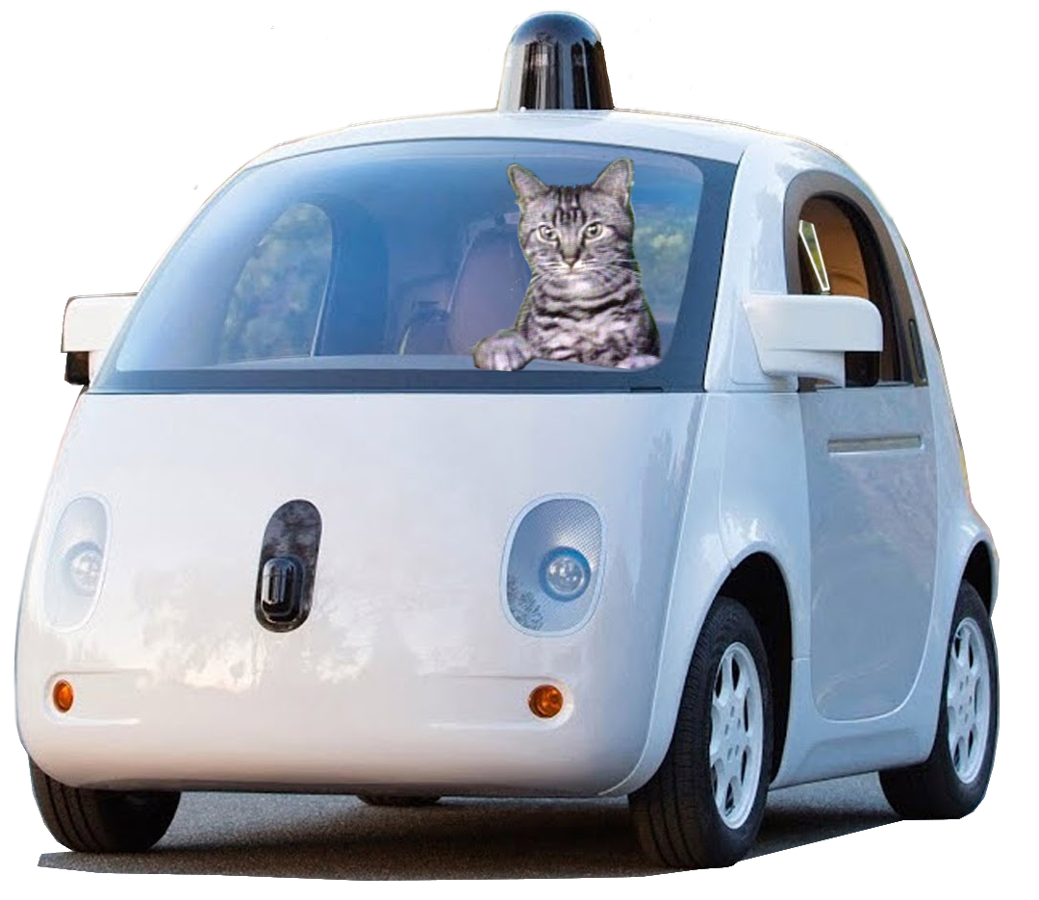
Taking CAR for a Spin, and so Much More!
Candace McKinley Philpott
University of Arkansas
Presentation adapted by Wink Harner for AHG 2018
with permission.

Slide 2
Well… We have something to rev you up!
Are your current accessible
alt format processes a wreck?
Do you sputter out when trying to
help students access their accessible
alt formats?
Are your current PC text-to-speech programs lemons?
Tired of trying to explain non-intuitive text-to-speech programs to students?
Notes:
(Read Slide)
CAR puns. Oh yes.

Slide 3
Where are we going? …on an Adventure!
Our route:
Intro to tools & processes used at UARK
CAT: What it can do for you and how to get it
CAR Checker: What is it?
Download & customize Central Access Reader (CAR) settings
Make mp3's in CAR
Technology UARK suggests to students
Check out our website: http://cea.uark.edu/students/alternative-formats/index.php
Notes:
Were our we going??? On an Adventure!
(Read Slide)

Slide 4
Our Processes…
Notes:
Our processes may not make much sense now, but I will re-review them towards the end of the presentation and at the point I can take some questions.

Slide 5
Some of our shop tools:
ABBYY FineReader/OmniPage Ultimate Pro
Microsoft Word
MathType (as needed)
Central Access Toolbar (CAT)
Central Access Reader (CAR)
Notes:
First of all, we should let you know the tools that we use in our shop.
(Read Slide)

Slide 6
1) Scan or receive materials from publisher, instructor, or student.
Notes:
To simplify, we have a 4 step process to conversion.
The first step of our process is to.. Scan or receive materials from publisher, instructor, or student.

Slide 7
2) Use ABBYY FineReader to OCR & edit layout
Notes:
The second step is to Use ABBYY FineReader to OCR & edit layout,
If you notice in the picture that boxes are being drawn in the text. We draw the boxes and then number the boxes to organize the order in which the text of a page is read.
Is currently about 169.99.

Slide 8
3) Edit DOCX in MS Word with CAT, our custom macros, and Word tools.
Notes:
3) Edit the document in MS Word with Central Access Toolbar (CAT), apply our custom macros, and some basic Word tools.
Our editing procedures actually consists of multiple steps: Applying Macros, Using CAT “Prepare Document” tool, adding or adjusting page numbers, headings, side-notes, and footnotes, performing a grammar check, adding alt text to all images, and making sure that at least all in-text symbols and equations are converted using MathType, so that can be read aloud in CAR. (I will touch on the macros and headings more in a bit).

Slide 9
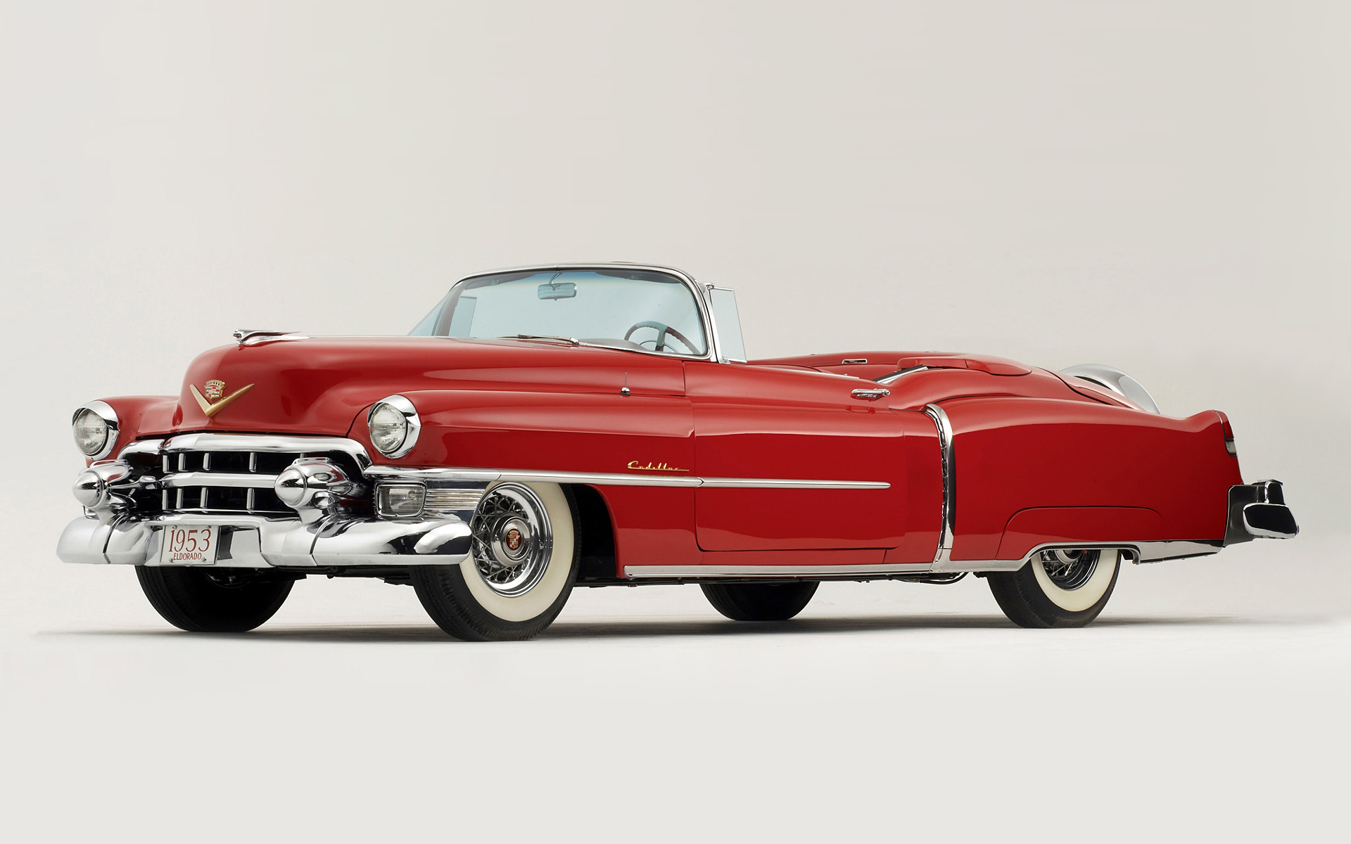
4) Finally, we quality check the final product with CAT and CAR.
Notes:
At this point we use the CAT tool, “Checker”, to verify all images have alt text, all page numbers are correct, spell check has been ran, correct formatting has occurred, and that no boxes, WordArt, charts, or SmartArt is still in the text.
AND then in Central Access Reader (CAR) we check that the document will open, Headings and pages numbers are correct, and that there are no issues with CAR reading it.

Slide 10
CAT (Central Access Toolbar)
Q: What kind of cars do cats drive?
A: Catillacs!
Notes:
What Kind of cars do cats drive
Catillacs!!

Slide 11
Let’s first cover these…
Navigation Panes
Headers
Notes:
Let’s now talk about CAT….
(Read Slide)

Slide 12
Navigation Pane
To bring up the Navigation Pane
Click the “View” tab
Select the box beside “Navigation Pane”
Document Headers are displayed.
Notes:
Does anyone know what the navigation pane does?
(Read Slide)

Slide 13
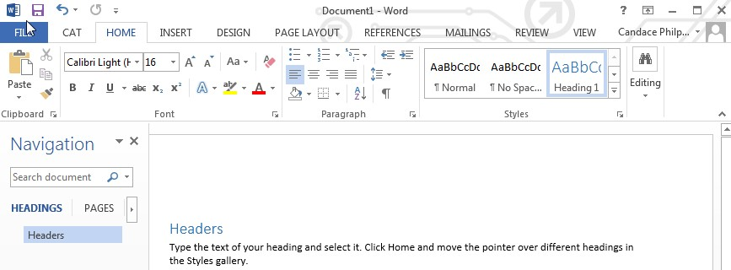
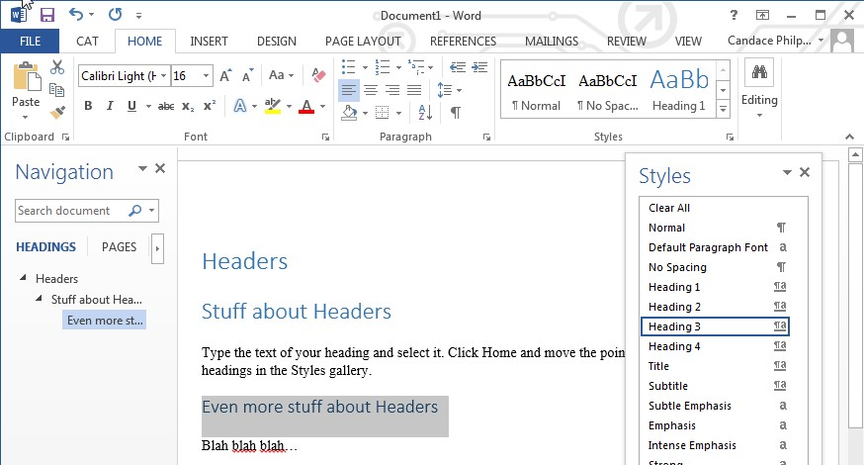
Headers
Click the Home tab and then type the text of your heading. Once you select it, move the pointer over different headings in the Styles gallery and pick a header.
As you add Headers, they will show up in the “Navigation Pane”.
Always have Headers in numerical order and do not go past Header 4
1
2
3
Notes:
Does anyone know what the Style Gallery does on the Home Tab? Before I started my current job, I had no clue
(Read Slide)
In this example, I used the factory Headers. We have our own set of headings, developed by the Robert Lee Beach of Kansas City Kansas Community College. They are pretty much considered the standard.
If you would like us to share our templates and macros with you, please contact us at cealab@uark.edu.

Slide 14
CAT and its Features
Guide Me
Prepare Document
Checker
Cat Tracks
Notes:
Now back to business….
Here are the main CAT features…. (Read Slide)
CAT was developed by Central Washington University and is currently still in beta. I spoke with Wendy Holden, Director of Disability Services for CWU last week.
At this point, they are not sure if they want to give it away or sale licenses. She said that if anyone here is interested in CAT, to contact her directly. I have included her contact info in the references list at the end of this PPT. I suggest calling.

Slide 15
Guide Me
…your workflow assistant.
Guide Me teaches steps of document processing as you go.
No previous experience needed.
https://www.youtube.com/watch?v=oaPT5vV9IDw
Notes:
Well… When our lab got a hold of the download, they were so excited that explored all the tabs first and wish they would of started with this one.
Central Washington University gives a great overview of this feature just click this link .
I also have this listed in the References slides at the end of this PowerPoint. https://www.youtube.com/watch?v=oaPT5vV9IDw

Slide 16
CAT Checker
Notes:
As we saw before… It gives you a list of things to check for.

Slide 17
Prepare Document
Notes:
This feature helps us with formatting of the document.
The image is an excerpt from our lab conversion training manual. It is showing our preferred settings.

Slide 18
CAT Tracks
UARK common uses:
Blue: Pages numbers
We don’t touch Orange
Magenta: clear formatting and spell check
Green & Brown: checker tools
We encourage you to check out all the tools!
Notes:
CAT TRACKS! This pretty colorful section houses some really cool tools.
We pick and choose what we need out of these.
(Read Slide)

Slide 19
CAR Checker
Looking for a compact to fit your needs? Try
Notes:
Looking for a simpler document checker? CAR Check is a “compact” version of CAT. OK. So…. You maybe telling yourself… That looks super cool, like she said!
OR you maybe saying this isn’t realistic for our office. We do not have a fancy conversion lab.. Those crazy razorbacks..
Well Central Washington has something that is simple and readily available. CAR Checker

Slide 20
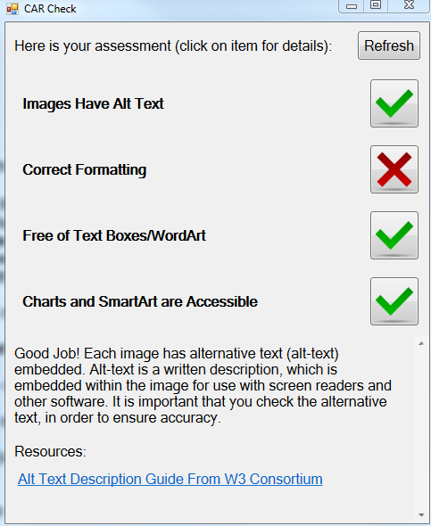
CAR Check
It has many of same features as CAT.
If you click on the “Checker” tab, a more simplified check box pops up to check the document.
Notes:
(Read Slide)
CAR Checker is a simplistic version of CAT. It is currently available for free download on the CWU site.
CWU recommends CAR Checker for faculty to use, but it is great for everyone.
CWU writes….
“CAR Check is an add-in for Microsoft Word for Windows, which provides a centralized set of tools that assist in creating accessible documents. Evaluate your document with an easy to understand score card of accessibility. CAR Checker then shows you how to correct issues.”

Slide 21
What is CAR? Central Access Reader
Central Access Reader: developed by Central Washington University.
Free, open source, text-to-speech application
specifically for students with print-related disabilities.
Reads Word DOCX and pasted text.
Uses built-in voices installed on your computer.
Intuitive interface and many customizable features.
Reads math symbols (if created with MathType software)
Export to mp3 files.
Use with PC and sometimes MAC.
https://www.cwu.edu/central-access/
Notes:
FINALLY!! What you have all been waiting for…..CAR or Central Access Reader.
(Read Slide)
To use this
Windows requires
64-bit Windows 8, 7, and Vista.
Minimum RAM: 2GB
Processor: Single-core, 1 GHz

Slide 22
Starting your CAR: Use WORD!
It is essential to save Word files as DOCX, because CAR only reads DOCX format.
When saving a file, DOCX format may appear as “Word Document” in the “Save as Type” drop down box
Notes:
(Read Slide)

Slide 23
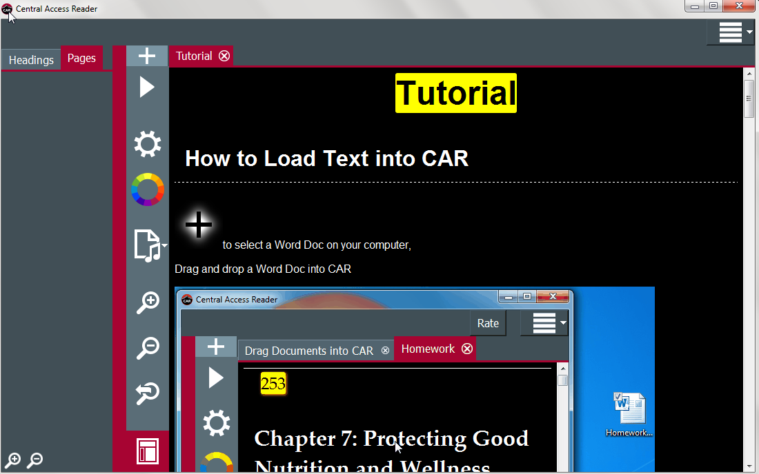
Here’s The Latest Showroom Model…
https://www.youtube.com/watch?v=-b0ykvwd3cc
Notes:
Here is what CAR looks like.

Slide 24
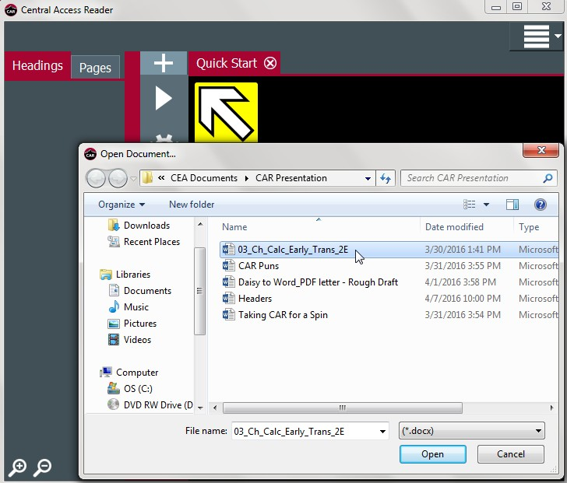
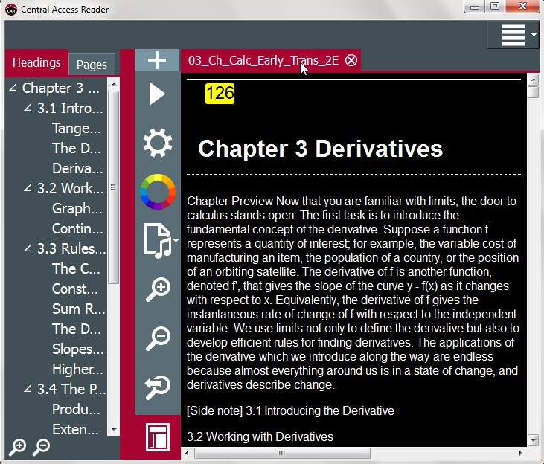
Open a Word DOCX in CAR
Click Plus to open a Word DOCX.
The “Open Document” window will be displayed.
Select document to open.
A new CAR tab will open at the top of the CAR window.
Notes:
(Read Slide)

Slide 25
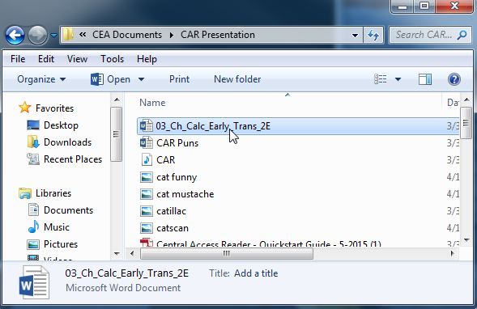
Using CAR to READ Other Text: Drag-and-Drop
Drag-and-drop a Word DOCX into CAR.
Notes:
If you notice, the “Quick Start” tab lists all the ways you can insert text or a DOCX file.
(Read Slide)

Slide 26
Using CAR to Read Other Text: Copy-and-Paste
Copy-and-paste text into CAR from
text-based PDF’s,
emails,
websites, etc.
Notes:
I really enjoy this feature for my own personal reading. Anytime that I have had to read long case studies with terrible multi-column formatting, I just copy in a column in at a time and have CAR read it to me.

Slide 27
Navigating the DOCX
The Headings and Page numbers* tabs are available for easy navigation of document content.
*Headers must be set up using styles in MS Word and page numbers can be added in ABBYY or CAT.
Notes:
(Read Slide)

Slide 28
Using Text-to-Speech
To read, click Play
Wherever cursor is located in text is where CAR will begin reading
Notes:
(Read Slide)
Short Keys:
Start Reading: CTRL + R
Stop Reading: CTRL + S

Slide 29
Text-to-Speech Options
Text-to-Speech options are within the General Settings button.
Users can customize by
Selecting a preferred voice,
Setting rate of speech, volume, and pause length
These options can also be accessed through the dropdown menu in the top right corner.
Settings -> General
Function → Read or Stop
Notes:
(Read Slide)

Slide 30
Interior Colors
While reading aloud, CAR can highlight the word and/or sentence in various colors.
Customize colors for:
Background color
Text color
Highlight background color
Highlight text color
Notes:
(Read Slide)

Slide 31
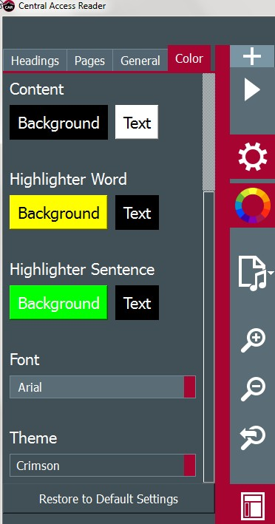
Customizing the Model
Select
preferred font.
color theme.
Change your mind? Reset to default settings.
Notes:
(Read Slide)

Slide 32
Going bigger (Zoom Settings)
Magnify the content text.
Magnify +
increases the zoom
Magnify -
decreases the zoom
Reset magnification
Click magnifying glass with the arrow
Notes:
Zoom Short Keys
Zoom in: CTRL + =
Zoom out: CTRL + -
Zoom Reset: CTRL + Backspace

Slide 33
Taking It On the Road with MP3
Notes:
(Read Slide)

Slide 34
Exporting File Options: Convert to MP3
You can convert Word or text documents into MP3 audio files.
To convert the loaded document:
Press the convert button.
In the dropdown menu, choose to save all or just save selected text.
A pop-up menu will appear to save the new mp3 file in the preferred destination.
Notes:
(Read Slide)
This is something that the mechanics in our alt-format shop has even used on car rides. It is great for re-listening to your class notes or self made study guides.

Slide 35
Export to HTML
You can also convert documents into HTML files.
1. Press the convert button
2. In the drop down menu, choose HTML.
3. Choose where to save the file.
Notes:
We have not had to use this, but we wanted to let you know that it is an option.

Slide 36
Ready for a test drive?
Notes:
Open CAR and open the Calc Early Trans doc.

Slide 37
Review of conversion process
1) Scan or receive files from the publisher, instructor, or student.
2) For text-based files, use ABBYY FineReader to OCR and edit the layout; For STEM content, use Omnipage Ultimate
3) Edit the document in Microsoft Word with CAT, custom macros, and Word tools.
4) Finally, quality check the final product with CAT and CAR
Questions?
Notes:
(Read Slide)

Slide 38
Are we there yet?
Nope. There’s more.
Notes:
(Read Slide) Sorry. We are close. I promise.

Slide 39
Other UARK recommended applications and software
On our website, we cover apps for:
Windows
Mac
iOS
Android
Notes:
We also included the following Some Alternative Format Specifics
on our site:
“To use an alternative format, special software or apps may be necessary.
Costs: $0 to over $1000.
Mindful that students are often on very tight budgets, the majority of software or apps listed are free or relatively inexpensive.
Many other software or apps may exist but are not listed.
Select the appropriate link above to investigate some software or apps available for a specific operating system.”
http://cea.uark.edu/students/alternative-formats/alt_formats_for_assistive_tech.php

Slide 40
Software for Windows
MS Word, Text, Clipboard
Central Access Reader (CAR) [FREE]
MS Word, PDF (text-based)
Balabolka [FREE]
Natural Reader [Free and pay versions available.]
Multiple formats
TextAloud (Free limited-time demo)
Full DAISY
AMIS [FREE]
Dolphin EasyReader
High-end Software with Tools for Reading, Writing & Learning
TextHelp Read & Write
Read: Outloud
Kurzweil 3000
WYNN (What You Need Now)
Notes:
(Read Slide)

Slide 41
Software for Mac
MS Word, Text and Text-based Information
Text to Speech
How to use the Text to Speech (TTS) tool on your MAC
(BETTER THAN VOICEOVER!!!)
Convert text into an mp3 - Text to mp3 on Mac - YouTube video
MS Word, Text-based formats
Ghost Reader
High-end Software with Tools for Reading, Writing, & Learning
TextHelp Read & Write
Read: Outloud
Kurzweil 3000
Notes:
(Read Slide)

Slide 42
Apps for iOS
Multiple formats
Voice Dream Reader
ezPDF Reader
TextAloud for iOS
Text-based information
Text to Speech
VoiceOver
PDF, ePub
iBooks
PDF, MS Office
ReaddleDocs
Full DAISY
Read2Go (Bookshare edition)
Checkout Bookshare.org for a free student membership and access to thousands of accessible reading materials!
Notes:
(Read Slide)
*****Bookshare also has an amazing assortment of semi current higher Ed textbook. Even though
Bookshare specializes in different kinds of DAISY formats, but…. we found that we can easily concert the DAISY files into DOCX files.
This is important, since Penguin and other publishers now only make their books available through Bookshare. If you would like more information I would be happy to discuss our process with you later.

Slide 43
Apps for Android from Google Play
ePub
Cool Reader (FREE)
Calibre (FREE)
Multi-media PDF, ePub
ezPDF Reader
ePub, DAISY
Go Read
Multiple formats
Moon+ Reader/Moon+ Reader Pro
Want additional voices?
IVONA Text-to-Speech HQ: (FREE)
Notes:
(Read Slide)

Slide 44
Q&A
Notes:
Central Access Reader: Frequently Asked Questions (FAQs)
CAR is not screen-reader compatible. However, CAR can export documents as a fully accessible HTML file. We are currently working on an interface that will allow blind users to export content to HTML and MP3 independently.
Q: Will CAR work if I don't have Microsoft Word installed on my system?
A: Yes!
Q: Can I save documents to Word (.DOCX), if I don't own Microsoft Word?
A: Yes! Most modern word processing programs allow users to save documents as .DOCX.
Q: How do I insert math into my word document?
A: CAR supports Word's Equation Editor and MathType equation entry.
Equation Editor is built into every modern copy of Microsoft Word: http://office.microsoft.com/en-us/word-help/where-is-equation-editor-HA0...
MathType is proprietary software by Design Science: http://www.dessci.com/en/products/mathtype/default.htm
Q: Why are my TTS voices limited, and why does it differ between computers?
A: CAR uses the voices installed on the computer in use.
Q: How do I change the way CAR reads math?
A: Open 'Speech Settings' (the Sprocket icon). Select the discipline from the drop-down menu.
Q: I've noticed problems or I have ideas to make CAR better. How do I let Central Access know?
A: The 'Help' menu of CAR lets you report bugs and provide feedback, or provide feedback online.
Q: Does CAR support 32-bit systems for Windows?
A: No, the Central Access Reader does not support 32-bit systems for Windows.
Q: Does CAR support Mac OS?
A: Yes! Central Access released the Mac OS version on 8/12/2013.
Q: My computer tells me CAR is from an unnknown publisher and may be harmful to my computer. Can I trust CAR?
A: CAR was built without ad-ware, spyware, or viruses. Central Washington University installs CAR on all of its computers.
Q: My MAC won't let me install CAR, because it is from an "unknown publisher". How do I fix this?
A: In order to install CAR on your computer, you will need to change your Gatekeeper settings: http://support.apple.com/kb/HT5290.
Q: How do I get headings to work?
A: Use the heading styles built into every copy of Word. The headings will appear when you open the document in CAR. Learn more about how to add headings.
Q: How do I get pages to work in CAR?
A: To add page navigation to your Word Document, style the page numbers with "Page Number" style in Word. You can also use "Page Number (DAISY)" style in word.
Q: Can I copy MathML/MathJax from the internet into CAR?
A: No. However, CAR does support math input within word (OMML or MathType entry only).
Q: Is CAR Screen-Reader compatible.
A: No, CAR is not screen-reader compatible. However, CAR can export documents as a fully accessible HTML file. We are currently working on an interface will allow blind users to export content to HTML and MP3 independently.
<<Central Access Reader
http://www.cwu.edu/central-access/central-access-reader-fequently-asked-questions-faqs

Slide 45
References
Central Washington University
Colorado State University

Slide 46
References
Contact Wendy Holden, Director of Disability Services for Central Washington University, at holdenwe@cwu.edu or (509) 963-2149 for request of Central Access Toolbar
Information about CAT https://www.cwu.edu/central-access/toolbar
CAT’s “Guide Me” feature video https://www.youtube.com/watch?v=oaPT5vV9IDw
Free Download of CAR http://www.cwu.edu/central-access/reader
Free Download of CAR Checker https://www.cwu.edu/central-access/carcheck
ABBYY FineReader http://www.abbyy.com/finereader/professional/
Onmipage Ultimate Pro: https://www.nuance.com/print-capture-and-pdf-solutions/optical-character-recognition/omnipage/omnipage-ultimate.html

Slide 47
Even More Resources
Check out our website: http://cea.uark.edu/students/alternative-formats/index.php
UARK “Apps to Use Alternative Formats” http://cea.uark.edu/students/alternative-formats/alt_formats_for_assistive_tech.php

Slide 48
image urls
http://4.bp.blogspot.com/_zxsbVMrOUNw/TMZlrtqxgxI/AAAAAAAAEOs/1NjGBn33BpY/s1600/toonces.jpg
Slide 2 http://www.kyranarcher.com/frustration-and-a-return/
Slide 4 https://www.yellowoctopus.com.au/cat-playhouse-catillac
Slide 5 http://9gag.com/gag/5815398/study-cat
Slide 21 http://www.nwnprod.com/forum/viewtopic.php?p=777342&sid=71fcb29a2a88ad6d2cf41abc4706a627
http://www.designcrowd.com/design/8836583
http://www.cartridgesave.co.uk/news/uploads/2012/04/6.jpg
https://pixabay.com/static/uploads/photo/2015/12/24/12/59/mechanic-1106774_960_ http://img1.joyreactor.com/pics/post/funny-pictures-auto-mechanic-pony-475179.jpeg 720.jpg
http://gallerily.com/gallery/sit+and+ride+cars/24

Slide 49
More image urls
http://freedesignfile.com/upload/2012/09/Show_girl-5.jpg
https://s-media-cache-ak0.pinimg.com/736x/a3/70/9e/a3709ea3989db1cf25f8b24ec239debb.jpg
https://s-media-cache-ak0.pinimg.com/236x/ee/f7/a5/eef7a5126fec34e9fbede5261b34a0f8.jpg
http://carbuzzard.com/wp-content/uploads/2012/05/Volkswagen_Beetle_2012_25L-rfq.jpg
https://i.ytimg.com/vi/icqDxNab3Do/maxresdefault.jpg
https://s-media-cache-ak0.pinimg.com/originals/05/47/b4/0547b4d6eec360a45e569d324d8bf3cb.jpg
https://i.ytimg.com/vi/sefXS0FmpQY/maxresdefault.jpg
https://blogs.libraries.indiana.edu/ref/2011/05/10/hit-the-road-jack/
http://news.o2.co.uk/2014/07/17/cats-cars-and-cortana-the-weeks-tech-news-condensed/

Slide 50
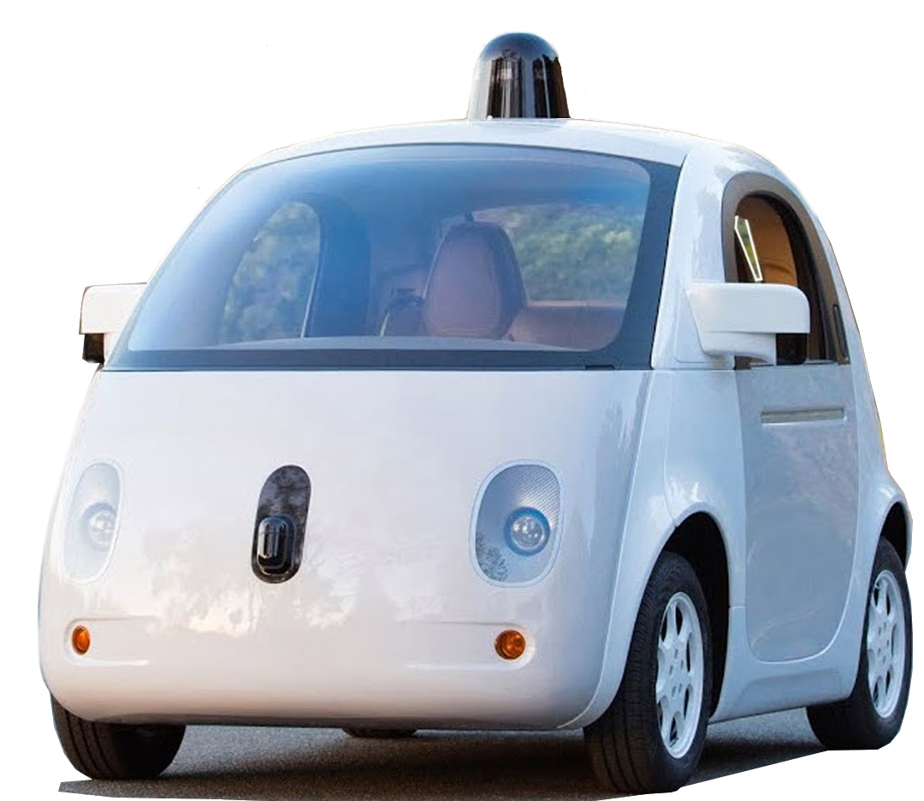
http://news.o2.co.uk/2014/07/17/cats-cars-and-cortana-the-weeks-tech-news-condensed/

Slide 51
http://warriorcats-rpg.foroactivo.com/

Slide 52
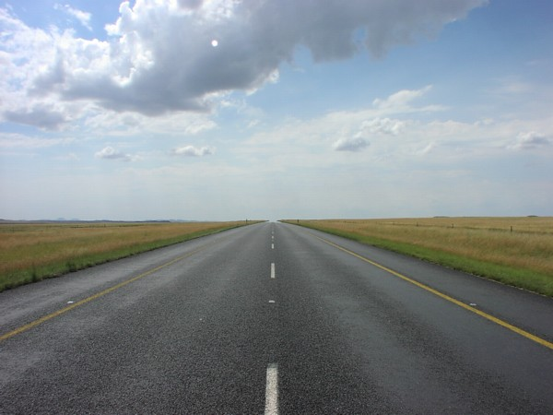
Life is a highway, I wanna ride it all night long.
Tom Cochrane

