Slide 1
Experiences of Students with Visual Disabilities with Tactile Graphics
Accessing Higher Ground Conference: November 2018
Guy Toles, Braille Production Manager, AMAC Accessibility
Georgia Institute of Technology, College of Design
Notes:
-Thank you for joining me today.
-My name is Guy Toles
-Housekeeping Items: Thumb drive with presentations and tactile graphics

Slide 2
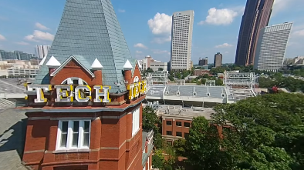
Presentation Outline
Background
Who am I?
AMAC Accessibility
Braille Services Unit
AMAC Research
Organizational Model
Tactile Graphics
What is a tactile graphic?
Survey

Slide 3
Background

Slide 4
Who am I?
Guy Toles
Current Position: Production Manager: Braille Services at AMAC Accessibility
Education: Bachelors of Business Administration in Marketing from the University of Georgia
Certifications: Library of Congress Braille Transcriber in Literary & Mathematics
Experience: 12+ years of Braille experience including literary/STEM transcriptions at all grade levels, tactile graphic creation, mass production, training and research.
National Affiliation/Role: BANA, NBA, CTEBVI
Notes:
Braille Authority of North America (BANA)- Serve on Board representing AMAC, Board liaison to the Braille Formats Committee, Member of the Electronic Braille Translation Committee and the Outreach Committee
National Braille Association (NBA)- Board of Directors, Chair of Public Relations/Marketing Committee, Member of Tactile Graphics Committee
California Transcribers and Educators of the Blind and Visually Impaired (CTEBVI): Member and Conference Presenter

Slide 5
AMAC Accessibility
AMAC Accessibility is a research and service center within the Georgia Institute of Technology’s College of Design committed to the promotion of technological innovation and the development of user-centered research, products, and services for individuals with disabilities.
AMAC was created in 2005 to provide complete, timely, and efficient accommodations to students with print related disabilities. We first started with textbook conversion and have added many departments and services over the years.
Notes:
Created in 2005, AMAC is a research and service center within Georgia Tech’s College of Design. We first began textbook conversion and have added many department and service since.

Slide 6
Products and Services
E-Text Production provides textbooks, supplements, journals, brochures, and manuals in a variety of accessible electronic formats, including PDF, DOC, DAISY, PowerPoint, HTML, and EPUB files.
Braille Services produce timely, cost-effective, high-quality electronic and embossed Braille and custom tactile graphics.
Captioning and Described Media Services make classroom lectures, meetings, labs, or webinars fully accessible for deaf or hard-of-hearing and provide post-production transcripts, captioning, and described video.
Assistive Technology Team conducts on-site and remote assessments, and offer demonstrations, training, and assistive technology for education, work, and daily living environments.
Web Accessibility Compliance & Training focus on the accessibility needs of organizations, offering training, technical assistance, customer support, and evaluation of overall website accessibility.
Notes:
Accessible Electronic Text
Braille
Captioning and Described Media
Assistive Technology
Web Accessibility

Slide 7
Braille Services Unit
A robust braille production operation producing millions of pages of braille per year that currently reaches braille readers in 41 states and various parts of Canada.
Customers range from colleges and K-12 school systems to state/federal agencies, corporations and non-profits.
We convert textbooks, exams, supplemental educational materials, brochures, government documents/statements, and novels into braille.
Committed to providing accurate, timely, and affordable transcriptions and tactile graphics.
Specialize in STEM content transcriptions and tactile graphics.
Notes:
The unit that I manage is the Braille Services Unit.
We specialize in converting STEM subject matter into braille.
Customers range from colleges, k-12 school systems, state and federal government entities, and corporations
Successful contractor for the Library of Congress

Slide 8
External Partners
Prison Program Training Partnership/Collaboration
National Prison Braille Network (NPBN)
Texas Department of Criminal Justice (TDCJ)
Georgia Department of Corrections (GDC)
Curriculum/Training Development
Providing Real Opportunities For Income Through Technology (PROFITT)
Reentry Guidance and Support
Win, Win, Win, Win
Corrections need training programs
Participants are in high demand for employment once release
AMAC increases capacity and reduces costs
Proven success in reducing recidivism
Notes:
Internal Team of 10 certified and experienced braille transcribers and production technicians.
Georgia and Texas Prison Program Partnerships
PROFITT Curriculum
Braille
Soft skills
Small business management
Basic Computer Skills
Extensive Graphics Training

Slide 9
AMAC Research

Slide 10
Organizational Model
Scientific Knowledge
Expert Knowledge
Real Life Practice
We address unmet needs in higher education, government, non-profits, and corporations by providing accessible and inclusive environments for all.
We conduct research and development on accessible electronic materials, services, and assistive technologies.
We offer courses to advance the global accessibility knowledge, research to improve academic success, and services to provide accessibility solutions.
Notes:
Research Scientists-Field Expertise (unit managers-practiticioners)
Conducting research that allows us to learn and then incorporate what we learn into our products and services

Slide 11
Tactile Graphics

Slide 12
What Is a Tactile Graphic?
Tactile graphics are the transformed representations of images that are adapted for the sense of touch.
A map, chart, diagram, or figure that is presented in a tactile format in order to best present a concept.
Notes:
STEM Content is full of maps, charts, diagrams and figures that have to be recreated tactually in order to understand a concept or answer a question.
Samples

Slide 13
Survey
Experiences of Students with Visual Disabilities with Tactile Graphics
Aim of the Study
Rationale
Methodology & Data Collection
Participants
Data Analysis & Results
Discussion & Next Steps
Notes:
The results thus far are preliminary.
Survey is still open.
At the time of the presentation was created we had 7 respond.
Components for the remainder of the presentation are:

Slide 14
Aim of the Study
The goal of this exploratory project is to investigate experiences of students with visual impairments with tactile graphics.
We wanted to hear from students we serve in terms of :
How do they use tactile graphics
How did they learn to read tactile graphics
Challenges they encounter
Feedback they have for us
Notes:
How do they currently use tactile graphics.
How did they learn to read tactile graphics
Challenges encountered while utilizing tactiles
Additional feedback

Slide 15
Rationale
Tactile graphics design guidelines were developed with limited input from end users
Users’ feedback should be gathered to understand problems and challenges
Users should be included in revising tactile graphics design guidelines
Notes:
Tactile guidelines were developed with little input from braille readers
User’s feedback should be gathered to understand challenges
Feedback should be incorporated in guideline revisions

Slide 16
Methodology & Data Collection
This exploratory study employed online surveys utilizing both open ended and closed ended questions.
Survey invitations were sent to our network
Survey is still open and data collection is ongoing
Results we present here are preliminary
Notes:
Network

Slide 17
Participants
This study used selective sampling technique to select participants.
Students:
who are visually impaired
who had experience with Tactile Graphics
who are 18 years old and older participated in this study.
Notes:
Selection criteria for participants:
Visually impaired
Experience with Tactile Graphics
18 years or older

Slide 18
Data Analysis and Results
Results are presented under three titles as:
Demographic Information
Background in Tactile Graphics
Experiences with Tactile Graphics

Slide 19
Results- Demographic Information

Slide 20
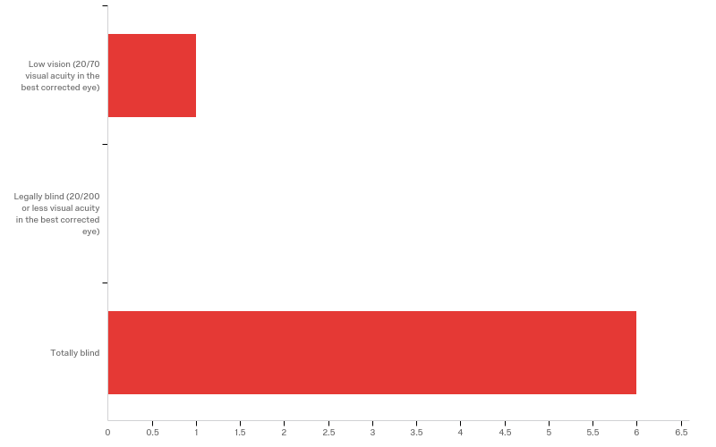
Visual Disability Status
Answer | % | Count
Low vision | 14.29% | 1
Legally blind | 0.00% | 0
Totally blind | 85.71% | 6
Total | 100% | 7
Notes:
6 were totally blind.
1 was low vision

Slide 21
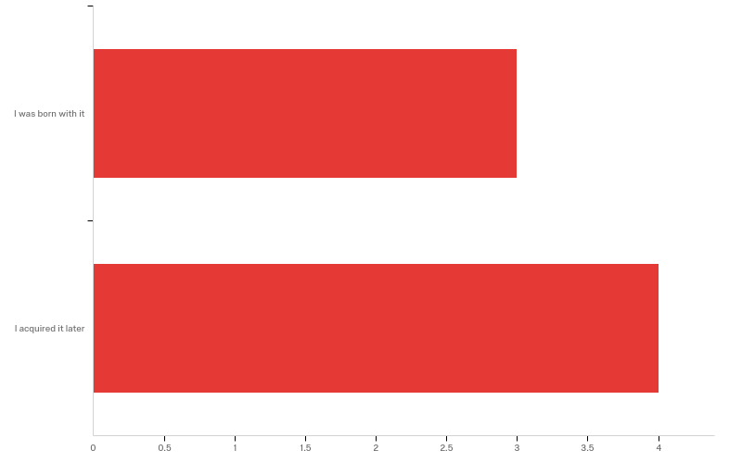
When Visual Disability was Acquired
Answer | % | Count
I was born with it | 42.86% | 3
I acquired it later | 57.14% | 4
Total | 100% | 7
Notes:
3 were born with it
4 developed disability later in life

Slide 22
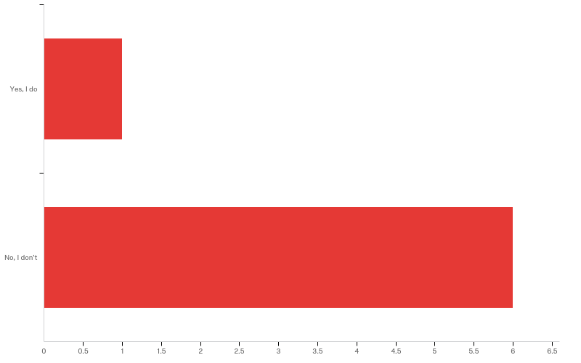
Experiencing Other Disabilities
Answer | % | Count
Yes, I do | 14.29% | 1
No, I don't | 85.71% | 6
Total | 100% | 7
Notes:
Only 1 of the 7 answered yes but disability wasn’t related to LD

Slide 23
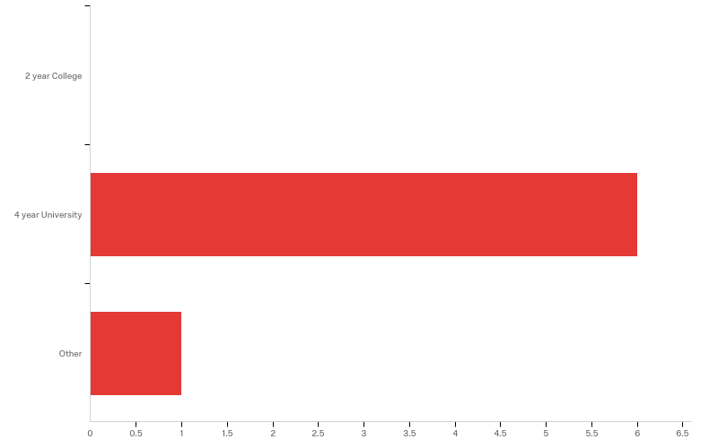
Type of School Participants Currently Attending
Answer | % | Count
2 year College | 0.00% | 0
4 year University | 85.71% | 6
Other | 14.29% | 1
Total | 100% | 7
Notes:
6 of the 7 attended a four-year university.

Slide 24
Participants’ Area of Studies
What is your major?
Do not wish to answer
Computing Science
Music education
Psychology
Biology and Public Health
Computer Science
Special Education
Notes:
2 computer science
1 Music
1 Psychology
1 Biology
1 Special Education
1 Did not wish to answer

Slide 25
Results - Background in Tactile Graphics

Slide 26
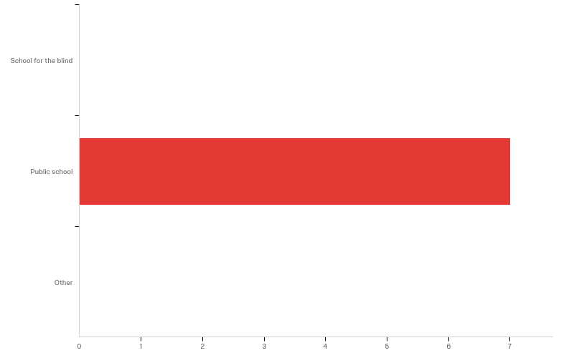
Type of High School Participants Attended
Answer | % | Count
School for the blind | 0.00% | 0
Public school | 100.00% | 7
Other | 0.00% | 0
Total | 100% | 7
Notes:
All 7 intended public school

Slide 27
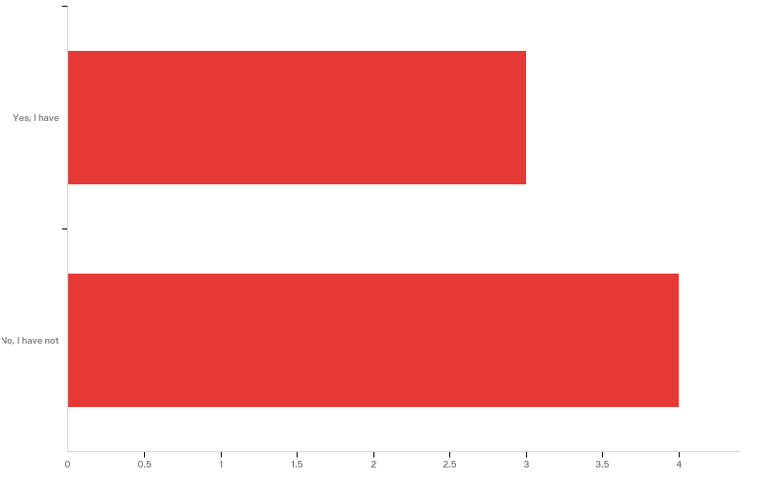
In-school Training to Read Tactile Graphics
Answer | % | Count
Yes, I have | 42.86% | 3
No, I have not | 57.14% | 4
Total | 100% | 7
Notes:
3 had received in-school training
4 had not

Slide 28
Brief Explanation of In-school Training
Please explain your in-school training briefly
TVI provided instruction supplemented by classroom teachers
Work on maps and geometry with a TVI
Teachers telling what kinds of things to look for in tactile graphs
Notes:
Teacher of the Visually Impaired

Slide 29
How Participants Learned Reading Tactile Graphics without Formal Training
Please explain briefly how you learned to read tactile graphics
Self taught
College accessibility advisor created and trialed tactile graphics with the participant
Over time as the participant needed tactile graphics for classes
Trial and error

Slide 30
When Participants Started Using Tactile Graphics
Answer | % | Count
Pre-kindergarten | 28.57% | 2
Kindergarten | 14.29% | 1
5th grade | 14.29% | 1
College,post-secondary school, or higher education | 28.57% | 2
I am not sure | 14.29% | 1
Total | 100% | 7

Slide 31
Courses Participants Used Tactile Graphics during Spring 2018 semester
Please list the names of the courses you used tactile graphics during spring 2018 semester
Vocal Pedagogy
Math - Grade 11 Equivelant
Sociology of Death and Dying
Linear algebra
Notes:
This question may be deleted

Slide 32
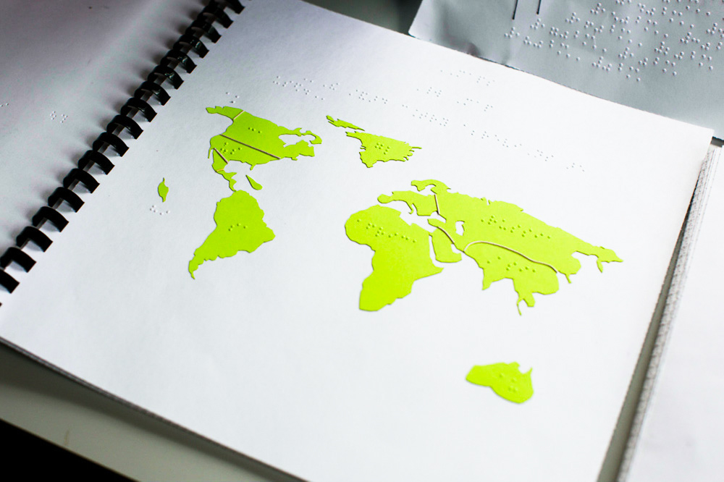
Results – Experiences with Tactile Graphics

Slide 33
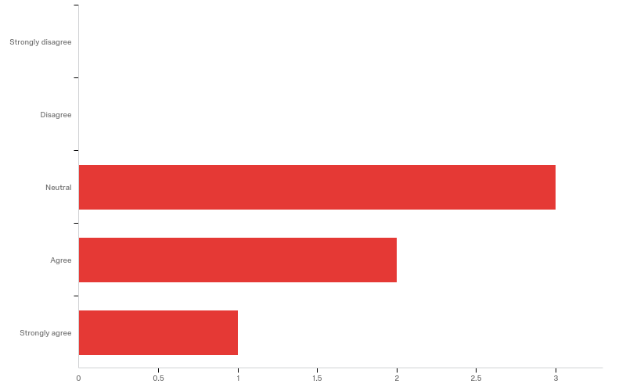
Tactile graphics are easy to understand
Answer | % | Count
Strongly disagree | 0.00% | 0
Disagree | 0.00% | 0
Neutral | 50.00% | 3
Agree | 33.33% | 2
Strongly agree | 16.67% | 1
Total | 100% | 6
Notes:
3 neutral
2 agree
1 strongly agree

Slide 34
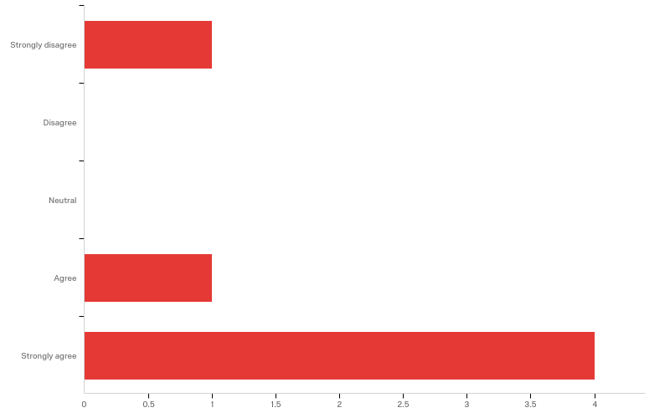
Tactile graphics are helpful to understand the course content
Answer | % | Count
Strongly disagree | 16.67% | 1
Disagree | 0.00% | 0
Neutral | 0.00% | 0
Agree | 16.67% | 1
Strongly agree | 66.67% | 4
Total | 100% | 6
Notes:
1 strongly disagree
1 agree
4 strongly agree

Slide 35
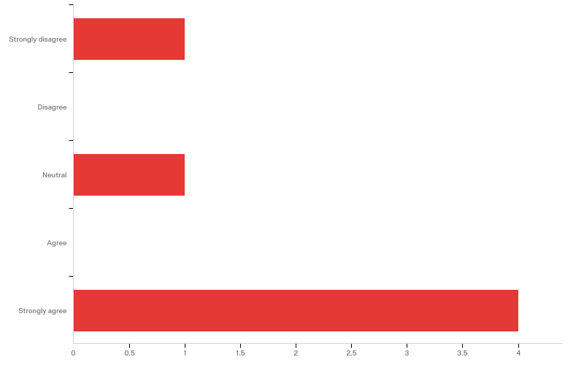
Descriptions provided with tactile graphics are helpful to understand what graphics are about
Answer | % | Count
Strongly disagree | 16.67% | 1
Disagree | 0.00% | 0
Neutral | 16.67% | 1
Agree | 0.00% | 0
Strongly agree | 66.67% | 4
Total | 100% | 6
Notes:
1 strongly agree
1 neutral
4 strongly agree

Slide 36
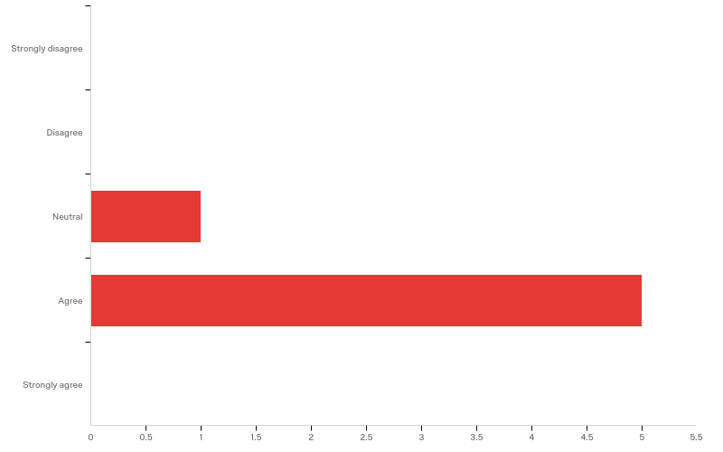
I can accurately find requested information in tactile graphics
Answer | % | Count
Strongly disagree | 0.00% | 0
Disagree | 0.00% | 0
Neutral | 16.67% | 1
Agree | 83.33% | 5
Strongly agree | 0.00% | 0
Total | 100% | 6
Notes:
1 neutral
5 agree

Slide 37
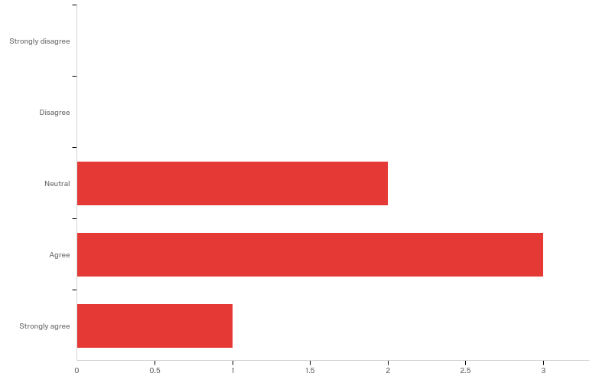
I understand tactile graphics without someone’s help
Answer | % | Count
Strongly disagree | 0.00% | 0
Disagree | 0.00% | 0
Neutral | 33.33% | 2
Agree | 50.00% | 3
Strongly agree | 16.67% | 1
Total | 100% | 6
Notes:
2 neutral
3 agree
1 strongly agree

Slide 38
Challenges Participants Experience with Tactile Graphics
Too Busy If they are too complex, no matter the quality of the diagram, it won’t be useful because the tactile image will be unreadable. Overall Size Sometimes the graphic are not made large enough to distinguish between data points, especially if there are multiple lines or sets of dots plotted. Production Time It takes my advisor a really long time to make my tactiles because she has to make each math diagram, graph or figure with a 3D Doodler pen. Noticeable Difference Between Fields and Lines Sometimes the textures or difference in the lines are similar to the touch.
Notes:
Common threads with one response for each.

Slide 39
What would Help Participants to Understand Tactile Graphics Better
Noticeable Difference Between Fields and Lines Prefer tactile diagrams on material that creates sharp lines and distinct Braille. Overall Size Diagram is large as possible. Too Busy Instead of cramming information/descriptions onto the same page, maybe the information should be placed on the previous page, the left page, while the graph takes up the entire right page--when a tactile diagram is in some type of booklet.
Notes:
Same common threads

Slide 40
Extra Feedback
Production Time The biggest issue I face is getting tactile graphics quickly in a good enough quality to be useful and helpful.
Tactile materials should be produced and tested in cooperation with individuals who will use them.
Notes:
Common thread and overall theme

Slide 41
Discussion
Tactile Graphics Production Issues
Guidelines are lacking user input
Timing
System problems
Different level of teaching in different schools
Who is responsible to produce tactile graphics
Gap in the literature
Educational media design principles

Slide 42
Next Steps
AMAC Braille will conduct “User Experience” Study
NSF Proposal in progress focusing on Tactile Graphics
BANA Tactile Graphics Committee
Guy Toles – guy.toles@amac.gatech.edu
Zerrin Ondin- zerrin.ondin@amac.gatech.edu
Tactile Graphics Survey
Notes:
Contacts
Business Cards
Link to Survey
Special Thanks to Zerrin Ondin, AMAC’s Research Scientist

Slide 43
www.amacusg.org

