Slide 1
Reduce, Reuse, Recycle Saving Your Sanity by Single Sourcing Content
University Information Technology Services
INDIANA UNIVERSITY

Slide 2
Introduction

Slide 3
Who are we?
Michael Mace – Principal Accessibility Consultant
Greg Hanek – Accessibility Architect

Slide 4
Why are we here?
KMS
Websites
Knowledgebase
Canvas
Centers for Teaching and Learning
IT Training
IU has a content problem…
Content is everywhere
Quality varies
Updates sporadic
Software constantly updates

Slide 5
The Knowledge Management System

Slide 6
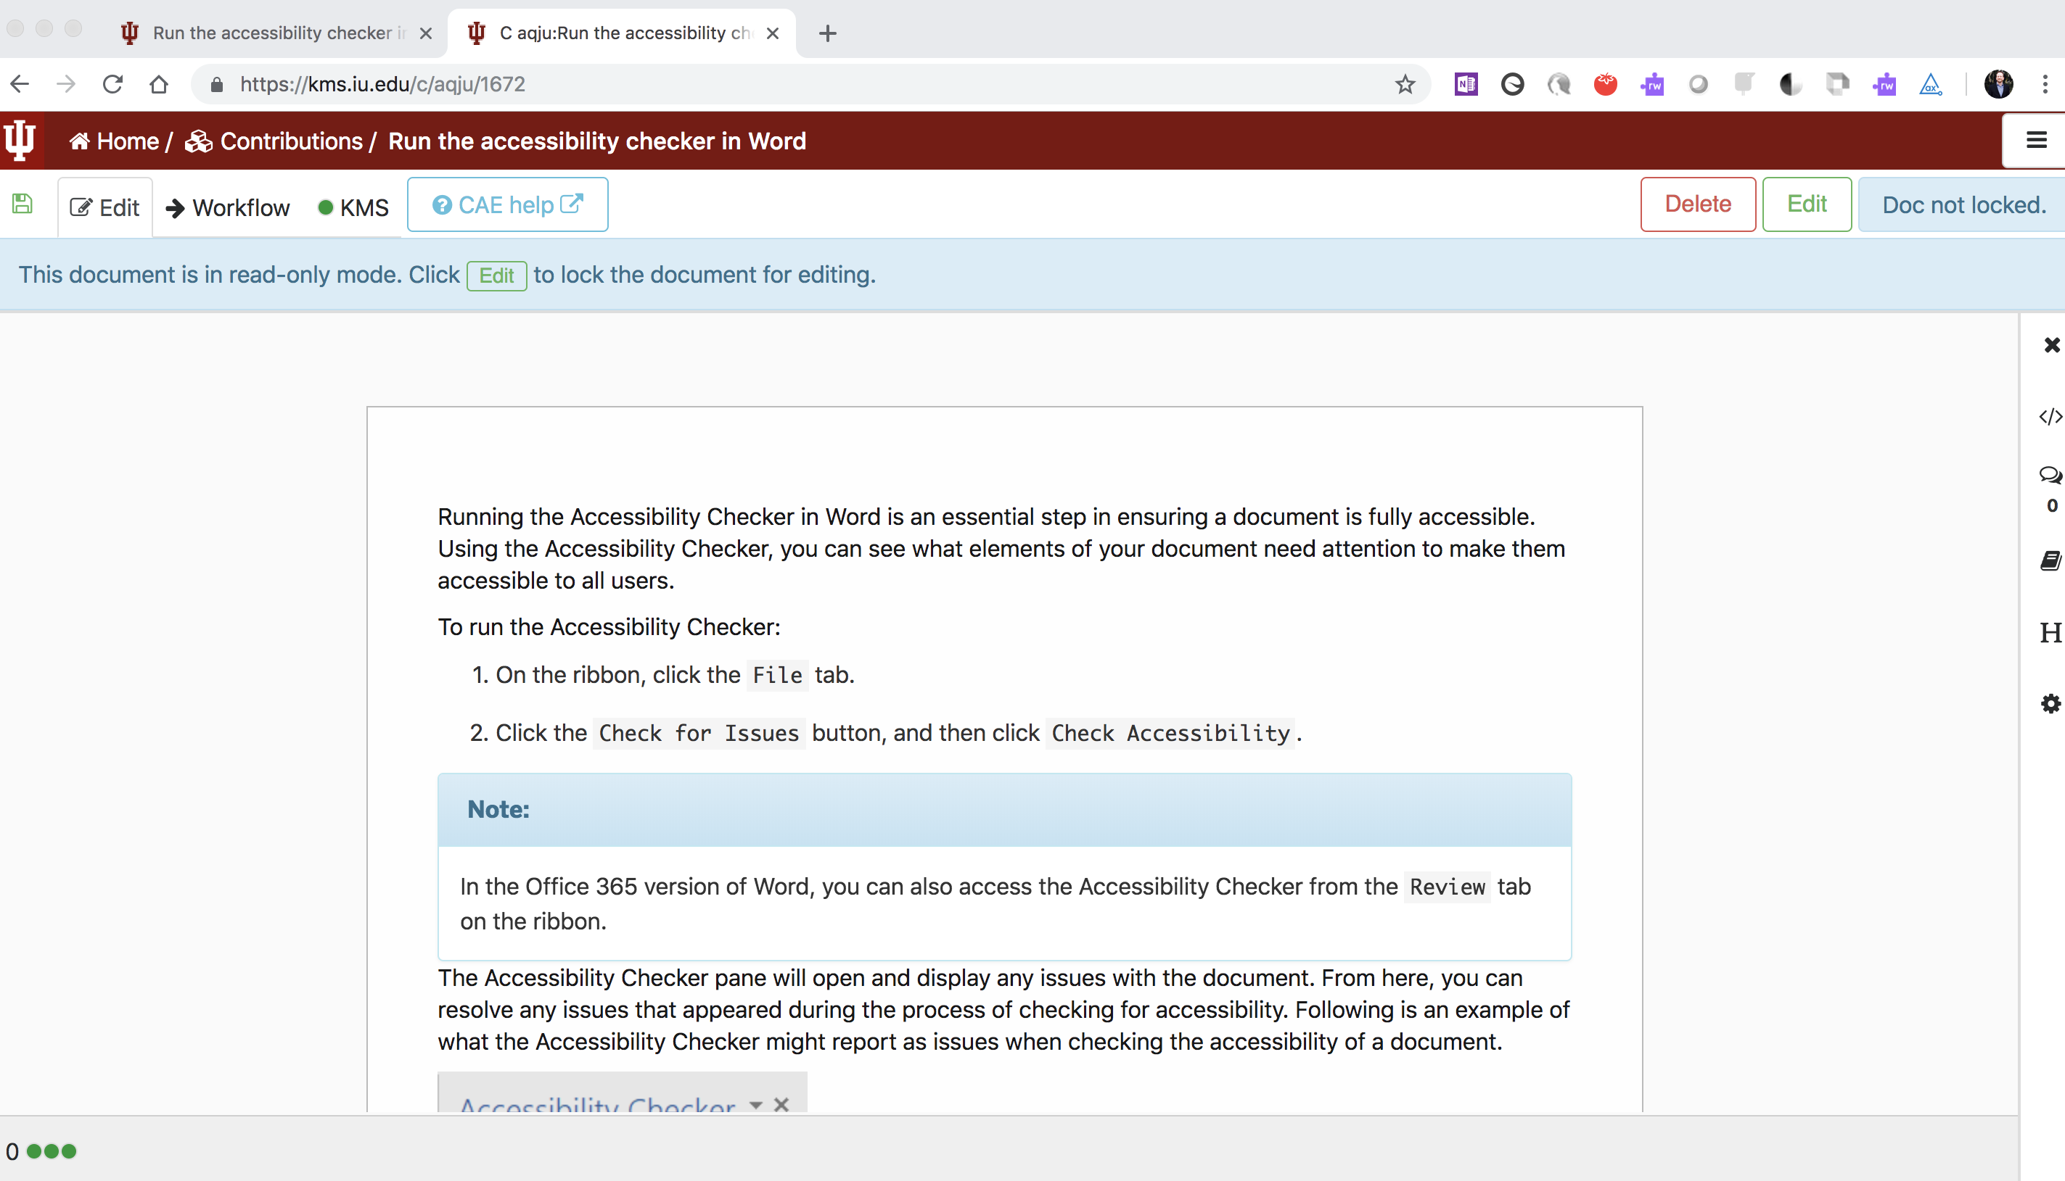
KMS Author Screen

Slide 7
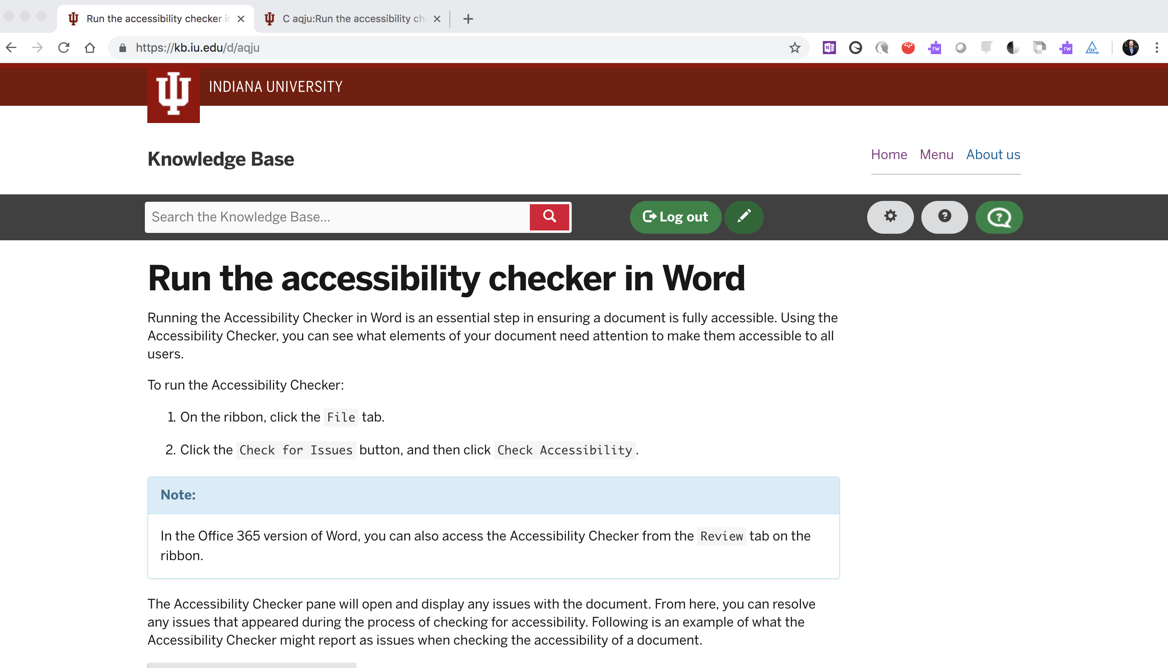
Knowledgebase Website

Slide 8
Canvas

Slide 9
The thing about Canvas…
Canvas doesn’t allow publishing via API
We use a webserver and an iframe

Slide 10
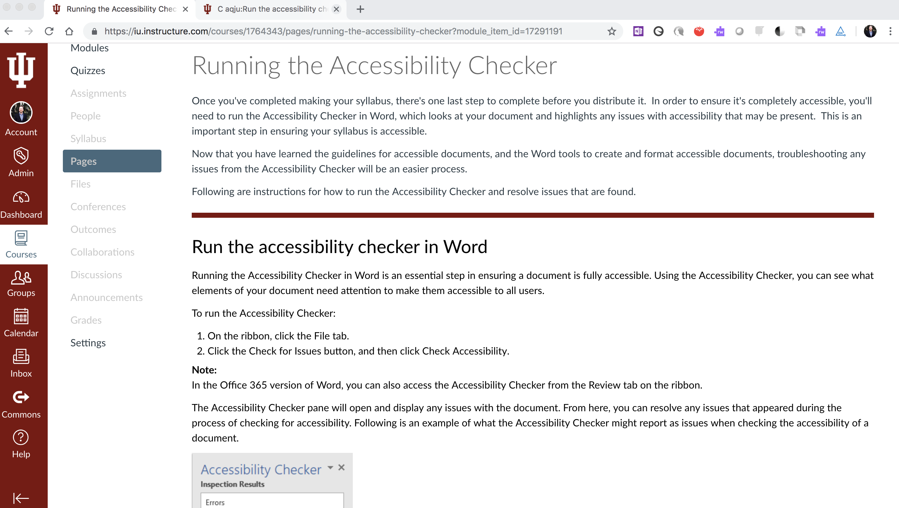
Canvas Course Screen

Slide 11
What’s in it for you…

Slide 12
We are opening this up to everyone

Slide 13
Thank you for attending!

