Slide 1
Making Math Accessible Doesn’t Have to be Terrifying!
Susan Kelmer
Alternate Format Production Program Manager
University of Colorado Boulder
Susan.Kelmer@Colorado.edu

Slide 2
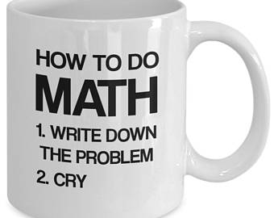
“I cannot math, I have the dumb”

Slide 3
Math Doesn’t have to be fun…but that doesn’t mean we shouldn’t be making it accessible for our students
Today we will cover:
What is math, and what isn’t?
How to code math so that it works for a student (even if you don’t understand what the math problem means)
How to output that math to a file that a student can use with technology to “hear” math

Slide 4
Why? WHY WHY WHY?? I Hate the math!
Most of the time, our students need to take math to get their degree.
Math is fundamental to many things that we do.
Students with print disabilities taking math deserve our best efforts to make it accessible for them.

Slide 5
But how will students access The math I create?
For sighted, but impaired (reading disability):
Car (https://www.cwu.edu/central-access/reader)
STEMReader (https://stemreader.org.uk/)
For vision-impaired/blind:
MathML (html) files (Jaws and NVDA – full experience)
Word files with MathML (NVDA reads MathType natively)
Word files with LEAN conversion (Jaws)

Slide 6
Fine. I’ll do the maths.
Regardless of output, math needs to be created in a MathML format.
MathType

Slide 7
You mean…there’s SOFTWARE to do this? And I don’t have to know the maths?

Slide 8
Thank you! Please fill out your evals! Alt format of carnoon: TV narrator: Next, mel Gibson stars as a Pennsylvania farmer who discovers a mysterious crop circle in his cornfield. Will his knowledge of basic trigonometry be enough to determine the y-coorinates of points on the circumference? Find out, as we present the television debut of M. Night Shyamalan’s “Sines.” First boy: This new math channel rules! Second boy: Did you catch “Charlie’s Angles” last night?

