Slide 1
Navigating the course: Creating Accessible Stem
Megan Gibbs
Kennesaw State university

Slide 2
KSU Information
Over 70 online programs (minor, certification, endorsement, undergraduate, and graduate programs)
Over 35,000 students
Over 1,100 full time faculty and over 800 part-time faculty

Slide 3
Academic Accessibility at KSU
KSU Web Accessibility Policy developed in 2016
Web Accessibility team (two people) focuses on faculty and staff accessibility related professional development
Accessibility Basics Online Workshop Series launched in September 2017
To date over 100 course completers
30 participants are already registered for our Spring sessions

Slide 4
Accessibility workshop series
Faculty members are responsible for courses accessible
Based off the Faculty Four of Accessible Development
Designed for a broad faculty audience and utilizes UDL principles
After facilitating multiple sessions I realized the need for more STEM specific guidance

Slide 5
Diving into stem accessibility
I first reached out to faculty who had completed the Accessibility Series who teach in the STEM fields to learn more about their needs
Began researching other institutions and how they handle accessibility in STEM courses
Did not want to overlap with what we teach in our ABS course so had to focus specifically on strategies that were realistic for our faculty
Determined an online guide would be the best way to start

Slide 6
Goals
Create a comprehensive resource for faculty who teach in the STEM fields
Expand upon alternative text creation strategies specific for STEM courses
Encourage the use of MathML for equation creation
Reinforce the need for accessible charts and tables with more in-depth examples that go beyond what is taught in the ABS course
Provide open source resources for further study

Slide 7
Initial Challenges
Quickly realized that other institutions that do encourage accessible STEM have a lot more resources available than we do
Finding vendors who are focused on STEM accessibility can be a challenge, many of our existing tools were not as accessible when it came to STEM as we had thought they were
Since our team only consists of two people it was important to focus on strategies that faculty could easily implement
Finding open source accessible materials that were STEM specific AND relevant for higher education was not as easy as previously thought

Slide 8
Accessible equations
By far the most challenging endeavor
Focused on what resources were already available to faculty (D2L, SoftChalk, Microsoft Office etc)
Explored and manually tested the accessibility of the equation builders for each of these tools
In some cases the equations were presented as images which is not accessible
Determined that creating equations in D2L was the most accessible way for our faculty to do it themselves

Slide 9
Alternative text
Determined that many STEM faculty were unsure when it was appropriate to use alternative text
Can the image be described in 120 characters or less?
Does the image contain text?
Does the image show a process or contain important/critical content?
Provided examples of complex images and gave strategies for making them accessible based off the recommendations from The National Center for Accessible Media
Asked faculty to consider recreating images such as equations and charts or graphs in an accessible format

Slide 10
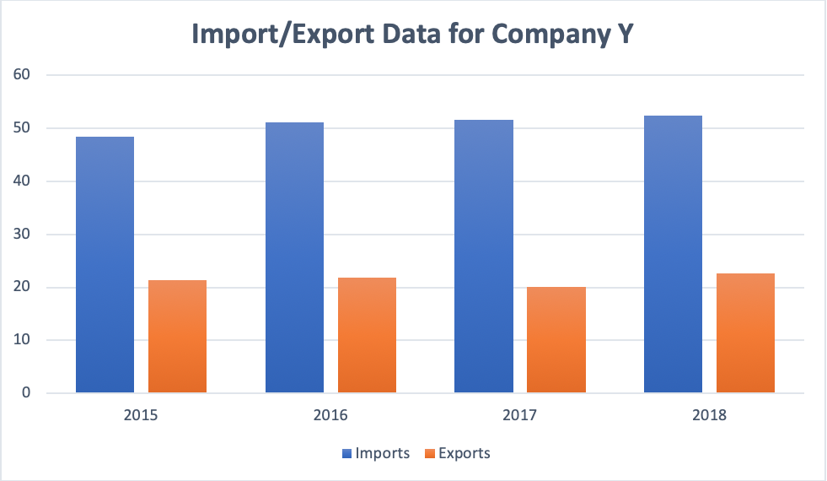
Accessible charts and tables
Reinforced the importance of creating these items in HTML or Word vs. using screen shots
Provided specific examples on how to make bar graphs, line graphs, and concept maps accessible
Year | Imports | Exports
2015 | 48.4 | 21.4
2016 | 51.2 | 21.8
2017 | 51.7 | 20.1
2018 | 52.5 | 22.7

Slide 11
Stem resources
Throughout my exploration I created a list of what I felt was appropriate open resources for higher education faculty
Accessible Molecular Structures
Accessible Periodic Table
Review of common statistical software done by a blind faculty member
Perkins School for the Blind STEM Resources
University of Washington's Do-It Center - AccessSTEM
Access2Science
Accessible Online Calculators
Graphing Calculator
Scientific Calculator
Four Function Calculator

Slide 12
Future goals
Research tools that can EASILY assist faculty with the creation of accessible STEM and how/if we can implement them on campus
Work with more STEM faculty to learn what is most needed and find opportunities on where to expand
Explore possibly moving the guide into an online format to supplement our regular ABS course (if there is a demand)

Slide 13
Final thoughts
Not possible to make all inclusive guide for faculty
Vendors not making STEM a priority
Will still have to focus on individual accommodations

Slide 14
Questions?
Megan gibbs
Mmacdon3@kennesaw.edu

