Slide 1
EIT Accessibility at YounGstown State University
Thomas Madsen and
Gina McGranahan
Youngstown State University

Slide 2
Outline of presentation
Part 1: Who are we?
Part 2: Our story of accessibility
Part 3: Where we are now
Part 4: We are still working on …

Slide 3
Who are we?
Gina McGranahan is the Assistant Director of Disability Services and the Title II/ Section 504 Coordinator for Students.
Thomas Madsen is an Assistant Professor in the Department of Mathematics and Statistics

Slide 4
Youngstown State University

Slide 5
Youngstown State University
Currently (2018)
Enrollment: 12,731 students
Full time faculty: 418
Part time / adjunct faculty: 568
Staff: 1025
Full time faculty to student ratio: 22.4:1

Slide 6
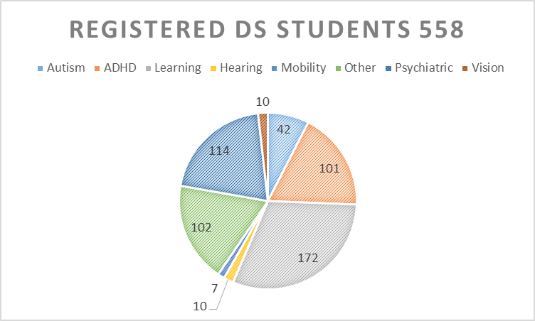
Center for Student Progress Disability Services

Slide 7
Center for Student Progress Disability Services
Disability | Number
Autism | 42
ADHD | 101
Learning | 172
Hearing | 10
Mobility | 7
Other | 102
Psychiatric | 114
Vision | 10

Slide 8
Center for Student Progress Disability Services
We currently do not have any students who are totally blind.
We have one student who uses interpreters, but is not totally deaf.
The Disability Services (DS) office is a part of the learning center on campus.
Staff of DS
Assistant Director
Department Secretary
¼ time Graduate Assistant Intern
Currently doing a search for a 20 hour a week 10 month Coordinator

Slide 9
Disclaimers
While we have worked with accessibility for some time now, we do not claim to be experts. We are certainly not IT experts.
We do not have answers to all questions.
We are here today to primarily share our experiences.

Slide 10
Our Story of Accessibility
In May 2013 a compliance review was initiated by the Office of Civil Rights (OCR) under the Department of Education.
From the review a number of issues came up.

Slide 11
Our Story of Accessibility
During the course of this investigation, OCR identified compliance violations relating to the University’s nondiscrimination notice, as well as the accessibility of particular pages on the University’s website. Prior to the conclusion of OCR’s investigation of the remaining issues in its review, the University expressed an interest in voluntarily resolving the investigation and entered into an agreement that commits the University to specific actions to address those issues. This letter summarizes the applicable legal standards, the information gathered during the investigation, and how the investigation was resolved.

Slide 12
Our Story of Accessibility
In November 2014 YSU signed an agreement with the OCR.
YSU formed a small committee to implement this agreement and meet certain deadlines.
By February 2015 YSU had an EIT policy and EIT plan drafted and submitted to the OCR

Slide 13
Our Story of Accessibility
In May 2015 an announcement went out to the campus stating in part: “The agreement stipulates that the university must be in compliance by Dec. 30, 2015.”
Part of the communication/miscommunication:
all electronic content should be accessible and “in compliance”. Any content not readable using a screen reader is no longer allowed,
faculty are personally liable.

Slide 14
Our Story of Accessibility
Faculty and the campus community responds by removing all content from our Learning Management System (LMS) and they stop emailing students electronic documents.
Before the announcement approximately 60% of faculty were using Blackboard.
After the announcement, this dropped to 33 %
Our current adoption is approximately 52 %
This was not the intended outcome.

Slide 15
Our Story of Accessibility
In summer 2015 Thomas Madsen joins the committee as a faculty voice.
For a while we did not have much movement. Our CIO retired and the new (interim) CIO was unaware of what had been happening.
In February 2017 we received response from the OCR essentially approving our EIT policy.

Slide 16
Our Story of Accessibility
Initially the motivation was legal, but it quickly became about more.
Frequent questions that comes up: What does it mean that a document is accessible? How is this evaluated?
Discussion about compliance vs. accessible.

Slide 17
Where are we now? Public Facing Content
YSU has a new evolving website.
We have a set of general accessibility standards that outline what “accessible” means. The document is general with some specifics.
Policy: All content on the YSU website must be accessible or have an accessible equivalent posted along side of it. For the most part we have achieved this.

Slide 18
Where are we now? Closed courses
Disability Services (DS) is normally advised of the registration of a student with a disability 1-2 months prior to classes starting. DS has an appropriate internal procedure to prepare for these students and coordinate with faculty.

Slide 19
Where are we now? Closed courses
While documents used in closed courses need not be accessible, it is strongly encouraged that a process is thought out for how to make accessible versions quickly.

Slide 20
Where are we now? Closed Courses
Should a student declare a disability in a closed course less than 2 weeks before classes start, our Rapid Response Plan says that Disability Services (in collaboration with the faculty member) will make material available within 10 business days.

Slide 21
Where are we now? working with vendors
This is still being discussed.
Currently: We do not have a formal assessment of accessibility of purchased software.
Future: If software is purchased through the university, Procurement has a step where accessibility is evaluated.
If software is acquired outside the Procurement process, the vendor is asked to submit a statement on accessibility. If they are unable or unwilling to do this, we will not use the software.

Slide 22
Where are we now? Other Things
Training: (Online and groups) Anyone who has control over part of the website needs to attend training.
All new faculty attend training as part of their new faculty orientation.
Currently 1037 have attending the general accessibility workshop.

Slide 23
Where are we now? Other Things
EIT Lab: A lab with student workers run by the Office of Distance Education is available to help faculty and others with converting documents to accessible formats.

Slide 24
Where are we now? Other Things
We have purchased the Ally tool with Blackboard.
We are considering purchasing the Ally WebCrawler.

Slide 25
Where are we now? Mathematics
It is our understanding that currently no perfect solution exists for making documents containing mathematical notation accessible.
Our standards say to use LaTeX since this can be converted into HTML + MathJax and possibly MathML.
Faculty has already been educated about this process.

Slide 26
We are still working on …
This continues to be a work in progress.
Working with vendors is a challenge.
How to properly assess accessibility of documents.
How the processes touches on other areas of campus.

Slide 27
Lessons learned
Get faculty involved as early as possible.
Get people from across campus involved to get consistent and coherent solutions.
While we care about the legal aspects, do not lose sight of why we are doing this.
Don’t ignore Disability Services when issues are pointed out.

Slide 28
Wish list
There is, in our opinion, a need for universal authoritative guidelines and standards in addition to better awareness of what currently exists.
Wish more universities and public institutions would push vendors to make accessible products.

Slide 29
Questions?
Gina McGranahan
330-941-2090
glmcgranahan@ysu.edu
Thomas Madsen
330-941-4398
tlmadsen@ysu.edu
https://ysu.edu/accessibility

