Slide 1
Chemistry in PDF FORMat
Scanned to PDF or received as electronic PDF file from publisher

Slide 2
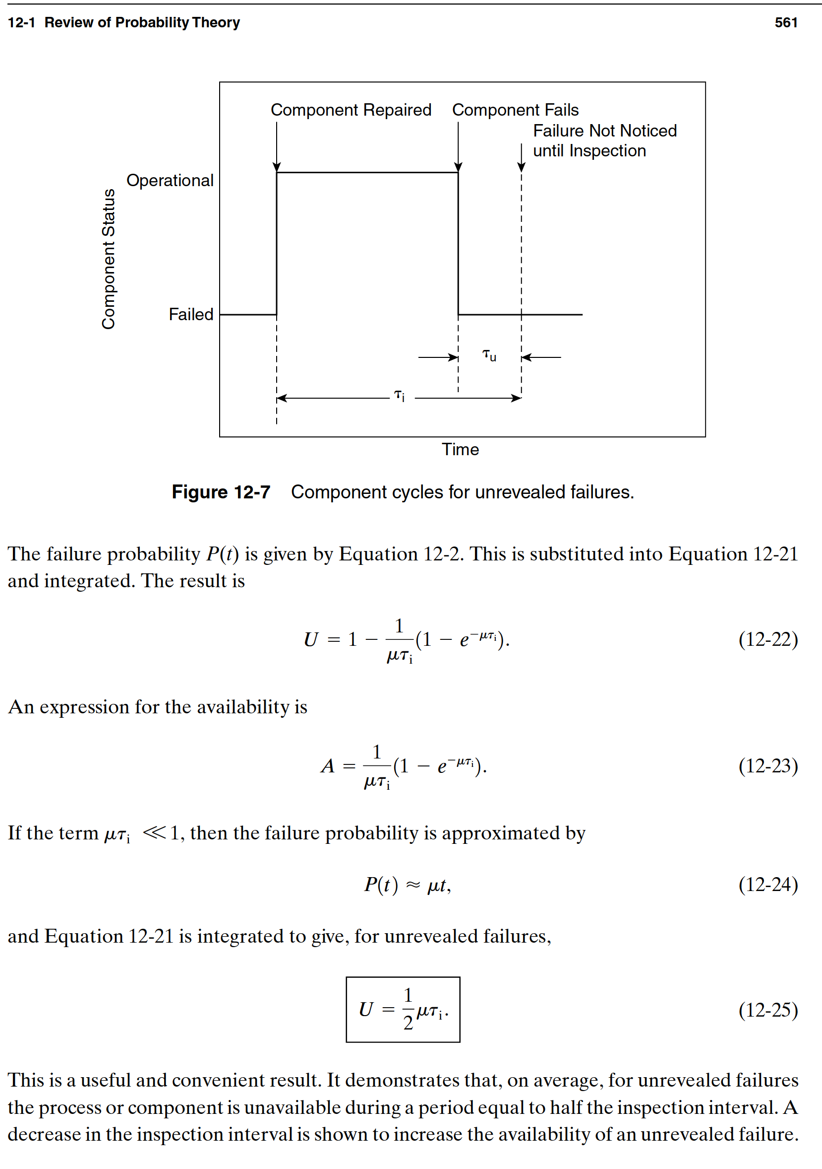
Chemistry in PDF FORMAT

Slide 3
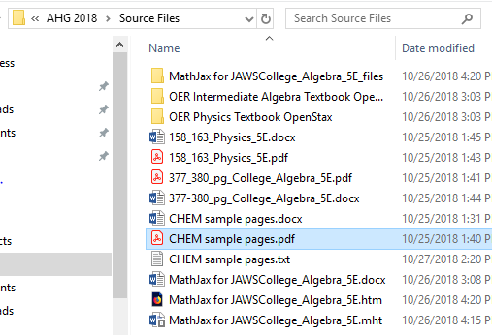
CONVERTING PDF TO ms word
- RIGHT CLICK ON PDF ICON
IN FILE MENU
- SELECT OMNIPAGE FROM
DROP DOWN MENU
- SELECT CONVERT
TO TEXT (RTF)

Slide 4
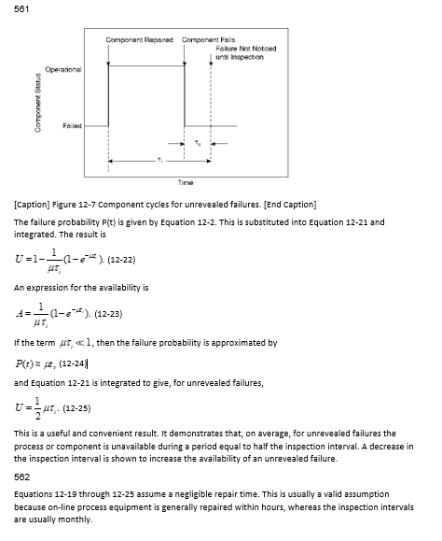
Chemistry in rtf FORMAT CONVERT pdf FILE With omniPAGE ULTIMATE save as rtf

Slide 5
REMEDIATE CHEMISTRY WITH MATH TYPE &CHEM4WORD
http://www.wiris.com/plugins/demo/chemistry/

Slide 6
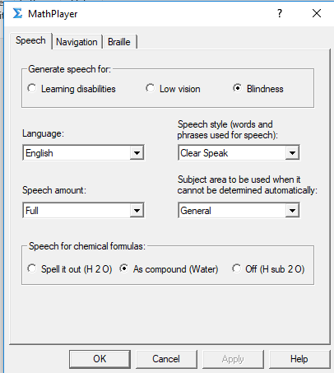
From MATHTYPE toolbar: 1. CLICK insert 2. click equation 3. select mathplayer from toolbar 4. select settings 5. from speech for chemical formulas, select either “spell it out” “as a compound” or “off” 6. click “apply” then “ok”

Slide 7
CHEM4WORD Add-in
PRACTICE WITH CHEM4WORD
The Chem4Word add-in allows the user to interact with chemistry in a document as follows:
- Edit / draw your structures using an embedded open source chemical structure editor called ChemDoodle Web Sketcher.
- Edit textual descriptors for a structure.
- Import chemical structures from web services such as PubChem and Opsin.
- Import files in CML or MDL Molfile format.
- Export drawn or imported structures in CML or MDL Molfile format. You can use this option to copy drawings to other documents of share them with colleagues.

Slide 8
PRACTICE WITH CHEM4WORD
USER DOCUMENTATION: https://github.com/Chem4Word/Version3/tree/master/doc
2. TRAINING VIDEOS: https://www.chem4word.co.uk/
A. DRAW A STRUCTURE IN A DOCUMENT USING CHEM4WORD:
Step-by-step
Clicking the Chemistry ribbon’s “Draw Structure” button to open a structure editor in which you can draw your structure.
Click the OK button and Chem4Word will search ChemSpider to see if we can find a name for your structure, that you can use that name elsewhere in your document; we’ll show you how in a separate tutorial.
Edit the name that was found or just leave it as it is
You now have your first structure in your Microsoft Word document!
https://youtu.be/J-DMPuGzs8I

Slide 9
PRACTICE WITH CHEM4WORD
3. TRAINING VIDEOS: https://www.chem4word.co.uk/
HOW TO EDIT EXISTING STRUCTURES IN MICROSOFT WORD
Step-by-step
- Double-clicking a structure will open a structure editor in which you can edit your structure.
- You can edit the currently selected structure by clicking the “Edit” button on the Chemistry ribbon.
- Click the OK button and Chem4Word will search ChemSpider to see if we can find a name for your structure, that you can use that name elsewhere in your document; we’ll show you how in a separate tutorial.
- Edit the name that was found or just leave it as it is
You now have edited your first structure in your Microsoft Word document!
https://youtu.be/9M26tAAcfMY

Slide 10
PRACTICE WITH CHEM4WORD
4. HOW TO ADD CHEMISTRY FROM A PUBCHEM SEARCH
Step-by-step
- Clicking the Chemistry ribbon’s “Import” button allows us to search PubChem for structures, rather than having to draw them manually.
- Type a search term, such as a common name or IUPAC name for the chemistry you want to include in the document.
- Select the correct compound from the list of results from the search.
- Click the OK button and Chem4Word will search ChemSpider to find a name for your structure, that you can use that name elsewhere in your document.
Edit the structure to remove excessive hydrogen atoms that may have been drawn.
You now have your first structure from PubChem in your Microsoft Word document!
https://youtu.be/K0dpEvyNPpo

Slide 11
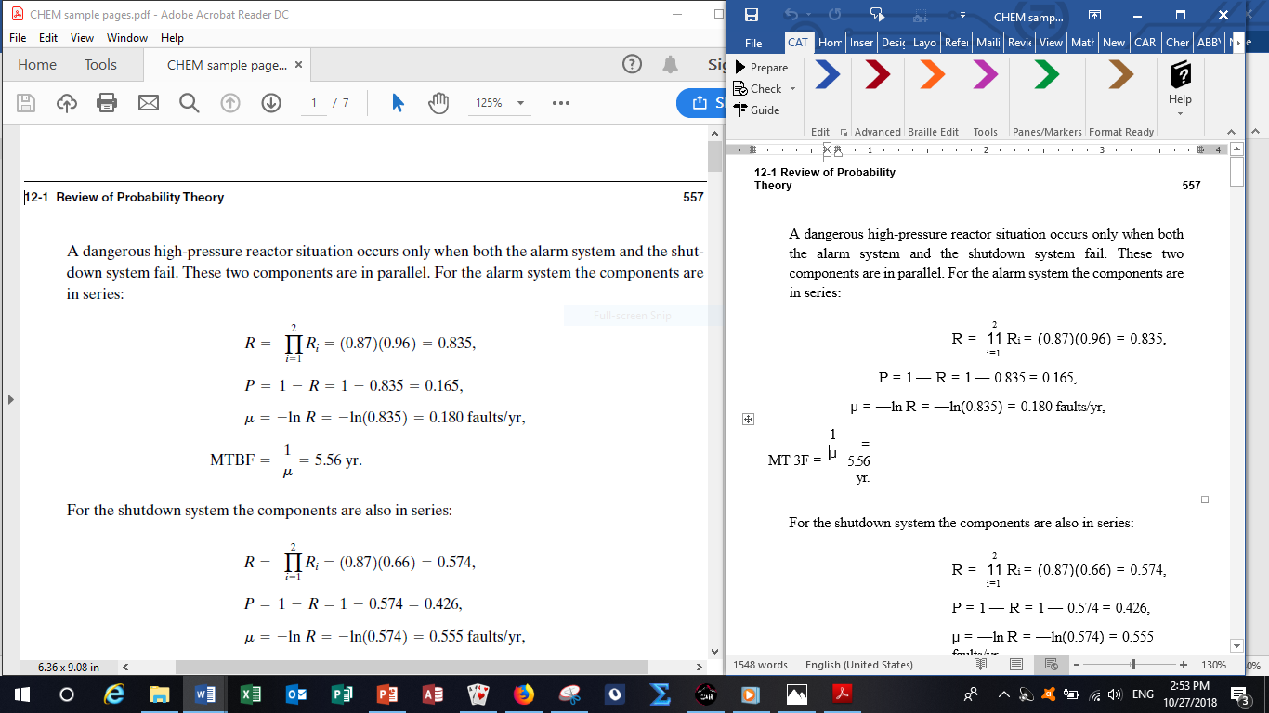
REMEDIATING CHEMISTRY with MATHTYPE
OPEN UP A SPLIT SCREEN (OR USE 2 MONITORS) . CHEMISTRY PDF IN ONE SCREEN & RTF IN THE 2ND SCREEN
PDF as source file open on one screen.
RTF in MSWORD on 2nd screen.
Select MATHTYPE from ribbon.
Formulas & mathematical symbols are
retyped and embedded in MSW doc. Simply
CLICK the X close window button
in the MATH TYPE inline editing
window and it will ask if you want to
transfer to your document. Click YES.
Move math text box where it needs to be.
Save as DOCX file.

Slide 12
Chemistry FROM DOCX TO CENTRAL ACCESS READER TTS
OPEN WHOLE DOCUMENT IN
CENTRAL ACCESS READER OR COPY
A SELECTION OF TEXT FROM CHEMISTRY SAMPLE DOCX PAGE AND PASTE INTO CAR
PRESS “PLAY” BUTTON.

Slide 13
Chemistry to mhtml FOR JAWS w/MathJax
OPEN CHEM DOCX FILE WHICH YOU HAVE CORRECTED IN MATH TYPE AND RESAVED AS A [NEW NAME] FILE
CLICK on MATHT YPE tab in MS Word ribbon.
From drop down menu, select PUBLISH TO MATH PAGE
In the dialogue box, name the file and choose location to save it

Slide 14
Chemistry TO NVDA with MATH PLAYER
NVDA quick key guide: https://dequeuniversity.com/screenreaders/nvda-keyboard-shortcuts
Start NVDA: CTRL + ALT + N
OPEN CHEM DOCX FILE WHICH YOU HAVE CORRECTED IN MATH TYPE AND RESAVED AS A [NEW NAME] FILE

Slide 15
Chemistry PRACTICE
FROM OPENSTAX COLLEGE
https://web.ung.edu/media/Chemistry2/Chemistry-LR.pdf

Slide 16
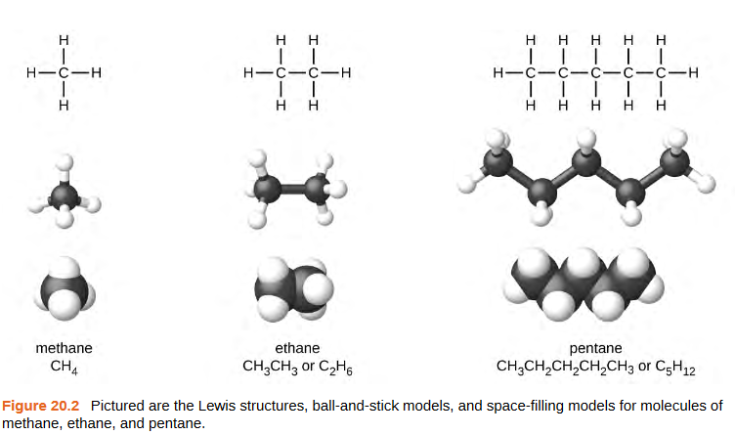
ORGANIC CHEMISTRY
CHEMISTRY PRACTICE – see MSW folder included in the workshop folder.
FROM THE FOLLOWING DIAGRAM FROM CHAPTER 20, ORGANIC CHEMISTRY, OPENSTAX, PAGE 1127, USE MSW with MathType and CHEM4WORD to
Sketch the Lewis Structures using
ChemDoodle for METHANE, ETHANE and
PENTANE
2. Use MathType and CHEM4WORD with
equation editor and Chemistry speech enabled,
recreate the chemical molecules
3. Use MathPlayer and the Speech button,
listen to the TTS
4. Retype the text from the example below
with the inline equations you’ve created, then
use NVDA and MathPlayer to listen.
Https://web.ung.edu/media/Chemistry2/Chemistry-LR.pdf

Slide 17
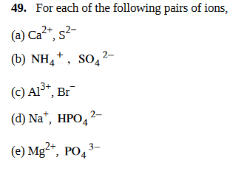
CHEMISTRY PRACTICE
CHEMISTRY PRACTICE – see MSW folder included in the workshop folder.
Try this one: Calculation of Percent Abundance example 2.5, page 93
And this one on page 133 where you retype the ions. Note that where there are two ions separated by a comma, there are really two separate inline equations. Tab out of the first equation, type a comma, then open a new inline equation window.
Https://web.ung.edu/media/Chemistry2/Chemistry-LR.pdf

Slide 18
CHEMISTRY PRACTICE
DENSITY OF A NEUTRON STAR
See example 3 on in the MSW Chemistry Practice folder
FROM THE DIAGRAM FROM CHAPTER 21, ORGANIC CHEMISTRY, OPENSTAX, PAGES 1184-85, USE MSW with MathType and CHEM4WORD to
Use MathType and CHEM4WORD with
in-line equation editor and Chemistry
speech enabled, retype the figures in
brackets from the following paragraph
from the MSW file. The first paragraph
is in Microsoft Word (editable), and the
second is an image from the text.
Use MathPlayer and the Speech button,
listen to the TTS of the individual
equations.
b. Use NVDA and MathPlayer to listen.

Slide 19
CHEMISTRY PRACTICE
DENSITY OF A NEUTRON STAR for the very intrepid:
And if you’re really brave, try these in-line formulas found in MSW practice folder:

Slide 20
CHEMISTRY PRACTICE
CHEMISTRY PRACTICE – see MSW folder included in the workshop folder for more practices to use from the OER chemistry book.

