Slide 1
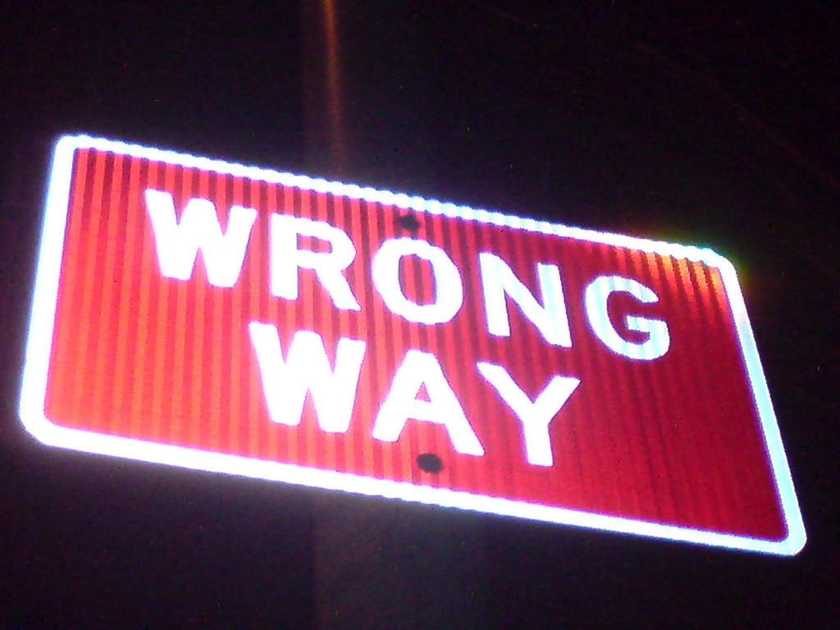
I Was Wrong!
Learn from My Accessibility Program Mistakes
Angela M. Hooker
Accessing Higher Ground Conference
November 2018

Slide 2

@AccessForAll | #WrongA11y | #AHG18 | #A11y

Slide 3
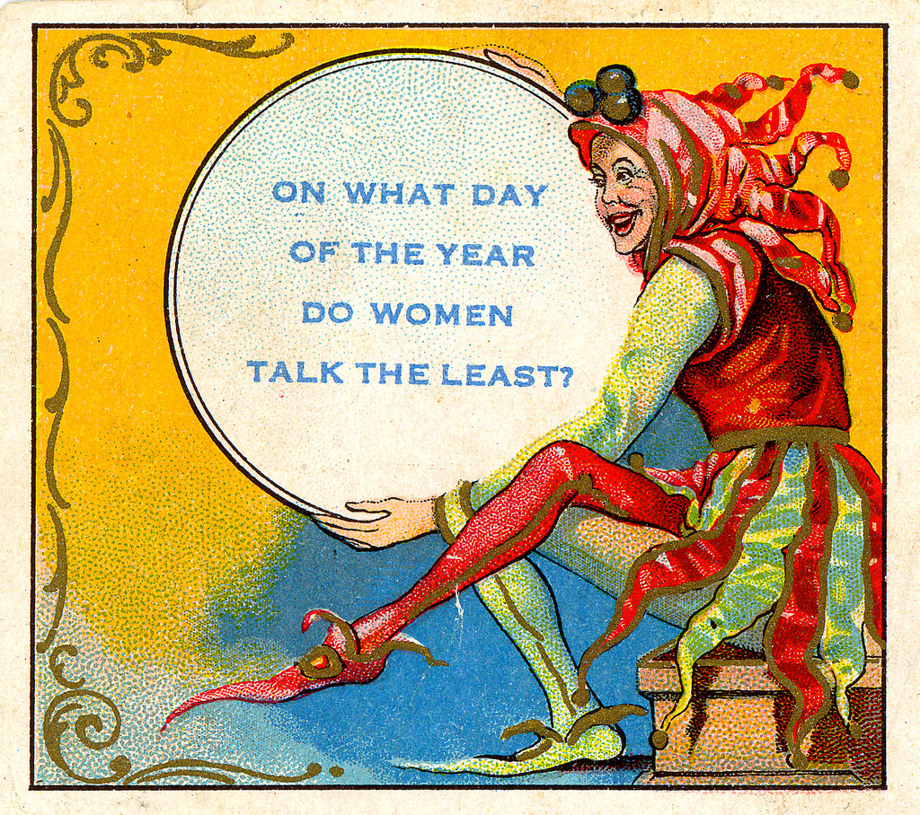
What do I know, anyway?
Notes:
Different stages in my career; different stages in the web landscape
Where I am now: Corporation/organization of engineers: Started an accessibility program, almost from scratch.
Where I was before:
Freelance web designer, developer, content writer: Accessibility was a part of my work; it made common sense to address it in my everyday tasks.
Government: Several agencies, including center of excellence and experience
They knew they were supposed to be compliant but had approached accessibility as a QA issue. While they were happy to address accessibility in their written content and design, along with the requisite development, they didn’t realize that they should address accessibility at the beginning of their projects.

Slide 4
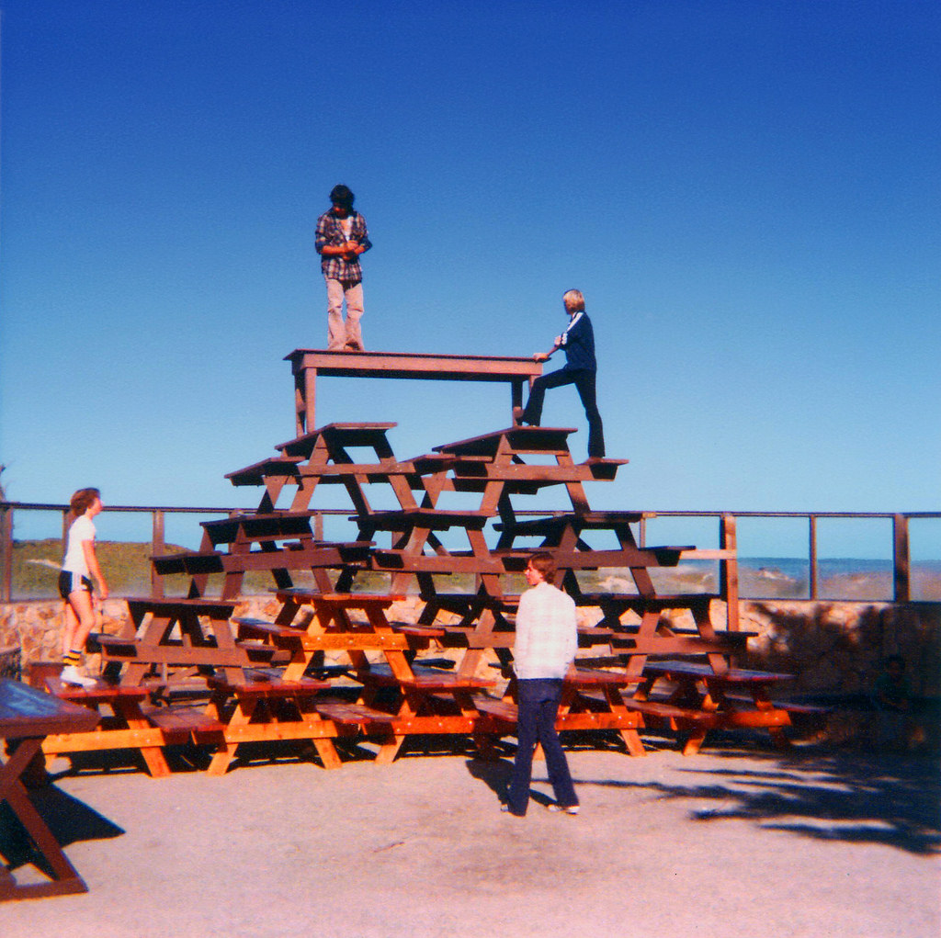
Who does that?
Notes:
Why am I admitting that I’ve made these mistakes?
It’s not a false sense of modesty that pushes me to do this; in fact, it’s quite the opposite.
I have such a love of accessibility and have heard all the stereotypical negative remarks people make about those involved in accessibility that I want others to succeed without having to go through such drastic measures to learn.
Look at where the web has come from. I’m excited about where it’s going, and it will be easier for people coming into accessibility to bring more creativity and innovation into digital media.

Slide 5
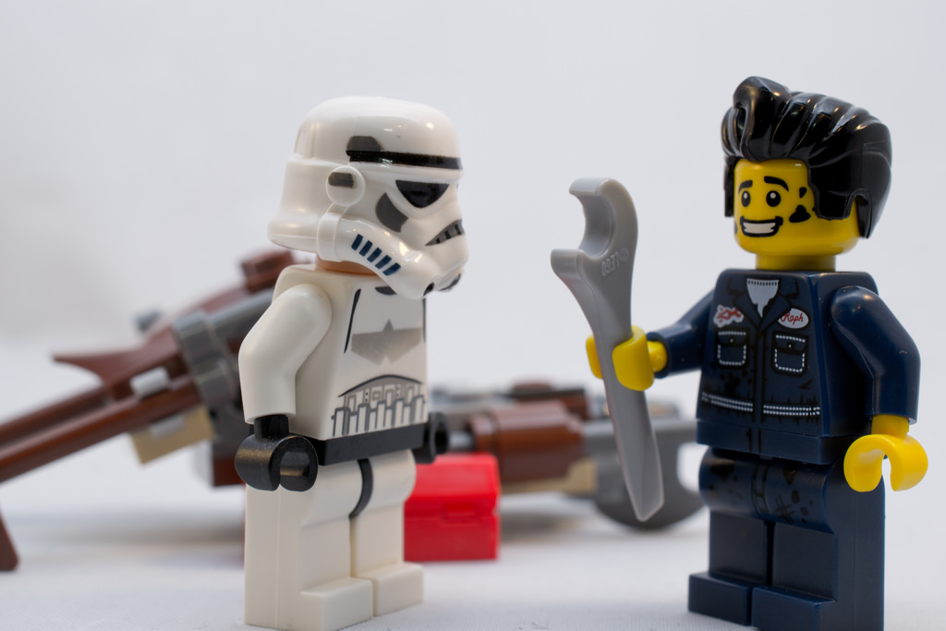
Bad mechanics
Notes:
Some of our core ways of working had problems.
Mechanics are the foundation—don’t build on an unstable foundation.

Slide 6
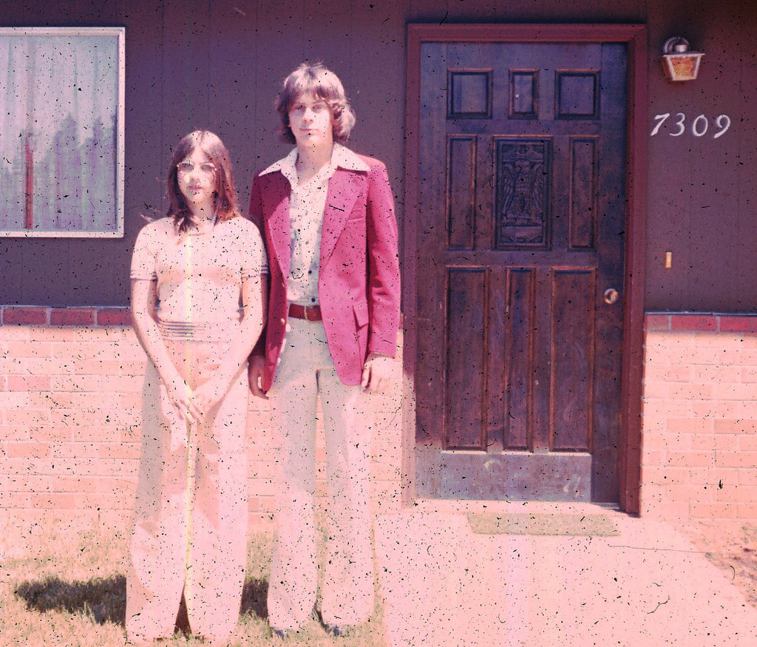
Not addressing accessibility in our style guide
Notes:
Consider the language you use, the fact that you need to consider people with cognitive impairments, low-language proficiency, non-native speakers, people who are distracted, people on the spectrum who don’t grasp certain concepts easily (irony, colloquialisms, etc.).
You’ll need a standard for how you’ll write for each component—forms, search boxes, headings, page titles—for everyone.
Edit and edit mercilessly.

Slide 7
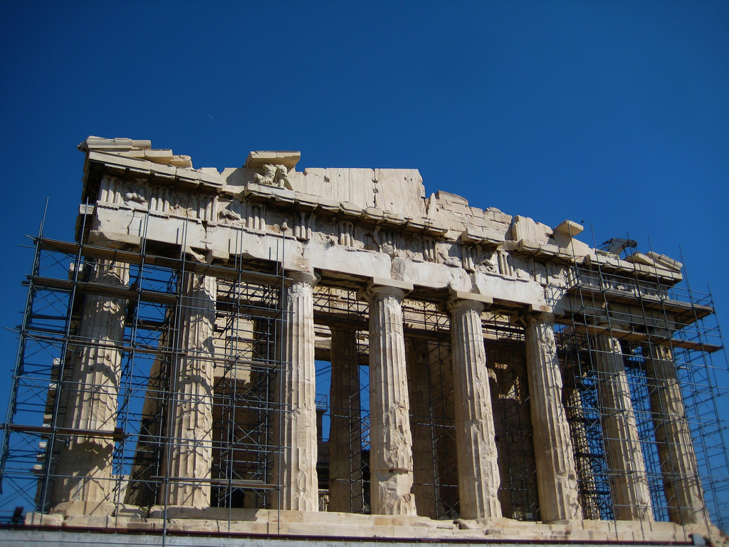
No framework to help designers and developers create accessible work
Notes:
Your CMS can’t always carry the weight of producing accessible code: Most people have WYSIWYG editors within their CMS.
Create a design pattern library.
Create code snippets and/or a CMS-agnostic framework—you should be able to use it anywhere.
There’s no excuse for poor coding standards in these frameworks.

Slide 8
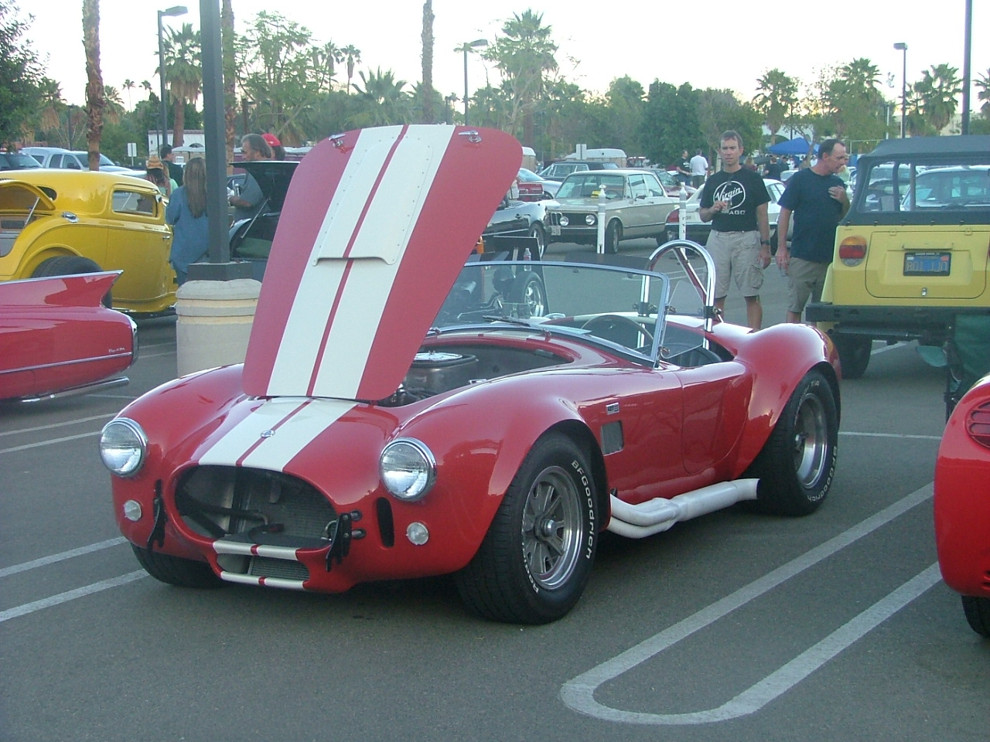
Not customizing templates when content needs it
Notes:
We are living in a templatized world, and I am a templatized gal.
But…sometimes you may pour your content into a template where it just doesn’t work.
Create a custom component for that content to make it the most understandable, the most usable.

Slide 9
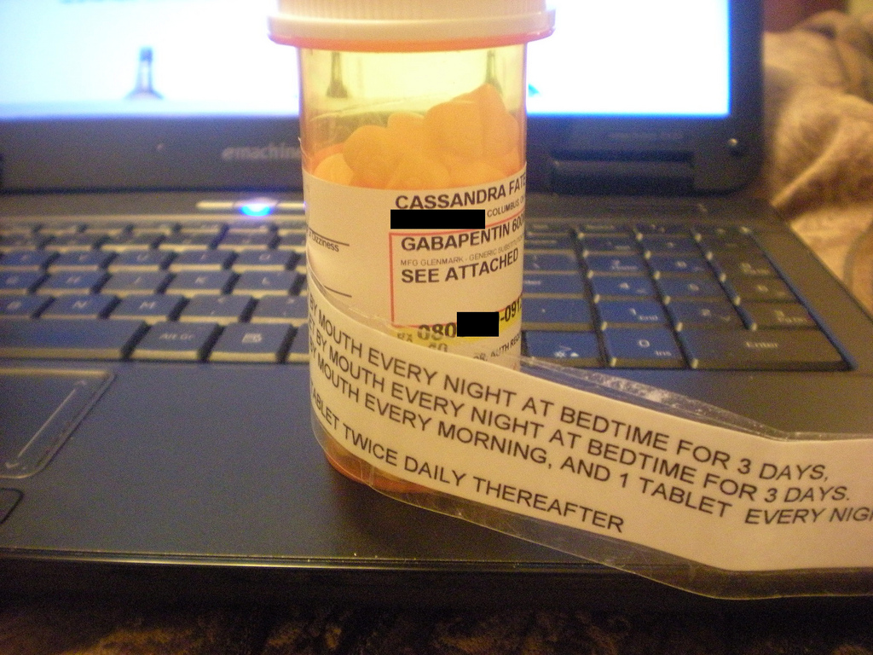
Not having accessibility help info on our website
Notes:
I lost this battle, so it wasn’t exactly my mistake, but learn from this.
When people need help on sites or other digital media, what do they look for? Help or contact us: My leadership refused to have accessibility help on the site because they felt that it made us look like we weren’t compliant—the leadership team was obsessed with compliance because of legal concerns.
Transparency will make your audience trust you more.

Slide 10
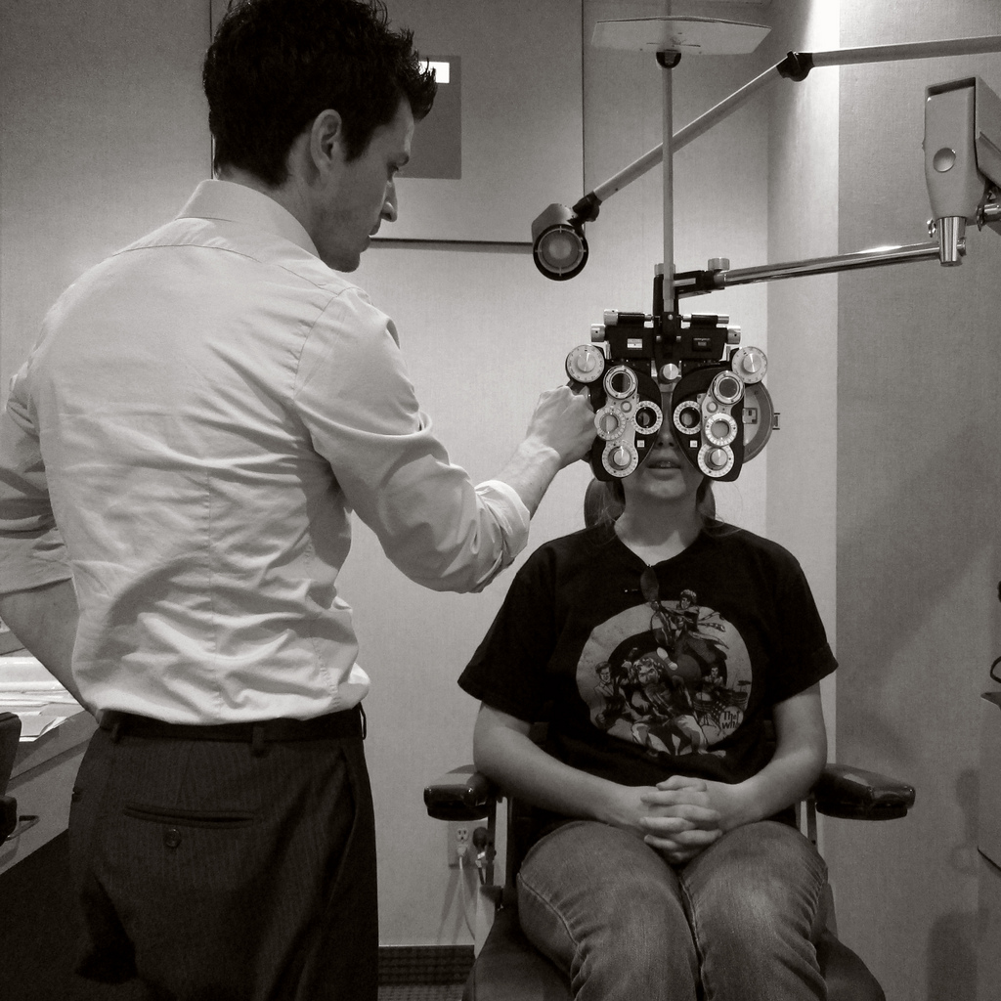
Not testing iteratively
Notes:
Too much trust that people would produce accessible work when they hadn’t been trained to do so
Each person must be able to test their own work and/or test with other people, to ensure it’s accessible
Designers should be able to test color contrasts, fonts for readability, info flow, etc.
Developers should ensure their code is valid and should use tools and manual reviews.
Writers: I recommend usability testing for content to ensure that it’s understandable and the flow is logical.

Slide 11
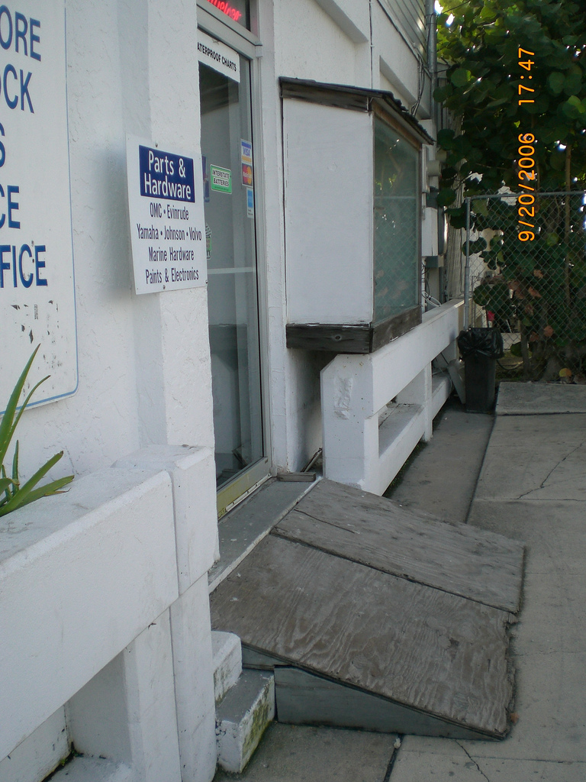
Not testing our work with people with disabilities
Notes:
I also lost this battle.
You are not your audience.
Also, not testing with assistive technologies on your end is a problem. This helps you anticipate problems on browser or AT side.

Slide 12
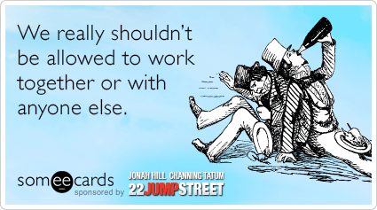
Bad program management

Slide 13
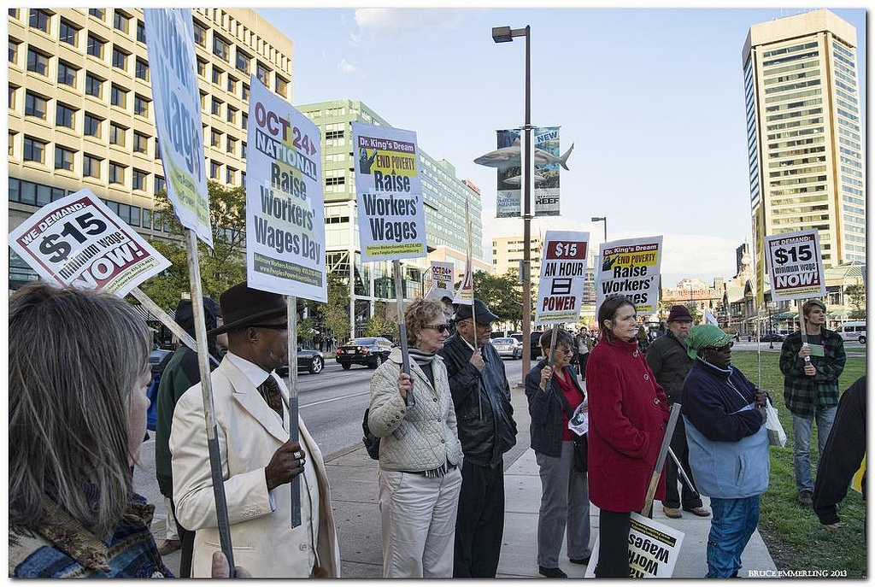
Leadership setting standards without understanding the impact on user experience
Notes:
This isn’t my personal mistake, but if you find yourself in leadership, please don’t make this mistake.
Inclusive design vs. accessibility—management may set requirements when they don't understand them; pursuing inclusive design without tapping into people with disabilities’ specific needs.
Falling under leadership’s spell of “we must be compliant” rather than “we must be accessible”
I want to do what’s best for our audience…and save us money. I can do both and be compliant.

Slide 14
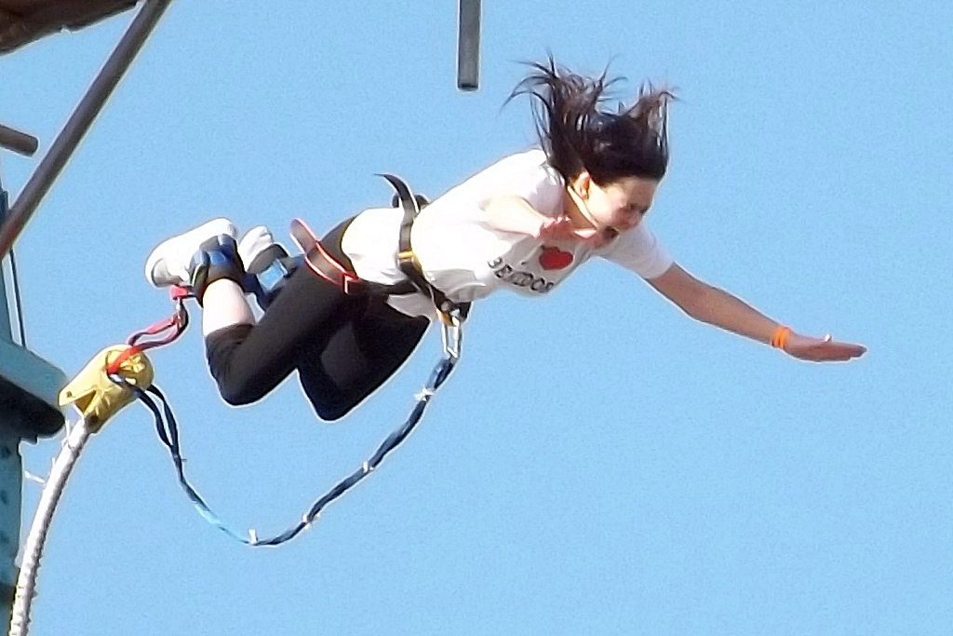
Being too cautious in new situations
Notes:
I usually move decisively—weigh the facts; consider my options.
I fell into analysis paralysis, in a situation with tough issues, and it slowed me down.
Get advice from other people in the field; find a mentor inside or outside your organization.
Don’t hesitate to pose the question on any of the accessibility forums. I’ve noticed that we’ll ask about code, but we go it alone when it comes to program issues.

Slide 15
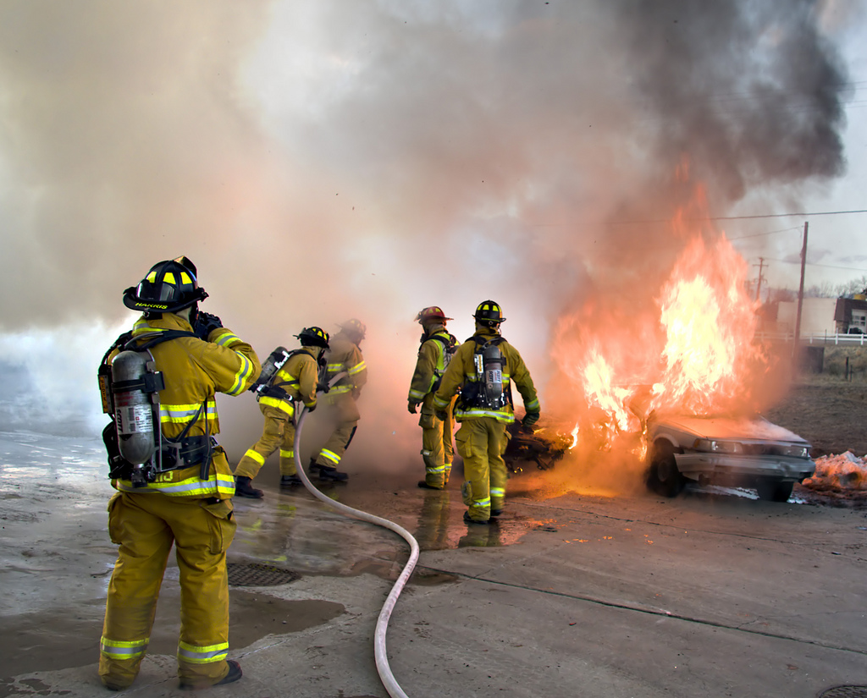
Scope and scalability: You can’t do it all
Notes:
This is a rookie mistake borne out of wanting to help everyone.
Don’t lose sight of your goals.
You will damage your team’s morale if you try to take on more work than you’re able.
Prepare self-service type materials and resources in advance so that you can offer limited help.

Slide 16
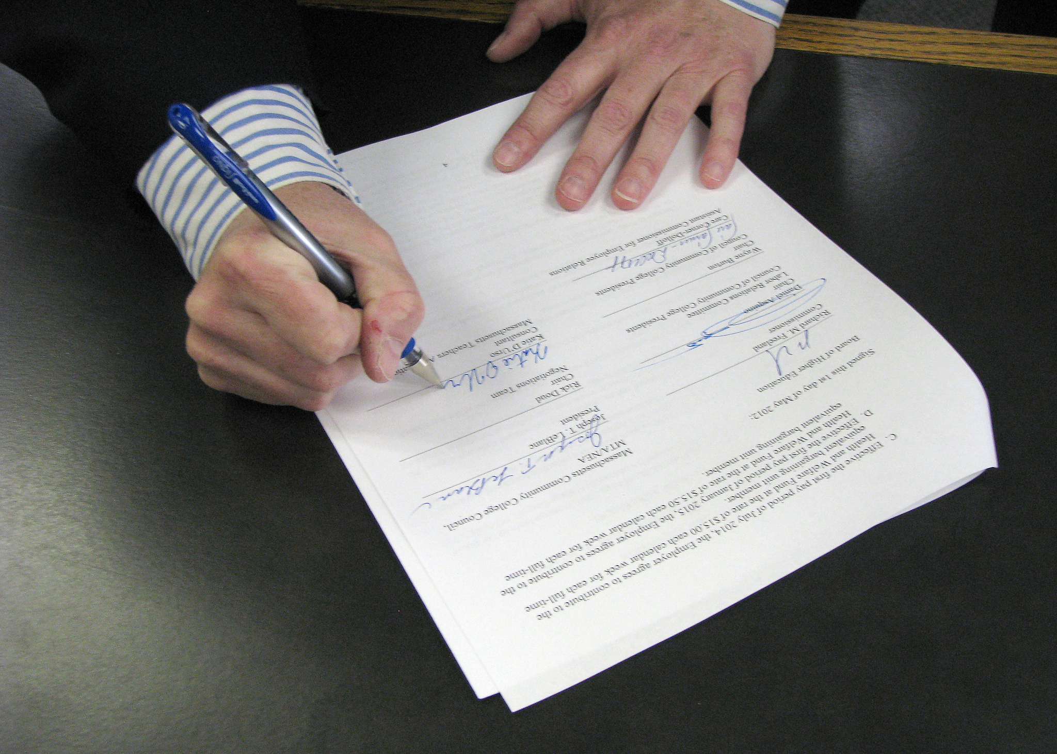
Not having the right language in contracts
Notes:
Contracts have to be specific about who is responsible for accessibility.
Vendors are responsible for producing accessible work.
Vendors must meet the standards that we set, as we define them—do not leave it to a vendor to interpret your standards or the standards you use.
Vendors must share their process for building in accessibility.
When turning in their work, vendors must submit supporting info that documents how they addressed accessibility in the project.

Slide 17

Believing what worked in one organization will work everywhere else
Notes:
I had to navigate a super-sized organization. I had to hit the ground running without much guidance or oversight. It was far different than any other place I'd set up an accessibility program.
I had to adjust to the organization’s culture and size and tailor what I thought would work for them.

Slide 18
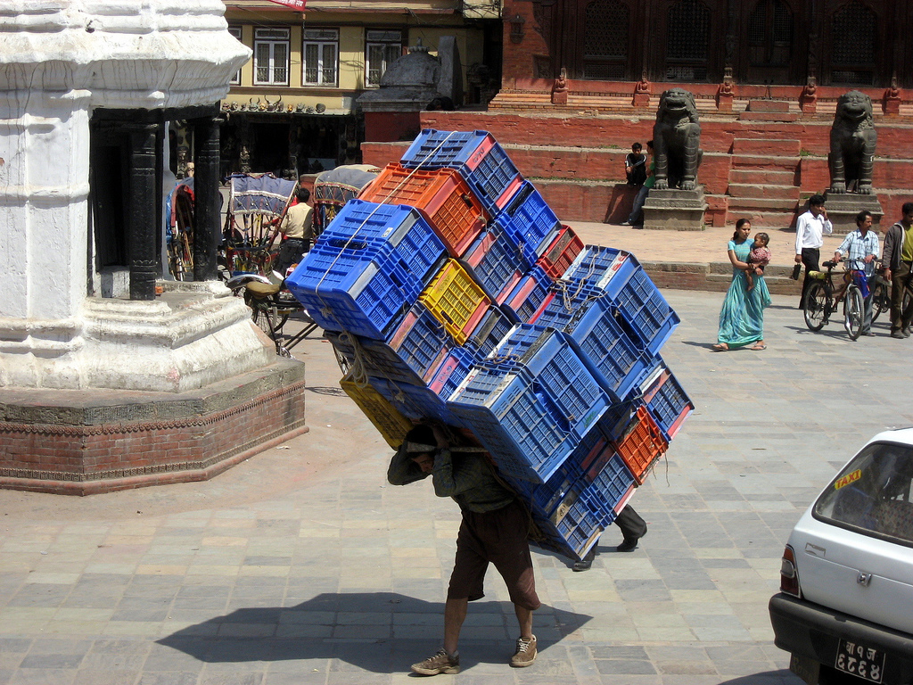
Bearing the responsibility for another team’s work
Notes:
What do I mean by that?
My team has an advisory role—we can’t force people to change things on their site. However, we were the ones who would fall if that site wasn’t accessible. This is wrong, and it’s a morale killer.
Don’t let leadership make you responsible for something for work over which you have no authority.

Slide 19
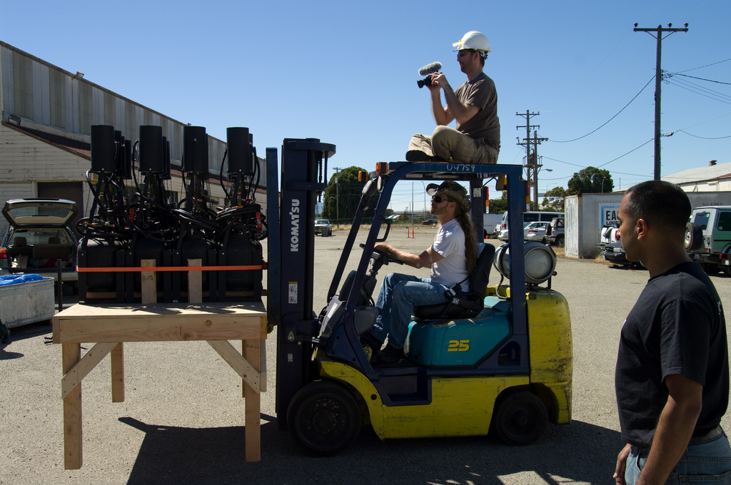
Doing another team’s work
Notes:
Don’t “pass the buck”; put the buck where it belongs.
Your teams will never learn if you continue to do the work for them. Allow them to take responsibility. Stop spoon-feeding people when they need to step up.

Slide 20
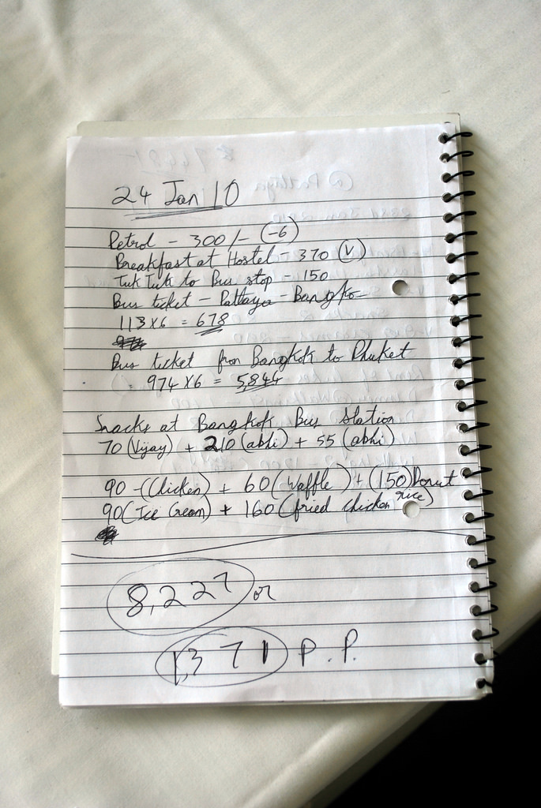
Improper or inconsistent documentation
Notes:
Rookie mistake
Trust your team, but always check people’s work. ANYONE can have an off day. I can, my manager can, ANYONE.
Your accessibility documentation will protect your organization, and your team, if anyone calls your compliance into question.

Slide 21
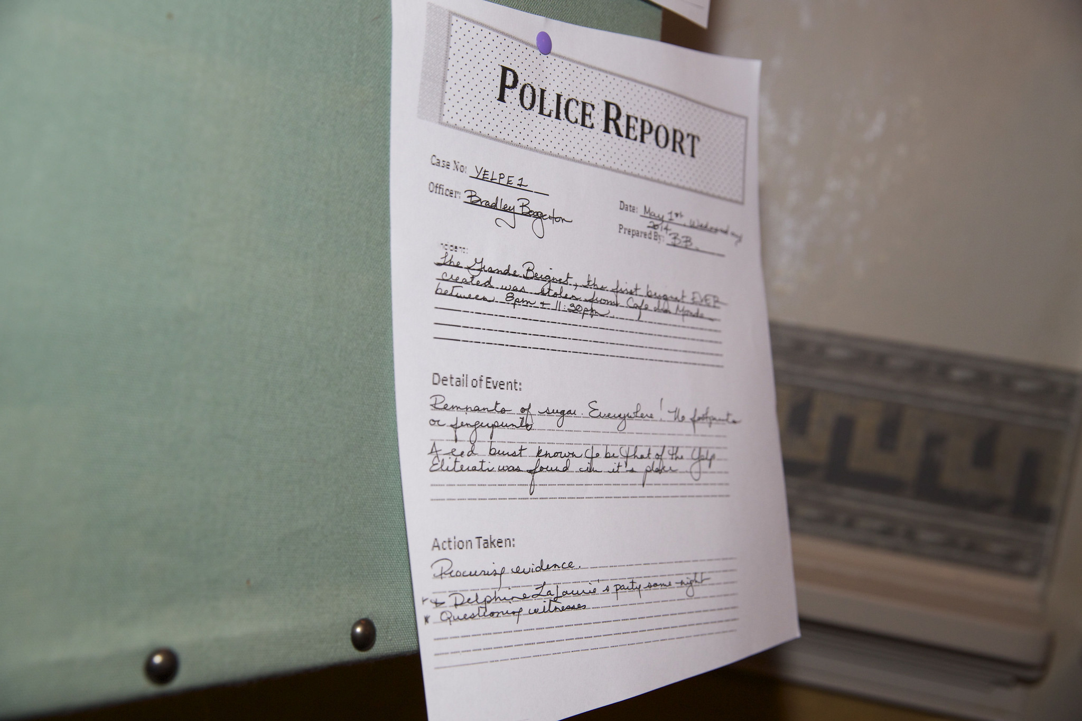
Not getting documentation from other teams
Notes:
It’s appropriate to ask other teams you work with for their documentation.
People often feel insulted when you ask them for documentation, but if you have to answer to your leadership, you’d best have records of other teams’ work.

Slide 22
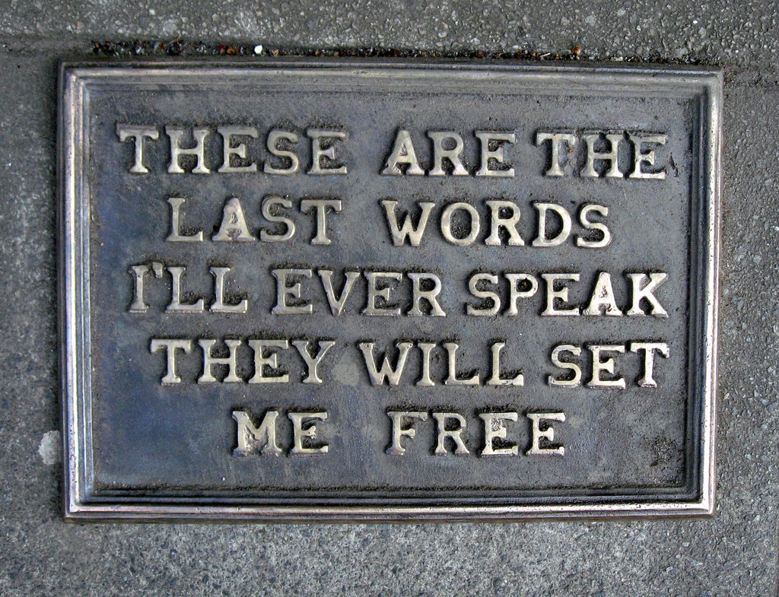
Last words
Notes:
There's no one size fits all prescription for accessibility program ills—what works in one place won't necessarily work in another.
Don’t do nothin’. Don’t get caught up in analysis paralysis.

Slide 23

Questions and comments: How’s your accessibility program going?
Notes:
Ask questions
Share thoughts
What’s worked or hasn’t worked for you?

Slide 24
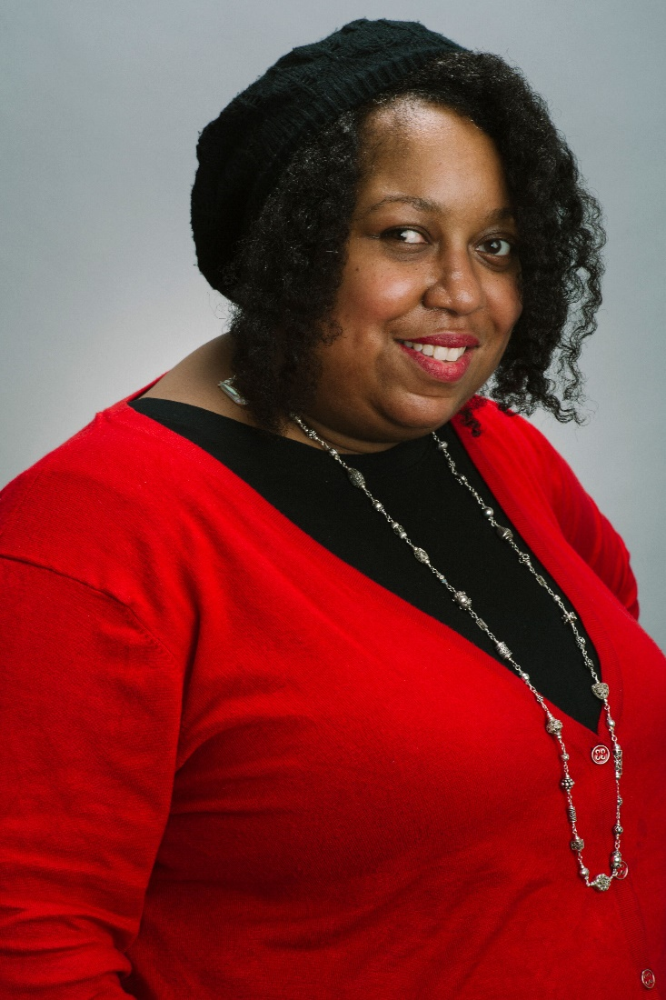
Thank you!
#WrongA11y | #AHG18
@AccessForAll
LinkedIn: /angelahooker
ange@angelahooker.com

Slide 25
Photo credits 1
“Twitter variations,” by Marie Slim; license
“WomanTalk,” by Kathleen Amt; license
“The Picnic Table Caper,” by Pip R. Lagenta; license
“Let Me Borrow,” by Robert McGoldrick; license
“Leisure Suits,” by Glenn Malone; license
“Scaffolding,” by Börkur Sigurbjörnsson; license
“Palm Springs Spa Resort Casino Classic Car Show & Auction,” by Atomic Hot Links; license
“2011-02-06 024,” by Rubbertoe; license

Slide 26
Photo credits 2
“Which looks better one or two?” by Robert Couse-Baker; license
“Handicap Ramp,” by Richard Elzey; license
“Team Work,” by Budz Life; license
“Aaaaaaaaaagh,” by Mark Harkin; license
“Firefighters,” by Andrew Magill; license
“Minimum Wage Protest,” by Social Justice – Bruce Emmerling; license
“MCCC Contract Signing,” by MassHigherEd; license

Slide 27
Photo credits 3
“Human Forklift,” by Wonker; license
“2pir on a Forklift,” by Ed Hunsinger; license
“Expense Reports,” by Harsha K R; license
“Police Report,” by Yelp Inc.; license
“These are the last words I will speak. They will set me free.” by Duncan C; license
“Grab the mike and drop it!” by Epi Ren; license
“Wrong,” by Alison; license

