Slide 1
Accessibility for Anxiety
Making Web Pages Accessible for Persons with Anxiety Disorder Using WCAG Guidelines and UDL

Slide 2
Valorie Sundby
CPWA (Certified Professional Web Accessibility - IAAP)
PCWA (Professional Certification in Web Accessibility Compliance – Univ of South Australia)

Slide 3
Disclaimers
Informal anecdotal research with students and other persons with anxiety disorder or comorbid anxiety diagnosis
Citations and Resources are listed at the end of this presentation
Idea for this research came from my involvement in the CPACC Certification through IAAP. Knowing particular impairments in depth deepens the understanding of the importance of what we do in ICT Accessibility.

Slide 4
Agenda
When impairment becomes a disability
Understanding Anxiety Disorder
Enable Success
UDL
WCAG 2.1

Slide 5
When impairment becomes a disability
Impairment becomes a disability when it meets a barrier. (Social model of disability)

Slide 6
In the brain, there are rules
"There are rules in the brain that say to avoid things that are unpleasant, painful or scary.
To communicate information that may be unpleasant, painful or scary, we need to communicate information accurately but also give people the capacity to process and deal with psychological pain."
Shankar Vedantam, Hidden Brain – The Ostrich Effect
https://www.npr.org/2018/08/06/636133086/you-2-0-the-ostrich-effect

Slide 7
Our Role
Communicate information accurately
Give people the capacity to process and deal with psychological pain

Slide 8
Anxiety
a feeling of worry, nervousness, or unease, typically about an imminent event or something with an uncertain outcome.
For people living with an anxiety disorder, the incidence of panic attacks may be frequent. The person may stay in a hyper-alert state anticipating the next attack.

Slide 9
Everyone experiences fear
The frontal cortex in humans performs a function to sooth unwarranted fears.
As children grow, they learn skills to calm anxiety, discern perceived and actual danger.
Studies of brain activity show that people who use self-talk in upsetting situations have an increased activity in the frontal cortex with decreased activity in the amygdala.
When the frontal cortex is occupied, anyone can have an amygdala hijack (panic attack).
Cain, S. (2013). Quiet: The Power of Introverts in a World That Can't Stop Talking. New York: Random House.

Slide 10
Panic Attack
28.3% of people will have a panic attack at least once in their lifetime.
Jieun E Kim, S. R. (2012, 11 20). The role of the amygdala in the pathophysiology. Retrieved from Biology of Mood & Anxiety Disorders: https://biolmoodanxietydisord.biomedcentral.com/articles/10.1186/2045-5380-2-20

Slide 11
Anxiety Disorder characteristics
People with anxiety disorders:
May not have the ability to react in a controlled manner
The incidence of panic attacks may be frequent
May remain in a high alert state excessively
May develop unusual methods of coping
May respond fearfully in the absence of actual danger

Slide 12
Common Anxiety Disorders
People with anxiety disorders may not have the ability to react in a controlled manner.
GAD (Generalized Anxiety Disorder)
OCD (Obsessive Compulsive Disorder)
PTSD (Post Traumatic Stress Disorder)
Panic Disorder (PD)

Slide 13
How we typically think about impairment?

Slide 14
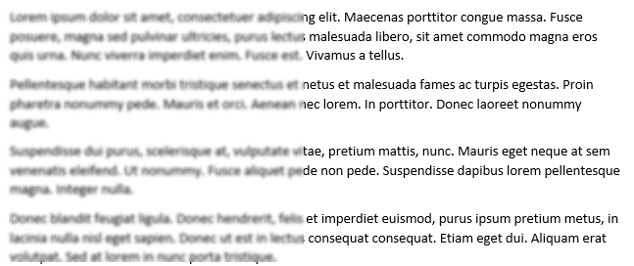
Impairments and Solution Stability
Presbyopia – We expect our glasses/contact to work everyday

Slide 15
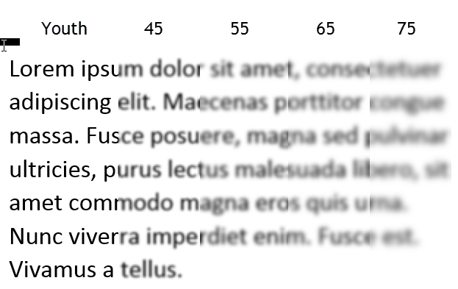
Impairment and Change
Presbyopia – over many years, presbyopia may progress

Slide 16
Anxiety: change happens within seconds and solutions do not work consistently.

Slide 17
Anxiety Impact is a Spectrum
Impact can be felt within a few seconds or can build over several minutes or days.
Physical response – flood of hormones
Increased heartrate
Blood pressure increase
Lowered Cognitive Ability
Slower Processing Time
Slower Reaction Time

Slide 18
Other Impact Consideration
Recovery time from anxiety attack
Impact of effort to "keep it together"
Medication side effects
Tiredness
Dry mouth
Lowered Cognitive Ability
Slower Processing Time
Slower Reaction Time
Ability to focus
Medications to address side effects

Slide 19
Success with Anxiety
Role:
Communicate information accurately
Give people the capacity to process and deal with psychological pain
Predictability – no surprises
Consistency – conformity; that which is necessary for the sake of logic, accuracy, or fairness.
User Control - choices

Slide 20
Enable Success - WCAG 2.1

Slide 21
WCAG 2.1 SC 1.4.2 (A) Audio Control
Audio that plays automatically for 3 seconds or more needs a mechanism to stop or pause the audio or ability to control sound independent from system volume.
IMPACT: Unexpected audio can be a source of anxiety for some people. Those with PTSD may associate certain sounds or sound pattern with a traumatic event.
PREVENTION: Being able to control “when” and “how” audio plays can be critical in preventing an Amygdala Hijack.

Slide 22
WCAG 2.1 SC 2.2.1 (A) Timing adjustable
Turn off, Adjust, Extend
Exceptions: Real-time, Essential, 20 hour
IMPACT : Time limits add undue stress on people with anxiety disorders; also on people who know they process information slower, those who use assistive technology, or use alternate formats.
PREVENTION: When timeouts are encountered, providing a clear method to turn off or extend time is important to prevent anxiety. (SC 2.2.3 (AAA) No timing – is even better!)

Slide 23
WCAG 2.1 SC 2.2.2 (A) Pause, Stop, Hide
For moving, blinking, scrolling, or auto-updating information
IMPACT: People with PTSD can have an anxiety reaction to motion. With no mechanism to stop motion, people may leave the page quickly to avoid a panic attack.
PREVENTION: Providing a method to stop, pause or hide moving content gives the individual control over the motion and can thereby dispel anxiety reactions.

Slide 24
WCAG 2.1 SC 3.2.3 (AA) Consistent Navigation
IMPACT: When navigation is inconsistent, people may begin to doubt their own ability to remember the location and order of menus and menu items.
With Anxiety, "I can't remember"
Without Anxiety, "This design is inconsistent."
PREVENTION: Providing consistent navigation can prevent anxiety by allowing people to be confident that items will be in the same location each time they look for it.

Slide 25
WCAG 2.1 SC 3.2.4 (AA) Consistent Identification
IMPACT: Similar to the impact as inconsistent navigation, being inconsistent with identification can have the same impacts.
Label: Next, Next, Next, Continue, Next
Role: Button, button, button, link, button
PREVENTION: Providing consistent identification can prevent anxiety by allowing people to be confident that items are named the same and work the same way.

Slide 26
Enable Success - UDL

Slide 27
Universal Design for Learning (UDL) provides the capacity to process
Principle I: Provide Multiple Means of Representation (the “what” of learning)
Principle II: Provide Multiple Means of Action and Expression (the “how” of learning)
Principle III: Provide Multiple Means of Engagement (the “why” of learning)
OLD: http://www.udlcenter.org/aboutudl/whatisudl/3principles
NEW: http://udlguidelines.cast.org/?utm_medium=web&utm_campaign=none&utm_source=cast-about-udl

Slide 28
Principle I: Checkpoint 1.1 Offer ways of customizing the display of information
IMPACT : Eye strain or fatigue, can trigger anxiety as the learner thinks about the study time that is being lost.
PREVENTION: Being able to personalize the perceptual features can prevent the anxiety trigger of losing study time due to eye strain or fatigue.

Slide 29
Display customizations
Color – background, text
Contrast
Size
Speed and ability to stop motion
Layout – linearization
Font

Slide 30
Principle I: Checkpoint 1.2: Offer alternatives for auditory information
IMPACT : For all learners, having technology fail can bring on anxiety. For those with anxiety disorders, technology failure can be derailing.
PREVENTION: Knowing that an alternative is available when technology fails, the learner with anxiety can stay the course and continues with their learning.

Slide 31
Auditory Alternatives
Volume
Speech - Text transcript
Data - Diagrams, charts
Music – musical notations, color, visual pulses
English speech – ASL
Emotion – emoticons
Sound effects – tactile representations (vibration)

Slide 32
Principle I: Checkpoint 1.3: Offer alternatives for visual information
IMPACT : When a single method of study is provided visually, the student with anxiety may excessively worry about the availability of the method and having sufficient time to read and process the information.
PREVENTION:
Providing additional alternatives can dispel anxiety by assuring the user that duplicate inputs are available which may help reduce processing time.
Providing an alternative for visual information also dispels the anxiety associated with the possibility of technology failure.

Slide 33
Visual alternatives
Text – provide audio
AT – text to speech (synthetic)
Human reader
Images – alternative text
Graphics –
Data,
Tactile graphics,
Text description

Slide 34
Creating Success for people
Deeper understanding of impacts of impairment (Shameless plug for IAAP CPACC Certification)
Practice gleaning the guidelines for methods to prevent barriers

Slide 35
Thank you Valorie Sundby valoriesundby@gmail.com Denver, CO

Slide 36
Citations and Resources
American Psychiatric Association. (n.d.). What Is Obsessive-Compulsive Disorder? Retrieved from American Psychiatric Association: https://www.psychiatry.org/patients-families/ocd/what-is-obsessive-compulsive-disorder
Anxiety and Depression Association of America. (n.d.). Generalized Anxiety Disorder (GAD). Retrieved from Anxiety and Depression Association of America (ADAA): https://adaa.org/understanding-anxiety/generalized-anxiety-disorder-gad#
Cain, S. (2013). Quiet: The Power of Introverts in a World That Can't Stop Talking. New York: Random House.
Goleman, D. (1995). Emotional Intelligence. New York: Bantum Books.
Jieun E Kim, S. R. (2012, 11 20). The role of the amygdala in the pathophysiology. Retrieved from Biology of Mood & Anxiety Disorders: https://biolmoodanxietydisord.biomedcentral.com/articles/10.1186/2045-5380-2-20
NHS Choices. (n.d.). Post-traumatic stress disorder (PTSD). Retrieved from NHS.UK: https://www.nhs.uk/conditions/post-traumatic-stress-disorder-ptsd/
Barron, Daniel (2018, 10 11). Is Chronic Anxiety a Learning Disorder? Retrieved from Scientific American Blog Network: https://blogs.scientificamerican.com/observations/is-chronic-anxiety-a-learning-disorder/.
Shankar Vedantam (2018, 08 06), Hidden Brain – The Ostrich Effect. Retrieved from NPR: https://www.npr.org/2018/08/06/636133086/you-2-0-the-ostrich-effect
UDL: http://udlguidelines.cast.org/?utm_medium=web&utm_campaign=none&utm_source=cast-about-udl
WCAG 2.1: https://www.w3.org/TR/WCAG21/

