Slide 1
“We don’t have enough staff assigned to making IT accessible!”
Sheryl Burgstahler, Director
Accessible Technology Services, UW-IT

Slide 2
Two ATS Centers at UW
Access Technology Center
1984–
To ensure IT procured, developed & used at UW is accessible
DO-IT Center
1992–
Supported with grants
2007– DO-IT Japan
Disabilities
Opportunities
Internetworking
Technology

Slide 3
Presentation topics
The University of Washington journey
Promising practices that can be implemented by institutions without making major changes in staffing/funding
Resources

Slide 4
History at UW
1984 Micro Support Group (MSG)
Evolved into Desktop Computing Services (DCS)
(IT access for faculty, students & staff always part of list of services for MSG & DCS)
Focus on assistive technology in Access Technology Center
1992 NSF began funding DO-IT Center
Steadily increasing efforts on the procurement, development & use of accessible IT
2016 WA State Policy # 188 became effective

Slide 5
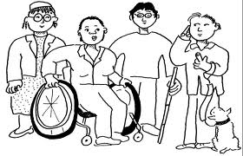
Legal basis for IT accessibility
Section 504 of the Rehabilitation Act of 1973
The Americans with Disabilities Act of 1990 & its 2008 Amendments
WA Policy #188

Slide 6
WA Policy #188 – IT Accessibility
establishes the expectation for state agencies that people with disabilities have access to & use of information & data & be provided access to the same services & content that is available to persons without disabilities unless providing direct access is not possible due to technical or legal limitations.
-OCR & DoJ resolutions

Slide 7
UW IT Accessibility Policy
The UW strives to ensure that people with disabilities have access to the same services & content that are available to people without disabilities, including services & content made available through the use of information technology (IT). IT procured, developed, maintained, & used by the UW should provide substantially similar functionality, experience, & information access to individuals with disabilities as it provides to others. Examples of IT covered by this policy include ...

Slide 8
UW Policy aligns with:
the UW’s vision to educate a diverse student body & its values of diversity, excellence, collaboration, innovation & respect.
the UW’s obligations under Section 504 of the Rehabilitation Act of 1973.
the Americans with Disability Act of 1990 together with its 2008 Amendments.
Washington State Policy #188 – Accessibility.
UW Executive Order 31 – Nondiscrimination & Affirmative Action.
UW Administrative Policy Statement 2.3 – Info Technology, Telecommunications & Networking Projects & Acquisitions.

Slide 9
What does “accessible” IT mean?
“Accessible” means a person with a disability is afforded the opportunity to acquire the same information, engage in the same interactions, & enjoy the same services as a person without a disability in an equally effective & equally integrated manner, with substantially equivalent ease of use. The person with a disability must be able to obtain the information as fully, equally & independently as a person without a disability.
-DoJ, OCR Resolutions

Slide 10
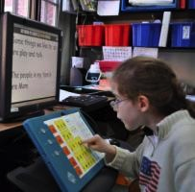
Technology: Approaches to the provision of assistive features
as assistive technology designed for people with disabilities
as a UD feature for the purpose of ensuring access to everyone

Slide 11
Common accommodations for online courses at UW
Creating accessible documents (70% PDFs)
More than 13,000 pages of PDFs/quarter taking 130 hours to remediate
Captioning videos
More than 120 hours captioned costing more than $20,000 per quarter

Slide 12
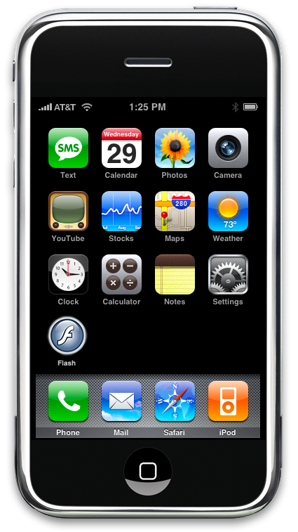
Universal design =
“the design of products & environments to be usable by all people, to the greatest extent possible, without the need for adaptation or specialized design.”
The Center for Universal Design www.design.ncsu.edu/cud

Slide 13
Apply UD to create inclusive
physical spaces
technology
services
learning activities

Slide 14
Learn from OCR/DoJ resolutions
Get commitment of leadership & key organizations
Develop organizational structure with stakeholders
Identify key IT developed, procured, & used (websites, PDFs, videos, software) & develop priorities, strategies & assignments, regular reports
Create & disseminate policy, guidelines, standards
Provide resources, training, promotional activities
Develop procurement policies & procedures
Undertake efforts that are both reactive & proactive, top-down & bottom-up
Develop & publicize grievance procedure

Slide 15
UW leadership
IT Accessibility Coordinator
IT Accessibility Team (ATS)
IT Accessibility Task Force
IT Accessibility Liaisons

Slide 16
Task Force activities
Review high-level web pages to ensure that they reflect a high level of accessibility.
Ensure that current & future templates for UW web pages, PPts are designed to be accessible.
Review the UW’s Accessible Technology website (uw.edu/accessibility/) & recommend content useful to the campus community.
Develop plans for promoting IT accessibility.
Submit annual progress reports & recommendations to sponsors.

Slide 17
IT Accessibility Liaisons
communicate online; keep them informed about resources & activities
meet as a group ½ day 3 times per year.
continue to learn about how IT used on campus can be made more accessible.
collect information from & spread the word within their units about the UW’s IT Accessibility Policy & resources

Slide 18
UW’s IT Accessibility Guidelines
Purpose
Definition
Scope
Standards—Web Content Accessibility Guidelines (WCAG) 2.0 Level AA, World Wide Web Consortium (W3C)
Progress & Plan
Resources
Resources & Support for IT Accessibility
Additional Campus Resources
Legal and Policy Requirements

Slide 19
IT Procurement
Procurement policy
Procurement steps
Solicit accessibility information.
Validate information received.
Include accessibility assurances in contracts.
Work with vendors

Slide 20
UW “free” video captioning
Secured pilot, then service funding to caption high-impact videos, eg:
Highly viewed videos available to the public
Videos that will be used multiple times in a course
Videos developed by several faculty members to be used in several different courses
Notes:
funding to caption highly-visible, high-impact, multiple use, &/or strategic videos. Examples:
Highly viewed videos available to the public
Videos that will be used multiple times in a course

Slide 21
Cost-saving UW approaches, 1/3
Promote accessibility within context of UD, civil rights, & inclusive campus
Model IT accessibility compliance after IT security compliance efforts
Build on existing policies, procedures, & job/unit assignments. Assign specific roles to individuals
Undertake efforts that are both
reactive & proactive
top-down & bottom-up

Slide 22
Cost-saving UW approaches, 2/3
Create
a high level task force,
a small team of individuals with deep knowledge
a large community of liaisons, build their enthusiasm & support them.
Integrate training, activities within those sponsored by other campus units

Slide 23
Cost-saving UW approaches, 3/3
Create campus-specific resources, & use others’ (websites, MOOCs, Lynda.com, webinars)
Search for internal funds to:
offer incentives (e.g., video captioning)
hire hourlies/consultants; &
purchase tools (e.g., Ally, SensusAccess, Site Improve)
Consider external funding options

Slide 24
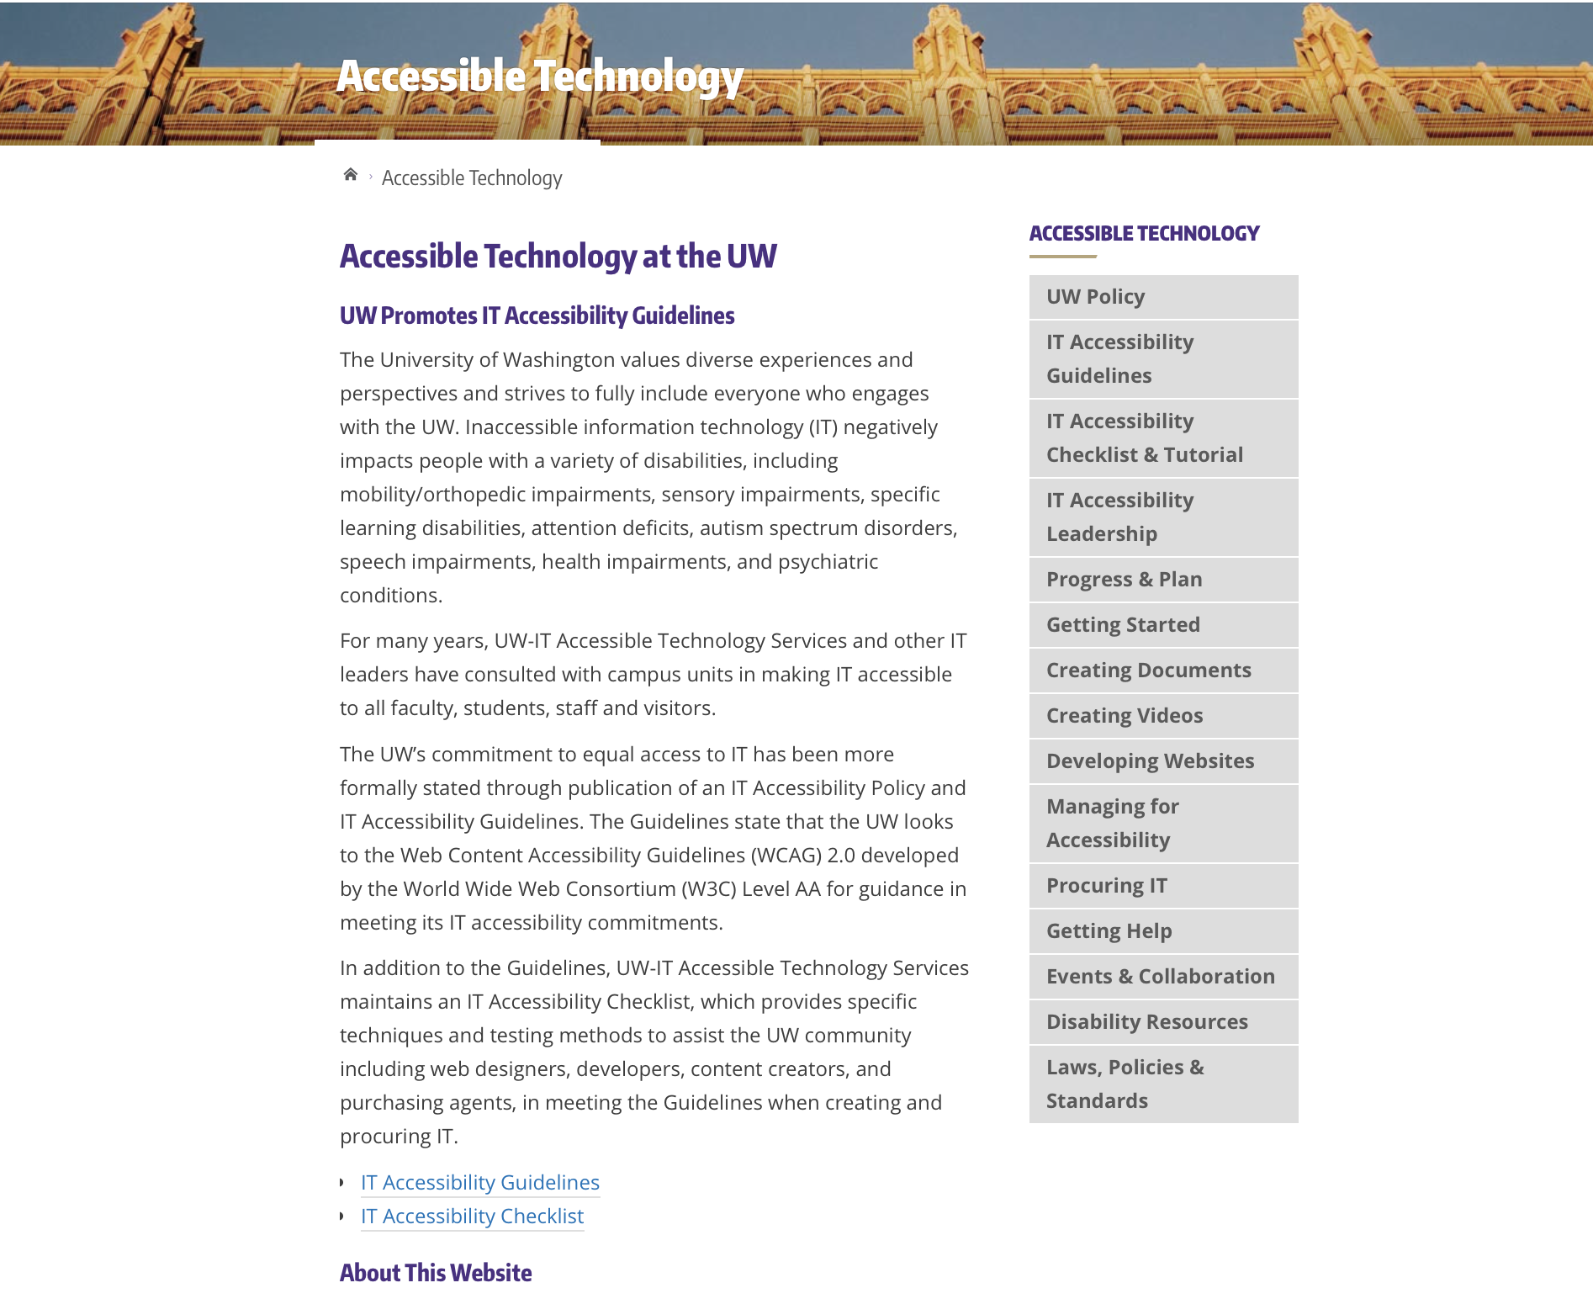
Accessible Technology website
Notes:
Terrill

Slide 25
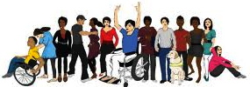
DO-IT Resources
www.uw.edu/doit
Knowledge Base of Q&As, promising practices, case studies
Publications
Videos…

Slide 26
Q&A, Sharing of other Practices Sheryl Burgstahler, sherylb@uw.edu

