Slide 1
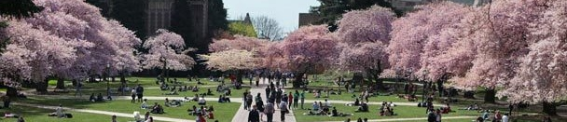
Building a campus-wide universal design framework from the ground up
Sheryl Burgstahler, Director
Accessible Technology Services, UW-IT

Slide 2

Two ATS Centers at UW
        Access Technology Center
          1984–
          To ensure IT procured, developed & used at UW is accessible
          DO-IT Center
          1992–
          Supported with grants
          2007– DO-IT Japan
Disabilities
Opportunities
Internetworking
Technology

Slide 3
Presentation outline
Resources
An inclusive environment
History of approaches to human differences
The UD approach
UD alignment between institutional values, vision, goals, etc.
How might a campus-wide UD framework guide inclusive, including IT, practices

Slide 4
Online resources
Center for Universal
Design in Education
www.uw.edu/cude
UDL on Campus
udloncampus.cast.org
IT Accessibility
www.uw.edu/accessibility
AccessComputing
www.uw.edu/accesscomputing

Slide 5

Book: Universal Design in Higher Education (UDHE): From Principles to Practice
>40 authors/co-authors
Harvard Education Press
Email doit@uw.edu to join
the UDHE online community
of practice

Slide 6
Challenges for students
diminished support systems after high school
little access to successful role models
inadequate self-advocacy skills
lack of or ineffective accommodations
low expectations on the part of people with whom they interact
no/limited access to technology

Slide 7
Challenges for institutions
Implementing accommodations that provide equal access within an inclusive setting, & within a reasonable time period
Providing accessible technology
Helping students transition from one educational level to another & to employment

Slide 8
Basic approaches
When we are working with faculty, staff, institutions, technology companies, we promote
UNIVERSAL DESIGN (UD)
When we are working with students, we promote
SELF DETERMINATION

Slide 9
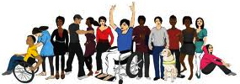
In an “inclusive” environment everyone
  who meets requirements, with or without accommodations, is encouraged to participate
  feels welcome
  is engaged

Slide 10
“Inclusiveness” requires efforts that are
proactive & reactive
individual & institutional

Slide 11
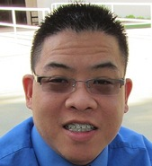
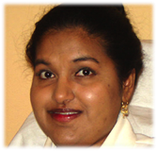
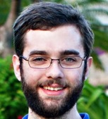
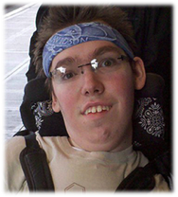
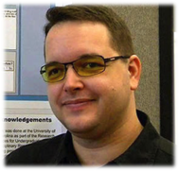
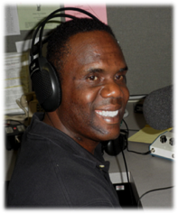
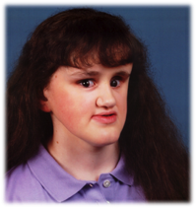
Characteristics

Slide 12
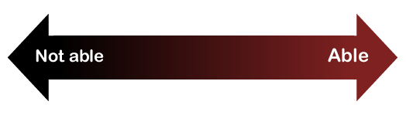
Consider ability on a continuum
understand English, social norms
see
hear
walk
read print
write with pen or pencil
communicate verbally
tune out distraction
learn
manage physical/mental health

Slide 13
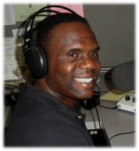

One-minute history lesson—Evolution of responses to human differences
        Eliminate, exclude
        Segregate
        Cure
        Rehabilitate
        Accommodate
        Social justice: Inclusion &
        universal design

Slide 14

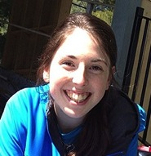
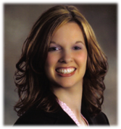
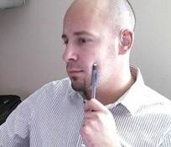
Note
Most disabilities are “invisible”
Fewer than 1/3 of students with disabilities may be reporting them to the disability services office

Slide 15
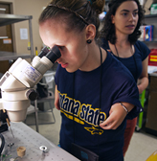
Typical approach— accommodation
An accommodation adjusts a product
or environment to
provide access to a
specific person
(extra time,
alternative formats,
sign language
interpreters, …).

Slide 16
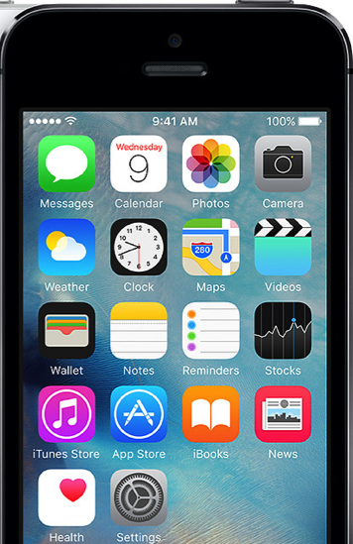
Universal design =
  “the design of products & environments to be usable by all people, to the greatest extent possible, without the need for adaptation or specialized design.”
  The Center for Universal Design
  www.design.ncsu.edu/cud

Slide 17
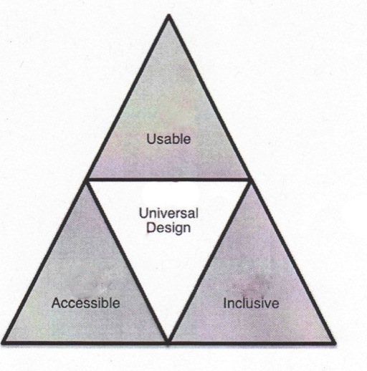
Terminology
Accessible design
Usable design
Inclusive design
Universal design
Barrier-free design
Design for all

Slide 18
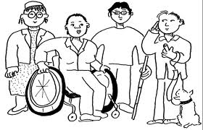
How UD can promote compliance?
Section 504 of the Rehabilitation Act of 1973
The Americans with Disabilities Act of 1990 & its 2008
Amendments
State laws & policies

Slide 19

Apply UD to create inclusive
        physical spaces
        services
        learning activities
        technology

Slide 20
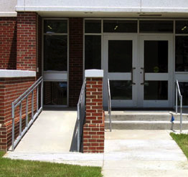
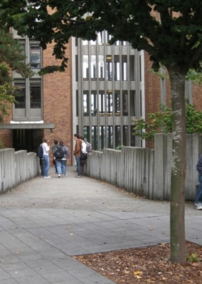
UD on a continuum
Interpreter for deaf student
Captioned & audio described video
Uncaptioned
video
Captioned video

Slide 21
Incorporating UD framework within a model for an inclusive campus
How does UD align with campus & diversity visions, missions, goals, values, etc.?
How might a UD framework contribute to a campus model for inclusive practices?
How could this model guide the procurement, development & use of accessible IT?

Slide 22
Campus vision/mission
The University of Washington educates a diverse student body to become responsible global citizens and future leaders through a challenging learning environment informed by cutting-edge scholarship.
-UW

Slide 23
Campus values
Integrity
Diversity
Excellence
Collaboration
Innovation
Respect
-UW

Slide 24
Diversity
At the UW, diversity is integral to excellence. We value & honor diverse experiences & perspectives, strive to create welcoming and respectful learning environments, & promote access, opportunity and justice for all.
-UW

Slide 25
Diversity vision
We are leaders in advancing equity for underrepresented groups in higher education, & build from our legacy of advocacy to promote broad inclusion & enact positive change.
-UW

Slide 26
Diversity mission
We create pathways for diverse populations to access postsecondary opportunities, nurture and support their academic success, and cultivate a campus climate that enriches the educational experience for all.
-UW

Slide 27
Diversity values
Excellence
Equity
Access
Community
Social Justice
Innovation
-UW

Slide 28
Diversity blueprint goals 2017-21
Cultivate an inclusive campus climate
Attract, retain, & graduate a diverse & excellent student body
Attract & retain a diverse Faculty
Attract & retain a diverse Staff
Assess tri-campus diversity needs
Improve accountability & transparency
-UW

Slide 29
Incorporating UD framework within a model for an inclusive campus
How does UD align with campus & diversity visions, missions, goals, values, etc.?
How might a UD framework contribute to a campus model for inclusive practices?
How could this model guide the procurement, development & use of accessible IT?

Slide 30
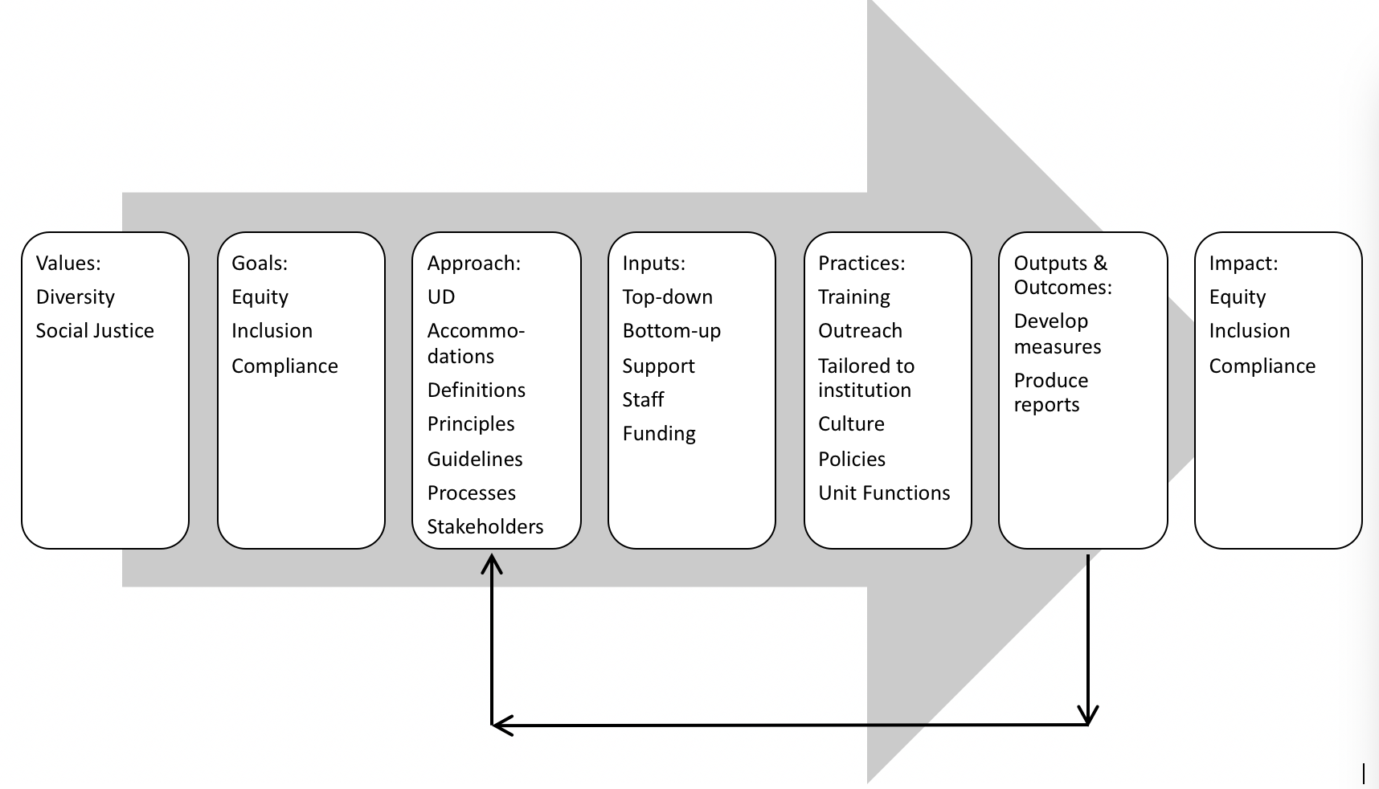
Building your model: Potential values
  Diversity
  Social justice
  &/or???

Slide 31
Potential goals
  Equity
  Inclusion
  Compliance
  &/or???

Slide 32
Potential approaches
  UD
  Accommodations
  Definitions
  Principles
  Guidelines
  Process
  Stakeholders
  &/or???

Slide 33
Potential inputs
  Top down
  Bottom up
  Support
  Staff
  Funding
  &/or???

Slide 34
Potential practices
  Training
  Outreach
  &/or???

Slide 35
Potential outputs & outcomes
  Measures
  Reports
  &/or???

Slide 36
Potential mpact
  Equity
  Inclusion
  Compliance
  &/or???

Slide 37

A model for building a more inclusive campus

Slide 38
Incorporating UD framework within a model for an inclusive campus
How does UD align with campus & diversity visions, missions, goals, values, etc.?
How might a UD framework contribute to a campus model for inclusive practices?
How could this model guide the procurement, development & use of accessible IT?

Slide 39
Apply the model to accessible IT
Values: What campus values (e.g., diversity?) can the UD of IT approach support?
Goals: How can UD of IT approach support campus goals (eg., equity, compliance?).
Approaches: What mix of UD & accommodation strategies can help reach your accessible IT goals? Identify definitions, principles, guidelines, stakeholders.
Inputs: What issues (e.g., processes, support, funding) need to be addressed both bottom-up and top-down?
Practices: What IT accessibility practices can be tailored to your institution, culture, policies, and unit functions?
Outputs & Outcomes: What measures should be used & analyzed & what reports should be created?
Impact: What impacts can/should be measured?

Slide 40

Q&A
Sheryl Burgstahler
sherylb@uw.edu

