Slide 1
Teaching about Accessibility in Computing and IT Courses: A Capacity-building Institute
Facilitator: Sheryl Burgstahler, Ph. D.
Co-PI AccessComputing,
Director, DO-IT Center

Slide 2
AM agenda
9:00–10:30 am Welcome, logistics, introductions
Basic disability, IT access issues/approaches that can be integrated into courses
Video: Teaching Accessibility: Including Accessibility in Your Courses
10:30–10:45 am Break
10:45-11:15 Industry engagement through Teach Access
11:15-12:00 Examples of accessibility content to incorporate in specific computing/IT courses, discussion
12:00–1:30 pm Lunch (on your own)

Slide 3
PM agenda
1:30–2:30 pm More examples of accessible IT content that can be easily integrated into postsecondary computing & IT courses
2:30–3:00 pm Two promising practices: Incorporating accessibility content into web design courses
3:00–3:15 pm Break
3:15 - 4:00 pm Panel: CBI participants share promising practices for integrating accessibility topics in their courses & engage in discussion with all participants
4:00–4:30 pm Resources, invitation for further engagement, evaluation

Slide 4
NSF-funded AccessComputing
DO-IT Center
Department of Computer Science & Engineering
iSchool
Ultimate goal: Increase the participation of people with disabilities in computing & IT fields & improve these fields with their expertise & perspectives

Slide 5

Presentation topics
General access approaches/content
Motivation
Survey
Examples
Resources

Slide 6
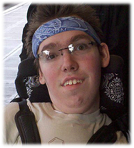
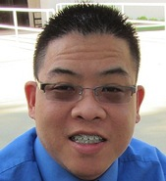

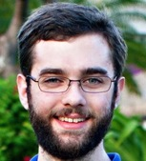

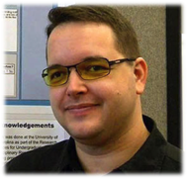
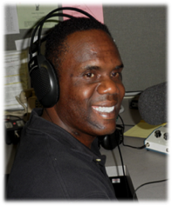
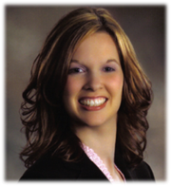
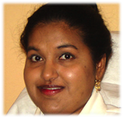
Student characteristics

Slide 7
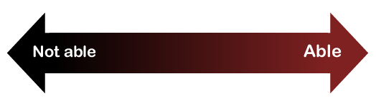
Look at ability on a continuum
see
hear
walk
read print
write with pen or pencil
communicate verbally
tune out distraction
learn
manage physical/mental health

Slide 8
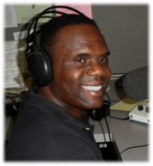

One-minute history lesson—Evolution of responses to human differences
        Eliminate, exclude
        Segregate
        Cure
        Rehabilitate
        Accommodate
        Social justice: Inclusion &
        universal design

Slide 9
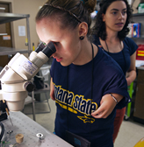
Typical approach— accommodation
An accommodation adjusts a product
or environment to
provide access to a
specific person
(extra time,
alternative formats,
sign language
interpreters, …).

Slide 10

But sometimes it is the design
of the product or environment
that should be reconsidered…

Slide 11

“Coffeepot for Masochists”, Catalog of Unfindable Objects by Jacques Carelman; in Donald Norman’s The Psychology of Everyday Things, 1988

Slide 12
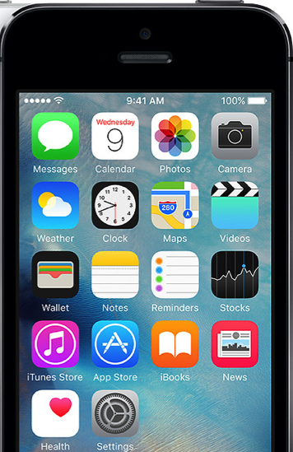
Universal design =
  “the design of products & environments to be usable by all people, to the greatest extent possible, without the need for adaptation or specialized design.”
  The Center for Universal Design
  www.design.ncsu.edu/cud

Slide 13
How could you universally design a nametag?

Slide 14
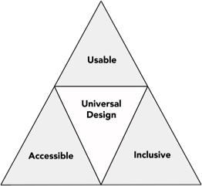
Proactive design terminology
accessible design
usable design
inclusive design
universal design
barrier-free
design
design for all
user-centered design
…

Slide 15

“When you plant lettuce,
if it does not grow well, you don't blame the lettuce. You look for reasons it is not doing well.
It may need fertilizer,
or more water,
or less sun...”
-Thích Nhất Hạnh,
Vietnamese
Buddhist Monk

Slide 16
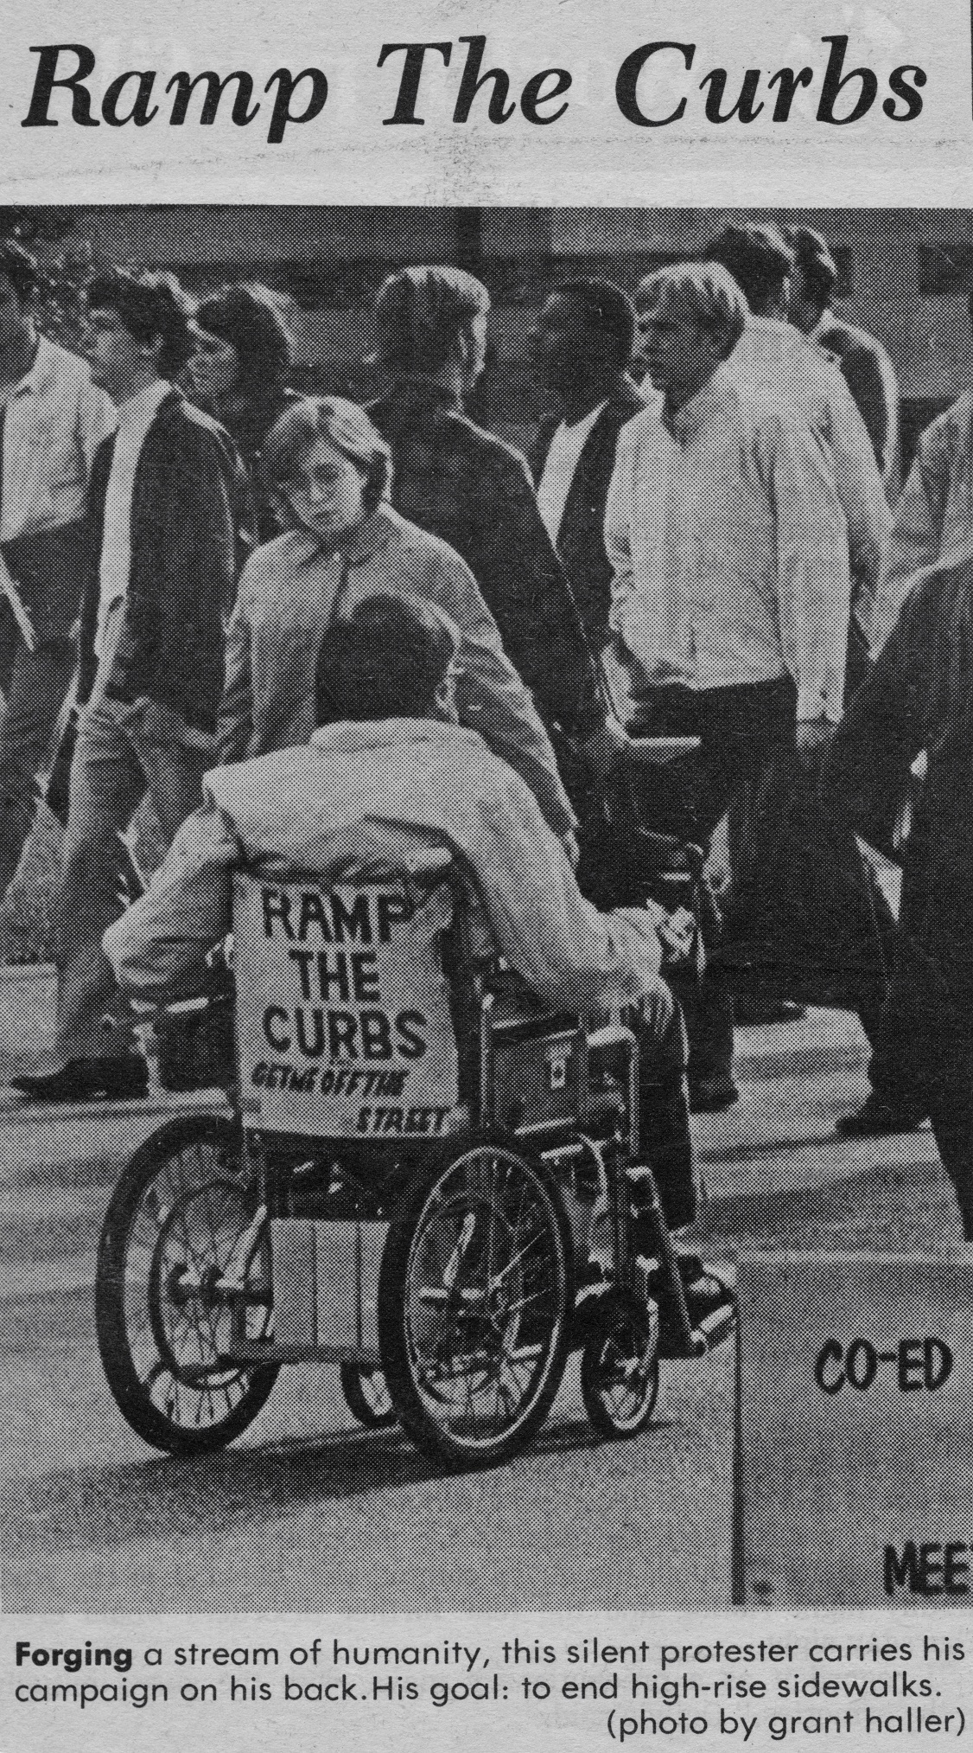
“The Daily” UW
1970

Slide 17
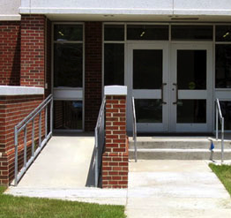
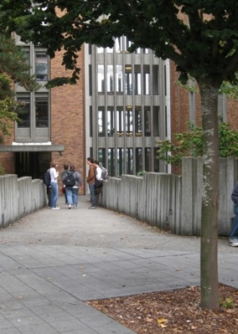
UD on a continuum
Interpreter for deaf student
Captioned & audio described video
Uncaptioned
video
Captioned video

Slide 18
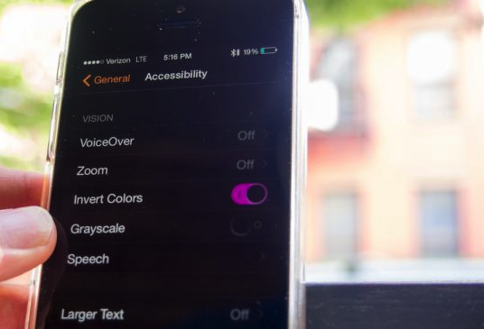
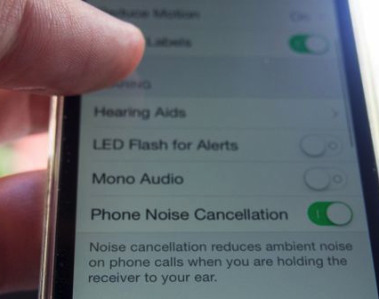
Universally designed technology
builds in
accessibility & flexibility
is compatible with assistive technology

Slide 19
Assistive technology
How much to you/your students need to know?
Learn from videos, presentation by assistive technology experts on your campus, panel of students, success stories

Slide 20
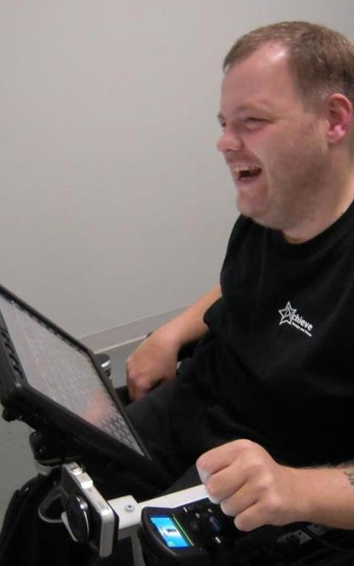
Anthony
AT Specialist
Prentke Romich Co.
grammar/spell checkers
synthesized voice on communication device
touch screen
computer-based environmental control, phone access

Slide 21

Nicole
BA, Computer Science
Stanford
Google
speech output
Braille translation software
Braille display & printer

Slide 22

Jessie
BA, Informatics, UW
Business Analyst
Amazon.com
speech output
speech input
grammar/spell checkers

Slide 23
What to know about assistive technology
Assistive Technology: | Therefore:
Emulates the keyboard, but may not emulate the mouse | Design web, software to operate with keyboard alone
Cannot read content presented in images | Provide alternative text
Can tab from link to link | Make links descriptive
Can skip from heading to heading | Structure with hierarchical headings
Cannot accurately transcribe audio | Caption video, transcribe audio

Slide 24
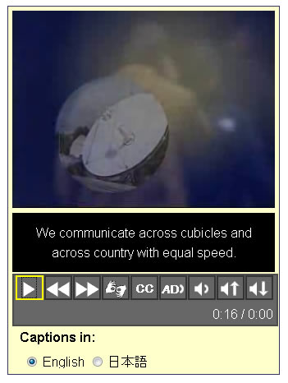
Beneficiaries of captions on videos…People who:
are unable to hear the audio
are English learners
are in a noisy or noiseless
location
have slow Internet connections
want to know the spelling
of words
need to find content quickly

Slide 25
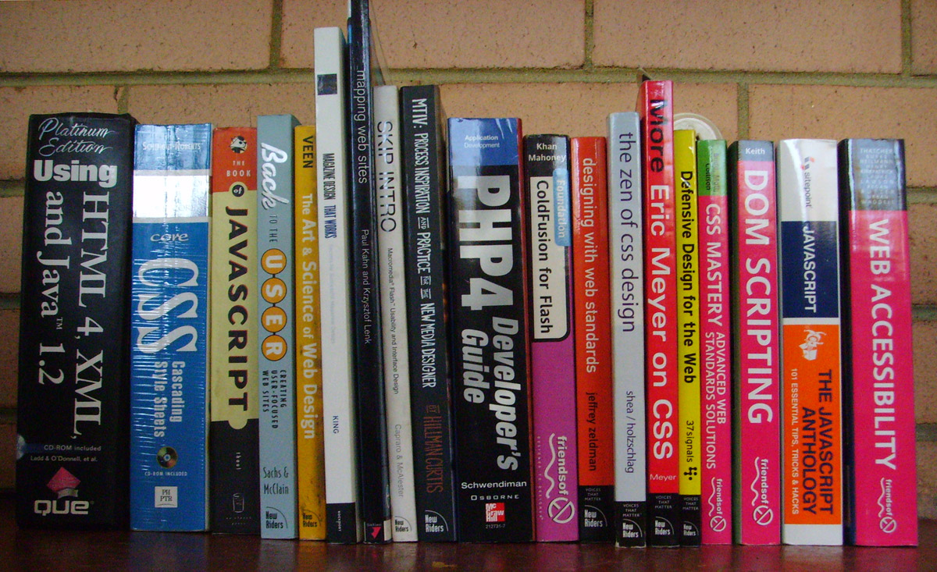
But where is accessibility covered in computing/IT curriculum/textbooks?

Slide 26





Motivation to teach UD
reach diverse audiences
disability-related legislation
ethics, social justice
accessibility benefits everyone
emerging standards: ACM, ABET…
demand from companies

Slide 27
Engineering design definition
"Engineering design is the process of devising a system, component, or process to meet desired needs & specifications within constraints. … examples of possible constraints include accessibility, aesthetics, constructability, cost, ergonomics, functionality, interoperability, legal considerations, maintainability, manufacturability, policy, regulations, schedule, sustainability, or usability.”
-ABET (accreditation board for postsecondary engineering & computing programs)

Slide 28
Question
“Who Teaches Accessibility?: A Survey of U.S. Computing Faculty”
RIT: Kristen Shinohara,
UW: Saba Kawas,
Andrew Ko
Richard Ladner
2018 Proceedings of the 49th ACM Technical Symposium on Computer Science Education, pp. 197-202.
faculty.washington.edu/ajko/papers/Shinohara2018AccessComputingSurvey.pdf

Slide 29
Research questions
Who is teaching accessibility?
What barriers do faculty see to teaching accessibility?
What factors predict who is teaching accessibility?
+ What resources do you need?

Slide 30
Survey sample
Faculty at 4-year universities & colleges
  Computer Science
  Information Science
  Other interdisciplinary computing departments
We identified major accredited programs on:
  Wikipedia
  Computing Research Association
  iSchool Caucus charter list for Information Schools

Slide 31
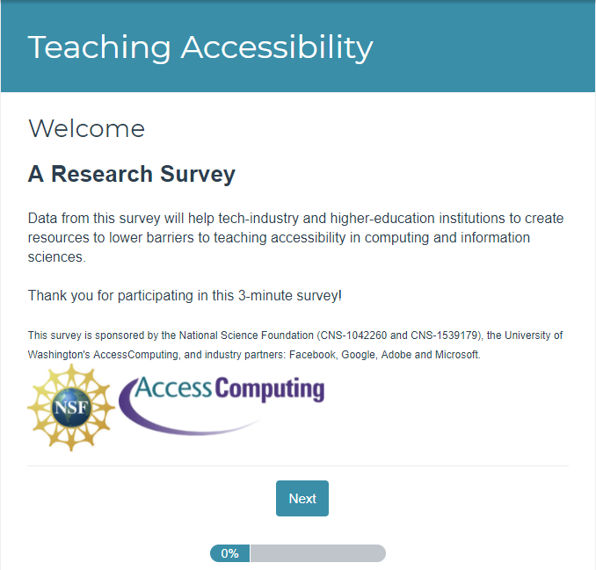
Survey launches & response rate
SurveyGizmo, 3 launches
Emails with link to survey sent
To 14,176 faculty
From 352 institutions
Received full responses from
1,867 faculty
318 institutions
Response rate: 13%

Slide 32
1: How many are teaching accessibility?
20% respondents DO teach courses that incorporate accessibility
Representing 175 unique institutions
  At least 2 faculty at 75 institutions
Authors estimate at least:
  375 out of 14,176 or 2.6%
  175 institutions out of 352 or 50%

Slide 33
1: Who is teaching accessibility?
Females
More likely to know someone with a disability
Most common area of expertise: Human-Computer Interaction
17% had a disability

Slide 34
1: Areas of expertise
Teaches
Accessibility
Does Not Teach Accessibility
HCI
Software Engineering
Information Assurance
Cybersecurity
Library & Information Science
Computer Science Education
Other Applied Areas
Algorithms
Theory
Artificial Intelligence
Machine Learning
Programming Languages

Slide 35
1: Learning objectives
Understand technology barriers
Understand design concepts
Engage diverse populations
Evaluate web accessibility standards & heuristics
Develop accessible web technologies
Employ design techniques
Understand Legal regulations (Section 508, ADA)
Understand Models of disability
Employ accessibility-focused technical languages & tools

Slide 36
2: Challenges to incorporating accessibility
Not core part of curriculum
Don’t know enough to teach it
No appropriate textbook
Lack of students & administrator awareness
Lack of support for topics addressing real challenges for disabled
Difficulty engaging students
Lack of demand in industry
Difficult to recruit people with disabilities

Slide 37
2: What do faculty need?
Help with connections to people with disabilities to interact with 1-1 &/or bring into classroom
Tools, technologies, guidelines, problem examples
Curricular samples for specific courses
Training & other opportunities to gain expertise

Slide 38
2: We need…
“Appropriate lesson plans for different classes (algorithms, theory, intro programming). This should be taught across the CS curriculum, not just in a specialty topics course. But, I feel that students & faculty feel that “it is not directly related to the curriculum” & so they don’t incorporate it.”
-Survey comment

Slide 39



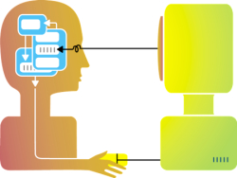
3: What factors predict who is teaching accessibility?
1.5 times as likely to know someone with a disability
2 times as likely to identify as female
2.1 times as likely to agree that accessibility is part of computing
3.5 times as likely to report having knowledge of accessibility

Slide 40
Recommendations to the CS education community
Local change agents can foster curricular change through social & instructional discourse, contributing to institutional culture
Barnett et al, 2001; Kirk & MacDonald, 2001; Kezar & Eckel, 2002
Hire HCI faculty
Develop discipline-specific course & class level materials that incorporate accessibility
Teach & train faculty accessibility concepts

Slide 41
Career benefits for students
IT companies are encouraging the teaching of accessible design practices
At UW student workers in Access Technology Lab have secured jobs in parts because of accessibility knowledge

Slide 42

Q&A, discussion
Sheryl Burgstahler
sherylb@uw.edu
uw.edu/accesscomputing

Slide 44
PM Agenda
1:30–2:30 pm More examples of accessible IT content that can be easily integrated into postsecondary computing & IT courses
2:30–3:00 pm Two promising practices: Incorporating accessibility content into web design courses
3:00–3:15 pm Break
3:15 - 4:00 pm Panel: CBI participants share promising practices for integrating accessibility topics in their courses & engage in discussion with all participants
4:00–4:30 pm Resources, invitation for further engagement, evaluation

Slide 45
AccessComputing resources www.uw.edu/accesscomputing
Publications, videos, bios, curriculum modules, …
Knowledge Base:
  Q&As: Are “QuickLinks” dropdown lists accessible?
  Case Studies: Conference engagement via robot: A case study in an option for a student unable to travel
  Promising Practices: AccessComputing Engagement: A Promising Practice in universally designing remote meetings

Slide 46
Other resources

