Slide 1
Risk Analysis & Portfolio Prioritization for Higher Ed Accessing Higher Ground November 16, 2018 Presented by: Bill Curtis-Davidson
Download link: https://accessinghigherground.org/risk-analysis-and-portfolio-prioritization-for-higher-ed/

Slide 2
Agenda
Risk Analysis and Portfolio Prioritization for Higher Ed
Importance of Prioritization
Inventorying digital assets
Using a prioritization model
Planning for accessibility remediation
Resources

Slide 3
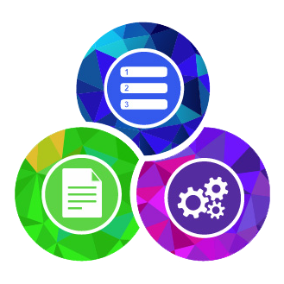
The importance of prioritization
Risk Analysis and Portfolio Prioritization for Higher Ed
Focus on the most important assets / issues for accessibility first
Ensure your limited program resources focus on areas with the most potential return
Demonstrate value to and better collaborate with stakeholders
Focus on the highest risk / exposure assets, and be more efficient
Avoiding “boiling the ocean”

Slide 4
Inventorying Digital Assets

Slide 5
Where do you start?

Slide 6
Developing an asset inventory
Implement a process in your institution, and perform on an ongoing basis
Verify applicable legal requirements
Verify priority asset types
Identify key stakeholders
Conduct interviews with stakeholders
Gather baseline inventory of digital assets (web, mobile, electronic documents focus)
Deploy ACCESS Analytics® on web assets
Run analytics for 4+ weeks and review inventory in AMP®

Slide 7
Tip #1: Prioritize asset types
Make general high, medium, low categories for your institution’s assets
Some assets may be generally more important than others; Priorities can change!
Use the categorization to determine which stakeholders and asset owners to engage
Helps you focus so you don’t have too wide a scope for the effort
Highest Priority
Medium Priority
Lower Priority
Academic Program
Academic Resource
Admissions and Registration
Continuing Ed / Certification
Diversity & Equal Rights
Employment
Health, Safety, Security
Human Resources
Learning Management System
Student Life and Resources
Tech Infrastructure/CMS
Communications
eDocs, Forms, Surveys
Intranet
Legal, Compliance
Marketing & Blogs
News & Events
Parent Resources
Research
Social Media
Technology Support / Services
Videos and Multimedia
`
Administration
Advancement, Development and Fundraising
Alumni
Athletics
Community
Facilities
Financial
Publishing

Slide 8
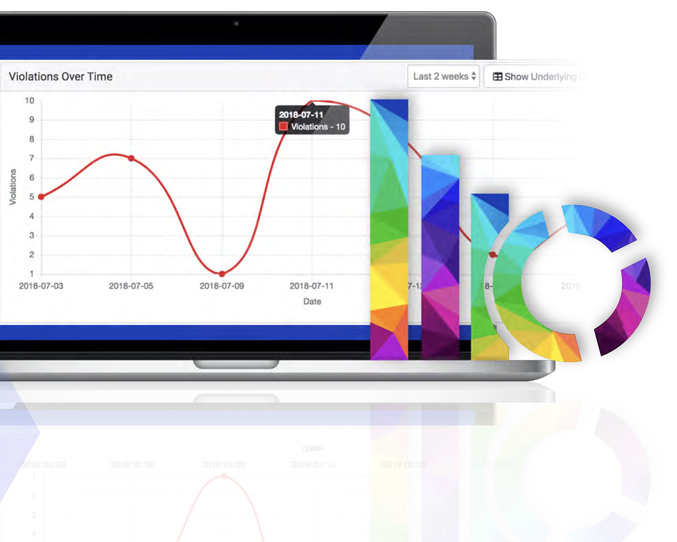
Tip #2: Analytics is your friend
ACCESS Analytics® from Level Access
Deploy ACCESS Analytics® on high-priority sites by simply placing a JavaScript resource header (or use Google Tag Manager)
Automatic discovery / risk profiling of site pages
Continuous monitoring of sites and applications
Highlight priority areas / measure risk exposure over time
Comprehensive reporting of compliance violations and Assisted Technology usage
For sites that don’t deploy analytics, spidering, DNS lookups, other techniques can be used (not preferred)

Slide 9
Using a Prioritization Model

Slide 10
How can you prioritize?

Slide 11
Institutional & Tool-Derived Priorities
The foundation of a robust prioritization and risk model
Institutional Priorities
Tool-Derived Priorities
Traffic: Amount of traffic derived from ACCESS Analytics®
Average Violations by Page: Derived from ACCESS Analytics® for domains and sub-domains
S-N-T: (S) Severity measures impact of issue on users, (N) Noticeability measures whether an issue might be detected, and (T) Tractability is the likely amount of effort to fix an issue
1
2
Websites
3
Mobile Apps
Social Media
Asset Type Priorities: High, Medium, Low categorization

Slide 12
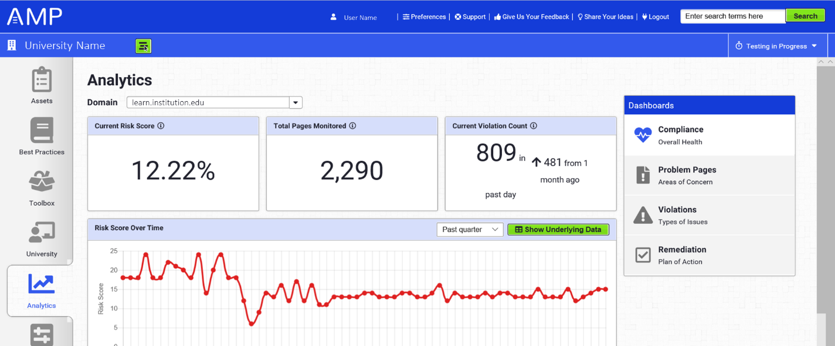
Applying the Model to High Priority Assets
Leverage analytics and AMP® Platform to efficiently apply the model
Highest Priority
Deploy
Run 30+ Days
Academic Program
Academic Resource
Admissions and Registration
Continuing Ed / Certification
Diversity & Equal Rights
Employment
Health, Safety, Security
Human Resources
Learning Management System
Student Life and Resources
Tech Infrastructure/CMS
Websites
AMP® Analytics Dashboard
Risk scores for each domain
Number of violations
Real-time traffic / use

Slide 13
Analytics Dashboard – Compliance
Example AMP® Analytics Dashboard

Slide 14
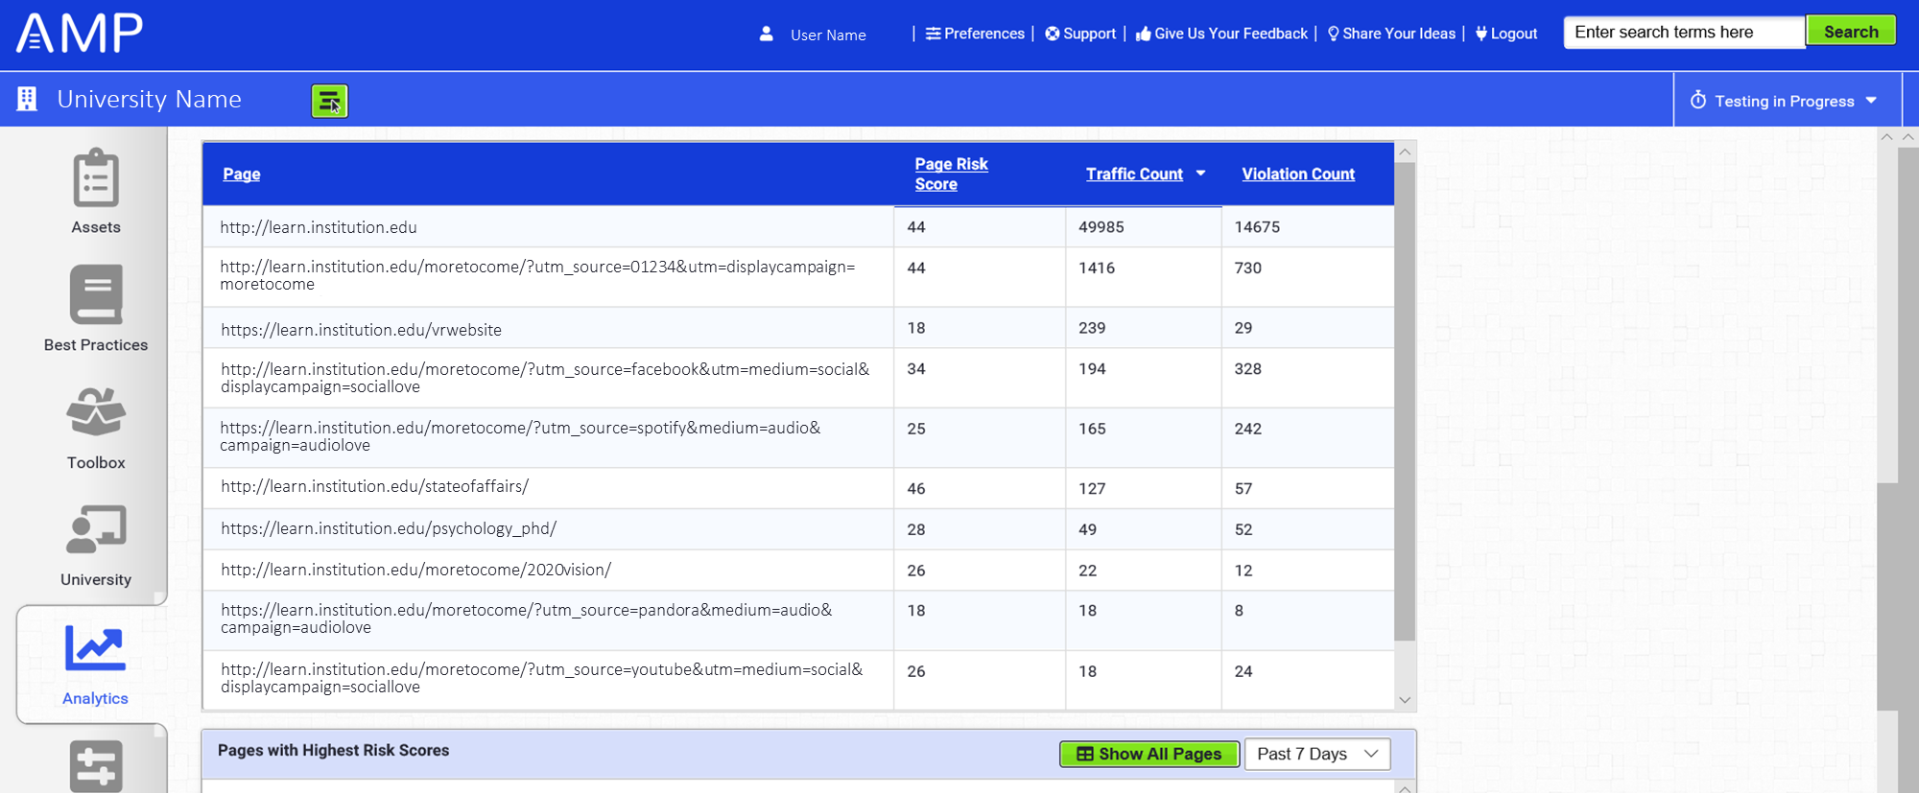
Analytics Dashboard – Problem Pages
Example AMP® Analytics Dashboard

Slide 15
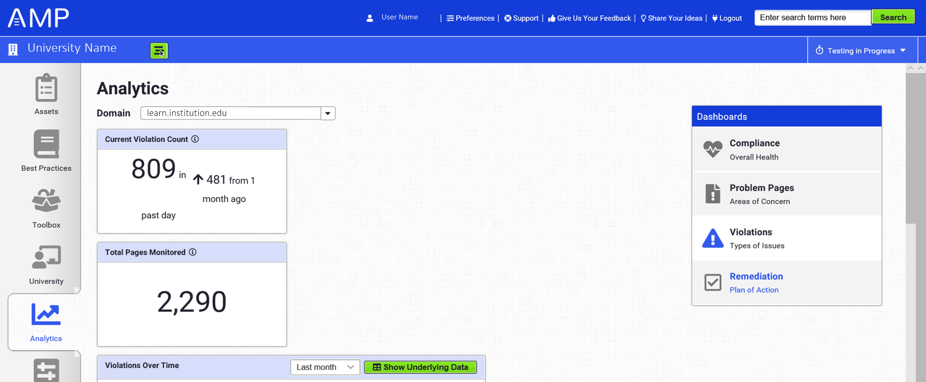
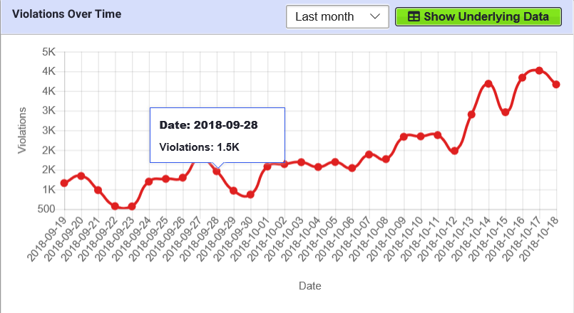
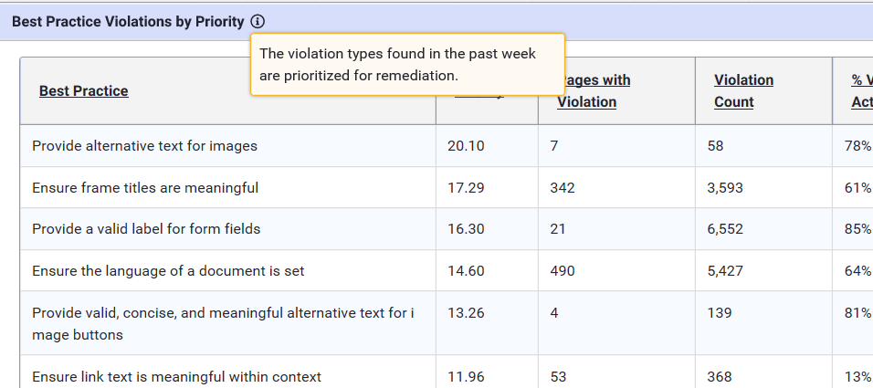
Analytics Dashboard – Violations
Example AMP® Analytics Dashboard

Slide 16
Planning for Accessibility Remediation

Slide 17
How can you better collaborate?

Slide 18
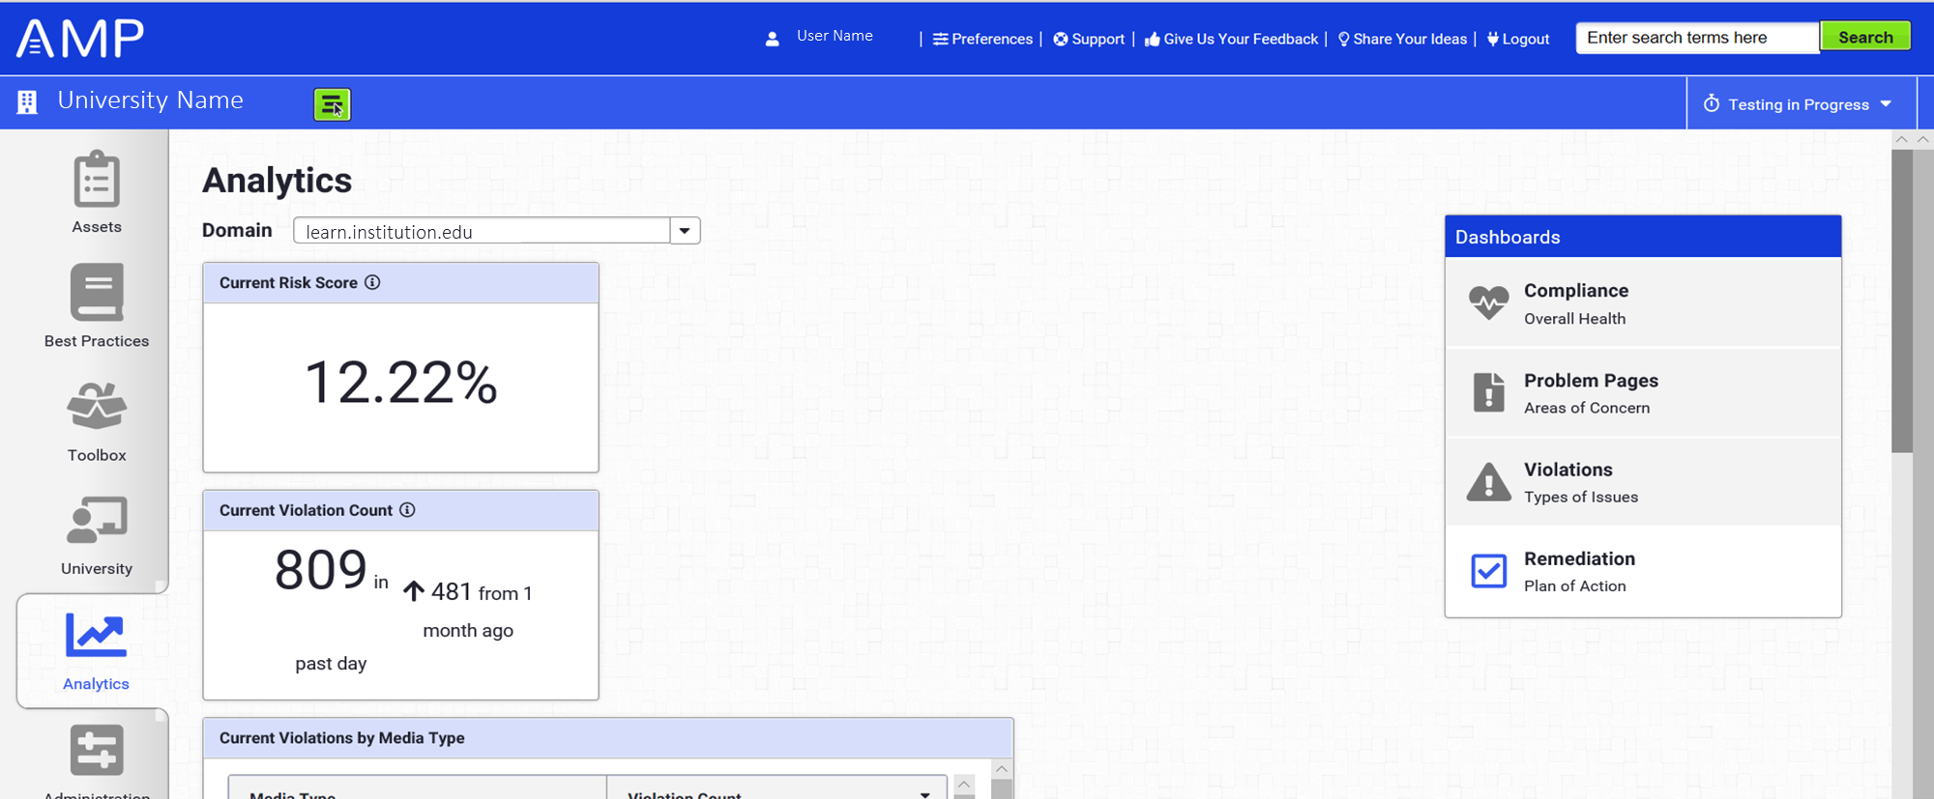
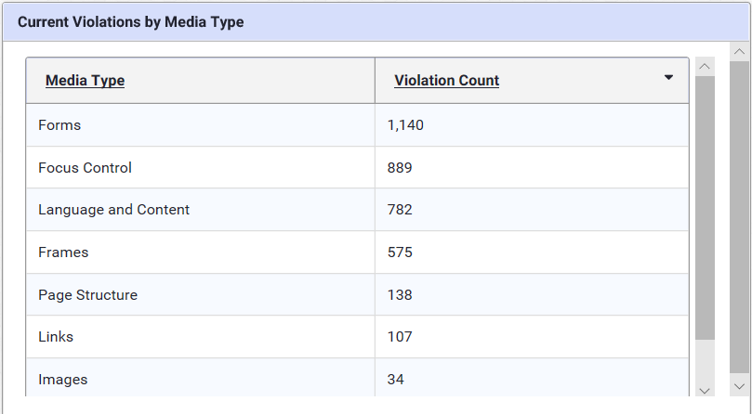
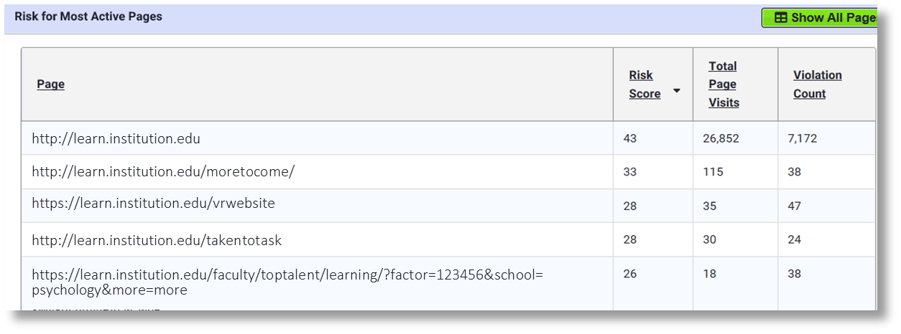
Planning for Remediation
Use analytics to help teams better collaborate and plan for remediation

Slide 19
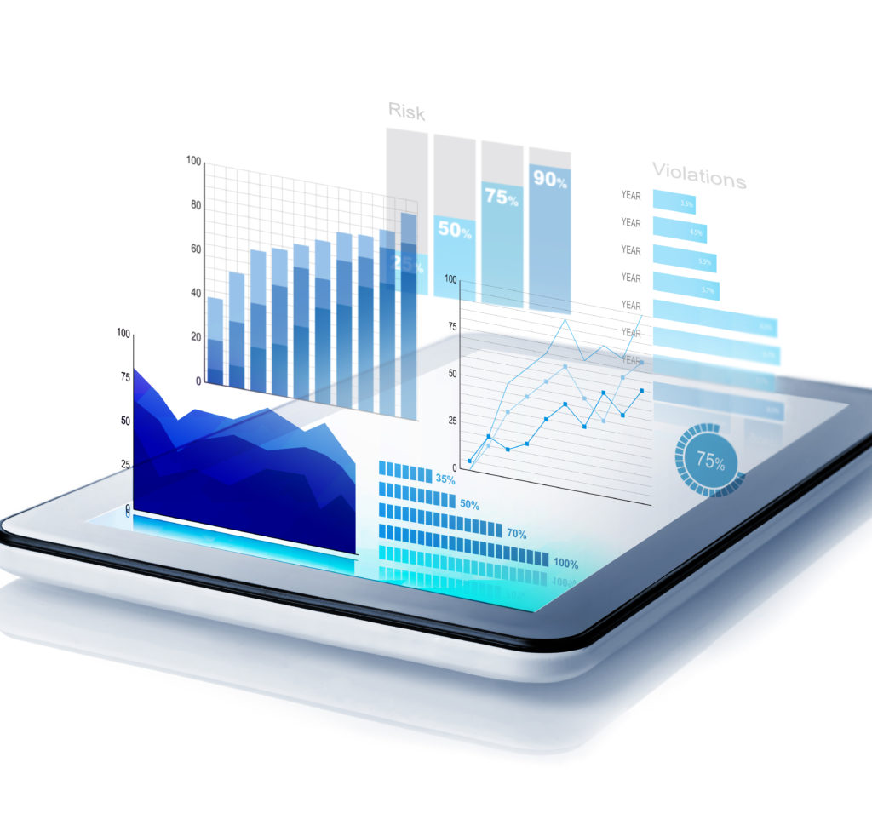
Ongoing Prioritization Post Remediation
Analytics can be used in ongoing monitoring program
Continue deploying ACCESS Analytics® on additional sites such as medium-priority, with documented access needs, etc.
Repeat the process of monitoring compliance, problem pages and violations to drive continued remediation
Over time, aim to have compliance scores improve and number of violations decrease

Slide 20
Questions & Answers
Download this presentation here, or scan QR code with mobile phone: https://www.levelaccess.com/resources/risk-analysis-higher-ed/

Slide 21
Thank You
Contact Us
Bill Curtis-Davidson
Senior Director, Strategic Consulting
bill.curtis-davidson@levelaccess.com
(404) 307-4607
Rachael Edenbaum
Higher Education Sales
rachael.edenbaum@levelaccess.com
(800) 899-9659
Follow Us
LevelAccessA11y
Level-Access
Level Access
Level Access Blog
Download link: https://accessinghigherground.org/risk-analysis-and-portfolio-prioritization-for-higher-ed/

Slide 22
Please Fill Out an Online Evaluation for this Session
This will help us understand your interests and help us continue to improve our conference and offerings.
accessinghigherground.org/evaluate
#17632 Risk Analysis and Portfolio Prioritization for Higher Ed

