Slide 1
Engaging Student Workers to Advance Inclusion for Students with Disabilities
Craig Levins, Broward College
Nazely Kurkjian, SUNY System Administration

Slide 2
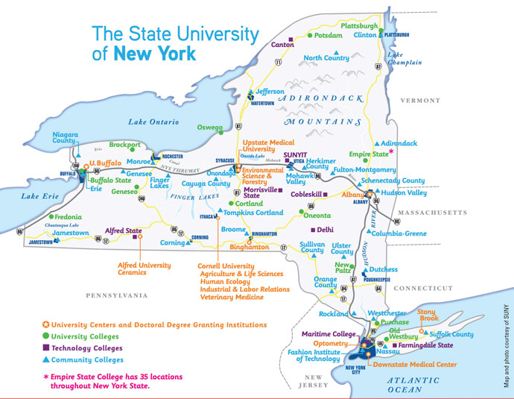
Notes:
~28,000 students with disabilities (self-identified, unduplicated)
Increase in number of students (neurodevelopmental & mental health)
Promoting technology to ensure meaningful independence
Surveying our Disability/Accessibility Resources Offices, we found:
AT training primarily provided by Disability/Accessibility Resources Offices
Conversion of alternate formats primarily provided by Disability/Accessibility Resources Offices
Captioning is more likely a shared responsibility - multiple offices handling
Campuses at SUNY express challenge meeting accommodation requests due to:
Lack of funding
Lack of staffing (identified as highest need for many campuses across the System)
Campuses that hire student workers:
Binghamton University
SUNY Cortland
SUNY Oneonta
Onondaga Community College
Dutchess Community College
Niagara County Community College
Morrisville State College
University at Buffalo

Slide 3
SUNY Campus A
Adaptive Technology Specialist
Adaptive Technology Assistant
Alternate Format Conversionist
Alternate Format Conversionist
Alternate Format Conversionist
Alternate Format Conversionist
Notes:
Research university (4 year), residential college
Before this organizational chart became a reality - Services for Students with Disabilities Office had a part-time AT Specialist
Funding for all positions came from first round, one-time funding through the campus “Roadmap to Premier” strategic plan (2014/2015)
Under strategic priority 3 (inclusive campus), came Adaptive Technology and Information Access Services
Goal: Ensure all University members access to all visual and auditory aspects of University-related programming
Changed part-time AT specialist to full-time
Funding permitting hiring and training 6 students to convert materials to accessible formats
6 students were not always needed. Depended on amount and complexity of coursework
ATS:
Conduct, research, assess, and monitor AT and alternate format program (including requesting books from publishers)
Manage and mentor student employees
Establish operational relationships across campus
Provide professional development to faculty/staff re: accessibility
This structure of 1 FT Professional (ATS) + several student employees allowed ATS to focus on campus outreach and establishing training to faculty, librarians, and other campus professionals

Slide 4
Student Positions
Adaptive Technology Assistant
Oversight of Adaptive Technology Rooms
Alternate Format Text Conversions
Research and Training
Alternate Format Conversionist
Convert course materials to accessible formats
Track conversion
Notes:
Adaptive Technology Assistant (formerly called Student Manager of Adaptive Technology)
Initial idea was to hire a Computer Science Student
Hired 3 Computer Science Students (2 graduate, 1 undergraduate), & 1 Biology Student (undergraduate) during my tenure
1 year position unless they could stay longer (1 left early to work for IBM)
Adaptive Technology Rooms
3 in main library, 1 downtown center library, science library
Academic building
Evaluated low-cost - free AT
Training
Created checklists for training
Kept training log
Helped with presentations for faculty/staff to advance equity and inclusion in digital environments
Helped with Transition Program for students (like mini orientation)
Paid $15 - $17 per hour
Alternate Format Conversionist
Initially hired for Braille conversion - they converted for 2 students who were blind who used Braille (1 computer science major, 1 math/history major)
Creating, scanning, editing, proofing
Some researched and evaluated AT too. Created 1 pager how-to’s, how-to videos
Paid $14 per hour
Tracked materials and amount of time taken to complete conversions was essential in continuously funding positions. The number of conversionists needed varied semesterly, based on need and complexity of content. We all kept track in Google Drive (used folders for different semesters, logging hours, etc).

Slide 5
Job Requirements
Maintain strict confidentiality
Have strong/comfort with computer and technology literacy
Ability to work independently and effectively within a team setting
Scheduling flexibility during busy parts of the semester
Excellent communication, organizational and problem-solving skills
Notes:
General requirements…
Attention to detail
Experience with writing scripts/programs
Could be
Undergraduate and/or graduate students (typically upperclassmen)
Students with/without disabilities
Peak conversion time = summer & winter breaks
Peak training time = beginning of semesters

Slide 6
Technologies
Used for Conversion
Juliet Pro 60
Tiger Spotdot
Duxbury
JAWS
Adobe Acrobat Professional
ABBYY FineReader
Used for Training Students
Kurzweil 3000
Dragon Naturally Speaking
Livescribe Smartpen
Assistive listening units
Built-in tools
Apps
Notes:
Hardware/software - not exhaustive list. We had other tech but less used or not needed
Conversionists weren’t experts in all of these tools but knew basics of
formulating various formats
printing and binding Braille
using screenreader to test reading and navigation
Adaptive Technology Assistant
built-in tools: Dictation, Google Voice Typing, Adobe Reader text to speech
Apps/online tools: quizlet, pomodoro, notability, voicedream, capti narrator, etc.

Slide 7
Accessible Formats
Braille
E-text
Closed Captions
STEM, History, English, Tactile Graphics, & more.
PDF, Word.
YouTube, Amara, Camtasia.
1
2
3
Notes:
Adaptive Technology Specialist created a Braille Conversion Guide for converting different complexities of content to Braille (Textual mostly versus STEM or graphics)
Added some closed captioning responsibility for Adaptive Technology Assistant

Slide 8
How did you enter this field?
Notes:
As a student affairs professional - background in disability services, particularly assistive technology/accessibility - it’s important for us to think about the pathways to this field.
There’s been an increase in certification and college programs for assistive technology, but it is my observation that many folks “fall” into this field. Now I ask you all: how did you enter this field?
Nazely: This funding literally helped me - an undergraduate Philosophy major, asked once to be a notetaker for a student with a disability - go from unaware of disability services/student affairs administration > student notetaker > alternate format conversionist > Adaptive Technology Specialist > today. I am living proof that students can work in accessibility, excel and advance inclusion for our students with disabilities, from individual campus to System.
Transition to Craig

Slide 9
SUNY Campus B
Student-driven Approach
Director became the AT Specialist
Conduct individualized assessments.
Approve accommodations and AT.
Training as needed.
Students hired to provide peer training and support and conduct research.
Read & Write Gold
SmartPens
Grant monies pursued to develop the peer model.
Notes:
Comprehensive college (4 year), residential
Started with a grant...http://www.nysdsc.org/resources/Pictures/NYSDSC%20Presentation%20-%20ADA.pdf

Slide 10
A Student-driven Approach to Assessing and Utilizing Assistive Technology to Improve Course Accessibility, Classroom Inclusivity, and Student Engagement
1. Coming up with an idea
2. Finding a grant
3. Writing the grant
4. Identifying the AT: http://techmatrix.org/product-search-api
5. Finding space, creating a lab
6. Hiring students

Slide 11
A Student-driven Approach to Assessing and Utilizing Assistive Technology to Improve Course Accessibility, Classroom Inclusivity, and Student Engagement
7. Beginning the project
Phase 1: Assess apps, extensions, and equipment
Phase 2: Utilize highest rated apps, extensions, and equipment
Phase 3: Engage with faculty and support services to integrate AT campus-wide; Create instructional videos for global, student-centered education
Phase 4: Aggregate Data for public use; Continue phase three; Build student-driven social media network

Slide 12
A Student-driven Approach to Assessing and Utilizing Assistive Technology to Improve Course Accessibility, Classroom Inclusivity, and Student Engagement
Collaboration
Working through the problems; Trusting the students; Continually moving forward; Planning for the end; Planning for the future
Pros and Cons of a student-centered approach

Slide 13
A Student-driven Approach to Assessing and Utilizing Assistive Technology to Improve Course Accessibility, Classroom Inclusivity, and Student Engagement
Phase One: Assess apps, extensions, and equipment
Phase Two: Utilize highest rated apps, extensions, and equipment
Phase Three: Engage with faculty and support services to integrate AT campus-wide; Create instructional videos for global, student-centered education
Phase Four: Aggregate Data for public use; Continue phase three; Build student-driven social media network

Slide 14
Student Instruction
Find as many apps, extensions and built-ins as possible and assess each individual trial. If a product appears worthwhile do multiple trials and refer to your peers.
Try to find as many free/cheap options as possible.
Windows, Mac, iOS, Android, Chrome Apps and Extensions, AT
203 Total Trials 41% of trials under 30 minutes
51% rated easy to use 13% rated difficult to use
61% would be recommended 34% were noticeable to classmates

Slide 15
Name of AT/App
Trial number
Platform Used
Platform Restrictions
How long did you use this product today?
Who would likely benefit form this product?
How easy was it to use this product?
Where would students likely use this product?
How frustrated did you get while using this product?
If used in the classroom how apparent would this product be?
Can this product be used silently in the classroom?
Provide important info about this product, including strengths/weaknesses.
Would this product assist students who don’t have a disability?
Comment on any costs, including add-ons.

Slide 16
Read & Write Gold
Dragon Dictation
Mac and Windows Dictate
Talking Calculator
PIAF Printer
Sensus Access
Robobraille
Sonnocent Audio Notetakter
Echo Smart Pen
Audio Graphing Calculator
Math Talk
MathType
Daisy Math
Dolphin Easy Converter
Dolphin Publisher
ZoomText
BAT One Handed Keyboard
Voice Dream
Assistive Technologies Assessed
SpeakIt!
Announcify
What’s Up
Ginger
Grammarly
Bee Line Reader
Visor
Scrollr
Chrome Vox
Oswald
Voice note 2
Google Dictionary
Save to Pocket
Carat Browsing
Scribble Toolbar
@Voice Aloud Reader
Read &Write Gold
for Chrome
Read & Write Gold
for Edge
Zoom – iPad
Evernote
White Noise
NVDA (Non visual
Desktop Access)
Word Equation Editor
Central Access Reader
Evernote Touch
Evernote Web Clipper
Microsoft Translate
Google Translate
Select and Speak
Readability
Voice Note II
My Study Life
Accessibility Conversion
Pocket
AT Bar
Permanent Readability
Voice eBook
iPad Magnifier
76% cognitive
48% visual
43% physical
34% psychiatric
18% acoustic
Notes:
All apps included here
Merge hidden slides below into one slide

Slide 17
Chrome Ext. Speak It – 100% Approval
Used in the Accessibility Resources Exam Lab for Blackboard exams
Converts text to speech, select text and listen
Easy to use; Less than 30 minutes to learn to use; cognitive, visual, physical
Effective for shorter reading as opposed to longer readings.
Cognitive, physical, visual
Text to speech to read any text in the browser
75 % took less than 30 minutes to use
Free version available in 27 different languages
21 different speed settings
very easy to use, little to no wait time
$3.99 monthly upgrade, offers for schools

Slide 18
AT - Read and Write Gold (100% Approval)
Improves reading comprehension: hear web pages and documents read aloud with a choice of natural voices
Helps students understand unfamiliar words with text and picture dictionaries
Develops writing skills and confidence with word prediction
Supports homework and independent research with study skills tools
Turns documents and web pages into MP3 files for easy listening on the move
Assists English Language Learners and students studying a second language
Accessibility features like screen masking give extra support to students with dyslexia and other literacy challenges
Universally Designed/Campus License/Orientation
Tutorial Videos
Notes:
DAISY - Digital Accessible Information SYstem
RWG works in chrome, internet explorer, safari, and firefox

Slide 19
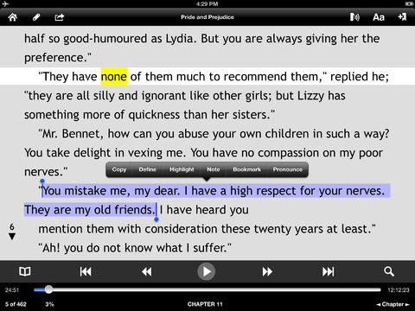
AT - Voice Dream 100% Approval Recommended by Accessibility Resources

Slide 20
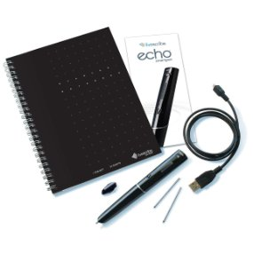
AT Notetaking - Echo Smartpen Very High Approval from Students
Recommended by Accessibility Resources, currently 70 pens issued
Universally Designed
Budget Savings of ~ $4,000 per year/print our own notebooks
The smartpen uses a microphone, infrared camera, and dot paper to create a pencast
Written notes, recordings, and pencasts can be uploaded, viewed, and stored on a computer through Echo Desktop
Psychology; Math; Biology; CADE
Notes:
Audio can be recorded on its own. If the pen is on and you write on the dot paper, your pen strokes will be recorded.
Smartpens work with dot paper. Dot paper makes it possible to record the location of your writing. There are 8 different notebooks, each has their own dot pattern.
Connecting the smartpen to a computer via a USB cable allows you to upload your notes. You can find the pencasts, recordings, and written notes on Echo Desktop (livescribe’s program).

Slide 21
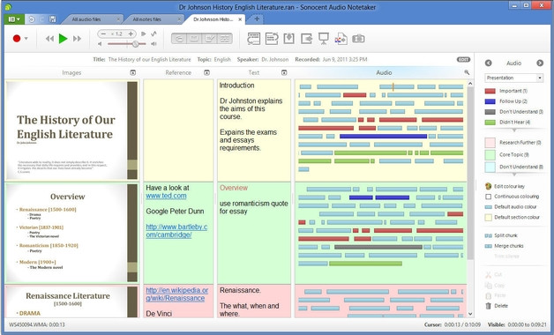
AT Notetaking - Sonnocent Audio Notetaker High Approval from Students
Record audio and then annotate the recording
Color coding
Text and image annotation
Isolate and move coded
sections
Import audio files
Enhanced sound quality
Can type notes
Notes:
Breaks up recording into blocks based on pauses in the speech
You can color code the audio clips for organization – each can correspond with its own category
You can add text and images to annotate the audio clips
You can select audio and extract it to a new file
You can import audio files
Sound quality can be enhanced after recording with in the program

Slide 22
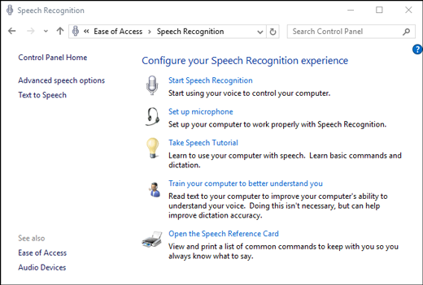
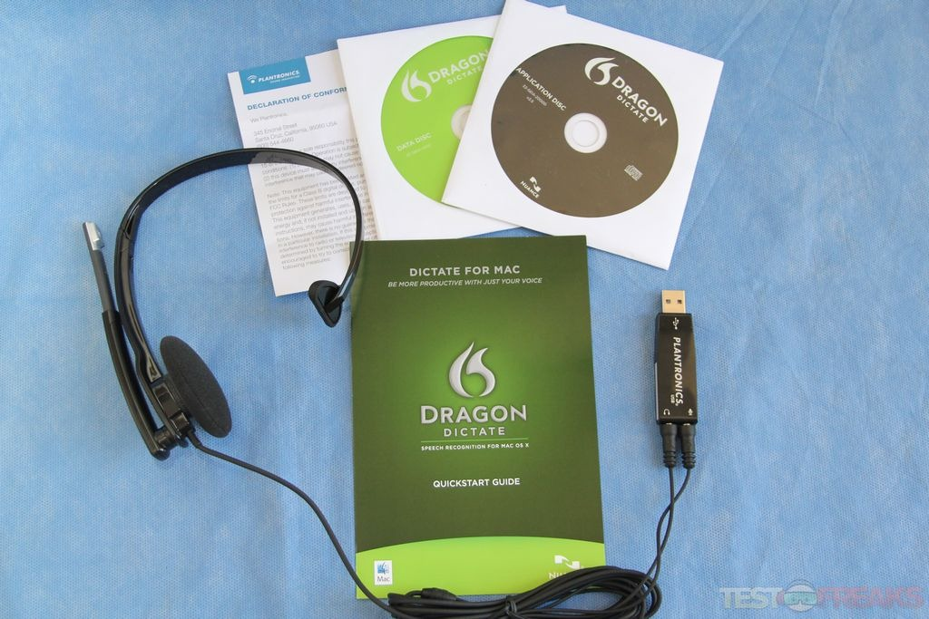
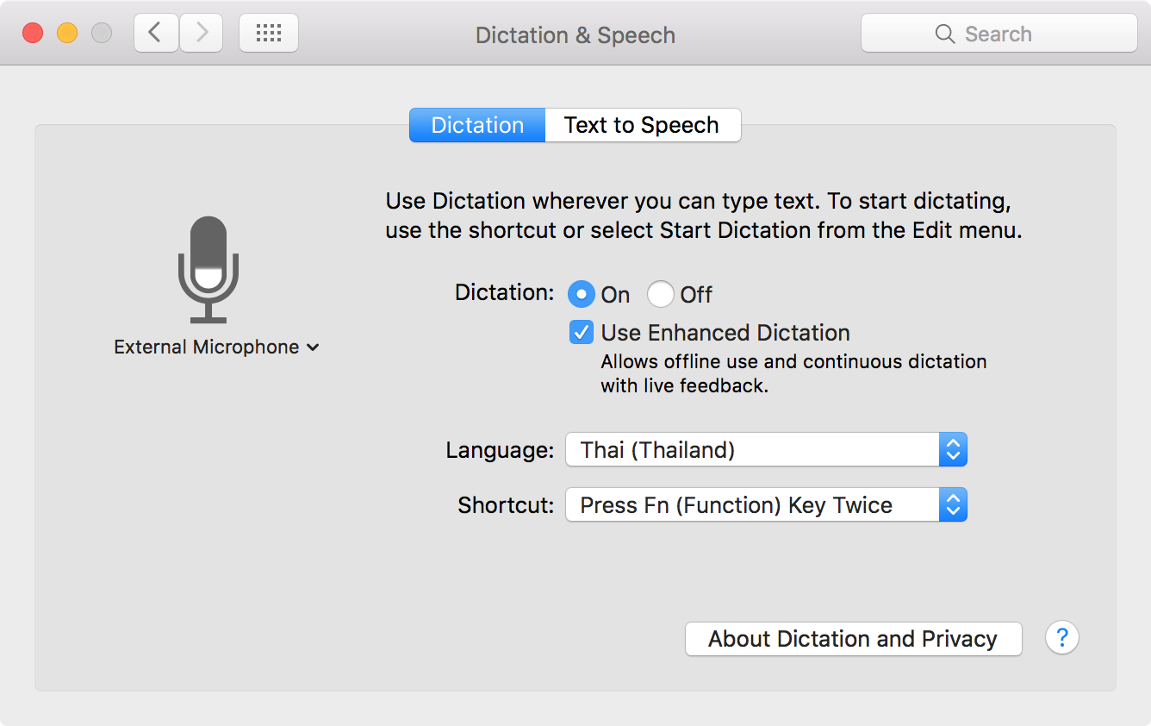
AT - Speech-to-Text All Highly Rated

Slide 23
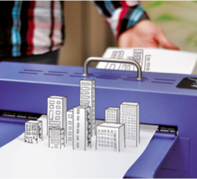
P.I.A.F Tactile Image Maker
Pictures in a flash!
3D printing
Accessible Graphics
Research Methods
Math
Low Tech Options
3D Pens
Puff Paint
Notes:
Selecting the right image is an important part of creating tactile images. The image should not be cluttered and room should be left for the lines to expand
Swell Paper or Capsule Paper – contain microcapsules of alcohol that when exposed to direct heat expand where there is ink which is what makes the pictures 3D form
Either print or copy pictures – must have high carbon content ink
Or
Draw it with the PIAF Pen – pen should be high in carbon, some people use China markers (grease pencil)
Heat up the machine for about 10 minutes prior to putting any paper through
Then just run the paper through
The paper can reused. Additional markings can be made and then run through the printer to create new lines. This can be used to convey a sense of progression.

Slide 24
Student Made Tutorial Videos

Slide 25
Inclusive Course Design Initiative
Student Roles
Closed Captioning
PDF Conversion
Adobe Pro
SensusAccess

Slide 26
Broward College Model (1/2)
67,000 students, 4 full time staff.
Director is the AT specialist
Train DS staff to make individualized assessments.
Positioning for a full time AT specialist.
Multiple campuses and centers (9), but only 4 campuses with DS staff
Peer training/support.
DS staff training/support.
Develop training videos
Build peer networking (social media) throughout each campus and across other schools

Slide 27
Broward College Model (2/2)
Board of Trustees approved one time money to build AT program.
Grant monies being sought (collaboration)
Transition planning with county-wide secondary school representatives.
Aligning AT as much as possible between high schools and college.
Making high school students aware of the transition process, the AT used at BC, and that finding out AT at target schools that is available.

Slide 28
Benefits of Student Employees???
Engagement
Educational
Advancing cultural competence and inclusion
Reducing ableism in future workforce
Financial
Innovative
Notes:
Students who are engaged on campus are more likely to persist and attain academic goals. Involvement is a powerful predictor of satisfaction (for both 4 year and 2 year institutions)
Formalized, student peer-to-peer learning is effective. Has great potential. Having students work together and help each other out helps to build community
Learning outside of the classroom, “real world” experience: On-campus jobs can provide a supportive and non-threatening environment where students learn to interface comfortably with the public, understand the value of teamwork, develop time management and computer skills, and build self-esteem as they are recognized for their accomplishments.
Could be considered an applied learning experience
Expands proficiency in skills our students need to succeed beyond our institutions
Promotes a culture of values (equity, inclusion, working in teams)
employment will engage students in the operation of the campus and create a sense of ownership commensurate with their level of responsibility and awareness of the institutional mission.
It costs less to pay students to convert content than outsource to company.
Students can be and often are quicker to learn newer technologies. Much of the AT is already built into their phones and other devices. They can teach us!
Sources:
https://www.ruffalonl.com/documents/shared/Papers_and_Research/2010/StudentEmployeeSuccess.pdf
https://web.stanford.edu/dept/CTL/Tomprof/postings/418.html
https://www.ccsse.org/aboutsurvey/docs/CCSSE%20Validation%20Summary.pdf

Slide 29
Contact Information
Craig Levins
District Director, Disability Services
Broward College
Fort Lauderdale, FL
clevins@broward.edu
Nazely Kurkjian
Coordinator of Disability, Diversity & Nontraditional Student Services
SUNY System Administration
Albany, NY
Nazely.Kurkjian@suny.edu

