Slide 1
EPUB 101: Understanding the Structure and Contents of an EPUB
Accessing Higher Ground November 14, 2017
Rachel Comerford • Director of Content Standards Macmillan Learning
Korey Singleton • Assistive Technology Initiative George Mason University
Amy Salmon • Senior Accessibility Consultant Tech For All, Inc.

Slide 2
All About ePUB
In today’s workshop, we will answer the following questions
1) What is ePUB?
2) Where and how is ePUB used?
3) What are the accessibility benefits of ePUB?
4) How to determine and test the accessibility of an ePUB?
5) What do you do if the ePUB is not accessible?

Slide 3
Welcome
Introduce yourself and tell us what you hope to learn today.

Slide 4
What Is EPUB?
• Electronic publication, digital book, e-book
• Maintained and improved in the w3c (world wide web consortium) publishing groups by publishers, universities, and experts
• #1 e-book format worldwide
• EPUB 3.1 = HTML5
• Other e-book formats – PDF, Kindle (mobi, kf8)

Slide 5
Why EPUB?
• One time creation
• Multiple distribution channels
• You can see an epub on vitalsource, redshelf, etc. (Shameless promotion alert – Macmillan ePUBs can be found at any of these distributors.)
• Supported on computer, tablet, and mobile phone e-reading systems
• Available online or offline

Slide 6
Why EPUB?
Reflowable or fixed-page layout
Enhanced content, such as
Interactive activities
Video/Audio
MathML

Slide 7
Out-Of-The Box Accessibility
EPUBs are built using HTML5, CSS and javascript, making EPUBs more accessible from the beginning.
{demo of EPUB without accessibility remediation}

Slide 8
Account Assignments
Name | Account Login | Password
Christianson, Wendy | epub101attendee1@xyz.com | Password#1
Vance, Joanna | epub101attendee2@xyz.com | Password#2
Blicker, Lesley | epub101attendee3@xyz.com | Password#3
Nisbet, Laura | epub101attendee4@xyz.com | Password#4
Powell, Charlotte | epub101attendee5@xyz.com | Password#5
Richwine, Brian | epub101attendee6@xyz.com | Password#6
Watkins, Dawn | epub101attendee7@xyz.com | Password#7
Cavano, John | epub101attendee8@xyz.com | Password#8
Carrie Anton | epub101attendee9@xyz.com | Password#9
James Ray Westmoreland | epub101attendee10@xyz.com | Password#10
Amanda Rodino | epub101attendee11@xyz.com | Password#11
McGoldrick, Petria | epub101attendee12@xyz.com | Password#12
 | epub101attendee13@xyz.com | Password#13
 | epub101attendee14@xyz.com | Password#14
 | epub101attendee15@xyz.com | Password#15

Slide 9
EPUB Statistics: The following statistics are provided from VitalSource Technologies, Inc. as of June 15, 2017.
2016
• Top 25 titles: 24 EPUB, 1 PDF
• Top 50 titles: 46 EPUB, 4 PDF
• Top 100 titles: 77 EPUB, 23 PDF
• Top 250 titles: 141 EPUB, 109 PDF
• Top 500 titles: 233 EPUB, 267 PDF
2017 (as of June 15, 2017)
• Top 25 titles: 25 EPUB, zero PDF
• Top 50 titles: 48 EPUB, 2 PDF
• Top 100 titles: 81 EPUB, 19 PDF
• Top 250 titles: 159 EPUB, 91 PDF
• Top 500 titles: 239 EPUB, 261 PDF

Slide 10
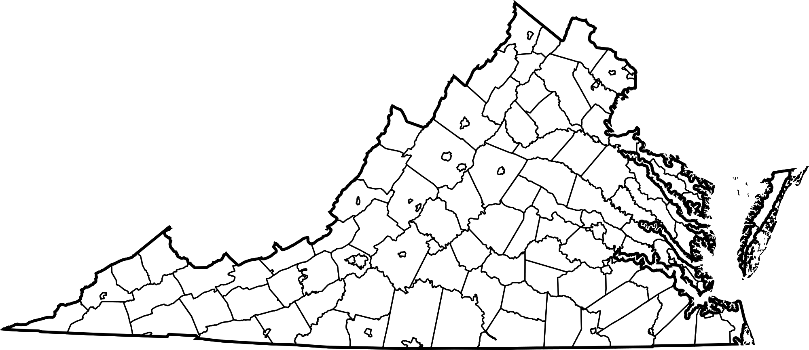
EPUB Usage in Higher Education: A Snapshot of Institutions in the Commonwealth of Virginia
Responses from seven institutions in the Commonwealth of Virginia:
4-year institutions
George Mason University
Virginia Commonwealth University
Virginia Tech University
University of Virginia
James Madison University
2-year institutions
Northern Virginia Community College
Tidewater Community College)

Slide 11
EPUB Usage in Higher Education: A Snapshot of Institutions in the Commonwealth of Virginia cont.
Students can request books in format of their choosing (e.g., Word, PDF, mp3, etc.). Requests for ePUB are rare.
File requests from institutions are primarily filled by AccessText.
Additional sources: Bookshare, Learning Ally, Project Gutenberg, and direct from publisher
Formats provided: Close to 100% of all requests are PDF format. Occasionally, ePUB available from AccessText, Bookshare, and direct from publisher.
File formats returned to students:
Primarily accessible PDF and Word formats

Slide 12
EPUB Usage in Higher Education: Takeaways from Commonwealth of Virginia Institutions
Majority of students unfamiliar with ePUB formats.
Don’t know to ask
Some students accessing format outside of request process in place with DSS or Accessibility Offices.
Limited training/understanding as it relates to ePUBs.
Formats not consistently provided by publishers…rare actually
What platform should be used to read ePUBs? Create/remediate ePUBs? For example, Calibre’, Adobe Digital Editions, VitalSource, iBooks, etc…
Common perception that PDFs are easier to work with
Notes:
Familiarity!

Slide 13
EPUB Usage in Higher Education: Educating Students about EPUBs
Start requesting ePUBs from DSS Office
Familiarize yourself with your AT
Familiarize yourself with existing ePUB platforms and the accessibility of those platforms

Slide 14
EPUB Usage in Higher Education: Educating Faculty/Staff about EPUBs
Request ePUB versions of textbooks
Faculty should request information from publisher regarding accessibility of the eBooks
Ask for print versions that can be loaned through library
Explore eBook usage with your students
Define accessibility in terms that students understand (e.g., headings, images, page numbers, etc.)
Highlight platform-specific features (e.g., built-in text-to-speech, support for refreshable braille, etc.)
Work with DSS Office to identify AT-specific commands/keystrokes
PDF
Protected
Print-friendly
EPUB
Annotations
Searchable
Reflowable
Accessibility

Slide 15
EPUB Formats
Import/Side Loading
• Pros:
Ability to access and modify EPUB files
Use automated accessibility tools
• Cons:
Requires HTML5, CSS and javascript experience
Not all features supported in e-reading systems (e.g., search, highlights, notes)
VitalSource Bookshelf Side Loading Instructions:
https://support.vitalsource.com/hc/en-us/articles/203256896-Sideloading-EPUBs-with-Bookshelf

Slide 16
EPUB Formats
Digital Rights Management (DRM)
The EPUB is only available on a specific reading system (e.g., Apple iBooks).
• Pros:
Enhanced functionality supported by e-reading system (e.g., search, highlights, notes)
• Cons:
Unable to modify EPUB files.
Inability to use automated accessibility tools

Slide 17
EPUB Reading Systems
There are a number of e-reading systems for EPUB content
• Online
• Offline
• Computer applications (Windows & Mac)
• Tablet apps
• Mobile phone apps
• Stand-alone hand-held units (e.g., Kindle)

Slide 18
EPUB Test
Check out EPUBTest to find out which EPUB reading systems are accessible:
http://epubtest.org/testsuite/accessibility/
{demo of EPUBTest results}

Slide 19
BREAK

Slide 20
Is It Accessible?
How can you check if the EPUB content is accessible?
1) Know the EPUB Accessibility 1.0 requirements.
2) Use automated tools.
3) Conduct manual testing.
4) Return to publisher for remediation.

Slide 21
EPUB Accessibility 1.0 Requirements
Published in January 2017, the EPUB Accessibility 1.0 requirements provide a detailed resource for testing the accessibility of an EPUB file.
https://www.w3.org/Submission/2017/SUBM-epub-a11y-20170125/
The accessibility checklist that has been loaded into VitalSource for you has a plain language breakdown of the standards

Slide 22
Automated Tools
Following are some resources for automated tools for checking an EPUB file.
• Only EPUB files that are not DRM-protected and can be imported or side loaded in to an e-reading system can be used with the automated tools.
• CAUTION: Automated tools will catch only approximately 25% – 40% of errors. Manual testing is essential.

Slide 23
EPUBCheck
EpubCheck is a tool to validate EPUB files. It can detect many types of errors in EPUB. OCF container structure, OPF and OPS mark-up, and internal reference consistency are checked. EpubCheck can be run as a stand-alone command-line tool or used as a Java library.
https://github.com/IDPF/epubcheck

Slide 24
Ace by DAISY
• ACE, the Accessibility Checker for EPUB, is a tool developed by the DAISY Consortium to assist with the evaluation of accessibility features of EPUB publications.
• ACE is a tool to run automated accessibility checks for EPUB publications, in order to assist in the evaluation of conformance to the EPUB Accessibility specification.
https://github.com/daisy/ace
ace --outdir ~/Desktop/test_epub-report ~/desktop/test_epub.epub
{Demo of ACE. Show report and discuss difference between errors and failures.}

Slide 25
Ace by DAISY, Accessibility Checking Tool
The DAISY Consortium developed an open source accessibility checking tool: First Public Beta.
Publishers and service providers will be able to use it to implement accessibility.
It will also enable distributors and consumers to verify the accessibility claims.
This tool performs automated checks to evaluate conformance to the EPUB Accessibility Specification.
The initial version will check against the rules defined in WCAG, ARIA, and HTML.
It is impossible to perform a 100% complete evaluation of accessibility requirements in a fully-automated manner. Many criteria require human judgement and manual inspection.
Ace by DAISY does not claim to be a yes/no validator or a certification tool. It will not issue an accessibility score, percentage of conformance, etc.
It is not intended to be used for repairing inaccessible content.
The tool will not be able to analyze encrypted content or any other DRM-protected EPUB

Slide 26
Certification and Verification
Global Certified Accessible by Benetech
https://benetech.org/our-work/born-accessible/certification/about/
Benetech has developed an evaluation program that assesses the full range of accessibility features currently detailed in the EPUB 3.1 specification.
This program was developed over a nine-month period during which Benetech conducted in-depth reviews of scores of titles across all sectors – with a particular focus on complex STEM titles – against a suite of accessibility guidelines.
These included the EPUB Accessibility 1.0 Specification (also known as the “Baseline”) and the World Wide Web’s (W3C) Web Content Accessibility Guidelines 2.0 (WCAG 2.0) for levels A, AA and AAA.
Additional features specific to ebooks are also included.

Slide 27
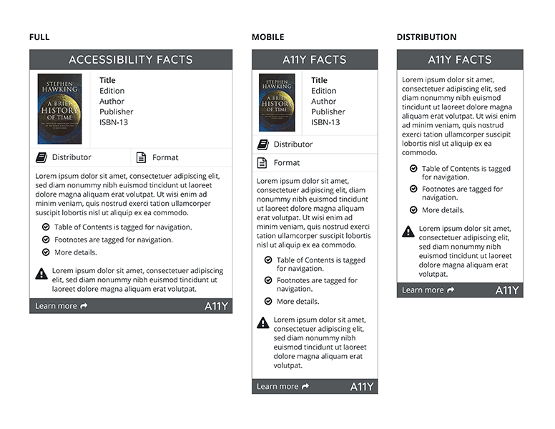
AMAC/CAMI Accessibility Facts Label
http://cami.gatech.edu/afacts.php
Accessibility Facts discloses a11y features of texts and other e-documents through a label format.
A11y Facts labels are created by publishers, distributors, retailers, and other content providers through the A11y Facts Portal, an online application built by CAMI.
The label consists of an accessibility statement, a detailed list of accessibility features, and known issues that would impact accessibility.

Slide 28
Understanding accessibility metadata
http://www.a11ymetadata.org/the-specification/metadata-crosswalk/
Accessibility metadata reveals what is and is not accessible within an epub.
accessibilitySummary is an open text box metadata field - this is a chance for the ePUB creator to explain any quirks that the user or adopter should be aware of.
accessibilityFeature identifies specific features within the book like MathML, captions, etc
accessibilityHazard identifies areas to look out for such as flashing or motion
accessibilityControl indentifies how an epub can be used such as fullkeyboardcontrol

Slide 29
Manual Testing Resources
NV Access
https://www.nvaccess.org
WebAIM: Using NVDA to Evaluate Web Accessibility
https://webaim.org/articles/nvda/
WebAIM: Using JAWS to Evaluate Web Accessibility
https://webaim.org/articles/jaws/
WebAIM: Using VoiceOver to Evaluate Web Accessibility
https://webaim.org/articles/voiceover/
Colour Contrast Analyzer
https://developer.paciellogroup.com/resources/contrastanalyser/

Slide 30
BREAK

Slide 31
Manual Accessibility Testing
Use the EPUB 3 Accessibility Checklist for manual testing.
{Hands-on demonstration of manual testing using EPUB 3 Accessibility Checklist.}

Slide 32
Account Assignments
Name | Account Login | Password
Christianson, Wendy | epub101attendee1@xyz.com | Password#1
Vance, Joanna | epub101attendee2@xyz.com | Password#2
Blicker, Lesley | epub101attendee3@xyz.com | Password#3
Nisbet, Laura | epub101attendee4@xyz.com | Password#4
Powell, Charlotte | epub101attendee5@xyz.com | Password#5
Richwine, Brian | epub101attendee6@xyz.com | Password#6
Watkins, Dawn | epub101attendee7@xyz.com | Password#7
Cavano, John | epub101attendee8@xyz.com | Password#8
Carrie Anton | epub101attendee9@xyz.com | Password#9
James Ray Westmoreland | epub101attendee10@xyz.com | Password#10
Amanda Rodino | epub101attendee11@xyz.com | Password#11
McGoldrick, Petria | epub101attendee12@xyz.com | Password#12
 | epub101attendee13@xyz.com | Password#13
 | epub101attendee14@xyz.com | Password#14
 | epub101attendee15@xyz.com | Password#15

Slide 33
DRM-Protected EPUB
If the EPUB file is DRM protected:
• Unable to use automated tools.
• Conduct manual accessibility testing.
• Unable to modify EPUB content.
• Return to publisher for remediation.
NOTE: Several publishers and e-reading system developers are integrating the ACE tool in their systems. EPUB files are checked for accessibility prior to DRM protection and information about the accessibility test results are provided.

Slide 34
Inaccessible EPUB Content
What do you do if the publisher is not able or willing to remediate the EPUB content for accessibility?
Short term:
Request an accessible option (e.g., Microsoft Word, PDF or text file) from the publisher.
If EPUB is not DRM, you can fix the code...(caveat: you’ll need to know HTML5, JavaScript, and CSS)
Identify other alternatives to support the student (e.g., If available, borrow print copy in library)
Provide custom solutions – alt text for images, accessible tables, by chapter and location etc.
Long term:
Educate your students about EPUB formats
Educate your faculty about requesting/selecting accessible formats from publishers.
Secure print copies as a backup

Slide 35
Questions?
Rachel Comerford • Director of Content Standards • Macmillan Learning
Email: Rachel.Comerford@Macmillan.com
Twitter: @rallyfora11y
Korey Singleton • Assistive Technology Initiative • George Mason University
Email: kinglet@gmu.edu
Twitter: @AccessibleMason
Web: http://ati.gmu.edu
Amy Salmon • Senior Accessibility Consultant • Tech For All, Inc.
Email: asalmon@tfaconsulting.com
Twitter: @Asalmonamy

