Slide 1
ePUB vs PDF
Why ePUB is the new standard for
accessible ebooks

Slide 2
Who Are These People?
Rachel Comerford
Director of Content Standards
Macmillan Learning
Co-Chair, W3C ePUB Community Group
Email: Rachel.Comerford@Macmillan.com
Twitter: @rallyfora11y
Amy Salmon
Senior Accessibility Consultant
Tech For All, Inc.
Email: asalmon@tfaconsulting.com
Twitter: @Asalmonamy

Slide 3
Why are we here?
The most frequent request we hear about from accessibility services offices is for accessible ebooks.
This used to mean creating a pdf or word doc that the student can navigate.
As technology develops and standards are born, these formats are no longer the ideal experience for students.
Accessible ePUBs represent an opportunity to provide files to students without waiting for remediation.

Slide 4
What are we going to learn
What are the primary differences between a PDF ebook and an ePUB?
What reading systems use ePUB and how can you tell if they’re accessible? A look at ePUBTest.org
How do I know if the ePUB I want is accessible? Understanding Certification and Verification.

Slide 5
What IS an ePUB? How is it different from a PDF?

Slide 6
What’s the Difference?
Mobility/Reflowing - Students are reading on a variety of devices and in this case, size matters. ePUBs have a reflowable format: line length changes based on size of the screen
Inherent accessibility of an epub - Using an out of the box, unremediated epub is easier to use than an out of the box, unremediated pdf
Remediating pdf requires source file, reprints require starting from scratch - When the textbook your psych department is using goes into a new edition - you are remediating a new pdf from scratch
Less interactivity possible in a pdf - Students receiving a pdf while peers use an epub are deprived of pop-up definitions that are within the text, answerable assessment, etc
HOWEVER - You can’t remediate epubs on your own unless you know html and css, and the epub isn’t drm’d

Slide 7
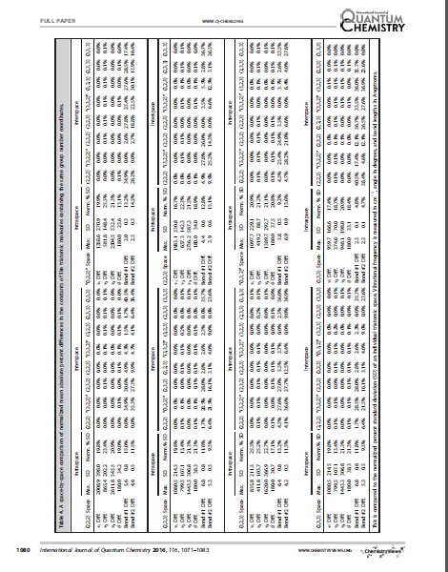
Chemistry Journal PDF Table
The PDF option conforms to accepted norms in publishing, but it is not optimized for screen viewing, nor is it accessible.

Slide 8
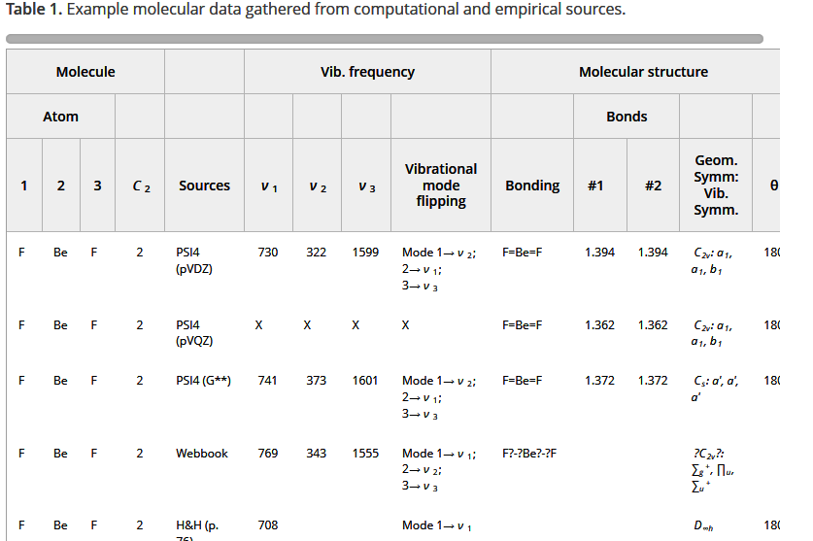
Chemistry Journal HTML Table
HTML table would look better with some improved CSS, but provides more flexibility than the pdf.

Slide 9
Are ePUBs Available?
What are Reading Systems Selling?
For this past fall back to school season, of the top 100 most used titles in the VitalSource Reader, 28 are PDF, 72 are EPUB.
Of the top 500, 260 are EPUB, and 240 PDF.
What are Publishers Doing?
Macmillan is producing only epubs from copyright 2017 on.
Pre-copyright 17? We remediated over 200 titles for accessibility and continue to do so on demand.

Slide 10
What ePUB readers are available? Are they usable?

Slide 11
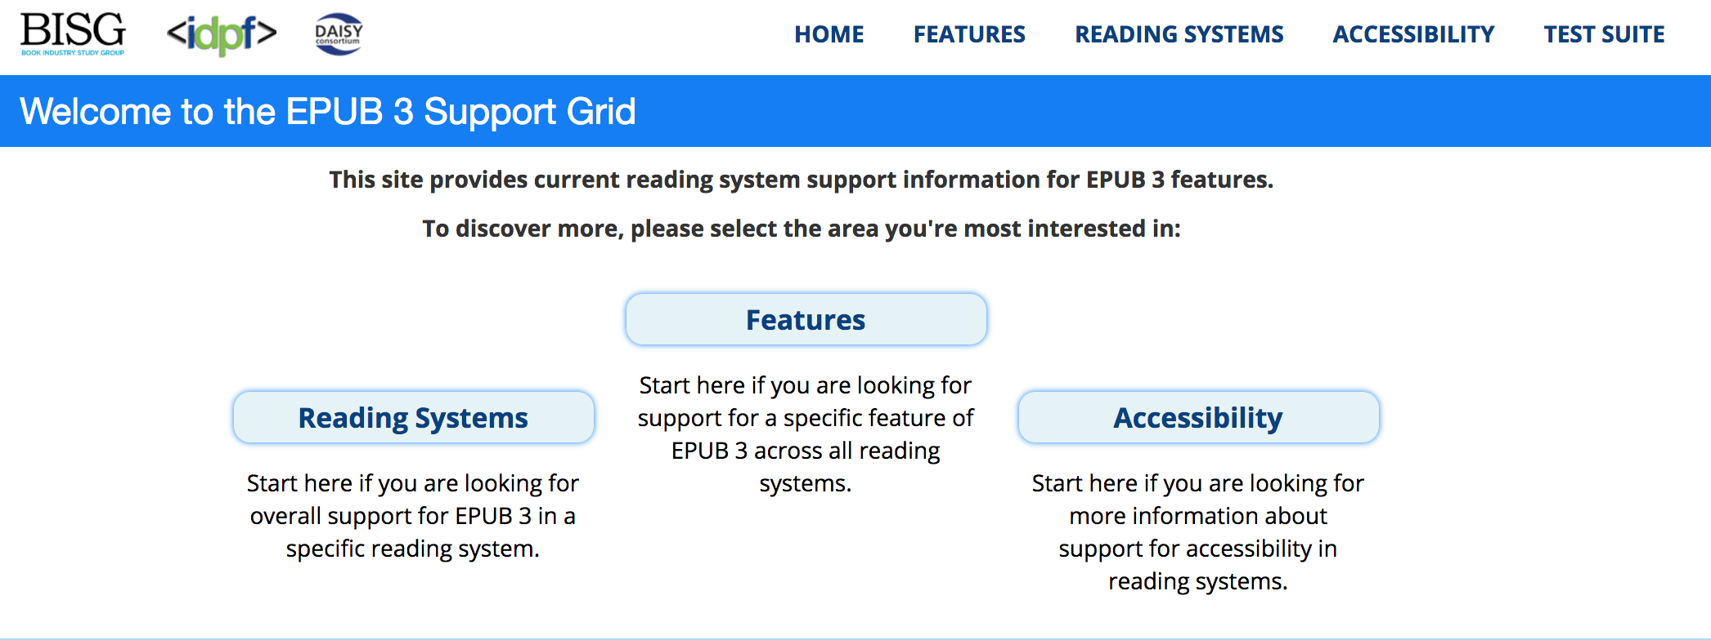
What reading systems use ePUB and how can you tell if they’re accessible?

Slide 12
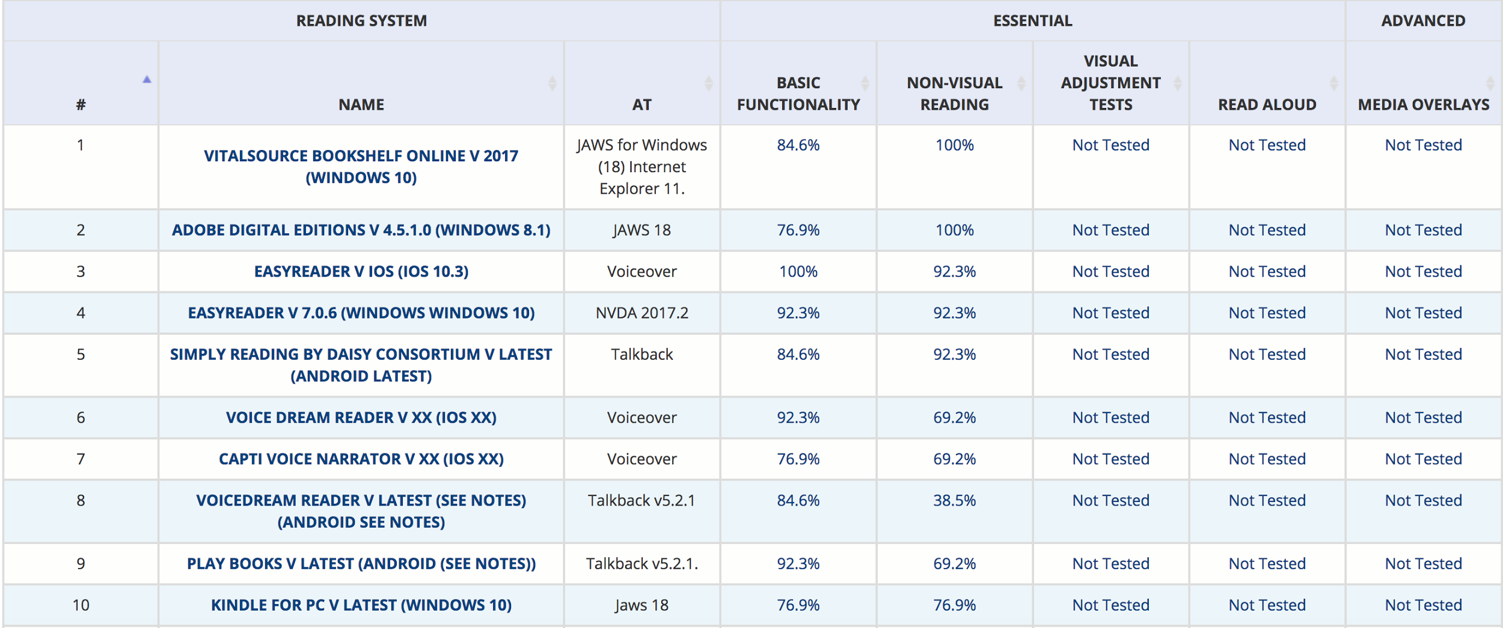
Reading the epubtest.org Grid

Slide 13
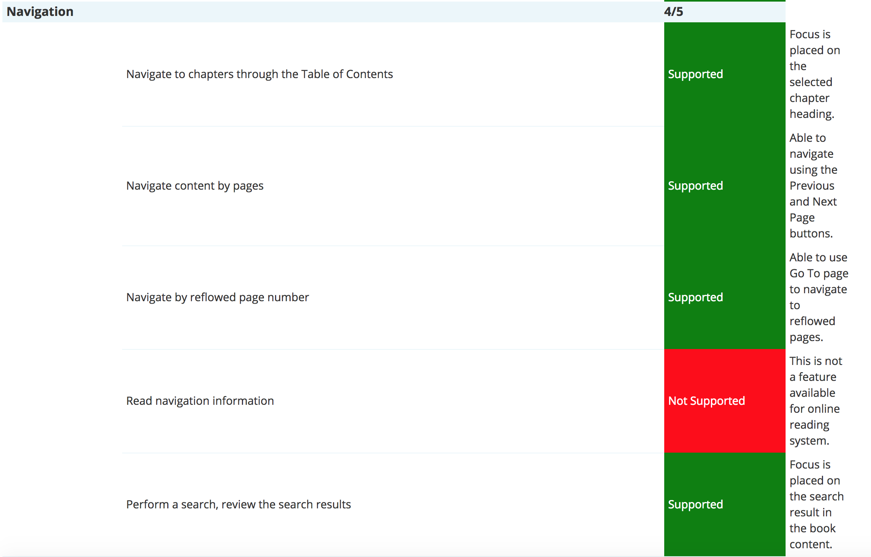
Detailed View of a Single Reading System Review

Slide 14
But Wait… How do I Know the ePUB is Accessible?

Slide 15
Ace by DAISY, Accessibility Checking Tool
The DAISY Consortium developed an open source accessibility checking tool: First Public Beta.
Publishers and service providers will be able to use it to implement accessibility.
It will also enable distributors and consumers to verify the accessibility claims.
This tool performs automated checks to evaluate conformance to the EPUB Accessibility Specification.
The initial version will check against the rules defined in WCAG, ARIA, and HTML.
It is impossible to perform a 100% complete evaluation of accessibility requirements in a fully-automated manner. Many criteria require human judgement and manual inspection.
Ace by DAISY does not claim to be a yes/no validator or a certification tool. It will not issue an accessibility score, percentage of conformance, etc.
It is not intended to be used for repairing inaccessible content.
The tool will not be able to analyze encrypted content or any other DRM-protected EPUB

Slide 16
DRM-Protected EPUB
If the EPUB file is DRM protected:
• Unable to use automated tools.
• Conduct manual accessibility testing.
• Unable to modify EPUB content.
• Return to publisher for remediation.
NOTE: Several publishers and e-reading system developers are integrating the ACE tool in their systems. EPUB files are checked for accessibility prior to DRM protection and information about the accessibility test results are provided.

Slide 17
Certification and Verification
Global Certified Accessible by Benetech
https://benetech.org/our-work/born-accessible/certification/about/
Benetech has developed an evaluation program that assesses the full range of accessibility features currently detailed in the EPUB 3.1 specification.
This program was developed over a nine-month period during which Benetech conducted in-depth reviews of scores of titles across all sectors – with a particular focus on complex STEM titles – against a suite of accessibility guidelines.
These included the EPUB Accessibility 1.0 Specification (also known as the “Baseline”) and the World Wide Web’s (W3C) Web Content Accessibility Guidelines 2.0 (WCAG 2.0) for levels A, AA and AAA.
Additional features specific to ebooks are also included.

Slide 18
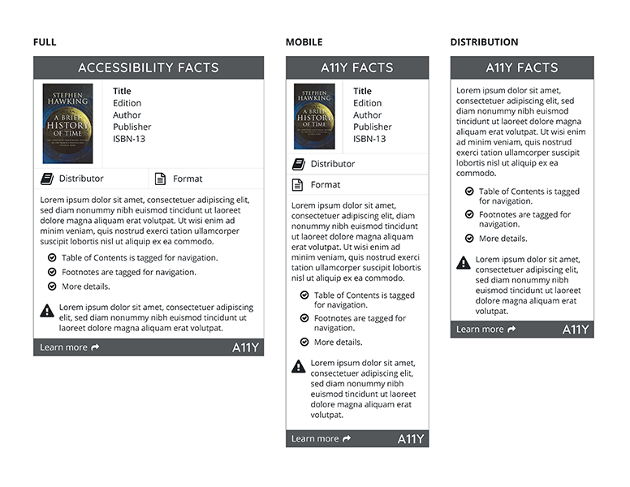
AMAC/CAMI Accessibility Facts Label
http://cami.gatech.edu/afacts.php
Accessibility Facts discloses a11y features of texts and other e-documents through a label format.
A11y Facts labels are created by publishers, distributors, retailers, and other content providers through the A11y Facts Portal, an online application built by CAMI.
The label consists of an accessibility statement, a detailed list of accessibility features, and known issues that would impact accessibility.

Slide 19
Understanding accessibility metadata
http://www.a11ymetadata.org/the-specification/metadata-crosswalk/
Accessibility metadata reveals what is and is not accessible within an epub.
Are you limited to the labels you’re about to see?
No. accessibilitySummary is an open text box metadata field - this is a chance for the ePUB creator to explain any quirks that the user or adopter should be aware of.

Slide 20
Understanding accessibilityFeature
Metadata Tag | Type | Expected Values | More Expected Values
accessibilityFeature | Text | alternativeText annotations audioDescription bookmarks braille captions ChemML describedMath displayTransformability highContrastAudio highContrastDisplay largePrint latex longDescription | MathML none printPageNumbers readingOrder signLanguage structuralNavigation tableOfContents taggedPDF tactileGraphic tactileObject timingControl transcript ttsMarkup unlocked

Slide 21
Understanding accessibilityHazard
Metadata Tag | Type | Expected Values
accessibilityHazard | Text | flashing noFlashingHazard motionSimulation noMotionSimulationHazard sound noSoundHazard

Slide 22
Understanding accessibilityAPI
Metadata Tag | Type | Expected Values
accessibilityAPI | Text | AndroidAccessibility ARIA ATK AT-SPI BlackberryAccessibility iAccessible2 iOSAccessibility JavaAccessibility MacOSXAccessibility MSAA UIAutomation

Slide 23
Understanding accessibilityControl
Metadata Tag | Type | Expected Values
accessibilityControl | Text | fullKeyboardControl fullMouseControl fullSwitchControl fullTouchControl fullVideoControl fullVoiceControl

Slide 24
Manual Testing
Using the epub checklist to manually check your book
Checklist available upon request
Demo!

Slide 25
And if it’s NOT Accessible?

Slide 26
What do I do if the textbook is not accessible
Ask the Publisher for help.
No really.
Try it.
We (mostly) don’t bite.

Slide 27
Inaccessible EPUB Content
What do you do if the publisher is not able or willing to remediate the EPUB content for accessibility?
Short term:
Request an accessible option (e.g., Microsoft Word, PDF or text file) from the publisher.
If EPUB is not DRM, you can fix the code...(caveat: you’ll need to know HTML5, JavaScript, and CSS)
Identify other alternatives to support the student (e.g., If available, borrow print copy in library)
Provide custom solutions – alt text for images, accessible tables, by chapter and location etc.
Long term:
Educate your students about EPUB formats
Educate your faculty about requesting/selecting accessible formats from publishers.
Secure print copies as a backup

Slide 28
Who Are These People Again?
Rachel Comerford
Director of Content Standards
Macmillan Learning
Co-Chair, W3C ePUB Community Group
Email: Rachel.Comerford@Macmillan.com
Twitter: @rallyfora11y
Amy Salmon
Senior Accessibility Consultant
Tech For All, Inc.
Email: asalmon@tfaconsulting.com
Twitter: @Asalmonamy

