Slide 1
The ‘I-Plan for Accessibility’
Our inclusive approach
Notes:
The ‘I-Plan for Accessibility’
Our inclusive approach
Presented by Sachin Gupta, Director of Services and Naveesha Maharaj, Accessibility Consultant

Slide 2
Agenda
Who are involved
What to Consider
Q&A
Accessibility Throughout
Case Studies
Partner Responsibilities
Notes:
Stakeholders Various Accessibility Considerations Steps impacted with Accessibility Case Studies Partner Responsibilities Q&A

Slide 3
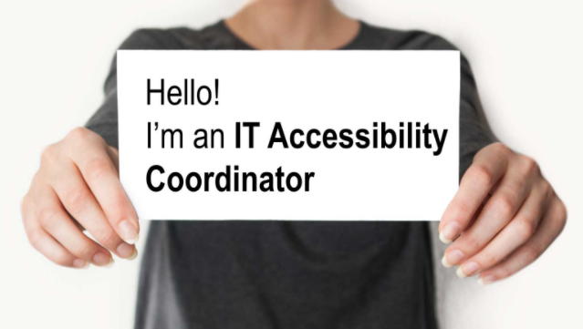
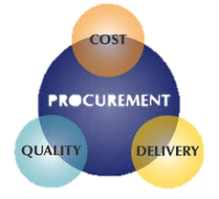
Who are involved
procurement
Legal Counsel
IT Team
Notes:
Who are involved in the act! Legal Counsel Procurement Customer Service IT team Training
Accessibility Coordinators
_____________________________________

Slide 4
What to Consider
Which Departments and/or Teams will be involved
What will your Accessibility Policy be
Who is your Audience
Is the website going to be Static or Interactive
5
What is the budget for Accessibility Specialist
Notes:
Couple of questions to think about..
Who is the content for?
Is the site or content going to be exposed to the public or is it for internal use. So in other words who is your audience?
Will your site be providing information, obtaining information, used as a resource hub, purchasing, all of the above and more?
Accessibility Plan
Disclaimers
How to provide inclusive assistance and how in return this will increase your SEO Budget for the SME

Slide 5
Accessibility Throughout
Labour Hours
Budget
Quality
Other Business Opportunities
Employee Morale
Notes:
When accessibility is left out from the foundation of the plan or from steps within the plan, what gets affected
labor hours,
budget,
quality,
other business opportunities,
employee morale
Are all affected!

Slide 6
Our I-Plan
Elaboration
Preservation
Construction
Transition
Inception
completion
Notes:
Flow chart to be shown of steps and how accessibility fits in an i-plan
Inception – brainstorming of possibilities, suggested plan developments, feasibility
Elaboration – detailed description of selected candidates
Construction – requirements, development, testing
Transition – Monitoring and Governance checks and balances and how to implement into deployment
Completion – Stabilizing stable accessibility support
Preservation – maintain the accessible state

Slide 7
Customer Case Study
Functionality is paramount…NFRs can be tackled later
But…it will be much more expensive to build accessibility in later
Requirements
Automations
Accessible Design
Governance
Accessibility Policy
Build Personas
Notes:
The product owners typically focus on functionality as the most important aspect of software. Non-Functional Requirements (NFRs) are an after-thought at best. The accessibility champions in the organization usually get to play the bad cops. There job is not only to ensure accessibility requirements are being built into the system, but very often also involves training the business partners on accessibility needs.
Building an accessible system can be much more expensive if not done throughout the process of development life cycle. However, a few activities to consider accessibility needs could make the incremental cost to build an accessible system fairly minimal. These activities include:
Building correct User Personas that also include people with disabilities
Picking and distributing an accessibility policy for the organization
Building a design with accessibility needs in mind
Creating accessibility requirements for development teams
Building and using automated methods/tools for accessibility testing
Putting appropriate governance in place for accessibility processes

Slide 8
Customer Case Study
Notes:
According to the journal of Defense Software Engineering, only about 36% of software defects are introduced during coding and implementation phase. 64% (majority) of the defects are introduced during Requirement analysis and design phase.
Also, in an independent study, IBM Systems Sciences Institute determined that cost to fix a software defect increases exponentially with each phase. If a defect will take x cost to fix if identified during design phase, it can take 6.5x, 15x and 100x the cost to fix if identified during Implementation, Testing, and Maintenance phases respectively.

Slide 9
Customer Case Study
WCAG Level AA
Actions
Policy
Requirements
Automations
Metrics collection
Prod Monitoring
Establish Training
Legal Alliance
Work with Vendors
Written for personas, and more than screenshots
Automate Unit and System Tests
Entry and Exit Criteria per phase
Auto Full Scans, Sample manual tests
Identify owner, frequency and content
The legal counsel established as a partner to business
Provide new requirements…but is it really that easy?
Notes:
An informed business owner can really make the difference in getting the system developed right the first time. In our case, the customer really embraced the accessibility needs of the system due to a combination of legal requirements and understanding of the needs for PwDs. While thinking about policy, they picked the WCAG Level AA guidelines as the accessibility policy. While writing requirements, all personas including PwDs were taken into account. Various external tools, plugins, and extensions were used both in Unit testing and system testing phases to check for accessibility issues. Focus is on identifying the bugs sooner in the development process rather than later. Various tools used were:
aXe, WorldSpace Attest during unit testing,
colour contrast analyser during design,
aXe, WorldSpace Assure during QA
WorldSpace Comply for production monitoring
As they start collecting metrics, they established very clear entry and exit criteria for each stage of development. For instance, any code could not make into system testing without a clean WorldSpace Attest report.
A regular training program (both LMS based, and Instructor Led) was put in place in partnership with their accessibility vendors. All the activities were performed keeping the Legal Counsel fully informed, and with their inputs incorporated. Having the legal team as the partners was very helpful to enforce compliance with internal team members. Vendor partners were also brought into loop to create accessible systems.

Slide 10
Customer Case Study
Inform
Share Policy
Provide Metrics
Provide Tools
Provide Training
Include in Reviews
Accountability
Contract
I have to implement what? Huh???
Notes:
When the vendor is brought into loop on accessibility requirements, in 90% of the scenarios these partners do not understand accessibility requirements in detail. It is even more problematic if they have partial education on this subject. In all of these instances, it is important to establish appropriate expectations with the partners. These usually can be accomplished through a series of steps:
Inform the partners of the need
Share the accessibility policy of the organization
Provide the partners with clear metrics that will be used to establish success criteria
Provide tools necessary to ‘do the job’
Provide training for partners as necessary
Inclusion in reviews is essential to get immediate and complete feedback.
While it is important to support the partner, accountability should be on the vendor to meet the requirements.
Finally, the contracts need to be amended to include accessibility requirements.

Slide 11
iPlan – fully incorporated
-Legal
-Accessibility Coordinator
-Customer Service
-Marketing
-IT
-Accessibility Coordinator
Preservation
Transition
Elaboration
Construction
Completion
Inception
-Legal
-Marketing
-IT
-Accessibility Coordinator
-Procurement
-Legal
-IT
-Accessibility Coordinator
-Customer Service
-Legal
-IT
-Vendor
-Accessibility Coordinator
-Customer Service
-Legal
-IT
-Accessibility Coordinator
-Customer Service
Notes:
Heads of Marketing, IT, Accessibility SME
Idea
Cost
Feasibility
Legal, Marketing, IT, Vendor, Accessibility SME, Procurement
Requirements
Design
Risks
Cost
Legal, IT, Vendor, Customer Service, Accessibility Coordinator
Development
Testing
Deployment
Legal, IT, Customer Service, Accessibility Coordinator
Deployment
Feedback
Legal, IT, Customer Service, Accessibility Coordinator,
Approvals
Next Steps or possible other phases to complete
Legal, Customer service, Accessibility coordinator,
Training
Sustainability

Slide 12
I-Plan Benefits
200
Cost 50
ROI 25
Compliance 42
High Morale 22
SEO 32
Inclusive 29
Notes:
Three Bad Examples:
Fast Implementation
100% accessibility
Best usability
Benefits:
Cost
Compliance
SEO
Inclusive
ROI
High Morale

Slide 13
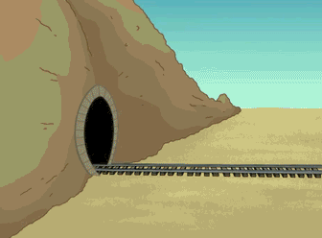
What’s Next
Notes:
Maintenance of Accessibility….steady state…training, governance
How to sustain efforts
Audits and metrics (governance)
Tools that can be used to measure progress as establish next step in phases
WAVE
WAT
Colour Contrast Analyser
aXe
WorldSpace Attest
WorldSpace Assure
WorldSpace Comply

Slide 14
Common FAQ’s
When and how much should we budget for?
How should we handle Design limitations?
Why should we consider accessibility right now?
How much work on accessibility is enough?
Does every component on the page need to be accessible?
How about 3rd party content?
Notes:
In conclusion..
In every organization, everyone is trying to either avoid the accessibility web or try to all fly into it all at once. Without a clear plan, time and resources are lost trying to figure out a workable approach, rather than actually implementing accessible design and development. We are hoping this will help you and your team put this process together to make accessibility an easy web for everyone to weave.
When does Accessibility budgeting take place - Elaboration Stage
How should we handle design limitations - Time frames, Due Date & risk considerations
Why do we need to consider accessibility right now - Accommodates for learning curve, Protects against law suit & Makes better business sense
How much is enough - achieving 100% accessibility is complicated due to change in technology, Once the main goal is met, training maintains preservation and all users can access what’s required, you’ve done well.
Does every component need to be accessible right now for example 3rd party content- Your vendors need to be as accessible as you are, it may not need to be right away but they do need to be advised and a plan put in place to complete

Slide 15
Let’s Hear From You
Any Questions?
Notes:
Floor is open..Any questions

