Slide 1
Training program: simple manual evaluation of websites & use of automated testing tools — a blended approach
Sue Cullen
Assistant Director
Accessible Technology Initiative
CSU Office of the Chancellor
Jeff Singleton
Senior Accessibility Solutions Consultant
Cryptzone, A Cyxtera Business

Slide 2
CSU and CS Partnership – Origin
License Compliance Sheriff tool proof of concept
Customization of ruleset to meet organizational needs
Mapping Section 508 to WCAG 2.0
Roll out to campuses
Training on tool and Customized Check Points
Building overall business process for auditing web environment
Consistent rule set
Speaking the same language
Refining and reporting
Notes:
jeff

Slide 3
Accessible Technology Initiative (ATI) Background
2005 Executive Order 926: The Board of Trustees Policy on Disability Support and Accommodations
2006 Coded Memo “Access to Electronic and Information Technology for Persons with Disabilities”
2007 - 2013 Coded Memo updates
CSU internal business audit - resulted in new report requirements
2015 Coded Memo amended with specific reporting requirements
Summary of ATI Reports to Campus Presidents
2016 Specific Web Strategies agreed upon
2017 Web Performance Reporting Requirements
ATI Policy at the CSU
Goals and Success Indicators
Notes:
Getting traction

Slide 4
ATI Specific Web Strategies agreed upon for implementation by CSU Campuses
Each campus to designate and support a web accessibility coordinator
Web accessibility evaluation and remediation training for web developer/ designers and related teams to web dev
Track Training Participation
Cryptzone training sessions
Cryptzone Online Webinars
Multiple trainings provided by ATI
CSU ATI Web Community of Practice
Notes:
April 2016 communication to campus presidents

Slide 5
Automated Scan of system websites – Spot Check
Based on the automated evaluation criteria common failures included:
Form Field Labeling
Frame Labeling
Proper Heading Order
Color contrast
Alternative Text
Link text describes link purpose
Interpretation needed of passes and failures

Slide 6
Quality Assurance -Web Accessibility/Universal Design – It’s a campus wide effort
Executive Support
Design
Graphic Designers
Development
Web Developers
Evaluation
Monitoring
Web Developers
UX Designers
Web Architects
Website Contractors
Website Contractors
Web Developers
Web Developers
Web Content Creators
Content Creators
UX Designers
Quality Assurance
User testing
Accountability
Notes:
Quality Assurance -Web Accessibility/Universal Design – It’s a campus wide effort
Executive Support – most important element – over sees the entire process; Appropriate personnel should be associated with each area of the web development process. Listed below are the areas and
personnel recommendations:
Design – personnel involved include
Graphic Designers
UX Designers
Web Architects
Website Contractors
Web Developers
Development
Web Developers
Website Contractors
Evaluation
Web Developers
Content Creators
UX Designers
Monitoring
Web Developers
Content Creators
Accountability – a campus reporting process should be in place that informs executive as to the level and improvement of web accessibility over time.

Slide 7
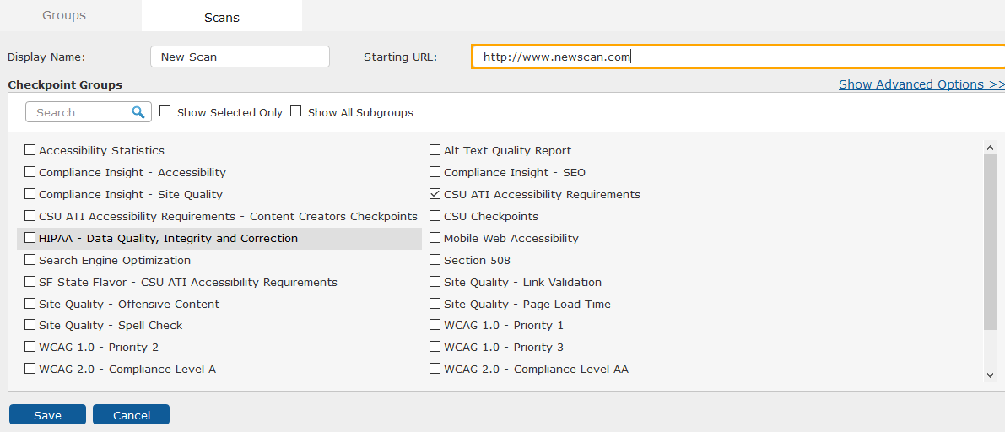
Web Performance Reporting Web Automated testing
Top two levels of campus.edu website public facing site encompass the most viewed content
The audit scan should be 1,500 – 2,000 pages starting at the home page
Use the ATI Accessibility Checkpoints
Remediate accessibility failures from the scans.
ATI and Jeff Singleton can assist campuses that have questions about setting up this scan
Scan monthly (systemwide designation of audit timeframe)
Notes:
Image of screen shot of compliance sheriff automated scanning selection of check points. Cal State University offers customized checkpoints for systemwide consistency of audits

Slide 8
Web Performance Report - Manual testing
Manual evaluation will include:
Campus Web Template
Top 5 visited pages (per campus analytics)
Scan each individual page using the CSU ATI Accessibility Check Points
Filter for Visual Checks
Conduct manual evaluation of Visual Checks curstomzied training resources embedded within Compliance Sheriff and Deputy
Record findings of visual check conducted by an individual
We all still have jobs – machines have not totally replaced us
Comment on findings (ex: Pass/Fail/Visual and why)
Comments within Web Performance Manual Testing Worksheet or Compliance Sheriff Revision Wizard
If using the Revision Wizard - save your work and comments periodically as you would any document.
Notes:
Manual testing can be overwhelming if you don’t spot check the

Slide 9
Prerequisite for Manual Testing Training:
Access to Compliance Sheriff
Basic understanding of navigation within Compliance Sheriff
Experience viewing Compliance Sheriff Report views
Installation and use of WAVE toolbar

Slide 10
Manual Testing Session Topics Session 1 (90mins)
Revision Wizard and built in training resources
Provide Worksheet of Check Points
Keyboard accessibility
Keyboard Traps
Video plays
Keyboard Focus
Default Tab Order
Resize Text
Meaningful Link Text
Meaning conveyed by color alone
Use of Headers

Slide 11
Manual Testing Session Topics
Session II (90mins)
Session III (90mins)
Manual Testing Continued
Accessible Tables: Layout, Data Tables
Scrolling Content
Worksheet of Check Points
Reviewing Visual Checkpoints and the Revision Wizard
Color Contrast

Slide 12
Session IV (90mins)
Topics:
Review Visual Checkpoints, Revision Wizard or Worksheet
Form Error message handling
Alternative Text
Captioning Multimedia
Timed Response
Language of the page
Use of abbreviations

Slide 13
Session V Future Plan
Advanced topics such as scripting
ARIA techniques
Users Case Scenario testing

Slide 14
Universal Design inclusive of accessibility
Accessibility testing uncovers usability problems
During manual testing training
Explored excessive scrolling
Distracting moving elements
Too many links
Inconsistent navigation

Slide 15
Tools
Open Source Evaluation Tools
Compliance Sheriff CSU information
CSU login required to access CSU-ATI-Requirements-Revised-12-23-15.docx via CSYou.
Important Note: Worksheet will grow to include more manual testing check points as the training is scaled. Compliance Sheriff report include CSU Custom training content

Slide 16
Web Performance Manual Testing Worksheet 2017
Testing Information
Evaluator Name:
URL evaluated:
Browser/Version used:

Slide 17
Training Resources: Less is More
Type of test | Check Point | Resources | Comments | F/P/NA
Keyboard Operable --tab through, look for visual focus and consistent behavior as you tab through for menus etc. Remember to check any video players on the site | G202 Keyboard Operable (WCAG 2) G149 Visual Focus | WebAIM Standard keyboard operability How to meet keyboard accessibility W3C Visible Focus Controlled visual Focus Example (not browser dependent): Deque: Designing usable focus indicators G202: Ensuring keyboard control for all functionality G90: Providing keyboard-triggered event handlers CSUN UDC Web criteria – Keyboard Accessibility
Notes:
Type of test=Keyboard Operable
--tab through, look for visual focus and consistent behavior as you tab through for menus etc.
Remember to check any video players on the site
Check Point =G202 Keyboard Operable (WCAG 2)
G149 Visual Focus
Resources =WebAIM Standard keyboard operability
How to meet keyboard accessibility
W3C Visible Focus
Controlled visual Focus Example (not browser dependent):
Deque: Designing usable focus indicators
G202: Ensuring keyboard control for all functionality
G90: Providing keyboard-triggered event handlers
CSUN UDC Web criteria – Keyboard Accessibility
Comments column
F/P/NA column

Slide 18
Keyboard Traps
Keyboard Traps --Do you get stuck, i.e. in video player or somewhere in a form on a page? | F10a Keyboard Traps (WCAG 2) Related to G107 Unexpected behavior | Problem examples: Interactive Accessibility - Training Example Unexpected behavior example – and Keyboard Trap - auto activate upon keyboarding into link without actually selecting it. UDC Web criteria – Keyboard Traps F10 Failure of Success Criterion 2.1.2 WCAG 2.0 No Keyboard trap WCAG Non-Interference
Notes:
Keyboard Traps
--Do you get stuck, i.e. in video player or somewhere in a form on a page?
F10a Keyboard Traps (WCAG 2)
Related to G107 Unexpected behavior
Problem examples: Interactive Accessibility - Training Example
Unexpected behavior example – and Keyboard Trap -
auto activate upon keyboarding into link without actually selecting it.
UDC Web criteria – Keyboard Traps
F10 Failure of Success Criterion 2.1.2
WCAG 2.0 No Keyboard trap
WCAG Non-Interference

Slide 19
Tab Order
Tab Order --Tabbing through the page, does it follow a logical order? | G59a Default Tab Order (WCAG 2) | I.E. toolbar plug in from Vision Australia can be used to expose the tab order using Structure, Tab Order Indicator UDC Web Criteria Keyboard accessibility- example tab order G59: Placing the interactive elements in an order that follows sequences and relationships within the content
Scrolling Content --Pause, stop, navigate | F16 Failure of Success Criterion 2.2.2 mechanism to pause and restart the content. (WCAG 2) | UDC Web accessibility criteria- screen movement WCAG F16 Scrolling Content
Notes:
Tab Order
--Tabbing through the page, does it follow a logical order?
G59a Default Tab Order (WCAG 2)
I.E. toolbar plug in from Vision Australia can be used to expose the tab order using Structure, Tab Order Indicator
UDC Web Criteria Keyboard accessibility- example tab order
G59: Placing the interactive elements in an order that follows sequences and relationships within the content
Scrolling Content
--Pause, stop, navigate
F16 Failure of Success Criterion 2.2.2 mechanism to pause and restart the content. (WCAG 2)
UDC Web accessibility criteria- screen movement
WCAG F16 Scrolling Content

Slide 20
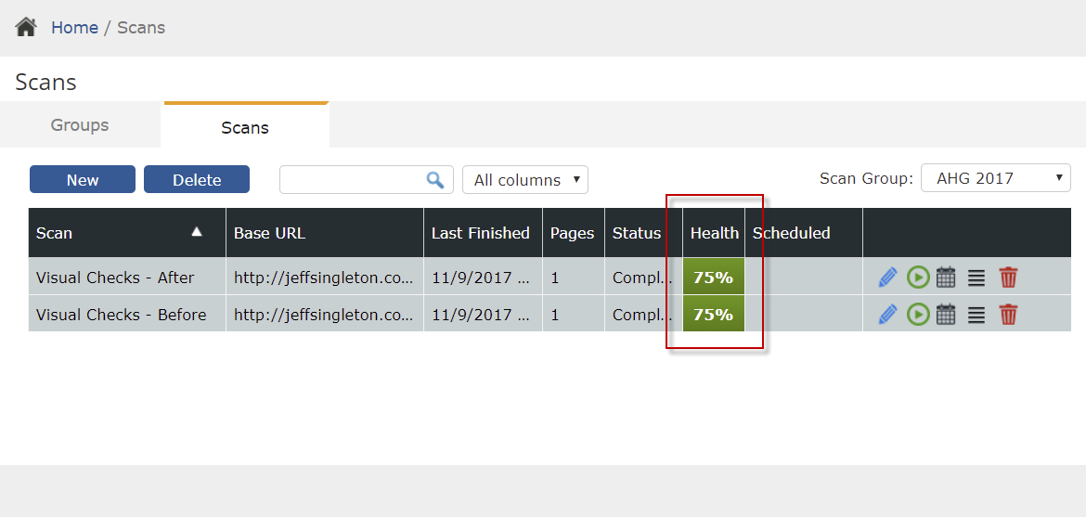
Scan Scores

Slide 21
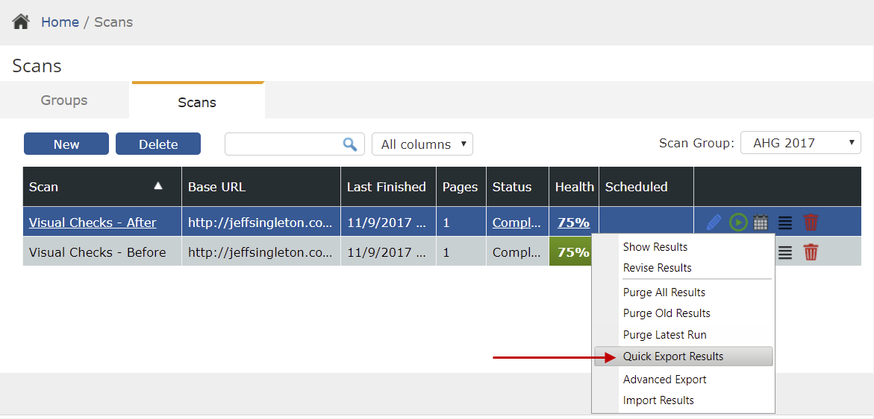
Quick export of results

Slide 22
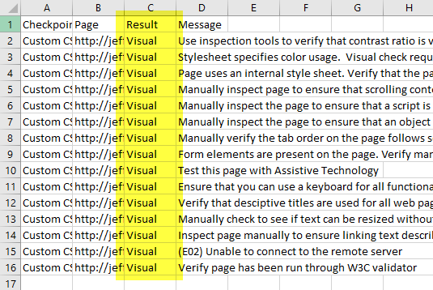
CSV file export visual checks

Slide 23
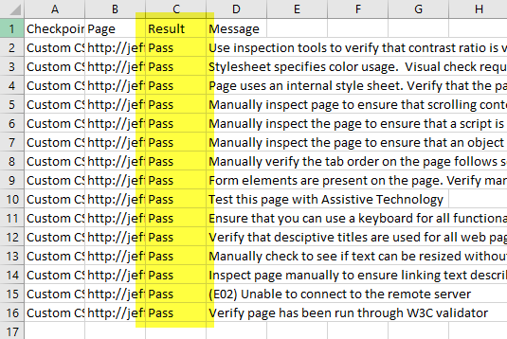
CSV file import of changed result

Slide 24
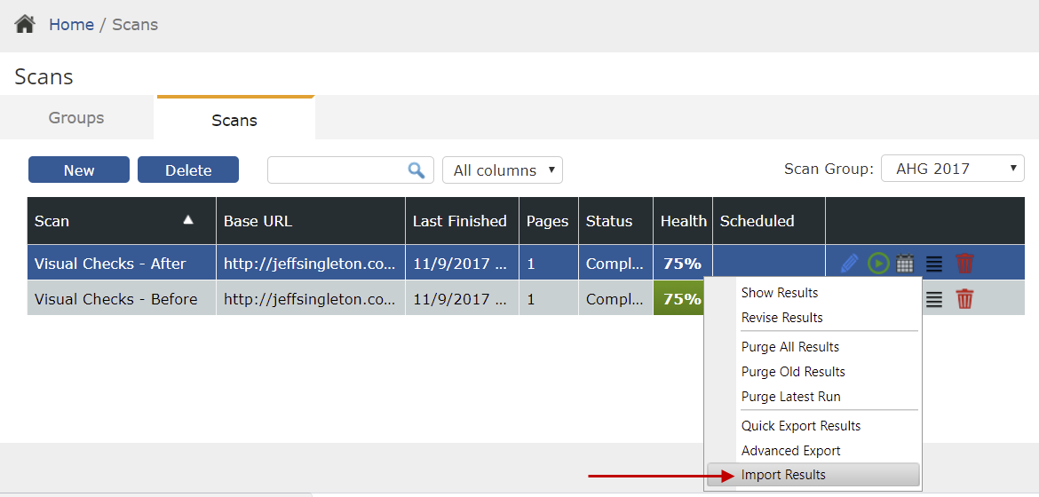
Import Results

Slide 25
Before and After import

