Slide 1
Exploring Accessibility in Open Online Learning
Mary J. Ziegler
November 15, 2017
Accessing Higher Ground

Slide 2
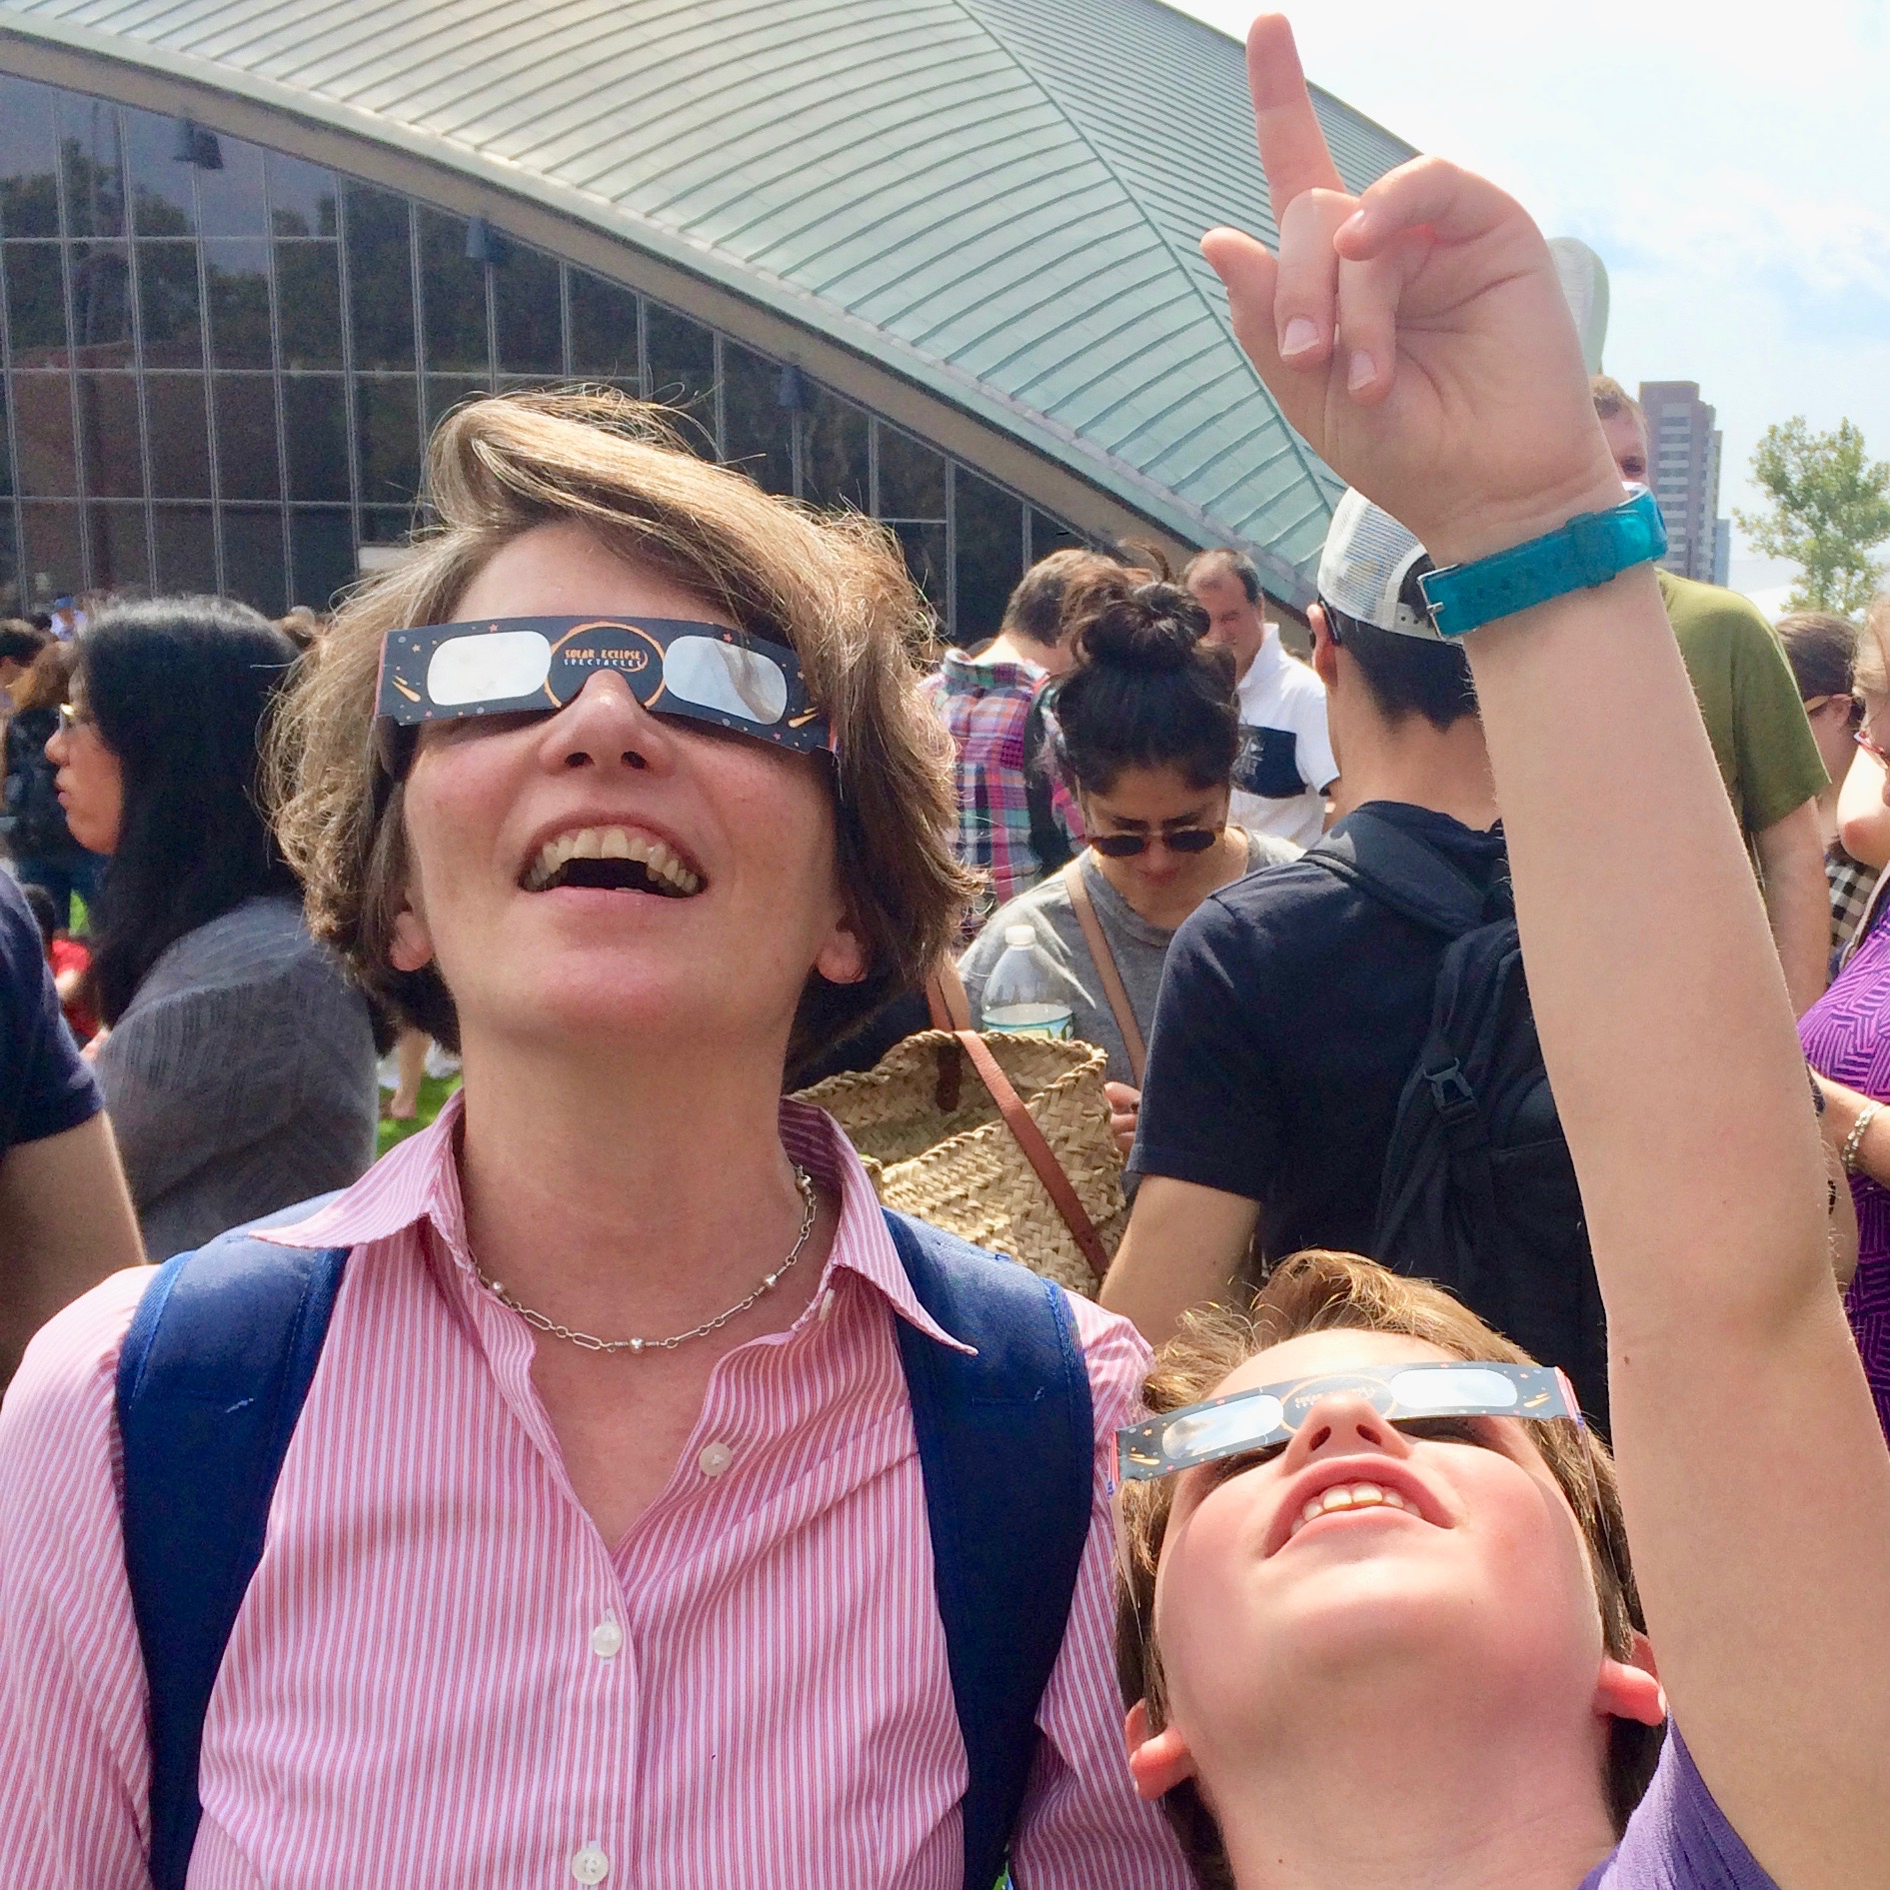
Hi! I’m Mary,
your tour guide and fellow explorer
Mary Ziegler
MITx Open Learning
maryz@mit.edu
@youhavetime

Slide 3
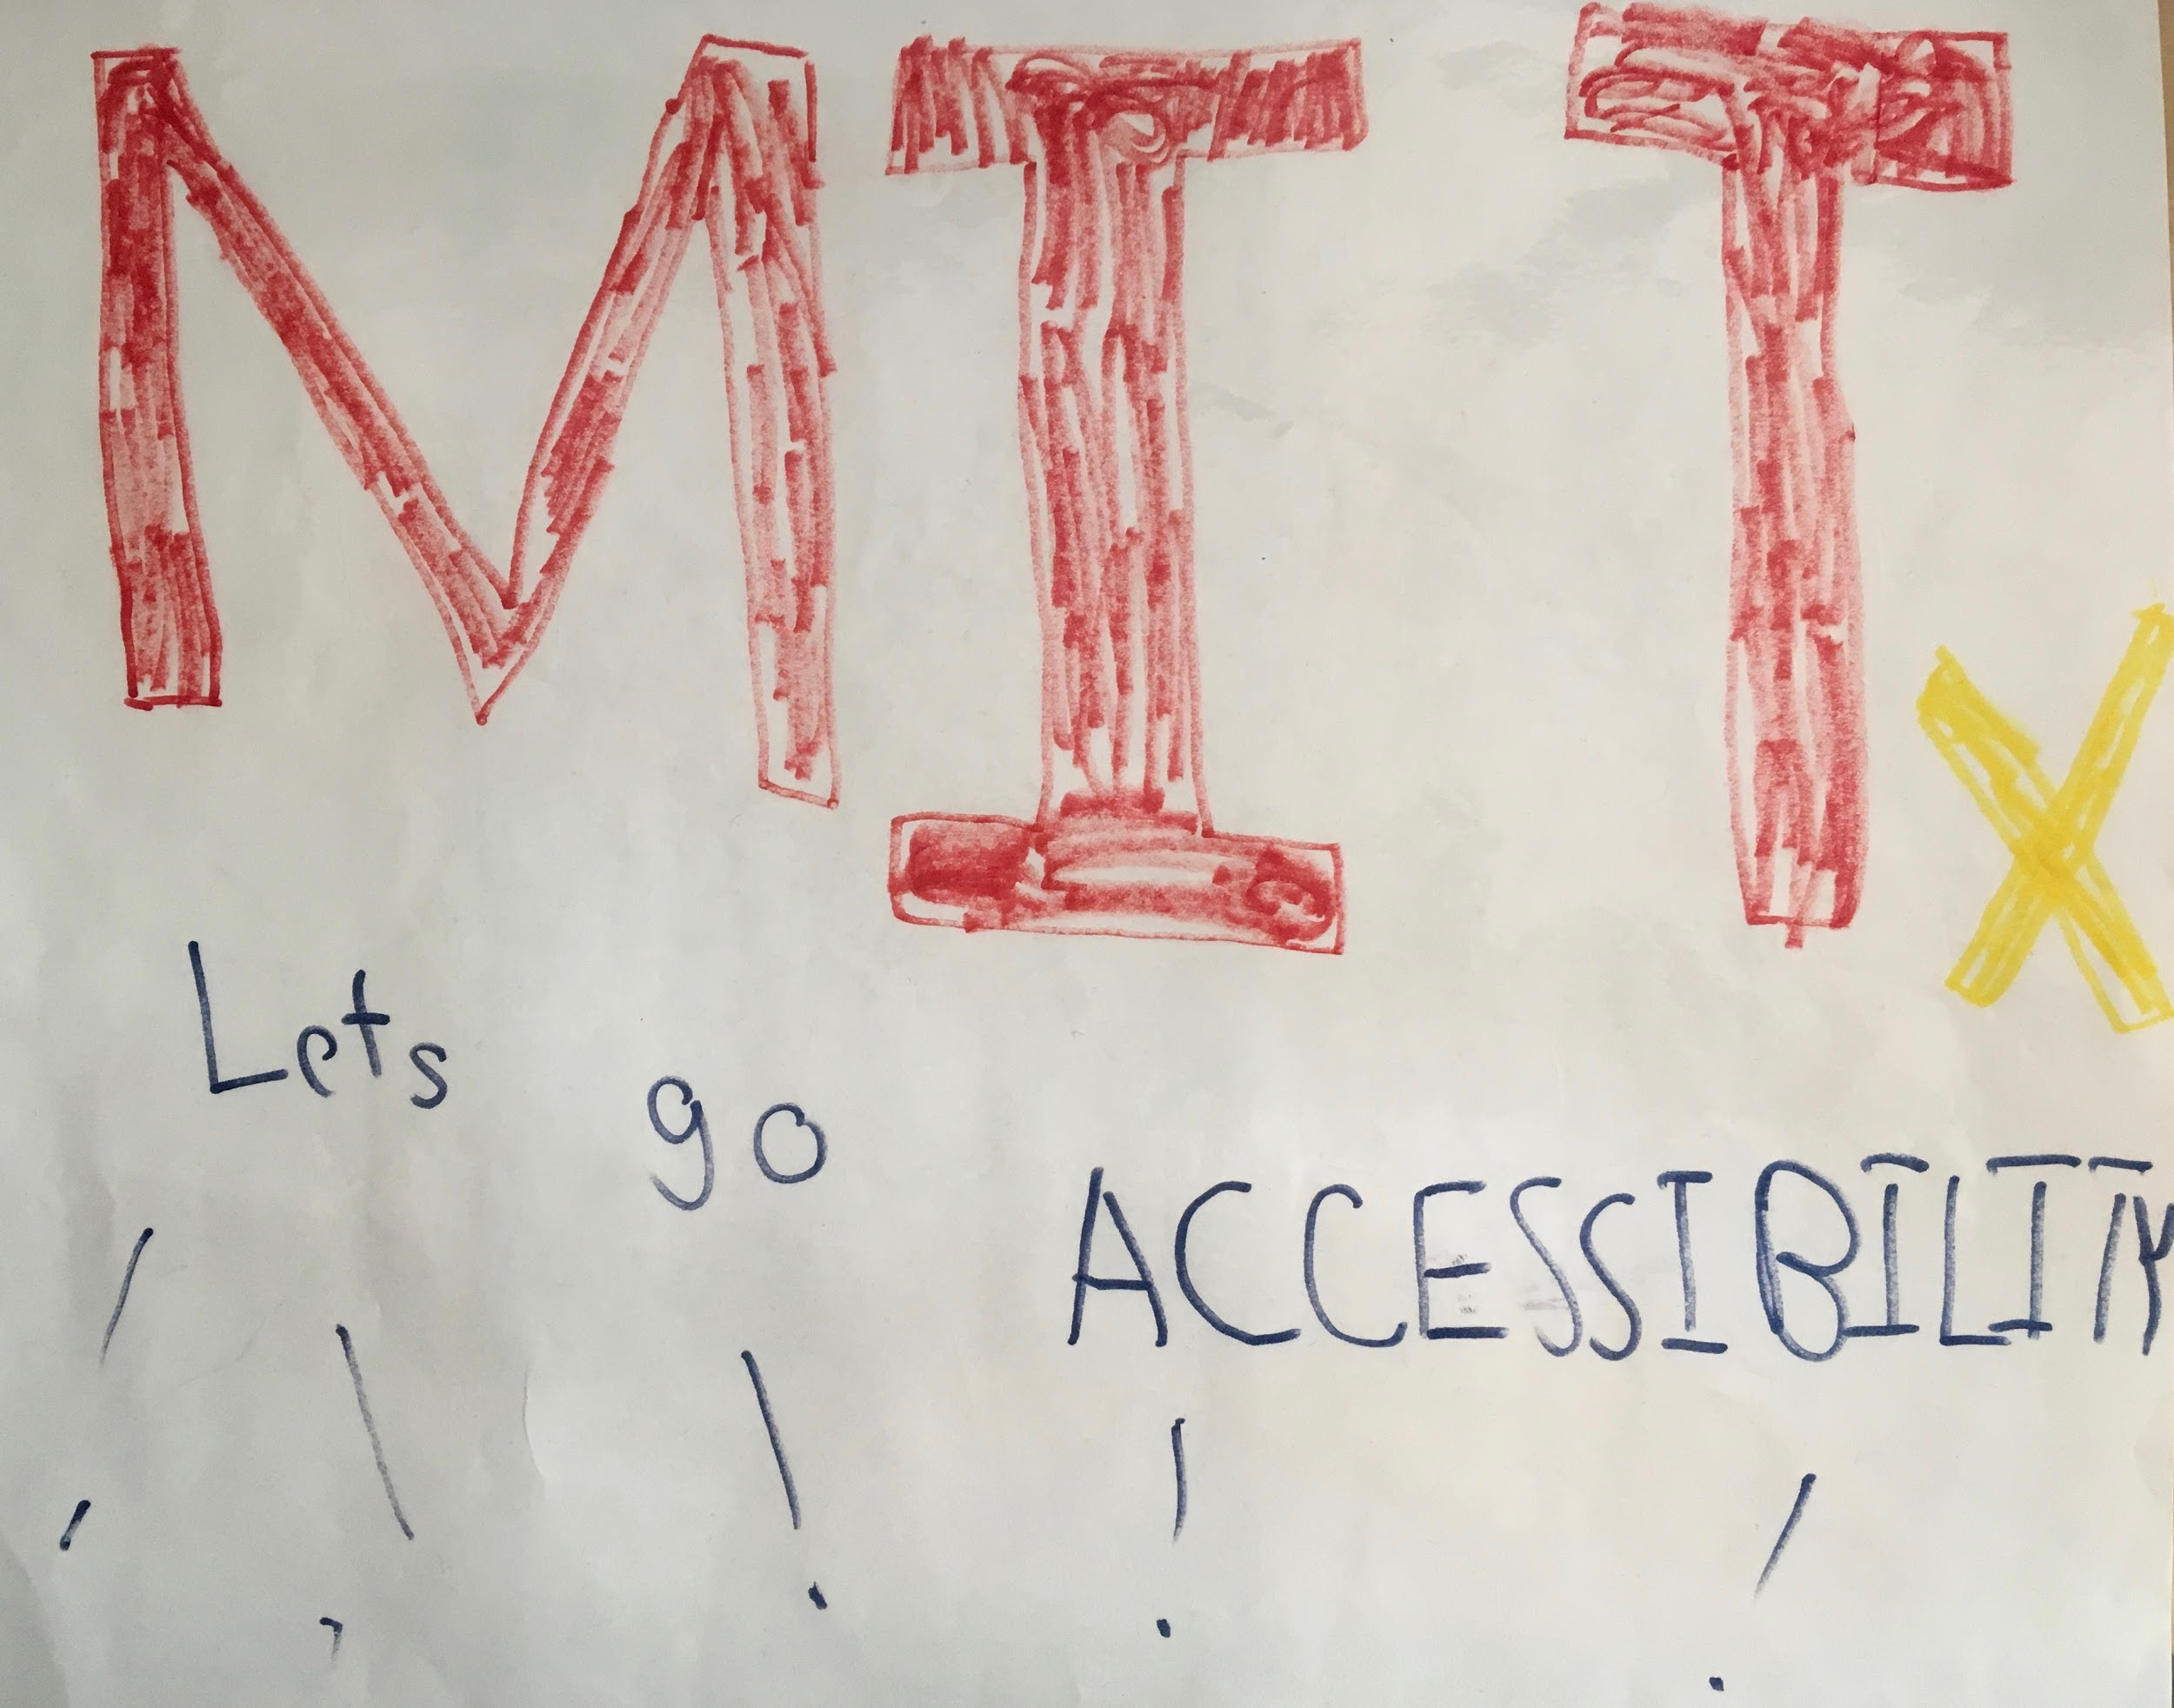
Let’s Go Accessibility!

Slide 4
Open and Online
Global Reach
New Forms and Opportunity
Digital connection

Slide 5
Global Reach
2016 stats report on MOOCS by Class Central
58 Million learners
edX News video on edX October 17, 2017
I3 million learners, Ages 7-95, All countries
MITx
2.7 million active learners
Learners with disabilities?
Open University UK starting to gather stats

Slide 6
New Forms of Learning
“Openness unlocks new forms of pedagogy, new ways of engaging, and interacting with one another.”
David Wiley Introduction to Open Education
“Many students already learn differently. They’ve only known content that responds to them. Online learning allows students to go back to lessons, again and again, to rewind and to pick up all the points they didn’t get the first time around.”
Allison Schrager and Amy Wong, The Vanishing University

Slide 7
Open brings new opportunity
Removes physical barriers
Supports flexible learning styles
Encourages social inclusion
Leads to future opportunities
MIT Alum Amol Bhave’s story of
OpenCourseWare and MITx leading
him to apply to MIT

Slide 8
How learners connect to open online learning
Internet connection
→ Learning Platform
→ Course Curriculum
→ Learner Technology
All learners need technology to connect.

Slide 9
2. Learning Online
Connecting learners to content and teachers

Slide 10
Contributors to Open Online Learning
Contributor | Role
Leaders | Fund, set priorities
Instructors, faculty | Author content, teach
Technology developers | Develop learning platform
Instructional designers | Design content to fit technology
Educational technologists | Make the learning technology run
External providers (OER, etc.) | Provide outside curriculum & testing
Digital learning & data scientists | Analyze and study effectiveness
Accessibility, disability, UX, learner support specialists | Contribute to improvements and support learners
Students and learners | Learn and provide feedback

Slide 11
Learner tasks and online technology
Task | Technology
Watch, listen to lecture, demo | Video, podcast, vodcast, animation
Read, annotate, comment | Web (html), e-books, PDF, annotation tools
Communicate, discuss, share | Discussion, chat, conference, social media
Practice skills: write, draw, compute, code, play | Open response, multiple choice, drag and drop, simulations, virtual environments, games, etc.
Take a test: exam, quiz, problems | Machine-, peer-, teacher-graded. Timed or proctored.

Slide 12
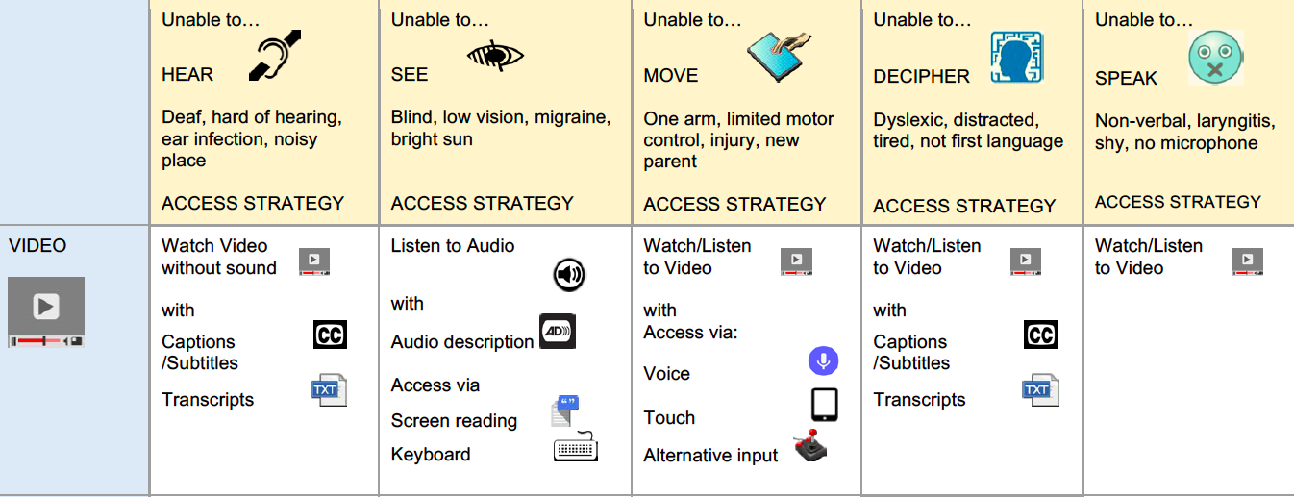
How learners with disabilities access online content
Screenshot sample of educational chart.

Slide 13
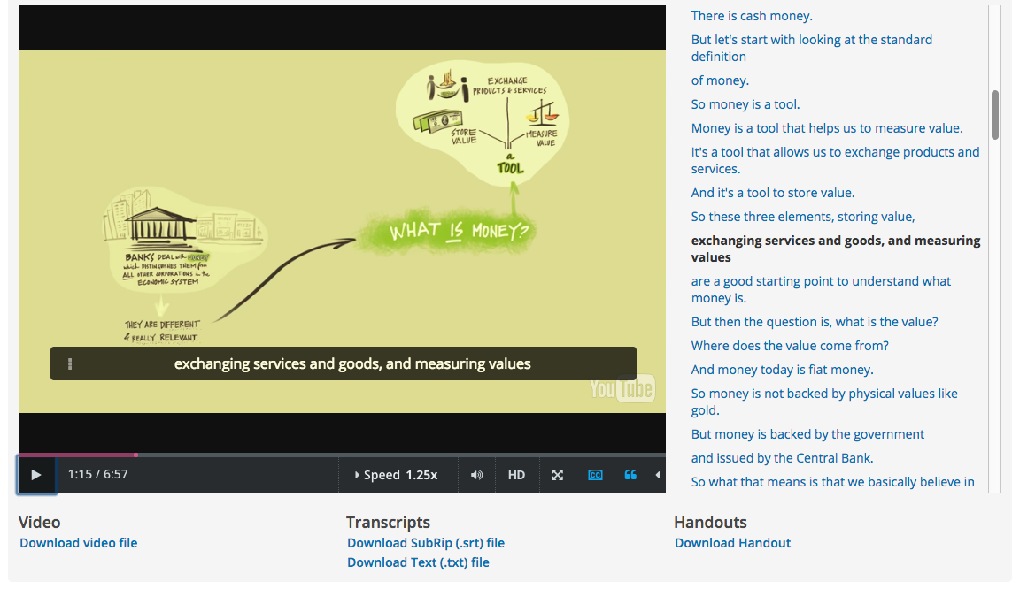
Flexible access video example
Video (variable speed)
Audio which describes visuals
In-line captions
Interactive transcript (searchable)
Transcript file (text or SRT format)
Video file
PDF file of graphic
6
Screenshot taken from MITx course on edX: Just Money: Banking as if Society Matters

Slide 14
Accessibility Gardening: Planting Seeds in Open Learning
Goals
Strategies
Partners

Slide 15
Open Learning
Accessibility Mission –
Promote curriculum accessible to learners with disabilities
Design
and
Develop
Guided by W3C WCAG
Engage
with
Learners
Guided by ADA/504
Innovate for
Inclusion
Lead with Technology
Foundation of International, National, and Local
Guidelines and Policy
Notes:
\

Slide 16
Design and Develop Accessible Curriculum
Goal
Strategies
Partners
Design and develop accessible digital learning course platforms, content, tools, assessments, discussion forums, and enhancements
EdX platform accessibility collaboration
Resources and Guidance on how to apply W3C Web Content Accessibility Guidelines
Feedback loop learners in courses
EdX Accessibility
MITx Educational Technologists
Instructional Designers
MITx Engineers
MITx Course teams
Faculty

Slide 17
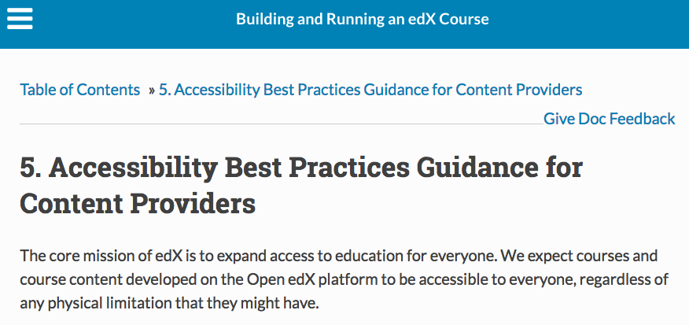
EdX Platform Accessibility
Policy
Guidance

Slide 18
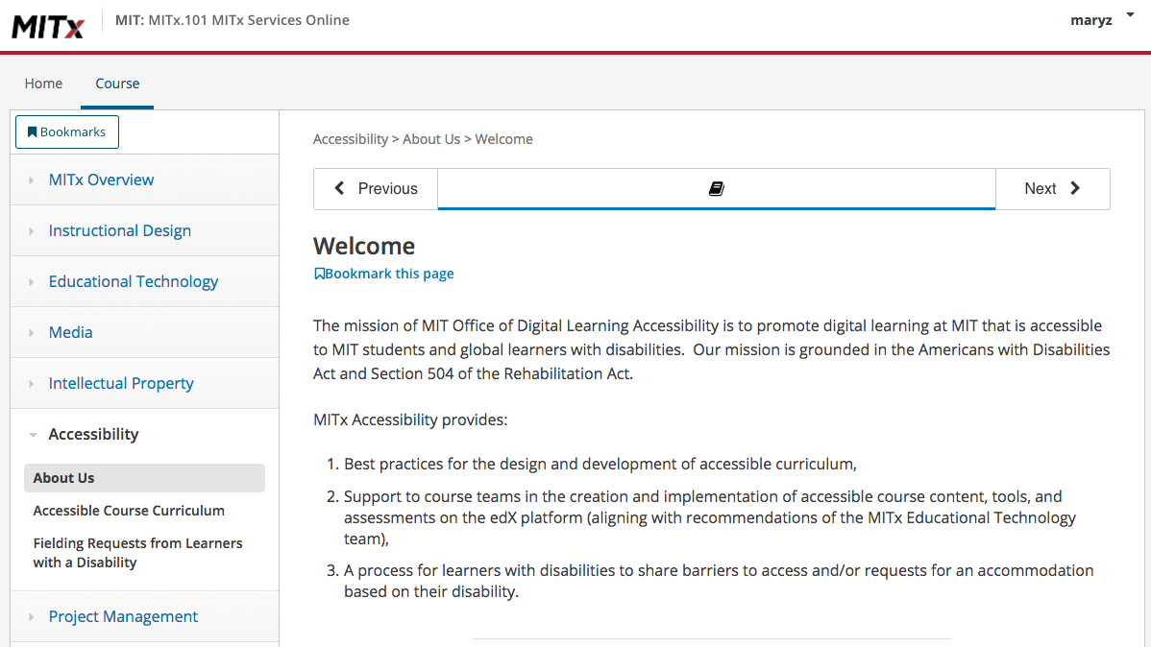
MITx Services Online

Slide 19
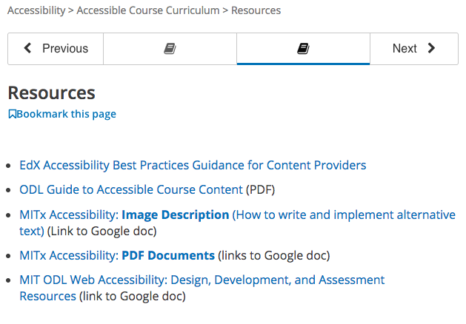
MITx Accessibility Resources
Resource Links
Edx
Guide to Content
Image Description
PDF
And more…

Slide 20
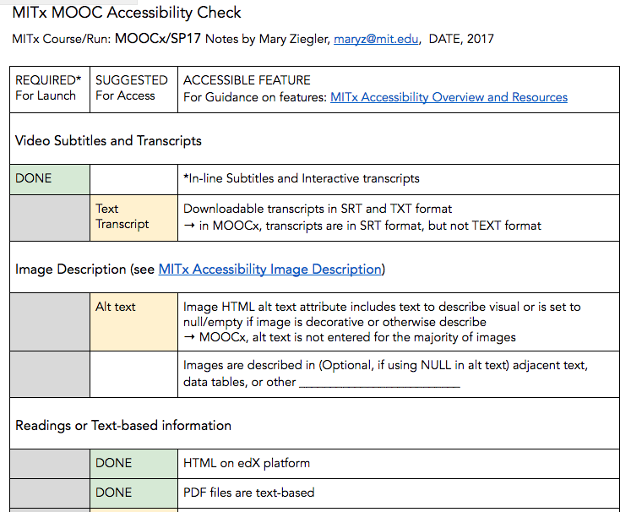
MITx Course Accessibility Check
Sample course content check
Call out accessible
Suggest access improvements
Link to guidance

Slide 21
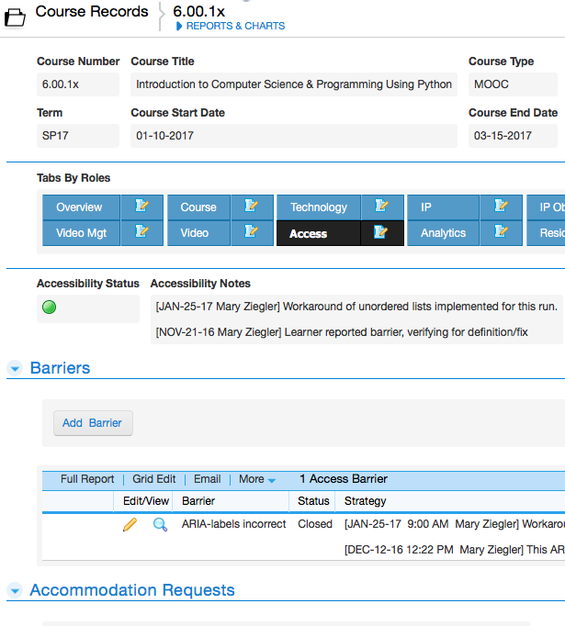
Tracking Course Accessibility
Course database includes sections on accessibility:
Status
Barriers
Requests

Slide 22
Engage with Learners with Disabilities
Goal
Strategies
Partners
Engage with learners with disabilities who request accommodation or report a barriers to access in support of commitment to accessibility and equal access
Commitment statement
Process for learners to follow: individualized, confidential, timely resolution
Responsibilities: learner, course teams, accessibility
Balance ADA obligations, academic integrity, and technical feasibility
Learners (initiate)
MIT Student Disability Services
MITx Course teams
As Needed
Platform/EdX
Ed Techs
Engineering
MIT Accessibility and Usability
22

Slide 23
Process for Engaging Learners
Step 2. Initial Reply / Message to Learner
Step 1. Request Received by EdX or MITx
Step 4. Response/ Solution Agreement
Step 0. Accessibility Information in Course
Step 5. Inform Learner / Implement Solution
Step 6. Documentation and Feedback
Step 3. Intake and Assessment
Notes:
“The MITx Commitment to Accessibility: If you have a disability-related request regarding accessing an MITx course, including exams, please contact us …”
Step 0. Accessibility Information in Course. Have a MITx commitment.
Step 2. Initial Reply / Message to Learner
Step 3. Intake and Assessment
Step 4. Response/ Solution Agreement
Step 5. Inform Learner / Implement Solution
Step 6. Documentation and Feedback

Slide 24
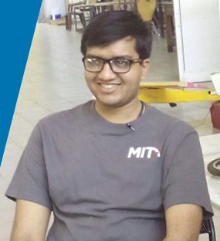
Learner data and stories
Confidentiality limits sharable data
Learners express gratitude and appreciation
As exams are limited by time or process (proctoring) requests for exam accommodations increase
Some learners share their stories: “The accessibility of the courses makes edX the perfect platform for me to learn about my interests.” Bhargav on blog.edx.org
Organizations creating pipelines for learners with disabilities

Slide 25
Innovate for Inclusion
Goal
Strategies
Partners
Identify opportunities to integrate accessibility into innovations to increase access and inclusion
Collaborate on projects with developers, research, industry, education, resource development to integrate accessibility
Open Learning leadership
Platforms edX
W3C Web Accessibility Initiative
Engineering
Educational Technologists
Instructional Designers
Learning Scientists
Faculty
Research and Industry

Slide 26
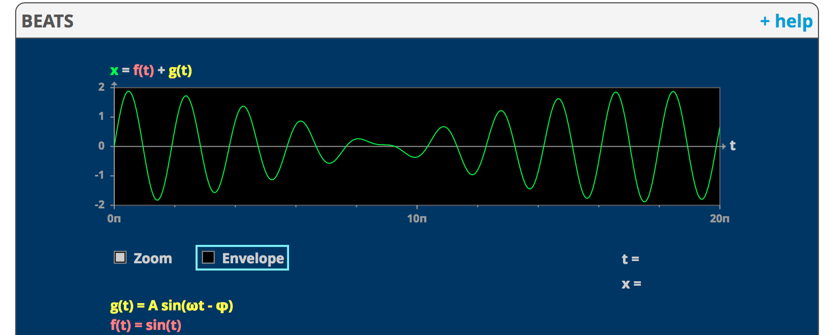
Innovation Example
MIT Mathlets – mathlets.org
- Keyboard accessible simulations; screen reader access coming

Slide 27
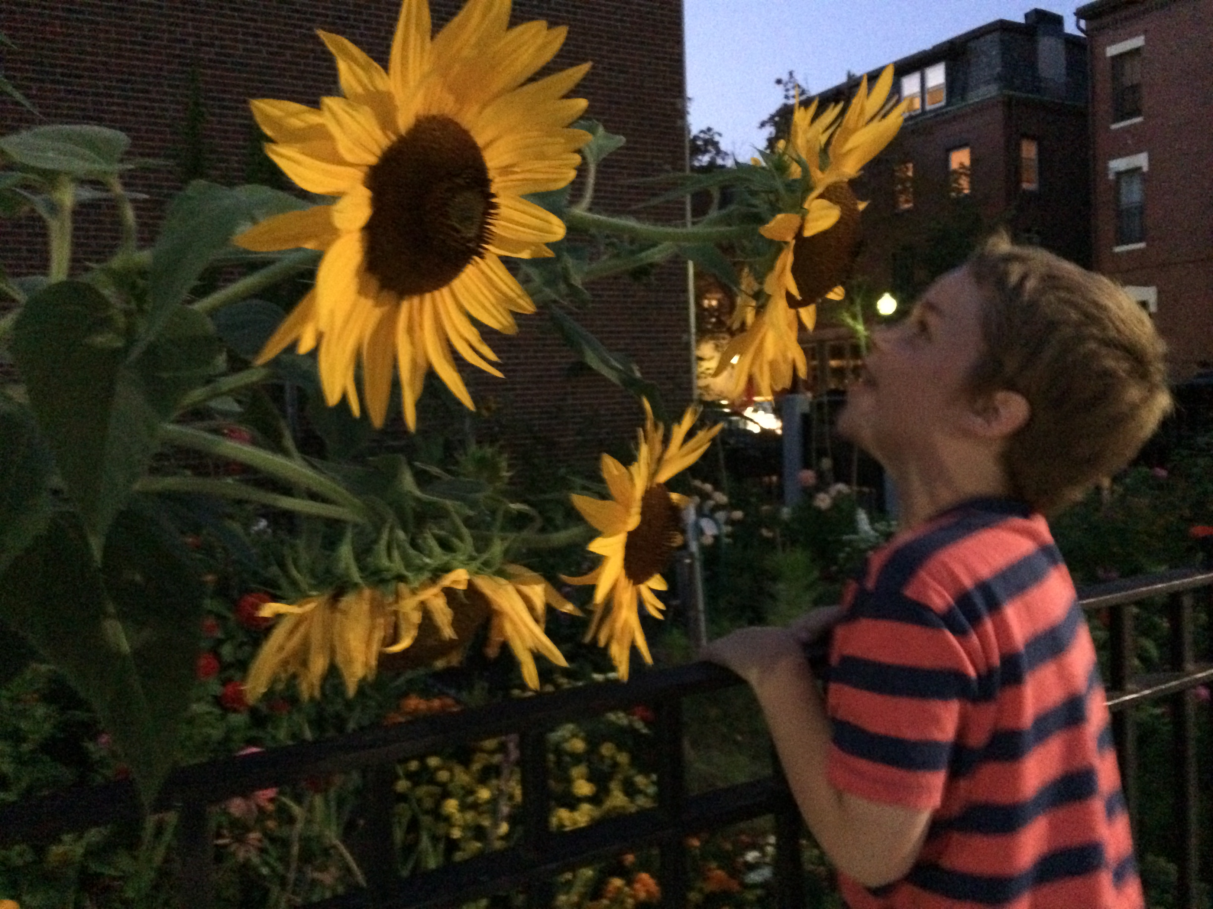
3. Future Gardens to Grow
Acknowledge and share gaps
Define your field of progress

Slide 28
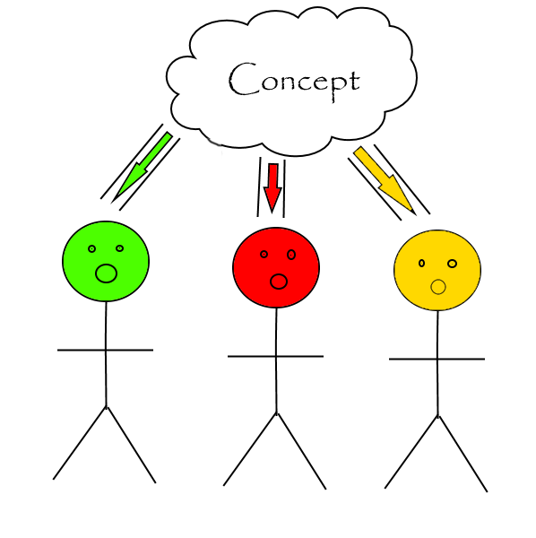
Recognize complexity of designing content for diverse learners
What is essential to access to learning and demonstration of knowledge?
Partner with educators, technology experts, learners, and more…
Graphic courtesy of grbcoolkid

Slide 29
Define accommodation broadly
“Accommodation is the most basic act and art of teaching. It is not the exception we sometimes make in spite of learning, but rather the adaptations we continually make to promote learning.”
Teaching is Accommodation, Anne-Marie Womack

Slide 30
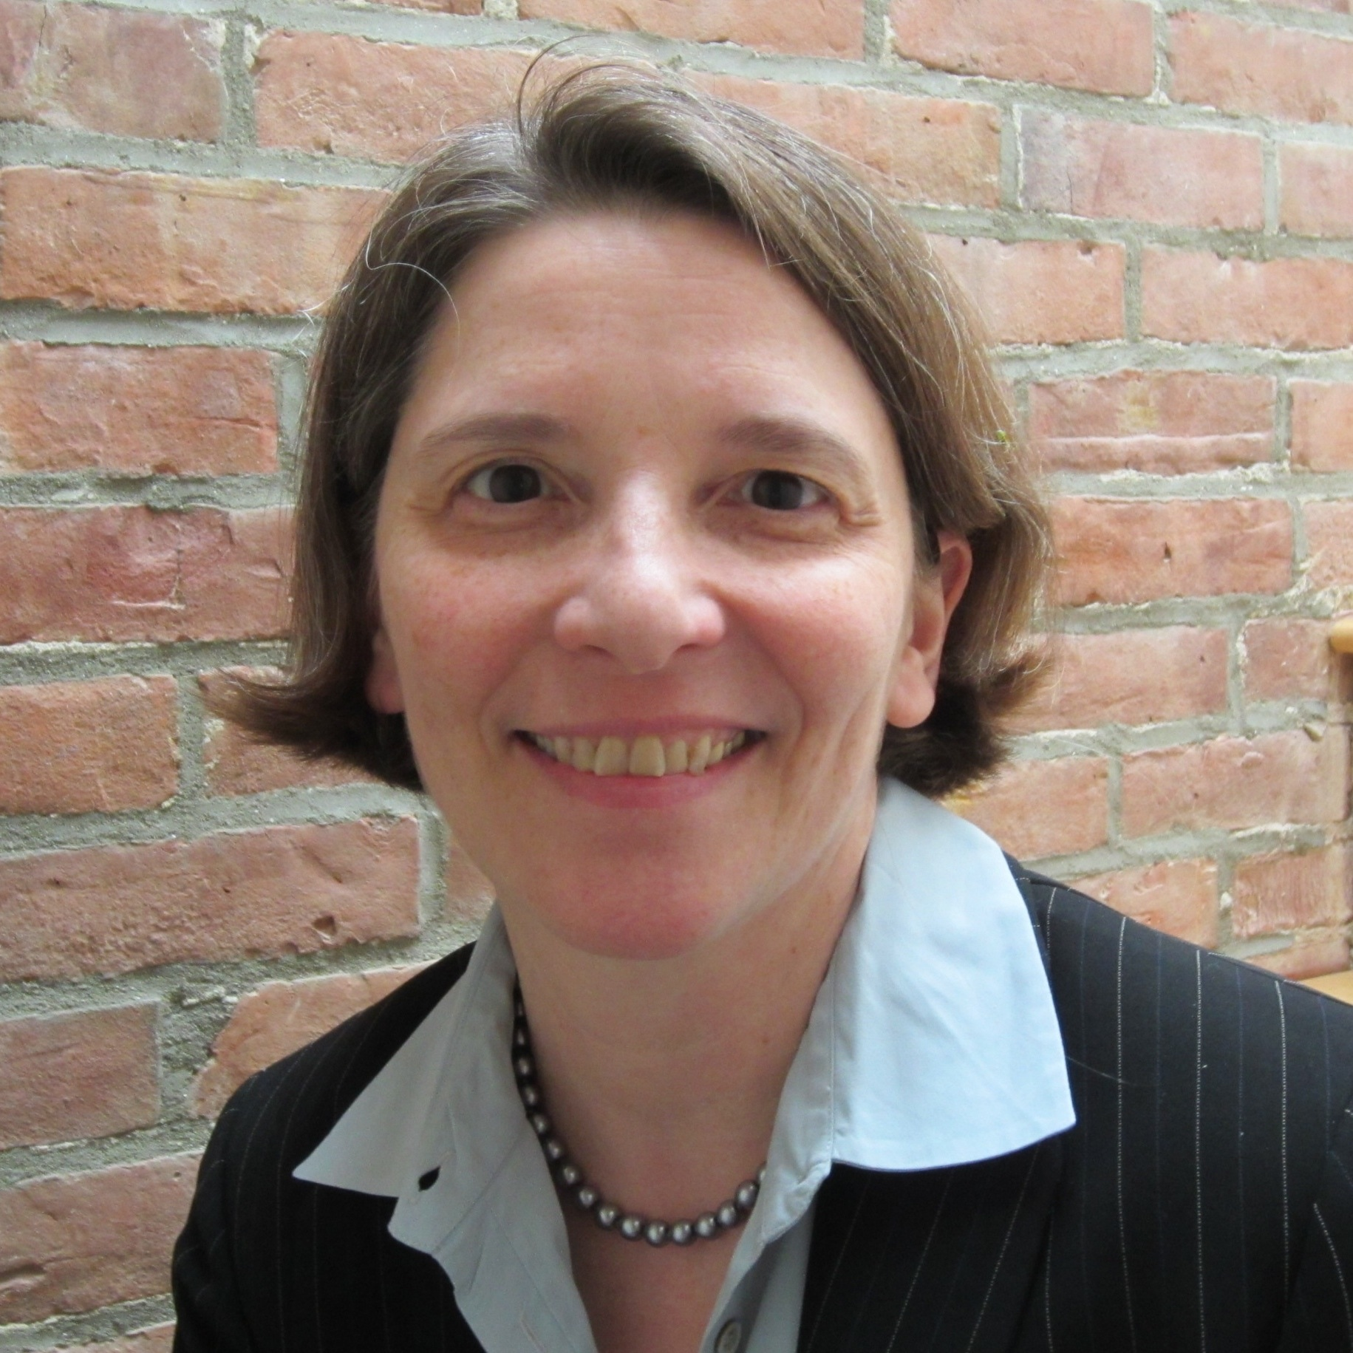
THANKS!
Questions?
Ideas?
Mary J. Ziegler
maryz@mit.edu
@youhavetime (twitter)

Slide 31
References
Class Central MOOC Stats https://www.class-central.com/report/mooc-stats-2016
Anant Agarwal on edX (video) http://www.wcvb.com/article/bargains-edx/13048356
David Wiley and George Siemens, Introduction to Open Education MOOC https://courses.edx.org/courses/course-v1:UTArlingtonX+LINK.OEx+3T2017/course/
The Vanishing University series Quartz September 2017 https://qz.com/1050869/the-college-lecture-is-dying-and-good-riddance/
“Online courses paved the way to MIT graduation” MIT News June 6 2017 http://ow.ly/T8kg30coDVj
MITx Course Just Money https://www.edx.org/course/just-money-banking-if-society-mattered-mitx-11-405x-0
Using Python to Develop Screen Reader Features – Meet Bhargav https://blog.edx.org/using-python-develop-screen-reader-features-meet-bhargav
VisionAid.org
NoticeAbility.org
MIT Mathlets http://mathlets.org
Anne-Marie Womack: “Teaching is Accommodation” http://www.ncte.org/library/NCTEFiles/Resources/Journals/CCC/0683-feb2017/CCCC0683Teaching.pdf

