Slide 1
It Takes a Village: Utilizing People, Systems, and Technology to Scale Online Course Accessibility Accessibility, Systems, and Technology to Scale Online Course Accessibility
Nancy Swenson, M.A.
Associate Instructional Designer
University of Central Florida
Notes:
Nancy:

Slide 2
Overview
Online Learning at UCF
Online Course Accessibility Support Model
People
Within Center for Distributed Learning
Collaborations across campus
Systems and Technology
Executive Information System (EIS)
Google Docs (Form B and D)
UDOIT
Quiz Time Extensions
VAST
3Play Media

Slide 3
Center for Distributed Learning
Central agent for online learning
Support online and mix-mode courses at the university
Teams
Instructional Designers
Webcourses@UCF Support
Techrangers
Learning Systems & Technology
Graphics
Video

Slide 4
Online Learning at UCF
Total University Headcount (Fall 2017): 65,699
Academic Year 2016-2017
42.2% total university SCH online/blended
32.5% fully online SCH
81% of all students took at least one online/blended course
83.7% of all undergraduates
62.8% of all graduate students
72% of all students took at least one fully online course
74.9% of all undergraduates
52.6% of all graduate students
Notes:
Predicting an 8% growth per year.

Slide 5
UCF SAS Connected Stats Spring 2017
Notes:
Nancy

Slide 6
UCF SAS Connected Stats Spring 2017
Notes:
Nancy

Slide 7
UCF SAS Connected Stats Spring 2017
Notes:
Nancy

Slide 8
UCF SAS Connected Stats Fall 2016

Slide 9
UCF Accessibility Policy
No institutional accessibility policy
Provost e-mail
Syllabus statement
Professional development is mandatory to teach online
Faculty are responsible for developing online course content

Slide 10
Notes:
Kathleen

Slide 11
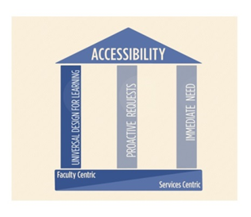
Universal Design for Learning
Enable faculty to apply Universal Design for Learning (UDL) principles when developing new online courses
Address the needs of diverse learners
Less time spent retrofitting courses when accommodation requests are received
All students benefit (e.g., ESOL students
benefit from video captions)
Notes:
Kathleen
All students benefit from UDL; allows student accessibility services to concentrate on more targeted needs (for individuals); e.g., provide for a live captioner for a synchronous online presentation
Captions: TV – largest percent of people using captions are ESOL; also benefits library, mobile

Slide 12
Integrate UDL in Professional Development
Integrate UDL in IDL6543
Addressed throughout the course
Online module on accessibility and UDL
Accessible Content Formatting Guidelines
Instructional design consultations
Module and course rubrics
Peer review
Notes:
Kathleen

Slide 13
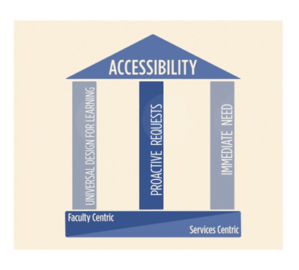
Proactive Requests
Legacy courses and faculty
Attended faculty development years ago
Designing and developing courses for years
Adding their own content
Documents
Images
Media
Notes:
Kathleen
Middle Pillar

Slide 14
Proactive Requests
Faculty member requests course review for accessibility
Instructional designer recommends course review for accessibility
Run UDOIT
Performed by usability checker
Report provided to ID
ID and faculty member develop strategy
IDL7000
UDOIT
Quality Course Design Check
Quality, High Quality, Exemplary
Notes:
Kathleen (John will discuss the last pillar – Immediate Need)

Slide 15
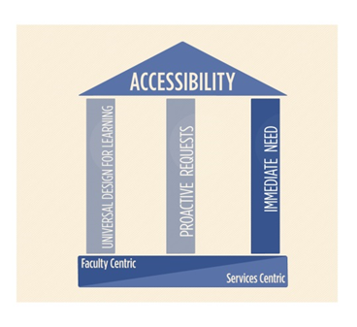
Immediate Need
Addresses student needs currently enrolled in a course
Some course materials may not yet be accessible
Developed workflow to address this specific need area
Notes:
John

Slide 16
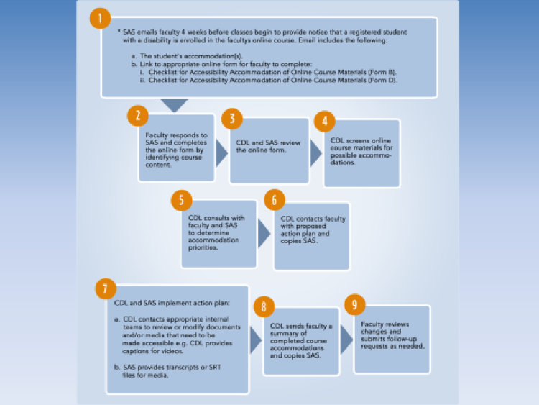
Immediate Need
CDL developed accommodation workflow
Identified tasks and responsibilities of CDL, SAS, faculty
Identified CDL teams that would make the accommodations
Identified CDL point person to coordinate all efforts inside and outside the unit
Notes:
John

Slide 17
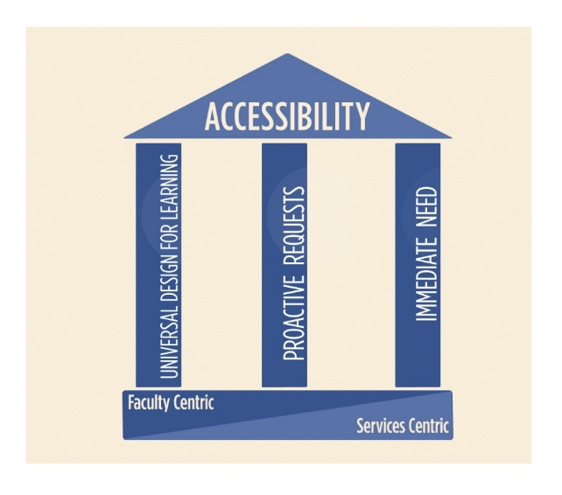
Benefits of Online Course Accessibility Support Model
More efficient in meeting the needs of students with disabilities
Improved Communication Across Campus
Regular meetings
Within CDL
All units who support faculty to discuss accessibility
SDS, CDL, Faculty Center for Teaching and Learning, and Office of Instructional Resources
Benefits of meetings
Identify potential problem areas
Improve processes
Increase efficiency
Increased Faculty Awareness

Slide 18
Technology to Scale Online Accessibility
Executive Information System (EIS)
Collection of accessibility statistics
Google Docs (Forms B and D)
Created VAST
Video Accessibility Scanning Tool to check courses for media
Use of 3PlayMedia
To caption instructional videos created by CDL
Development of Faculty Self-Service Tools
UDOIT
Quiz Extensions
UCF AblePlayer

Slide 19
Executive Information System (EIS)
Add accessibility information to existing reporting system
SAS provided access to data
Paired enrollment, faculty records, student disability/accommodation information
Ability to generate charts/graphs and track over time
Efficient and secure transfer of sensitive information

Slide 20
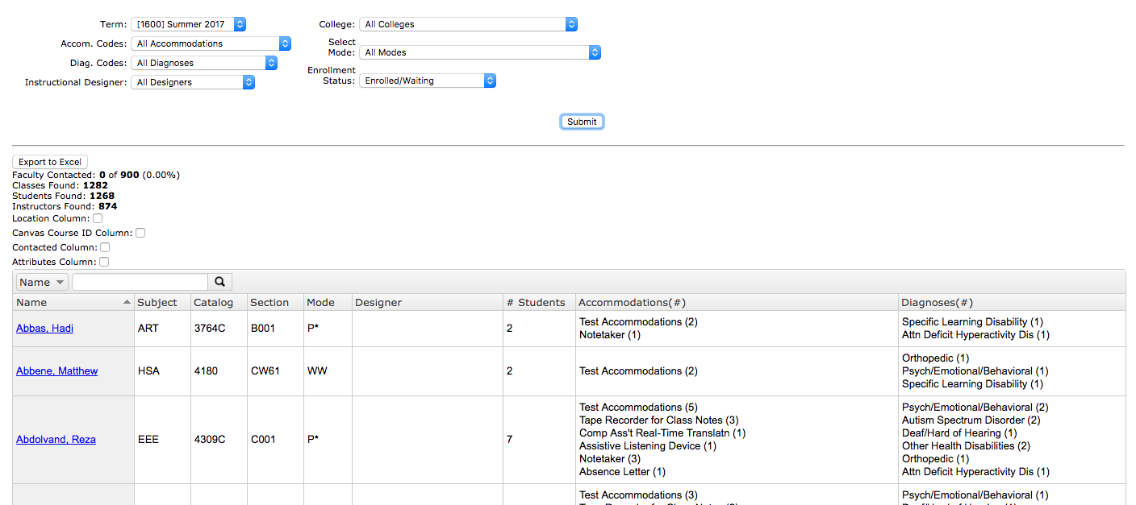

Slide 21
VAST Media Scanner
Canvas only
Python script scans courses of DHH students
Identifies media in courses:
External Video (YouTube/Vimeo)
Media files uploaded (SWF, MP4, MP3, etc)
URLS from customizable list.
Provides location
YouTube/Vimeo will check if captions are present via APIs

Slide 22
Captioning
Contracted with 3Play media to caption existing online course videos hosted on Vimeo. Paid by DL fee.
Used Vimeo API to check for captions, calculate length of video, download, and upload caption track
Bulk upload to 3play via FTP
Download text transcripts, captions in .SRT and .VTT
Upload captions to Vimeo via API.

Slide 23
Quiz Extensions
5 students, 15 quizzes
Calculate “double time”
5-7 clicks per student, per quiz
Minimum 375-400 clicks to add all extensions to course
Quiz Extensions reduces to 7-10 clicks
Notes:
Example: online anthropology course,

Slide 24
Quiz Extensions
One stop shop to add more time to all existing quizzes/tests
Custom LTI developed for Canvas
Pilot Spring 2016, launched Summer 2016
Overwhelming positive faculty response
In process of open sourcing

Slide 25
Quiz Extensions Stats Spring 2017
317 courses used Quiz Extensions
1115 extensions were provided to students
834 unique students had extensions
4285 quizzes had extra time applied
Notes:
Reduced clicks from

Slide 26
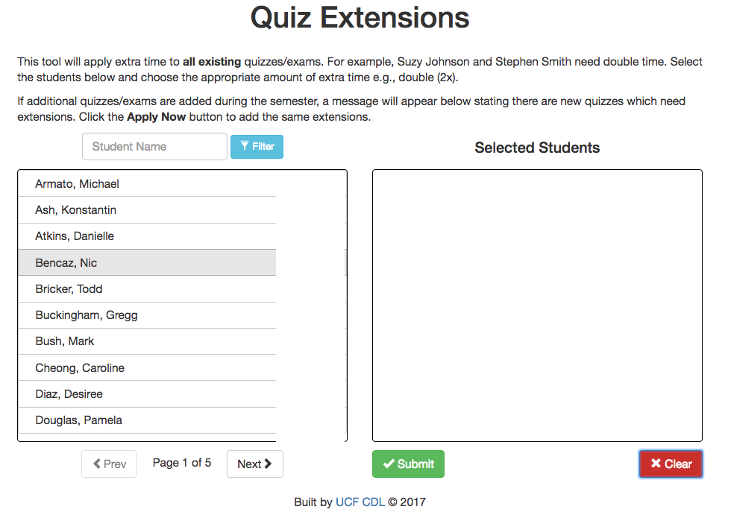

Slide 27
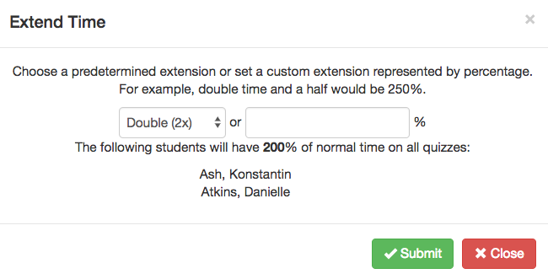

Slide 28
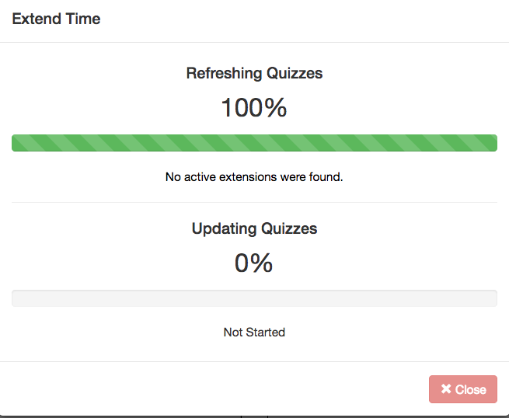

Slide 29
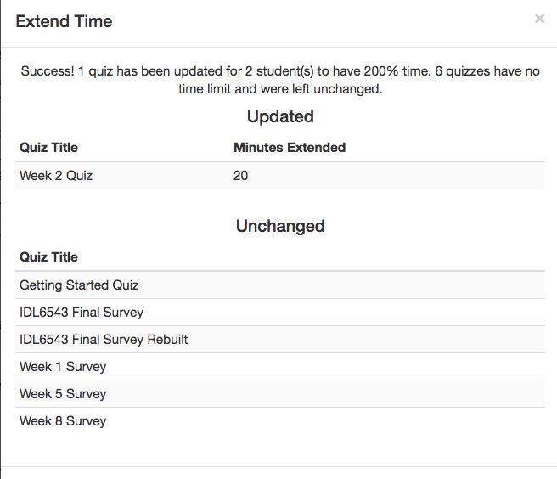

Slide 31
Accessibility Media Embedder
Issue: providing captions for 3rd party YouTube videos
Solution: adapted open source video player player to work inside of LMS (Canvas, Blackboard, D2L, Moodle)
Creating an LTI to embed player in LMS
Caption file hosted in database and overlaid with video.
Based on Able Player: https://github.com/ableplayer/ableplayer
Notes:
Around 6000 unique videos of Youtube videos in Canvas. 10% had english real captions

Slide 32
UDOIT
Universal Design Online content Inspection Tool (The ‘c’ is silent)
Scans course for common accessibility errors and generates report
UFIXIT: Allows faculty to fix most on the spot
Educates faculty – links to authoritative resources
Released open-source May 2015
Only works for Instructure Canvas
Open source
GPLv3 license
GitHub

Slide 33
UDOIT
What does it check?
Use of headings in page structure
Alternative text for images
Table headers
Color contrast
Video captions

Slide 34
UCF Resources
UCF Provost letter
Accessible Page Formatting Guidelines
Faculty Seminars in Online Teaching
CDL's Professional Development Offerings
UDOIT

Slide 35
UDL Resources
DO-IT & The Center for Universal Design in Education
Universal Design in Education: An Online Tutorial
Universal Design in Education: Principles and Applications
Checklist for Inclusive Teaching
CAST
UDL Guidelines Version 2.0
UDL On Campus: Universal Design for Learning in Higher Education
WebAim
UDL: Universe: A Comprehensive Universal Design for Learning Faculty Guide
EnACT UDL Syllabus Rubric
UNC: Center for Universal Design
UDL: A Systematic Approach to Supporting Diverse Learners
IT Accessibility Policies in Higher Education

Slide 36
Thank you for being here!
Contact info:
Nancy Swenson
nancy.swenson@ucf.edu
John Raible (EIS, Media Embedder, Quiz Extensions)
john.raible.@ucf.edu
Jacob Bates (UDOIT)
jacob.bates@ucf.edu

