Slide 1
Implementing GreyHeller PeopleMobile® in PeopleSoft Campus Solutions
Accessibility and Usability Project
11/15/2017

Slide 2
Agenda
Introduction
Overview of PeopleMobile project at CU
Accessibility testing process / results
Example screenshots
Questions & Answers

Slide 3
Introduction

Slide 4
University of Colorado
CU is a four campus system with Boulder, Colorado Springs, Denver and Anschutz Medical Campus
Aggregate enrollment over 64,000 students
Nearly 32,000 faculty and staff
Presenting today:
Art Figel, UIS Assistant Director of Student Systems
Brad Baker, UIS Assistant Dir of Student System Development
University Information Systems (UIS) within CU System office
Jennifer Goncalves, GreyHeller, Senior Director of UX

Slide 5
PeopleSoft Campus Solutions at CU
CU Implemented PeopleSoft Campus Solutions as an enterprise student information system in 2010, currently on version 9.0. Commonly referred to as CU-SIS.
Additional PeopleSoft applications in use at CU include Portal, HCM, FIN and CRM
University Information Systems (UIS) maintains and supports CU’s enterprise PeopleSoft applications
The Boulder Accessibility and Usability Lab (AUL) provides testing and evaluation of IT solutions, including Campus Solutions for usability and accessibility.

Slide 6
Campus Solutions and Accessibility
Student self service functions in Campus Solutions have several accessibility and usability challenges
Challenges include a lack of Aria attributes, highly complex pages, visual navigation and layout
In 2014, CU Boulder received a Department of Justice inquiry requesting information about possible ADA non-compliance
In response, CU Boulder launched a project that resulted in organizational structure changes, new policies, better communication and remediation of issues.
CU System (UIS) has been a partner in the evaluation of enterprise system accessibility and efforts to improve accessibility, including PeopleMobile.

Slide 7
Campus Solutions and Accessibility
Initial Campus Solutions accessibility remediation effort
External accessibility review by The Paciello Group from January thru April 2015
Initial CS remediation project from May 2015 thru May 2016
The initial project focused on PeopleSoft customization to mitigate accessibility issues
This was a challenging process due to automatically generated HTML
Multiple improvements deployed, but fundamental issues still remained
For example: complex page layout, lack of accessibility-focus on HTML, non-standard navigation remained

Slide 8
PeopleMobile AT CU
Overview of CU’s PeopleMobile project

Slide 9
GreyHeller Peoplemobile at CU
Beginning June 2016, CU worked with GreyHeller to evaluate and prototype a unique accessibility solution: PeopleMobile
What is PeopleMobile?
PeopleSoft add-on providing user experience, accessibility and mobilization improvements
Automatic transformation of PeopleSoft pages, includes configuration layer
No rebuild of standard PS pages required

Slide 10
GreyHeller Peoplemobile at CU
Why PeopleMobile?
Rapid deployment of accessibility improvement for Campus Solutions
Ability to completely transform the displayed content
Existing use of GreyHeller ERP Firewall, a part of PeopleMobile
Completed Proof of Concept from June – September 2016
The PeopleMobile implementation project began October 2016, completed May 2017
Ongoing improvements continue after project completion

Slide 11
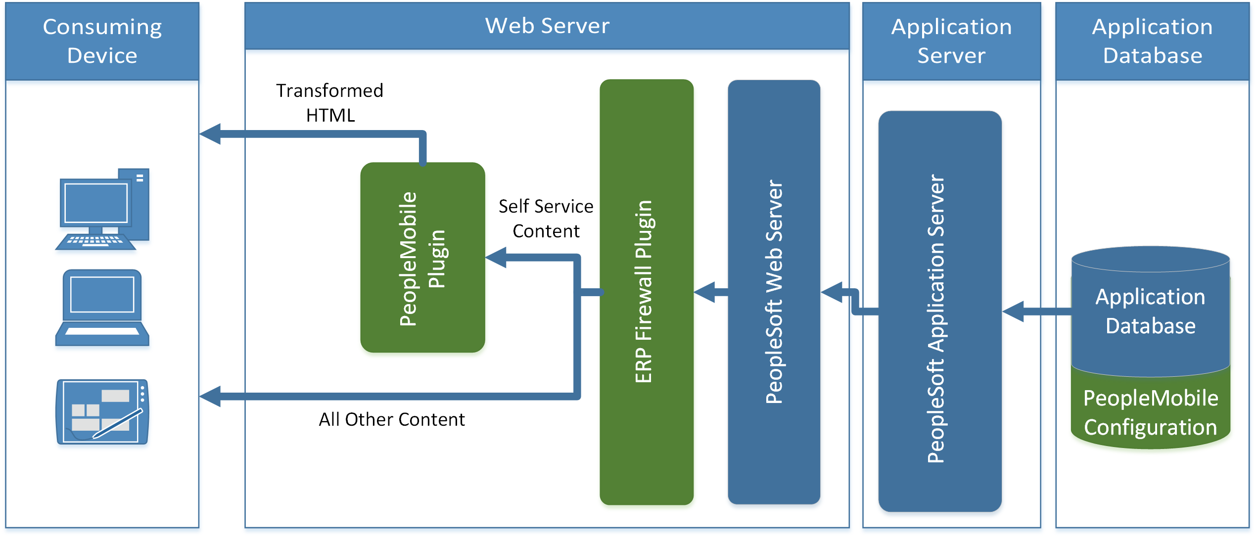
GreyHeller PeopleMobile Architecture
Operates as web server addon, in conjunction with ERP Firewall to transform PeopleSoft HTML. ERP Firewall filters for self-service content.

Slide 12
GreyHeller Peoplemobile at CU
Project process
Identified self service use cases in four groups:
Group1: Core functionality and Student Records enrollment
Group2: Other Student Records functions
Group3: Bio/Demo information
Group4: Financial Aid and Student Financials
Installed PeopleMobile in Campus Solutions
GreyHeller staff implemented transformations for use case groups 1, 2 and 3
CU Development staff implemented transformations for use case group 4

Slide 13
GreyHeller Peoplemobile at CU
Project process, continued
GreyHeller’s ERP Firewall product used to enable Peoplemobile in Self-service, not on administrative pages
Technical updates implemented:
PeopleSoft Message Catalog changes to support new interface
PeopleSoft Navigation Collections to customize tile navigation
Some PeopleSoft page and PeopleCode changes to improve automatic transform (Perkins Loan pages)
Accessibility improvements and technical fixes from the project included in future GreyHeller PeopleMobile builds

Slide 14
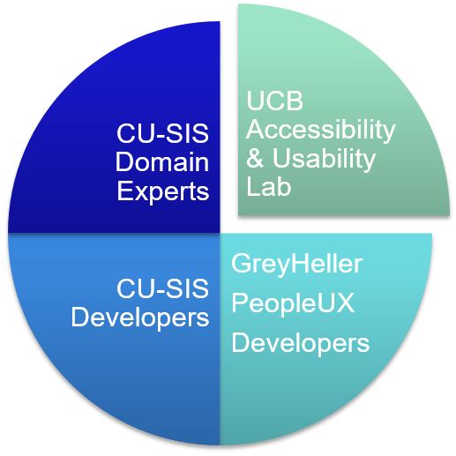
GreyHeller Peoplemobile at CU
Several teams were involved in the project, including:
CU-SIS domain experts, developers, Accessibility/Usability Lab and GreyHeller

Slide 15
GreyHeller Peoplemobile at CU
Functional testing
CU-SIS Domain Experts within UIS and at CU campuses provided in-depth testing
Development support
GreyHeller implemented PeopleMobile and primary use cases
CU-SIS Developers provided unit testing, related development support and additional use case development
Level of Effort varied based on use case:
GreyHeller use cases deployed quickly, less CU work
The CU-SIS supported use cases took longer than anticipated

Slide 16
GreyHeller Peoplemobile at CU
Accessibility testing
GreyHeller provided browser tool accessibility tests using: Chrome Add-On Axe, Chrome Add-On Audit, FireFox Add-On AInspector
CU Boulder Accessibility and Usability Lab provided detailed testing of all use cases for usability in actual system use. Tools used in AUL testing:
Windows 10 with Windows Magnifier (200%) / Microsoft Edge
Windows 10 with NVDA / Mozilla Firefox
Windows 10 with JAWS 18 / Mozilla Firefox

Slide 17
GreyHeller Peoplemobile at CU
Accessibility testing:
Partnered with UCB Accessibility and Usability Lab (AUL) for independent evaluation
Discovered new issues and added fixes to PeopleMobile
Increased expertise screen readers and accessibility tools
Access to screen readers like JAWS and NVDA helps when developing accessibility solutions

Slide 18
Accessibility Testing
Summary of accessibility testing process for the project

Slide 19
Browser Tools Test Results
Sample of Browser Testing provided by GreyHeller for CU’s PeopleMobile
Self Service: Add Classes to Cart
Test Tool | Desktop | PeopleMobile | Improvement
Chrome: Axe | 7 violations | 2 violations | 71.42%
Chrome: Audit | 4 severe violations | 0 severe violations | 100.00%
Chrome: Audit | 4 violation warnings | 1 violation warning | 75.00%
Chrome: Audit | 16 passed tests | 23 passed tests | +7 tests
Firefox: AInspector | 9 violations | 1 violation | 88.88%
Firefox: AInspector | 3 violation warnings | 2 violation warnings | 33.33%
Firefox: AInspector | 17 passed tests | 25 passed tests | +8 tests
Self Service: Class Search
Test Tool | Desktop | PeopleMobile | Improvement
Chrome: Axe | 5 violations | 0 violations | 100.00%
Chrome: Audit | 4 severe violations | 0 severe violations | 100.00%
Chrome: Audit | 4 violation warnings | 1 violation warning | 75.00%
Chrome: Audit | 17 passed tests | 23 passed tests | +6 tests
Firefox: AInspector | 7 violations | 1 violation | 85.71%
Firefox: AInspector | 3 violation warnings | 2 violation warnings | 33.33%
Firefox: AInspector | 16 passed tests | 25 passed tests | +9 tests

Slide 20
AUL Test Results
Testing spanned all use cases in student self-service
Broad testing identified misconfigurations and page-specific issues that had not been reported previously
Sample of AUL results and improvement in Student Records use cases:
Severe issues (make system inaccessible): 2 issues, both fixed
Significant issues (make system difficult to use): 17 issues, 6 fixed
Usability issues (make system less intuitive to use): 12 issues, 6 fixed
The above counts are after PeopleMobile, with fixes applied during the project, prior or after go-live
Remediation is ongoing for remaining issues

Slide 21
AUL Test Results
Severe issues:
Collapsible/expandable sections: Lack of heading text, lack of current status: Expanded or collapsed
Date Picker: Original format as javascript popup, changed to browser native
Other notable issues:
Clickable read on static text throughout application
Heading levels in page header vs page content
Focus management and announcing content changes
Functional issue tracking:
149 total issues: 135 resolved and 14 outstanding

Slide 22
Improvement following AUL testing
Several system wide issues were discovered and improved after AUL test feedback:
Color contrast improvements for gridlines, radio buttons, and other elements
Date Picker control improvements: Using browser controls
Collapsible section improvement
Page alert text reading redundantly in screen reader
Navigation role for the new navigation control
Improvement to Weekly Schedule display
Improvement to on page text, link labels, other items

Slide 23
Outstanding Issues from AUL
Remediation for AUL feedback continues, with some outstanding issues such as:
Row headers on tables needed, challenging to add
Understand screen reader announcement of page changes, and deploy improved page announcements
Improve loading or waiting feedback/display
Improve the progress bar to remove apparent links

Slide 24
Examples
Screenshot samples of PeopleMobile transformations

Slide 25
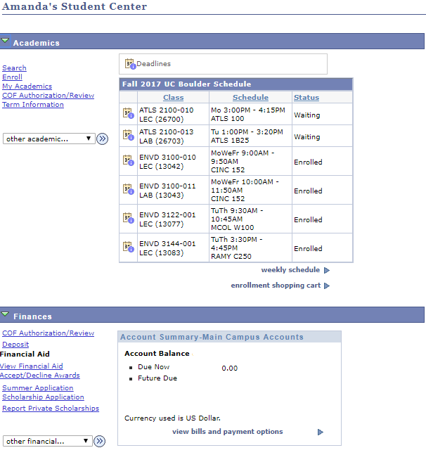
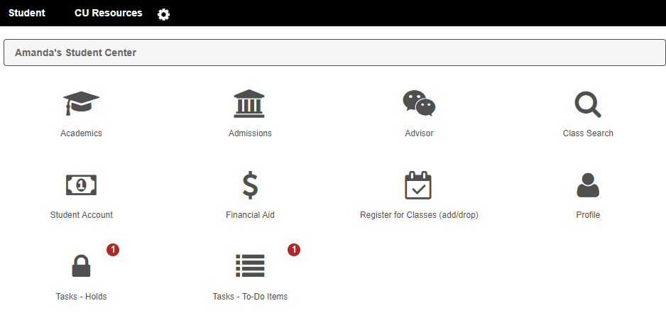
Student Center Tiles
Notes:
--Student center content grouped into tiles by topic

Slide 26
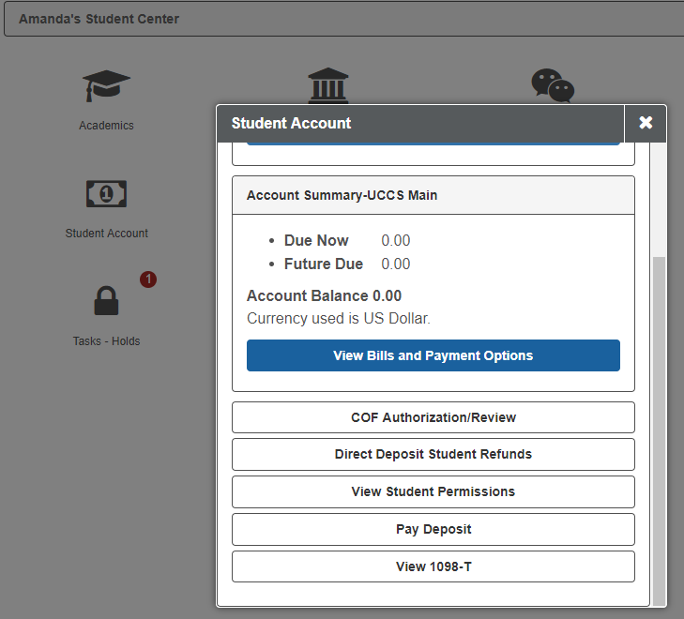
Student Center Content
Notes:
--Example of student account/finances tile, showing the account summary and links from the student center page

Slide 27
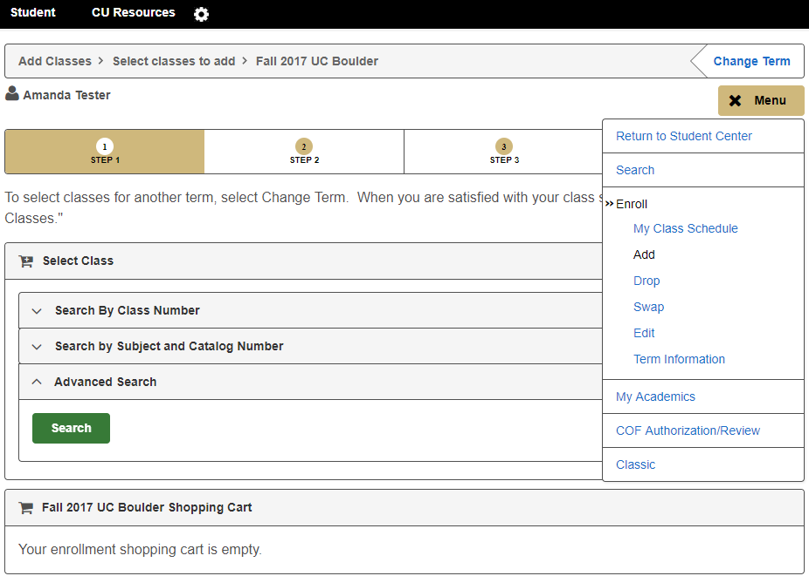
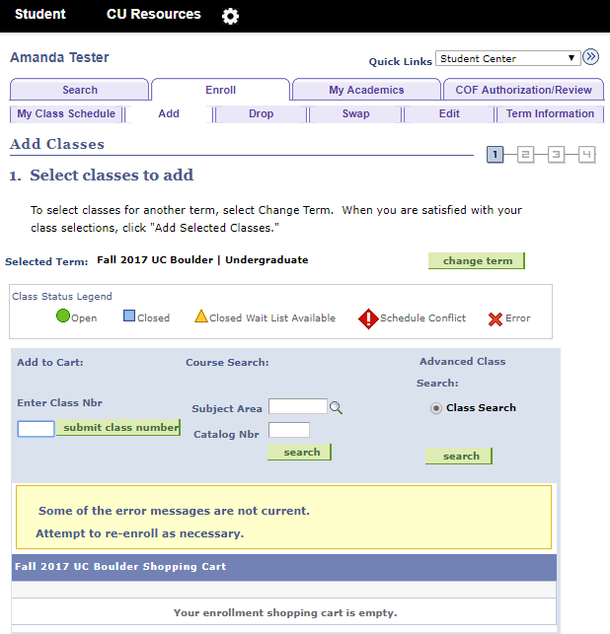
Enrollment: Adding Classes
Notes:
--Add classes example: Note grouping of content into collapsible sections, prominent step indication, and transformation of tabbed navigation to an expandable menu

Slide 28
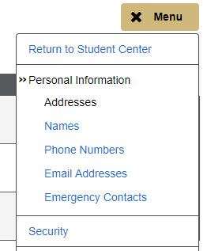
Navigation Improvement
Original internal navigation was visual layout of table and images
PeopleMobile transformation includes list of links in a list with navigation ARIA role

Slide 29
Collapsible Sections
In PeopleMobile, groups or sections on the page can be added to “collapsible sections”.
Originally, there was no text indication of current status or the effect of clicking on the control, as identified by AUL.
Improvement included hover text and aria-label indicating a click will collapse/expand. Tested in JAWS prior to rollout.

Slide 30
Conclusion
Summary of accessibility testing process for the project

Slide 31
Current Status – Going Forward
Some aspects were challenging such as:
Some issues required complex PeopleMobile page configuration logic
Performance is slower due to transformation, work continues to improve performance
Compatibility: encountered issues on certain devices and browsers
Issues working with certain browsers and screen readers, older JAWS versions
jQuery challenge for screen readers: Clickable issue

Slide 32
Current Status – Going Forward
Mobile Application:
After PeopleMobile project deployment, the interface was included in CU’s Student Mobile Application
Staff Training:
Ongoing training for development staff to understand the transformation process and code
Campus Solutions 9.2 and Fluid
Currently working on the CS 9.2 upgrade, and evaluating deployment or transformation of Fluid UI pages.
Consistent look and feel is a benefit of PeopleMobile in CS 9.2
Notes:
Fluid is PeopleSoft’s native solution for accessibility and mobilization

Slide 33
Questions?
Contact Information
Brad Baker: brad.baker@cu.edu
Art Figel: art.figel@cu.edu
Jennifer Goncalves: jennifer.goncalves@greyheller.com
GreyHeller PeopleMobile
CU Boulder AUL

