Slide 1
Analysis of Website Compliance of Foundations in Engineering Courses
Liz Spingola
lizsping@vt.edu
Virginia Tech

Slide 2
Digitally mediated courses
Not totally online courses
Canvas
Not sole manner in presenting class materials

Slide 3
Higher education LMS market share 2013 (Dahlstrom, et al, 2014)

Slide 4
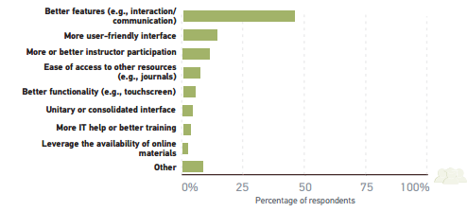
Student recommendations for improving the LMS if building it from scratch

Slide 5
WCAG
A
AA
AAA

Slide 6
What is the WCAG?
Guidelines
Legal
Compliance

Slide 7
Elements in the WCAG
Non-text content | contrast
focus order | link purpose
labels or instructions | error identification
parsing | name, role, value
Info and Relationships | timing adjustable
use of color | section headings
contrast | on input
images of text

Slide 8
Accessible Course Websites for Engineering
Minimal completely compliant
Minimal literature about accessable engineering course websites
Difficulties with different formats of classes

Slide 9
1215/1216
Small classes
One website per class
Instructors, Faculty, GTA
Notes:
class size of 30 means 67 sections of 1215 and 8 sections of 1216 in Fall

Slide 10
Content in engineering classes
Labs
Computer coding
Circuits
Free body diagrams
Formulas
Videos
Graphs
Statistics

Slide 11
For this Study
reviewed 11 instructors
25 sections
out of: 30 instructors in 75 sections

Slide 12
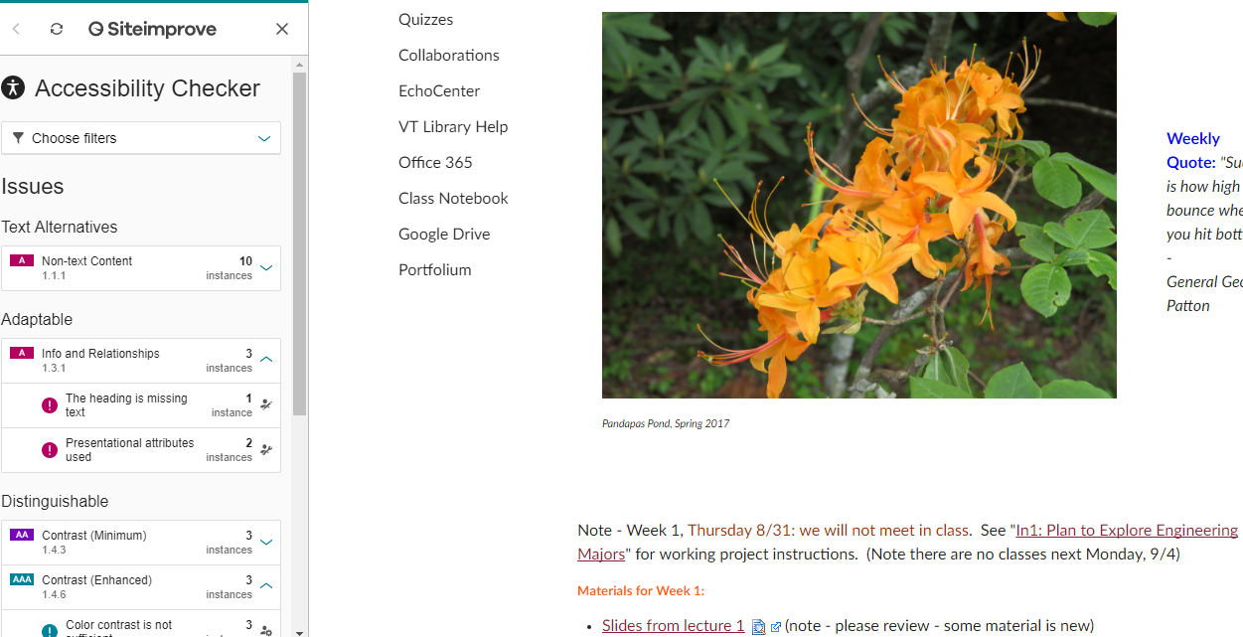
Canvas Website
Notes:
Screen shots from Ken

Slide 13
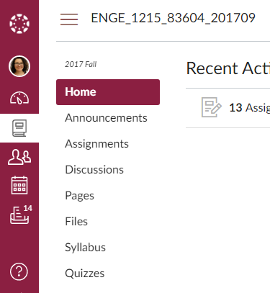

Slide 14
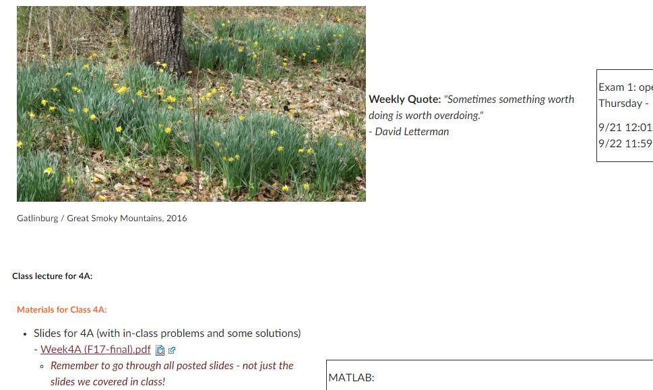

Slide 15
Working within Templates
What are your school/company colors?
Flexibility with using Cms systems (content management systems such as Drupal)
Working within an LMS (learning management system)

Slide 16
Exercise!
Group the Variables with the probable items that could contribute to producing more or less errors

Slide 17
Discuss
What did you find?
Based on your experience and knowledge what demographic elements will influence compliance to the WCAG

Slide 18
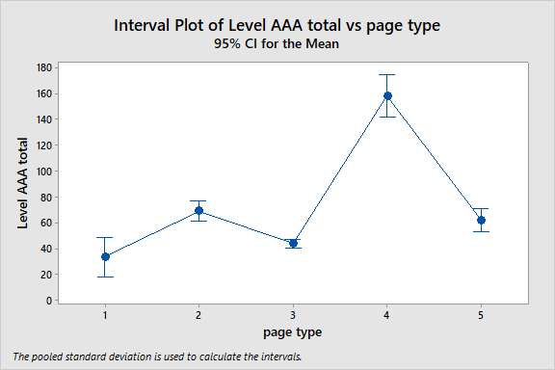
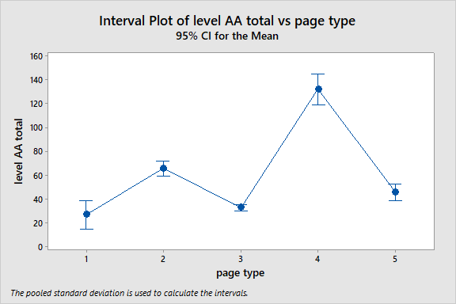
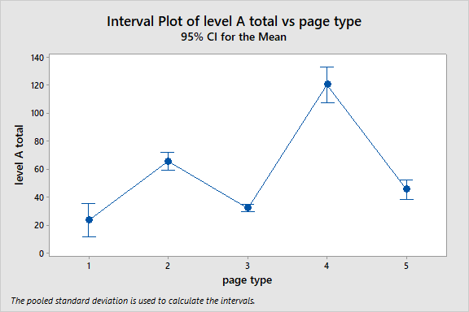
1= home 2 = assignments
3 = pages 4 = syllabus 5 = announcements
Notes:
Key to say what each page type is

Slide 20
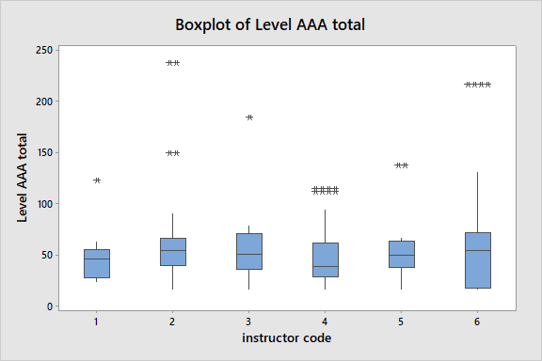

Slide 21
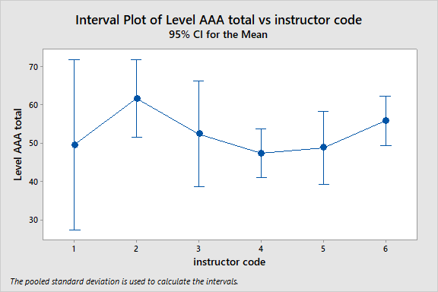

Slide 22
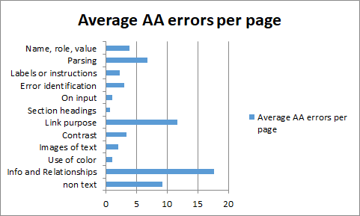

Slide 23
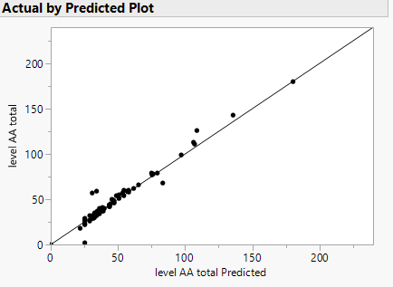
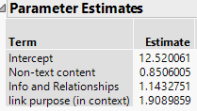
Notes:
R squared 0.96

Slide 24
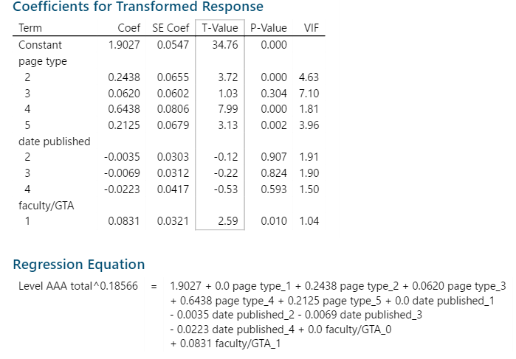
Notes:
30% predictive power

Slide 25
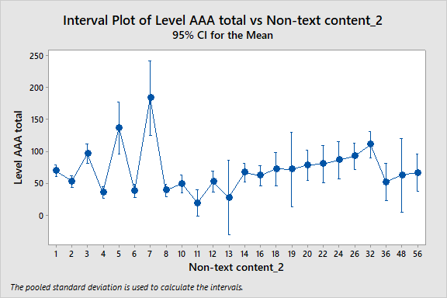
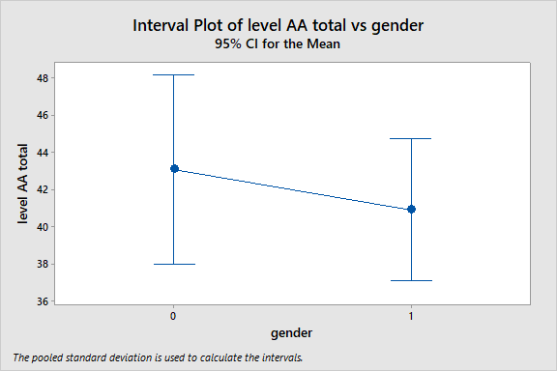
Notes:
No statistical difference

Slide 26
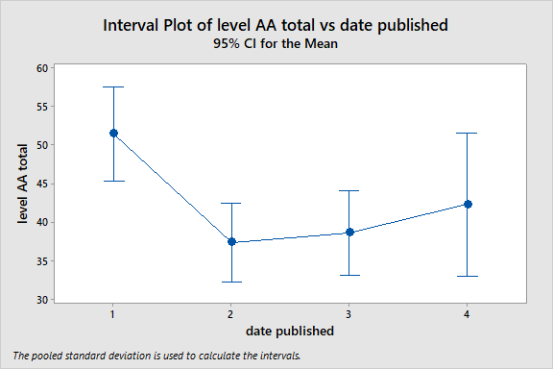
Notes:
1 and 2,3 are different
4 not different from ⅔ or 1

Slide 27
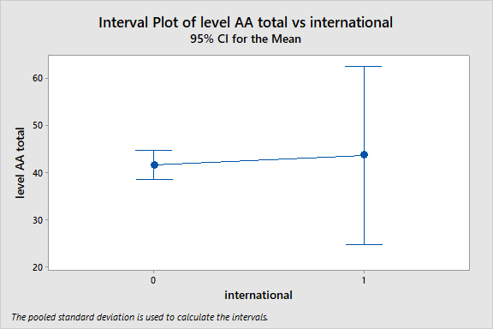
Notes:
No difference

Slide 28
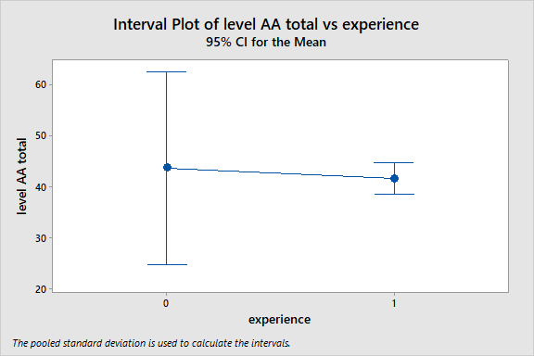
Notes:
No difference

Slide 29
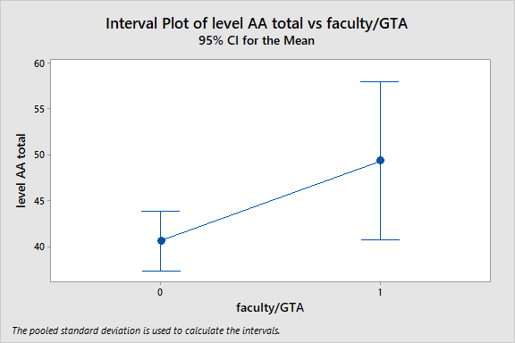
Notes:
0.06 p value

Slide 30
Differences?
What are some surprising aspects of the information presented?
What did you expect?

Slide 31
Criteria that were especially problematic
Links
Images
Relationships
Contrast

Slide 32
What Can We Do About It?
Training for both faculty and GTAs
Encourage to use automated scanners
Apps
UDOIT
Workshops
Continuing education classes
Creation of digital repositories of accessible engineering tools

Slide 33
Thanks!
Lizsping@vt.edu
Any Questions?

