Slide 1
Tips for Collaboration Between Disability & Technology Services
Sheryl Burgstahler
Director
Accessible Technology Services
UW-IT
Krista Greear
Assistant Director
Disability Resources for Students

Slide 2
Two UW Units
Accessible Technology Services (ATS), including
DO-IT Center
Access Technology Center
Disability Resources for Students (DRS)

Slide 3
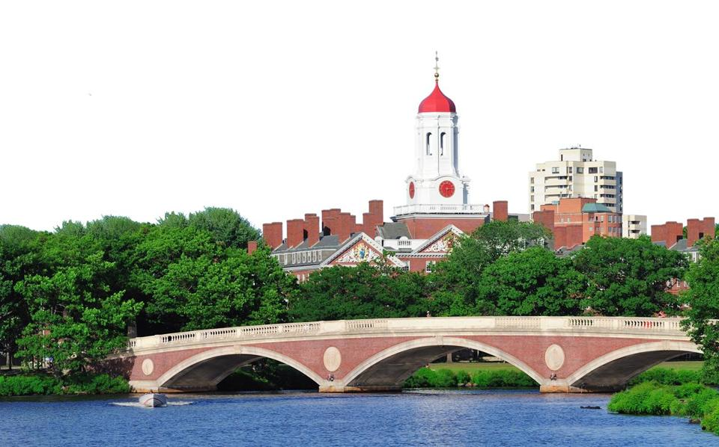
What do they have in common? www.uw.edu/accessibility
U of Cincinnati
Youngstown State U.
U of Colorado-Boulder
U of Montana-Missoula
UC Berkeley
South Carolina Technical College System
Louisiana Tech U
MIT
Florida State U
CSU Fullerton
Maricopa Community College District
California Community Colleges
Ohio State U
Harvard
…

Slide 4
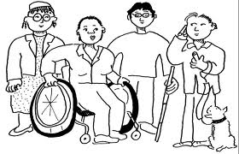
What is the Legal Basis?
Section 504 of the Rehabilitation Act of 1973
The Americans with Disabilities Act of 1990 & its 2008 Amendments
State & local laws & policies (e.g., WA Policy #188)

Slide 5
UW Policy – IT Accessibility
The University of Washington (UW) strives to ensure that people with disabilities have access to the same services and content that are available to people without disabilities, including services and content made available through the use of IT. IT procured, developed, maintained, and used by the UW should provide substantially similar functionality, experience, and information access to individuals with disabilities as it provides to others. Examples of IT covered by this policy include web sites, software systems, electronic documents, videos, and electronic equipment such as information kiosks, telephones, and digital signs.

Slide 6
UW’s IT Accessibility Guidelines
Purpose
Definition
Scope
Standards
Web Content Accessibility Guidelines (WCAG) 2.0 Level AA, World Wide Web Consortium (W3C)

Slide 7
UW’s IT Accessibility Guidelines cont
Progress and Plan
Resources
Resources and Support for IT Accessibility
Additional Campus Resources
Legal and Policy Requirements

Slide 8
WA Policy #188 – IT Accessibility
Establishes the expectation for state agencies that people with disabilities have access to and use of information and data and be provided access to the same services and content that is available to persons without disabilities.

Slide 9
What Does “Accessible” Mean?
“Accessible” means a person with a disability is afforded the opportunity to acquire the same information, engage in the same interactions, & enjoy the same services as a person without a disability in an equally effective & equally integrated manner, with substantially equivalent ease of use. The person with a disability must be able to obtain the information as fully, equally & independently as a person without a disability.
-DoJ OCR Resolutions

Slide 10
Consider Ability on a Continuum
see
hear
walk
read print
write
communicate verbally
tune out distraction
learn
manage physical/mental health

Slide 11
Approaches to Access
Accommodations
Universal/Inclusive Design
Both are important
in academia

Slide 12
Creating Accessible Documents*
Avg 231,759 files/quarter
2,318 hours to convert (100 pgs/hr for non-STEM)
290-8 hr days
23,176 hours to convert (10 pgs/hr for STEM and Braille)
2,897-8 hr days
45% of files are PDFs
18% of files are Document
23% of files are Image/Presentation
*based on data from A11y from Win 17-Fall 17

Slide 13
Creating Accessible Videos
 | Winter 2017 | Spring 2017 | Summer 2017 | Autumn 2017
Videos | 566 | 547 | 54 | 404
Hours | 703 | 554 | 105 | 333
Cost | $48,718 | $47,935 | $5,085 | $25,023

Slide 14
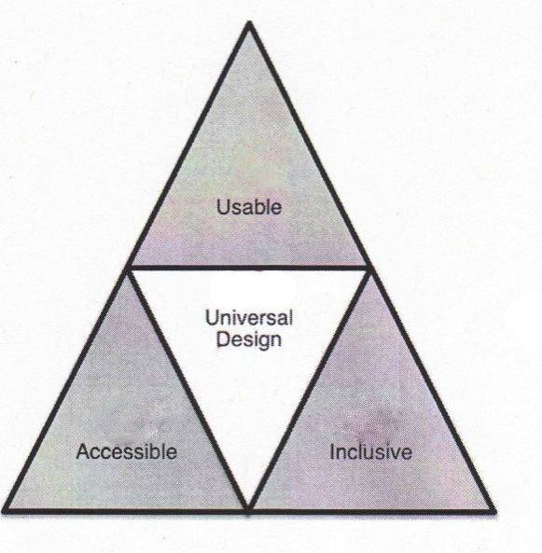
Universal Design
“the design of products & environments to be usable by all people, to the greatest extent possible, without the need for adaptation or specialized design.”
The Center for Universal Design www.design.ncsu.edu/cud

Slide 15
UW’s IT Accessibility Efforts Guided By
UW vision to educate a diverse student body & values of diversity, excellence, collaboration, innovation, & respect
DoJ & OCR resolutions
2015 EDUCAUSE report “IT Accessibility Risk Statements & Evidence”
Policy #188

Slide 16
Leadership
Policy #188 Coordinator
IT Accessibility Team, ATS
IT Accessibility Task Force
IT Accessibility Liaisons
+ (statewide) AccessibleIT community

Slide 17
Collaboration 1 of 3
Promote accessibility within context of UD, civil rights, & inclusive campus culture
Build on current policies & procedures
Undertake efforts that are
both reactive & proactive;
both top-down & bottom-up
Charge a campus-wide IT Accessibility Task Force
Enlist IT Accessibility Liaisons
Develop IT accessibility policy, guidelines, checklists
Enhance uw.edu/accessibility website

Slide 18
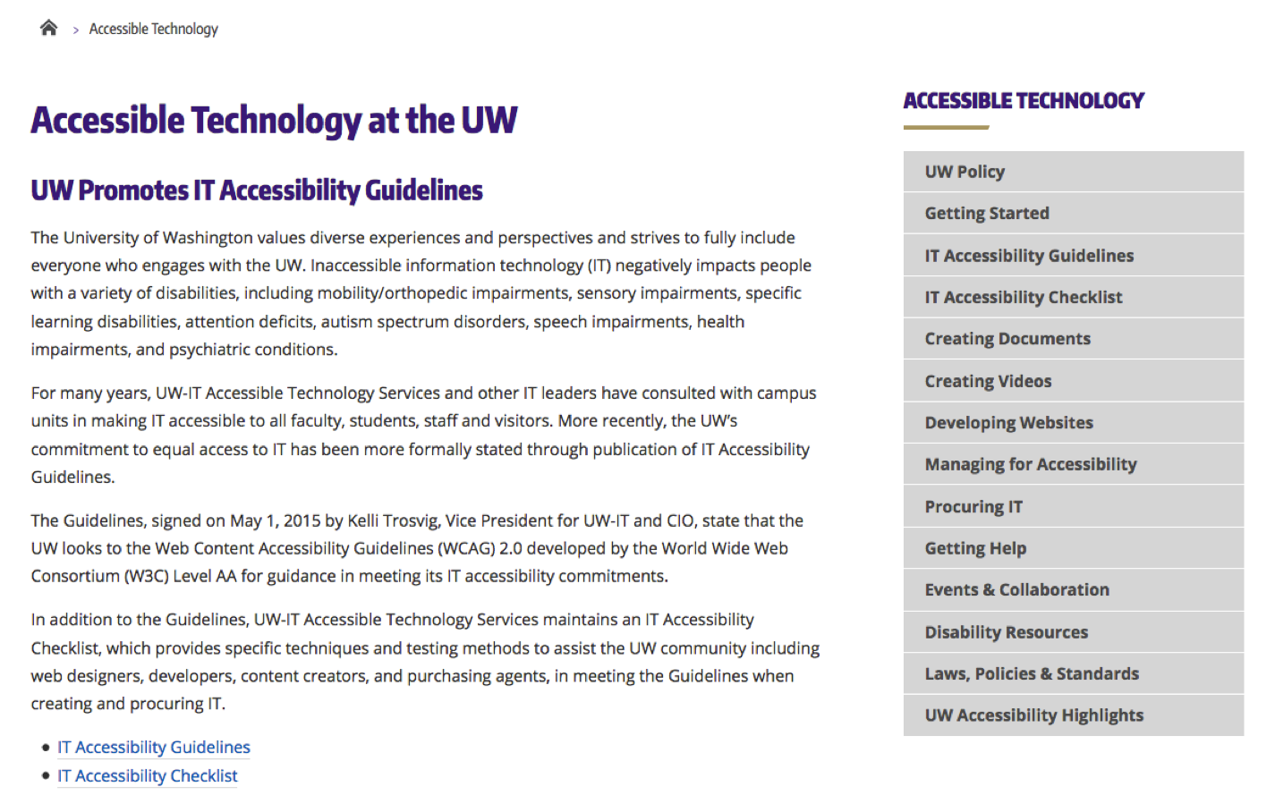
uw.edu/accessibility

Slide 19
Collaboration 2 of 3
Contract with SensusAccess, 3PlayMedia; explore other software options
Use same tools (e.g., Adobe Acrobat)
Collaborate on a11y efforts
Caption videos
Share data
Offer training, consultation, captioning parties, capacity building institutes, & other events
Support multiple user groups (accessibleweb@u, accessibleIT@u, informal captioning group)

Slide 20
Collaboration 3 of 3
Test websites, PDFs & help remediate
Swap knowledge/processes RE PDF accessibility, etc.
Brailling
Plan for collaborative space
Host UW & state-wide Capacity-Building Institutes, & support Community of Practice

Slide 21
Lessons Learned
Engage both disability & IT services
Adopt the same vision
Stay informed about what others are working on
Don’t be overly concerned about redundancy & unit boundaries
Gain administrator buy-in from both sides
Make service boundaries transparent to students & other stakeholders

Slide 22
Q&A
Sheryl Burgstahler, sherylb@uw.edu
Krista Greear, greeark@uw.edu

