Slide 1
Universal design in the Inclusive Classroom
NLI Summer Track May 31, June 1, 2017
Christa Miller, christa.miller@vt.edu Assistive Technologies
Hal Brackett, brackett@vt.edu Assistive Technologies
TLOS: Technology-enhanced Learning and Online Strategies
Notes:
This work is licensed under the Creative Commons Attribution-ShareAlike 4.0 International License. To view a copy of this license, visit http://creativecommons.org/licenses/by-sa/4.0/.

Slide 2

Agenda Day 1
Topic | Time
Accessibility Made Conscious | 8:30-9:30
Assistive Technologies | 9:30-10:30
Accessible Documents | 10:45-12:00
Lunch provided in Torg 1100 | 12:00-1:00
Instructional Materials in Practice | 1:00-2:30
Canvas and UDOIT | 2:30-3:00
Multimedia | 3:15-4:30
Image Credit: EcologyofEducation.net

Slide 3
Agenda Day 2
Topic | Time
Speech Recognition or PDF Accessibility | 8:30-9:30
Exercise (from homework) | 9:30-10:30
The Inclusive Classroom | 10:45-12:30
Image Credit: EcologyofEducation.net

Slide 4

Introductions
Name
Department
Favorite morning beverage

Slide 5
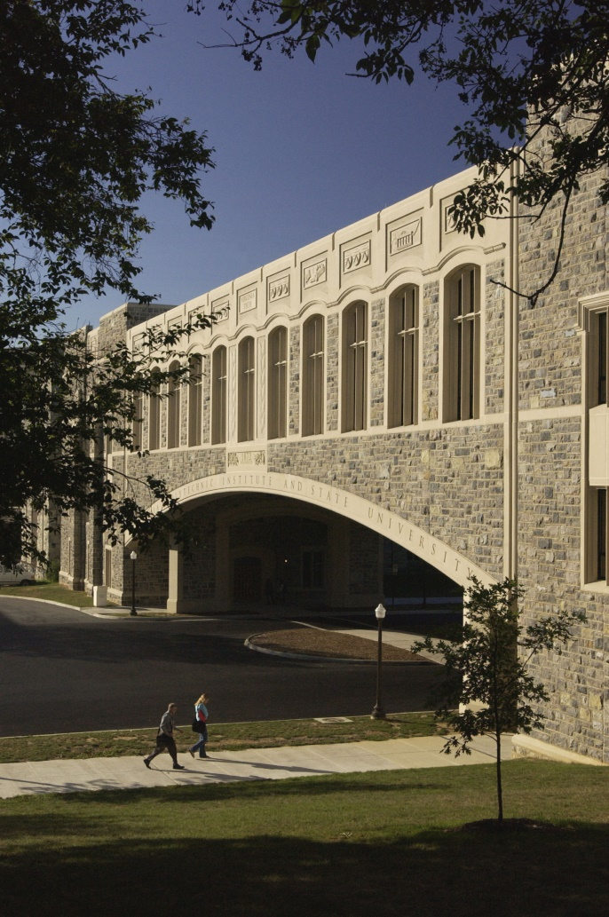
About Assistive Technologies
Provide accommodations to students and employees (through SSD and HR)
  Such as: Text-to-Speech, Voice Recognition, Braille, Captioning, Magnification, etc..
Provide consultations on: Web Accessibility, Research, Captioning, Universal Design for Learning
Training on Assistive Technology
Assistive Technologies Lab
1180 Torgersen Hall

Slide 6
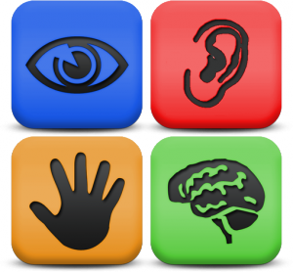
Accessibility Made Conscious
Objectives:
Identify at least 1 pre-existing belief about accessibility
Identify 3 positive outcomes of accessibility by design

Slide 7
Complete a phrase…
A sidewalk is accessible when it…
A door is accessible when it…
A TV news report is accessible when it…
A room sign is accessible when it has…
An eBook is accessible…
Has a Ramp or cutout
Has automatic doors
Has Close Captions or Subtitles
Has Braille
Has user preferences enabled

Slide 8
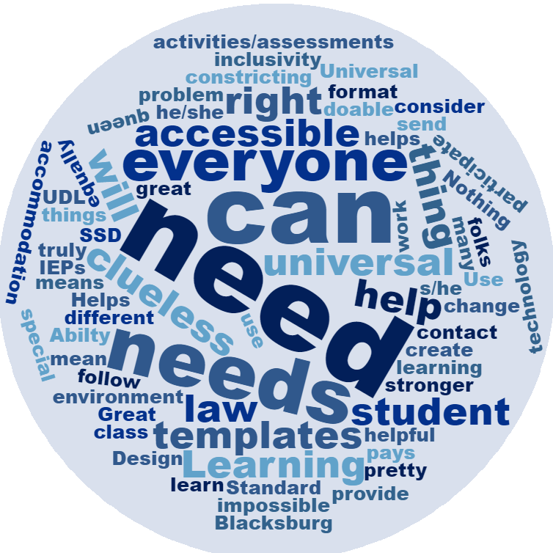
Implications for Learning Spaces
What are the digital equivalents of ramps, automatic doors, etc. for our digital learning spaces?
How do we define
Accessible?
Notes:
This is a word cloud created from the responses of previous participants. The most frequently used words are need, can, needs, and everyone. That probably sums up the reason for accessibility nicely. Everyone needs it and it can be done.

Slide 9
Defining Accessible
Group Definition
Webster’s Definition
Accessible (n., v., adj.)
Accessible (adj)
1: able to be reached or approached
2: able to be used or obtained
3: easy to appreciate or understand
Merriam-Webster.com
Found August 25, 2015

Slide 10
More Definitions of Accessible
Accessible (n., v., adj.)
Webster: able to be reached, approached, used, obtained; easy to appreciate or understand. Merriam-Webster.com As of October 2016
Tim Berners-Lee, W3C: The power of the web is in its universality. Access by everyone regardless of disability is an essential aspect.
Google Material Design: Accessible design allows users of all abilities to navigate, understand, and use your UI successfully.
  Google Material Design Retrieved August 29, 2016

Slide 11
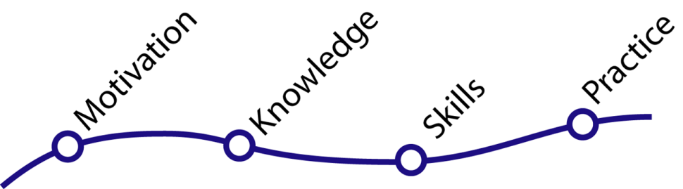
Where am I? & What’s next?
Feelings may be:
Positive, neutral, or negative
Indicates where you are on the continuum

Slide 12
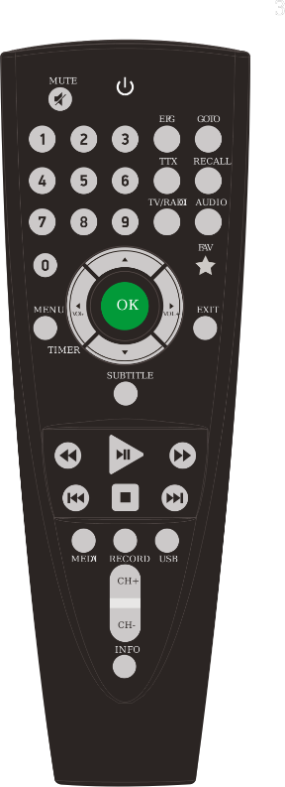
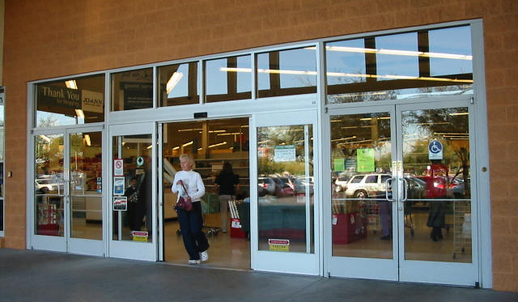
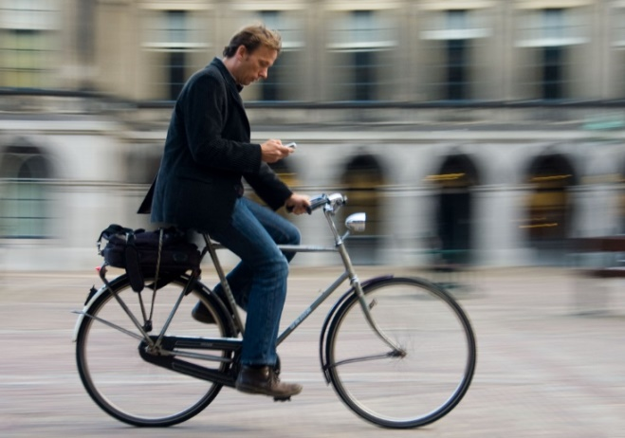
Day-to-day accessibility
Apply our definition to our daily activities
  Online or offline tool(s) that you rely on as part of your daily routine
  1 tool that makes life easier
  1 tool that makes life harder
Notes:
Now that we’ve established a working definition of “accessible” let’s apply it to our daily activities. What tools technology based or otherwise do we rely on daily that make life easier.
-email: (share Norm Coombs story about deaf student)
-smart phones: great navigation aids for those with visual impairments
-Automatic doors: provide access for wheelchairs, scooters, strollers, etc..
Next let’s share some examples of tools we use in our daily activities that frustrate us or make life more difficult.
-email: Gmail search feature and auto-hide feature

Slide 13

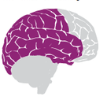

Basic Principles
Our definition aligns with the basic principles of Universal Design for Learning.
  Engagement: stimulate interest and motivation for learning.
  Representation: present information
  and content in different ways.
  Action and Expression: differentiate the ways that students can express what they know.
Source: CAST.org UDL Concepts
Notes:
Engagement = Why of learning
Representation = What of learning
Action and Expression = How of learning
Source: CAST.org UDL concepts

Slide 14

Universal Design for Learning
Universal Design for Learning helps achieve accessibility in the classroom.
UDL and Accessibilty Intersection (UDL on Campus by Cast.org)
(CAST = Center for Applied Special Technology)
Notes:
Skip Stahl
Senior Policy Analyst; Co-Director, National Center on Accessible Educational Materials, CAST
CAST = Center for Applied Special Technology

Slide 15

Bringing accessibility into the classroom
List tools/materials that our clients (e.g., students) use.
Instructional Tools Survey

Slide 16
Accessibility Is Not Accidental
Each element of the previous list has to be accessible. You can:
  Test it yourself
  Find someone else to test it
  Learn about Assistive Technologies and their interactions to create accessible material by design.
Notes:
Accessibility if it is not already part of your professional practice needs to become part of it.
Just by being here today you’ve taken the first step towards having an accessible classroom.
And how do we know it’s accessible is probably the question blooming in your mind…
Well we can
-Test it ourselves
-find someone to test it
-Or learn enough about AT to understand how what we create is used by people who use assistive technologies.

Slide 17
Conclusions
“For people without disabilities,
assistive technologies make things easier;
for people with disabilities, assistive technologies make things possible”
–Anonymous
Coming up…
  Exploring Built-In Assistive Technologies
Notes:
Exploring Built-In Accessibility
Accessible Documents by Design
Accessibility in the flipped classroom
Voice Recognition or Video Captioning

Slide 18



Exploring Built-in Assistive Technologies
Objective:
List 3 built-in accessibility features of one operating system and describe how they work

Slide 19
What is Assistive Technology?
Assistive Technologies are software or hardware that improve one’s ability to actively participate in life.
Speech Recognition
Screen Reading, Text-to-Speech
Magnification, Visual Enhancements
On-screen Keyboard, Word Prediction
[Closed Captions & Audio Descriptions]
Notes:
Closed Captions and Audio Descriptions do not technically fall into the definition I have given. But they are essential the access of digital video and/or audio materials.

Slide 20


Think of accessibility as
A Bridge
Accessibility
Person wants to interact…
…with some course material
Assistive Technologies
Accessible Materials
Notes:
We can think of accessibility as a bridge. On the one side we have a person who wants to interact with some course material. Accessibility is the bridge between that anchored by the Assistive Technologies used by the participant and the design of accessible instructional materials on the other.

Slide 21



When accessibility is in place AT can be used effectively
Accessibility
Notes:
In practical terms we will look at what AT is built into the Apple and Microsoft operating systems. After lunch we will look in depth at how to build the necessary structures into our course materials so that it can be accessed via Assistive Technologies.

Slide 22
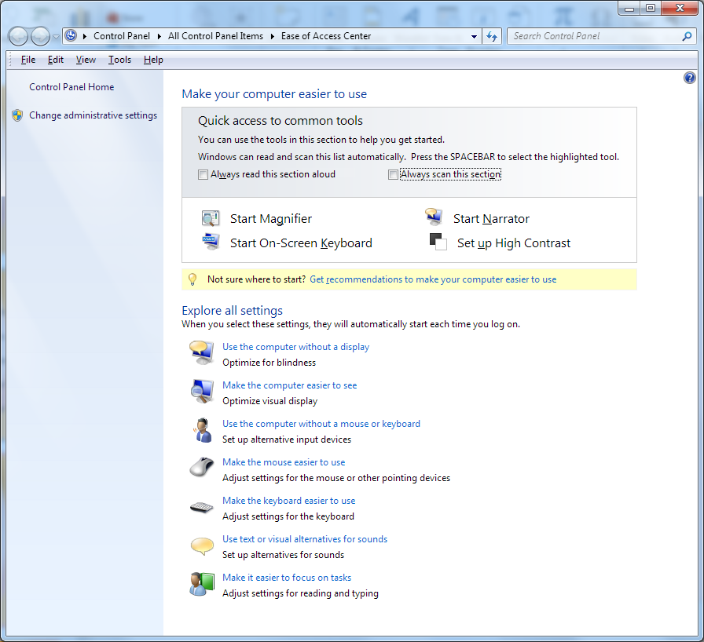
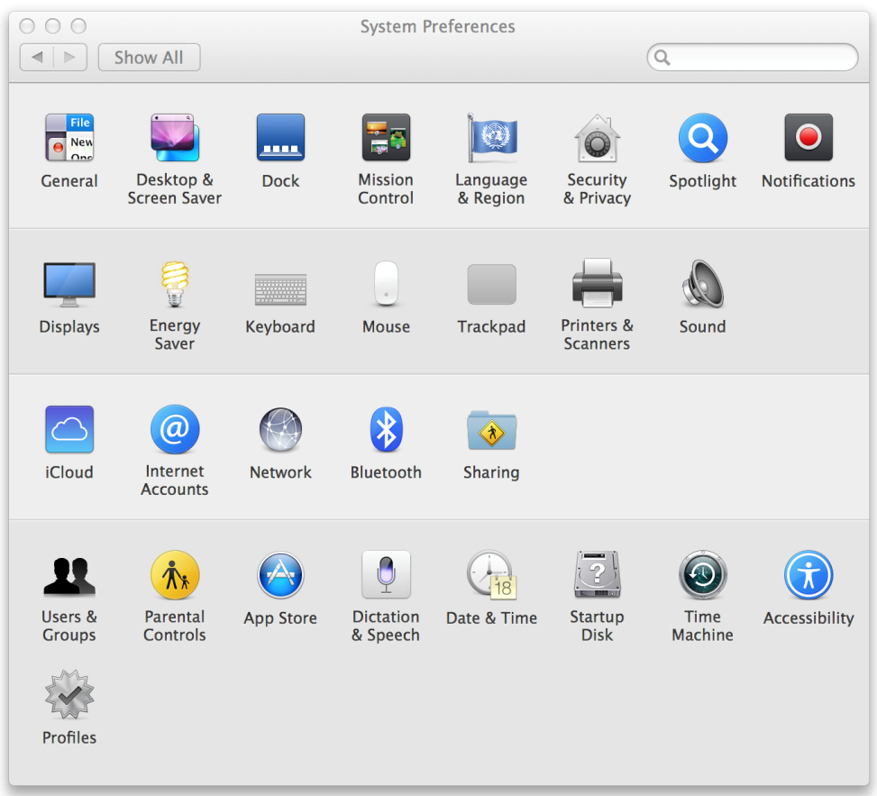
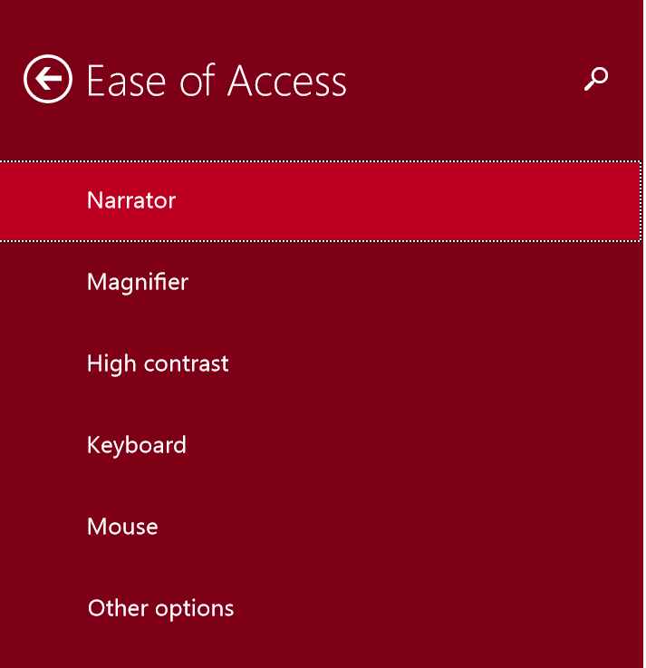
Ease of Access or
System Preferences
Windows
Control Panel/Settings >> Ease of Access
OS X
Systems Preferences >> Accessibility
Notes:
The AT features of the operating system can be found in Systems Preferences for OS X and the Ease of Access center on Windows.

Slide 23
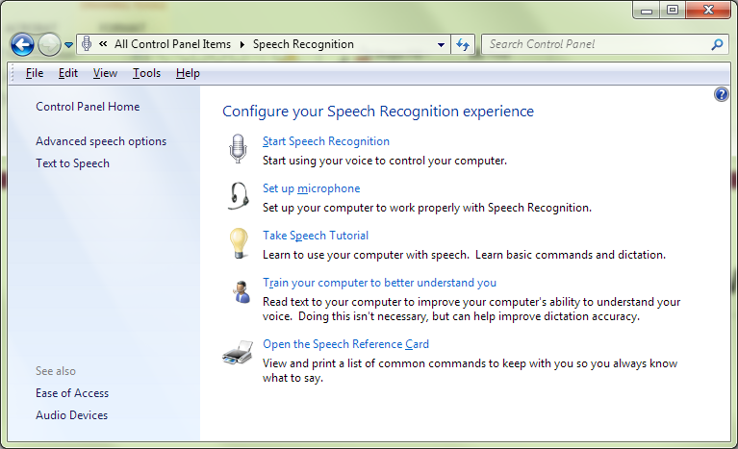
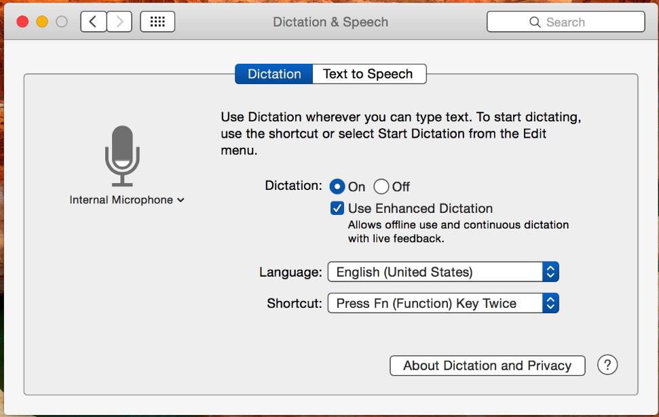
Speech Recognition & Dictation
Start >> type Speech, Enter
System Preferences >> Dictation & Speech
Notes:
For Windows go to the start menu and begin typing Speech then select it from the options. The window shown in the screen capture will appear. Choose the Start Speech Recognition icon to begin.
For OSX, open system preferences and open “Dictation and Speech”. Make sure you enable Enhanced Dictation to get the best recognition speed and avoid sending any Personally Identifiable Information to Apple.

Slide 24
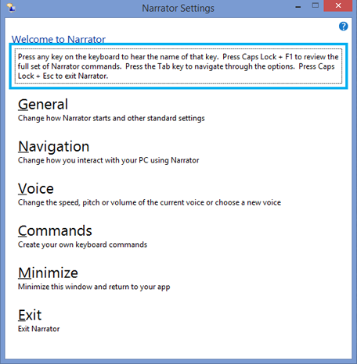
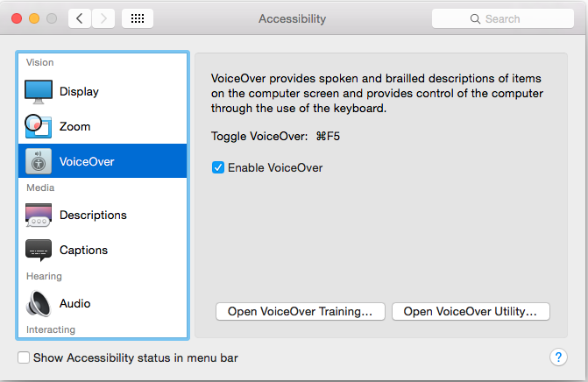
Screen Reading
Activate Narrator
Ease of Access >> Make the computer easier to see >> Turn on Narrator. Windows Key+Enter
Win8 Narrator Guide
Activate VoiceOver using Command+F5.
OSX VoiceOver Guide

Slide 25
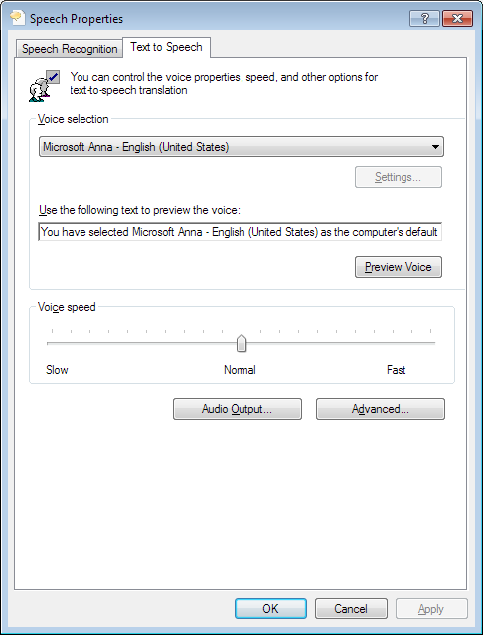
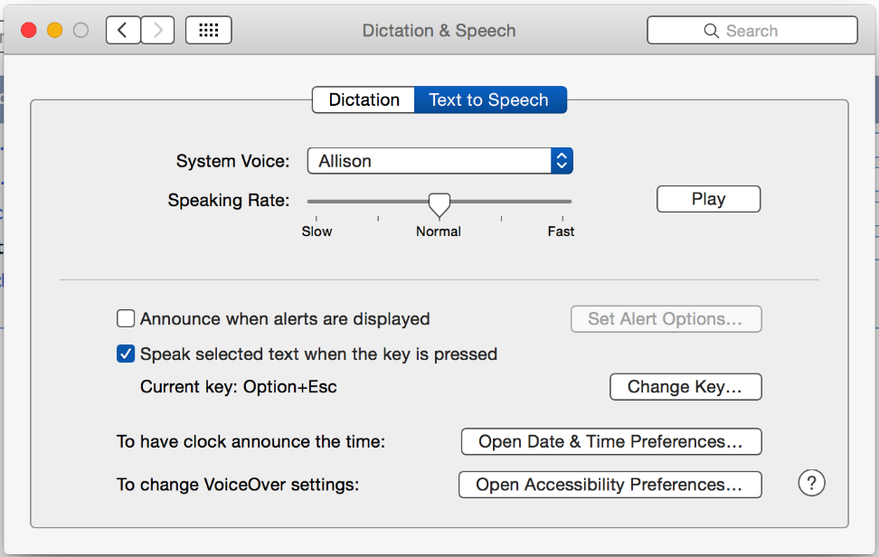
Text-to-Speech
Adjust Text-to-Speech settings
From Speech >> Advanced Speech Options
Then enable Speak in MS Office
Activate Text-to-Speech
System preferences >> Dictation & Speech
Set preferred key combo
Notes:
In the Speech Properties you can change the voice used and the speech rate. MS Office 2013/2010 Guide
https://support.office.com/en-us/article/Using-the-Speak-text-to-speech-feature-459E7704-A76D-4FE2-AB48-189D6B83333C

Slide 26

Visual Enhancements
Display Options
Contrast
Magnification

Slide 27
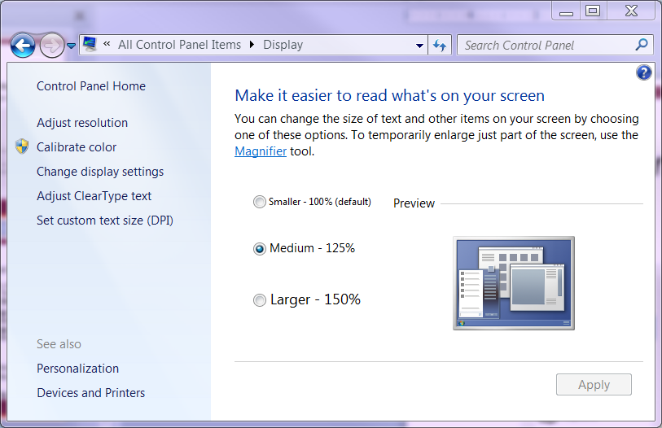
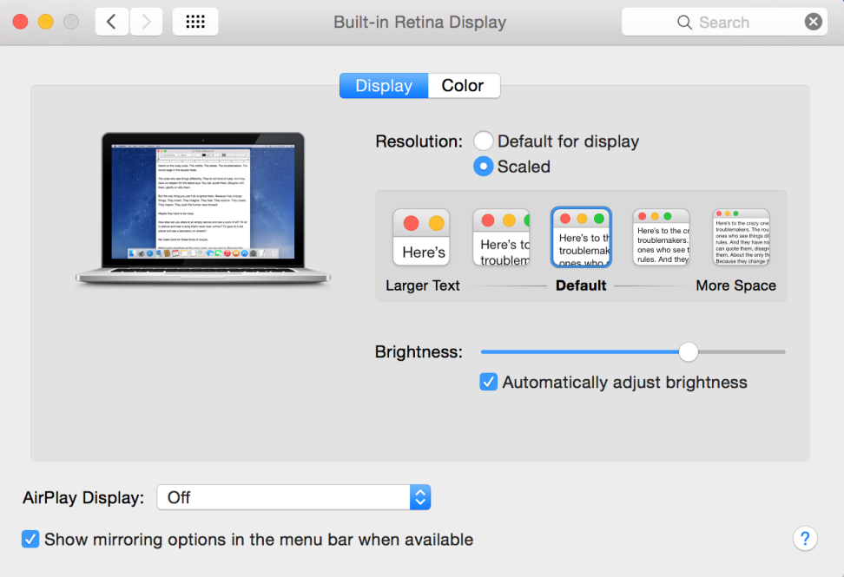
Display
Control Panel >> Display
System Preferences >> Display
Notes:
Make things BIGGER

Slide 28
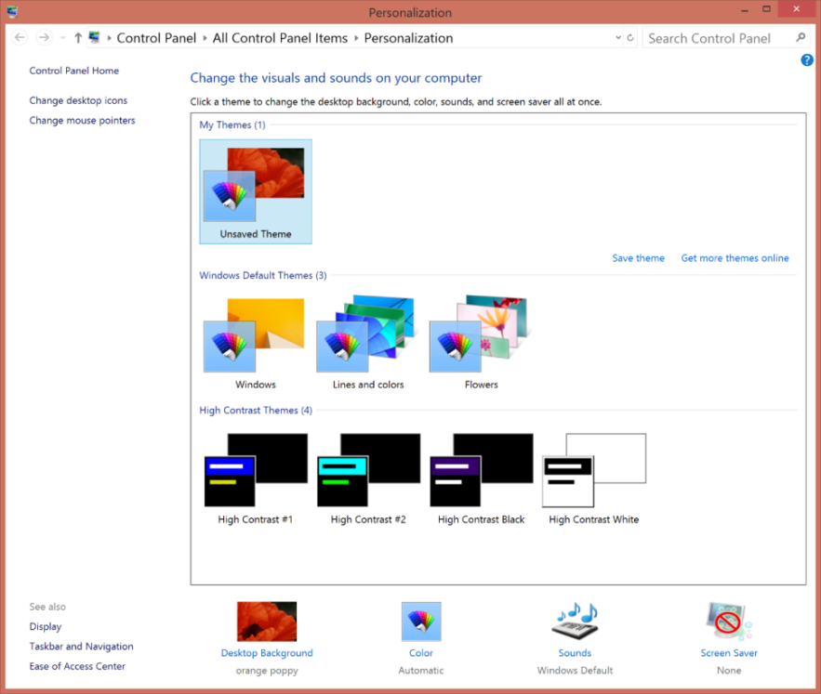
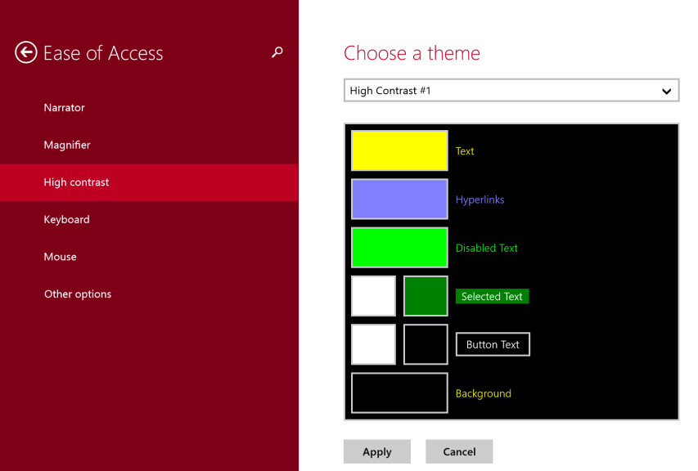
Contrast, Windows
Windows 8.1 :
Ease of Access Center >> “Set up High Contrast”
or
Windows 8.1/10
From the PC Setting >> Ease of Access >> “High contrast” to select a theme

Slide 29
Contrast, OS X
System Preferences >> Accessibility >> Display

Slide 30

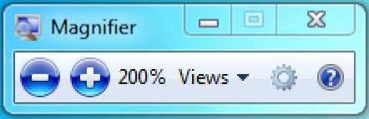

Magnification, Windows
Windows Key >> Ease of Access >> Magnifier (Windows 8.1, 10)
Zoom in: Windows Key +
Zoom out: Windows Key -

Slide 31
Magnification, OS X
System Preferences >> Accessibility >> Zoom
          Zoom in: Shift+CMD+=
          ⌥⌘=
          Zoom out: Shift+CMD+-
          ⌥⌘-

Slide 32
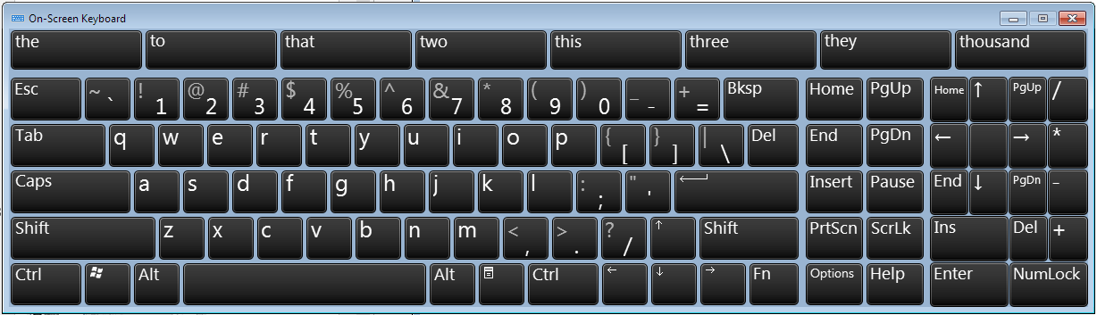
On-Screen-Keyboard Windows
Windows key >> Type “osk”, Enter (Windows 8.1, 10)
Words predicted will appear as you type

Slide 33
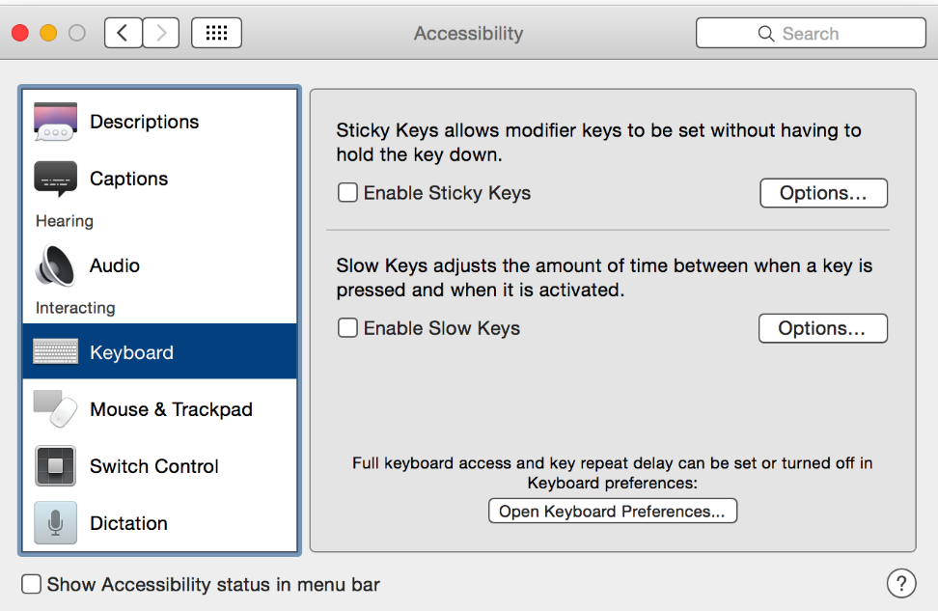
On-Screen-Keyboard, OS X
System Prefs >> Keyboard
Input Sources
Show Input menu in menu bar

Slide 34
What are Closed Captions and Audio Descriptions?
Closed Captions: the audio portion of a video or audio recording written out and can turn on and off.
Dear YouTube: HEAR ME OUT by Tyler Oakley
Audio Descriptions are all the visual elements of a video described in words.

Slide 35
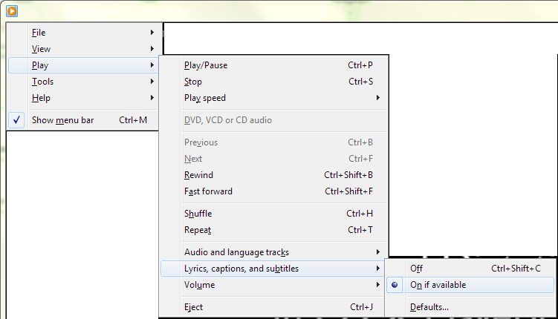
Captions, Windows
Available in Windows Media Player
Alt >> Play >> Lyrics, captions, and subtitles >> On if available

Slide 36
Captions, OS X
To turn on Closed Captions:
System Preferences >> Accessibility >> Captions

Slide 37
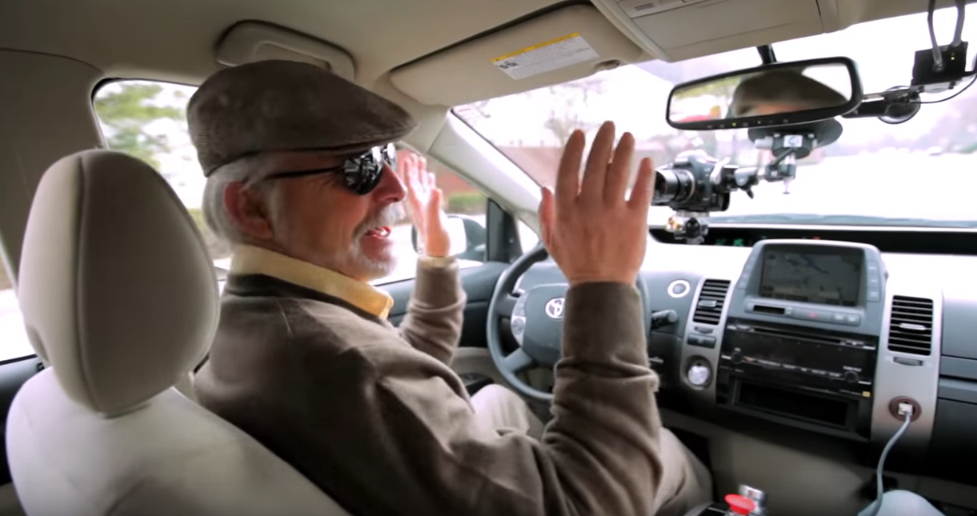
Audio/Video Descriptions
Self-Driving Car Test: Steve Mahan

Slide 38
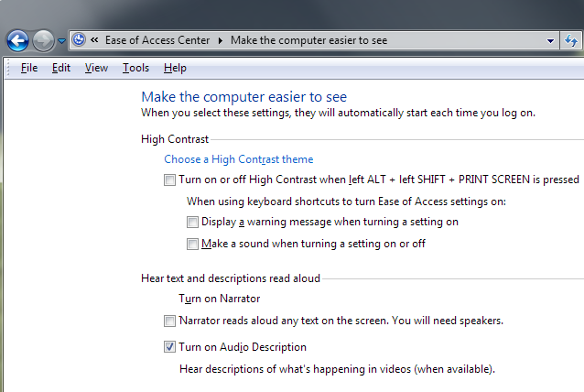
Audio Descriptions, Windows
Ease of Access Center >> Make the computer easier to use
Check “Turn on Audio Description”

Slide 39
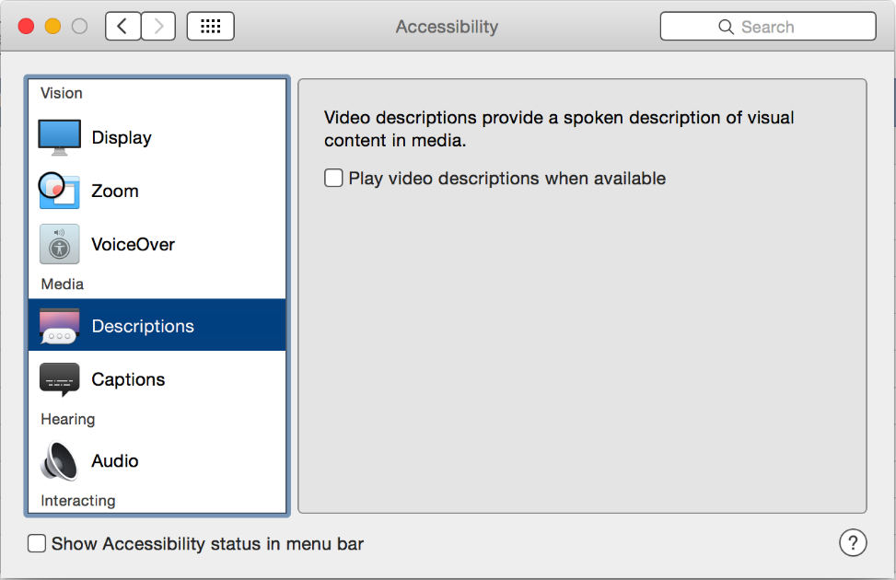
Audio Descriptions, OS X
Accessibility >> Descriptions
Check “Play video descriptions when available”

Slide 40
Conclusion
“Usability issues affect everyone,
but it tends to affect people with disabilities
much more dramatically.”
-- Derek Featherstone, Simply Accessible, Inc.
Coming up…
  Accessible Documents by Design
Notes:
Exploring Built-In Accessibility
Accessible Documents by Design
Accessibility in the flipped classroom
Speech Recognition or Video Captioning

Slide 41

Accessible Documents by Design
Objectives:
Demonstrate ability to create accessible documents
Demonstrate ability to use Accessibility Checkers

Slide 42
Remember the “Bridge”
Assistive Technologies on one side,
Accessible Material on the other side
Notes:
This workshop will focus on the accessibility tools
The next workshop will focus on making instruction materials accessible

Slide 43
Working Document
Open a document that you update regularly, such as a syllabus or yearly report

Slide 44
Best Practices
Headings
Alternative Text for images
True Document Structures
Table Heading row labeled
Tag Reading Order
Minimally we need to be able to check all boxes to be confident in the accessibility of our documents.
Assuming Best Practices for Style are also used:
Use San Serif fonts:
Arial, Calibri, Verdana…
Use 12 pt font minimum
18 pt font for screen captures
Use whitespace
Use good color contrast

Slide 45
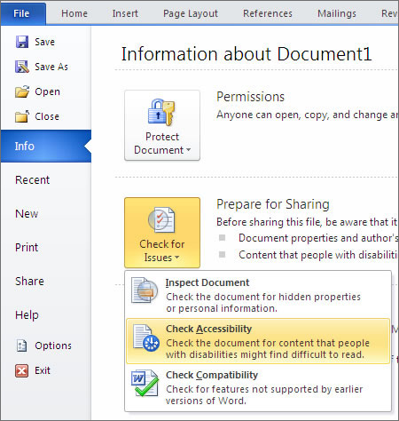
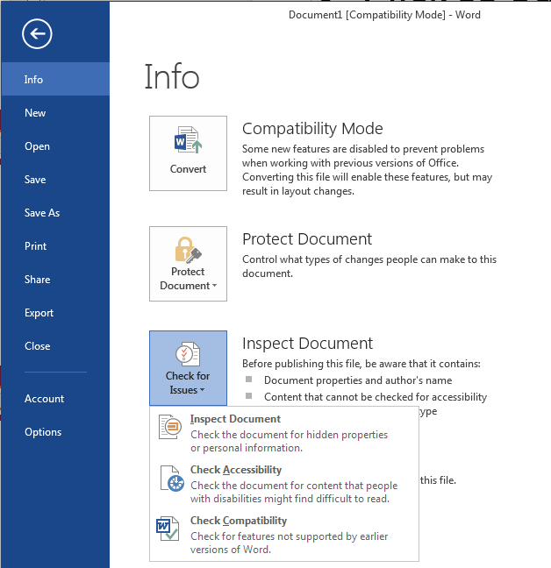
Find the Accessibility Checker
Accessibility Checker in Word 2013
Accessibility Checker in Word 2016
Notes:
Show how to add Accessibility Checker to Quick Toolbar
Under REVIEW in Mac 2016

Slide 46

  Run The Accessibility Checker on Your Document
  What Errors did you find?

Slide 47
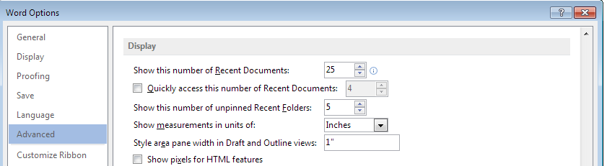
Enable the Area Pane
Turn Area Pane on to make styles visible in Draft and Outline views
Win: File >> Options >> Advanced >> Display (2013, 2016)
Mac: Home >> Styles Pane (2011, 2016)
Notes:
Area Pane does not exist in Mac 2011, but you can use the Style Box

Slide 48
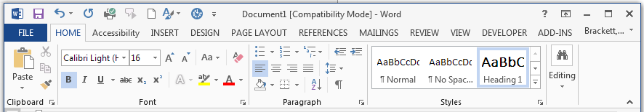

Headings
Select text, apply style
Create your own style (Right-click on style and select “Modify…”)
  Insert Headings in: your document
Notes:
Benefits:
Users of screen readers
Helps make PDF files accessible
Used in creating table of contents

Slide 49
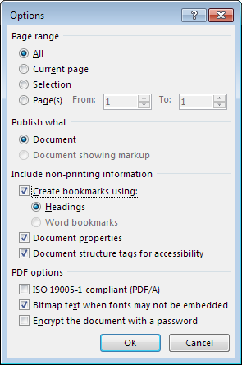
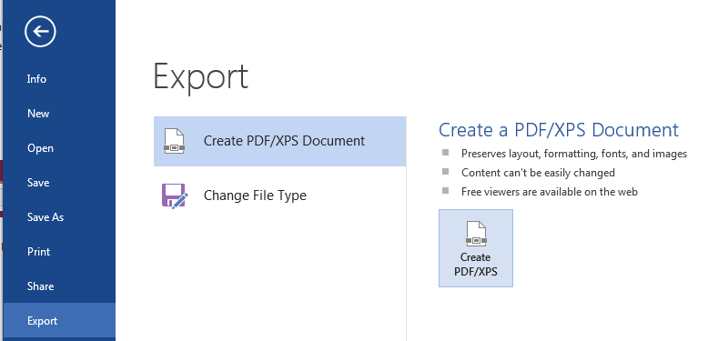
When exporting to PDF maintain the structure
Windows: Export to PDF (2013, 2016)
Mac: Save as PDF (2011, 2016)
Notes:
Do not print to PDF

Slide 50
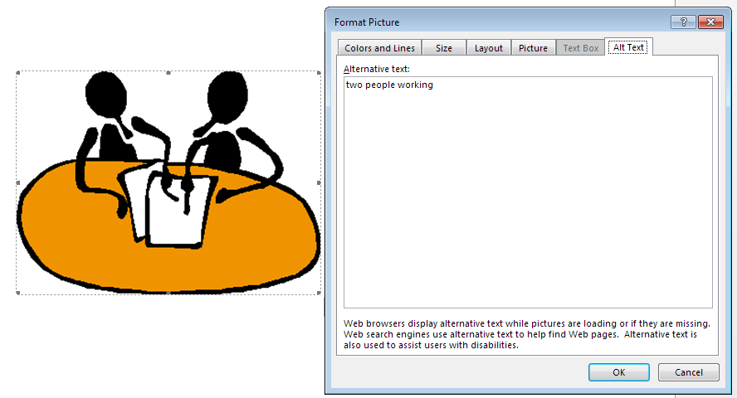
Alternative Text
Right-click on image, pick Format Picture… select Alt Text tab
Enter alternative text in edit box labeled Description or Alternative Text
Notes:
Benefits:
Users of screen readers
Useful for documentation

Slide 51


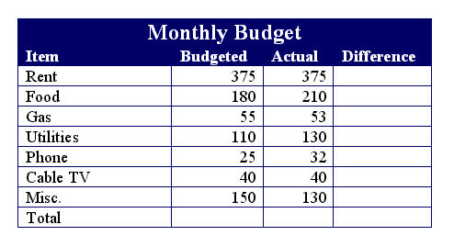
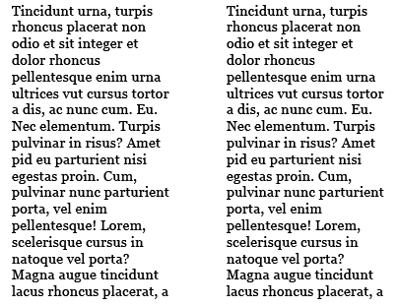
Document Structures
Lists, Numbered or Bulleted
Columns
Tables
Notes:
Bulleted or numbered lists

Slide 52
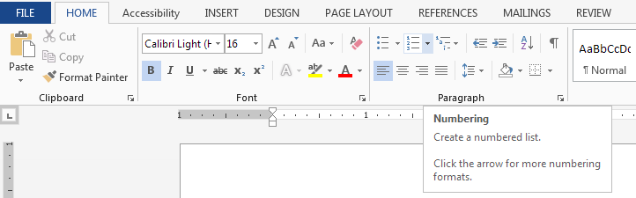
Document Structures -Lists
Apply the numbered lists and bulleted lists from the Home ribbon
Notes:
Bulleted or numbered lists

Slide 53
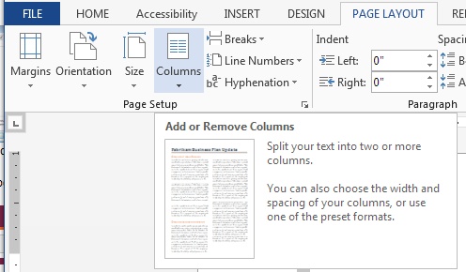
Document Structures -Columns
Establish columns by clicking on the columns dropdown in the Page Layout ribbon

Slide 54
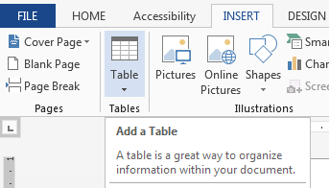
Document Structures -Tables
Create tables by clicking on the Table dropdown in the Insert ribbon

Slide 55
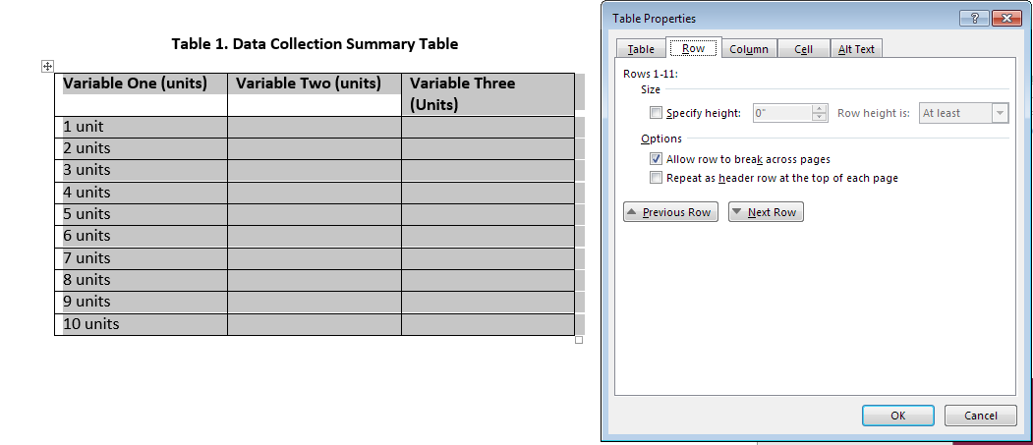
Document Structures –Tables (con’t)
Assign headers to table columns
Right-click on table crosshairs, select Table Properties
Select row tab and put a checkmark in Repeat as header row at top of each page

Slide 56

Finish making changes to your document and rerun the Accessibility Checker.

Slide 57

For PDF maintain the structure
Windows: Export to PDF (2013, 2016)
Mac: Save as PDF (2011, 2016)
Notes:
Do not print to PDF

Slide 58
Open resulting document with Acrobat Reader/Professional
Acrobat Reader
  Check accessibility by looking at bookmarks
  Check reading order by Read Out Loud (View >> Read Out Loud) Use the down arrow key to move through document
Acrobat Professional
  Accessibility Checker
  Action Wizard >> Make Accessible
  Demo…

Slide 59
PowerPoint
Follow same steps as in Word
  Headings
  Alternative Text for images
  Document Structures
  Accessibility Checker
Additional topics:
  Reading order
  Text boxes
  Tables
  Transitions
Notes:
Talk about reading order

Slide 60
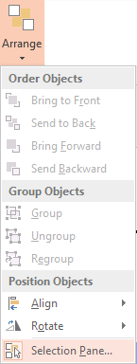
Accessibility Checker in PowerPoint
Located in the same location as in Word
Open the Selection Pane to check for reading order (Home ribbon, Arrange, Selection Pane)
Notes:
Open powerpoint Show the Accessibility Checker and the Selection Pane

Slide 61
Text Boxes
Text boxes are not read by screen readers when Reading Order is not specified in Arrange
Text box content not included in search
Use Outline View to double check what Computer (…Assistive Technologies) see
This is really important!
It will be on the final!
Notes:
Te

Slide 62
Tables
When possible, avoid using tables in PowerPoint
For small tables, add alternative text
Attendee | Number of Donuts Eaten
Bob | 3
Lisa | 1
Jerry | 4

Slide 63
Transitions Best Practices
Use simple transitions
  Note: Some transitions cause screen readers to re-read slides
Use a subtle sound to indicate slide change
Avoid automatic slide transitions
Exporting slides to PDF sometimes makes several slides out of one slide

Slide 64
External Resources
The National Center on Disability and Access to Education (NCDAE) NCDAE Cheatsheets
National Center for Accessible Media (NCAM) NCAM Image Descriptions
Diagram Center Making Accessible Images
A good video on marking up a PDF file: Tagging a PDF file by Paul Bohman
Lynda.com Lynda.com Sign In
  Advanced Accessible PDFs (with Acrobat Pro XI) (2.5 hrs)
  Creating Accessible PDFs with Acrobat DC (5 hrs)
  Creating Accessible PDFs (with InDesign) (4 hrs)

Slide 65
Documents Conclusion
“Remember: Digital does not mean Accessible”
-- Portland State University
Office of Academic Innovation
www.pdx.edu/oia/content
Accessible documents are less work to create than to repair later.
Coming up next….
  Instructional Materials in Practice
Notes:
Accessible Documents by Design
Accessibility in the flipped classroom
Speech Recognition or Video Captioning

Slide 66
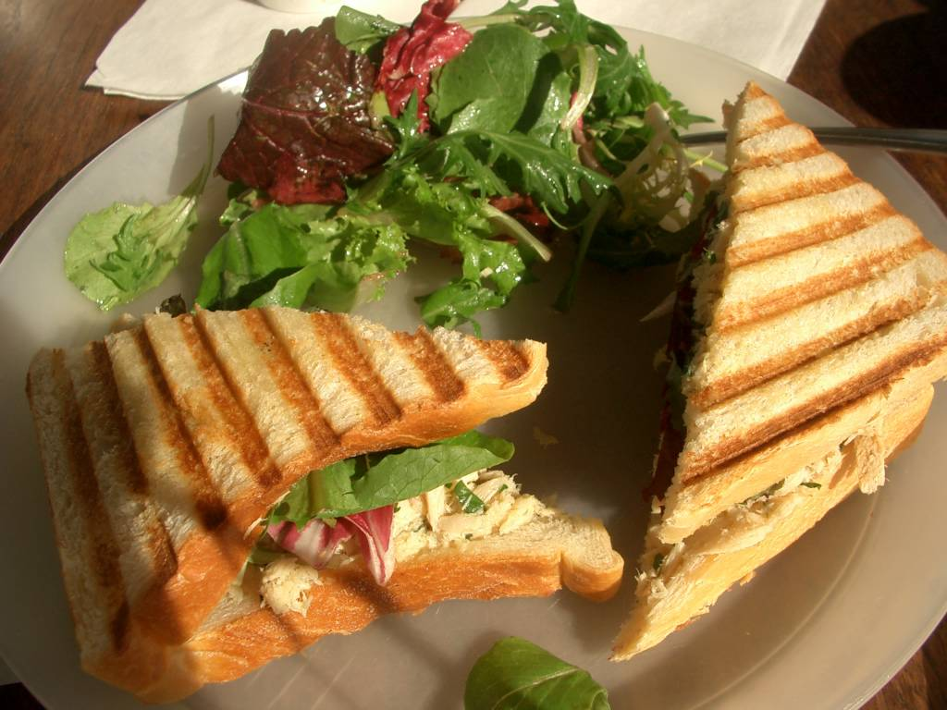
Lunch
Time for a break. Enjoy some lunch in 1100 Torgerson we’ll be back at 1pm.

Slide 67
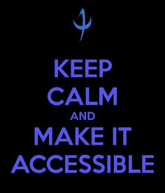
Instructional Materials in Practice
Objective:
Practice creating accessible documents

Slide 68
From Here to There…
At this point we will take some time to practice designing or correcting documents for accessibility.

Slide 69

Accessibility and Canvas
Objectives:
Identify formatting structures available in Canvas
Implement the formatting structures necessary to achieve accessibility by design
Instructure is Committed to Accessibility

Slide 70
Where do I need Accessibility?
Rich Text Editor
Document Uploads
Using Multimedia

Slide 71
Online Practices
Alternative Text for images
Headings
True Document Structures (lists, columns, etc.)
Create and sync closed captions
Minimally we need to be able to check all boxes to be confident in the accessibility of our documents.
Assuming Best Practices for Style are also used:
Use San Serif fonts:
Arial, Calibri, Verdana…
Use 12 pt font minimum
Use 18 pt font on screen capture
Use whitespace
Use good color contrast

Slide 72

Practice with Real Document
Using a syllabus or another document that you can copy and paste, put it into a content page and begin adding the checklist of accessibility to-dos

Slide 73
Canvas Specific Resources
  From Instructure
  https://community.canvaslms.com/
  docs/DOC-2060
  UDOIT (Universal Design Online content Inspection Tool)
  https://community.canvaslms.com/
  docs/DOC-6504

Slide 74

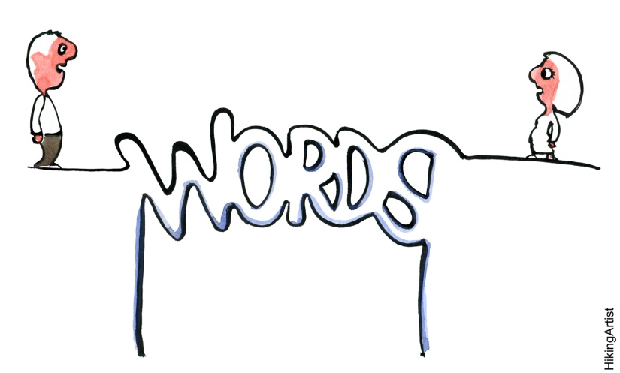
Multimedia and Accessibility
Objectives:
Know the 6 basic rules for captioning
Create a video with Closed Captions

Slide 75
What Counts as Multimedia?
Images
Graphs
Charts
Movies
Animations
Audio Recordings
Still or Moving Visual
Auditory Component
Notes:
Let’s name some kinds of multimedia.

Slide 76
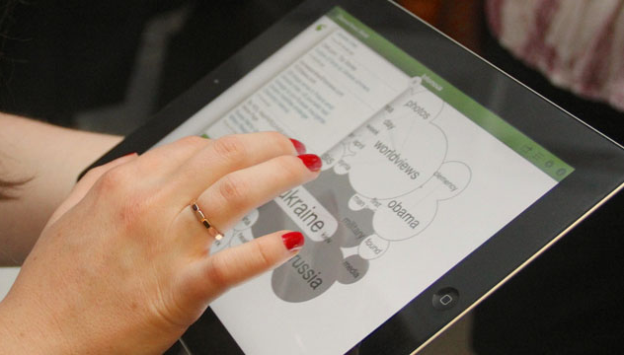
The Text Alternative Goal
Images
  Alt Tags
Graphs/Charts
  Long Descriptions
  In-line text
Movies
  Closed Captions
Audio Recordings
  Transcripts
“more than one”
What text alternatives exist:

Slide 77
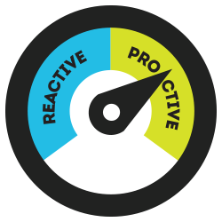
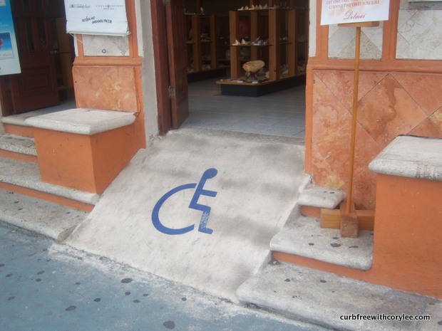
Two Methods:
Proactive
Reactive
Multimedia is an important element for proactive accessibility design
Notes:
Reactive design means to renovate, recreate, or accommodate afterwards. When it comes to multimedia the cost in time, effort and resources for remediation exceeds the time, effort, and resources required for proactive design.

Slide 78
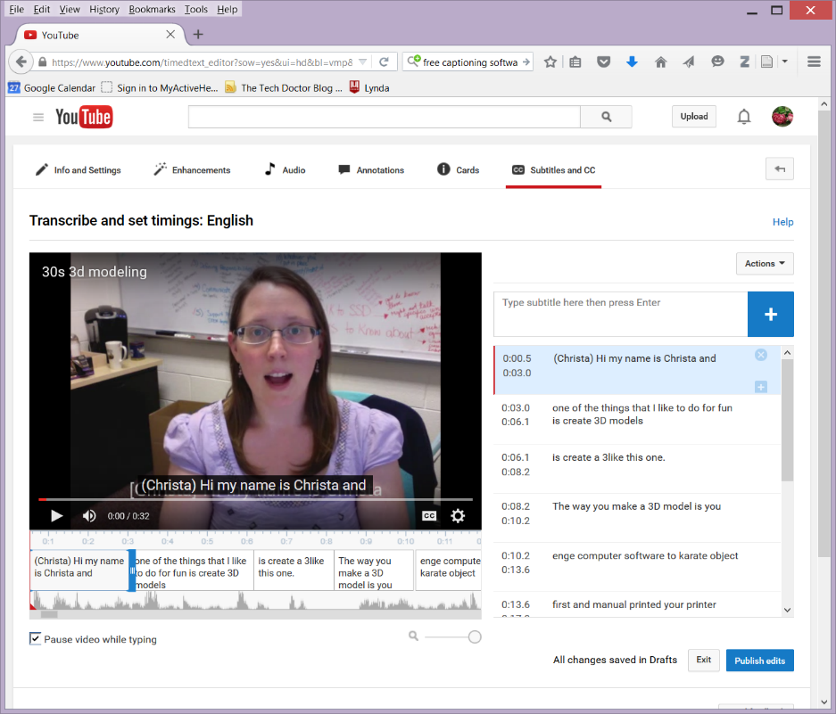
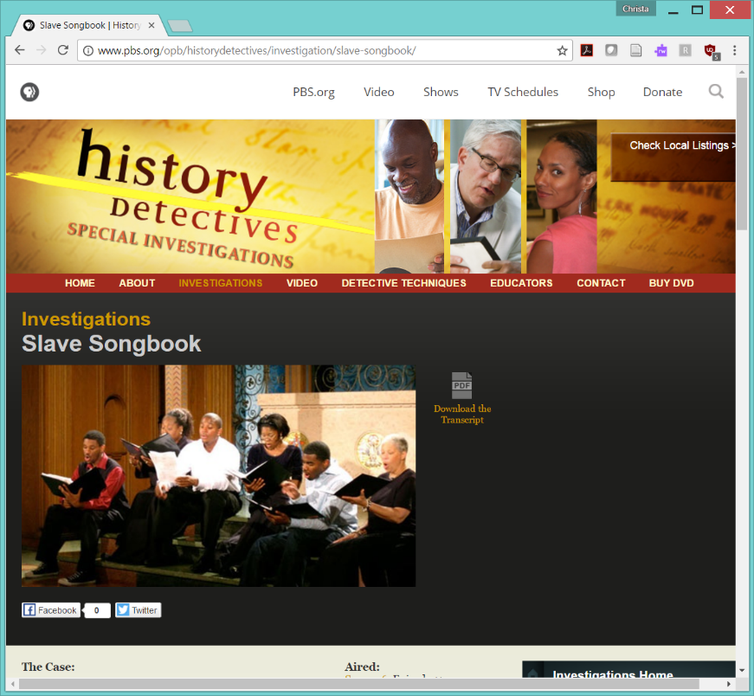
Video Accessibility
Closed Captions
Transcripts
Ex. Closed Captions support students with hearing loss & ADD.
Ex. Transcripts support students with print disabilities
Notes:
Video accessibility in particular is a hot topic both here at VT and in the US nationally.

Slide 79
Think, Pair, Share
In groups of 2-3 pick one of the following questions to answer.
  Who needs captions?
  When should there be captions?
  Why should we do it?

Slide 80
5 W’s for Video Text Alternative
Who: Everyone who creates video content
What: to make quality video content
Where: On every video we create; at every location where that video is published
When: Pre-script or Post-production script
Why: Law, Increase User Base, Increase Retention, Environment
HOW: it depends on where the video comes from and goes to.
Notes:
If you are sitting in this workshop it is likely that you are already in support of- or at least prepared to caption a video. But just in case, I think it’s important of all of to be on the same page about the motivation behind creating closed captioning. And here it is:
Who should create captions? Everyone who creates video content. And if the creator does not self-caption, they should use one of the available methods for obtaining captions.
What should we be doing? Making quality captions and more broadly making accessible video content
Where should we put captions? On every video we create and at every location where that video is published
When do we create captions? Creating a script before hand is by far the most efficient way to caption, but for anyone who prefers an unscripted performance there is technology that can make creating a post-production script easier.
Why I’ve summarized the why into 4 broad reasons, but the best list I’ve seen comes from 3PlayMedia and their list reads:
Accessibility to Deaf or Hard of Hearing Viewers
Protection against disability discrimination lawsuits
Better comprehension
Viewability in sound-sensitive environments
Increased search engine optimization
Better Video searching and User experience
Creating derivative content
Translation into foreign languages
HOW This is where we will spend the majority of our time today, but what tools you use depends on what was used to create the video and where the video is published.

Slide 81

Basic Rules
www.captioningkey.org
Accurate
  Errorless transcription
Consistent
  Uniform style/formatting
Clear
  ALL audio recorded
Readable
  Enough display time
Equal
  Meaning/intention kept
Note: Be aware that when captioning for the first time it takes ~10 minutes to caption 1 minute of video.
Notes:
The best captioning guide I have seen comes from the Described and Captioned Media Program.
You can use the HTML version at www.captioningkey.org
In order to achieve a quality output, the captions must meet these 5 basic properties
Accurate meaning without errors
Consistent meaning that there should be no changes in font, size, color, format
Clear ALL the audio, including sounds, music and speaker changes must be recorded
Readable Put it up for long enough and don’t overload it
Equal Wherever an adjustment is needed to maintain the proper timing or length of a caption, carefully choose alternatives so that the meaning and intention are kept.

Slide 82
Captioning Must Haves
Identify all speakers ( )
Identify all non-speech audio [ ]
Display time 2 to 5 sec
32 characters per line (48 max)
No more than 2 lines per caption
Avoid line breaks in phrases and descriptions
These are just the basics, for more details always go back to the manual
Notes:
Here is my summary of the Captioning Must Haves. Essentially, without following these 6 rules the captions may not be useable.
Remember however that these are just the basics, it is always good to go back to the Captioning Key by DCMP and make sure that there are no special situations that need to be considered.

Slide 83
Try an Example
Record yourself with your webcam (~15 sec)
Transcribe the words to text

Slide 84


Techniques
Whenever possible, choose a video that is already captioned or has subtitles.

Slide 85




The 4 Steps of Captioning
Create a Script/transcript
Combine video and transcript
Chunk the transcript into captions
Proofread and sync

Slide 86
Techniques for: The Script
Having a script ahead of time will go a long way towards reducing the time it takes to create captions.
  Use Speech Recognition
  Offer Student volunteer Incentive
  Write it longhand
  Use post-production Speech-to-Text
Notes:
Creating captions can be a time consuming process but it becomes easier with practice.
The script is the basis for your captions. The best practice for creating captions both DIY and pay-for is to have a script ahead of time.
For retroactively creating closed-captions, whether you use technology to assist or undergraduate volunteers is entirely up to you.

Slide 87





Techniques for: Creation
Camtasia by TechSmith
MovieCaptioner by SynchriMedia
YouTube by Google
Amara
Notes:
So in order to create captions you need software. Here are some of the robust tools that are used heavily in higher education.
Camtasia, by TechSmith is a screen capture tool that allows the user to create videos of live demonstrations and presentations. It has a tool integrated that allows you to create, upload, or export captions. Be aware that if you choose to use Camtasia, you may find that you have to play a few tricks on it to separate the captions for upload to some video players.
MacCaption and MovieCaptioner are not video editing tools. They only create captions. They take video and text and then combine and sync to created either embedded captions or standalone caption files.

Slide 88


Setup your captioning workspace
Practice creating captions using your short self-capture
Amara.org will let you caption content from the web!
Notes:
Let’s pause here to get everyone’s workspace set up.
If you did not bring a video today, navigate to the Virginia tech athletics YouTube channel. Open a new tab or new browser window and navigate to amara.org. Amara does require registration before using, but it is free.
If you brought a video and script, open them now.
What video editors are people using? Does everyone have access to a captioning tool?

Slide 89
How to create captions
No matter what editing tool you use there are 4 primary steps to creating captions
  Open the video in an editor or captioning tool.
  Add/Create the transcript
  Proofread the transcript
  Sync the script with audio
  Export captions
  Upload video and captions

Slide 90


Find your caption editor
This step completely depends on the tool used.
Creating a plain text (*.txt) document is a highly compatible format for a script
Find your captioning workspace

Slide 91

Import your script text
Depending on the tool you may be able to import your script, copy and paste, or use a speech-to-text tool

Slide 92

Proofread Transcript
Whether you had a pre-production script or created one post-production you definitely want to proofread the script while listening to the video and check for errors.
Do this during and after sync-ing
Notes:
A little tip: additional line breaks are created using Shift+Enter for many captioning tools

Slide 93
Sync Transcript
After the transcript is imported or created it is time to sync.
Go to the beginning and press play.
Check transcript for errors
Fix timing issues
  Remember 2-5 seconds long
  35 (42 max) characters per line
  2 lines per caption

Slide 94

Captions and Video players
When captions are complete:
  Export a copy for later upload and backup
  *.srt is widely used and *.vtt for many web players
Let the video render before adding captions

Slide 95
Captioning Conclusion
“Part of creating an optimal user experience
means adding closed captions and
multilingual subtitles to your videos.”
– Emily Griffin, 3PlayMedia
Coming up…
  Accessibility and Instructional Approaches
Notes:
Exploring Built-In Accessibility
Accessible Documents by Design
Accessibility in the flipped classroom
Voice Recognition or Video Captioning

Slide 96

Maintaining Accessibility in the Modern Classroom
UDL is one strategy to remove access barriers
Current approaches can improve the experience for students with disabilities
Notes:
Welcome to this session on Maintaining Accessibility in the Modern Classroom and thank you for attending. My name is Christa Miller and I’m from Virginia Tech, which is tucked into the beautiful Blue Ridge mountains of Southwest Virginia.

Slide 97
Results from Tools Survey
Notes:
Heat map of instructional tools survey results. Shows that taking is the most frequently used tool. Word Documents, Excel documents, and videos come in second. PDF documents in third.
Other Category Includes:
crayons, clay, craft supplies
student phones, cameras and computers, sketchbooks, ...
typed outlines
Camtasia
Student Presentations
Dropbox

Slide 98
Step 1: Review
What does it mean to be accessible?
  ______________
What technology is at our disposal to either check the accessibility of our materials or make their creation easier?
  ______________
What are the 3 aspects of Universal Design for Learning (UDL)?
  ______________
Notes:
What does it mean to be accessible? (Accessibility Made Conscious) --Available to…
What technology is at our disposal to either check the accessibility of our materials or make their creation easier? (Built-In Accessibility and Accessible Documents)
What does Universal Design for Learning (UDL) tell us to bear in mind? Representation, Engagement, Action and Expression.

Slide 99

What is an instructional approach?
Active Learning
Blended Learning
Hybrid Learning
Fully Online Learning
Problem-based learning
Project-Based Learning
Team-Based Learning
Writing Tools by peteoshea. http://www.mywritingblog.com/
2014_10_01_archive.html CC BY 2.0
n. A method for delivering content that relies on a set of strategies to achieve a learning objective
Notes:
I feel confident that there are many more approaches we could add to this list. [read aloud].
And what may you ask yourself is an instructional approach exactly?
Given that we are looking at this list with our accessibility glasses on, I think it is fair to state that these different types of learning scenarios have at least 1 thing in common. Each approach is simply one method of delivering content knowledge employing a set of strategies that lead to achieving learning objectives. The approaches listed here may be used together or separately. For example, two instructors implementing the same approach may not use any of the same activities or assessments, while two instructors using different approaches may use many of the same activities and assessments. We are in somewhat grey territory here. This is actually good news for us. It means that rather than trying to become an expert on all the variations of instruction and all of the technologies employed we can focus our attention on the set of strategies they have in common to address barriers.

Slide 100

Making an approach accessible:
Requires the integration
of Instruction, People,
& Technology
Instructional Strategies
  Direct Instruction
  Indirect Instruction
  Experiential Learning
  Interactive Instruction
  Independent Study
Notes:
To make any of those approaches accessible we have to consider the people, technology and the ideas that are being integrated. I’ve tried to indicate that rather than tackling the accessibility of a particular approach we can focus on the instructional strategies instead. The figure I’ve included here comes from a school in Saskatchewan Canada. I’ve provided a larger and clearer version in the handouts. From this graphic I want to highlight that the various learning activities, for example direct instruction which includes lectures, simulations, drills and practice these activities in many cases are not themselves “new”. A professor might say, “I’m using Team-based learning. How do I make it accessible?” And the appropriate response to that is, “what kind of strategies are you employing?”
Take a moment and look at the handout I’ve provided. The list of activities is somewhat extensive. Notice that students are still being asked to express their learning through speaking, reading, writing, arithmetic, and creative expression. History and personal experience remind us, however, that empowering students with disabilities to succeed in these tasks corresponds to how the learning environment and learning experience are designed.

Slide 101
Using UDL to power the instructional method
Informs an instructor’s choice of:
Activities to require
Resources to provide
Technology to utilize
Examples:
  Watching Videos with captions/transcripts
  In-class small group problem-solving
  Using digital study guide with customizable text
  Submitting typed reading summaries through an LMS
Goal:
Structured and Flexible Design
Notes:
The big question then becomes, “how?” As instructors make choices about activities, resources, and technologies, they can use UDL to make sure that activities provide opportunities for students to engage with content in a variety of ways. For example, students may engage through independent reading, through small group problem solving, and through a field trip. When choosing resources to include the instructor can represent content in a variety of ways. For example, students might encounter content through watching a short video, through reading a selected text or research article, and through watching demonstrations. When choosing technologies to incorporate instructors provide multiple means for students to act out and express their knowledge and mastery. For example, students may express knowledge through a short quiz at the beginning of class made available through the Learning Management System (LMS), submitting typewritten reading reflections as homework, and completing group projects.
In no way do I mean for the idealized environment I’ve described to be either a free-for-all or an impossible goal. We must resist the temptation when using UDL to overwhelm students with too many options and we must not assume that accommodations will become irrelevant. The middle ground between these extremes is instruction that is both structured and flexible. What would structured-flexibility look like in a course where one of these instructional approaches is in place?

Slide 102
Establish Learning Objectives
Ask “What do my students need to be successful?”
Learning Objectives help guide the in- and out-of-class activities.
Use action verbs as much as possible
  Describe, Develop, Define, Discuss
  Identify, List, Measure, Review, State
  Explain, Express, Practice, Use, Apply
ASU Objectives Builder
Notes:
LOs activity.
Break into groups. Each group will have a member representing a hypothetical barrier to communication. Create 3 learning objectives in collaboration for a class on “_____”.

Slide 103
Statistics for Social Sciences,
Fully Online
Enrollment: 130 per semester
Activities
  10 to 20 min videos
  Individual statistical exercises
  Small group discussions
  Weekly quiz assessments
  1 final exam
Resources
  Closed Captioned Videos
  PowerPoint Slides
  Excel Data Tables
  Physical textbook
Technology
  LMS hosted videos
  LMS hosted file repository
  Gmail
  JMP statistical software
Notes:
Let’s take a look at some examples

Slide 104
Pre-Vet Anatomy, Team-Based
Enrollment: 500 per semester
Activities
  Reading assignments with physical or ebook
  Individual quizzes
  Team quizzes
  Team test & Team final
  Peer review
Resources
  Digital reading guides
  Textbook reading
  Captioned videos
Technology
  LMS file repository
  Learning Catalytics
  IFAT
  Paper tests

Slide 105
End-of-course Conclusions
The implementation of an instructional approach is what creates access barriers
UDL lets an instructor create a structured yet flexible learning environment.
Activities, Resources and Technology can be chosen so they support accessibility.

Slide 106

Please Provide Feedback
Please use the iPad mini and QR code to fill out a quick feedback survey for NLI.
Christa Miller christa.miller@vt.edu

