Slide 1
ACCESSIBLE WEBSITE PROCUREMENT Successfully Engaging an Agency Partner
Notes:
Primacy (Image of Agency building)
Title: Accessible Website Procurement Successfully Engaging an Agency Partner

Slide 2
Jordan Wilson
Director of Creative Technology - Primacy
20 years of interactive agency experience
Modemmedia - (built the first commercial website)
Startup Land
FCBi
Digitas – the largest interactive firm
6 years - Agency Accessibility Lead - Primacy
3 years - Healthcare Accessibility SME - Aetna
Notes:
Note – reading slides aloud

Slide 3
Who We Are
Services & Solutions
Account & Project Management
Strategy | Marketing | Creative | Technology
Brand Integrated Marketing Content Digital Research / VOC Personas / Journey Maps | Marketing Automation CRM Analytics Email Marketing Content Marketing Social Media SEO/SEM Events Media Planning, Buying | Brand Identity User Experience Content Development Marketing Assets Sales Enablement Video / Motion Graphics Virtual Reality Visual Design | Websites, CMS, Intranets, Portals, eCommerce Emerging Technology Mobile Applications Database Development Quality Assurance Accessibility Enterprise Hosting

Slide 4
Industry Alignment
Consumer Education Financial Services Healthcare Manufacturing
Notes:
List of our industry verticals – Consumer, Education, Financial Services, Healthcare and Manufacturing
Under Education we have done WCAG compliance website redesigns for Gonzaga, Yale Law School, MIT, Regis University and others

Slide 5
Higher Ed

Slide 6
Notes:
Large wrapped stacks of crisp $100 bills
How do we get from this

Slide 7
Notes:
To this
Deaf students, students being taught to talk through touch (George Brown College)

Slide 8
Notes:
And this
Graduation ceremony with blind student walking in cap and gown

Slide 9
Notes:
By using this
W3C’s WCAG 2.0 AA Standard

Slide 10
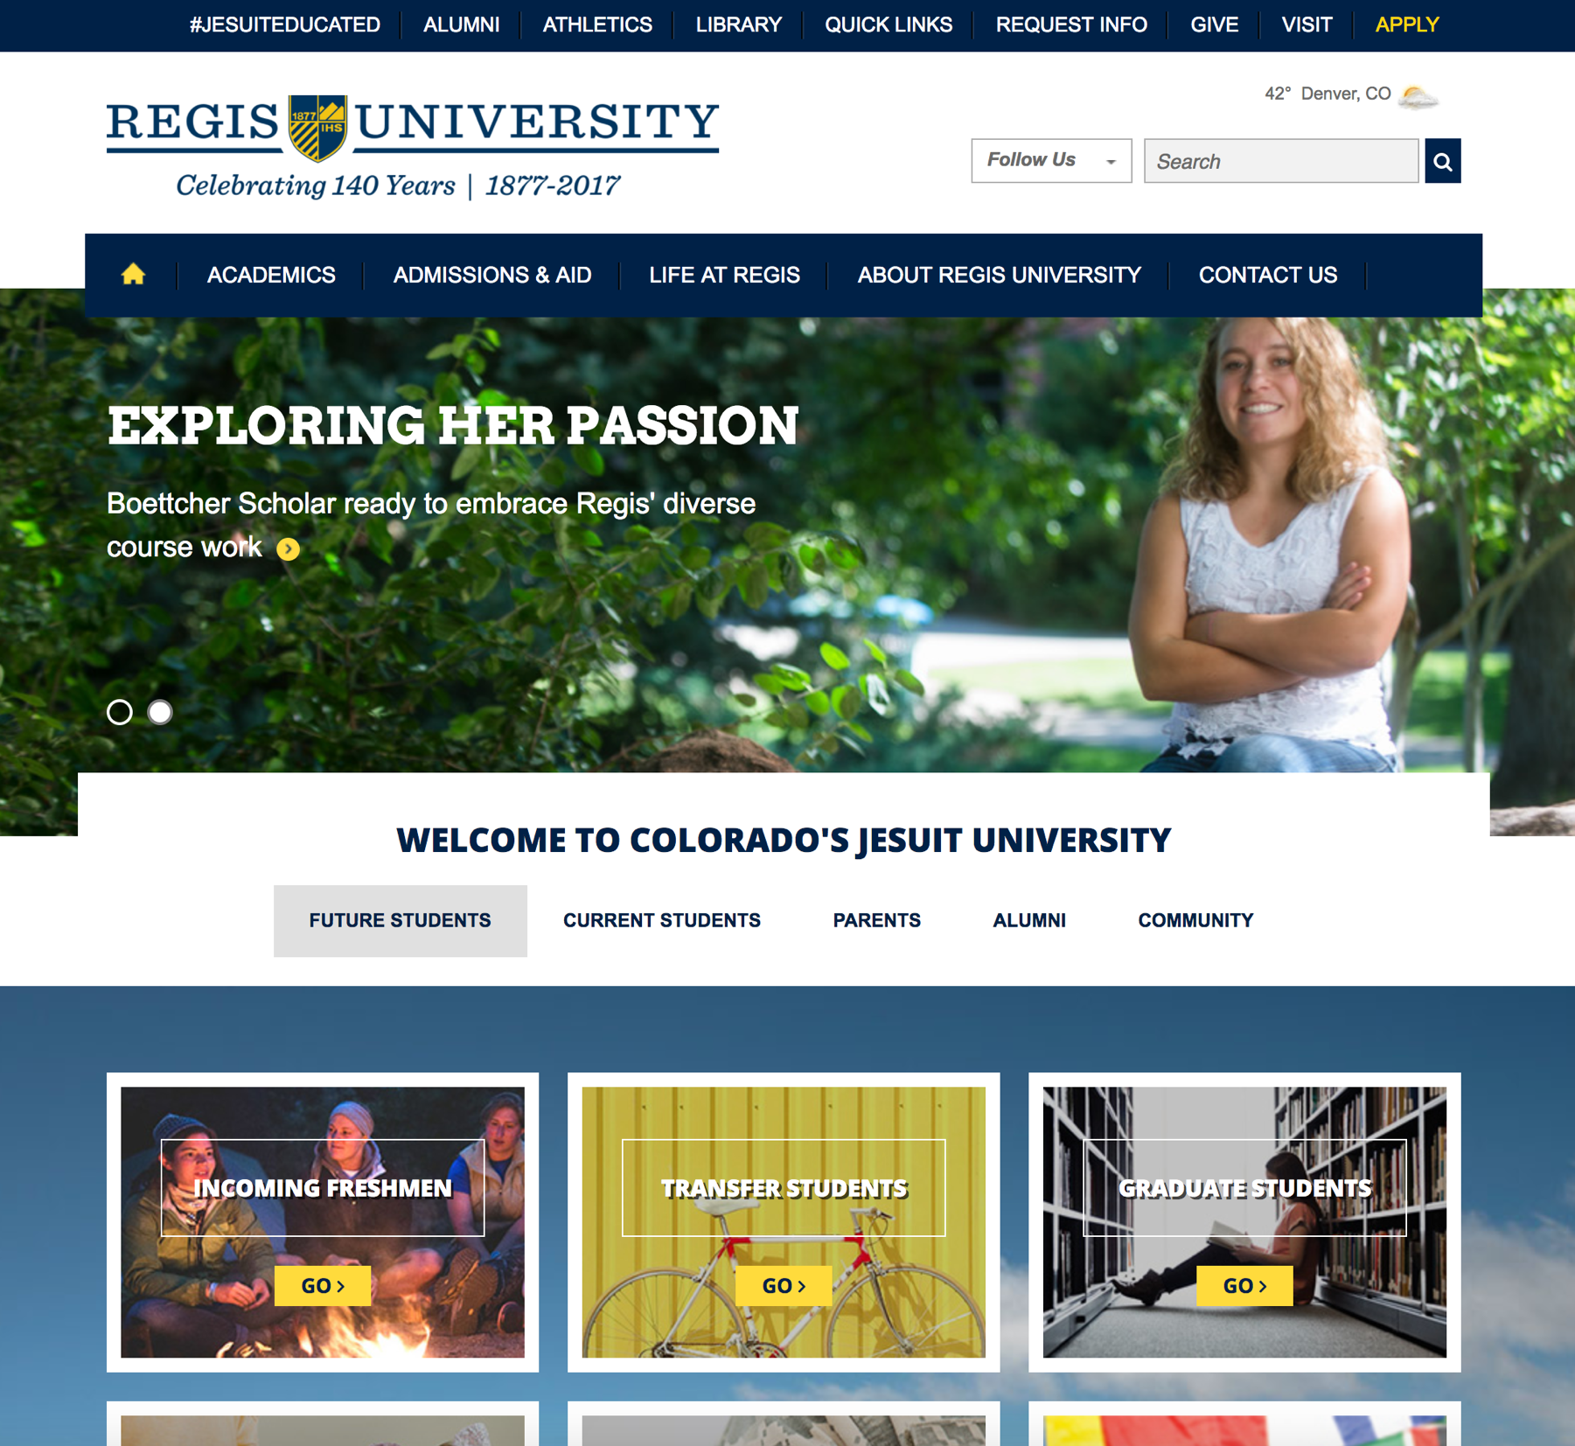
Notes:
To make these accessible
University Website (Regis University, Colorado)
Sometimes to get here, you don’t have the skills or resources in-house
So you turn to a 3rd party partner

Slide 11
Notes:
By partnering with folks like this…
Ad agency office w/ open concept, modern, creative environment, people working on couches, at desks and at a bar

Slide 12
Synopsis
While the requirements may be spelled out in the RFP, only a handful of projects make it to Launch Day with true accessibility compliance.
Instead most interactive agencies provide “Best Practice” accessibility. The big difference between built-in “Best Practice” accessibility and actual accessibility compliance is testing and remediation to a standard.
There’s no path to compliance that doesn’t include testing and remediating against your chosen standard.

Slide 13
A significant portion of major redesigns are not done in-house
Notes:
My first impression of accessibility was quite a shock. The assumption was that you built your own website, you had designer/developers on staff
In reality most major websites outsource some portion of strategy, IA, design, front and backend development and even testing.

Slide 14
A perception problem
Notes:
Table of WCAG 2.0 Guidelines comparing what is included in ‘Best practices’ with what is included in WCAG 2.0 A and AA
I put this up here to make a point of perception – ‘best practices’ is my own phrasing for what web developers learn in college
There is often a perception problem
Accessibility is…
Alt text – oh yeah we include alt text attributes
Good semantics – definitely, our code parses... we know how to code HTML really well – you’re not going to find any invalid code, unclosed divs
Strong CSS
We never put text in images
Keyboard – yes you’ll be able to tab through forms
Page titles – we love SEO
Good color – our designers know all about color contrast
We’ll even put in a skip-nav
Meet and certify that the

Slide 15
Notes:
A few questions before we continue
Show of hands…
I’m going to guess that all of you are here in part because at some point in the future you expect to work with an 3rd party partner...
How many of you have worked with an 3rd party partner on a project in the past?
How many of you are currently working with a 3rd party partner on a project?
Would any of you characterize your partner as a ‘Digital/Interactive Agency’? A creative shop?
Marketing site? Intranet site? Other software?
Would any of you characterize your experience(s) as hugely successful?
Would any of you characterize your experience as trying? Difficult?
Were any of you successful in meeting WCAG 2.0 AA?
Did it take longer than the original timeframe? Did everything go as planned? How much did you have to babysit a11y?
Probably some diversity… big and small, multiple vs none, successful vs unsuccessful
The goal then of this presentation is that each of you can go into your next engagement with a better roadmap on how to guide a11y through this process.

Slide 16
Before we start… the basics of successful B2B relationships apply
Do your homework during the RFP and selection process
Clearly communicate requirements and success criteria
Trust your partner’s expertise
Designate a main point of contact
Consolidate feedback in a timely manner
Uphold your responsibilities
Notes:
This is basic stuff, but you would be surprised how often these basic business rules are broken and how much that affects the project
Choosing the cheapest vendor has a cost
Be clear about requirements
Be realistic about unknowns and roadblocks
You selected a partner for a reason – utilize their experience
Understand their goals and motivations – revenue, awards, simplicity, interest
Have a united front – make decisions as a team and stick to them
You have responsibilities – content, decisions, approvals, requirements

Slide 17
Procurement lifecycle
Notes:
Procurement Lifecycle title slide

Slide 18
Lifecycle Responsibilities
Step | Vendor | Higher Ed Institution
Pre-engagement | - | Procurement / Policy / Awareness
RFP | RFP Response | RFP language + RFP assessment
SOW | SOW language | SOW language
Requirements | Digital Strategy | Requirements
IA & Design | IA and Design | Approvals
Development | Development | Content Development
Testing | Testing | Spot checks
Post-engagement | - | Maintenance + Ownership
Notes:
3 columns with headings: Step, Vendor and Higher Ed Institution
Each step in the far left column is related in the other two where responsibilities lie.

Slide 19
Get your house in order
Pre - engagement
Notes:
Pre – engagement title slide
Get your house in order

Slide 20
Internal policy and housekeeping
Commit as an organization to a standard – WCAG 2.0 AA
Involve legal oversight, coordinate w/ physical a11y leads
Budget for a11y
Think holistically – your users do
Catalog existing assets and evaluate risk
Train your team on accessibility awareness, appoint leads
Contract a11y resources, whether internal or 3rd party
Notes:
This could be a presentation on its own
Not the goal of this particular presentation, but you won’t be successful if you aren’t doing some of this
Start having these conversations as a team – you’re here – so its on your mind but that often doesn’t extend to the rest of your institution

Slide 21
Clear expectations and answers
RFP
Notes:
Modern cartoon version of the ‘tree swing’ project management satire – based on black and white drawings originally made in March 1973

Slide 22
RFP Language
Use exacting language that refers to the chosen standard
Get examples of previously compliant projects
Ask for details of their WCAG 2.0 AA compliance expertise
Understand capabilities in-house for testing and verification
How is a11y integrated into their overall process?
Notes:
Exacting language – we’re not looking for accessibility – we’re looking for demonstrable WCAG 2.0 AA Compliance
Projects that have similar objectives and scope would be best
Familiarity with WCAG as a compliance goal
Process integration –can they demonstrate a11y expertise in Strategy, Information Architecture, Design, Development (f/b) and Testing?
Description of their testing methodology, programmatic vs manual, toolset and AT expertise

Slide 23
RFP Review and Q&A
Underscore the importance of accessibility during Q&A
Evaluate a11y expertise – how complete is the methodology for testing, do they provide accessibility personas, design reviews?
Evaluate a11y process – is it thorough? Is it integrated throughout the project lifecycle from Strategy to Testing?
Evaluate existing projects - do a 5 minute “spot check” using a screen reader and keyboard testing and bring questions to the table
Discuss important asset types – if they will be producing PDFs or Video ask about past experience
Notes:
Ask at least one a11y related question in follow ups unless its clear that a11y is a core competency
Evaluate the maturity of their methodology and internal training and culture of a11y, how integrated? What are the gaps? Can they be patched by you or a 3rd party? Ask them if they have any plans to bridge those deficiencies
Do they walk the walk? How does their own website perform?
How strong is the compliance? Are there any glaring issues? Do they have a reasonable explanation?
Do they have PDF experience? Video player? E-mail & messaging?

Slide 24
Notes for RFPs that include software
Ask for a VPAT if one is available
You may be able to find one by doing an online search
Caution - Don’t rely on it fully. If a VPAT says the site satisfies all requirements with no comments that may be a red flag, do a spot check
Request a WCAG 2.0 VPAT if the existing VPAT uses 508
Ask if they have had a third party independent review
When was the last one?
Caution – not all third party reviewers are created equal
If compliance is incomplete, ask about planning
Accessibility is a process for us all – does their remediation line up with your own timeline?
Notes:
If you’re acquiring a highly templatized site that includes software such as off-the-shelf components, WordPress or Drupal templates
If you’re purchasing student-facing or prospect facing tools that include off-the-she
VPATs are the same thing still, just filled out to WCAG instead of the old 508 standards
You have some leeway if they demonstrate honest intent to comply and can provide clear details and timelines in writing

Slide 25
Choosing the finalists
Eliminate responses which cannot fulfill compliance
Compare Apples to Apples
Make sure competing RFP responses are providing equivalent services.
Do they provide equal levels of testing?
Is a11y training available?
Are the warranty periods equivalent?
Lower pricing quickly becomes higher pricing when revisions are needed because the effort fell short of the requirements.
Rate the contenders on a11y from top to bottom
A11y is probably not the deciding factor, but you want to influence a close choice
Be wary of those who ‘include’ accessibility at no cost
`
Notes:
A11y may well be limited as a deciding factor, so in choosing finalists you’re largely looking to eliminate candidates who cannot fulfill the reqs and then rate those that qualify so that you can potentially help influence a deadlock between contenders

Slide 26
Agreeing to terms
Statement of Work
Notes:
We will look through the 5 main tasks of the SOW – objectives, scope, schedule, price and assumptions

Slide 27
Statement of Work - Objectives
Declare the compliance standard
How will compliance be assessed?
Certification requirements
Content development
Creation, Migration, Scrubbing of existing content
Is training included?
Content Author training, Handoff and maintenance training
Maintenance contract after launch?
6 month interval, spot check and remediation
Notes:
Compliance standard is nearly always WCAG 2.0 A and AA – 2.1?
Content – who owns what portions of content for the project – typically most of this is not included, and you are responsible for all of it
Sometimes you ask the vendor to help scrub existing content, sometimes they are responsible for creating videos, writing pages, creating e-mail templates etc.
Assessment – How will the vendor test their work to ensure compliance? Do you retain the right to test? Whose word is final?
Training – do they offer training? Document accessibility? Content Author Training, Intro to WCAG, Basics of A11y? Webinars vs On-site?
Is there a budget for maintenance post launch? We recommend having the vendor re-audit the site at a 6 month interval post launch to help your team ensure compliance is being maintained

Slide 28
Statement of Work - Scope
Extent of compliance beyond the core project. Which asset types are included?
PDF, e-mails, messaging, video, content, web, mobile
Accessibility of 3rd party functionality
Dependencies outside of the vendor’s control
Rules for required 3rd party tools / data / content
Dependencies within the vendor’s control
Rules for plugins, components, libraries and frameworks
Notes:
Asset types – will the vendor be responsible for any PDFs, e-mails, messaging that will be hosted as part of the site or as part of the experience?
3rd Party functionality – Don’t expect 3rd party functionality outside of the scope to be included – will that be included in any assessment of the project? Can the project be deemed accessible if all dependencies are not in scope?
What project dependencies exist that the vendor must integrate with but which may introduce a11y violations outside of their control? What are you doing about it?
How will the vendor be held responsible for 3rd party dependencies that they introduce – many frameworks, libraries and plugins are common in use. The vendor should assume responsibility for the a11y of any tools they introduce or recommend. If a tool cannot be made compliant it should not be used.

Slide 29
Statement of Work - Schedule
How does compliance align with key dates?
How are your compliance responsibilities aligned to key dates and approval?
If the project is complete, but content isn’t ready – who is responsible for testing the final launch?
When will compliance be tested? Complete?
Template creation
CMS integration
Content completion and launch
Are Forms functionality or content?
Notes:
Key dates – what happens if key dates are missed? Launch day? Do you have time to verify compliance within the timeline? Is there enough time to remediate issues between compliance testing and release? Remediation and acceptance?
Typically content lags the process as it must be implemented into the CMS last after pages are built and integrated into the CMS. We recommend initially testing the templates prior to CMS integration. This provides a very strong understanding of compliance of the core functionality, but doesn’t provide a final test of the launch day site.
If you’re partnering with a 3rd party for ‘validation’ or ‘certification’ how much time do they need?
We recommend another testing phase at launch – when all pages are built and all content is entered. This is the last, largest and final test – but it should be faster since most of the template issues have been previously tested and remediated

Slide 30
Statement of Work - Price
Ask for a separate line item for accessibility
It should be enough to accomplish your objectives
Personas
Wireframes
Design
Content Development
Development
User Testing
CMS Integration
Testing
Remediation
Training
Post launch maintenance
A pool of hours for maintenance
Coordination / cost of 3rd party ‘certification’
Notes:
We ask for a separate line item because it prevents lip service to a11y from being obfuscated – seeing the a11y budget isolates it. It also makes them budget and scope the work seriously. They know you’re serious. You know they’re being reasonable.
Personas, Content Development, User Testing, Training, Post launch maintenance are highlighted in the list – these are typically options that vary greatly between clients

Slide 31
Budget Capacity
Budget for Accessibility
Much like Responsive Web Design, Accessibility Compliance for NEW projects is best budgeted as a percentage of the overall project
Most accessibility projects range between 5% and 10% of the overall project cost
Small
10%
Examples:
$400k Higher Ed Project
$37k Accessibility Budget (9.25%)
$1.5m Hospital Project
$94k Accessibility Budget (6.2%)
Large
5%
Informational (Marketing)
Functional
(Intranet)

Slide 32
Statement of Work - Assumptions
Will you need 3rd Party ‘certification’?
What happens if compliance is not met?
How will external dependency liabilities be handled?
Rules for student generated content
Who is responsible for what content?
Warranty Period for remediation?
For software?

Slide 33
Project Lifecycle
Strategy
UX & Design
Development
Training
Testing
Disability personas
Planning
Key demographics
User testing
Journey mapping
Content strategy
User-centric design
Heading structure
Reading order
Wireframes
Color palette
Reviewed for a11y
Standards-based semantics
Highly customized solutions
ARIA enhancement
CMS integration
Technology agnostic
Design Audits
Automated testing
Manual AT testing
Mobile testing
Best Practice solutions
Awareness
Accessibility as a core competency
Content author training
Understanding WCAG
Notes:
Very similar to RWD

Slide 34
Strategy
Do personas include disabilities?
Does your student population over-index in certain populations?
Can you include assistive technology users in stakeholder interviews?
**Start with basic compliance, add bonus features in secondary phases
Thoughtfully consider expert advice
Take responsibility for important decisions

Slide 35
Information architecture and Design
***Highlighting the importance of accessibility during wireframe and design will have the single most important influence on achieving compliance
Point out areas of concern
Strong heading structure
One page, one task
User-first design + Inclusive design
*Ask accessibility questions or for a demonstration of accessible aspects of the design

Slide 36
Development
Facilitate relationships and communication between in-house teams and the vendor’s developers
Avoid us vs them mentality here – involve technology in the selection process
Educate internal developers on the importance of a11y
Face-to-face kickoffs are highly recommended
Provide any internal development standards
**Ensure hand-off includes sufficient training of a11y features and techniques

Slide 37
Testing
We recommend:
Programmatic
Visual inspection
Keyboard only
Keyboard + Screen Reader manual testing
Mobile/Tablet/Desktop
Test at the template level
Consider working with an a11y consultancy for 3rd party approval or validation using more complex AT

Slide 38
Certification vs Verification
Certification – a respected organization provides an official attestation of compliance
Available as an option, but not required
Only a moment in time, invalid the next time you update content
Not widely requested
Verification – a professional services firm with a strong industry reputation validates the effort and scores your site / effort

Slide 39
CMS Integration
Ask about the a11y of key CMS features
Personalization
Form creation tools
Asset management
Messaging
Ask for a VPAT for the CMS interface itself
Especially important for Higher Ed w/ student editors
Training for content authors for maintaining compliance
Heading, Form Errors, Video, Link text etc.

Slide 40
Content
This is your #1 a11y responsibility
A site with 100% functional and design compliance will still fail without accessible content
Start early – train key content authors
Video leads, social leads, document creators, writers, site admins, migration team, student contributors
Scrub existing content including:
Tables, Lists, Links, Alternative Text, Videos, Audio, Charts, Graphs
Ask for assistance with key screens

Slide 41
VPAT?
A VPAT is your document – its your institution’s public attestation of a11y compliance. Asking a vendor to fill out a VPAT on the site they build for you (you own it) isn’t going to hold any water if you own the site.
VPAT requests make sense when the vendor is providing software which they own and you are licensing
You can still request they complete a certification of their effort
That can look a lot like a VPAT
You should own creating your VPAT

Slide 42
Maintenance
Accessibility is an iterative process, not a point in time
Once handoff is complete you are responsible for maintaining compliance
Content edits
New features
Consider adding a bucket of hours for maintenance checkups every 6mos to a year

Slide 44
ACCESSIBILITY At PRIMACY

Slide 45
Primacy’s A11Y Service Offerings
Site Redesign Compliance
Compliance Audit
Remediation
Primacy will complete accessibility compliance to a specified standard (most commonly WCAG 2.0 level AA) to all aspects of a site build.
Provides an in-depth assessment of the current site to identify areas of non-compliance, as well as recommendations for remediation.
Using a baseline accessibility audit as a guide, revisions may include: content, functionality, UI, and design to conform to a specified standard. A final audit will be conducted to demonstrate compliance.

Slide 46
Primacy’s A11Y Service Offerings
Training
3rd Party Certification
VPAT Creation
Primacy provides a variety of A11y training including Understanding the A11y Landscape, Content Author Training, Development, Testing and many others.
Primacy will recommend and work with a 3rd party certification partner to acquire a high-level review of ADA compliance as an additional step on top of a separate audit and remediation.
Assistance in developing a VPAT for 508/ADA contract qualifications. Provides a common, straightforward and standardized public declaration of web accessibility compliance.

Slide 47
Accessibility Chops
A11Y RELATED EXPERIENCE AND SOLUTIONS
Consulting
Testing
Solutions
Engaged Clients
Aetna
TIAA CREF
Yale New Haven Hospital
Tufts Medical Center
Regis University
SCAN Health
Boehringer Ingleheim
Gonzaga
MIT
Training materials
Policy development
Procurement
Communication strategy
Process refinement
Training curriculum
VPAT assistance
UX / Design prototypes
AMP / Alchemy
JAWS
NVDA
VoiceOver for OSX
Android TalkBack
VoiceOver for iOS
Keyboard-only
Functional testing
Audits
Design reviews
Compliant development
Remediation testing
Webinar training
Content remediation
Training documentation
AT user testing
Notes:
BI – Canadian Legal Compliance
Training Materials – Helping clients train their design and development teams
Keyboard-only – Can the site be used without a mouse?
Design reviews – Does the design foster accessibility?

Slide 48
Project Lifecycle
Strategy
UX & Design
Development
Training
Testing
Disability personas
Planning
Key demographics
User testing
Journey mapping
Content strategy
User-centric design
Heading structure
Reading order
Wireframes
Color palette
Reviewed for a11y
Standards-based semantics
Highly customized solutions
ARIA enhancement
CMS integration
Technology agnostic
Design Audits
Automated testing
Manual AT testing
Mobile testing
Best Practice solutions
Awareness
Accessibility as a core competency
Content author training
Understanding WCAG
Notes:
Very similar to RWD

Slide 49
Site Redesign Process
Plan
Design
Develop
Train & Maintain
Test
For a redesign, accessibility typically adds 5-10% cost and effort to the overall project
5% - Simpler, templatized, informational sites
10% – Complex, heavily interactive sites
Cost percentages decrease at scale
Notes:
At scale because of templatization there’s a bit of a drop off on cost as a percentage

Slide 50
Thank you!
For more information, please contact Andy Berling Andy.Berling@theprimacy.com or 860.404.3314

